Slide 1
IDEAL-N Annual Plenary
April 7, 2017
Laurie J. Kirsch Vice Provost for Faculty Affairs, Development, & Diversity
University of Pittsburgh

Slide 2
The Core Team
Dr. Anne M. Robertson, Change Leader
William Kepler Whiteford Professor of Engineering
Dr. Kristin Kanthak, Social Scientist
Associate Professor of Political Science
Dr. Laurie J. Kirsch, Co-Director

Slide 3
Institutional Transformation Theme
Building a culture that encourages and supports the professional development and career progression of mid-career women faculty at the University of Pittsburgh

Slide 4
Year 1 & Year 2 Activities
Identify issues and barriers that prevent or slow advancement of tenured women faculty from associate professor to full professor, and of non-tenure stream women faculty
Identify mechanisms that facilitate career advancement

Slide 5
Year 1 & Year 2 Activities
Data collection & analysis
Analysis of promotion patterns at Pitt
COACHE survey of full-time faculty
Focus groups of mid-career women faculty
Other studies and literature
IDEAL-N partner institutions

Slide 6
Pitt Demographics

Slide 7
Key Findings Progress of Faculty: 1991-2012
Men are significantly more likely to be promoted to Associate Professor than women.
It takes men significantly less time to be promoted than women.
Men are significantly more likely to be promoted from Associate to Full Professor than women.
But, among those promoted, men and women take similar amounts of time to achieve promotion to Full.

Slide 8
Key Findings COACHE Survey of FT Faculty: 2016
Compared to faculty at other institutions, Pitt faculty are:
Less satisfied about the clarity of tenure policies and the clarity of tenure expectations.
Less satisfied with the process of being promoted to full professor.
Pitt female faculty are less satisfied across many tenure and promotion metrics than Pitt male faculty.
More satisfied with tuition benefits, work-life balance, medical and family leave, and flexible workloads.

Slide 9
Key Observations Focus Groups and Panel: 2017
Women tend to say “yes” too often
Women tend not to ask for what they want
Women tend not to challenge the status quo
Women seem poorly informed about policies
Many associate professors want mentors
Faculty participants seemed truly energized by being part of focus groups

Slide 10
Activities
Expanding opportunities for networking, mentoring, and support for women faculty
Focus on mid-career faculty
Resources developed for website
Plans to launch Center for Mentoring
Faculty Recruitment (Diversity Committees)
Implicit & unconscious bias workshops
Packet of materials for faculty search committees

Slide 11
Family Friendly Programs for Pitt Faculty

Slide 12
Family Friendly Programs for Pitt Faculty

Slide 13
Activities
Dissemination of COACHE results
Presentations to senior leadership
Presentations to faculty groups (Senate, other standing committees, and faculty groups)
Individual discussions with deans
Developed website
www.pitt.edu/COACHE
Resources include infographics & “good practices”

Slide 17
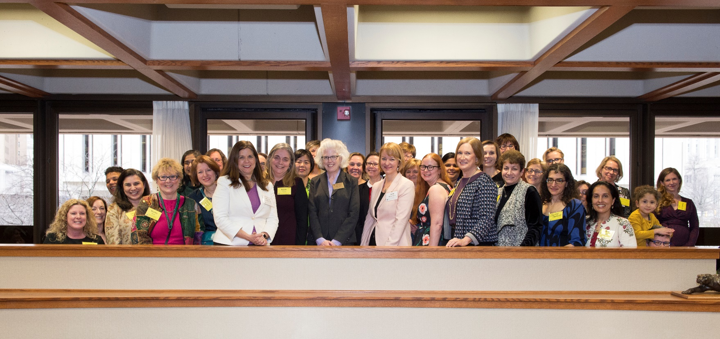
Activities
A Celebration of Newly Promoted Women Faculty
New annual event with inaugural celebration on 3/2/17
Complements event to welcome newly hired women faculty
Panel of senior women faculty offered advice & perspective

Slide 18
Going Forward
Continue to use COACHE results as a vehicle for discussing issues and making changes
Engage other groups at Pitt
Additional Mechanisms to Support Faculty
e.g., “Writing Groups”
Institutionalize Efforts

Slide 19
Thank you!

