Slide 2
IDEAL-N Plenary 2018
Mandy Munro-Stasiuk
Jenny Marcinkiewicz
Carla Goar

Slide 3
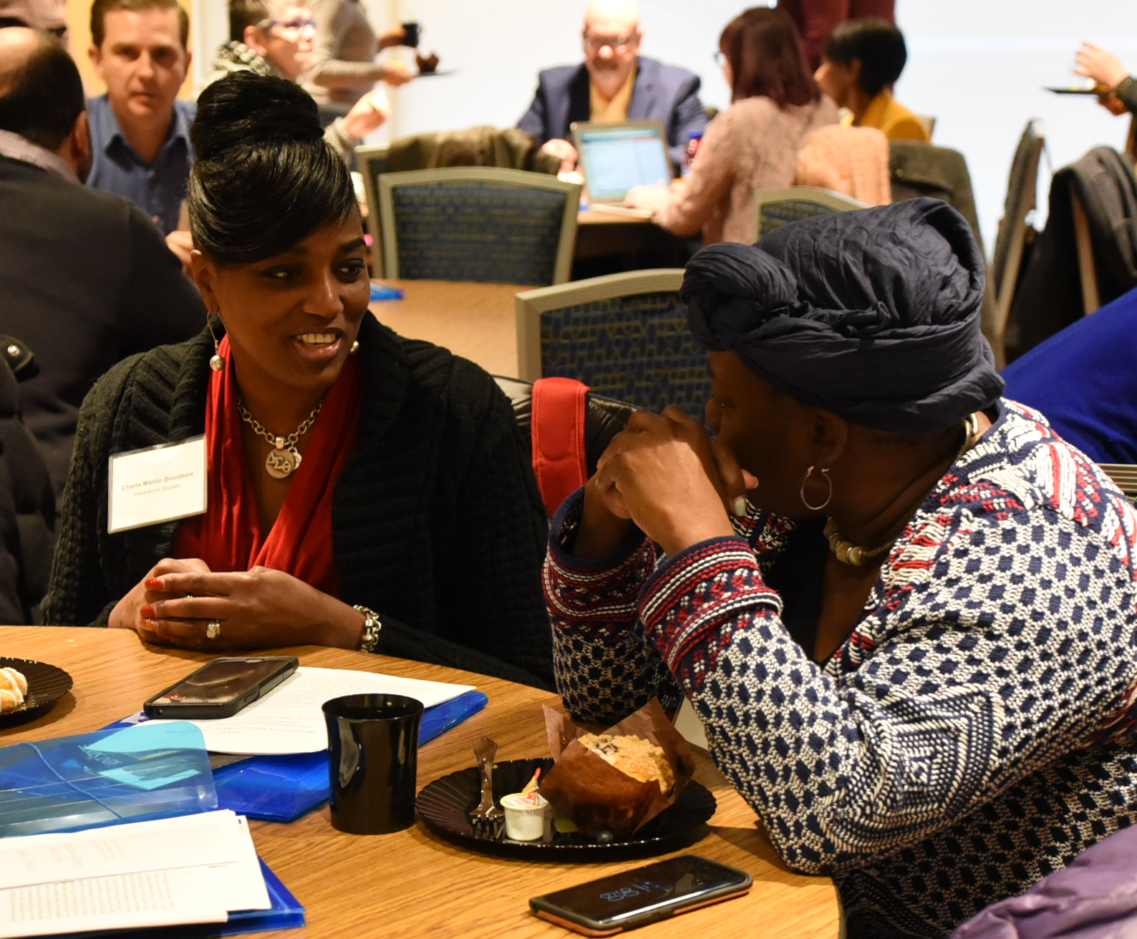
Overview of Activities
Kent State Women’s Collaborative
Women Faculty at Kent: Tips, Policies and Procedures
Summit on Women Faculty at Kent State
Mid-Career Programming
Brochure on Family-Friendly Resources for Faculty
Notes:
Jenny

Slide 4
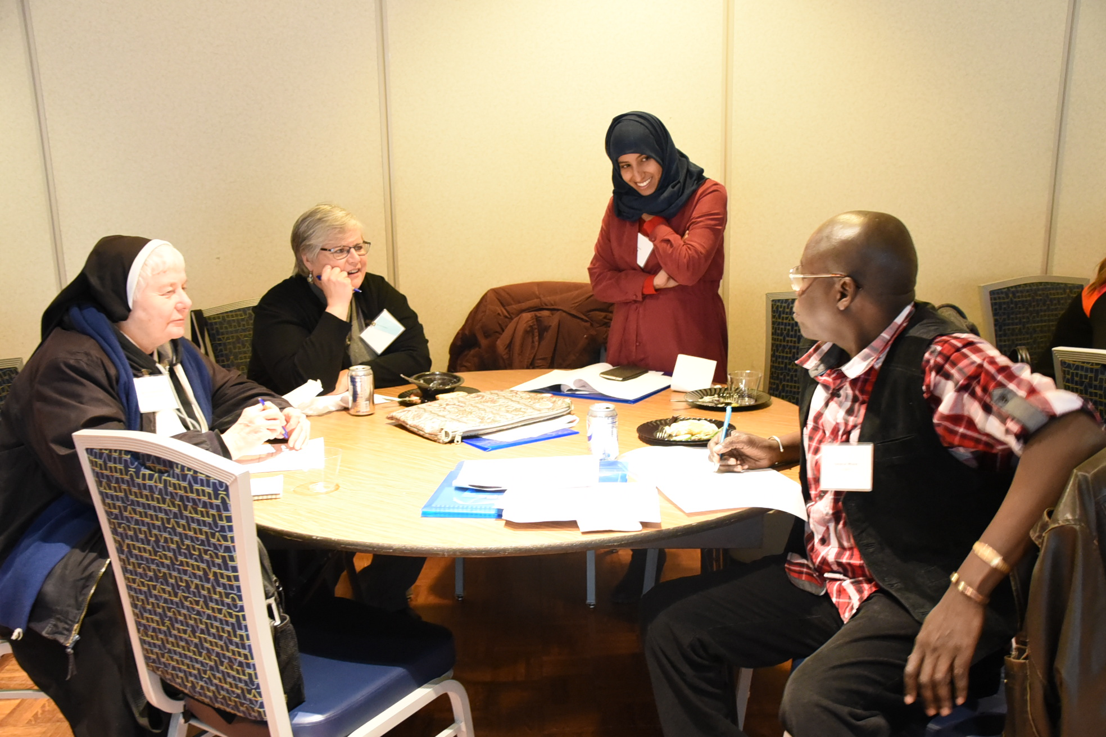
Kent State Women’s Collaborative
Female and female-identifying
For faculty & staff
Informal collaborative of volunteers
Notes:
Jenny

Slide 5
Breakfast meeting: Women Faculty at Kent: Tips, Policies and Procedures
Topics
Rights, Policies & Procedures
Tips for navigating difficult situations
Special focus on: Tenure clock extension (tolling), FMLA & grievance processes
Panel
Sue Averill, Associate Provost, Faculty Affairs
Jennifer Larson, President, AAUP, Tenure-Track Unit
Gina Zavota, AAUP Grievance Chair
Laura Kenney, Human Resources
Partners
IDEAL-N
Academic Affairs
Faculty Affairs
Women’s Center
Diversity, Equity & Inclusion
Center for Teaching & Learning
AAUP
Human Resources
Notes:
Mandy

Slide 6
Signature Event
Opportunity to bring women faculty and allies together
Interactive plenary on bystander intervention
Special sessions invited from the community
Notes:
Mandy

Slide 7
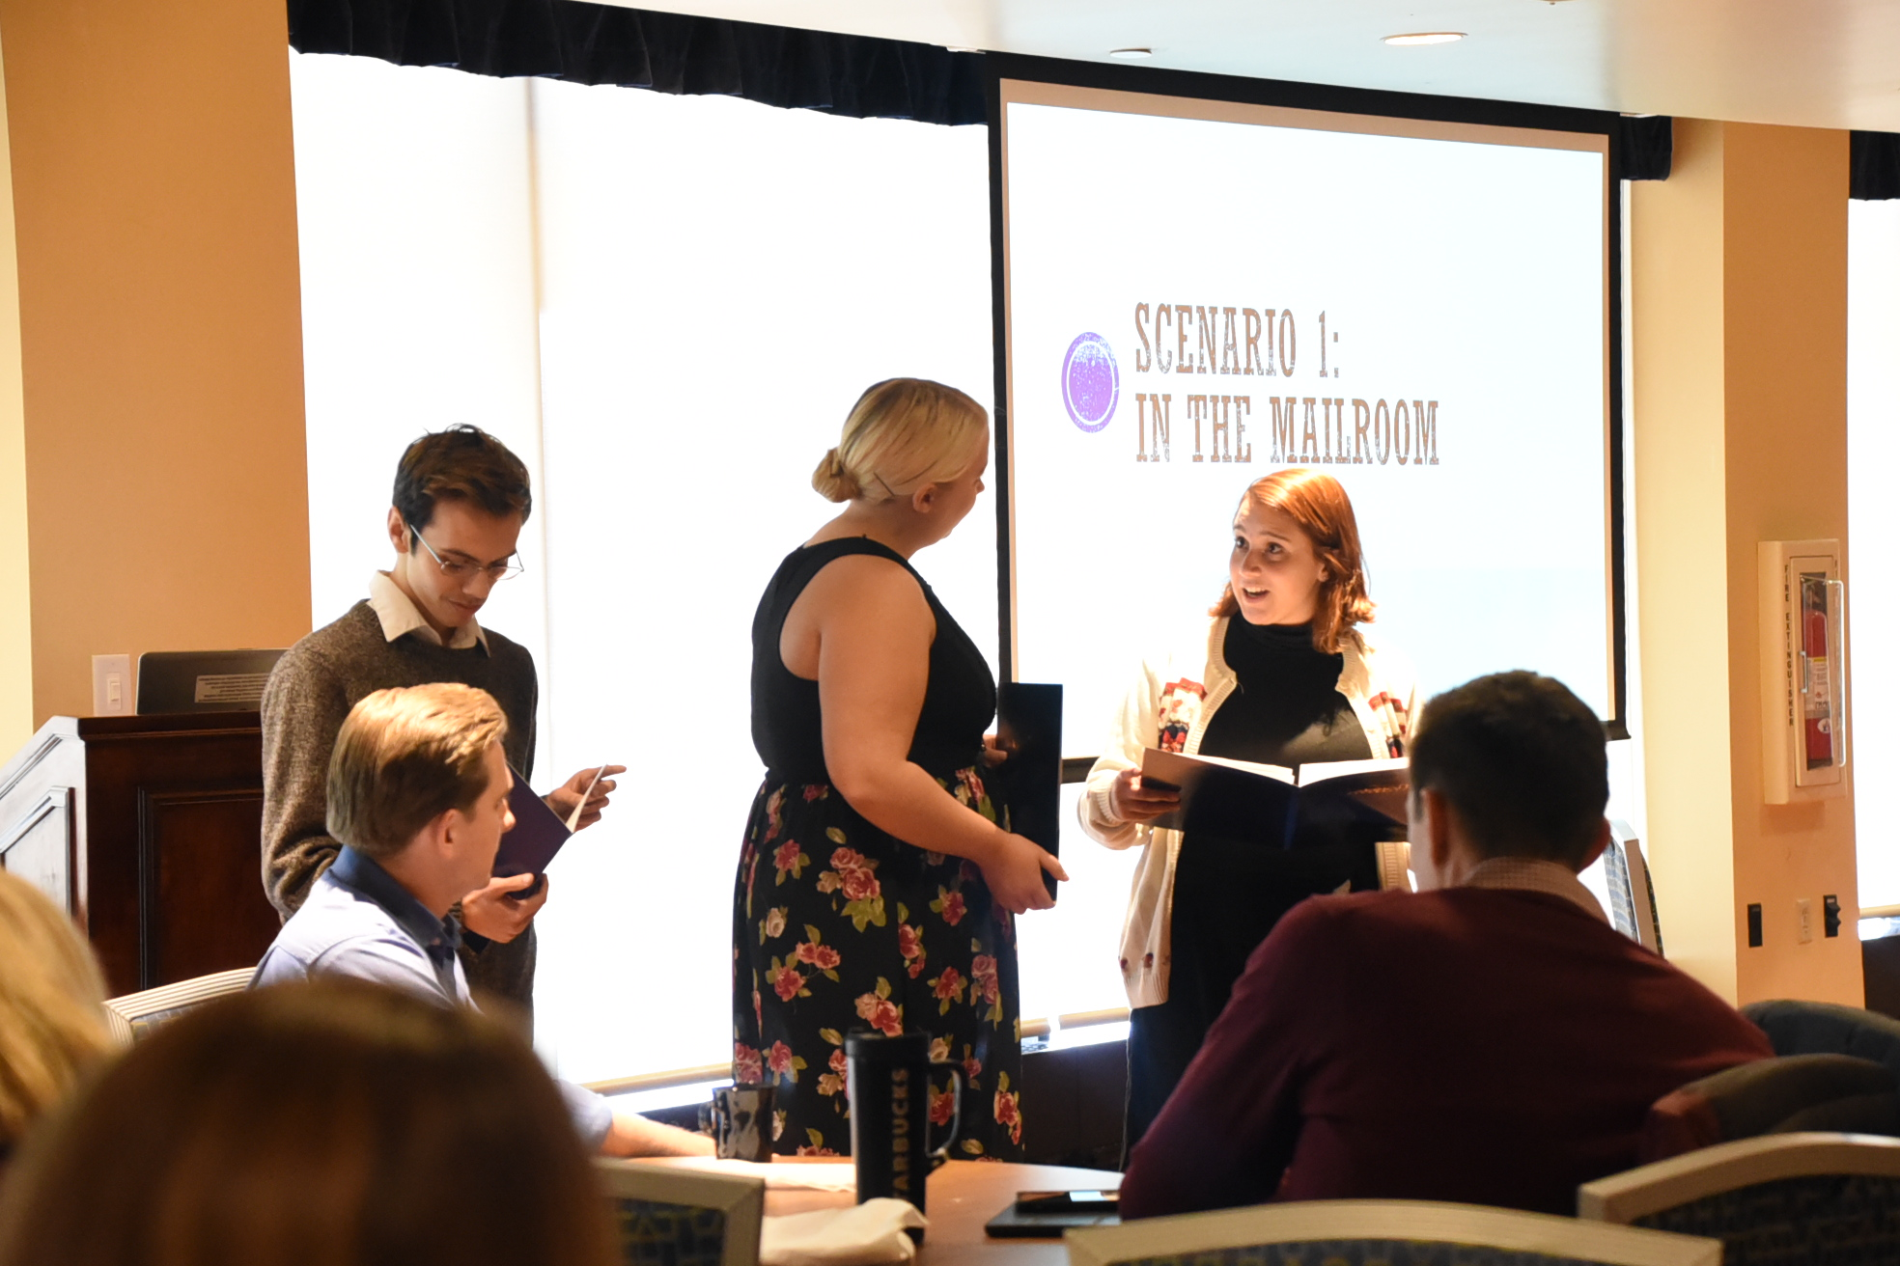

Slide 8
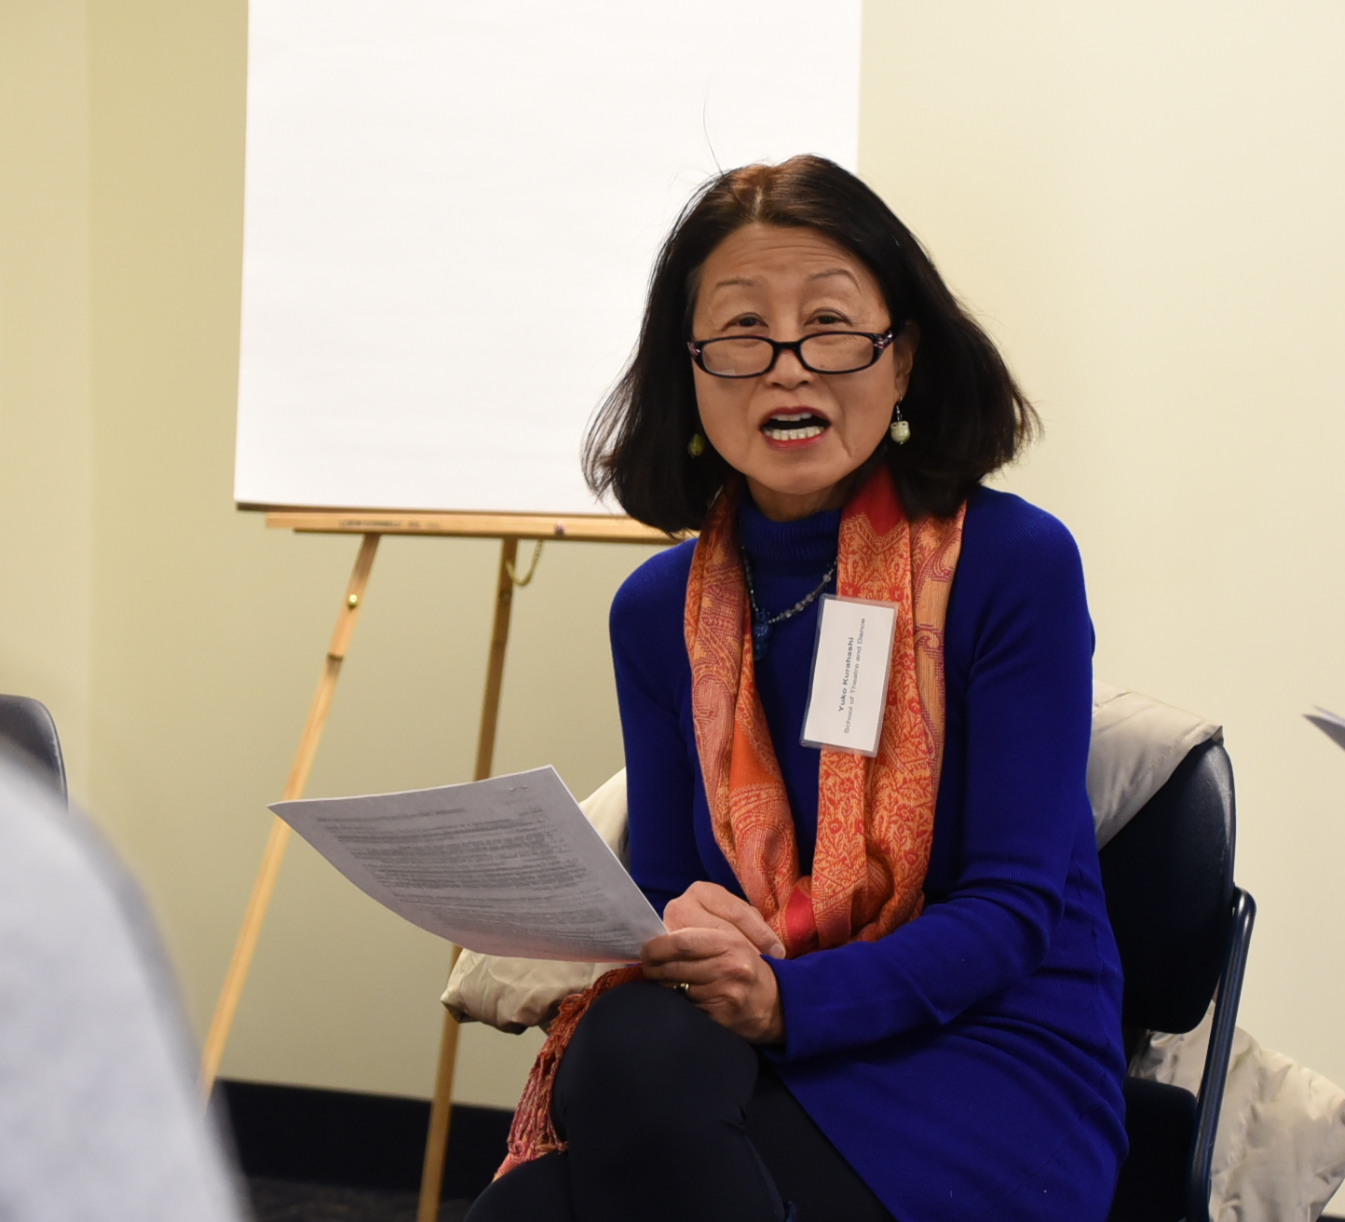
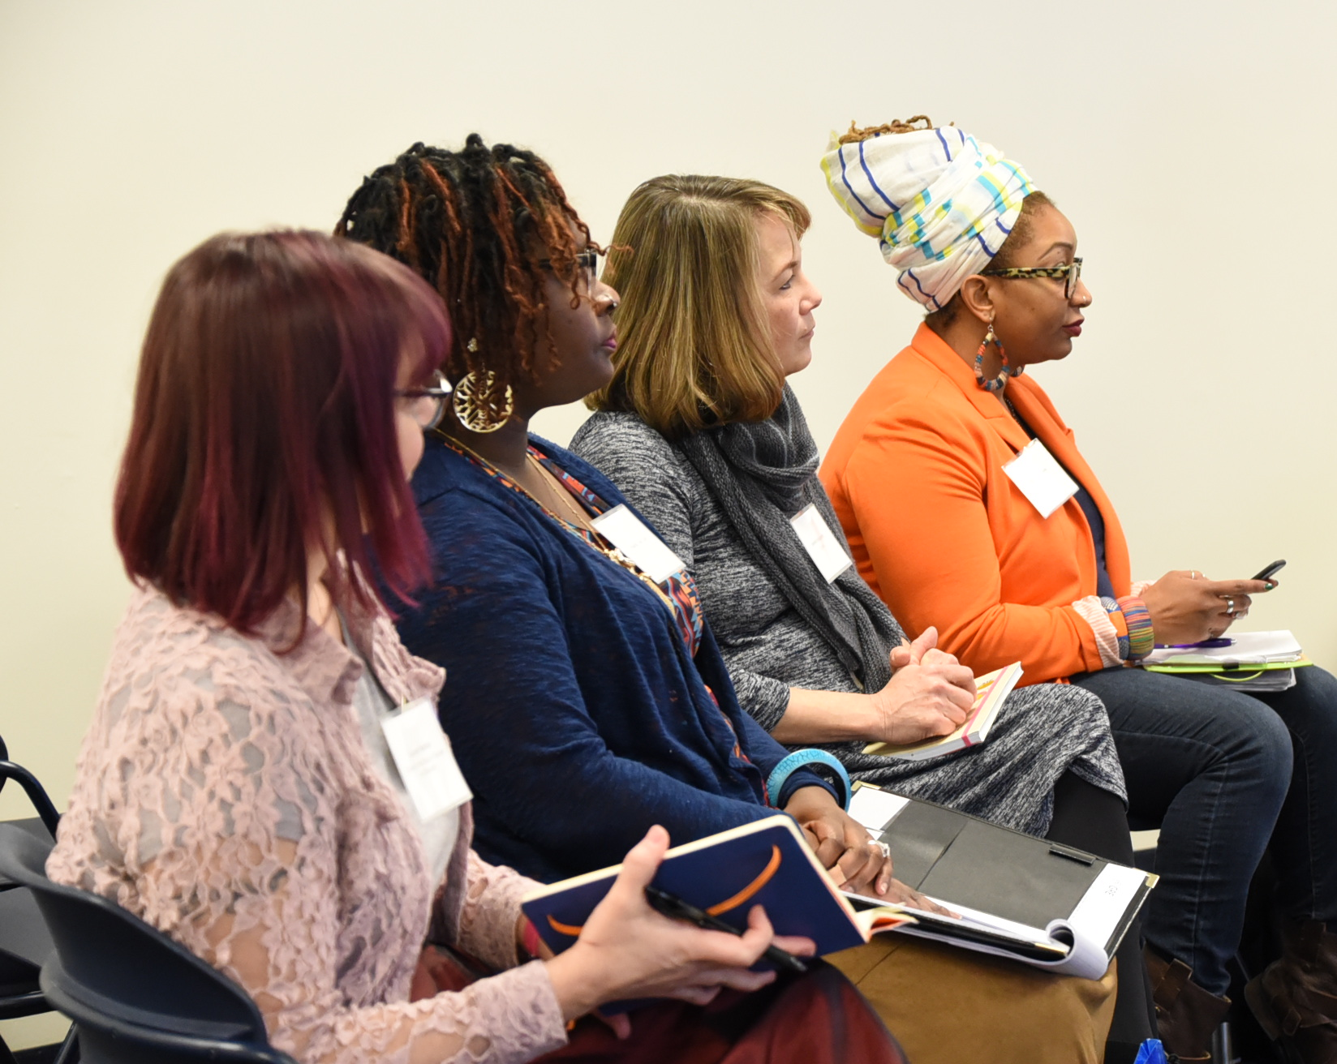
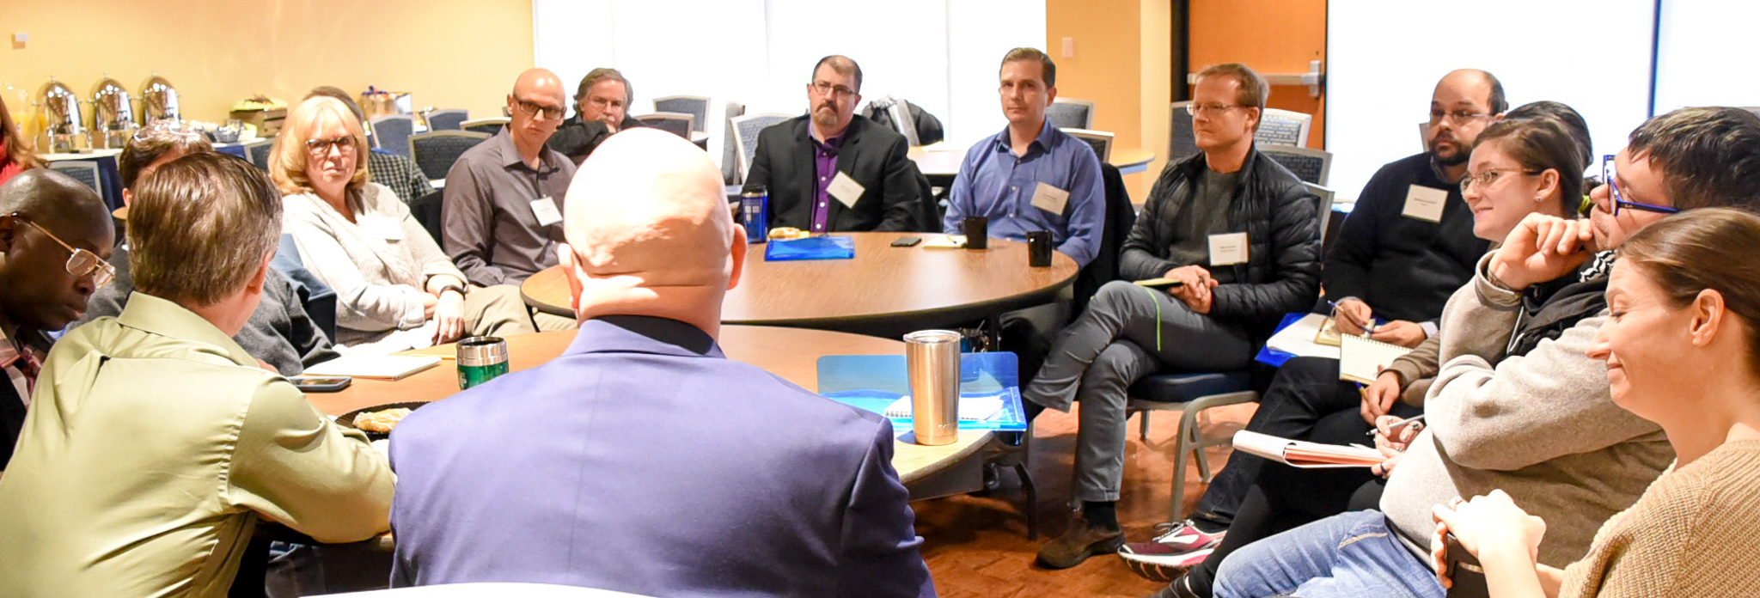
Breakout sessions Theme: resources and research pertaining to gender and intersectionality

Slide 9
Summit Sponsors
Provost’s Office
Diversity, Equity & Inclusion
Center for Teaching & Learning
*Colleges of Communication & Information, Business Administration and Public Health
*Stark Campus
Departments of *Anthropology, History, *Pan-African Studies, Political Science, Sociology
*IDEAL-N
*Kent State Women’s Collaborative
*Female Leadership
Notes:
Mandy

Slide 10
Summit on Women Faculty: Evaluation
Registration (136 total, 33 STEM women)
Evaluation
100% of the respondents rated the Summit as Excellent or Good
98% answered that they gained valuable resources
Selected comments:
This should be part of some required training/professional development for faculty
The lunch plenary was brilliant! Wish my chair attended
Inspiring
Excellent! Please have more summits!
Notes:
Mandy

Slide 11
Mid-Career Programming (2017-2018)
Promotion to Full Professor Sessions
So You’re Tenured! Now What?
Managing Your Time and Multiple Demands
Perspectives from Recently Promoted Faculty
Perspectives from Advisory Committee Members
2018: 30 total faculty (2 STEM Women)
Coaching
2018: 12 total faculty (3 STEM Women)
3 year program impact 43 faculty (6 STEM women)
Notes:
Jenny

Slide 12
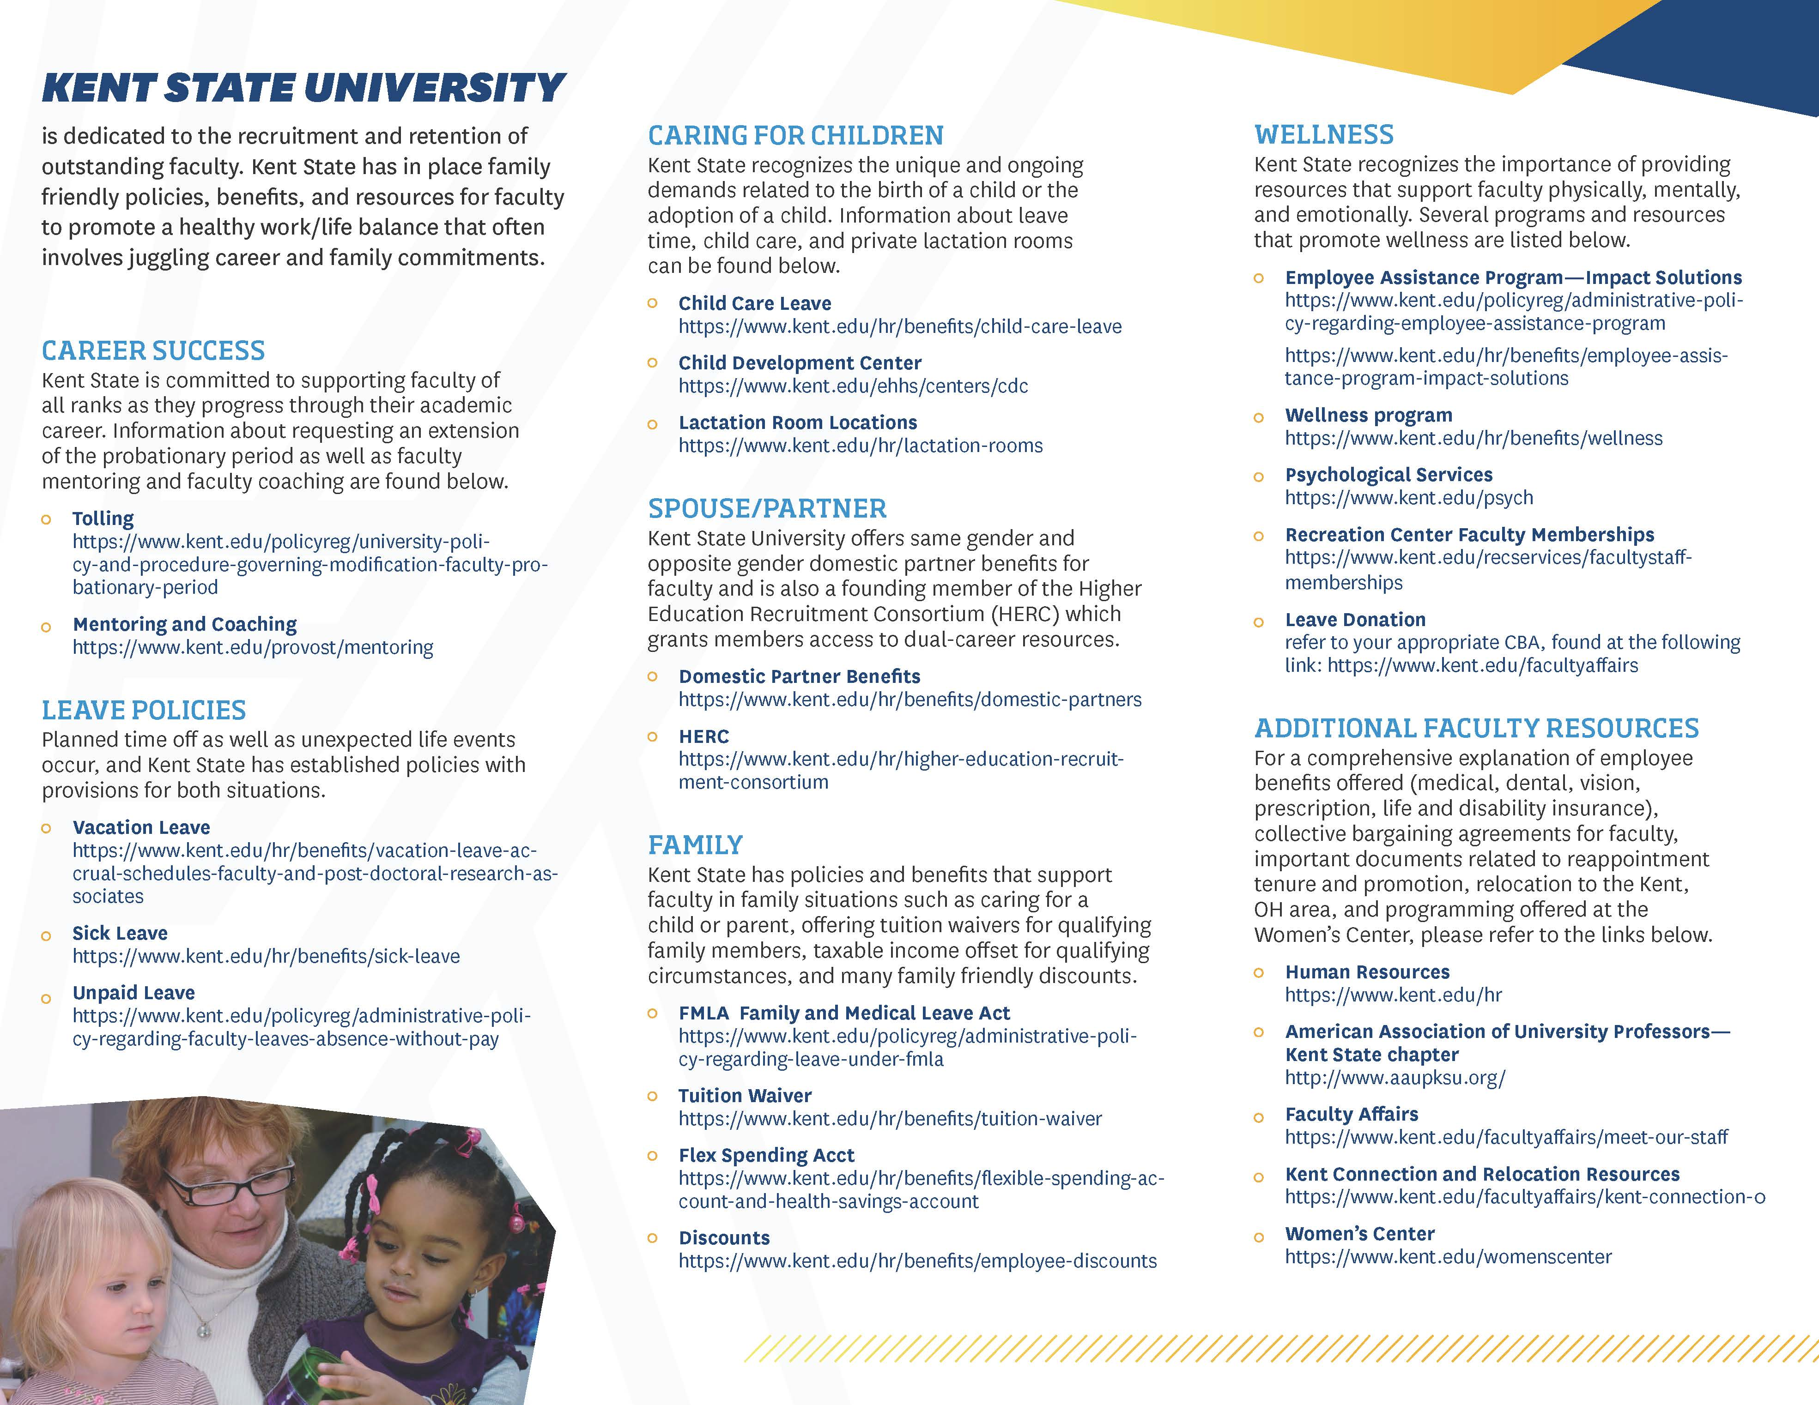
Family-Friendly Brochure
Purposes:
Resource for current faculty
Faculty recruitment tool
Avoids ”illegal” questions related to family status while providing important information to candidates
Thank You University of Pittsburgh!
Notes:
Jenny

Slide 13
Thank You!
Kent.edu

