Slide 1
Presenting
The Entering Class of
20
23
Dr. Lina Mehta
Associate Dean for Admissions

Slide 2
Application Statistics
Total Applications Nationally: 50,061 (-5%)
Total Applications to CWRU: 8,615(+6%, 15% of US apps)
2023 Entering Class Size: 216
University Program
Applications: 7,345
Interviews: 797
Matriculants: 172
CCLCM
Applications: 1,690
Interviews: 205
Matriculants: 32
MSTP
Applications: 440
Interviews: 103
Matriculants: 12

Slide 3
Demographics
51%
Female
23.8
Average Age
Age Range: 21-44

Slide 4
Demographics
“Alone” indicates those who selected only one race/ethnicity.
“In Combination” indicates those who selected more than one race/ethnicity response.

Slide 5
Asian | Alone | 77
 | In Combination | 10
 | Alone or in Combination | 87
Black or African American | Alone | 11
 | In Combination | 6
 | Alone or in Combination | 17
Hispanic, Latino, or of Spanish Origin | Alone | 13
 | In Combination | 7
 | Alone or in Combination | 20
American Indian or Alaska Native | Alone | 1
 | In Combination | 1
 | Alone or in Combination | 2
Other | Alone | 6
 | In Combination | 3
 | Alone or in Combination | 9
White | Alone | 73
 | In Combination | 18
 | Alone or in Combination | 91
Unknown |  | 10
Data includes duplicate information in each category
Unduplicated Total Matriculants |  | 216
Notes:
Needs Updated TM

Slide 6
Underrepresented in Medicine
Black or African American Alone | 11
American Indian or Alaska Native Alone | 1
Hispanic, Latino, or Spanish Origin Alone | 13
URiM in Combination | 13
Total URiM | 38
“Alone” indicates those who selected only one race/ethnicity response.
“In Combination” indicates those who selected more than one race/ethnicity response, including at least one category traditionally underrepresented in medicine.
Notes:
Needs updated TM

Slide 7
Demographics
LGBTQ: 27
First Generation College: 19
Rural Areas of US: 11
Military Service: 1
Nontrad (> or = 25 yrs old): 43
Graduated from college more than 1 year ago: 180
Notes:
Needs updated TM

Slide 8
2023 Application Statistics
Interviewees (all programs):
206 colleges and universities
41 states
Accepted Applicants (all programs):
137 colleges and universities
40 states

Slide 9
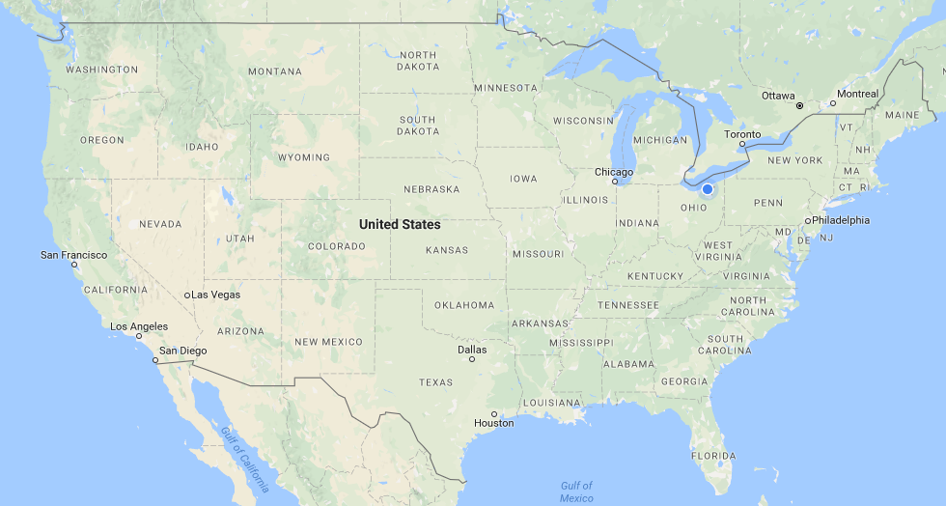
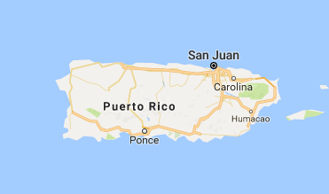
4
6
1
1
2
7
10
MA-8
2
CT- 1
12
39
14
NJ - 9
1
6
1
2
MD- 5
1
DC - 1
38
5
DE- 1
1
5
4
1
AK- 1
2
5
3
1
11
32 States of Residence + DC + Puerto Rico
5 Countries: Canada, India, China, Indonesia, and Serbia
18% In-state 82% Out-of-state

Slide 10
86 Different Colleges & Universities
27
17
13
10
8
8
7
6
5
5
5

Slide 11
Complete List of Schools
American University- 1
Auburn University- 1
Barnard College- 1
Brigham Young University- 2
Brown University- 1
California State University San Bernardino- 1
Carleton College- 1
Carnegie Mellon University- 1
Case Western Reserve University- 27
Central Michigan University- 1
Chapman University- 1
Clemson University- 1
Colby College- 1
Colgate University- 2
Colorado State University- 2
Columbia University- 3
Cornell University- 8
Dartmouth College- 3
Davidson College- 1
Duke University- 5
Earlham College- 1
Emory University- 5
Florida Institute of Technology Melbourne-1
George Washington University- 1
Georgetown University- 1
Georgia Institute of Technology- 2
Hamilton College- 1
John Carroll University- 1
Johns Hopkins University- 17
Loyola University Chicago- 1
Massachusetts Institute of Technology- 1
McGill University- 1
Miami University- 1
Northeastern University- 2
Northwestern University- 1
Occidental College- 1
Penn State University- 1
Pepperdine University- 1
Princeton University- 2
Rice University- 2
Rockhurst University- 1
Rutgers University- 1
Southern Methodist University- 1
St. Olaf College- 1
Stanford University- 1
Tennessee Technological University- 1
The Ohio State University- 7
The University of Alabama- 1
The University of Alberta- 1
University of California- Berkeley- 6
University of California- Irvine- 1
UCLA- 10
University of Cal., San Diego- 1
University of Charleston- 1
University of Cincinnati- 1
University of Colorado-Boulder- 1
University of Connecticut- 1
University of Florida- 5
University of Idaho- 1
University of Illinois at Chicago- 4
University of IL-Urbana Champaign- 1
University Maryland- 1
University of Miami- 1
University of Michigan- 13
University of Minnesota Twin Cities- 1
University of North Carolina Chapel Hill- 1
University of Notre Dame- 5
University of Oregon- 1
University of Pennsylvania- 4
University of Pittsburgh- 3
University of Southern California- 2
University of Toledo- 1
University of Virginia- 1
University of Washington- 1
University of Wisconsin- Madison- 4
University of Vanderbilt University- 3
Villanova University- 1
Virginia Military Institute- 1
Wake Forest University- 1
Washington and Lee University- 1
Washington University in St. Louis- 8
Wellesley College- 1
Wesleyan University- 2
West Virginia University- 1
Williams College- 2
Yale University- 1
Notes:
CE not checked yet

Slide 12
Majors and Graduate Degrees
Undergraduate Degrees
Animal Science, Anthropology, Biochemistry, Bioengineering, Biological Engineering, Biology, Biomedical Engineering, Biomedical Science, Biomolecular Science Biophysics, Business Administration, Cell and Molecular Biology, Cellular Biology, Chemical Biology, Chemical Engineering, Chemistry, Classics, Cognitive Science, Cognitive Studies, Comparative Literature, Computational and Systems Biology, Computer Science, Dance, Economics, Engineering, English, Environmental Biology, Environmental Science, Environmental Studies, Evolutionary Anthropology, Evolutionary Biology, Film Studies; Finance, Food Science, Genetics and Genomics, Exercise Science, Health and Society; Health Sciences, Health Systems and Population Health, Healthcare Management and Policy, Hispanic Literatures and Cultures, Human Health, Human Physiology, Integrated Health Studies, Interdisciplinary Studies, Literature, Materials Science, Mathematics, Medical Sciences
Medicine, Science, and the Humanities, Molecular and Cellular Biology, Molecular Environmental Biology, Molecular, Cell, and Developmental Biology, Movement Science, Music, Psychobiology, Natural Sciences, Neurobiology, Neuroscience, Neuroscience and Behavior, Petroleum Engineering, Philosophy, Psychological and Brain Sciences,
Physics, Psychology, Public Health, Sociology, Spanish, Statistics, Toxicology, Science, Technology and Society, Social Policy Analysis, Sports Medicine, Behavioral Biology
Graduate Degrees - 30 Engineering Chemical Engineering Biomedical Engineering Medical Physiology Healthcare Management Chemistry Accounting MBA MPH in Epidemiology Bioethics MPH Nursing (Nurse Practitioner) Liberal Studies Biostatistics Physiology Population and Family Health Molecular Microbiology & Immunology Population Health Sciences Law Education Anatomy Materials Science
45
Double Majors
2
Triple Majors
1
JD
2
Chemistry, Biomedical Engineering

Slide 13
Academic Credentials
3.83
Cumulative GPA
Range: 2.87-4.0 Median: 3.88
Mode: 4.0
National Avg. Matriculating Student Cumulative GPA (2022): 3.74 (SD = .25)
Average Cumulative GPA
Science GPA
Range: 2.43-4.00 Median: 3.86
Mode: 4.0
National Avg. Matriculating Student Science GPA (2022): 3.67
(SD = .31)
3.79
Average Science GPA
Notes:
Need National Averages for 2023

Slide 14
Academic Credentials
n= 198
Average: 518 (95%)
Median: 518 (95%)
Mode: 517 Range: 505-527
National Matric. Student Avg. 2022 = 511.9 (80-83%)
(SD = 6.6)
MCAT

Slide 15
Work/Extracurricular/Academic Activities
137
Volunteer Medical Experiences
120
Paid Medical Experiences
21
Artistic Endeavors
198
Research Experiences
148
Physician Shadowing,
Clinical Observation
96
Teaching/Tutoring/TA
145
Other Volunteer Experiences
54
Publications
11
Intercollegiate Athletics
94
Leadership Experiences

Slide 16
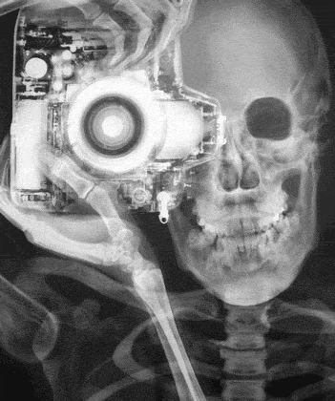
Just For Fun
Campus Tour Guide
Medical Scribes
Crisis Text Line Volunteers
Target Beauty Team Member
Yoga Instructor
Resident Directors
Youth Baseball Umpire
EMT
Unicyclist
Newspaper Reporter
MCAT Tutors
Health Policy Committee President
Weightlifting Club President
Elementary and Middle School Tutors
Healthcare Consultants
Bartender & Barista
Dog Rescuers
Film Director
Rowing World Record Holder
Hospice Caretakers
Ballet Dancers
Tax Associate/Financial Advisor
Medical Scribes
Shoe Designer
Habitat for Humanity Volunteers
Navy SEAL
Physical Therapy Aid
Phlebotomy Tech
Lifeguards
Online Academic Coach
Vaccine Distributor
Certified Scuba Divers and Instructor
Event Planner
Bollywood Fusion & Bhangra Dancers
First Degree Black Belt in Taekwondo
Seeing Eye Dog Trainer
Podcaster
Fraternity President
Magician
Marathon Runner
Expert Fly Fisher
Beer Brewer
Ice Cream Store Manager
Food Bank Volunteers
Latin Teacher
President of Student Government
Athletic Trainer
Nurse Practitioner
COVID 19 Mask Maker
Citizenship Test Study Assistant
Foreign Military Adviser
Saxophone Teacher
Teach for America Educators
Americorps Volunteers
Corrections Volunteer
Hiking Teaching Assistant
Licensed Private Pilot
Youtuber
Rock Climbers
Latin Dancer
Graphic Designer
Musical Theatre Performer
Firefighter
Figure Skater
Red Cross Volunteer
Nurse Practitioner
Spanish/English Translators
Manager for Youth Justice
Cartoonist
Ballroom Dancer
Instruments Played: Piano Guitar
Violin French Horn
Flute Piccolo
Saxophone Drums
Most Common…
Most Popular Names: Victoria (4) Jessica (3), David (3), Kevin (3), Michael (3), William (3)
Most Popular Birthdays: September 2 (4), January 12 (3), February 11 (3), March 10 (3), May 21 (3), July 14 (3), July 19 (3), August 30 (3), September 22 (3), October 21 (3), November 7 (3)
7/10- Jessica Cauley, 7/12- Rebecca Schur 7/14- Andres Hernandez, Haitong Tu, & Cammy Tang

