Slide 1
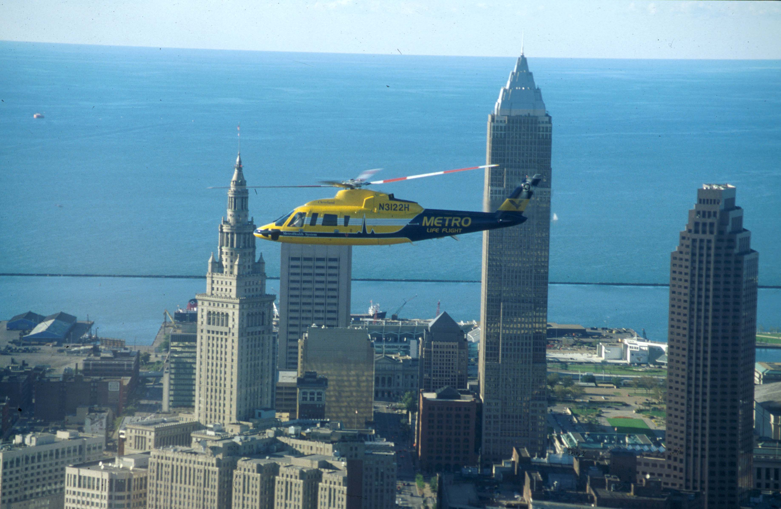
Using Office 2007 Type Your Title here – use font size 100 (this is Arial)
Type author/s here - use font size between 40- 70
This is a basic layout for a research poster.
Introduction (font size 70)
Methods
Results
To type or paste in information, insert a text box for each area of information.
Text boxes can be moved around, fonts changed, pictures added.
To change the background of a text box:
Right click on the text box > Format Shape> click on Solid Fill or Gradient Fill and use the drop down menus to select colors or texture. Hold the shift key as you click on the text boxes to select multiple text boxes.
Write your introduction here. This is Font Arial 48.
This is a text box.
This is a
text box with
outline/border that
lines up w/heading
text box
Background
This is Font Arial 54.
This is a text box with no outline/border.
Pictures:
Save image to your computer as a jpeg or tif file. (Make sure you use pictures so that the final print size is between 72-100 dpi. If you need to scan an image, scan at 300 -600 dpi.)
Open your poster > Insert > Picture > from file, select image and > Insert. Resize the picture by adjusting it from the corners.
Conclusion/Discussion
To change the background of the poster:
Right click on the background, select Format Background to change the color, add a texture or make a nice gradient color.
The possibilities are endless.
You can insert Graphs or Charts and Tables by copy-pasting in from Excel.
Copy the chart or table in Excel, open your poster, click on Paste > Paster Special > Picture (Enhanced MetaFile). Many other types of files do not copy well into PowerPoint. If you are having trouble, export the file as a jpeg or tif and use insert>Picture.
Cleveland, Ohio

