Slide 1
Social Work Competencies: 2 and 3 Advocacy and Inclusion
Field First Fridays
Dr. Chenobia Webster-Hill, DSW, LCSW
April 05, 2024

Slide 2
Welcome to
Field First Friday (FFF)!
First Friday of the month at 12:00pm EST
Zoom link will always be the same
Meeting ID: 673 987 5758 Passcode: 891923
Main objectives of FFF:
Enhance Field Instructors’ knowledge and understanding about best practices with students
Learn about resources and tools to help support student learning
Participate in solution-focused discussions and troubleshoot complex situations
Engage and network with other professionals within Ohio and the US
Enhance Field Instructors’ partnerships with the Mandel School & Field Faculty Advisors
Notes:
Informal event to talk, provide guidance and support, build relationships

Slide 3
Today’s Objectives:
Competency 2: Advance Human Rights and Social, Racial, Economic, and Environmental Justice (External)
Objective 1: Discuss basic skills in identifying and challenging systemic injustices by exploring the ways in which policies, practices, and institutions contribute to social, racial, economic, and environmental disparities.
Objective 2: Demonstrate the ability to help interns advocate for marginalized populations through beginner-level initiatives, such as raising awareness, participating in community organizing efforts, and collaborating with stakeholders to address social injustices.
Competency 3: Engage in Anti-Racism, Diversity, Equity, and Inclusion (ADEI) in Practice (Internal)
Objective 1: Develop introductory skills in conducting culturally competent assessments, recognizing and affirming the strengths and challenges of individuals from diverse backgrounds, and adapting interventions to meet the unique needs of clients.
Objective 2: Foster a commitment to ongoing learning and self-reflection regarding personal biases and cultural competence, actively seeking opportunities to enhance awareness and competence in anti-racist, diverse, equitable, and inclusive social work practices.

Slide 4
Competency 2: Advance Human Rights and Social, Racial, Economic, and Environmental Justice (External)
1. Understanding Systemic Injustices:
- Explore the interconnectedness of policies, practices, and institutions, and how they collectively contribute to perpetuating systemic injustices.
2. Critical Examination of Policies and Practices:
-- Develop the ability to recognize implicit biases within institutional frameworks and policies, fostering a comprehensive understanding of the mechanisms that sustain disparities.
3. Empowering Individuals for Advocacy:
- Foster a proactive mindset by encouraging interns to engage in conversations, raise awareness, and actively contribute to dismantling structures that perpetuate social, racial, economic, and environmental disparities.

Slide 5
Competency 2: Advance Human Rights and Social, Racial, Economic, and Environmental Justice (External)
1. Building Advocacy Skills for Interns:
- Provide interns with practical skills to advocate for marginalized populations by emphasizing the importance of empathy, active listening, and effective communication.
- Develop an understanding of the power dynamics at play and the role interns can play in addressing social injustices within their communities.
2. Initiating Beginner-Level Initiatives:
- Guide interns in developing and executing beginner-level initiatives, such as raising awareness campaigns, to shine a spotlight on issues affecting marginalized populations.
3. Collaborative Engagement with Stakeholders:
- Emphasize the significance of collaboration by guiding interns in building partnerships with stakeholders, including local organizations, community leaders, and other advocacy groups.

Slide 6
Small Group Activity: Ways to Celebrate Diversity in the Workplace
Pay Attention to Cultural Nuances.
Address Communication Barriers.
Develop a Cultural Calendar.
Encourage Education.
Create a Bulletin Board of Diversity.
Employee/Intern Diversity Training.
Support Employee/Intern Advancement.
Make Company Culture Important.

Slide 7
Competency 3: Engage in Anti-Racism, Diversity, Equity, and Inclusion (ADEI) in Practice (Internal)
1. Culturally Competent Assessments:
- Equip interns with foundational skills to conduct culturally competent assessments, emphasizing the importance of understanding diverse cultural backgrounds, values, and experiences.
2. Recognition and Affirmation of Diversity:
- Encourage a strengths-based approach that acknowledges the resilience and resources within diverse communities, while also addressing the challenges they may face.
3. Adaptation of Interventions:
- Provide practical strategies for tailoring interventions to align with cultural preferences, belief systems, and communication styles, ensuring that therapeutic practices are inclusive and responsive to individual differences.

Slide 8
Competency 3: Engage in Anti-Racism, Diversity, Equity, and Inclusion (ADEI) in Practice (Internal)
1. Promoting Ongoing Learning:
- Encourage a commitment to continuous learning by highlighting the dynamic nature of cultural competence and the importance of staying informed about evolving perspectives, research, and best practices.
2. Self-Reflection on Biases:
- Foster a culture of self-reflection by guiding interns to regularly examine personal biases and assumptions that may impact their professional practice.
3. Commitment to Anti-Racist and Inclusive Practices:
- Encourage interns to seek out opportunities for dialogue, advocacy, and collaboration that contribute to dismantling discriminatory practices and creating more inclusive environments within the field of social work.

Slide 9
What is the flower petal of inclusion activity?
As part of workplace diversity initiatives, consider incorporating the flower petal activity. In this activity, each group will craft a flower using petals, assigning a unique characteristic to each member on individual petals. These characteristics should highlight what makes each member distinct.
Additionally, in the center of the flower, identify and write down characteristics that are shared by everyone in the group. This activity promotes appreciation for individual differences while acknowledging commonalities among team members.

Slide 10
Flower Petals of Inclusion

Slide 11
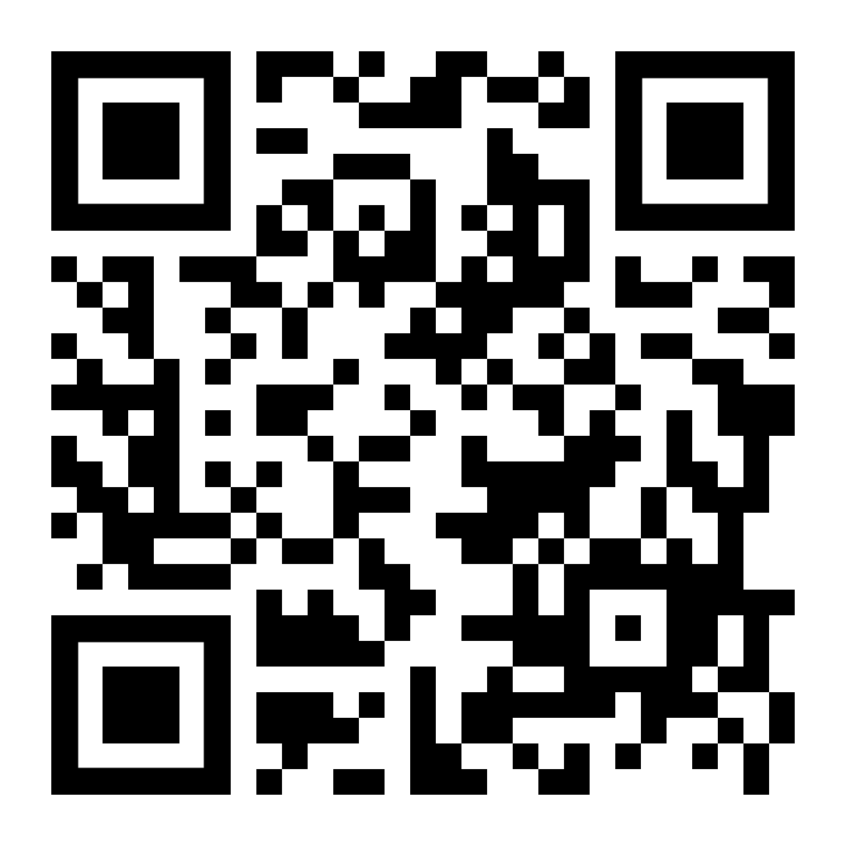
Recap, Questions, Concerns and Support
[Any additional comments, questions, feedback or resources please put here]
Share your feedback
Click here or scan

Slide 12
Upcoming Events
Field First Friday: Competencies 4 & 5
May 3, 2024
Facilitator: Addisu Bayle
Field Appreciation: Field Instructor Appreciation Breakfast
May 9, 2024
Facilitator: Field Education Team
ADEI Training Series: Language Matters: Embracing First-Person, Inclusive Language and Terminology
June 21, 2024
Facilitator: Naomi Sigg

