Slide 1
Cryptology
Polyalphabetic
Ciphers
MATH 408
Prof. David Singer

Slide 2
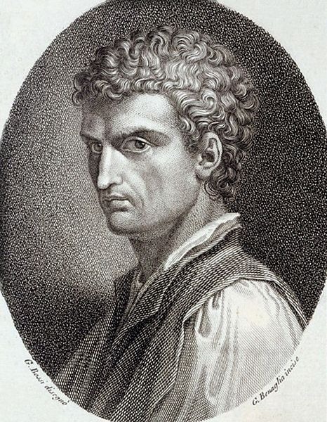
Thwarting the statistician
Leon Battista Alberti, De Cifris, ~1466

Slide 3
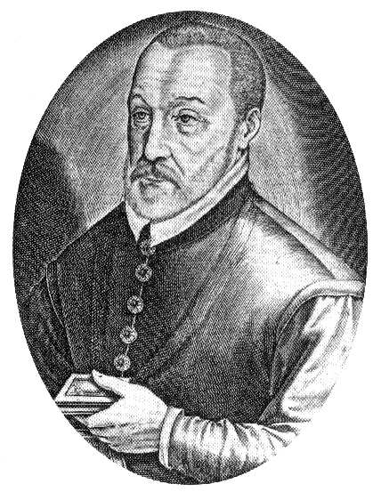
Thwarting the statistician
Blaise de Vigenère , Traicté des Chiffres ou Secrètes Manières d'Escrire, 1586

Slide 4
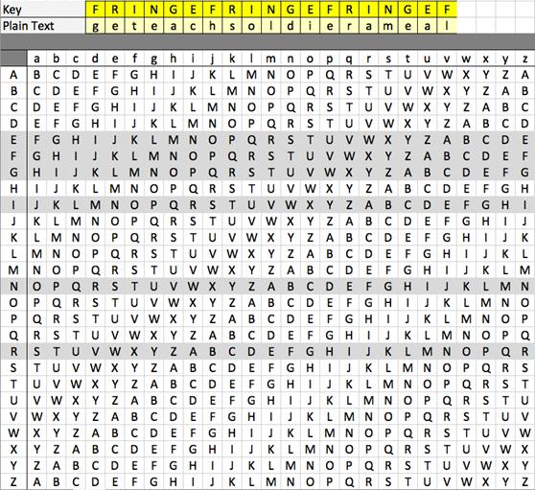
The Vigenère Tableau
Letters encrypted with different alphabets using keyword (fringe)

Slide 5
Vigenère Example
I am a professor in the
B AK E RBAKERBAK ER BAK
K BX F HTPQJKUPC NF VIP
mathematics department
ERBAKERBAKE RBAKERBAKE
RSVIPRSVJNX VGQLWLOFYY

Slide 6
Vigenère Example
KBXFHT PQJKUP CNFVIP RSVIPR SVJNX VGQLWL OFYY
We have destroyed the statistics! (e.g., the bold letters are a’s)
Vigenère’s system was le chiffre indéchiffrable (the unbreakable cipher) for 300 years.

Slide 7
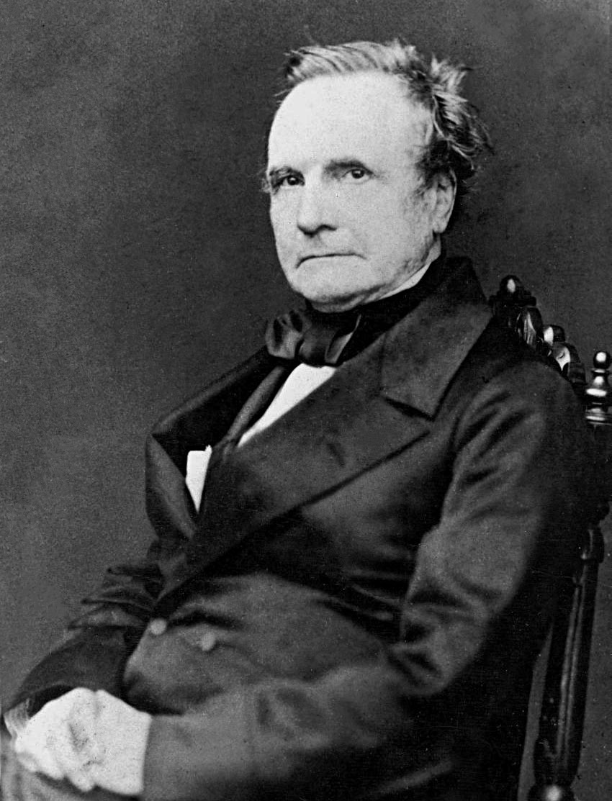
The unbreakable is broken
Charles Babbage -- 1854

Slide 8
The unbreakable is broken
Babbage did not publish his solution (possibly by order of British Intelligence during the Crimean War.)
But Friedrich Kasiski published his solution in 1863.

Slide 9
The unbreakable is broken
Key idea: look again at my cipher:
KBXFHTPQJKUPCNFVIPRSVIPRSVJNX VGQLWLOFYY
Notice the repetition of the string VIPRS. Why is it there?

Slide 10
Another Look
I am a professor in the
B AK E RBAKERBAK ER BAK
K BX F HTPQJKUPC NF VIP
mathematics department
ERBAKERBAKE RBAKERBAKE
RSVIPRSVJNX VGQLWLOFYY

Slide 11
Kasiski’s Attack
1. Look for repeated strings
2. Count the distance between beginnings of repeated strings.
3. Guess length of keyword
4. Divide and conquer!

Slide 12
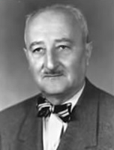
William Friedman
Developed a more sophisticated attack on Vigènere and other “polyalphabetic” ciphers. (1920)
Established a relationship between cryptanalysis and mathematics.

Slide 13
What can we learn from history?
1. Crypto is a constant struggle between cryptographer and cryptanalyst.
2. Cryptosystems are absolutely unbreakable – until they are broken.
3. Ignore Rule 2 at your peril.

Slide 14
What can we learn from history?
Kerckhoffs’ Principle: The security of a cryptosystem must not depend on keeping secret the crypto-algorithm (=method.) The security depends only on keeping secret the key.
No cryptosystem can be assumed unbreakable forever.

