Slide 1
Cryptology
Digital Signatures and Digital Certificates
Prof. David Singer
Dept. of Mathematics
Case Western Reserve University

Slide 2
Cryptographic Services
Privacy (encryption) – You can’t see it
Integrity (signing) – You can’t change it

Slide 3
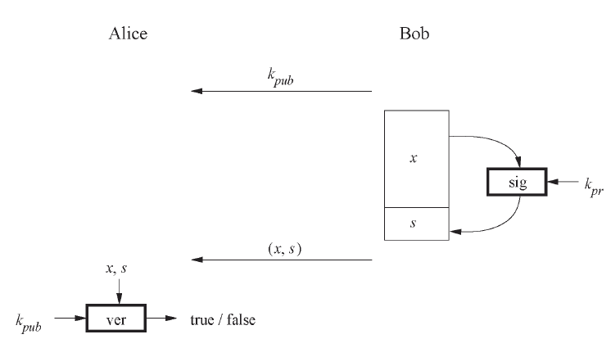
Digital Signatures
The basic scheme is shown here:

Slide 4
Digital Signatures
1.Bob signs using his private key.
2.Alice can verify the signature using Bob’s public key.
3. Anyone else can also verify Bob’s signature.
4. Since only Bob has the private key, only he could have signed. (Nonrepudiation)

Slide 5
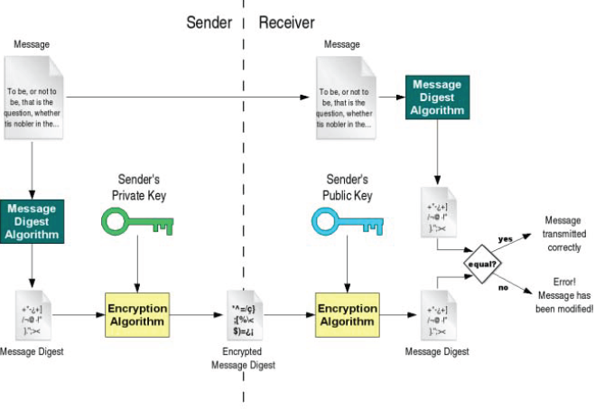
Digital Signatures
A more complete description:

Slide 6
What is a “message digest”?
It is derived from the old idea of a “checksum”, used to insure that a transmission has no errors.

Slide 7
Example: UPC
Add the digits in the odd-numbered positions together and multiply by three.
Add in the digits in the even-numbered positions.
Add the checksum digit.
If the result ends in 0, all is well.

Slide 8
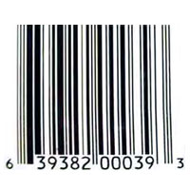
Example: UPC
Example: 639382000393
1. (6+9+8+0+0+9)X3=96
2. 96+3+3+2+0+3=107
3. 107+3=110

Slide 9
What is a “message digest”?
It is derived from the old idea of a “checksum”, used to insure that a transmission has no errors.
A message digest is computed from a message by a “hash” function.

Slide 10
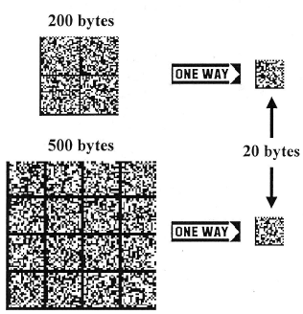
Secure Hash Function
A hash function is a compressed version of the message, using a one-way function.
The hash size is independent of the size of the message.

Slide 11
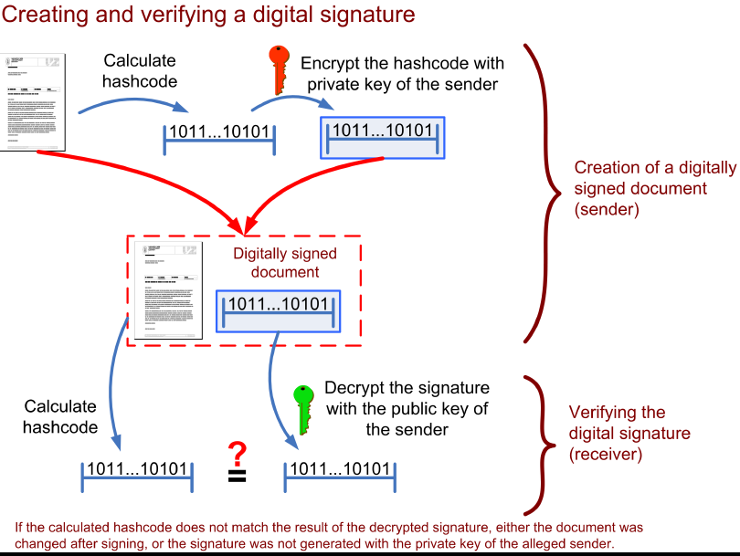

Slide 12
Why a “secure” hash?
Efficiency: only a small amount of data has to be encrypted.
Integrity: any change in the document will cause major change in the hash and invalidate the signature.
Nonrepudiation: Bob cannot later deny signing.

Slide 13
What is a “secure” hash?
A one-way function has the property: Given x, it is ‘hard’ to find another x’ with f(x)=f(x’).
This property, called (weak)collision-resistance, is vital for security against forgery.
In fact, we should need a stronger condition: it is hard to find x and x’ with f(x)=f(x’).

Slide 14
A Sneaky Forgery Scheme
Construct an agreement.
Find 32 places where the agreement can be changed slightly.
3. Construct forgery.
4. Find 32 places where forgery can be changed slightly.

Slide 15
A Sneaky Forgery Scheme
5. Find a copy of the message and a copy of the forgery with the same hash value.
Note: There are 4,294,967,296 versions of each document.
6. Now trick Bob into signing the version of the message which can be forged!

Slide 16
Moral of the Story
Before (digitally) signing a document written by someone else, make changes.
Make sure the hash function is cryptographically strong. (That means it is strongly collision-resistant.)
SHA-1 is an example of such a function.

Slide 17
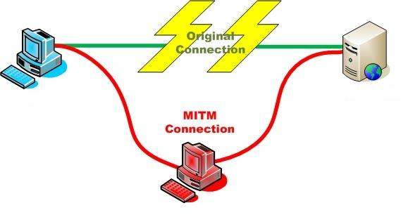
Mallory in the Middle
Alice "Hi Bob, it's Alice. Give me your key"--> Mallory Bob
Alice Mallory "Hi Bob, it's Alice. Give me your key"--> Bob
Alice Mallory <--KB Bob
Alice <--KM Mallory Bob
Alice "Meet me at Tommy’s!“KM--> Mallory Bob
Alice Mallory "Meet me at Sergio’s!“KB --> Bob
Alice
Bob
Mallory

Slide 18
Digital Certificates
One way to avoid the Mallory-in-the-middle attack is to have a trusted certificate authority (CA).
This prevents Mallory from inserting her own public key in place of Bob’s.

Slide 19
Certificate Authority (CA)
CA verifies identity and credentials of user (in person or by some other non-crypto method)
Issues certificate of public key.
Transmits key pair to user securely.
User can publish certificate.

Slide 20
Certificate Authority (CA)
Certificate has expiration date.
CA needs to be able to revoke certificate before expiration.
CA needs to backup keys and have procedure for recovery of lost keys.
Note: Certificates are included in browsers (IE, Firefox, etc.).

Slide 21
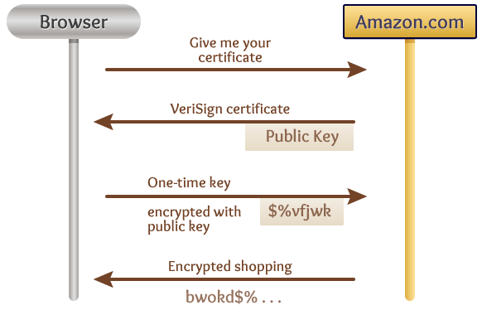
Your browser handles the security job for you!

Slide 22
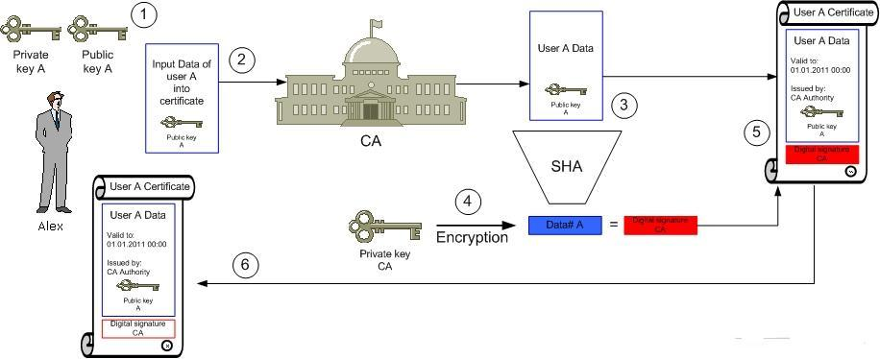
Getting a certificate

Slide 23
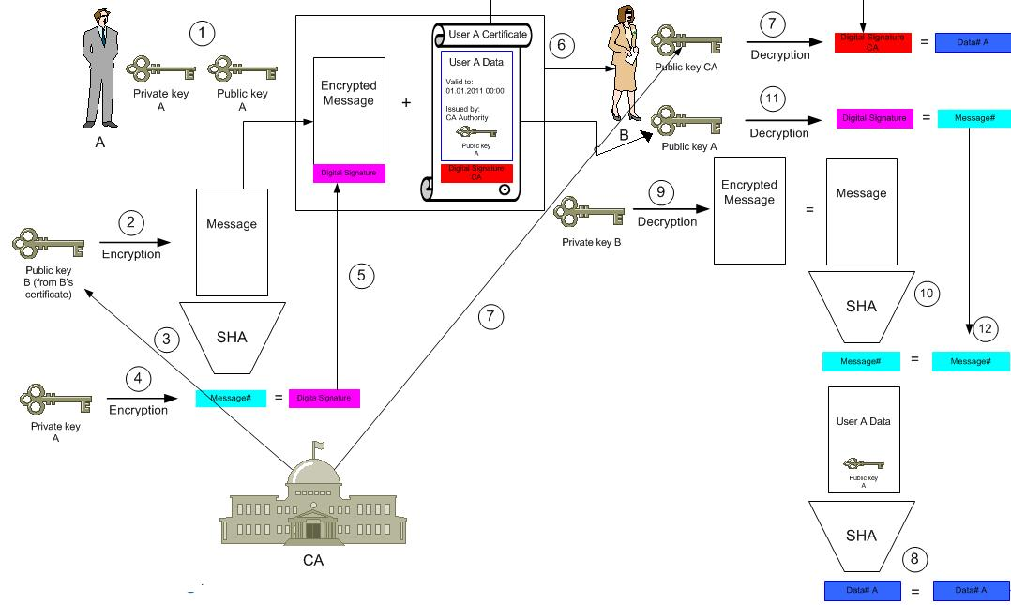
The complete process

Slide 24
Internet X.509 Public Key Infrastructure
“When a certificate is issued, it is expected to be in use for its entire validity period. However, various circumstances may cause a certificate to become invalid prior to the expiration of the validity period.

Slide 25
Internet X.509 Public Key Infrastructure
“Such circumstances include change of name, change of association between subject and CA (e.g., an employee terminates employment with an organization), and compromise or suspected compromise of the corresponding private key. Under such circumstances, the CA needs to revoke the certificate.”

Slide 26
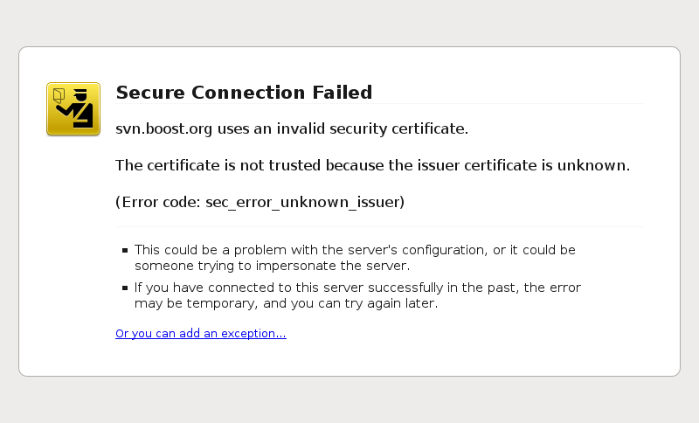
Did this ever happen to you?

Slide 27
More on Nonrepudiation
If Bob signs a document with his secret key, what is to stop him from later changing his public key and denying the signature?
Conversely, how can Bob prove that it was not his key that was used?

Slide 28
More on Nonrepudiation
Certificate Authority needs to keep records, including time stamped certificates and dates of revocations.
CA needs to be a trusted party. Can have multiple CA’s.
CA must protect its secret key.
Issued keys must be sound.

Slide 29
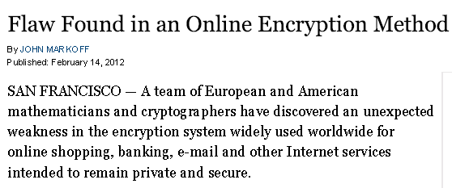
OOPS!

Slide 30
OOPS!

Slide 31
End

