Slide 1
Foci of Algebraic Curves
November 7, 2008

Slide 2
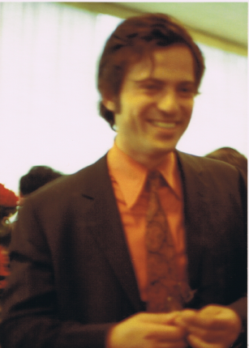
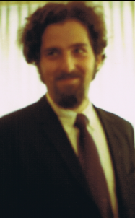
With thanks to my mentor

Slide 3
Outline of Talk

Slide 4
What are Foci?

Slide 5
Plücker Formulation

Slide 7
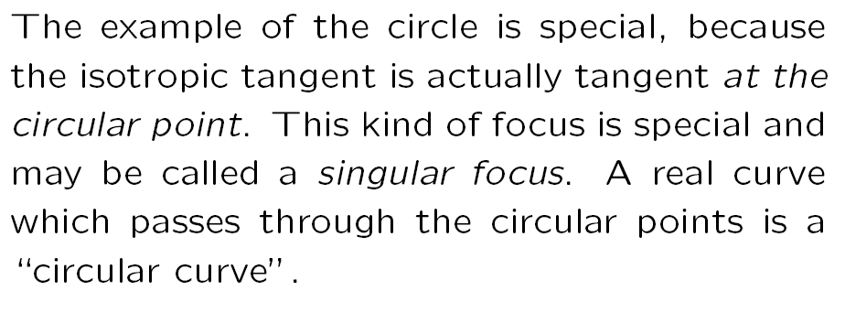

Slide 8
Example 1: The k-ellipse

Slide 9
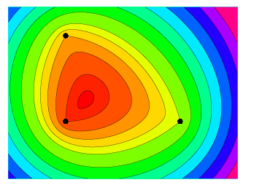
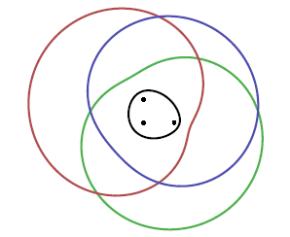

Slide 10
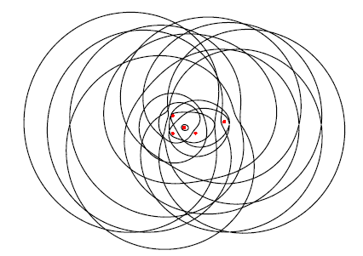

Slide 11
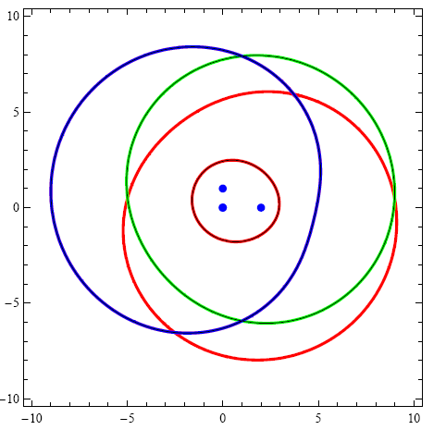
The 3-ellipse

Slide 12
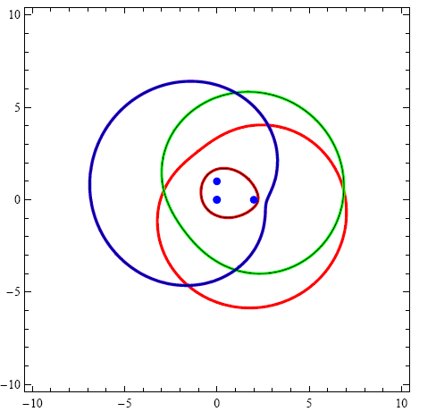
The innermost curve is convex

Slide 13
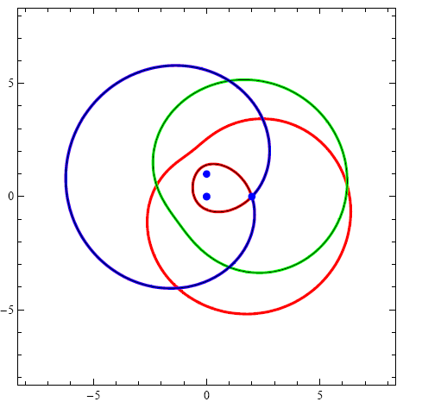
Non-smooth example

Slide 14
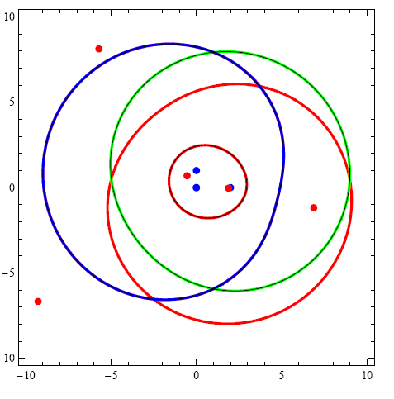
A 3-ellipse with 8 (of nine) foci

Slide 15
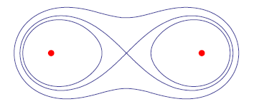
Example 2: Lemniscates

Slide 16
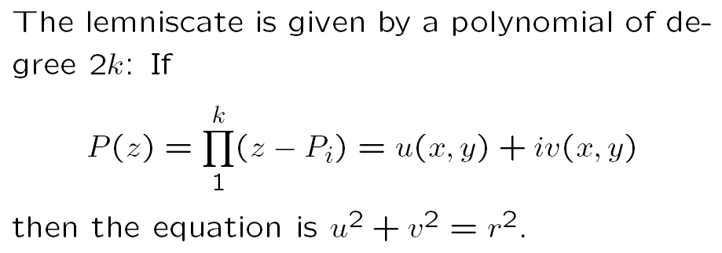

Slide 17
Lemniscates can be anything

Slide 18
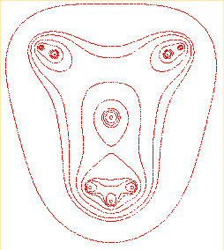
E.T.: Phone Home!
des cassiniennes alien ... par Alain Esculier

Slide 19
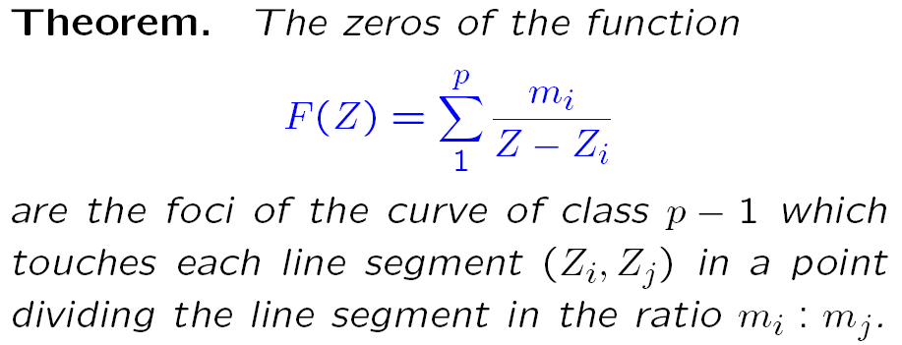
Example 3: Siebeck’s Theorem

Slide 20
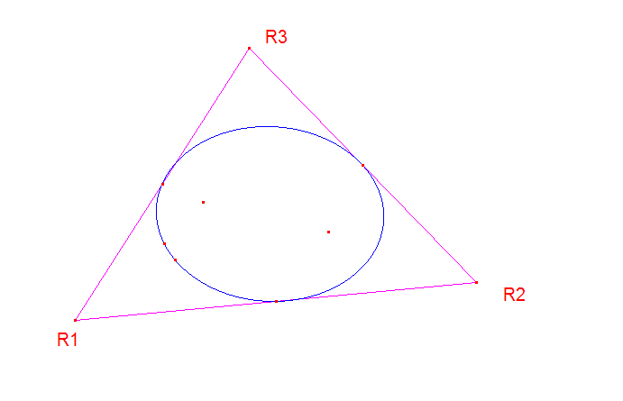
Bôcher-Grace Theorem

Slide 21
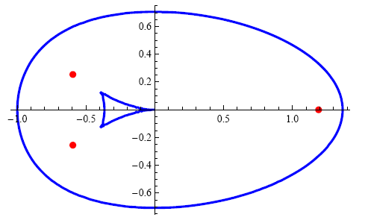
Class Three

Slide 22
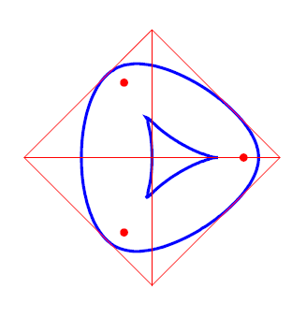

Slide 23
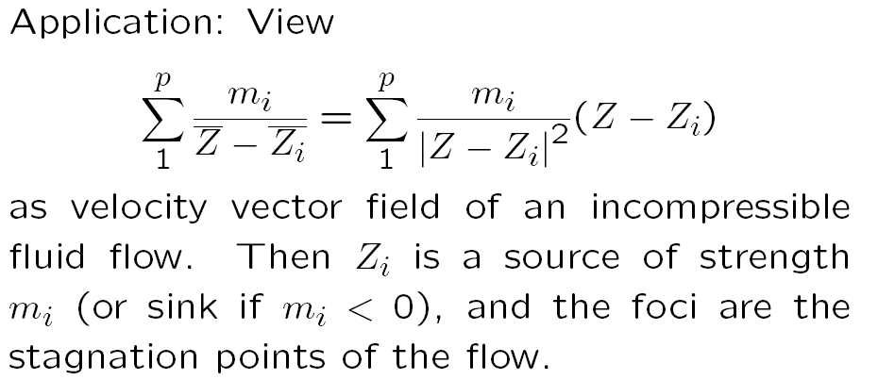

Slide 24
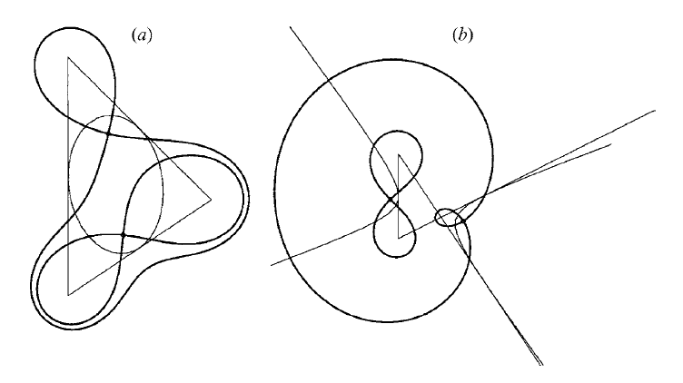

Slide 25
Example 4: Non-Euclidean polynomials

Slide 26
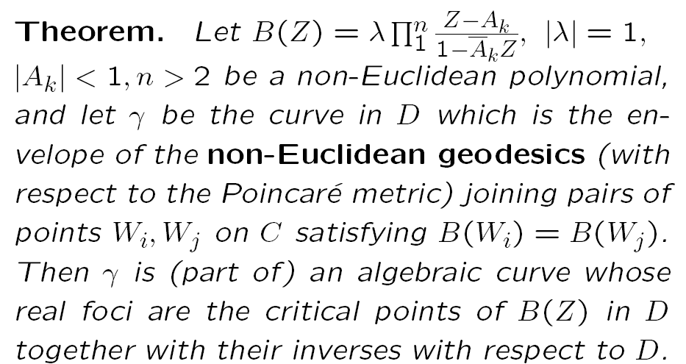

Slide 27
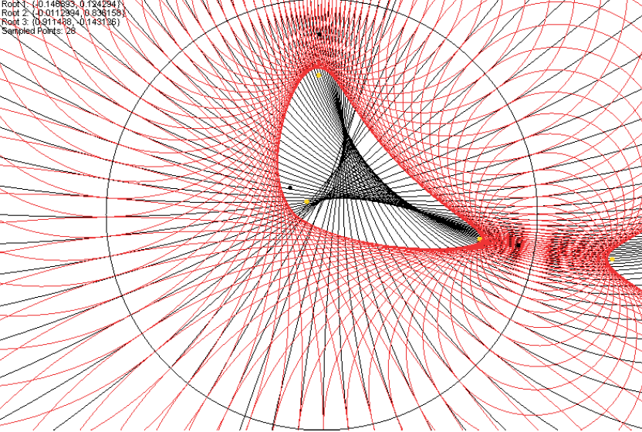
n = 4 example

Slide 28
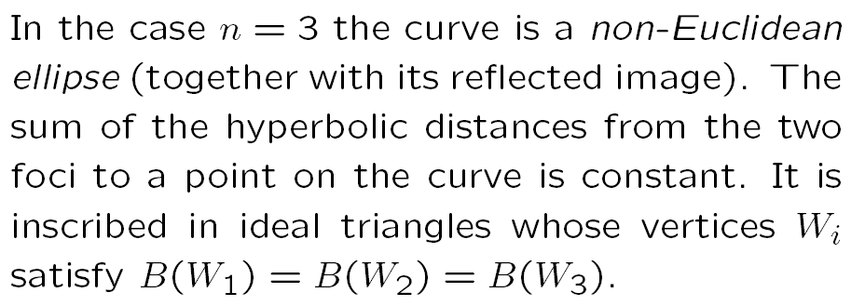

Slide 29
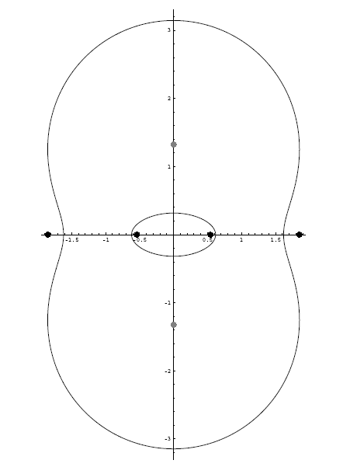

Slide 30
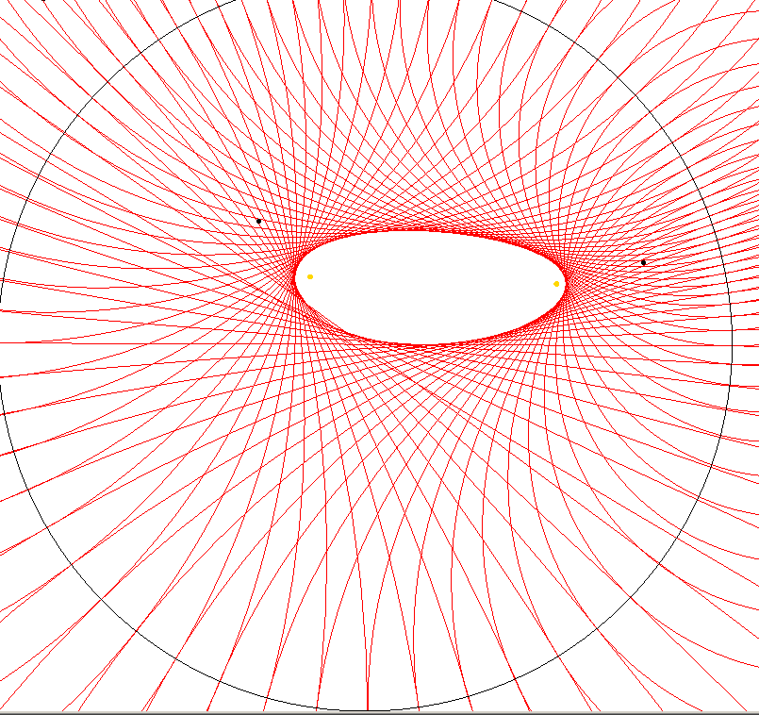
The hyperbolic ellipse

Slide 31
Example 5: Eigenvalues

Slide 32
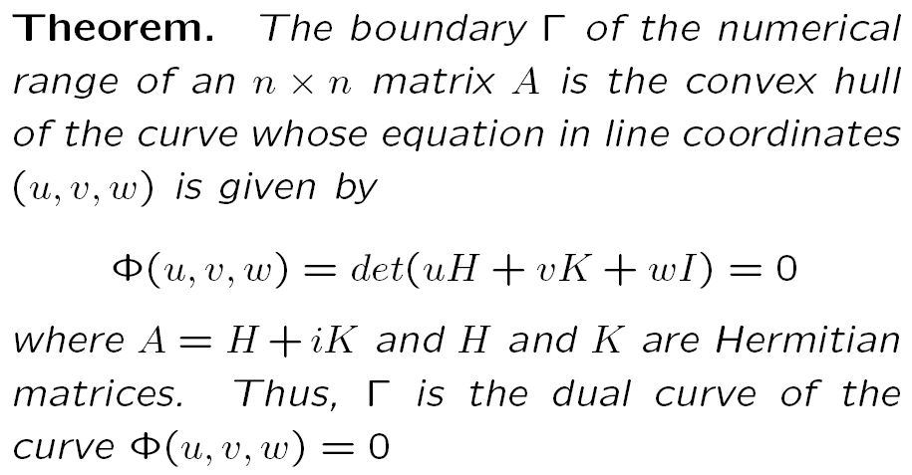
Kippenhann’s Theorem

Slide 33
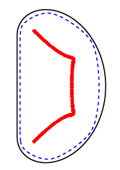

Slide 34
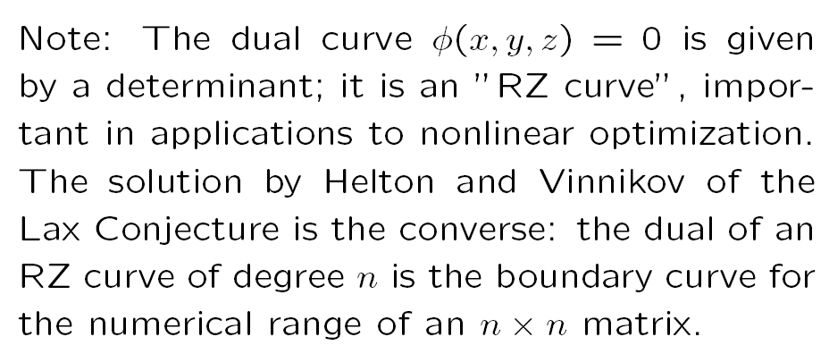

Slide 35
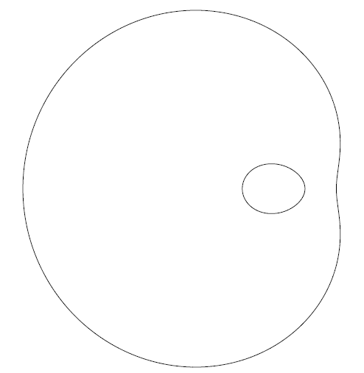
Example of an RZ curve

Slide 36
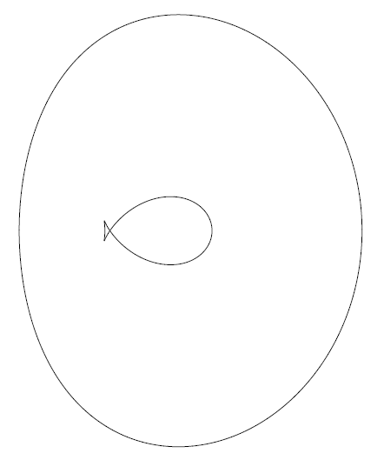
The dual curve

Slide 37
Example 6: Schwarz Reflection

Slide 42
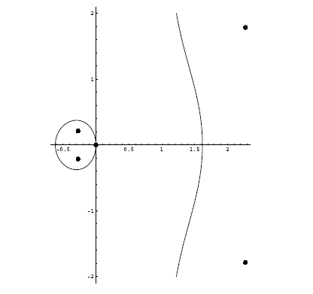
Conclusion: Foci are interesting

Slide 43
The End

