Slide 1
Cryptology
Passwords and Authentication
Prof. David Singer
Dept. of Mathematics
Case Western Reserve University

Slide 2
User Authentication
Computer systems often have to identify and authenticate users before authorizing them
Identification: Who are you?
Authentication: Prove it!
How can a computer accomplish these things remotely?

Slide 3
Authentication Factors
Something the user knows:
e.g, Password
Something the user has:
e.g., ATM card, browser cookie
Something the user is:
e.g., fingerprint, eye scan

Slide 4
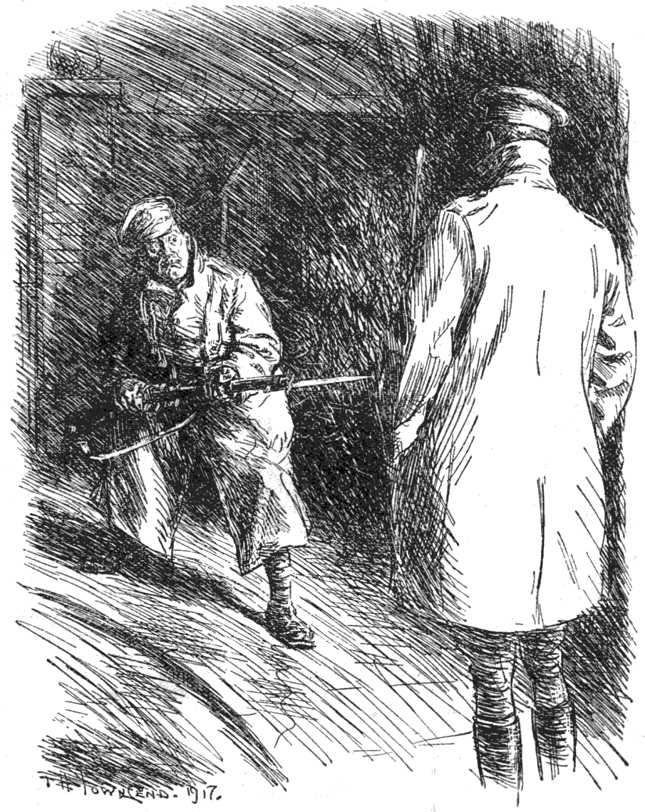
Passwords
Classical idea

Slide 5
Passwords
Classical idea.
User enters ID and password.
May allow more than one try.
Forgotten passwords may or may not be recoverable.
“The password must be impossible to remember and never written down.”

Slide 6
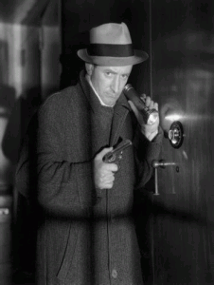
Attacks on Passwords
Brute Force
Try every possible password
Short passwords are unsafe.

Slide 7
Rubber Hose Attack
Different from Brute Force.
Related to the Bribe Attack.

Slide 8
Dictionary Attack
Try common words first
Most people use
real words as
Passwords.
Much faster
Than brute force.

Slide 9
Dictionary Attack
Some top passwords:
password iloveyou
123456 12345678
qwerty abc123
monkey letmein
trustno1 dragon
ninja sunshine
baseball 111111

Slide 10
Strong Passwords
The measure of strength of a password is its “entropy”.
Notion developed by Shannon of Bell Labs in the 1940’s.
Entropy= number of “bits” of “uncertainty”
Every bit helps! Each bit doubles the amount of work to guess a password.

Slide 11
Strong Passwords
0 1 (one bit)
00 01 10 11 (two bits)
000 001 010 011 100 101 110 111 (three bits = 8 possibilities)
0000 0001 0010 0011 0100 0101
0110 0111 1000 1001 1010 1011
1100 1101 1110 1111 (four bits = 16 possibilities)

Slide 12
Strong Passwords
A random string of length n of unknown 1’s and 0’s has n bits of entropy (uncertainty.)
Letters, numbers, and symbols are stored on a computer as binary strings of length 7.
An ordinary letter has about 4.7 bits of entropy (or less!)

Slide 13
ASCII
American Standard Code for Information Interchange
Standard symbols coded as numbers from 0 to 127.
Example: a=97 (decimal)
97=64+32+1
=1100001 (binary)
=141 (octal) = 61 (hexidecimal)

Slide 14
ASCII
a-z encoded as 1100001 to 1111010 (97 to 122)
A-Z encoded as 1000001 to 1011010 (65 to 90)
Using capitals mixed with small letters randomly adds exactly one bit of uncertainty!

Slide 15
Ascii
A random ascii character has 7 bits of uncertainty.
But since the first 32 characters are non-printing (like “backspace”), there are only about 6.5 bits of uncertainty in a random ascii string used in a password.

Slide 16
Entropy of Passwords
According to NIST, an 8-letter humanly generated password has about 18 bits of entropy.
However, other experts disagree with their methodology. They argue that Shannon entropy is not the right measure. (See Matt Weir)

Slide 17
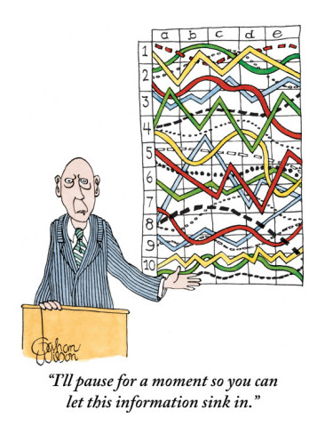
Password Policies
This is currently a difficult and controversial area of computer security.

Slide 18
What can you do?
Use letters, numbers and special characters
Choose long passwords (at least eight characters)
Avoid guessable roots
If supported, use pass phrase

Slide 19
What can you do?
Write down passwords but keep them in a safe place (no sticky notes!)
Don’t share them with others
Be careful in public places (There are “password sniffers” that can steal your passwords as you use them)

Slide 20
Sending passwords
Simple model:
Alice sends (ID, pwd) to Bob.
Bob compares with his list.
Bob says OK and gives access or NO and denies access.
Big problem: Someone can hack into Bob’s server and steal the password list!

Slide 21
Sending passwords
More secure method:
Bob keeps list (ID, H(pwd)) of hashes of passwords.
Alice sends (ID, (pwd))
Bob computes H(pwd) and compares with his list.
Bob says OK or NO

Slide 22
Sending passwords
If Bob’s server is compromised, the hacker only gets H(pwd).
Still vulnerable to off-line dictionary attack. Harriet takes dictionary file of passwords and computes their hashes. She compares these to the stolen list.

Slide 23
“Salt” on the table
Bob keeps a list of the form (ID, r, H(r,pwd)); r is a random number which is hashed with the password (salt).
This foils dictionary attack on stolen password list.

Slide 24
Challenge-response methods
Alice sends hello message to Bob.
Bob sends random challenge to Alice.
Alice computes response using her secret password.
Bob verifies response as correct.
Harriet overhears all but learns nothing.

Slide 25
Fiat-Shamir Protocol
Alice has public key N=pq,A and private key a,p,q. A=a² mod N
Alice chooses random r, computes x=r² mod N, sends to Bob.
Bob sends random b=0 or 1.
Alice sends y=ra^{b} mod N.
Bob checks that y²=xA^{b} mod N.

Slide 26
How does this work?
This is done through a “Zero-Knowledge Proof”.
(Colin will explain this.)

Slide 27
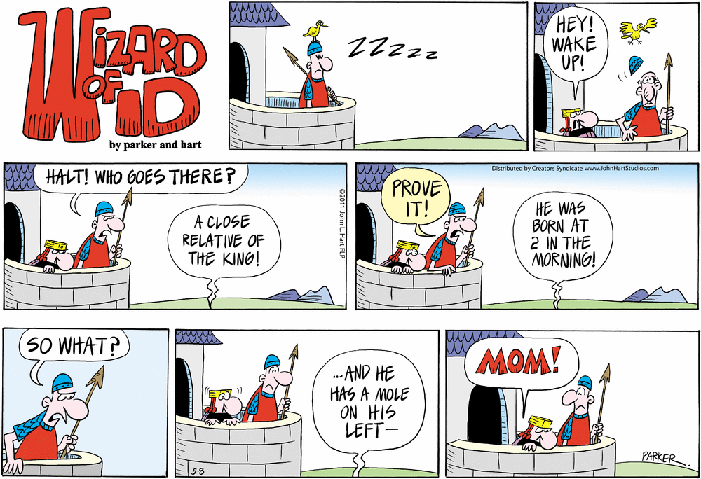
Extra security measure

Slide 28
Website password systems
Using public key cryptography, Alice and Bob set up a secure communication channel.
Alice sends her password to the server.
Bob verifies.
Hypertext Transfer Protocol Secure (HTTPS)

Slide 29
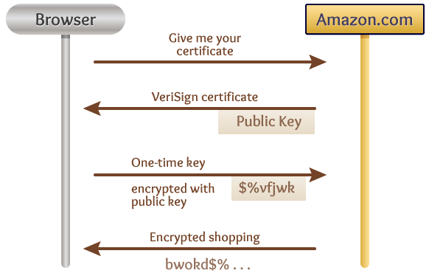
Your browser handles the security job for you!

Slide 30
End

