Slide 1
Prime Numbers and How to Avoid Them
Pi Mu Epsilon
April 19, 2012
CWRU

Slide 2
Sequences including primes
1, 2, 3, 4, 5, 6, 7, 8, 9, 10, 11, 12, 13, 14, …
2, 3, 5, 7, 11, 13, 17, 19, 23, 29, 31, 37,…
3, 5, 7, 9, 11, 13, 15, 17, 19, 21, 23, 25, …

Slide 3
Avoiding Primes
2, 4, 6, 8, 10, 12, 14, 16, 18, 20, 22, 24,…
That almost works. If we start with a non-prime, we can avoid primes entirely:
4, 8, 12, 16, 20, 24, 28, 32, 36, 40, 44, 48, …
But these numbers are all divisible by a common factor. That’s too easy.

Slide 4
Arithmetic sequences
Suppose we look only at sequences of the form {An+B} , Where A and B have no common factor.
199, 409, 619, 829,1039, 1249, 1459, 1669, 1879,2089, 2299, 2509, 2719, 2929, …
This was discovered by Edward Escott in 1910.
Green and Tao (2004) have proved that k consecutive primes occur in some arithmetic sequence, for any k.

Slide 5
But we want ONLY primes
Then by the prime number theorem arithmetic progressions will not work. Let’s try exponentially growing lists.
Numbers one less than a power of 2:
1,3,7,15,31,63,127,255,511,1023,2047,4095,
8191, 16383, 32767,65535, 131071,262143, 524287, 1048575,…

Slide 6
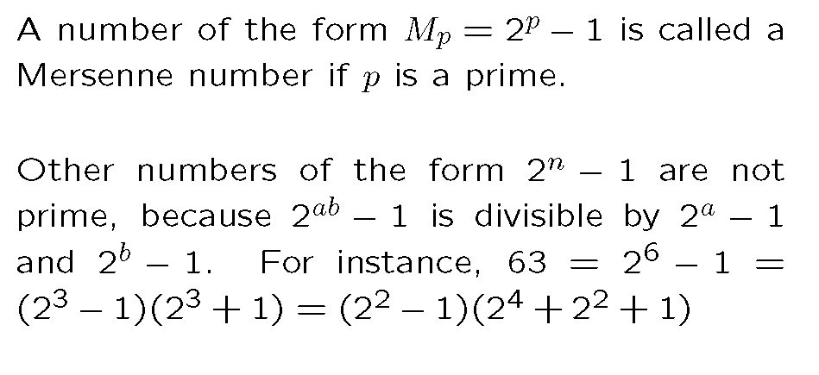
Mersenne

Slide 7
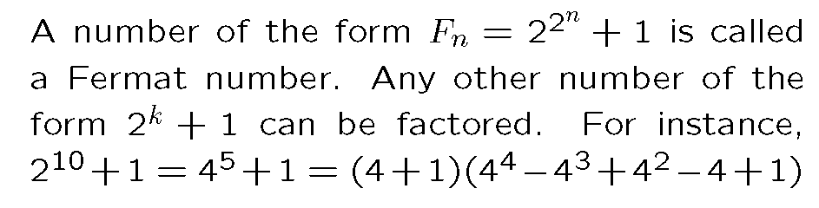
Add one instead

Slide 8
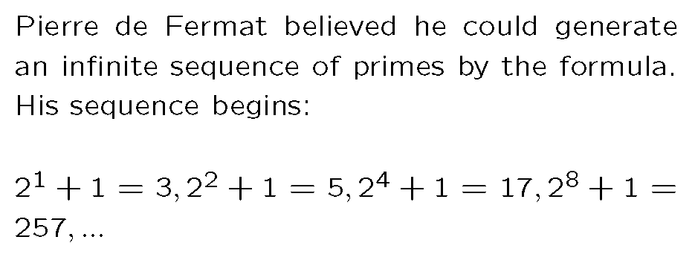
Finally getting somewhere?

Slide 9
Fermat Numbers
3, 5, 17, 257, 65537, 4294967297,
18446744073709551617,
340282366920938463463374607431768211457, …
Nice try, Pierre!

Slide 10
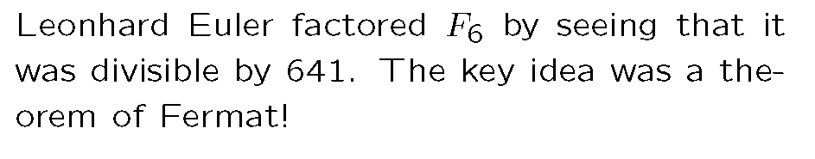
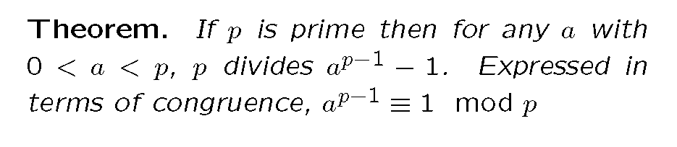
What went wrong?

Slide 11
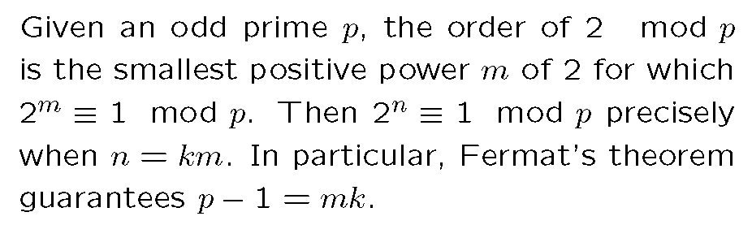
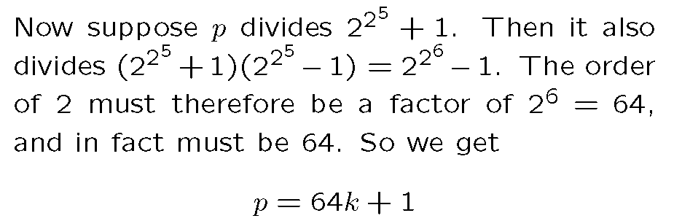
The order of 2

Slide 12
So Euler saw he only had to test divide by
65, 129, 193, 257, …, 64k+1
In fact, he only needed to divide by primes in this list. When k=10 it works.

Slide 13

Looking for Fermat Primes
By generalizing this argument, it can be seen that testing for Fermat primes requires looking at prime numbers of the form

Slide 14
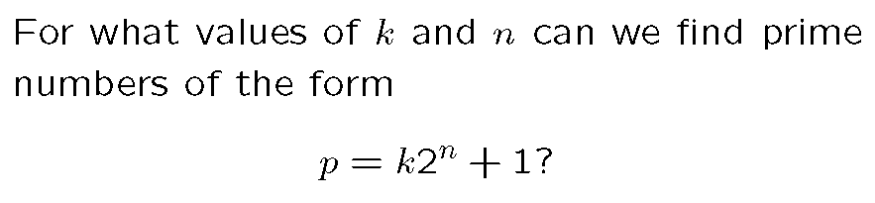
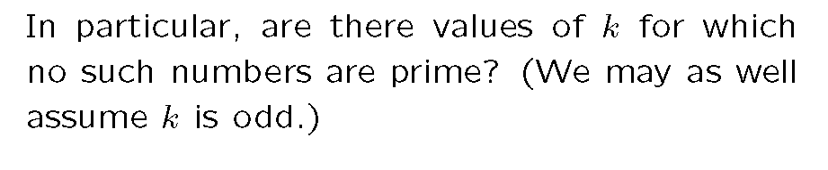
A New Question

Slide 15
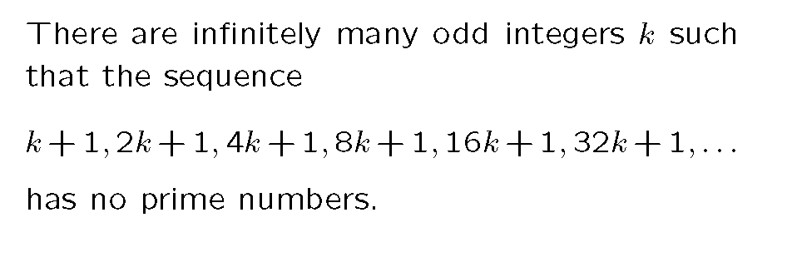
Sierpinski’s Theorem (1960)

Slide 16
Proof of Sierpinski’s Theorem
1 2 3 4 5 6 7 8 9 10 11 12 13 14 15 16
17 18 19 20 21 22 23 24 25 26 27 28 29 30 31 32
33 34 35 36 37 38 39 40 41 42 43 44 45 46 47 48
49 50 51 52 53 54 55 56 57 58 59 60 61 62 63 64
The integers can be divided into seven sets:
2n, 4n+1, 8n+3, 16n+7, 32n+31, 64n+15, 64n+47

Slide 17
Proof of Sierpinski’s Theorem
Now the plan is to divide the exponents into those seven groups, and for each group find a prime that always divides numbers whose exponents belong to that group.

Slide 18
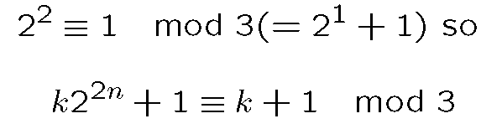
Proof of Sierpinski’s Theorem
So when k is any number of the form 3i+2, half the terms in the sequence will be divisible by 3.

Slide 19
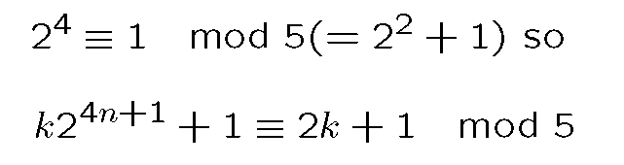
Proof of Sierpinski’s Theorem
Example: k=5 n=1,2,3,…
11, 21, 41, 81, 161, 321, 641, 1281, 2561, 5121,…
So when k is any number of the form 5i+2, a quarter of the terms in the sequence will be divisible by 5.

Slide 20
Proof of Sierpinski’s Theorem
When k=17, these happen at the same time:
35, 69, 137, 273, 545, 1089, 2177, 4353, 8705,17409, 34817, 69633, 139265, 278529, 557057, 1114113, 2228225, 4456449,…
Three quarters of the terms are divisible by 3 or 5, but occasionally a prime keeps showing up.

Slide 21
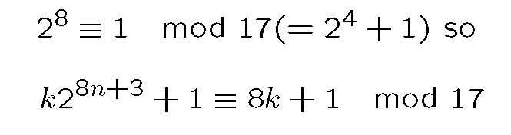
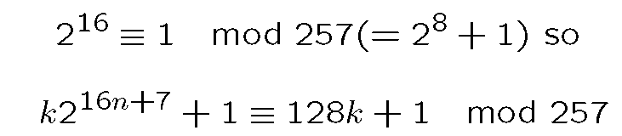
Proof of Sierpinski’s Theorem

Slide 22
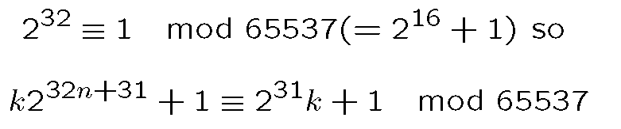
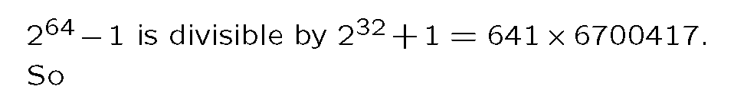
Proof of Sierpinski’s Theorem

Slide 23
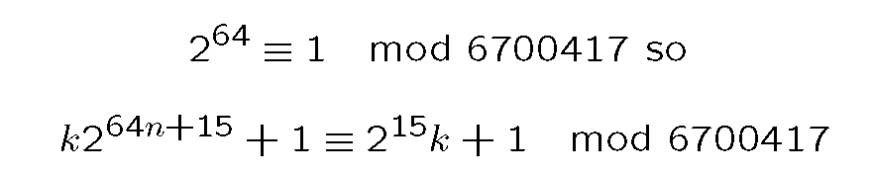
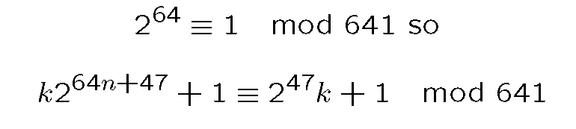
Proof of Sierpinski’s Theorem

Slide 24
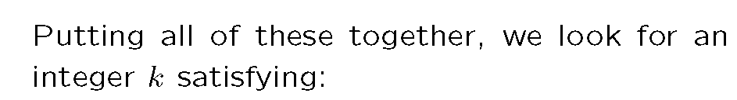




Proof of Sierpinski’s Theorem

Slide 25
Proof Concluded
The “Chinese Remainder Theorem” guarantees we can find infinitely many such numbers. The smallest is
k= 201 44650 31451 65117
This is a “Sierpinski number”, which makes every term in the infinite sequence composite. Half are divisible by 3, a quarter divisible by 5, etc.

Slide 26
What is the smallest Sierpinski number?
In 1962, John Selfridge found the number 78577 (= 17 x 4621). It is conjectured that this is the smallest such number.
To rule out a smaller value of k it is necessary to find a prime number for some n and this k.
As of March 2002 there were only 17 smaller values for which no prime had been found.

Slide 27
Seventeen or Bust
The Seventeen or Bust project was started in 2002 by two undergraduates.
As of October 2007, eleven of the possible counterexamples were ruled out by finding primes, the largest of which has almost four million digits.
Five of the eleven have been named Stephen Colbert primes.

Slide 28

This Man Has Your Number

Slide 29
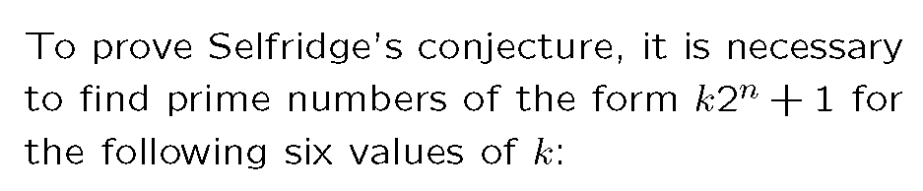
Seventeen or Bust

