Slide 1
Cryptology
4. Public KeyCryptography
Prof. David Singer
Dept. of Mathematics
Case Western Reserve University
Fall 2012

Slide 2
Modern Cryptography
New Directions in Cryptography,
by Whitfield Diffie and Martin Hellman, 1976.

Slide 3
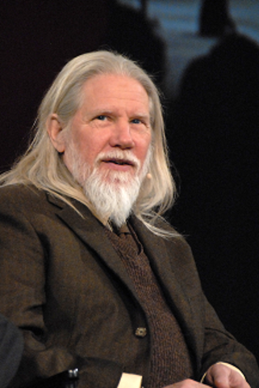
Whitfield Diffie

Slide 4
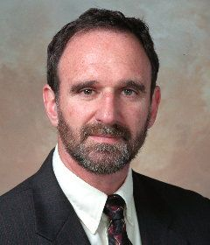
Martin Hellman

Slide 5
Modern Cryptography
New Directions in Cryptography,
by Whitfield Diffie and Martin Hellman, 1976.
(Also classified publication by James Ellis in 1970, declassified in 1997.)
J H Ellis, The Possibility of Secure Non-Secret Digital Encryption, CESG Report, January 1970.

Slide 6
James Ellis (1924-1997)
“It was obvious to everyone, including me, that no secure communication was possible without a secret key”
“Can we produce a secure encrypted message, readable by the authorised recipient without any prior secret exchange of the key etc?”

Slide 7
James Ellis (1924-1997)
“This question actually occurred to me in bed one night, and the proof of the theoretical possibility took only a few minutes.”
“The only remaining question was ‘Can it be made practicable?’ This took a while to answer.”

Slide 8
What is Public Key Crypto?
Bob has two keys: a public key, which is available to anyone, and a private key.
Alice uses the public key to lock (encrypt); Bob uses the private key to unlock (decrypt).

Slide 9
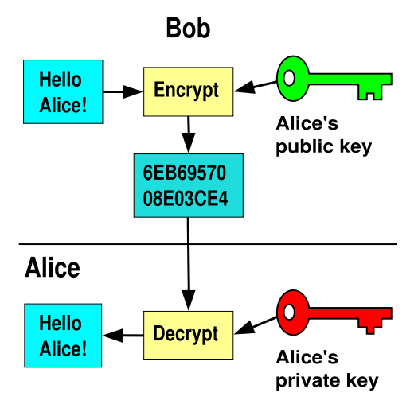
What is Public Key Crypto?

Slide 10
What is Public Key Crypto?
Alice can communicate without having previously contacted Bob.
No one but Bob can decrypt the message.
But how can this be done??

Slide 11
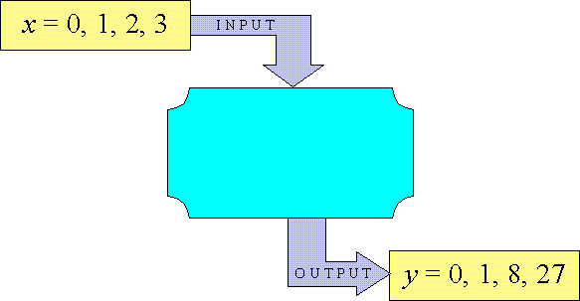
One-Way Functions
What is a function?
It is an “input-output” device.

Slide 12
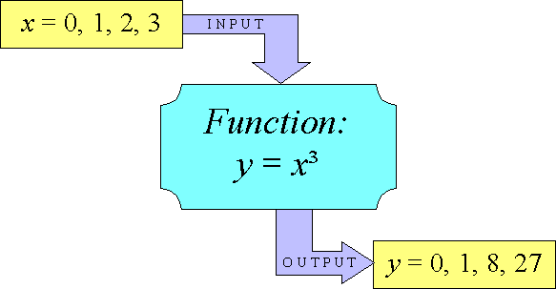
One-Way Functions
Going backwards may be harder.
Even if you know the rule.

Slide 13
Properties of one-way functions
If y=f(x) is one-way, then:
Given x, it is ‘easy’ to get y.
Given y, it is (generally) ‘hard’ to recover x.
Given x, it is ‘hard’ to find another x’ with f(x)=f(x’).

Slide 14
One-way trapdoor functions
Given x, easy to compute y=f(x)
Given y, hard to recover x
Trapdoor: Extra information k
Given k and y, it is easy to recover x =T(y,k)

Slide 15
How public-key works
Bob publishes his public key B
Alice wants to send message m. She Encrypts m with Bob’s public key by one-way function:
c=E_{B}(m)
Nobody can recover m from c.
That is, nobody except Bob.

Slide 16
How public-key works
Bob uses his secret key k to decrypt the message c:
m= D_{B}(c,k)
The mathematical formula we need is
D_{B}(E_{B}(m),k)=m

Slide 17
But can this be done??
First proposed system was apparently developed by Clifford Cocks at GCHQ (British Intelligence Government Communications Headquarters)
in 1973. Like Ellis, Cocks could not publish his results.
The first published system, RSA, was developed in 1977 at MIT.

Slide 18
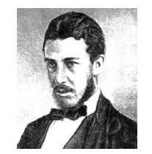
William Stanley Jevons (1835-1882)
From The Principles of
Science (1874):
“What two numbers
multiplied together will
produce 8616460799? I think it unlikely that anyone but myself will ever know.”
(Factored by Derrick Lehmer in 1903: 89681 x 96079)

Slide 19
Creating a mathematical secret
Multiplying numbers is “easy”
But factoring numbers is “hard”
Basis for RSA cryptosystem: L.M. Adleman, R.L. Rivest and A. Shamir, 1978

Slide 20
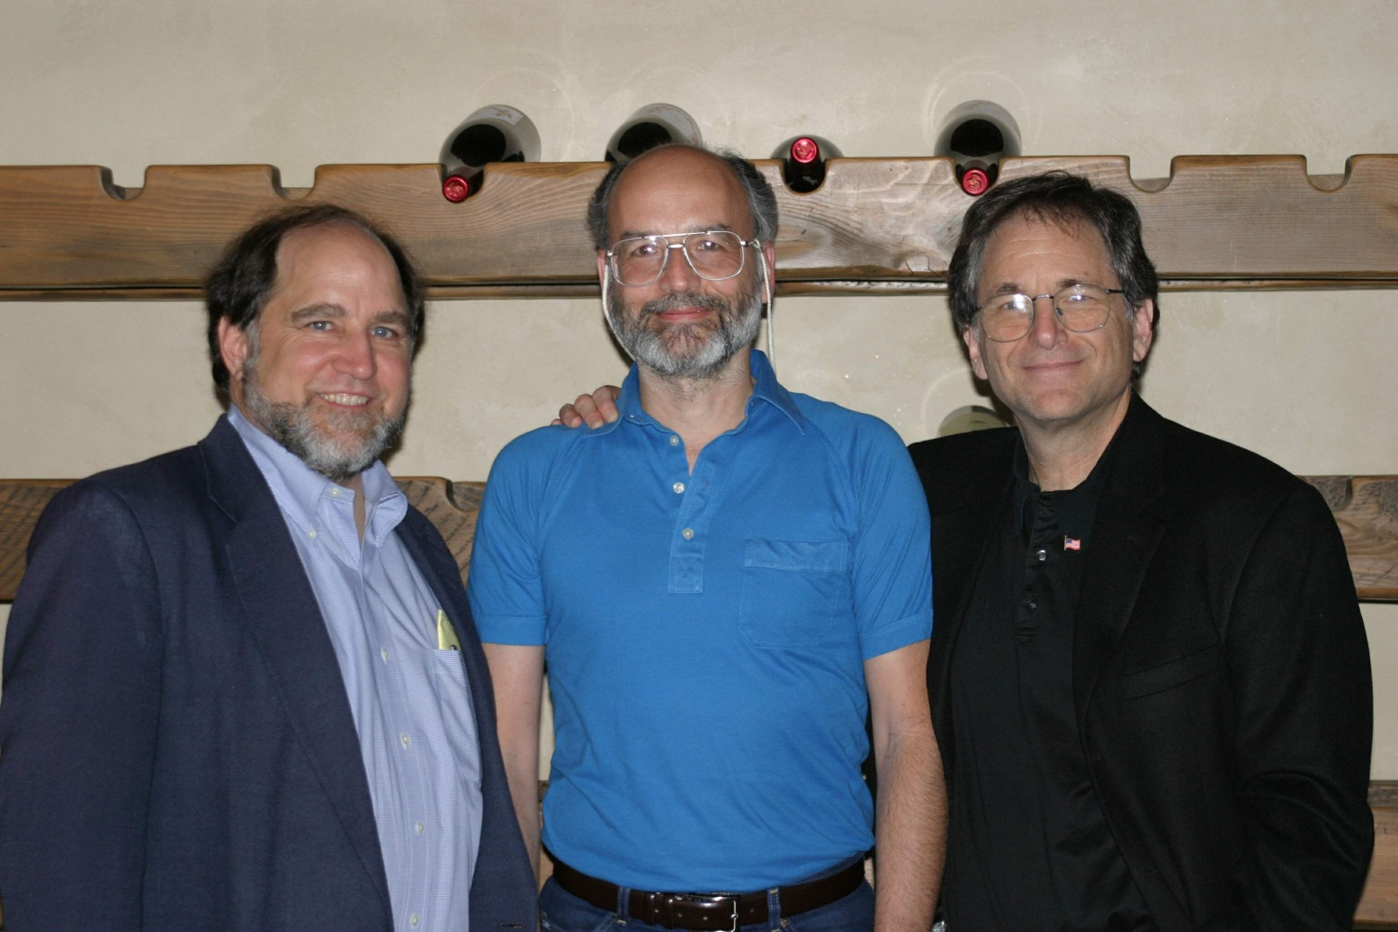
Rivest, Shamir, and Adelman

Slide 21
Warning! Technical stuff ahead — next three slides!

Slide 22
The RSA Cryptosystem
Generate two large prime numbers p and q. Multiply them together to get very large number N.
Compute “Euler Totient” T=(p-1)(q-1)
Choose numbers e and d for which the product e times d leaves remainder 1 when divided by T.
Publish (N, e) (this is the public key).
Keep the rest secret.

Slide 23
The Encryption algorithm
Turn message into a large number m (encoding)
Compute (this is the remainder left when th is divided by N).
The number c is the encryption of the message!
(Don’t Panic!)
Notes:
Ari, these next slides are maybe too technical!

Slide 24
The Decryption Algorithm
Compute
Decode m to get the message.
Mathematical principle: If you know the values of m, e, and N, you can compute c.
If you know the values of c, d, and N, you can compute m.
BUT if you know c, e, and N and can’t factor N, you (probably) can’t get m.

Slide 25
A Small Example: N=33

Slide 26
The one-way function
In RSA, the one-way function is
where
The idea is that if we know how to factor N we can take e^{th} roots, but not otherwise.

Slide 27
The one-way function
Anyone can compute e^{th} powers, so anyone can send a message to Bob.
But only Bob knows how to take e^{th} roots, so only Bob can read the message.

Slide 28
Diffie-Hellman Key Exchange
The idea of Diffie and Hellman allows two people who have never met to establish a secret key.
It is based on the idea that computing powers of a known number modulo a known number is a one-way function.

Slide 29
Diffie-Hellman Key Exchange (Math-heavy version!!)
Alice and Bob publicly agree on a large number p and a number z.
Alice picks a random secret number a, and Bob picks a random secret number b.
Alice computes
Bob computes

Slide 30
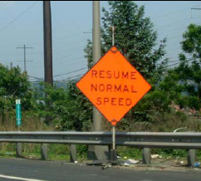
Diffie-Hellman Key Exchange (Math-heavy version!!)
This is done privately. Alice sends A to Bob and Bob sends B to Alice. This can be done publicly.
But now Alice and Bob can each compute a secret number K, given by:

Slide 31
Diffie-Hellman Key Exchange (With numbers)
Alice and Bob publicly agree on a large number 11 and a number 7
Alice picks a random secret number 3, and Bob picks a random secret number 6.
Alice computes
Bob computes

Slide 32
Diffie-Hellman Key Exchange (with numbers)
This is done privately. Alice sends 2 to Bob and Bob sends 4 to Alice. This can be done publicly.
But now Alice and Bob can each compute a secret number K, given by:

Slide 33
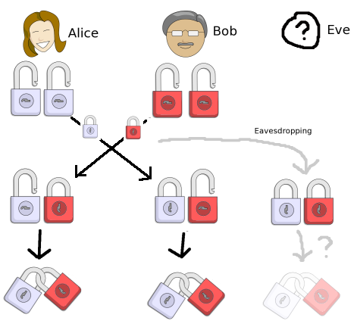
Diffie-Hellman Key Exchange
Here is a graphic illustration:

Slide 34
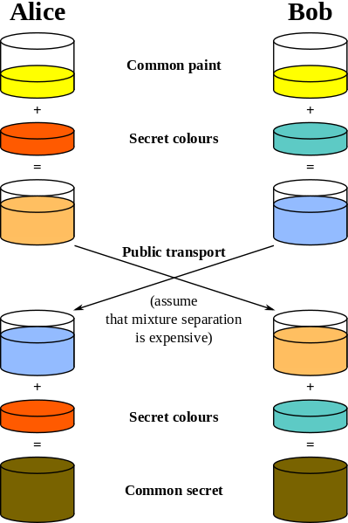
Diffie-Hellman Key Exchange
Another graphic illustration:

Slide 35
Diffie-Hellman Key Exchange
The point is, Alice and Bob have never met before, but they have publicly agreed on a private secret!
Now the secret number K is used as the secret key for doing ordinary cryptography!

Slide 36
Comments
Diffie-Hellman only produces a random number. It is not itself a cryptosystem.
RSA is a full-fledged cryptosystem; two people with public keys can exchange private messages.

Slide 37
Comments
In practice, only one party has a public key. (Amazon has a public key, but you don’t need one.)
Lots of details. In particular, how do you actually get someone’s public key?

Slide 38
End of Part 4

