Slide 1
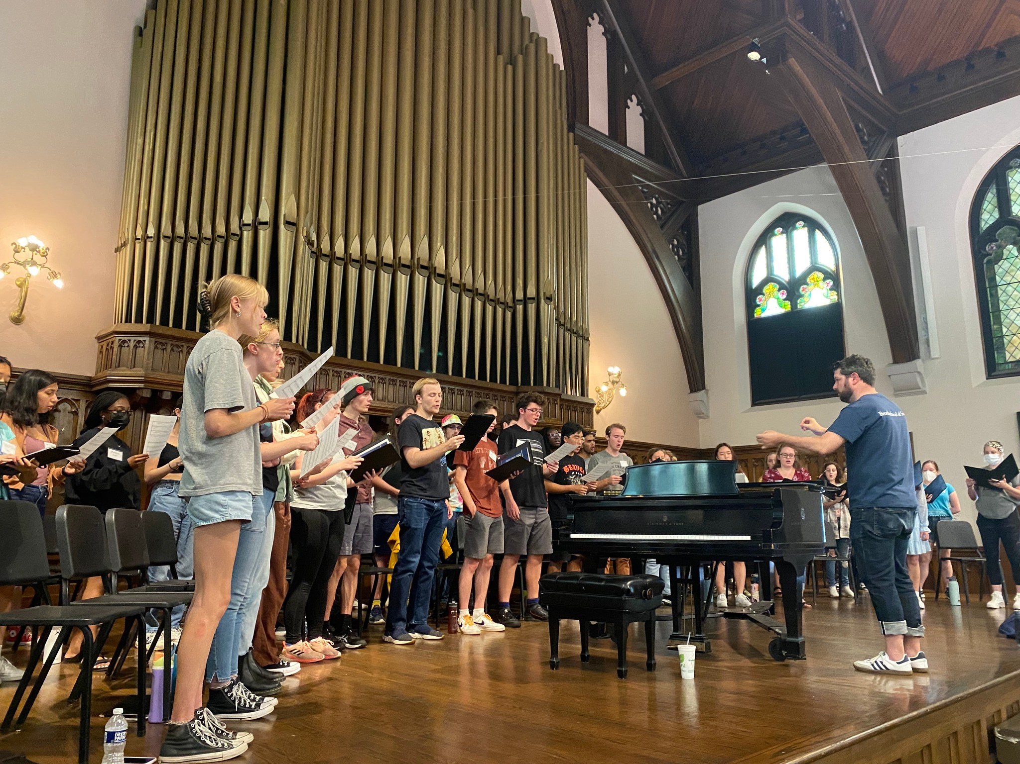


Department of Music
case.edu/artsci/music

Slide 2
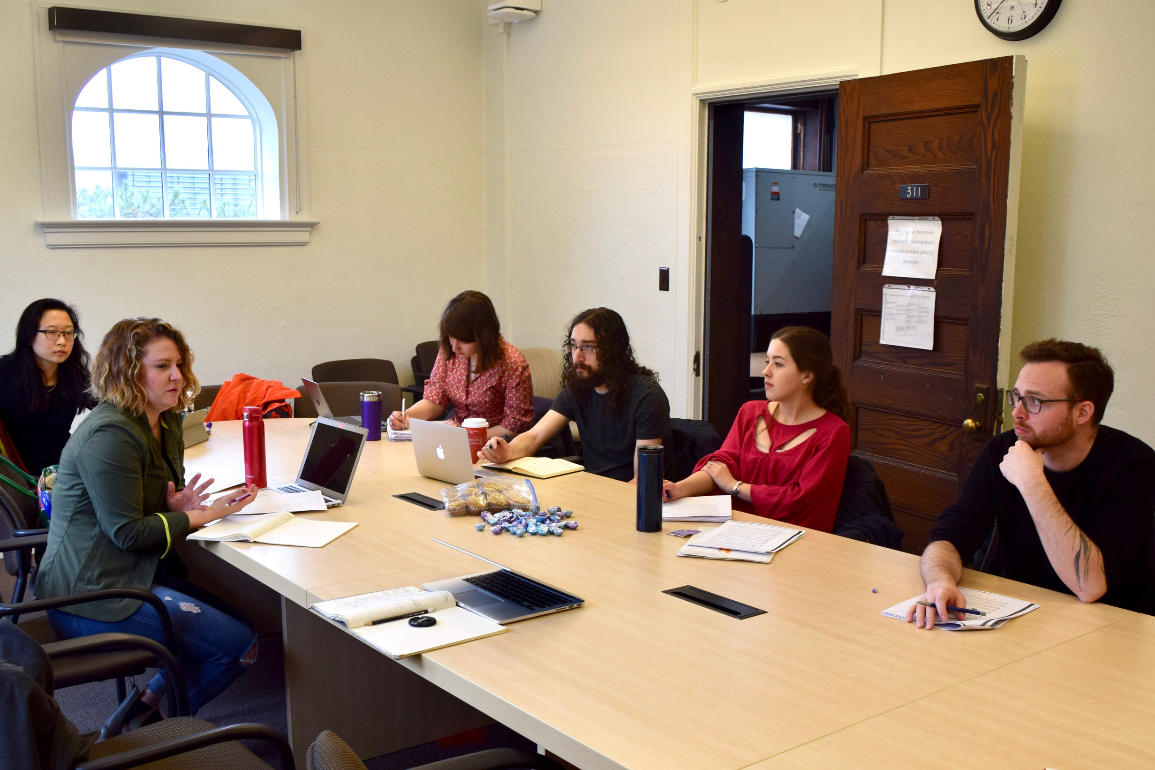
Personalized Attention & Inspiring Faculty
✔ Small class sizes = more personalized attention and meaningful connections
✔ Learn from world-class faculty who are active performers, scholars, and educators, bringing real-world experience into the classroom
✔ One-on-one advising and mentorship to help you navigate your academic and professional journey
✔ Opportunities to collaborate with faculty on research, performances, and creative projects
✔ Build lasting connections with professors who support, challenge, and inspire you to reach your full potential!

Slide 3
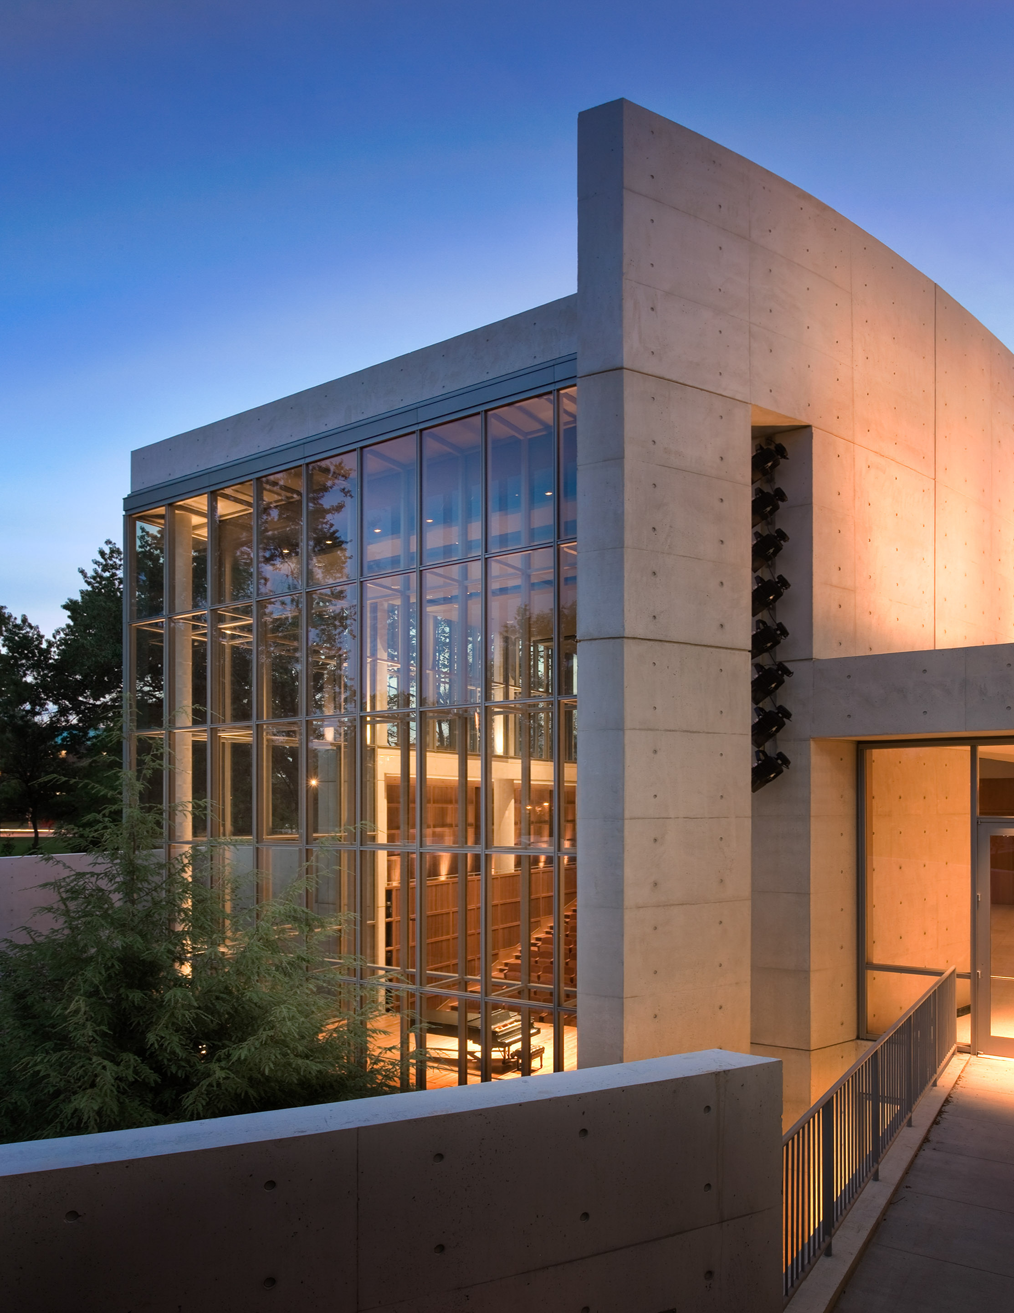
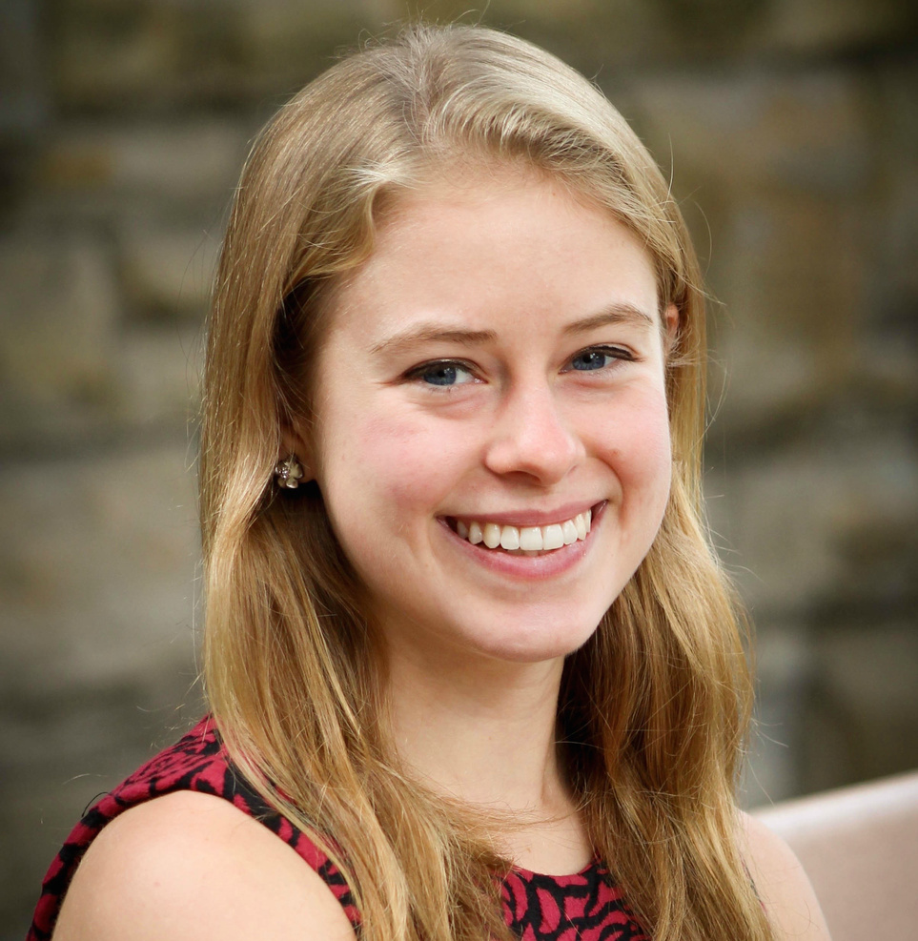
Joint Music Program
“The Joint Music Program allowed me to study with masters in their fields, from world-class musicologists and music educators to spectacular vocal teachers. It is really the best education I could have asked for.”
—Madeline Yankell, Music Education (CWR ‘19)

Slide 4
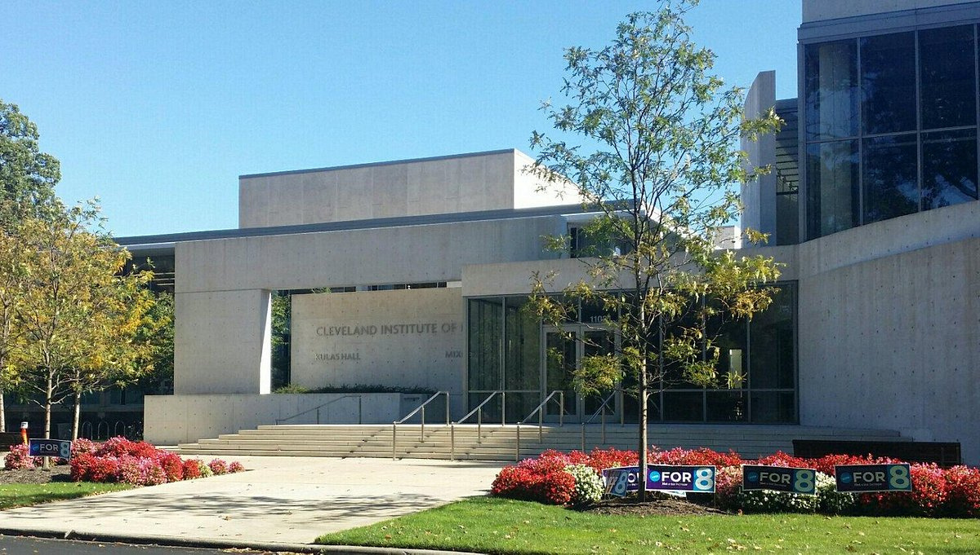
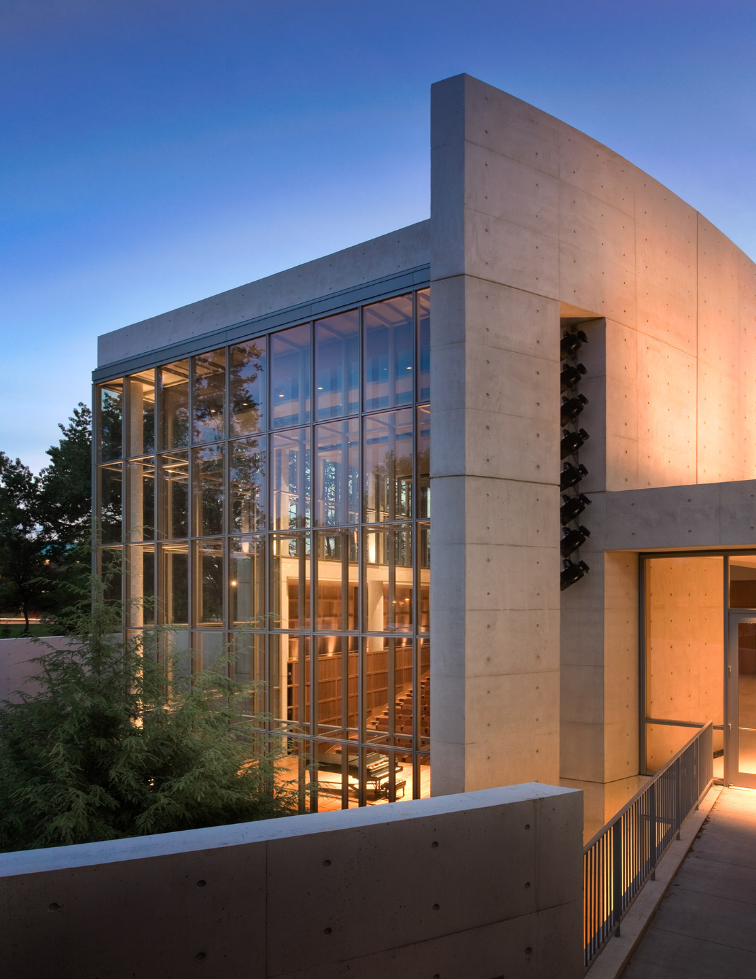
Cleveland Institute of Music

Slide 5
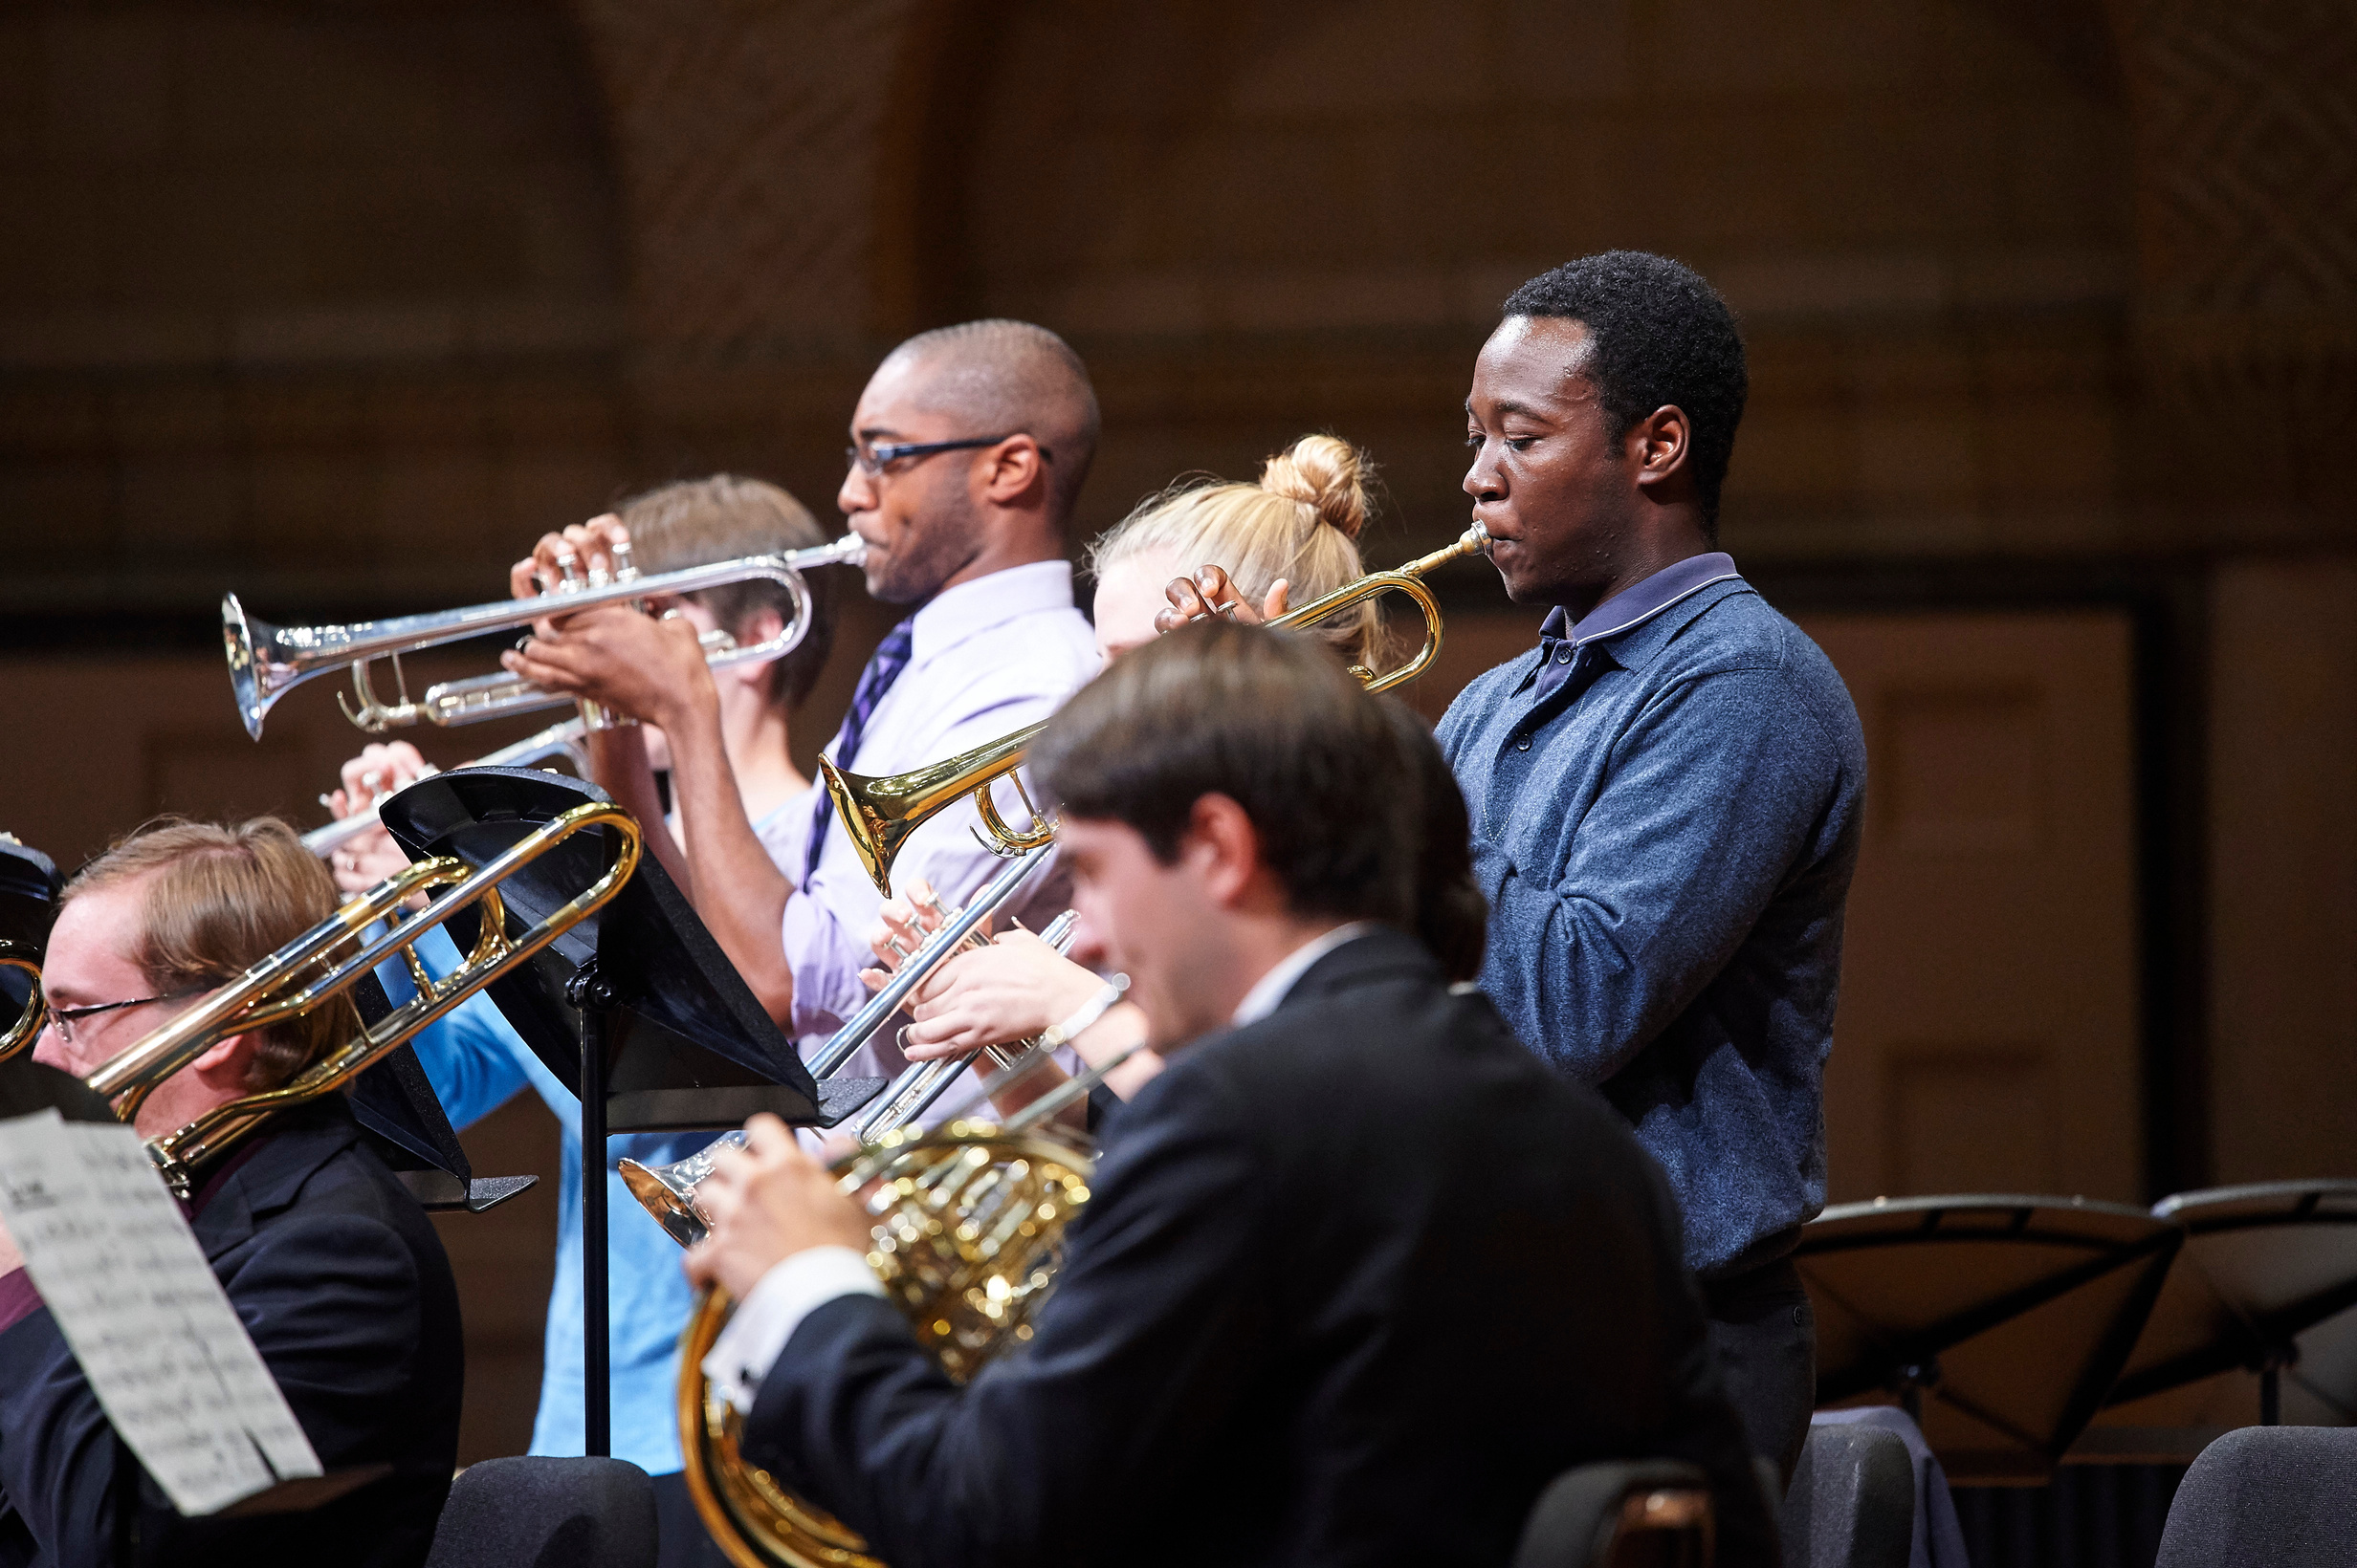
Flexible Degree Options
✔ BA in Music → Perfect for students who want to double major or even pursue a dual degree (combine music with engineering, mathematics, biology, business, psychology, computer science—you name it!) and still graduate in four years.
✔ BS in Music Education → A fully accredited program with real-world classroom teaching experience, preparing you for licensure and a career in music education.
✔ Not majoring in music? Add a Music Minor—no audition required!

Slide 6
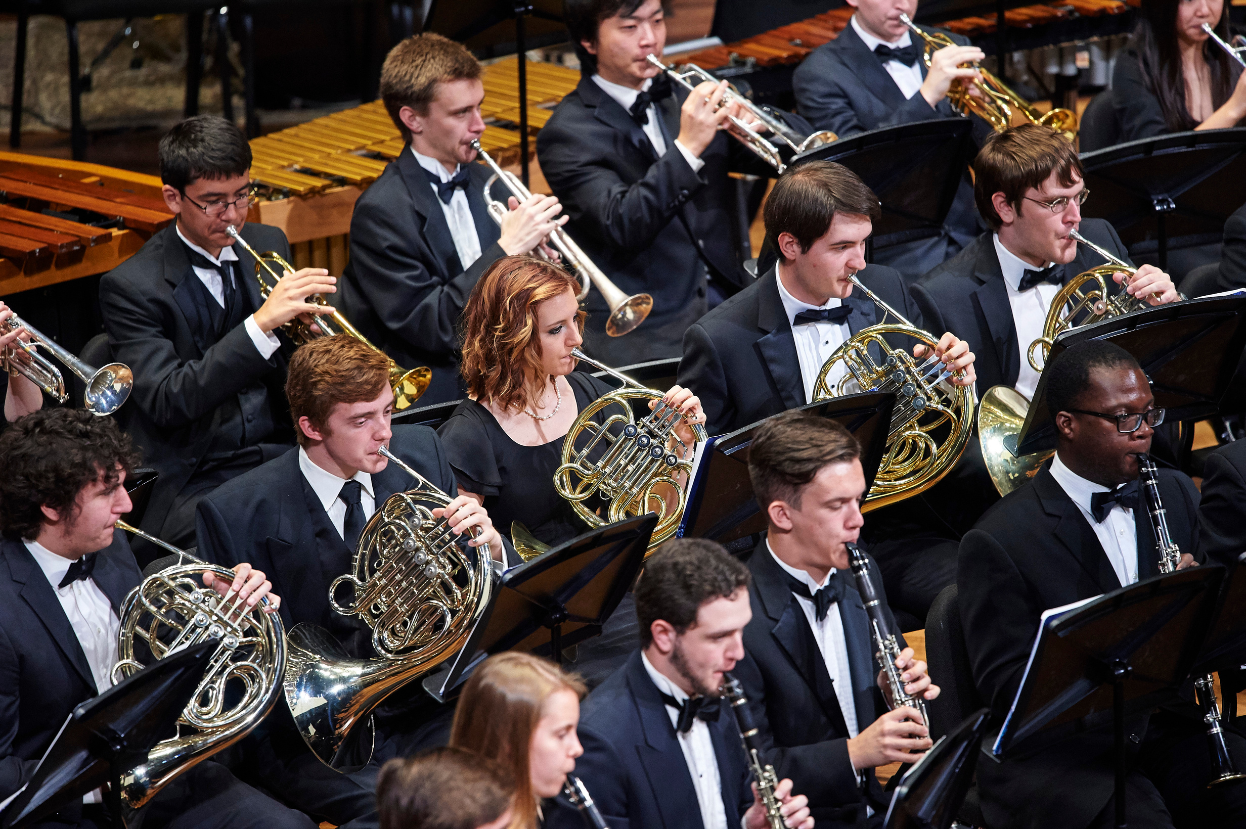
Performance & Ensembles
✔ Orchestras, bands, choirs, jazz ensembles, and chamber groups open to all students, regardless of major
✔ Auditions take place the first week of the fall semester
✔ We provide specialty instruments (like bassoons and tubas) and locker storage for your convenience
✔ Perform in stunning venues like the Maltz Performing Arts Center and historic Harkness Chapel

Slide 7
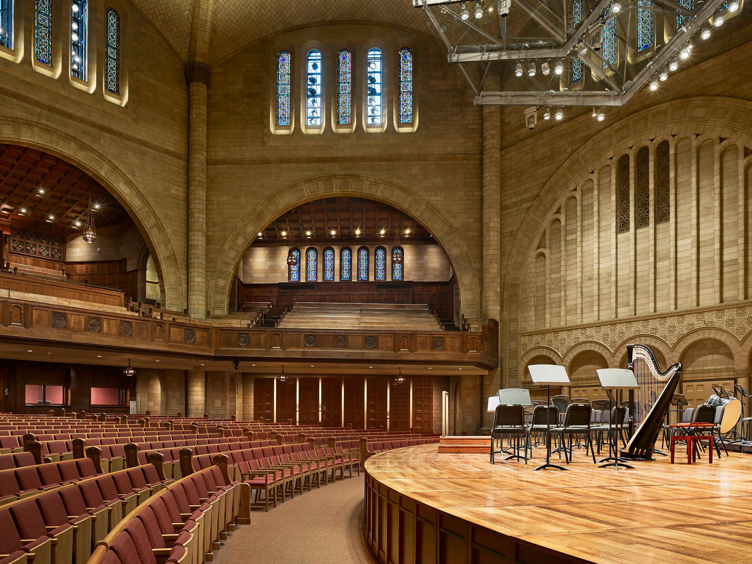
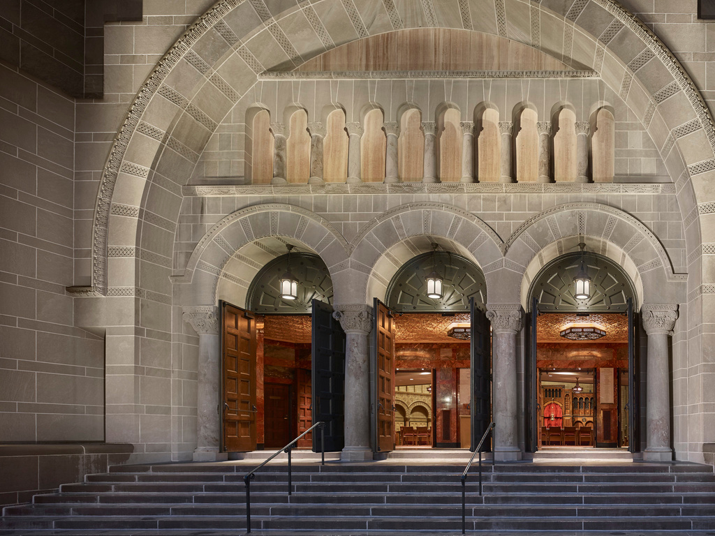
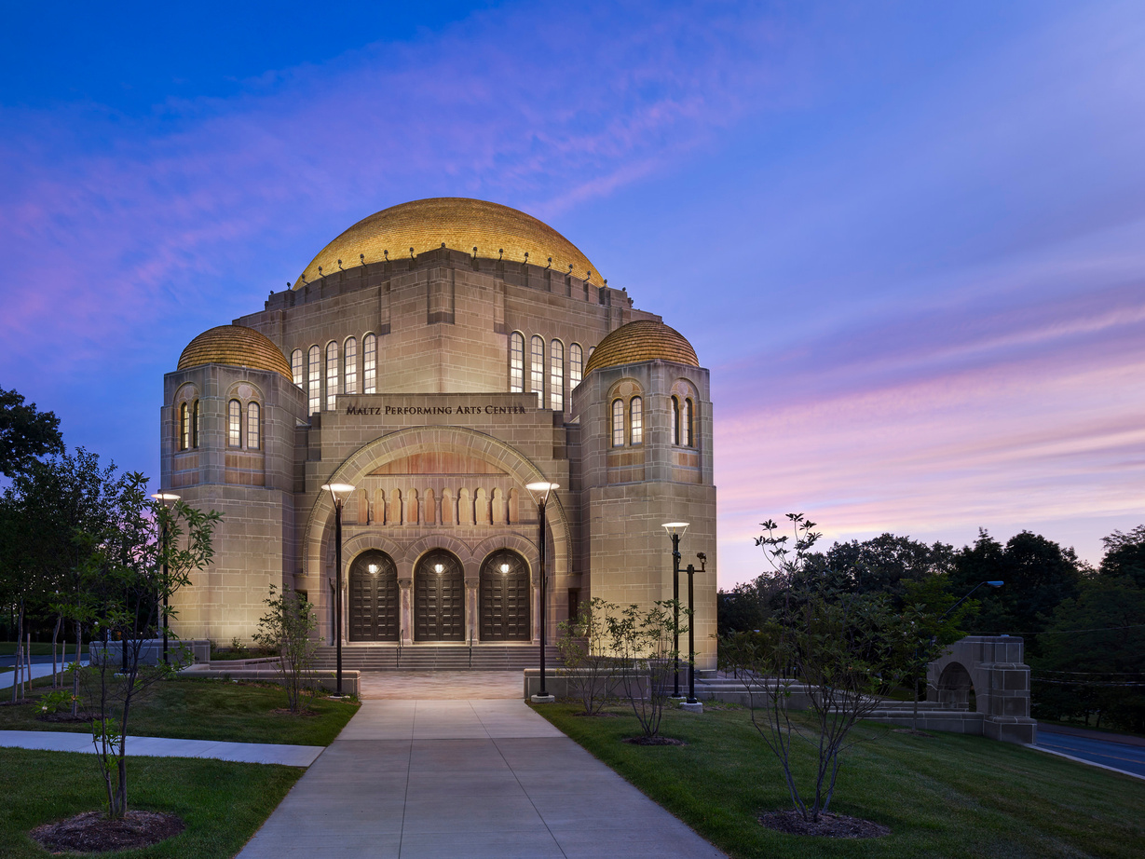
Maltz Performing Arts Center

Slide 8
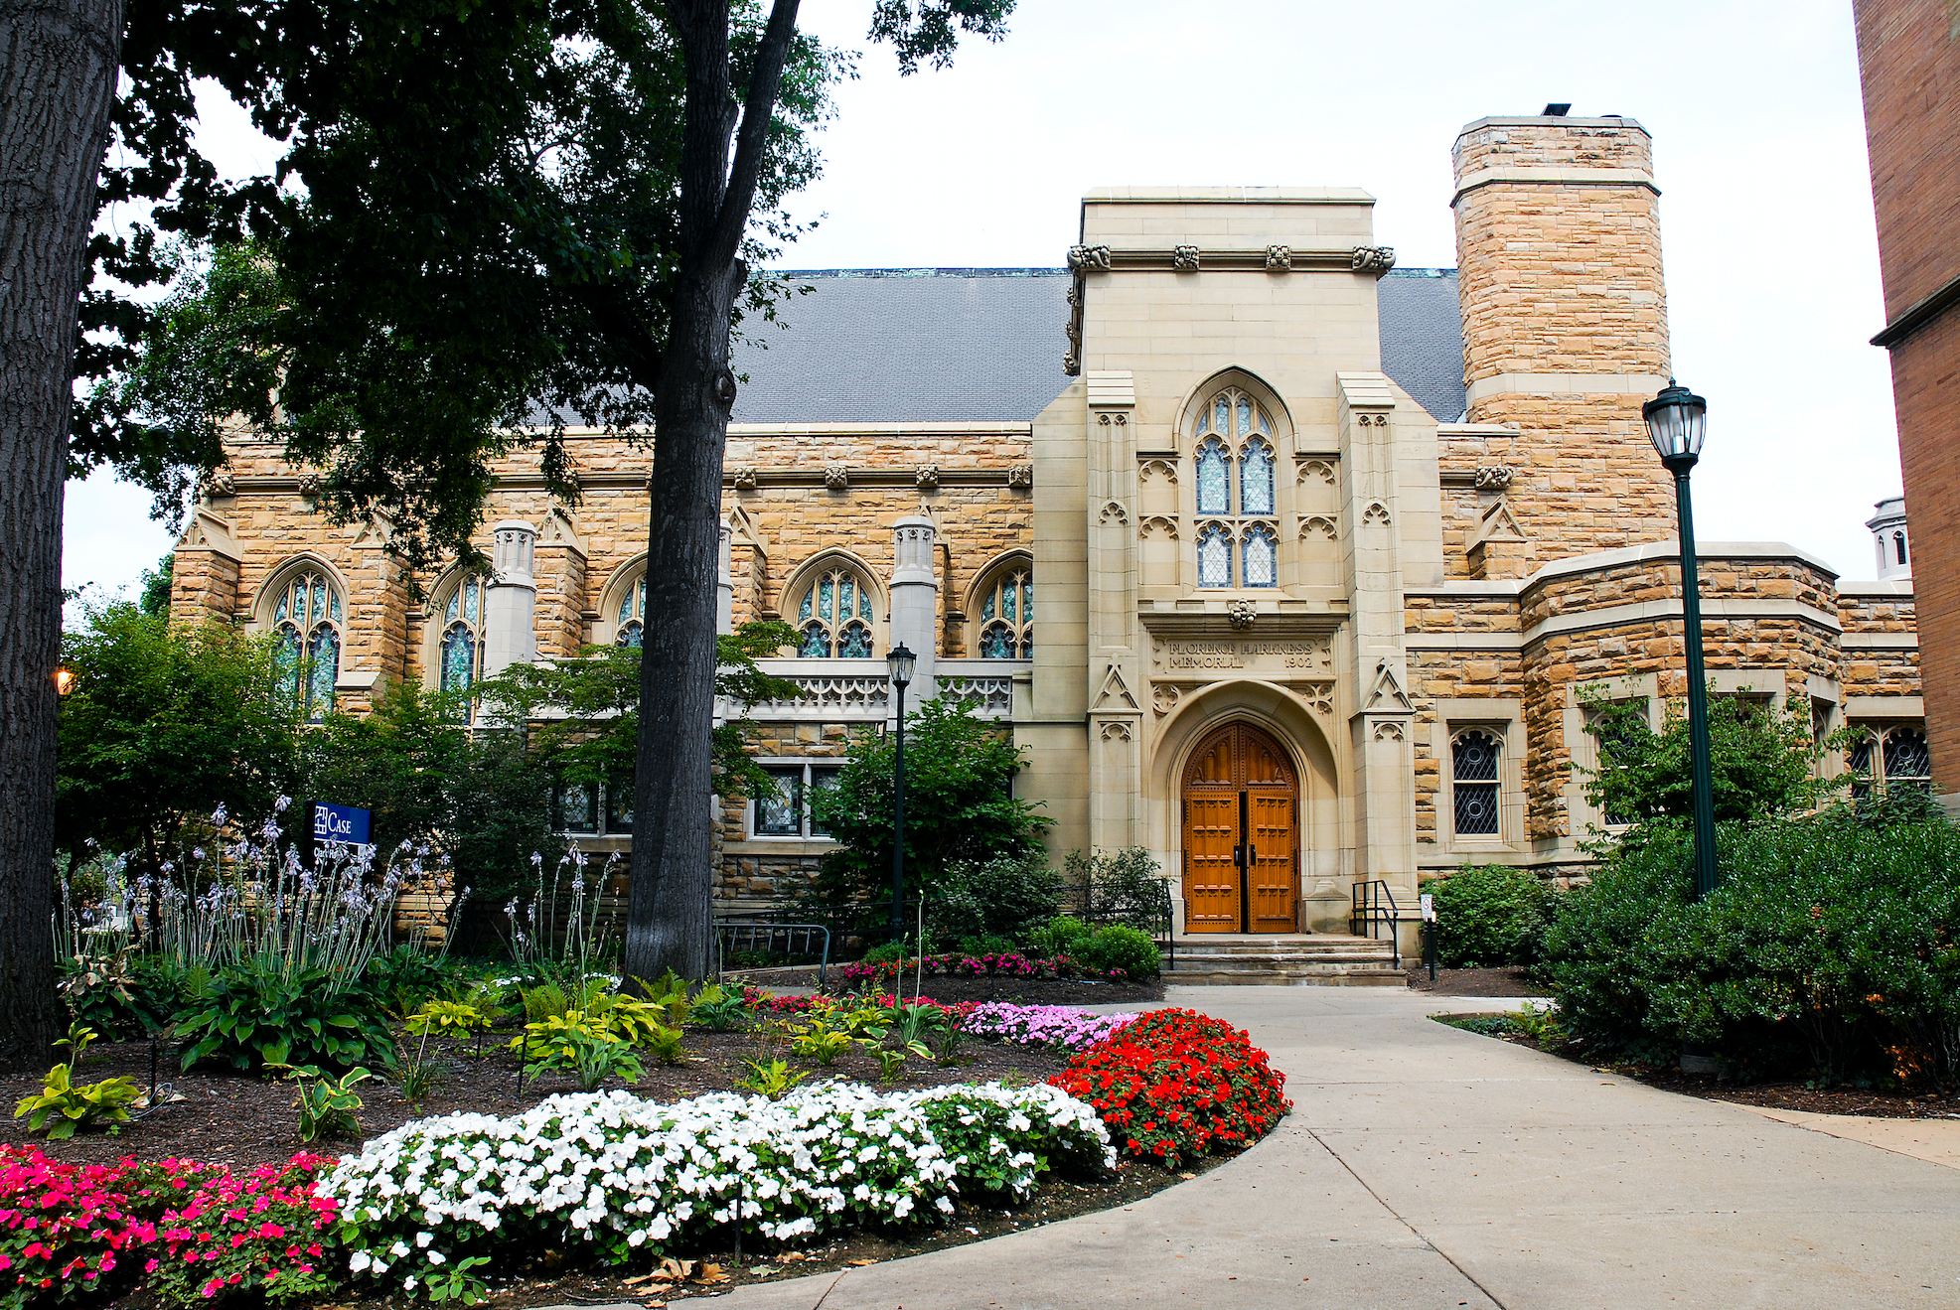
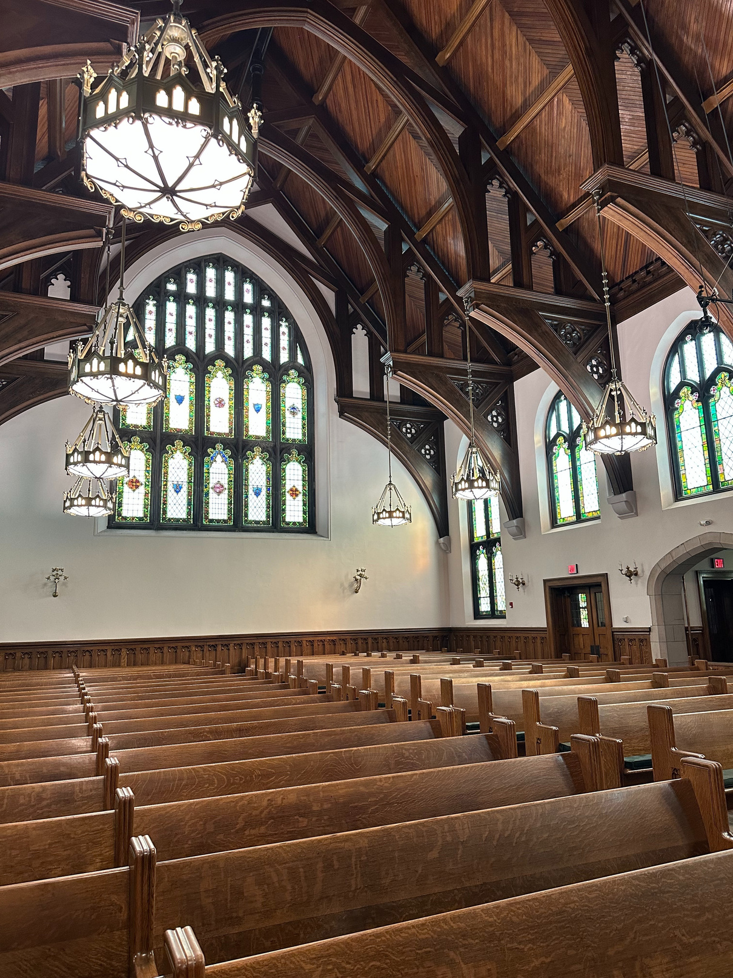
Harkness Chapel

Slide 9
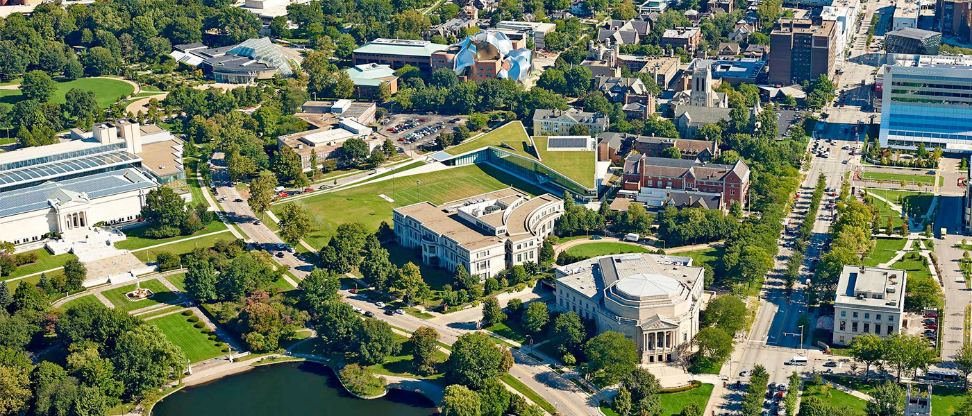
Where You’ll Study
We’re located in one of the most vibrant arts and cultural neighborhoods in the country—just steps away from world-class cultural institutions:
🏛 The Cleveland Orchestra – music majors enjoy free tickets!
🖼 The Cleveland Museum of Art, Museum of Natural History and more!
✔ Mather Quad – Home to Haydn Hall and Harkness Chapel, where many music classes, rehearsals, and performances take place.
✔ Denison Hall – Located near North Residential Village, with practice spaces, instrument storage, and ensemble rehearsal rooms.

Slide 10
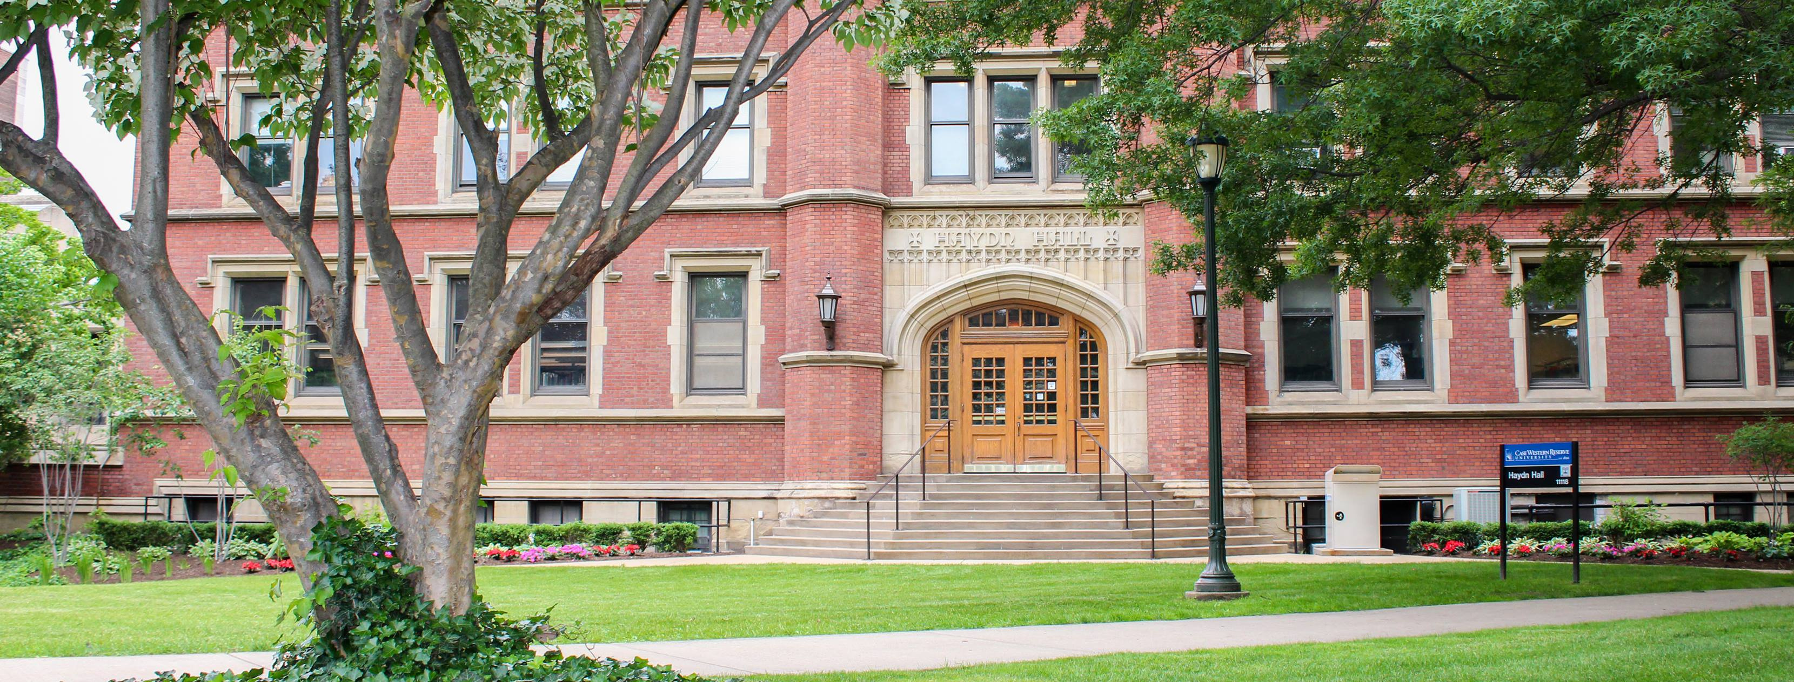
Haydn Hall

Slide 11
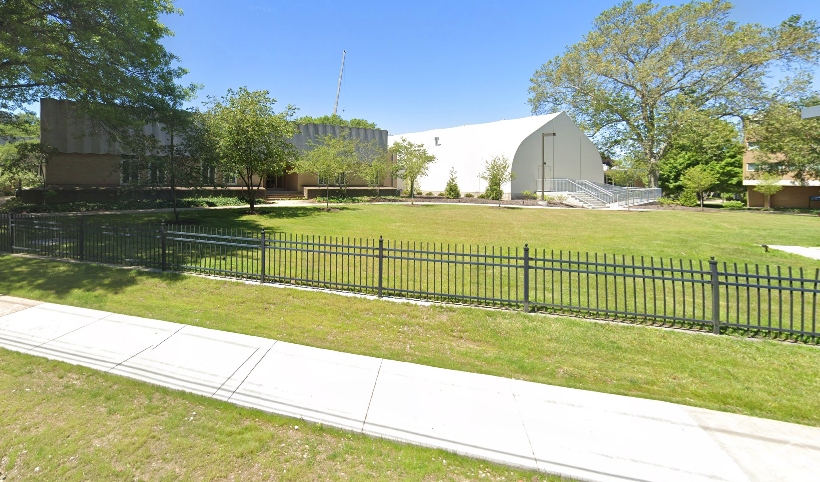
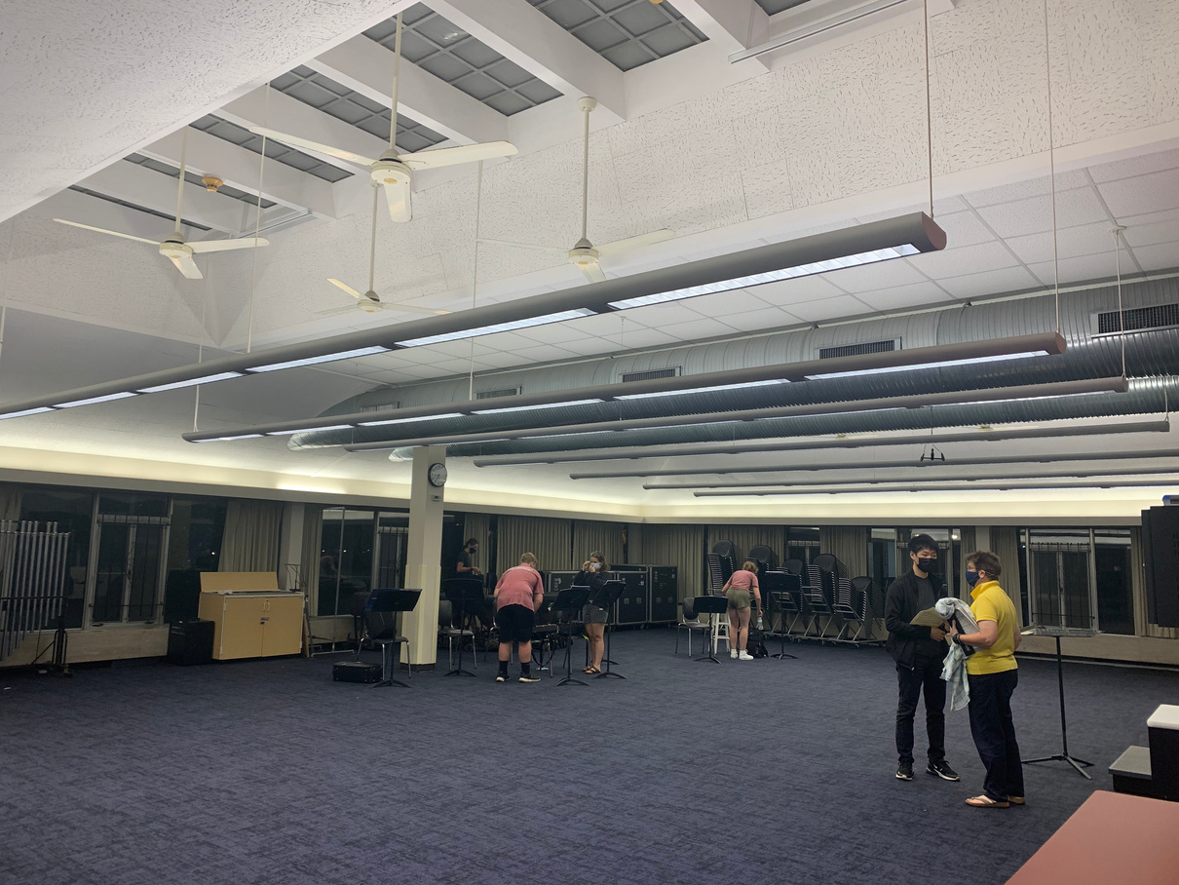
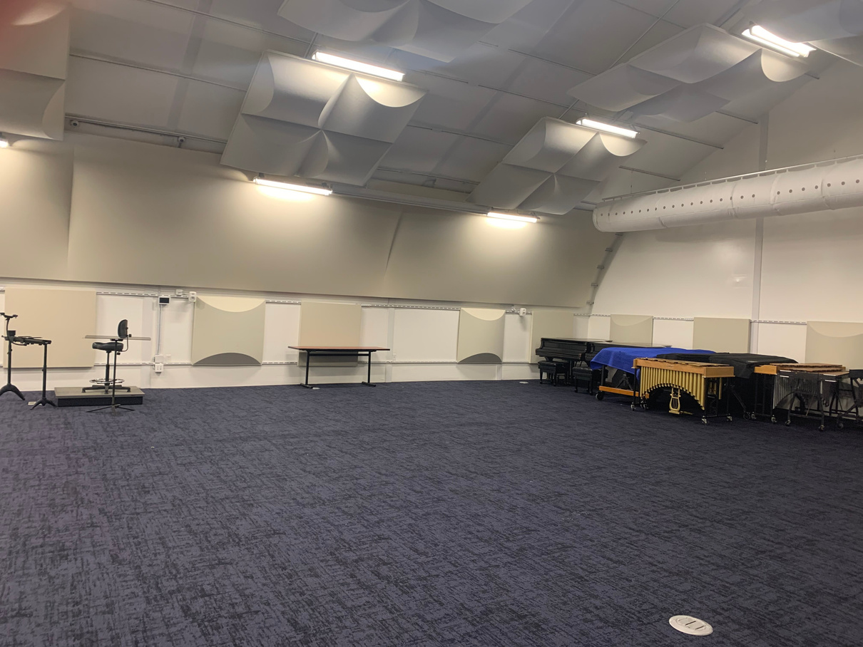
Denison Hall at Wade Commons

Slide 12
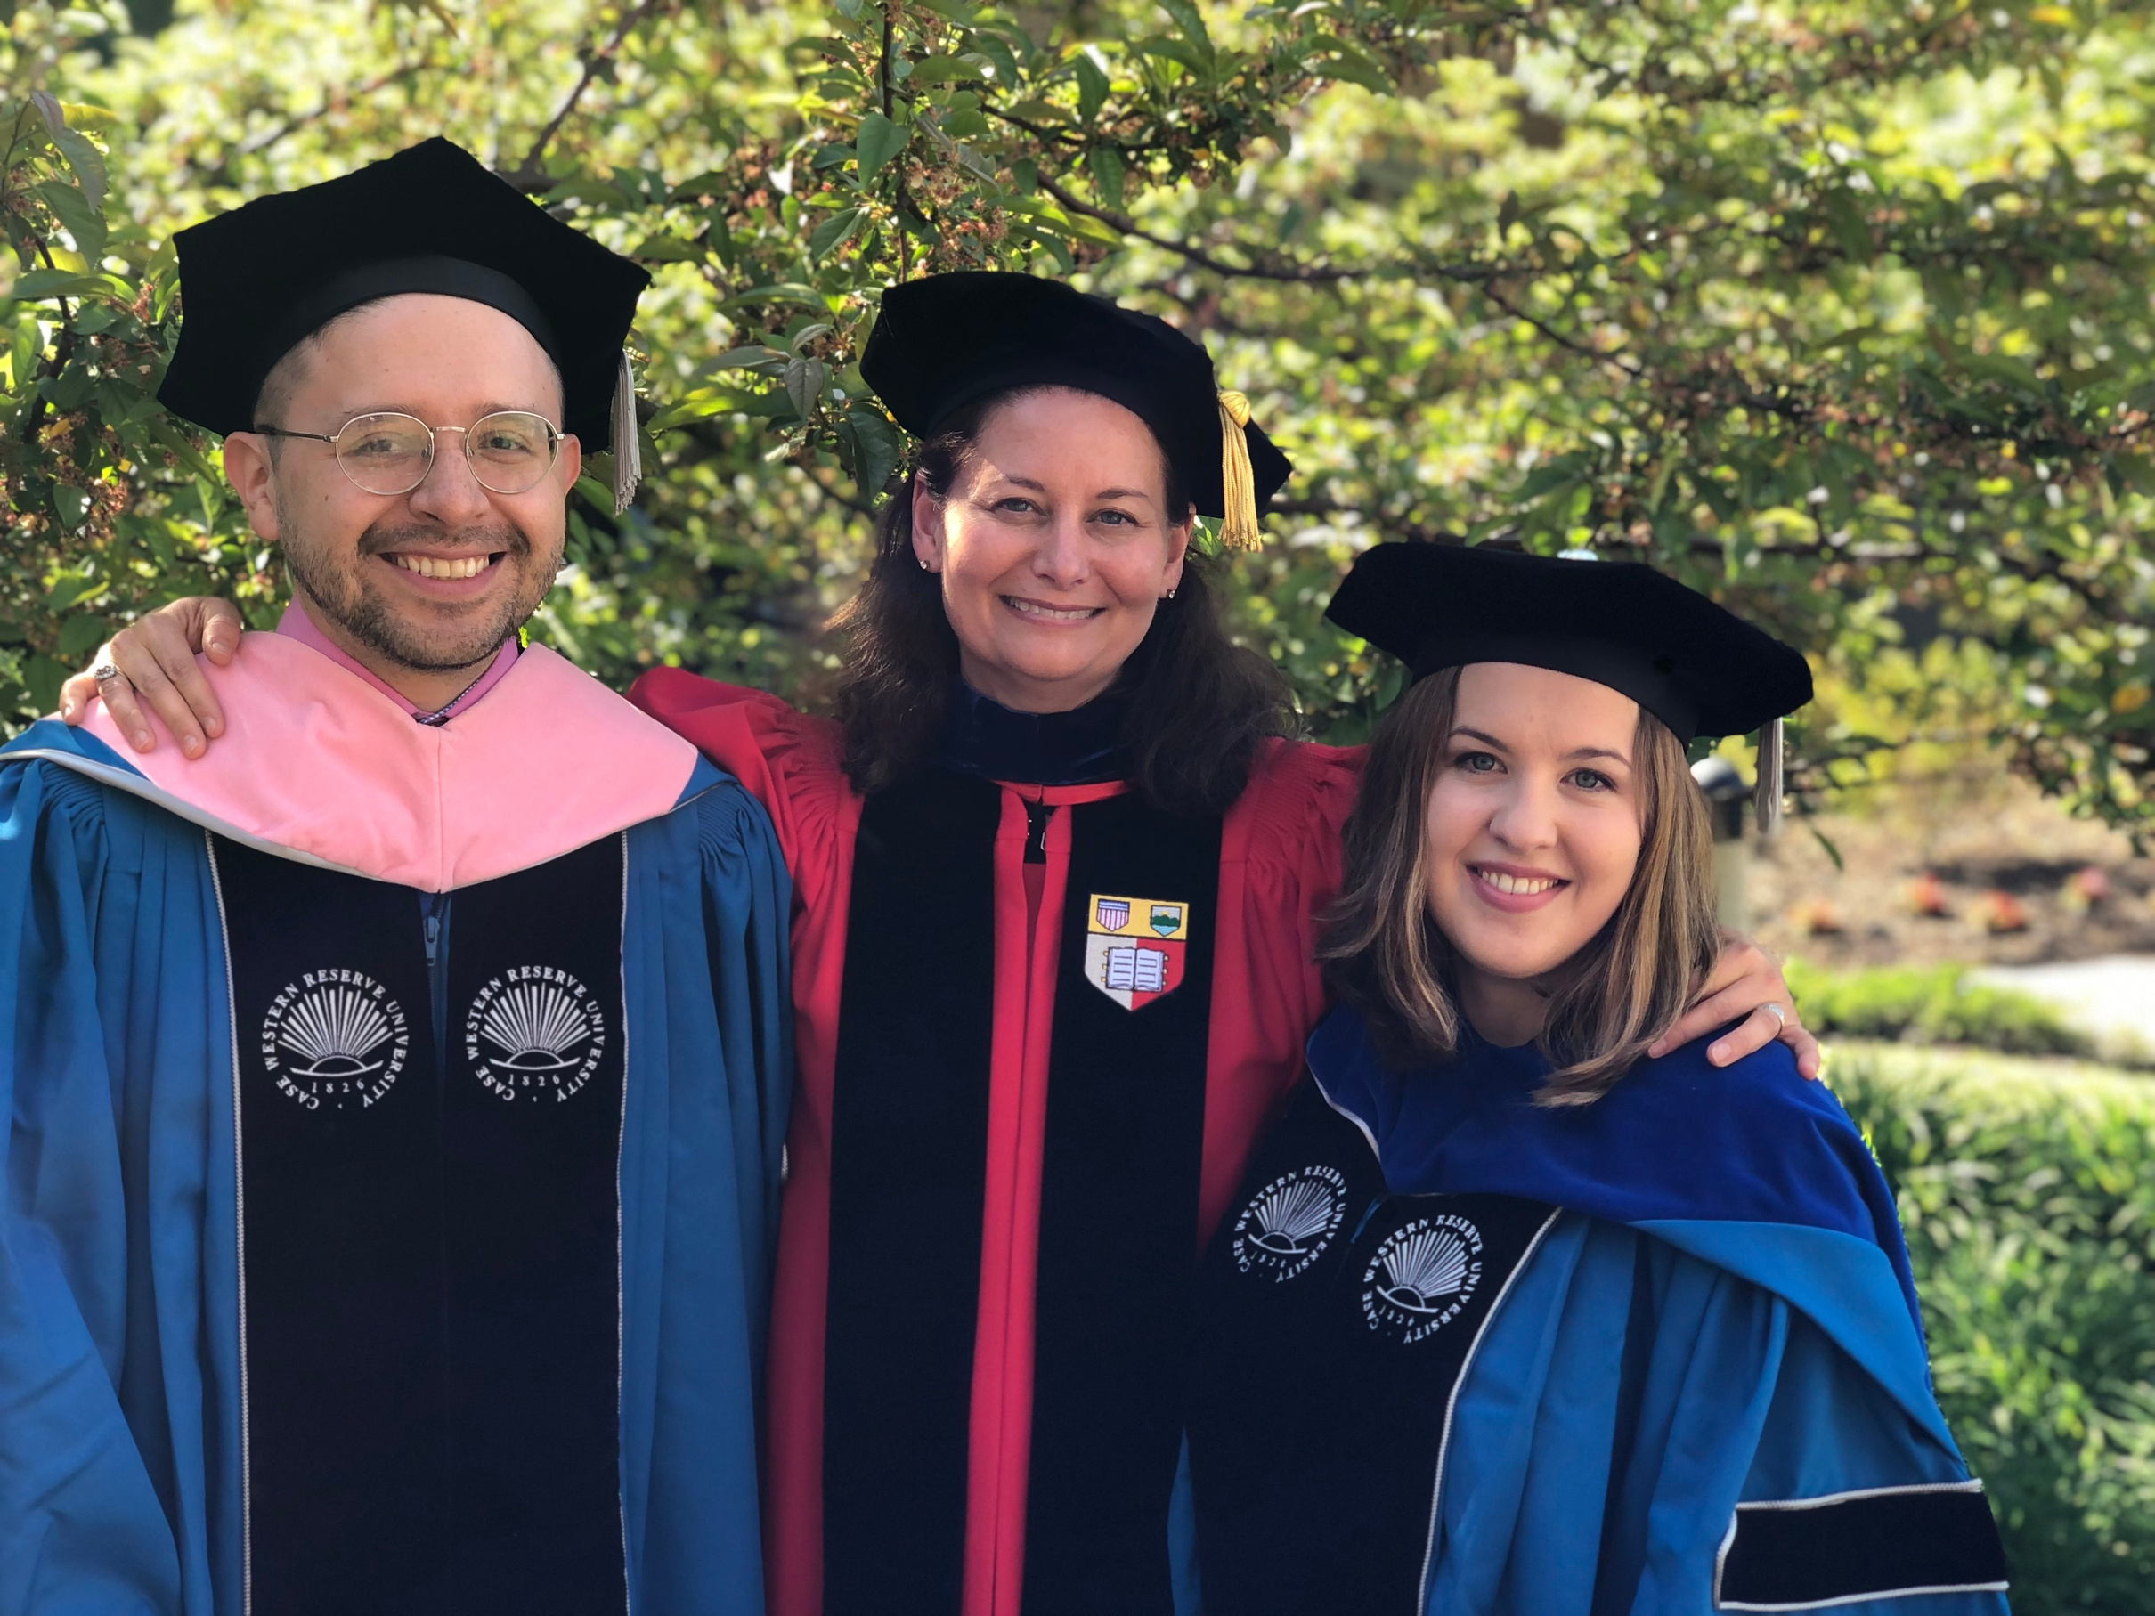
Career Readiness & Graduate Success
✔ Accepted into top graduate programs & conservatories
✔ Careers in music education, performance, arts management, and more
✔ Many students pursue careers beyond music in fields like medicine, law, technology, and business
✔ Some graduates continue research in music and interdisciplinary fields
Featured Alumni Endeavors

Slide 13
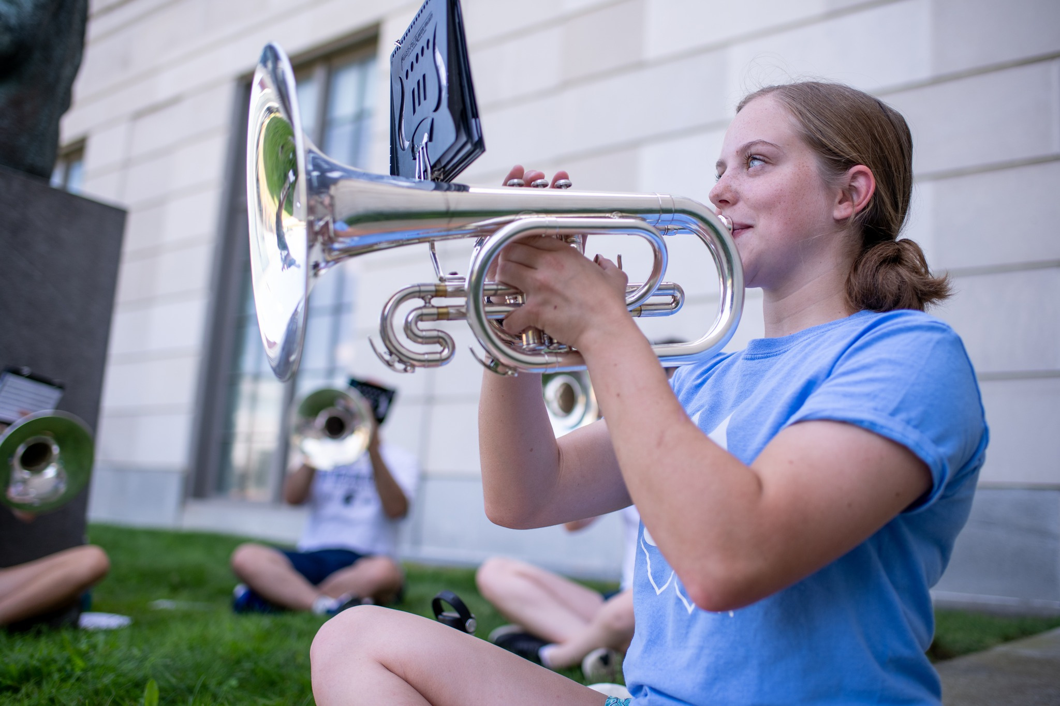
Apply & Audition
Early Action/Decision
Early Decision II or Reg Dec
CWRU Application
November 1st
CWRU Application
January 15th
Music Arts Supplement
November 15th
Music Arts Supplement
February 1st
An applicant must submit a Music Arts Supplement via their applicantion portal during the application process to be considered for the music major or music scholarship.

