Slide 1
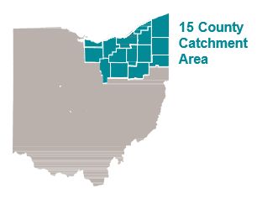
Osteosarcoma Incidence, 2001-2020 (20 Years)
Geography | Case | Crude Rate | Age-adjusted Rate
Catchment Area | 239 | 0.298 | 0.299
Ohio | 716 | 0.310 | 0.311
United States | 20,454 | 0.332 | 0.333
Ohio
Notes
1. Rates are per 100,000.
2. Only invasive cases are included (in situ stage cases are excluded).
3. Catchment Area includes 15 counties in Northeast Ohio: Ashland, Ashtabula, Cuyahoga, Erie, Geauga, Huron, Lake, Lorain, Mahoning, Medina, Portage,
Stark, Summit, Trumbull, and Wayne Counties.
Sources
1. US and Ohio Data: National Program of Cancer Registries and Surveillance, Epidemiology and End Results Program SEER*Stat Database: NPCR and SEER Incidence - U.S. Cancer Statistics Public Use Research Database, 2022 Submission (2001-2020). United States Department of Health and Human Services, Centers for Disease Control and Prevention and National Cancer Institute. Released June 2023. Accessed at www.cdc.gov/cancer/uscs/public-use.
2. 15-County Catchment Area Data: Ohio Cancer Incidence Surveillance System, Ohio Department of Health. Cancer Incidence Data (1996-2020).

Slide 2
Osteosarcoma Mortality, 2011-2020 (10 Year)
Geography | Case | Crude Rate | Age-adjusted Rate
Catchment Area | 60 | 0.151 | 0.142
Ohio | 178 | 0.153 | 0.146
US (20 SEER Regions) | 2,397 | 0.179 | 0.175
Ohio
Notes
1. Rates are per 100,000.
2. Only invasive cases are included (in situ stage cases are excluded).
3. Catchment Area includes 15 counties in Northeast Ohio: Ashland, Ashtabula, Cuyahoga, Erie, Geauga, Huron, Lake, Lorain, Mahoning, Medina, Portage,
Stark, Summit, Trumbull, and Wayne Counties.
4. US (20 SEER Regions) includes San Francisco Oakland SMSA, Connecticut, Hawaii, Iowa, New Mexico, Seattle, Utah, Atlanta, Alaska Natives, San Jose Monterey, Los Angeles, Rural Georgia, California excluding SFSJMLA, Kentucky, Louisiana, New Jersey, Greater Georgia, Idaho, New York, and Texas.
Sources
1. US and Ohio Data: Surveillance, Epidemiology, and End Results (SEER) Program (www.seer.cancer.gov) SEER*Stat Database: Incidence-Based Mortality - SEER Research Plus Limited-Field Data, 22 Registries (excl IL and MA), Nov 2022 Sub (2000-2020) - Linked To County Attributes - Total U.S., 1969-2021 Counties, National Cancer Institute, DCCPS, Surveillance Research Program, released April 2023, based on the November 2022 submission.
2. 15-County Catchment Area Data: Ohio Cancer Incidence Surveillance System, Ohio Department of Health. Cancer Incidence Data (1996-2020).

Slide 3
Methods to obtain rates of Osteosarcoma
OCISS does not have a variable that can directly identify osteosarcoma.
OCISS has Histology variable.
SEER*STAT has a variable named AYA Site that can capture osteosarcoma
SEER*STAT has state data but not county data for Ohio.
Using the “AYA Site = Osteosarcoma” from SEER*STAT to identify histology codes that can be used in OCISS to identify Osteosarcoma.
Cross check the previous step between SEER*STAT and OCISS for Ohio data.

Slide 4
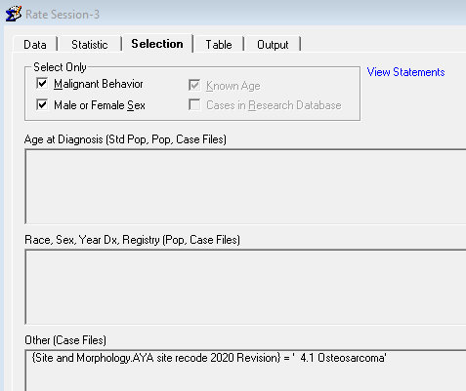
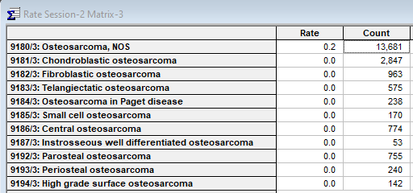
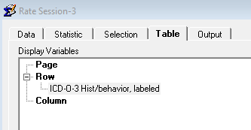
Get histology codes based on AYA site in SEER*STAT: Osteosarcoma
1. Inclusion Criteria: AYA site = 4.1 Osteosarcoma
3. Results
Histology code: 9180-9187, 9192-9194
Total cases: 20438
2. Display row: Histology

Slide 5
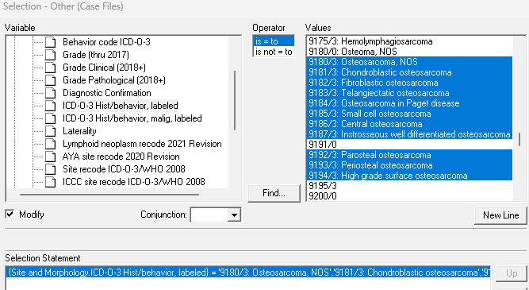
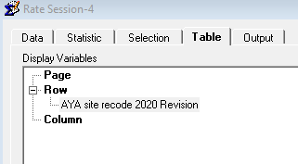
Check AYA sites based on histology codes in the previous slide
1. Inclusion Criteria: Histology codes in previous slide
3. Results: no other sites except for 4.1 Osteosarcoma
Total cases: 20438
(Same as in previous page)
2. Display row: AYA site
Next step:
Use the histology codes to capture Osteosarcoma in OCISS

Slide 6
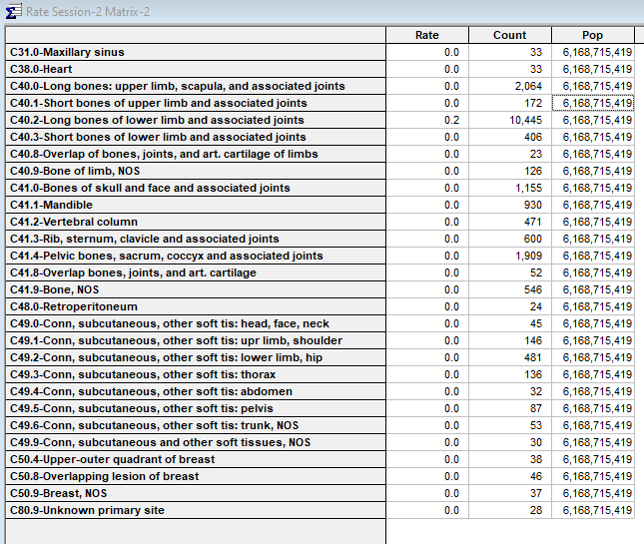
Can we use C codes to identify osteosarcoma?
Probably not.
This is a list of C codes based on “AYA Site = Osteosarcoma”

Slide 7
Compare Ohio Osteosarcoma cases between SEER*STAT and OCISS
Years = 2001-2020
SEER*STAT
AYA Site = Osteosarcoma
OCISS
Histology code: 9180-9187, 9192-9194
Crude rate
Results
Count: 715
Crude Rate: 0.310
Age-adjusted rate

Slide 8
Osteosarcoma in 15-County Catchment Area
Results from OCISS using Histology codes 9180-9187, 9192-9194
Count: 239
Crude Rate: 0.298
Age-adjusted: 0.299
* Population data are from SEER website. The Age-adjusted rate is calculated using an algorithm written in R.

Slide 9
Osteosarcoma in US
Crude Rate

