Slide 1

^{Celebrating}
^{Entrepreneurship}
^{October 15, 2010}

Slide 2

Aeroclay, Inc is a start-up company dedicated to commercializing an advanced material built on a platform technology.
The AeroClay® composites, which are a form of an aerogel, have
varied properties that are used to develop innovative products for customers. Applications for AeroClay® products range from insulation to absorption, sound barriers to packaging…biodegradable and eco-friendly polymers can be used to achieve even more opportunities.

Slide 3

BioInVision Inc. is an early-stage biomedical imaging company based in Cleveland which is commercializing cryo-imaging. With cryo-imaging, one can detect and spatially map in 3D nearly every fluorescently-labeled cell, in an organ or mouse, providing a unique ability to evaluate homing and engraftment of stem cells, drug distribution studies any many other applications such as mouse anatomical phenotyping.
Since 2007, BioInVision, Inc. has raised over $2M from NIH grant funding, with four different competitive awards. These awards are being used to grow applications of cryo-imaging in stem cells, toxicology, and nanoparticle imaging agent/drug delivery. The company is launching a fee for service imaging business in Q4 2010 followed by instrument sales.

Slide 4
CAL
C A Latham Corp
Technology for the Future
CAL was formed as an outlet for skills acquired from the formation and management of Thermagon, Inc., a technology-based company manufacturing and marketing thermally conductive materials for electronics worldwide. CAL’s mission is to assist start-up technology companies in the commercialization of their innovations and products. CAL serves entrepreneurs in an advisory capacity, assisting them on this mission. Focus areas include thermal management, energy, performance materials.

Slide 5

CitizenGroove (CG) originated at CWRU as a social networking project for musicians. Today, their Software-as-a-Service (SaaS) platform is designed as an ePortfolio solution for use by academic programs with multimedia intense recruitment processes (conservatories, film academies, summer music education festivals, etc.). School administrators can use this platform to screen a wider pool of international talent and ultimate recruit more efficiency. Since launching the Digital Audition Tool in August, CG has already licensed its software to 7 universities and closed a Series A Investment with the North Coast Angel Fund.

Slide 6

Collaborent Group, Ltd. develops group purchasing programs for local governments, private companies, and not-for-profit organizations. Collaborent developed a unique procurement vehicle to cut through the red tape of government purchasing and is the only company in the country that has established this capability, with virtually any local government in 48 states eligible to buy through our contracts directly. Our programs target a combination of highly complex procurements (such as Renewable Energy installations and financing) and more common commodity items (including office supplies and janitorial and sanitation products). Collaborent’s programs typically deliver savings between 15 and 30%. Ohio’s largest county is saving 42% on its office supplies and one of the area’s largest realty firms is saving 29.7% on its printers and copiers. Collaborent is the action arm of collaboration in the public, private, and not-for-profit sectors. www.Collaborent.com

Slide 7

Custom Rubber Corp. is a privately owned company supplying
molded, extruded, and die-cut rubber parts for a variety of American and international companies.
Responsiveness. That's our reputation and our promise.
Our philosophy is built on service. That's why we're committed to returning calls within 24 hours. Our target is to provide quotes in 3 days. Rush turnaround is a core competency. We've gained, and retained, customers when other suppliers couldn't meet critical deadlines.
http://www.customrubbercorp.com

Slide 8
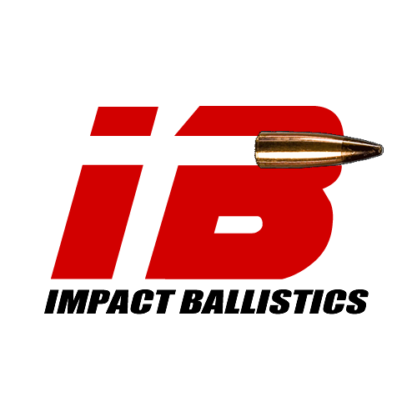



TEAM WENDY
Dan T. Moore Company, Inc., founded in 1969 and based in Cleveland, OH, is an R&D and acquisition entity and business incubator starting one new business per year based upon internally generated technology. The company actively manages the other companies in the portfolio and oversees 28 non-controlling private equity investments.

Slide 9
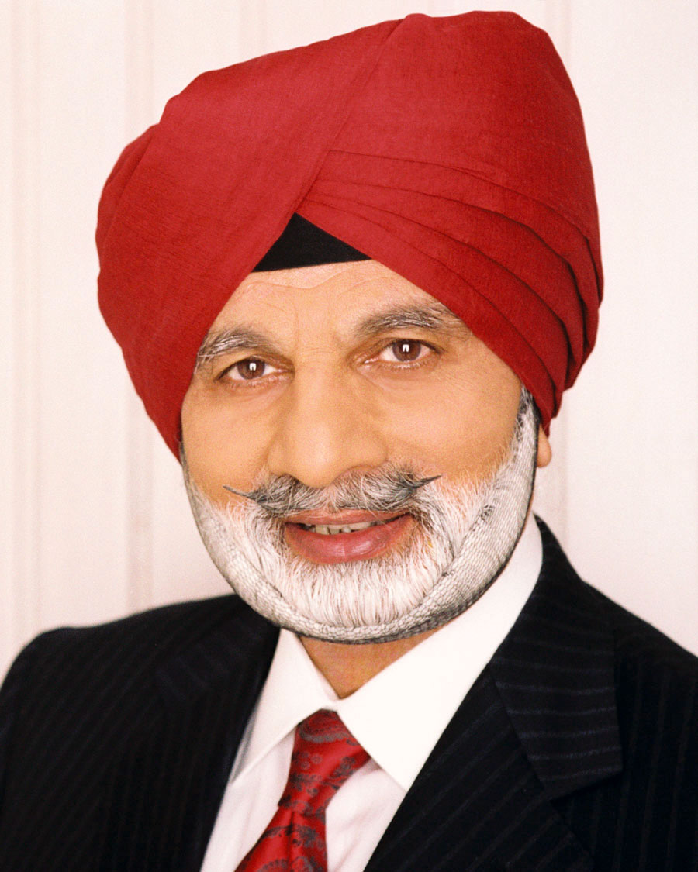



Reposition your company for:
Long-term Sustainability
Global Competitiveness
Enhanced Productivity
Strategic Innovation
Empowered Leadership
Discoverhelp, Inc. • 330-562-2499 • Aurora, Ohio

Slide 10

EDGE is committed to helping value-creating middle market companies in Northeast Ohio "win" though Education, Innovation, and Relationship Building, while building a culture that is supportive of entrepreneurial ventures.
The mission of EDGE is to support Economic Development in Northeast Ohio by focusing on middle market companies interested in growth and value creation.

Slide 11

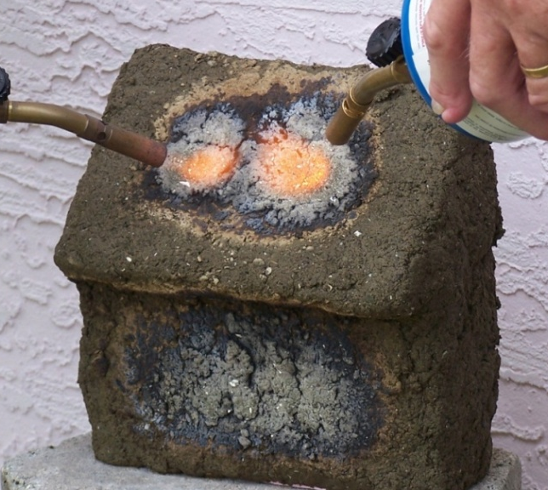
AquaTherm™
Aquatic Based Compounds
Fire resistant
Thermal Insulation
A better idea for the Environment & Industry

Slide 12

Interventional Imaging, Inc.
Interventional Imaging is an early stage company focused on vascular imaging and detection and treatment of atherosclerosis. The device is a catheter with MRI detectors, (a.k.a., “coils”) at its tip. These coils provide high resolution, cross-sectional imaging of the vessel as well as the ability to track the position of the catheter in the body. Together, these provide for improved guidance, stent placement and ablation. The device can be used as a stand alone product for assessment of atherosclerotic disease, or as a platform for deployment of therapies.

Slide 13


LifeServe Innovations, LLC is bridging the gap between academia and medicine to develop high impact medical technologies for critical care and oxygen delivery. Our products set a higher standard for innovation in medicine by improving health-care for our patients and their providers.

Slide 14

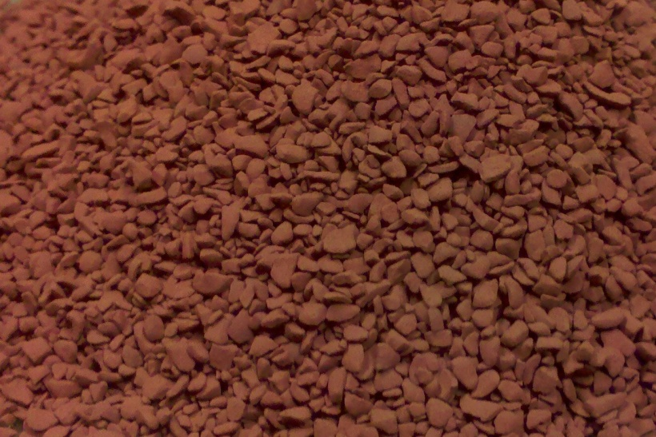
“ One of America’s Most
Promising Startups ”
- BusinessWeek Magazine
SORBSTER™ MEDIA FEATURES/BENEFITS:
Removal of metals to meet/exceed permit regulations
Less frequent replacement required due to high adsorbent capacity
Works effectively with high flow rates
Passes TCLP test, creating non-hazardous disposal option
Addresses the conflict between industry and the environment
APPLICATIONS:
Commercial and industrial treatment units with contaminated water
Municipal water treatment
Flue gas desulfurization
Waste water treatment
Process streams
Sorbster™ Media
CONTAMINANTS REMOVED:
Mercury Selenium Arsenic Chrome Lead Zinc Vanadium
Contact: Tony Lammers| CWRU Weatherhead School of Management ’91| tlammers@marsystemsinc.com

Slide 15
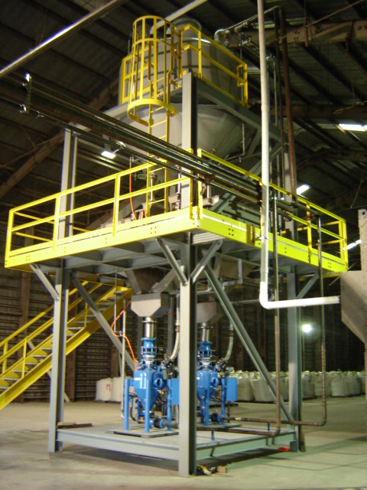
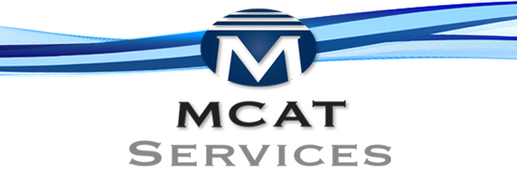
MCAT Services offers a new technology to the refining industry to produce processed catalyst from used ecat reducing landfill waste
Magnetic Separation
Catalyst Recovery
Technology is patented, proprietary and proven:
- Uses state-of-the-art high-flux magnets
- Separates “clean” ecat from ecat contaminated with metals
- Processed catalyst resold to the refining industry or tolled for your specific requirements
Contact: Claude Kennard | CWRU Weatherhead School of Management ’91 ckennard@mcatservicesllc.com

Slide 16
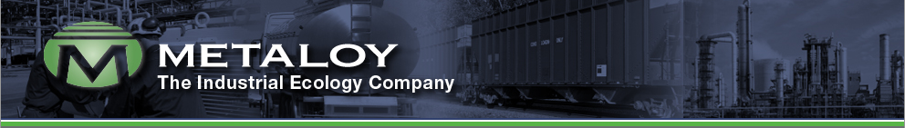
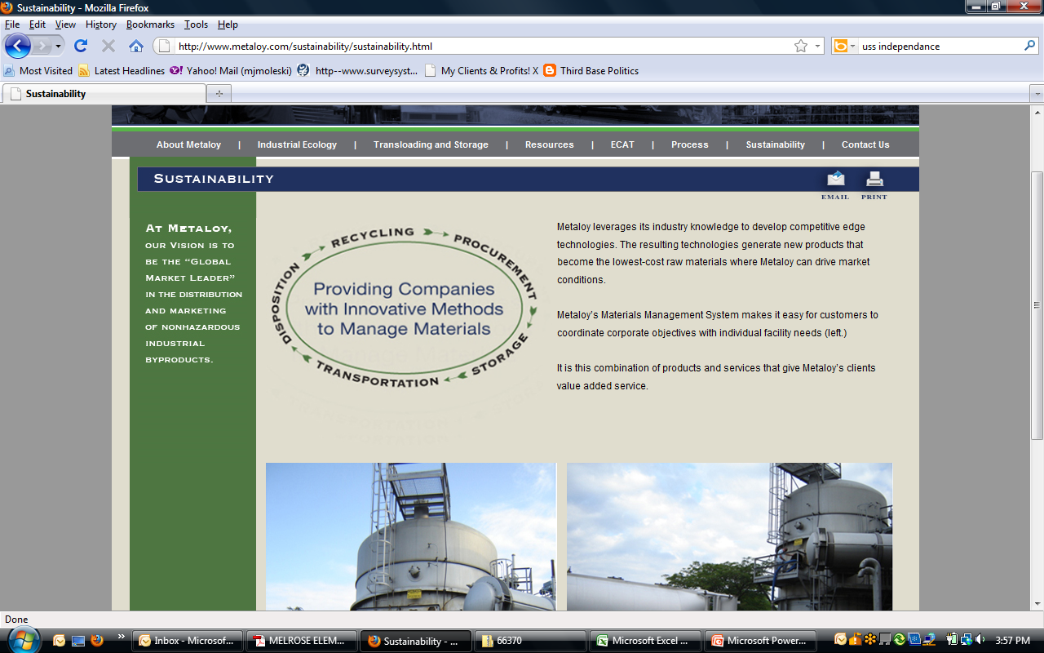
Over 27 Years of Excellence, Experience and Innovation
SPENT ALUMINA RECYCLING, ECAT MANAGEMENT & OTHER BYPRODUCT RECYCLING
Headquartered in Cleveland, Ohio, Metaloy is changing the concepts and manner by which companies manage equilibrium catalyst and recycling of non-hazardous by-products. We will assist your company to identify, process and implement cost-effective and environmentally safe solutions.
AT METALOY,
OUR VISION IS TO
BE THE “GLOBAL MARKET LEADER”
IN THE DISTRIBUTION AND MARKETING
OF NONHAZARDOUS INDUSTRIAL BYPRODUCTS.
Contact: Claude Kennard | CWRU Weatherhead School of Management ’91 | claude@metaloy.com

Slide 17

MIM Software Inc. provides practical imaging solutions in the fields of radiation oncology, radiology, nuclear medicine, neuroimaging, and cardiac imaging. MIM offers solutions for computer workstations, as well as mobile and cloud-based platforms. MIM sells its products globally to imaging centers, hospitals, specialty clinics, research organizations, and pharmaceutical companies

Slide 18

Nanofilm’s history can be traced to the earliest pioneering of nanotechnology. In the early 1980s, Nanofilm co-founder, Dr. Scott Rickert, was already researching self-assembling thin films as part of his work as a professor at Case Western Reserve University. The company began as a spin-off of that research and was co-founded by Dr. Rickert and businessman Don McClusky in 1985. The company’s initial expertise enabled the manipulation of coatings at the molecular level to enhance the durability, clarity, ease of use and performance of transparent materials.
Building on a foundation of success, Nanofilm’s expanded nanotechnology portfolio now includes optically clear, thin (nanometers to microns) coatings, self-assembling nano-layers, nanocomposites and surfactant products.

Slide 19

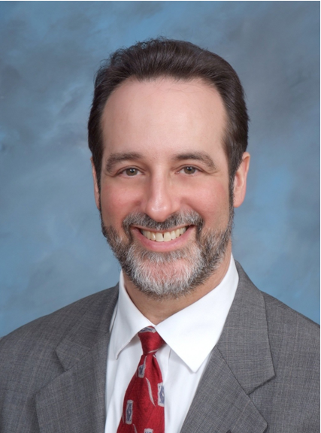

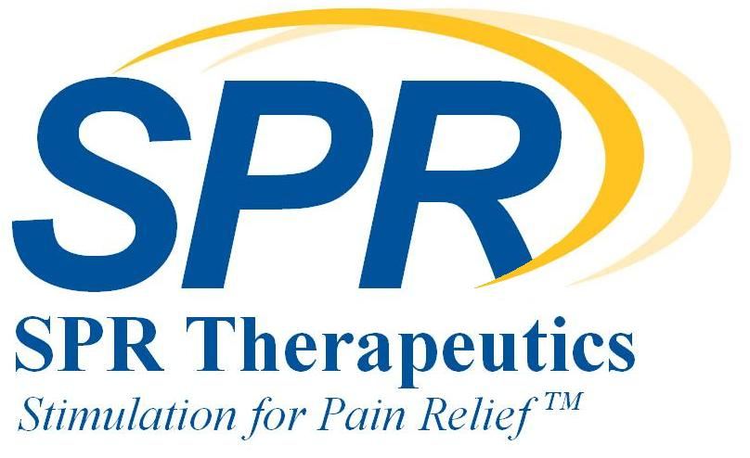
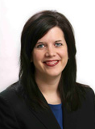
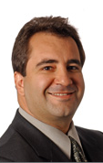
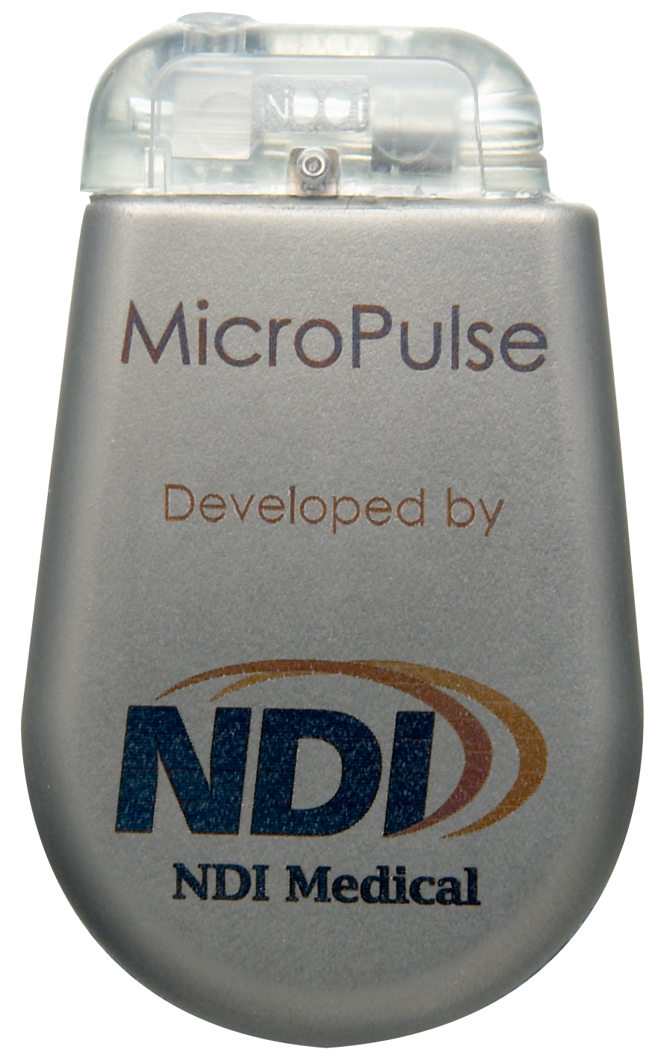
NDI Medical, founded in 2002, is a medical device incubator that develops high-growth companies focused on innovative neurostimulation technologies to address significant unmet health conditions.
Geoff Thrope, BS ‘79
President and CEO
Checkpoint Surgical, founded in 2009, sells advanced surgical tools designed by physicians for locating nerves and evaluating nerve and muscle function.
SPR Therapeutics, founded in 2010, aspires to revolutionize the treatment of pain with its neurostim pain therapy.
Len Cosentino, JD ‘87
President and CEO
Maria Bennett, MS ‘98
President and CEO

Slide 20



Quality Electrodynamics designs and manufactures MRI radio frequency coil technology for human body imaging. The company has been awarded contracts from the National Institutes of Health, the state of Ohio, the Global Cardiovascular Innovation Center at Cleveland Clinic Foundation, and the New Energy and Industrial Development Organization in Japan, and has strategic OEM partnership agreements with Siemens and Toshiba.

Slide 21
Synapse Biomedical Inc (SBI), headquartered in Oberlin, OH was founded in September 2002 to commercialize the NeuRx™ platform for treating a number of respiratory insufficiency conditions with minimally invasive neurostimulation technology.
The initial application of this technology was developed over a twenty-year period at Case Western Reserve University and the University Hospitals of Cleveland and has now been FDA approved and implanted worldwide through the partnership with Synapse Biomedical.

Slide 22

Tremont Electric, Inc. is a sustainable company that is dedicated to providing renewable energy to consumers around the world through a revolutionary technology called nPower®.
nPower's® unique method of generating environmentally friendly electricity positions Tremont Electric as the technology leader in kinetic energy harvesting. nPower® technology is scalable and provides a range of product opportunities from small, implantable bioelectrical generators, to human-motion powered generators, to large commercial scale Wave Energy Converters. nPower® is not just a device-making technology, it is an industry-making technology.

Slide 23
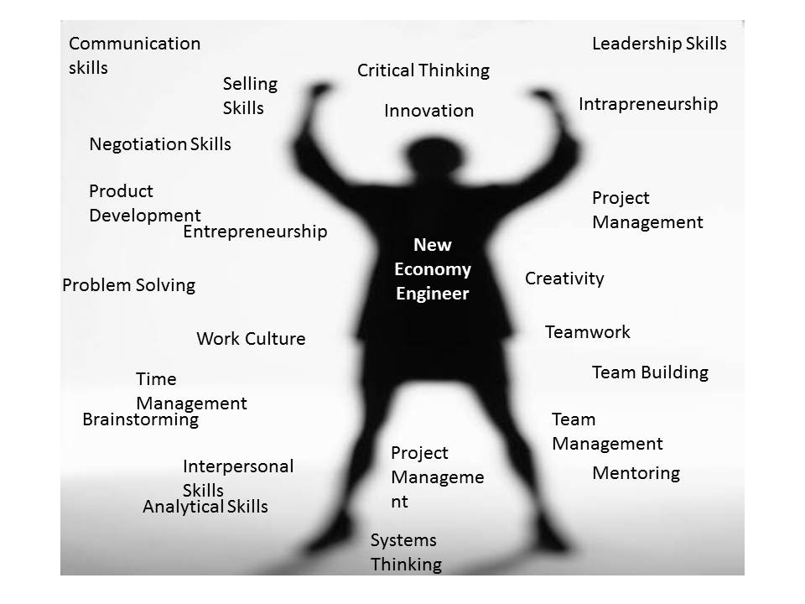
UNIVERSITY OF SOFT SKILLS
“A unique entity that offers only soft skills training and certification program; using P2P e-learning platform to recent engineering graduates and other entry/mid level professionals, with a content that is developed by peers, academia and experts based on the current needs and demands of industry”
Compelling problem
Need
Opportunity
Problem – An independent study conducted on CEOs, by Stanford Research Institute and Carnegie Mellon in the US, found that long-term job success depends 75 percent on soft skills and only 25 percent on technical knowledge
Need – Current education system lacks emphasis on Soft Skills
Opportunity – Combining E-learning, Social Networking, and P2P knowledge sharing on an Interactive Platform; to cater to a rapidly growing market

