Slide 1
Greater Circle Living
An Incentive to Live Near Work

Slide 2
About Greater Circle Living:
Greater Circle Living is a partnership that offers a mechanism for leveraging institutional and foundation funds to assist eligible employees with rental and purchase housing options, or repair of their owner-occupied homes in Greater University Circle neighborhoods.
Eligible participants can earn up to $30,000 in down payment assistance, up to $8,000 in matching funds for exterior home repairs and up to $1,400 for one-time rental assistance.

Slide 3
About Greater University Circle Initiative
A partnership between the University Circle neighborhood and The Cleveland Foundation focused on rebuilding the neighborhood
The Four Strategy Areas are as follows:
Institutional Partnership – Creating opportunities for institutions to work together
Catalyzing Development – Catalyzing transportation and real estate projects that reconnect neighborhoods
Economic Inclusion – Encourage buying, hiring, and living local
Community Engagement – Ensuring residents have authorship in the revitalization of the neighborhood

Slide 4
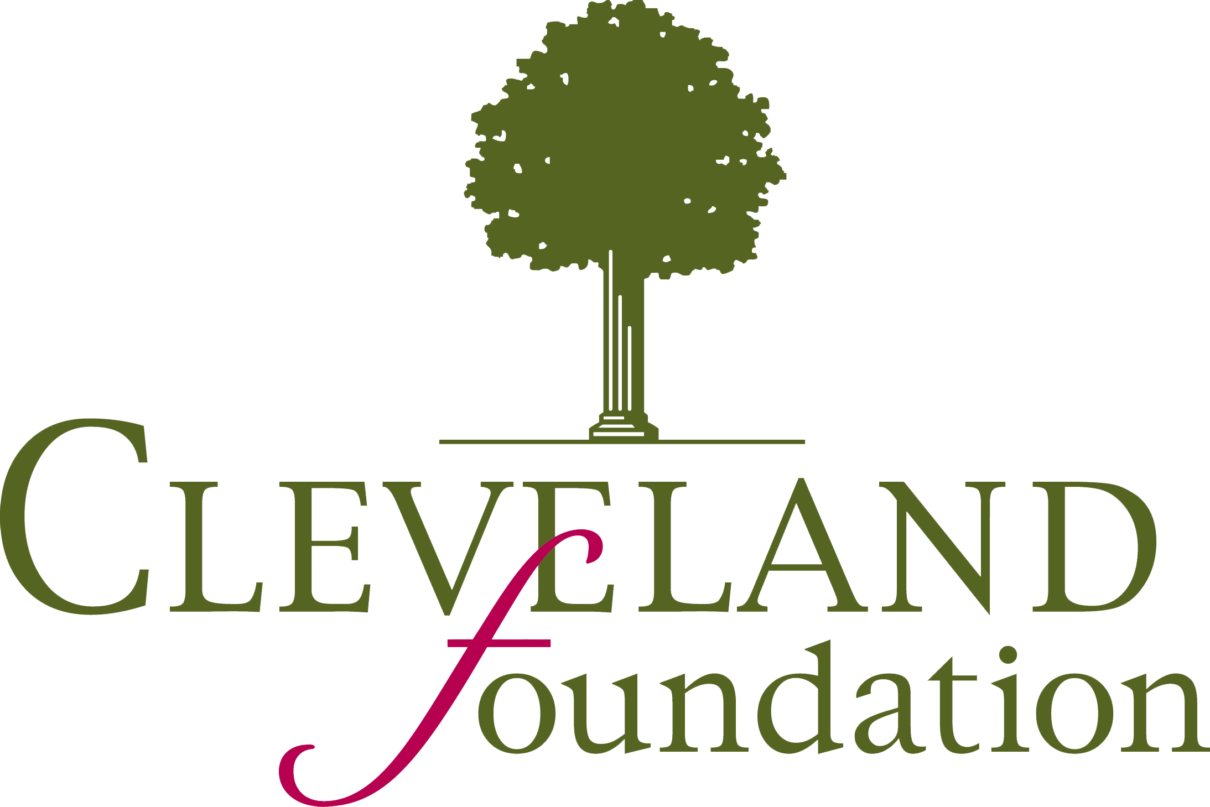
Partners:
* Other qualified 501(c)(3) nonprofit employers in the GCL designated geographical area which includes the Louis Stokes Cleveland VA Medical Center and non-profit employers that have been in existence for more than 24 months.
Notes:
Case Western Reserve University
Cleveland Clinic
The Cleveland Foundation
Judson at University Circle
University Hospitals
Other qualified 501(c)(3) nonprofit employers in the GCL designated geographical area which includes the Louis Stokes Cleveland VA Medical Center and non-profit employers that have been in existence for more than 24 months.

Slide 5
Participating Neighborhoods -
Buckeye-Shaker
Central-Midtown
Fairfax
Glenville
Hough
Little Italy
St. Clair-Superior
University Circle
Southwest Quadrant of East Cleveland

Slide 6
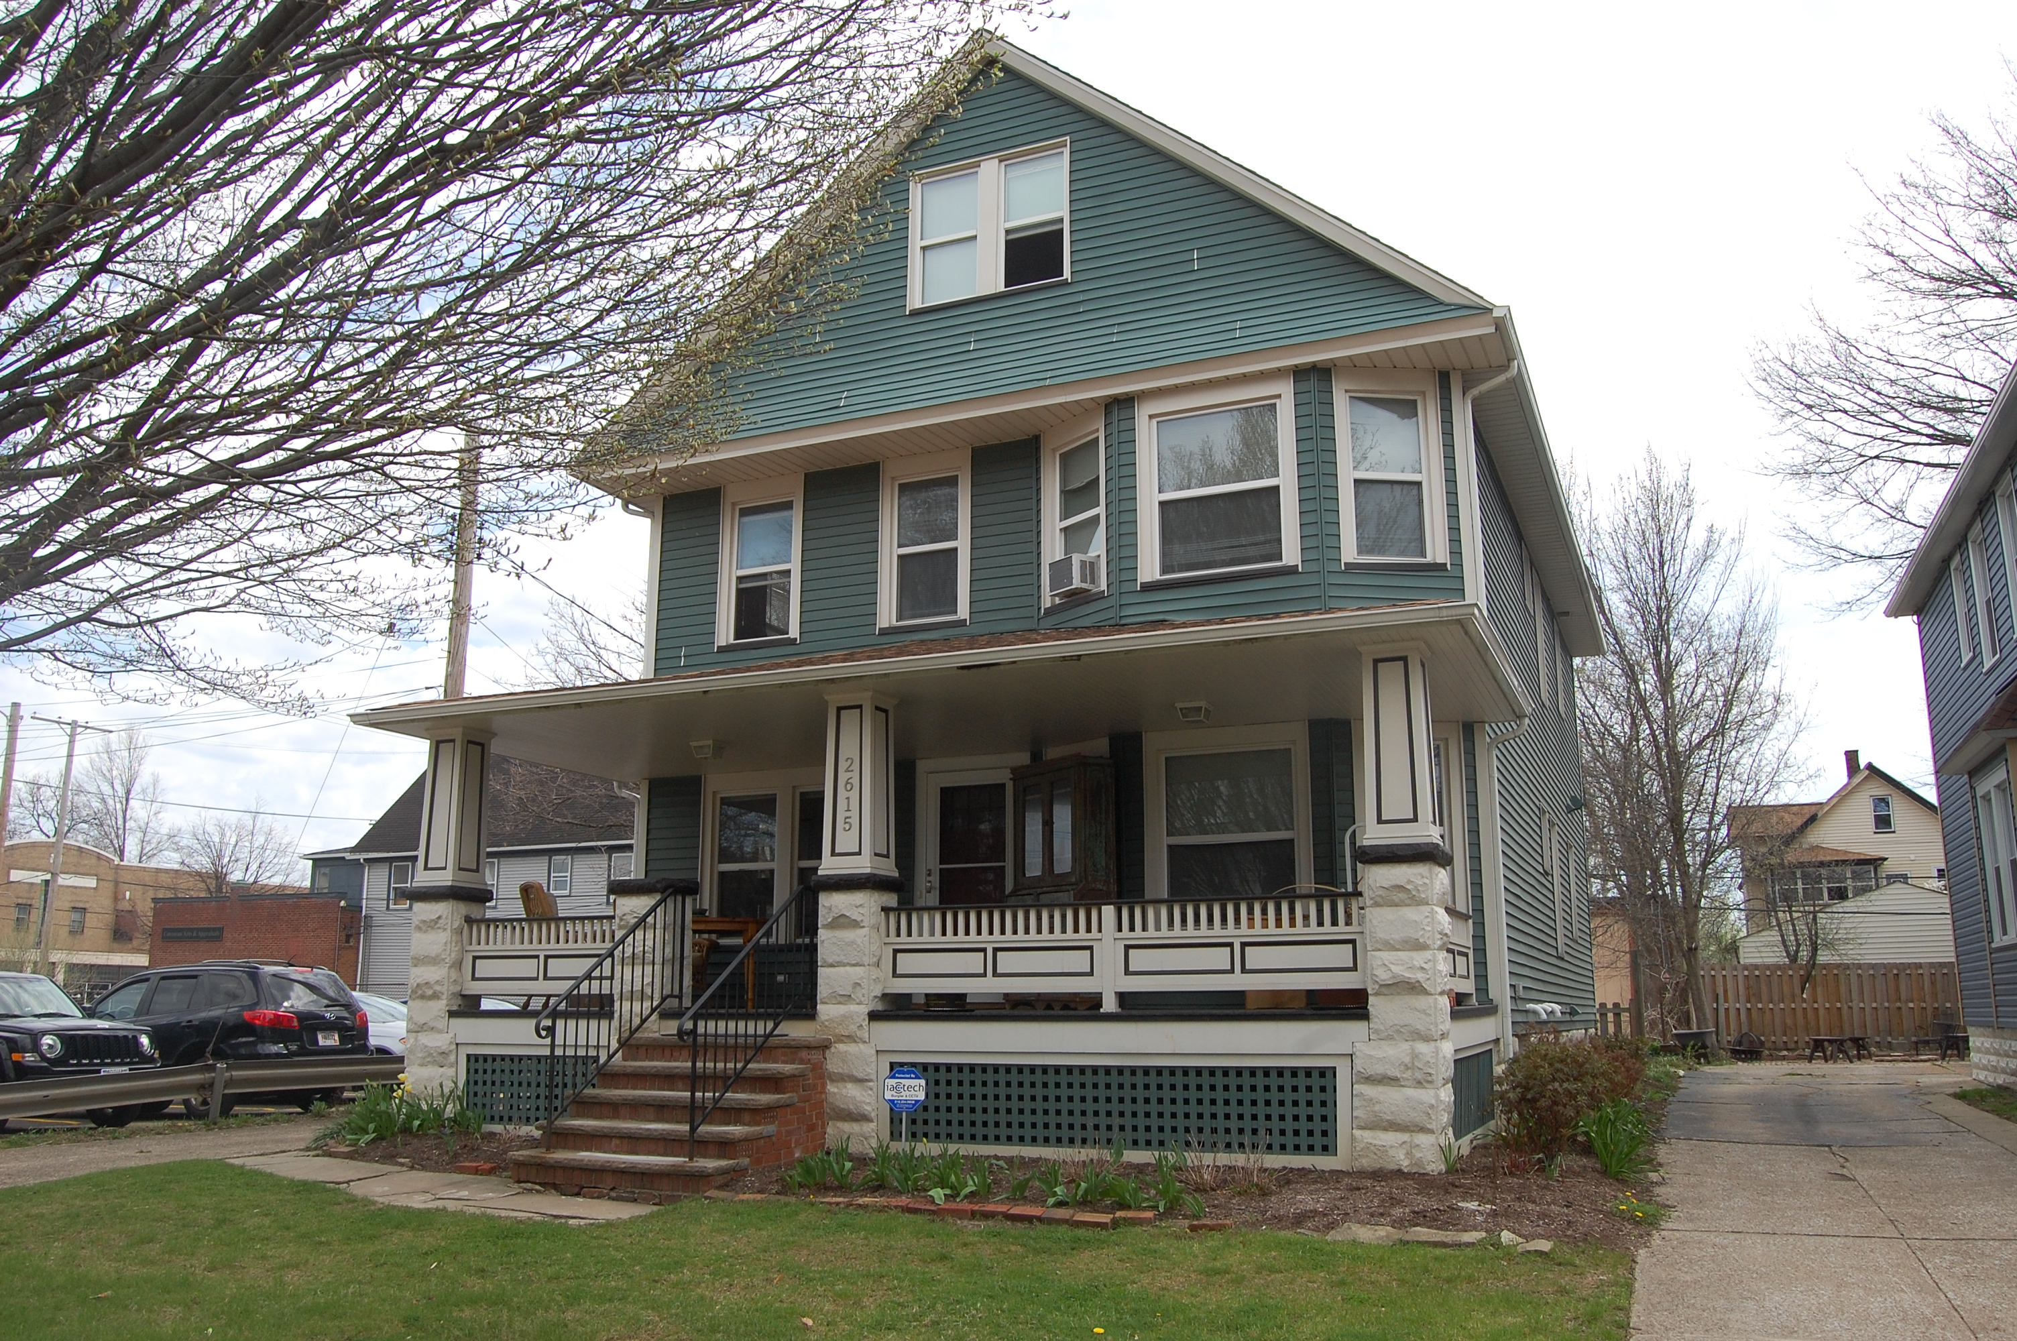
Buckeye Shaker
Population 11,680
Blend of the old Buckeye neighborhood and Shaker Square neighborhood
Centered around a historic shopping district and rapid transit station that connects to downtown Cleveland.
Living Options:

Slide 7
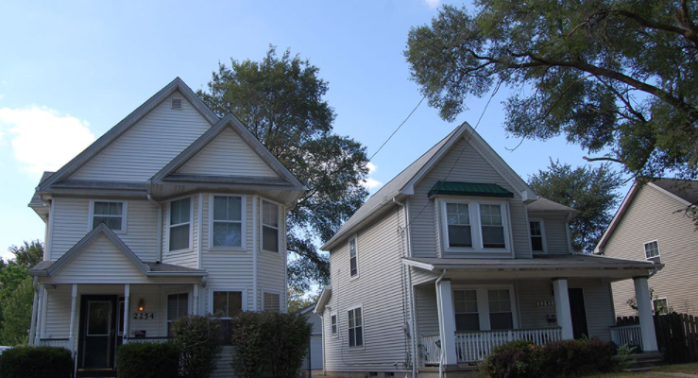
Central Midtown
Population – not a lot
Home to notable institutions and historic sites.
Phyllis Wheatly Association, Dunham Tavern, Agora Complex.
Offers a diverse selection of restaurants
Living Options –
New construction, single-family market rate homes, single-family lease-purchase homes, single-family public housing, townhomes.

Slide 8
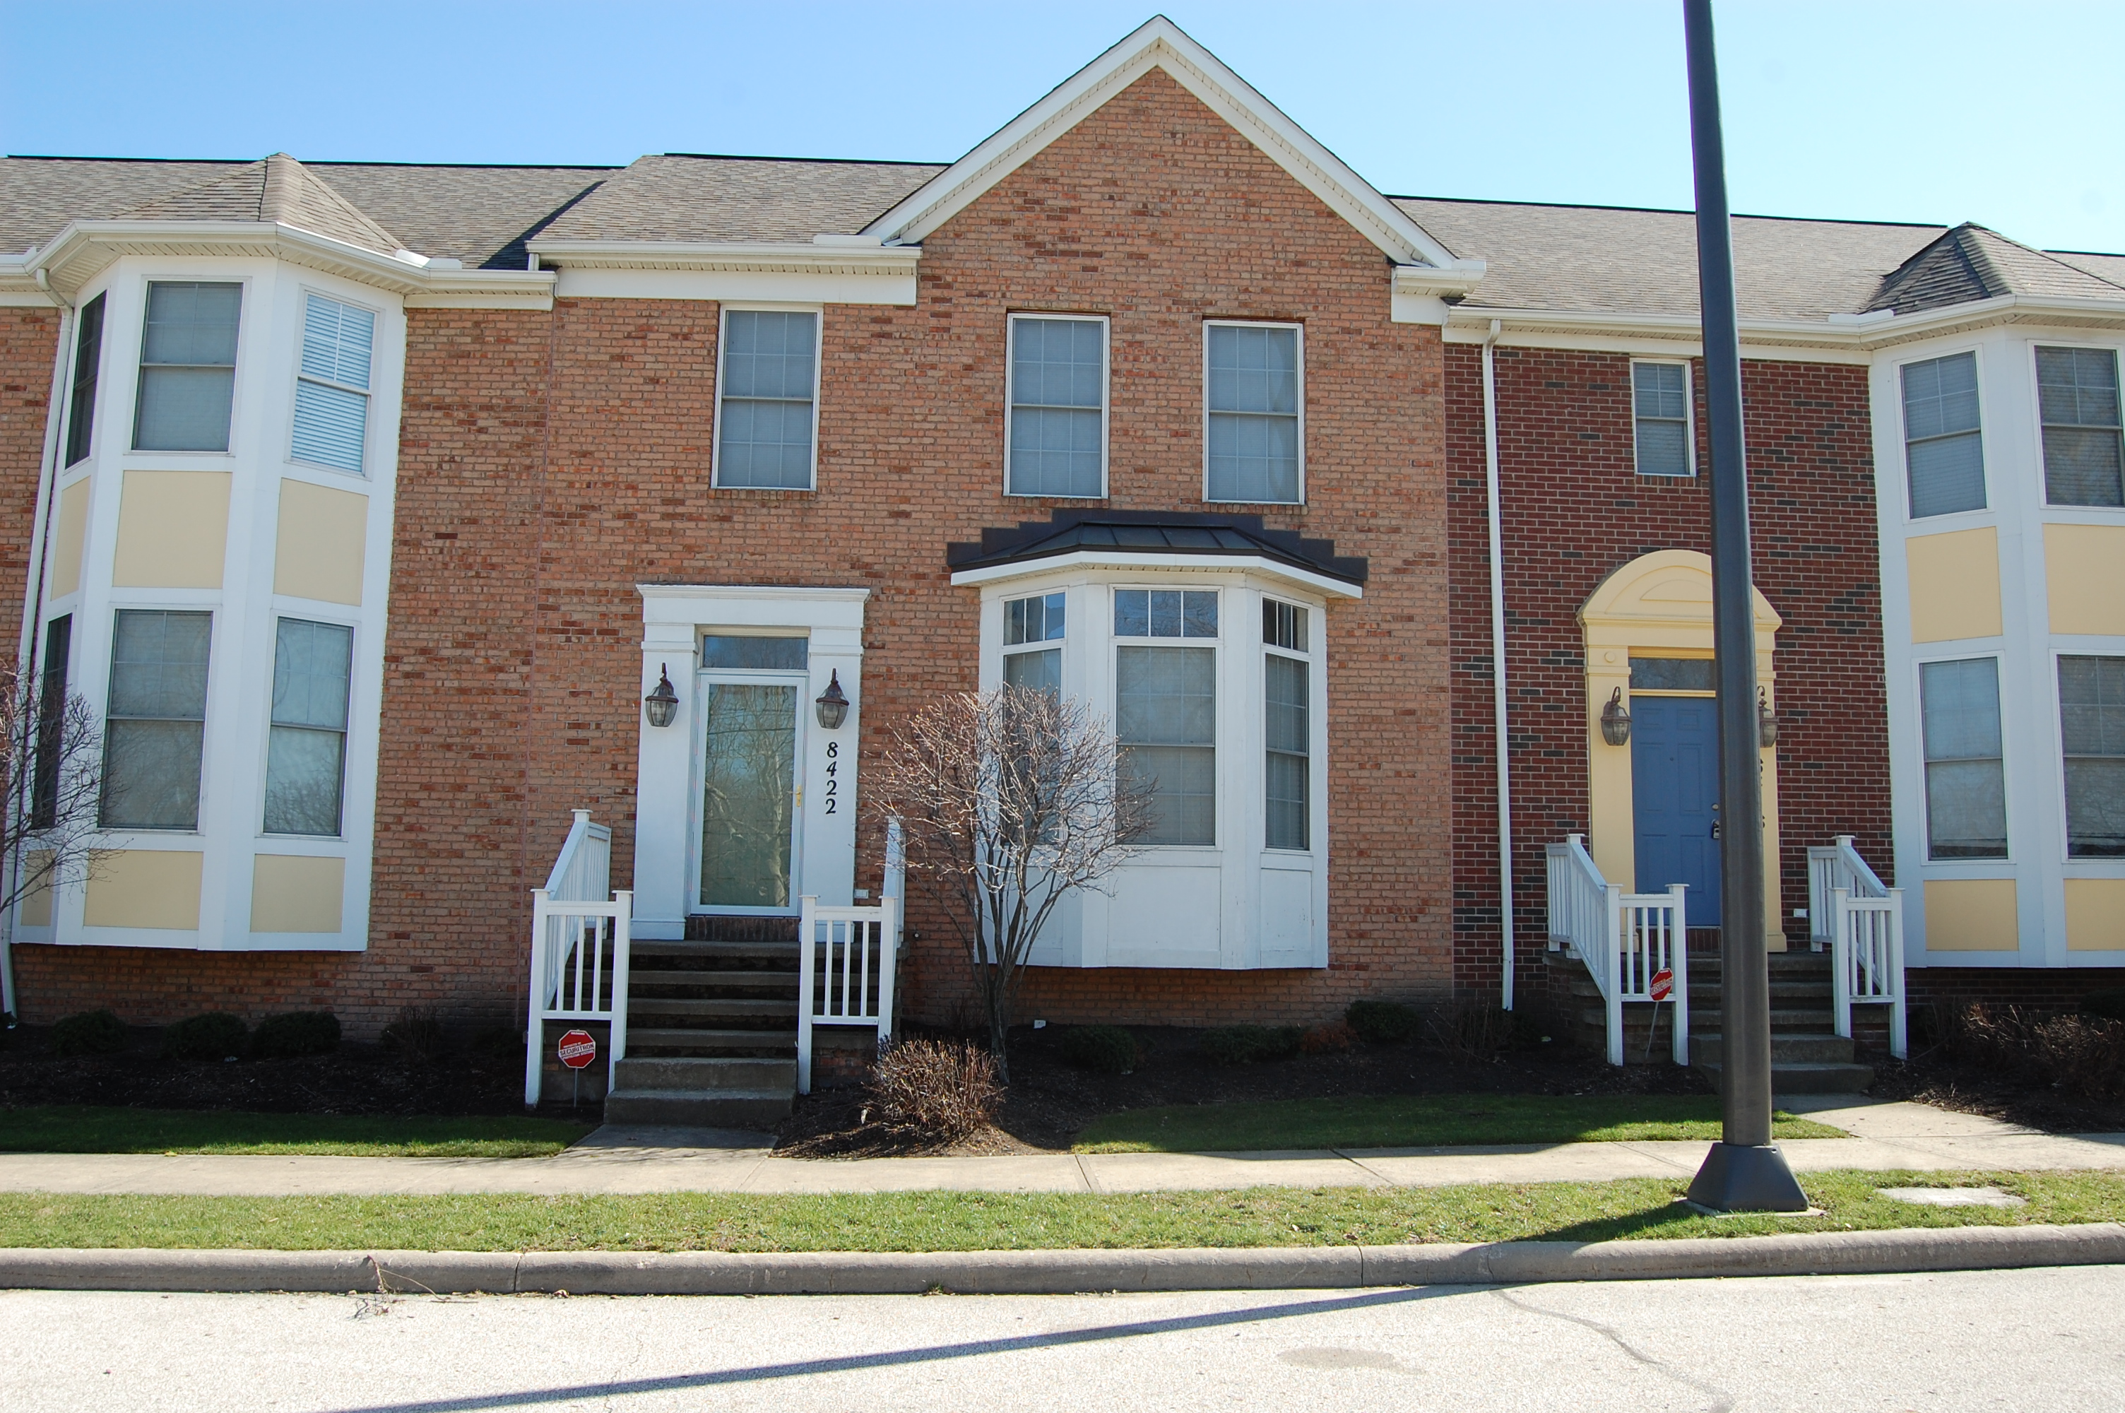
Fairfax
Population – 4,470
Home to historic locations and nationally recognized intsitutions.
Karamu House, Cleveland Clinic
Home to Jesse Owens, Langston Hughes
Living Options –
New construction, single-family market rate homes, single-family lease-purchase homes, single-family public housing, townhomes.

Slide 9
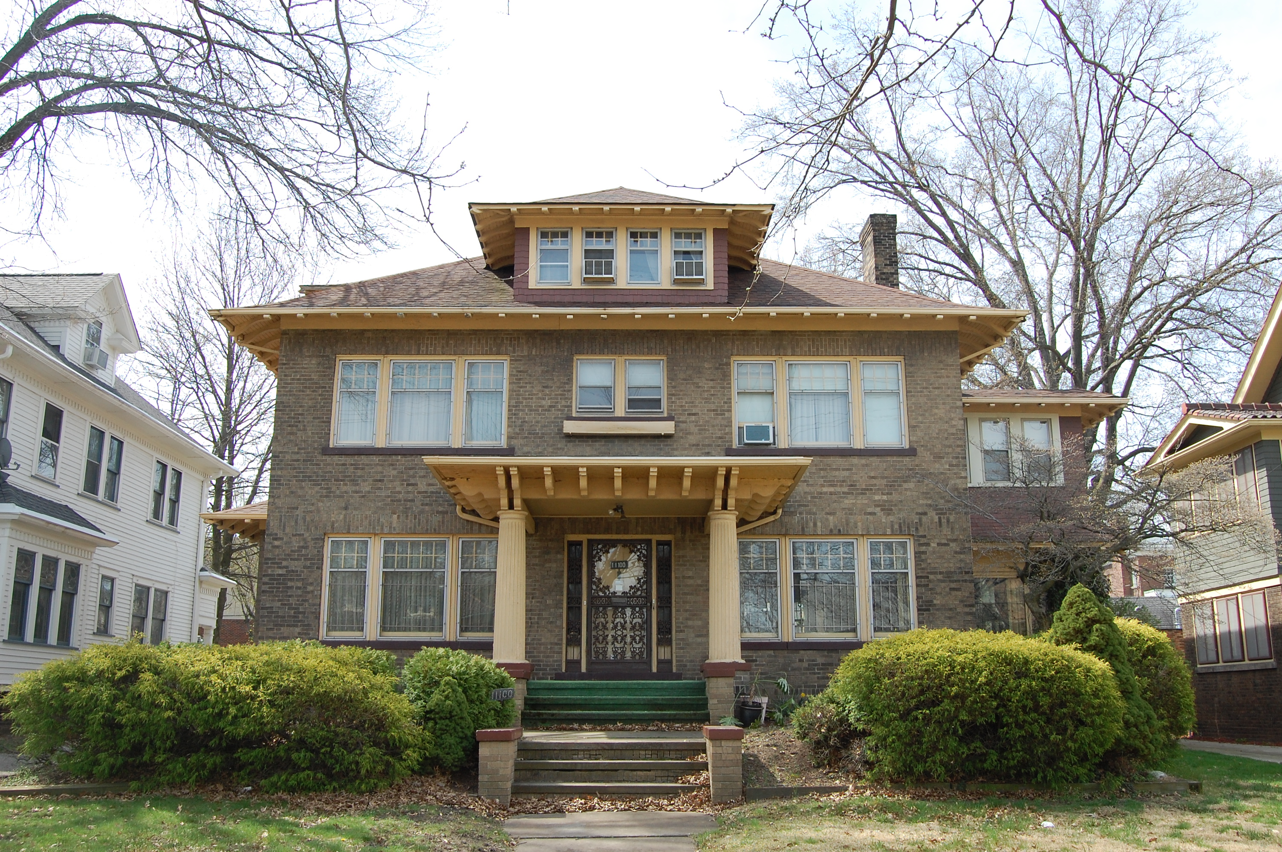
Glenville
Population – 10,850
Vibrant neighborhood located close to Lake Erie and Downtown
The area features shopping, dining, arts, and greenspaces
Living Options –
Apartments, new construction, and historic homes and buildings.

Slide 10
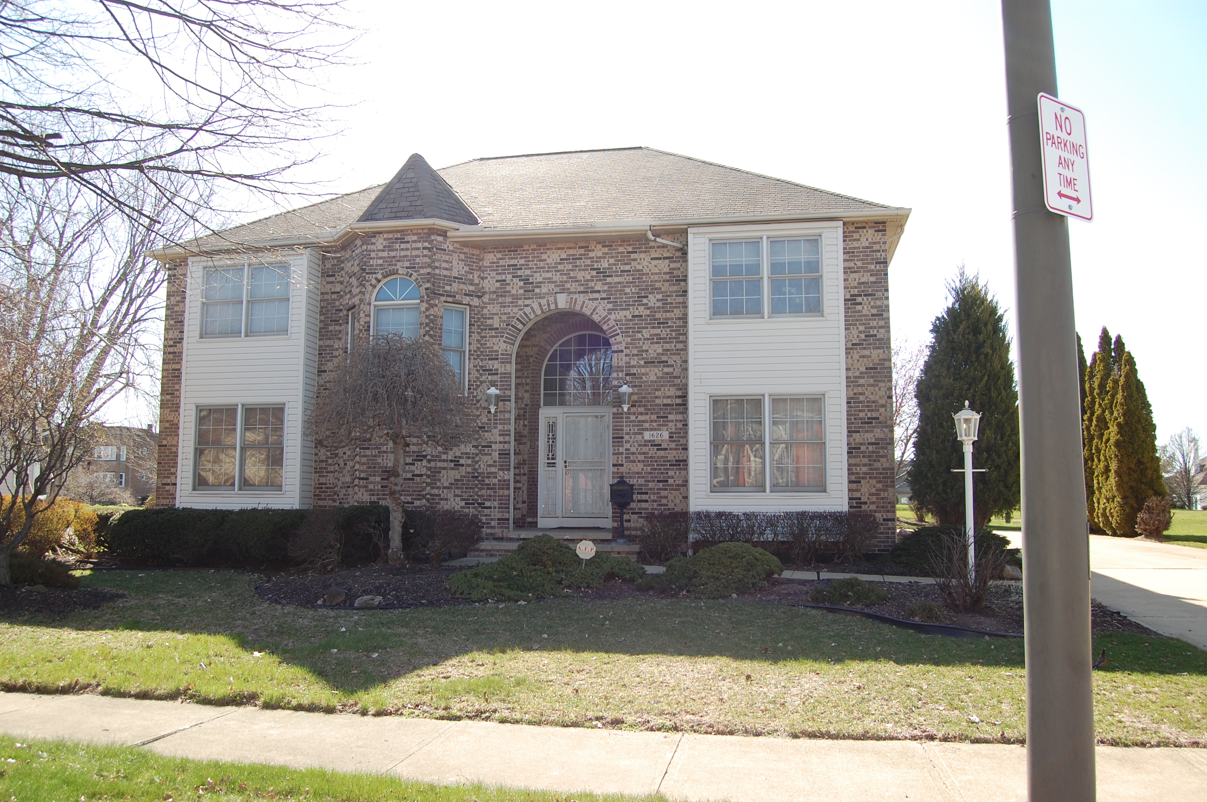
Hough
Population – 8,941
Located between University Circle and Downtown
Close to the RTA Health Line and several large employers
Living Options –
New and historic homes, single-family homes, townhomes, and newly built apartments.

Slide 11
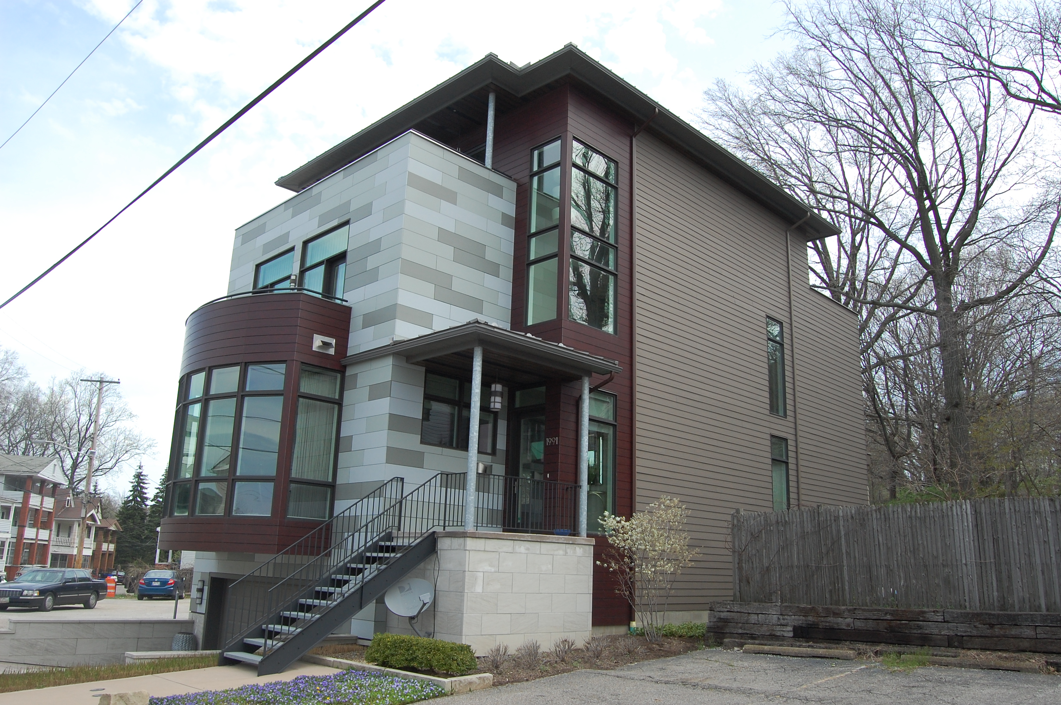
Little Italy
Population – 1,035
Located between University Circle and the suburb of Cleveland Heights
Attracts thousands of visitors each year to their restaurants, shops and more.
Living Options –
Single-Family Homes, multi-unit homes, store fronts with apartments, apartments, and townhomes.

Slide 12
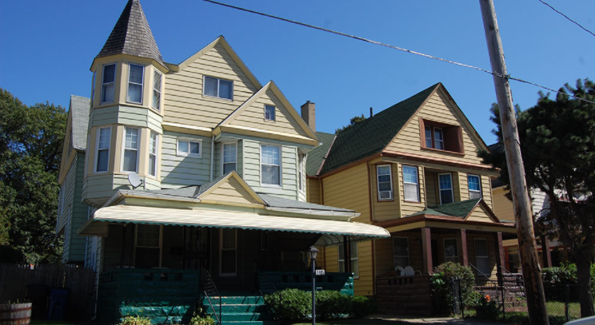
St. Clair Superior
Population – 7,200
Located between E. 30th St. Martin Luther King, Superior, and Lake Erie
Home to Asia Town which offers 20+ Asian restaurants and stores
Living Options –
All types of business and living options, live-work options, loft buildings, warehouse and single-family homes

Slide 13
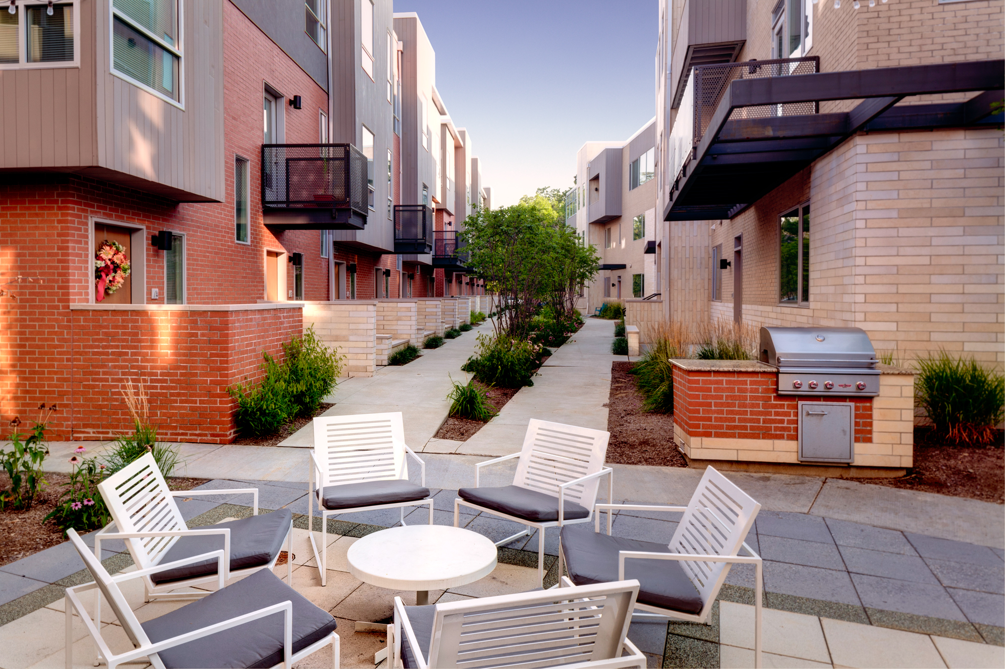
University Circle
Population – 7,615
Located between Little Italy, Glenville, Hough, and Fairfax
Home to top universities, hospitals, and museums with events that draw thousands of visitors
Living Options – historic single-family homes, new construction, apartments

Slide 14
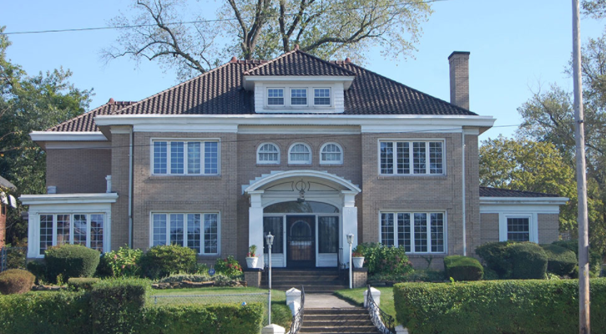
Southwest Quadrant of East Cleveland
Population – 16,730
Located northeast of the University Circle neighborhood
Original location of “Millionaire’s Row.” Home to Lakeview Cemetery
Living Options
Single-family market rate homes, single-family lease-purchase homes, single-family public housing.

Slide 15
Notes:
Red is the Cleveland Clinic boundaries, blue is everyone else.

Slide 18
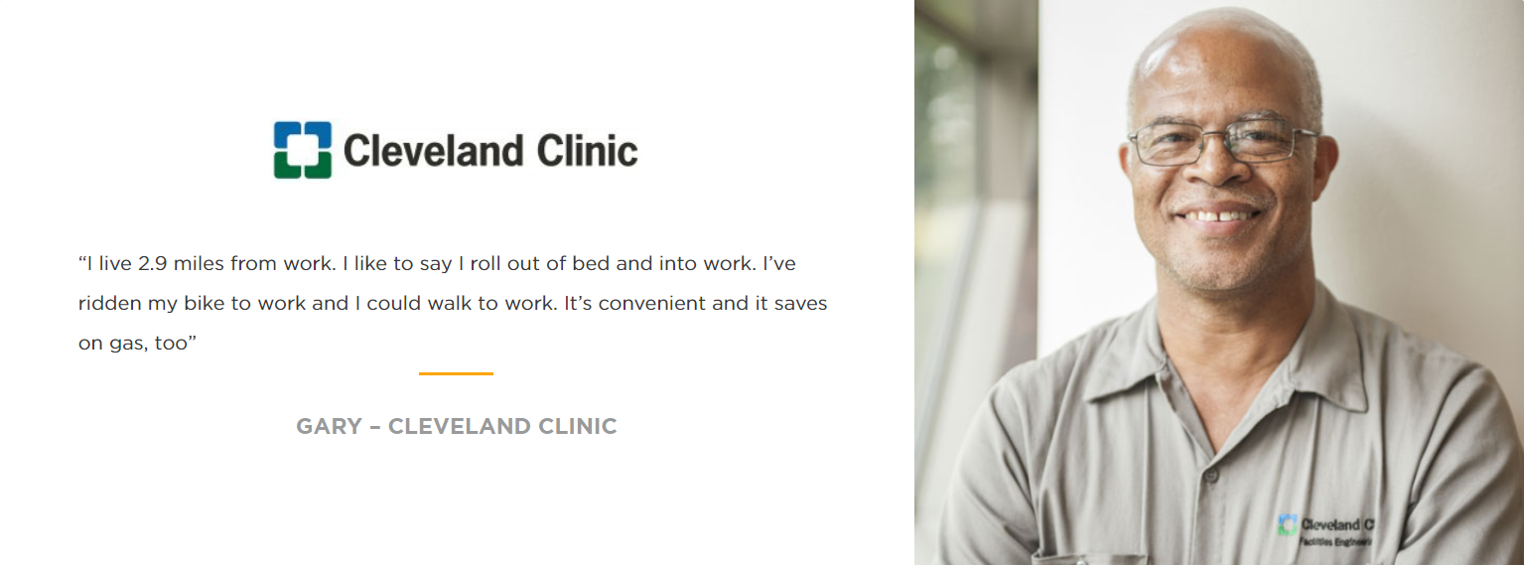

Slide 19
Home Purchase Program

Slide 20
About Home Purchase Program (HPP) -
GCL helps eligible employees afford purchasing a home in the Greater Circle Living Neighborhoods.
Participants find their own home (single-family or two-family homes, condominiums or townhomes) that meet the requirements of the program.
The HPP is administered by GCL. Down payment assistance is provided to the title company directly on behalf of the participant.
The Program Offers –
Up to $30,000 in forgivable loans for home purchase assistance.
A Secured loan.
0% interest rate.
Notes:
The GCL loan is a five-year loan that bears no interest. The GCL loan may only be used for down-payment, closing costs or mortgage points associated with the purchase of a primary residence in the designated area. As long as an employee remains employed at the same or other eligible nonprofit employer in the designated area, and continues to occupy the purchased property as a primary residence, a portion of the original principal amount will be forgiven annually on the anniversary of the loan closing date as described.

Slide 21
Home Purchase Eligibility -
Other qualified 501©(3) nonprofit employers that have been in existence for more than 24 months

Slide 22
Home Purchase Eligibility -
Complete an 8-hour, HUD-approved homebuyer education course
Contribute minimum 3% of own funds towards purchase price
Present a fully executed purchase agreement and proof of insurance for the home
Use a lender that accepts secondary community financing
Occupy the purchased home for at least 270 days per year
Provide 60 months of continuous employment service to same or other qualified nonprofit employers in the GCL area for loan to be forgiven
Notes:
Occupy purchased home 270 days/year loan will not be repaid if violated.
Up to $30,000 minimum is $10,000
Who is eligible for the full $30,000
please see your employer’s website or contact your benefits/human resources department for a definition of an eligible employee). Each employer has different eligibility requirements.

Slide 23
Exterior Home Repair

Slide 24
About Exterior Home Repair -
Assists eligible employees who already own a home in the GCL target area to maintain their homes and revitalize their neighborhoods
Provides up to $8,000 in employer match funds for approved exterior renovations
Renovations must be approved in advance
Funds are released once renovations are completed and inspected
Notes:
What type of exterior repairs are covered
Funds can be matched either by contributing funds, or in labor

Slide 25
Eligibility for Exterior Home Repair -
The property must be the owner's primary residence for at least 270 days/year
The owner must have written commitment from Fairfax Renaissance Development Corporation (FRDC) before beginning repairs
The home must not be in tax or mortgage foreclosure
The owner must provide proof of homeowners insurance
The employee must contribute 25% match of requested funds
This program can only be used once
Notes:
please see your employer’s website or contact your benefits/human resources department for a definition of an eligible employee). Each employer has different eligibility requirements.

Slide 26
Rental Assistance Program

Slide 27
About the Program -
The Rental Assistance Program helps eligible employees secure housing near employment in the target GCL area.
The program provides one month’s rental payment up to $1,400 excluding the first months rent and security deposit.
The employee must have a one-year lease (or lease renewal) to live in the unit.

Slide 28
Rental Assistance Eligibility
Employee of –
Cleveland Clinic
University Hospitals
Case Western Reserve
Judson at University Circle ($5,000) match
Requirements
Provide a signed 12-month lease agreement
Provide proof of payment for first months rent and security deposit
Occupy the rental property for at least 270 days/year
Can only be used by one household member
Can only be used once
Notes:
please see your employer’s website or contact your benefits/human resources department for a definition of an eligible employee). Each employer has different eligibility requirements.

Slide 29
Learn More and Apply
Contact
(216)361-8400
8111 Qunicy Ave., Suite 100
Cleveland, Ohio 44104
Hours of Operation:
M-F: 9:00 AM – 5:00 PM
Sat-Sun: Closed
greatercircleliving.org
Notes:
Contact with any questions of eligibility, and how to apply.

Slide 30
CWRU Employees
As of today all Case Western Reserve University applicants will be placed on a waitlist.
The waitlist functions on a first come, first serve basis
Availability of funds depends upon how many wait-listed employees move forward with the application process.
During this waitlist period
CWRU applicants can still apply for the Home Purchase Grant
This is a grant in the amount of $10,000 offered to all other nonprofit employees
Notes:
Contact with any questions of eligibility, and how to apply.

Slide 31
Questions?
Learn more and apply at greatercircleliving.org

