Slide 1
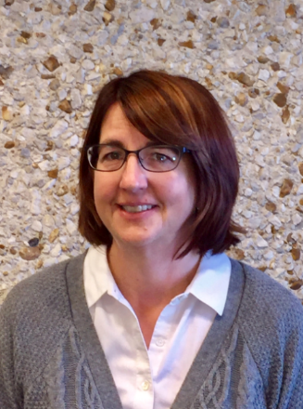
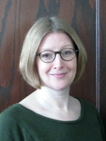
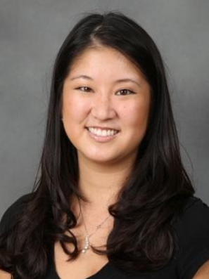
BGSU’s IDEAL-N Team
Dr. Julie Matuga
Vice Provost for Institutional Effectiveness
Co-Director
Dr. Peg Yacobucci
Professor of Geology
Change Leader
Dr. Lisa Hanasono
Assistant Professor of Communication
Social Scientist
https://www.bgsu.edu/provost/institutional-effectiveness/ideal-n.html

Slide 2
Building Bridges: Creating Connections for the Next Generation of Faculty Leaders
Develop opportunities for women and URM faculty to become leaders in their departments, colleges, and across the university
Focus is to develop a supportive network of current and future faculty leaders to advance the careers of post-tenure faculty and create a cohort of institutional change agents
Work so far:
Website
Review of existing leadership professional development policies and practices
Multi-institution survey on faculty leadership
Women’s Leadership Breakfast
Discussions with U Toledo IDEAL-N team re: partnerships

Slide 3
Preliminary survey results
BGSU, UT, CWRU, IUP
N= 531 Faculty (228 men, 274 Women, 29 Undisclosed)
“Are you interested in pursuing a specific faculty leadership position in the next 3 years?”
Yes (45.8%) vs. No (54.2%)
Binary Logistic Regression Results:
Efficacy, Peer Support, Negative Outcome Expectations, and Perceived Barriers predicted faculty members’ leadership interests.
Multiple Regression Results, R² = .06, F(3, 215) = 4.29, p = .006
No gender differences
Faculty who self-identified with the social identity of a university administrator were more interested in pursuing leadership opportunities.
Dr. Lisa Hanasono
Assistant Professor of Communication
Social Scientist

Slide 4
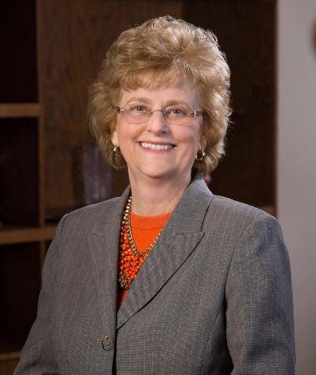
Women’s Leadership Breakfast
39 Attendees (27 Faculty; 12 Faculty Administrators)
Q&A with BGSU President Mary Ellen Mazey
Table discussions and gallery walk Networking maps
March 23, 2017

Slide 5
Women’s Leadership Breakfast
Opportunities:
Being a mentor
Being an institutional change agent
Institutional role models
Using community to empower others
Support of unit leadership (in some not all)
Direct encouragement to apply

Slide 6
Women’s Leadership Breakfast
Barriers:
Time commitment, work-life balance
Loss of research time, chance for promotion
Lack of mentoring, training, preparation
Bullies, negative power structure, what colleagues will think
Not getting credit for what we do already do, “silent service”

Slide 7
Women’s Leadership Breakfast
Professional Development Topics:
Administrative basics (budgeting, how to delegate, conflict, etc.)
Opportunities to get together as women to support women
Support for women faculty promotion & tenure
Work/life balance**

Slide 8
Women’s Leadership Breakfast
How can women better support women?
Advocate for each other
Acknowledge other women’s contributions publicly
Utilize information gathered to design and continue support efforts
Network!

Slide 9
Network Maps

Slide 10
Continue analyzing institutional & survey data
Assess networking maps
Begin developing leadership curriculum
Create online community for faculty interested in leadership
Work with University of Toledo team on joint activities

