Slide 1

IDEAL–N
Kent State University
Building Community through Intentional Mentoring

Slide 2
Why Mentoring?
COACHE (Collaborative On Academic Careers in Higher Education) http://coache.gse.harvard.edu/
Notes:
Major focus on Associates, but also on new faculty, especially FOC

Slide 3
Framed in the best practices of COACHE
Have a mentoring program!
Provide multiple pathways to mentoring
Set expectations for mentors and mentees
Provide guidelines for mentors and mentees
Be intentional when considering under-represented groups
Provide a reward structure for mentors
Develop an evaluation plan
Institutional
Unit
Individual

Slide 4
Institutional Practices
Writing mentoring duties into job descriptions
  Associate Provost for Academic Affairs
  Director of Center for Teaching and Learning
Focus groups
Professional career coaching sessions
Hiring of a new position in the Division of Diversity, Equity and Inclusion
  Executive Director of Faculty and Graduate Student Retention
“Check-ins” with faculty

Slide 5
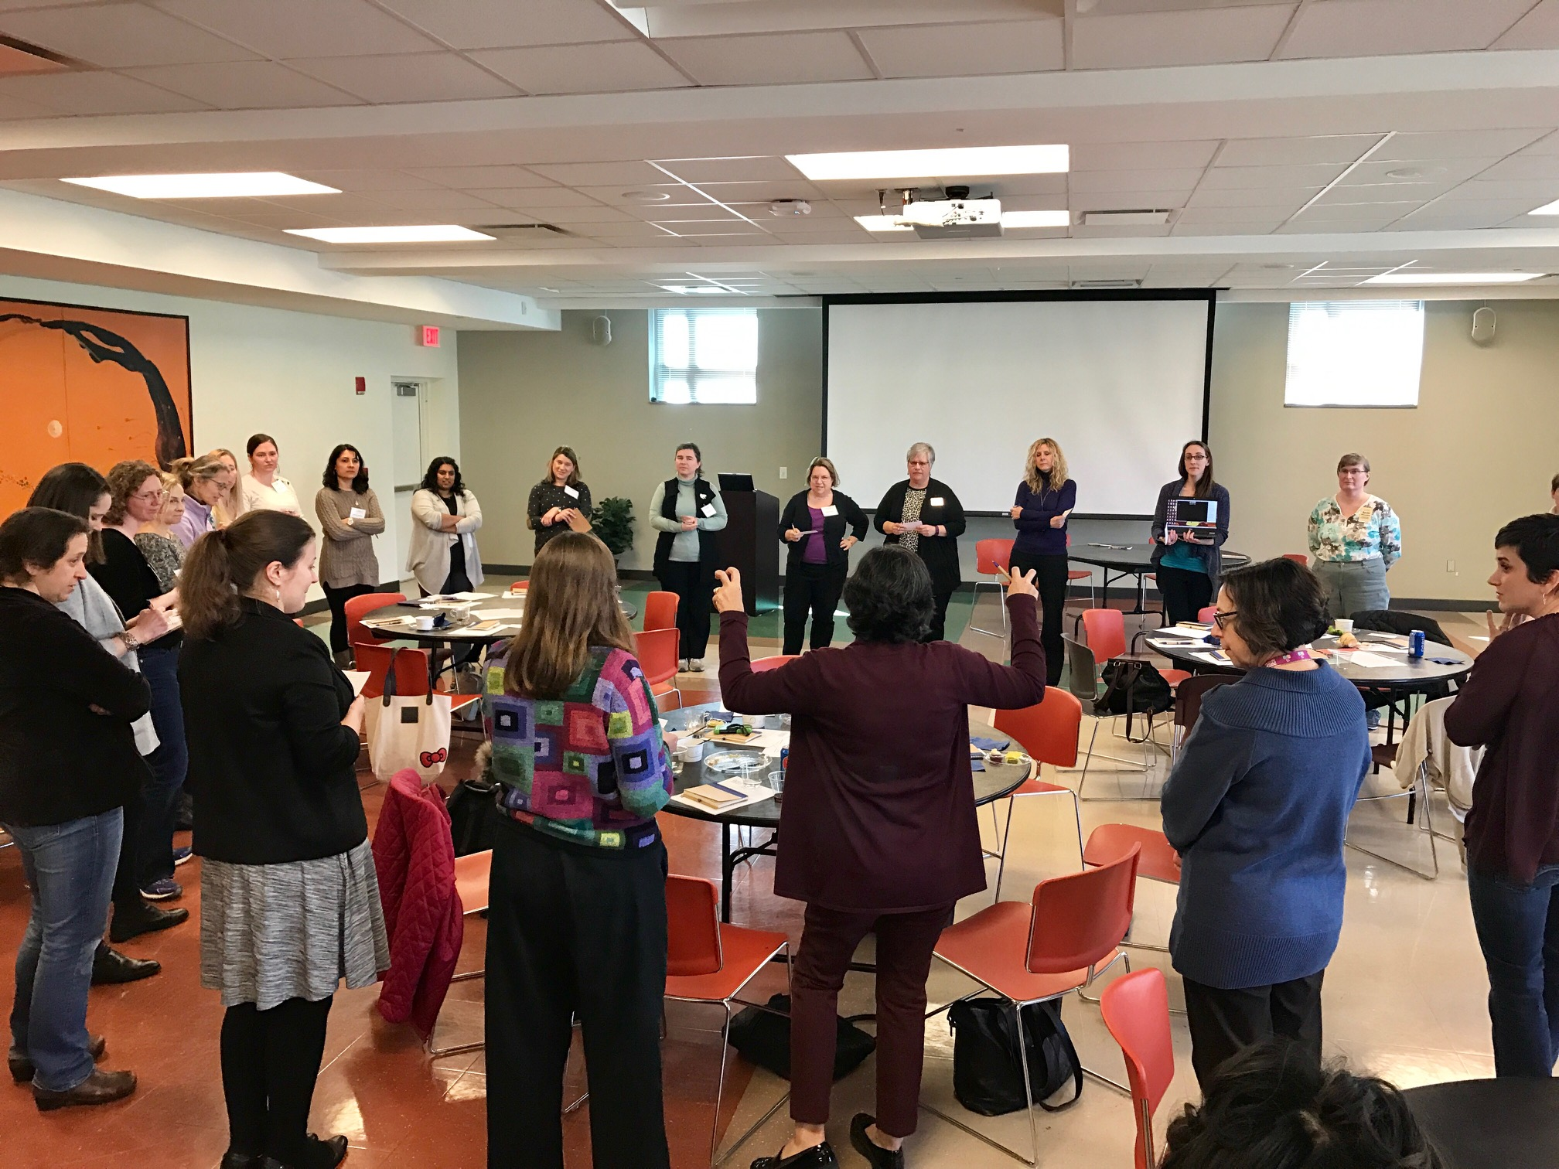
Focus Groups – open registration
Faculty of Color Session
  Purpose: identify pressing issues and share experiences back with upper administration (21)
Women in STEM Session
  Purpose: identify pressing issues and share experiences back with upper administration (23)
Mommy Professor
  Arose as a focus area from other sessions (28)

Slide 6
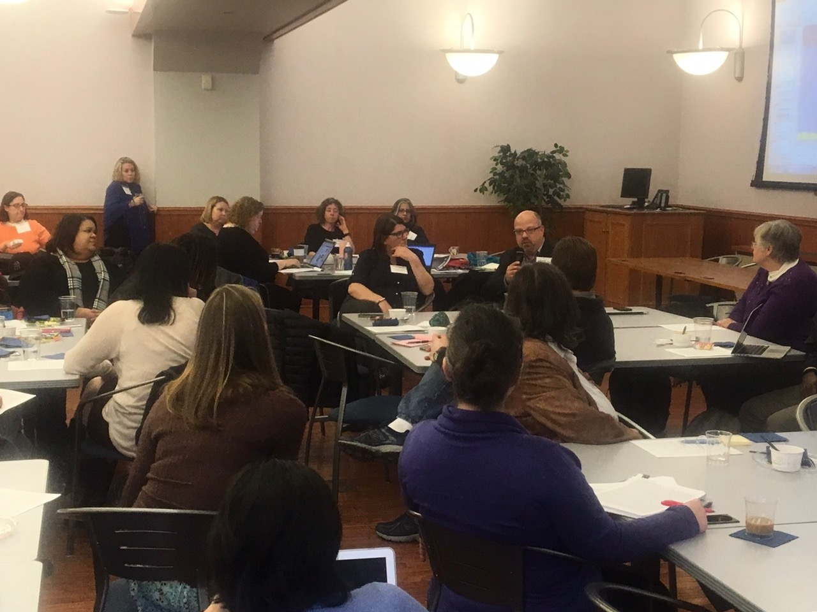
Focus Groups – open registration
Five mid-career sessions:
  So now you’re tenured! What next? (14)
  Managing multiple demands (33)
  Pursuing Promotion to Professor – with a panel of recently promoted professors (30)
  Pursuing Promotion to Professor at Tuscarawas Campus (7)
  Pursuing Promotion to Professor – with a panel of review committee members (?)

Slide 7
Instances of “no or low value” collected from Faculty of Color and Women in STEM focus groups
When everyone is referred to a Dr. So and So and your title is dropped and you are referred to by your first name
Serving on a search committee because they need someone of color and not your input
Questioned/challenged about my contribution to collaborative research projects, grants, and articles despite clearly being lead as identified by investigator status and authorship
My first semester here I taught two courses that were very similar in content to courses I had taught at another institution. It was assumed that I knew nothing about the content of these courses by the program coordinator and this was communicated to the students in my classes by her

Slide 8
Coaching – application process
“This is the first time as an Associate Professor that anyone asked me what help I needed”
Associate professors only
39 Applicants
  28 Female, 11 Male
  6 FOC (3 men, 3 women)
  1 Asian male
  32 White (7 men, 23 women)
19 accepted into program
  14 faculty are receiving personalized coaching
  5 faculty are receiving group coaching
Colleges represented by those receiving coaching
  Arts and Sciences (7 / 5 STEM)
  EHHS (5)
  Communication (3)
  Business (2)
  University Libraries (2)
  Kent Campus (15)
  Regional Campuses (4)

Slide 9
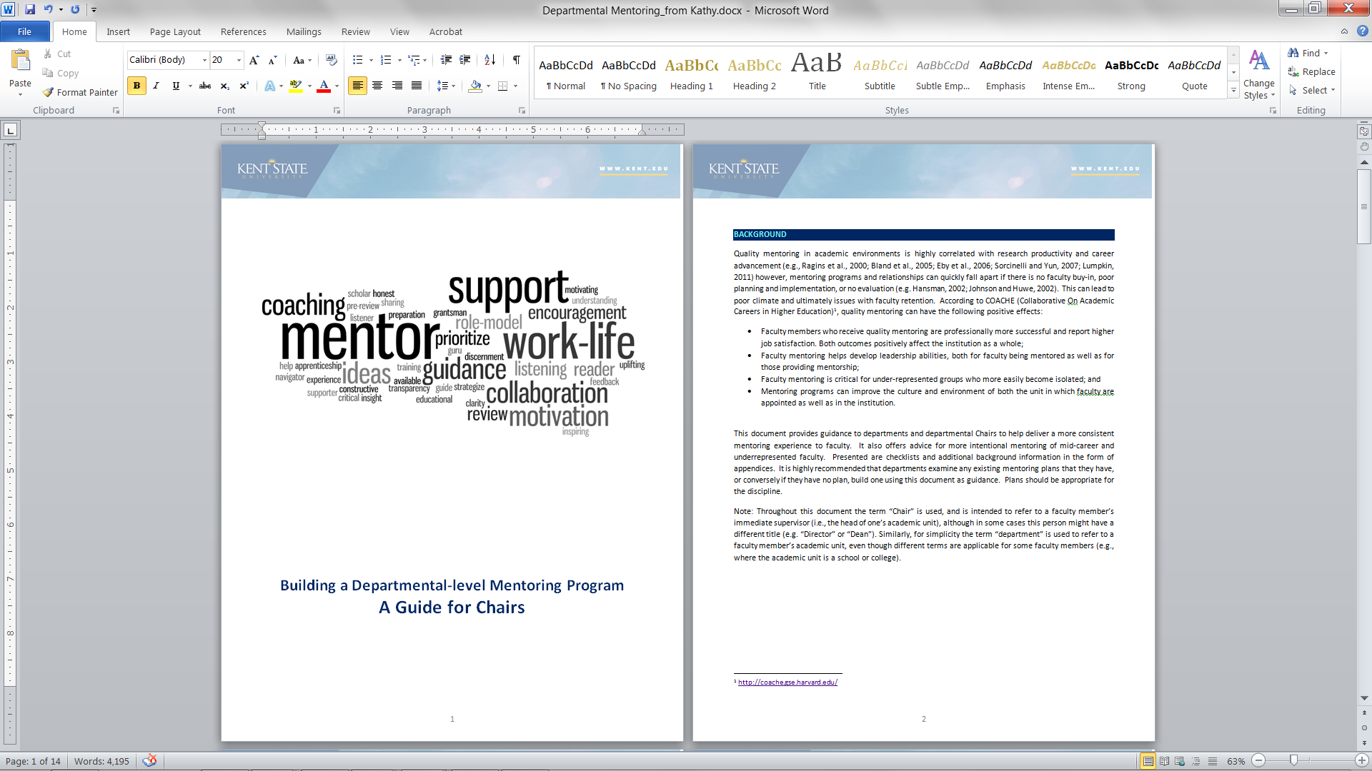
Unit level practices and support
Departmental mentoring programs built around COACHE best practices
Guidebook developed
Support for mentors developed

Slide 10
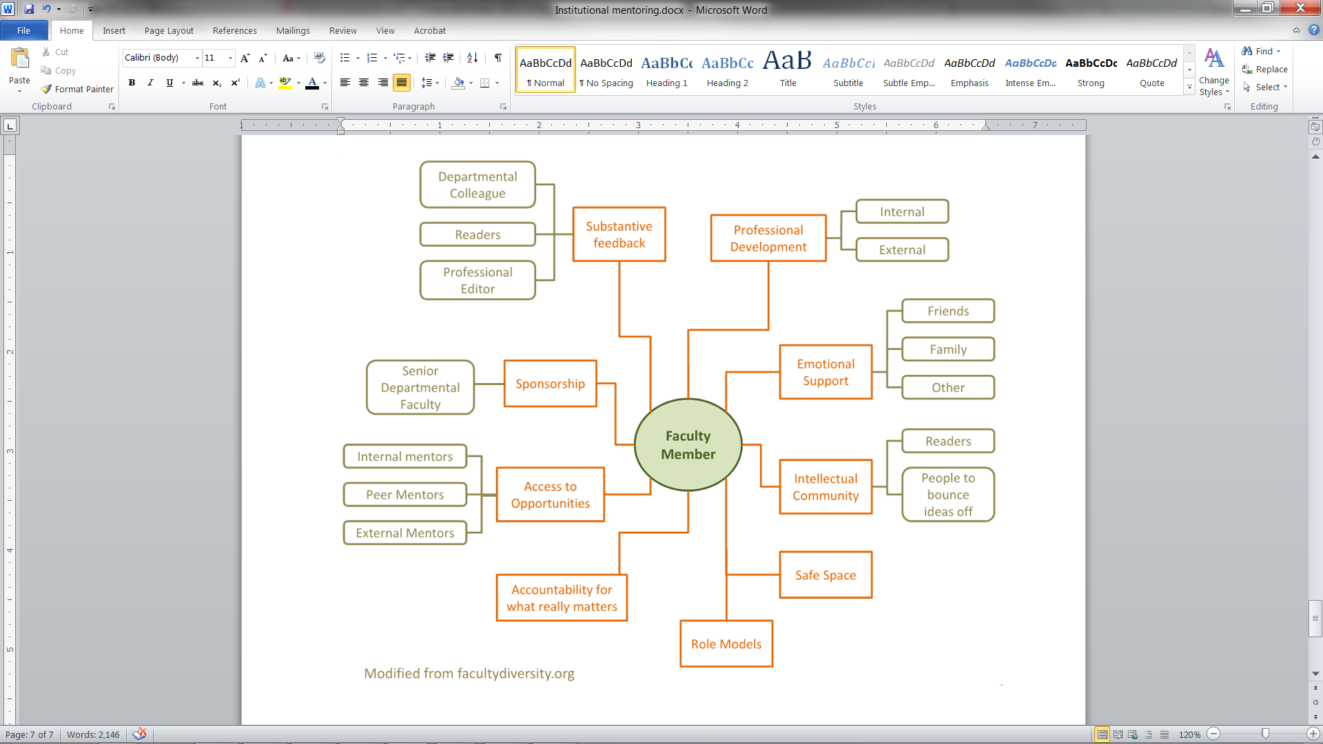
Practices focused on the individual
Personalized mentoring maps
Mentorship relationships

Slide 11
Moving Forward
Research on service loads of Associate Professor vs. Full Professor
Summer Academic Affairs retreat focused on faculty success
  Implicit bias awareness and stereotyping especially in the evaluation process
  Mentoring
Chairs Leadership Institute
2018 ADVANCE submission

