Slide 1

Gender Equity through Improved Work-Life Balance
Dr. William Morgan, Vice Provost
Dr. Cheryl Bracken, Associate Dean (Social Scientist)
Dr. Oya Tukel, Associate Dean (Change Agent)

Slide 2


Goals/Objectives of the Change Project:
Our ultimate goal is to improve the recruitment and retention of high quality STEM and other faculty who are attracted to our university because of its commitment to family friendly faculty policies as we have broadly defined them.

Slide 3

Taskforce on Family Friendly Faculty Policies Subcommittees
Tenure Extension (expanded in the 2017-2020 CBA)
Paternal leave, FMLA, and modified duties (clarified FMLA in 2017-2020 CBA)
Work/Life Balance (2017-2018 focused on Mentoring)

Slide 4

Year One and Two
Year 1 - Taskforce on Family Friendly Faculty Policies was charged with developing recommendations for innovative family friendly faculty policies.
Year 2 - Taskforce on Family Friendly Faculty Policies offered recommendations and implementation of recommendations begins

Slide 5
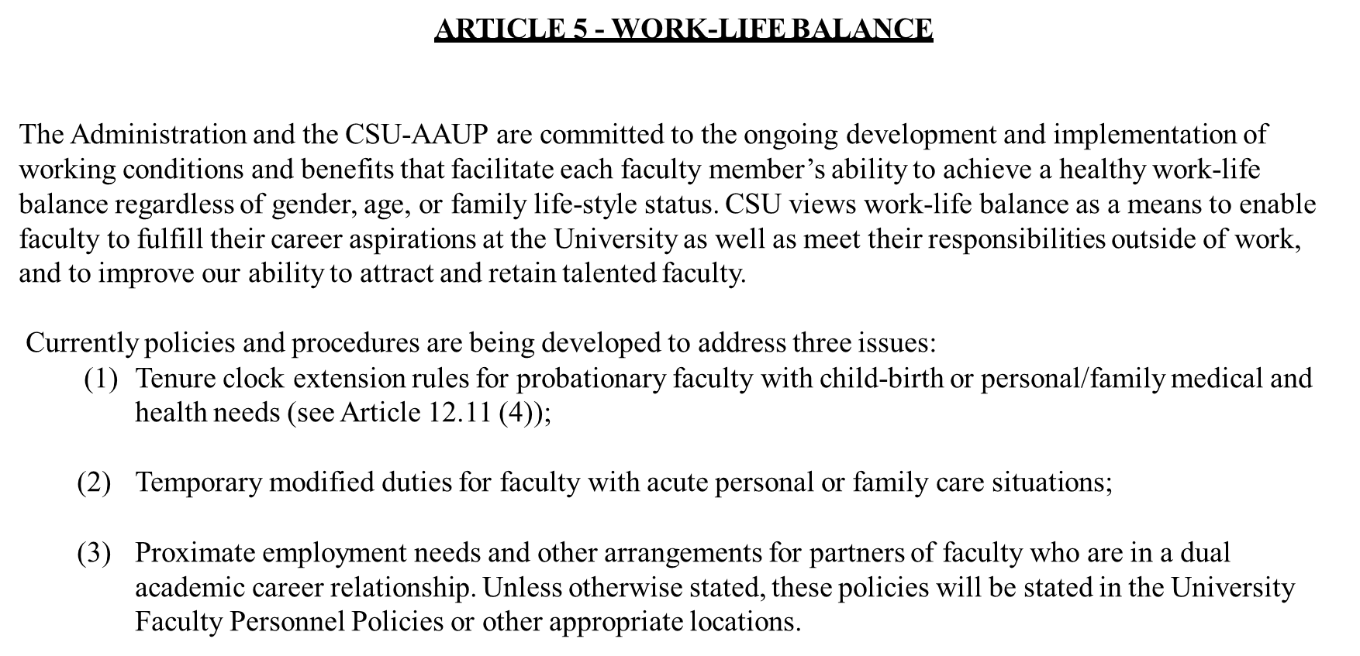
AAUP - Article 5
Work Life Balance

Slide 6

Year Three
Work/Life Balance = CSU Faculty Mentoring Program
Institutional Navigation:
Launch Committee
Socialization &
Confidential Communication
Speed Mentoring, Peer Coaching
Meeting Promotional Standards
eDossier Training

Slide 7
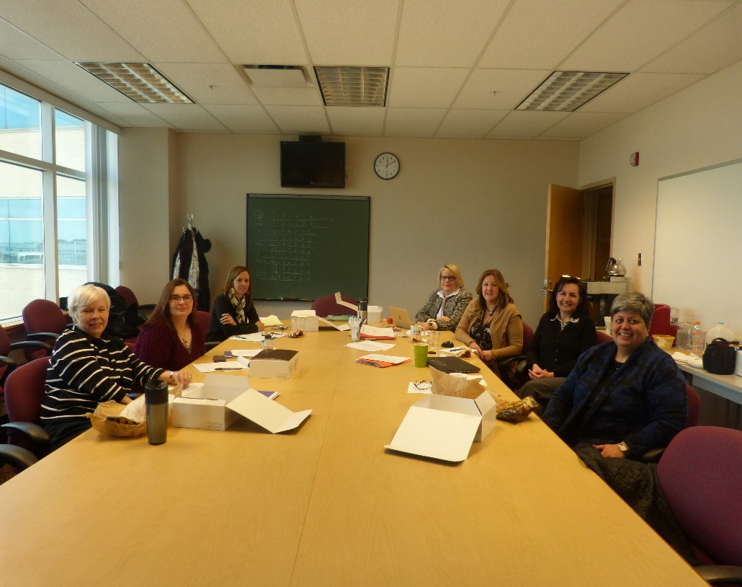
Create your own Mentoring Map
by Dr. Diana Bilimoria (2/5/2018)
Takeaways..
Most mentoring programs fail is that they are not well supported and organized
Should be adding to the mentoring and cultural norms of specific departments
Program management is ESSENTIAL!

Slide 8
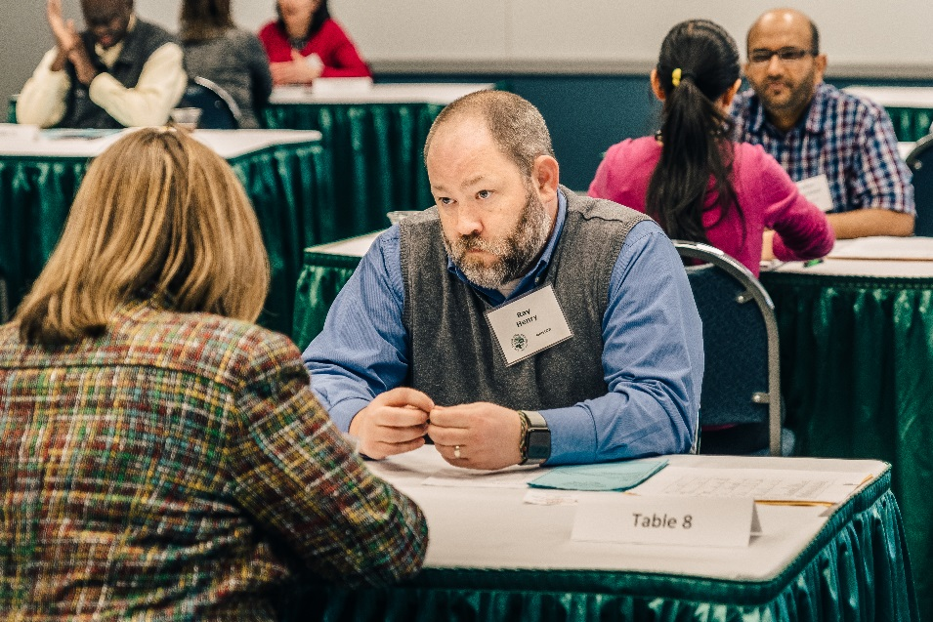
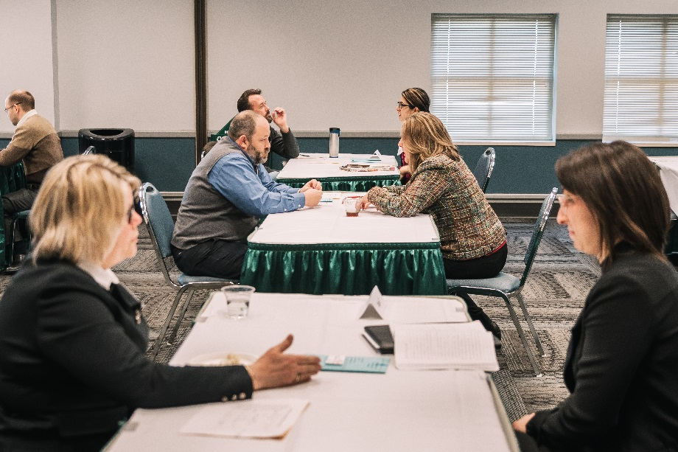
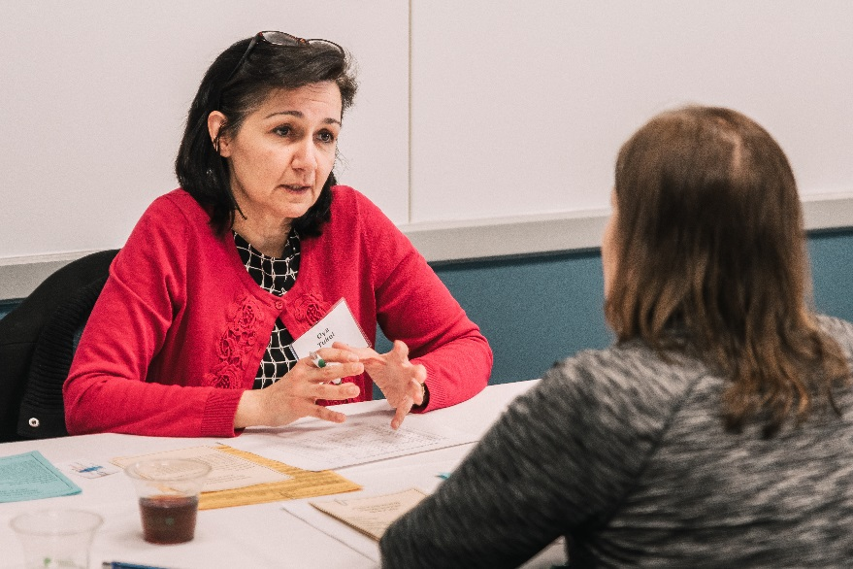
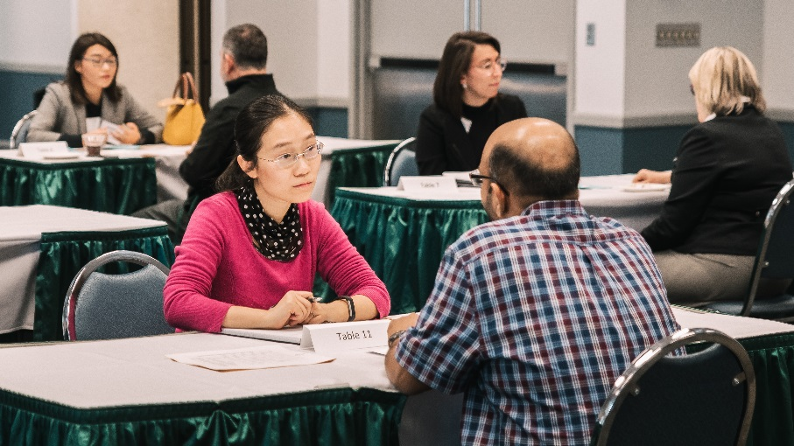
Speed Mentoring
March 22, 2018
Potential mentors meet mentees
Opportunity to connect
Relationships cannot be forced

Slide 9
Overall Attendees=24
 | Strongly Disagree | Disagree | Slightly Disagree | Neutral | Slightly Agree | Agree | Strongly Agree | n=
The atmosphere of the Speed Mentoring event was welcoming. | 0 | 0 | 0 | 0 | 0 | 6 | 13 | 19
 | Strongly Disagree | Disagree | Slightly Disagree | Neutral | Slighty Agree | Agree | Strongly Agree | n=
I felt comfortable interacting with other participants. | 0 | 0 | 0 | 0 | 0 | 6 | 13 | 19
 | Strongly Disagree | Disagree | Slightly Disagree | Neutral | Slightly Agree | Agree | Strongly Agree | n=
The majority of conversations were productive and helpful | 0 | 0 | 0 | 0 | 2 | 4 | 12 | 18
 | Strongly Disagree | Disagree | Slightly Disagree | Neutral | Slightly Agree | Agree | Strongly Agree | n=
The length of each “dating” conversation was appropriate. | 0 | 1 | 0 | 3 | 1 | 7 | 6 | 18
 |  | Mentor comment
 | Strongly Disagree | Disagree | Slightly Disagree | Neutral | Slightly Agree | Agree | Strongly Agree | n=
This was a constructive use of my time. | 0 | 0 | 0 | 2 | 2 | 2 | 13 | 19

Slide 10
Planned Activities
The Faculty Panel Discussion for Pre-Tenure Faculty April 19, 2018
My Career as a faculty member at CSU
What I needed to know but nobody told me

