Slide 1
NSF Perspectives on Current Challenges for Women and Minorities in STEM and Opportunities for Inclusive Excellence Tamera Schneider National Science Foundation Social Psychology Program Director tschneid@nsf.gov

Slide 2
The ADVANCE Model: Toward a Robust and Inclusive STEM Workforce
develop systemic approaches to increase the representation and advancement of women in academic STEM careers
develop innovative, sustainable pathways toward gender equity for men and women in the STEM academic workforce
contribute to the evidence base on gender equity and its intersection with other identities in STEM academic careers
Notes:
Social and behavioral research and organizational research provides evidence that the marginal representation and advancement of women and minorities in the STEM academy is often a function of external systemic factors, rather than the abilities, interests and technical skills of these left behind scholars. These systemic issues are predominately subtle and include exclusion from STEM partly due to biases in decision making, policies, practices, and reward systems, as well as the the culture and climate of the STEM research and education enterprise.
ADVANCE MODEL to address systemic issues
On top of these issues – there are societal influences as well such as on-going differential effects of work and family demands on women and men and the underrepresentation of women, especially women of color, in academic leadership and decision-making positions.
The great thing about the ADVANCE program is that it is focused on addressing these issues – which are harder to identify and harder to mitigate than overt biases and discrimination.
ADVANCE does not provide fellowships, research, or travel grants to individual students, postdocs, or faculty to pursue STEM degrees or research which are potential strategies for increasing participation and retention and should continue for those reasons – but more systemic approaches such as ADVANCE are also needed – given that we have had success in increasing the numbers of diverse individuals earning STEM degrees at all levels but these increases have not translating into those individuals gaining power within STEM in the form of tenure track positions that lead to full professorships and leadership positions that set the culture and climate of STEM education and research through policies and expectations.

Slide 3
Systemic & Organizational Change
ADVANCE addresses the systems and
organizations that drive access and success
Issues that impact equity:
Systemic and organizational change can evoke long-term change
Culture and climate
Work-life balance and career flexibility policies, programs, and usage
Salaries, start-up packages, access to resources
Institutional service allocations and requirements (committees, mentoring)
Accountability of STEM leadership, commitment to diversity
Recruitment, retention, tenure, and promotion policies and practices
Notes:
Org culture is a set of shared assumptions, values, and beliefs, that govern how people behave in organizations.
Many ways to change culture - A powerful, inspiring visionary at the top, or a large enough group within the organization - change vision, act differently and enlists others to do so. If the new actions produce better results, these results are communicated and celebrated, and if they are not shut down by the old guard then new norms and values will grow.
climate include aspects of the organization that are observed and felt by staff. Felt most keenly in localized units, departments, influence behavior, job performance, and job satisfaction (retention)
Ways to change climate – 1st understand it (survey); 2nd identify areas that are misaligned with mission and goals of organization; develop shared steps to address

Slide 4
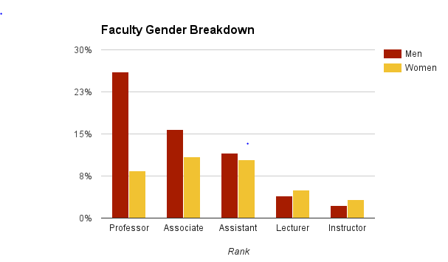
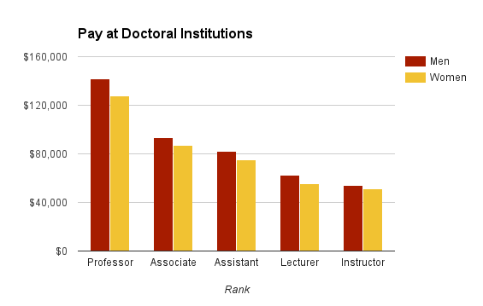
Equity (fairness, impartiality)
Issues may exist even if proportional representation is achieved
Pay gaps are one example of a gender equity issue in academics that persists, even with full participation of women
AAUP Faculty salary survey data U.S. doctoral institutions 2014-2015
Notes:
There are more women faculty than ever, underrepresented at the highest ranks but upward trend.
Gender inequities still persist, regardless of representation - e.g., pay gaps by gender within rank; one example of inequity that is likely the result of policies, procedures and practices within institutions of higher education
A Title IX review may identify this but not necessarily the reasons for the inequity which could be wide ranging; many reasons could be structural such as disproportionate teaching and service for women, inflexible work/family policies, difficult department or classroom climates, lack of transparency in tenure and promotion policies, and differences in starting compensation and start up practices.
Concl - while adding individuals from diverse groups is helpful, it’s not the same as equity. Inequity can exist even when you have proportional representation
http://www.aaup.org/reports-publications/2014-15salarysurvey

Slide 5
Many Influencers of Culture & Climate in STEM
IHEs are not the only organizations that impact gender equity in STEM academics
Professional societies
Publishers and editorial boards
Policy and research entities
State systems of higher education and legislation/funding
Industry
Advisory boards
Funding organizations and federal agencies
Faculty & Leaders
Social Science Research
HRM Title IX
Notes:
IHEs are not the only organizations that impact gender equity in STEM academics: STEM professional societies, publishers, industry, research and education funding agencies, etc.

Slide 6
Reach of ADVANCE Program and Strategies

Slide 7
NSF ADVANCE – Broad Reach
65 Institutional Transformation awards (~2% of all non-profit U.S. IHEs)
28% of very high research IHEs
Adaptation and Partnership awards to spread promising practices
99 additional non-profit U.S. IHEs
14 non-profit organizations (such as STEM professional societies)
Notes:
$270 M over 15 years
Portfolio:
3/2016: 159 different IHEs have had ADVANCE funding – Institutional Transformation (IT), IT-Catalyst, Leadership, PAID, PLAN (Collectively described as Adaptation and Partnership awards in the slide). + another 14 non-profit orgs including the National Academies.
Over 15 years the ADVANCE IT track (just one of three) has reached 1.8% of the IHEs in the U.S. and through the other tracks the program has reached 4.6% of the IHEs. (based on ~3,400 non-profit IHEs in the U.S. in 2010). 17% of the IT awards have gone to Minority serving institutions (HBCUs and HSIs).
Research Univs in US = 108 VH and ADVANCE has funded:
31 of the very high research institutions or 28.7%
Leads to peer institutional pressure effects where institutions take steps on their own to keep up with peer and aspirational institutions on areas of diversity
In addition, the movement of leadership between these and high research institutions brings ADVANCE to new locations. E.g., former President James Clement of West Virginia University (an ADVANCE IT awardee in 2010) moved to Clemson University in 2013 and has asked his faculty to develop an ADVANCE proposal and has articulated commitments and taken steps to enhance diversity within Clemson.
95% of IT projects experience PI turnover during the project - these PIs take ADVANCE with them to new institutions
Plus another 99 IHEs and 10 professional societies that are participating in the other ADVANCE program tracks (IT-Catalyst, Leadership, PAID, or PLAN) designed to adapt strategies to new contexts and settings or to disseminate promising practices, tools and materials to others or within a STEM discipline or to catalyze change within IHEs.
IDEAL-N is such a dissemination model

Slide 8
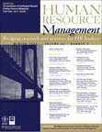
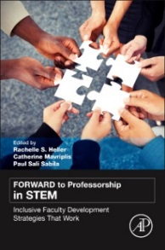
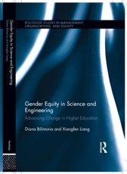
Organizational Strategies that Work
Improvement of Institutional Structures
Institutional data collection systems; Creating expectations for public reporting of data; Establish processes for using data in decision making; Review and revision of policies, practices, and processes (hiring, tenure, promotion and others) for transparency, clarity, and consistency
Equitable Career Support for Individuals
Formal mentoring programs; Faculty leadership development; Research network development; Policies to support faculty during life events and critical junctures; Checklists for start up packages for candidates
Empowerment of Individuals and Leaders
Training and awareness building of gender equity issues (implicit bias, micro-aggressions, stereotype threat); Creating tools and resources for faculty and leadership decision making; Creating accountability measures for decision makers; combating isolation and creating networks for women in STEM
Work Life Support Policies
Dual career offices and policies; flexible academic career policies; dependent care policies; other work-life balance programs; training for leadership on the implementation of these policies and programs
See also Strategies for Effecting Gender Equity and Institutional Change http://www.colorado.edu/eer/research/strategic.html
Notes:
In general, activities that have been shown to work fall into these general categories – Based on program office reviews of annual and final reports and what has been reported in the literature from ADVANCE grantees
See also Page 15-37 in 2012 Urban institute evaluation report where the models used by ADVANCE grantees is summarized.
The Strategies for Effecting Gender Equity and Institutional Change project was funded by NSF ADVANCE and does a good job of synthesizing what past ADVANCE grantees have implemented.

Slide 9
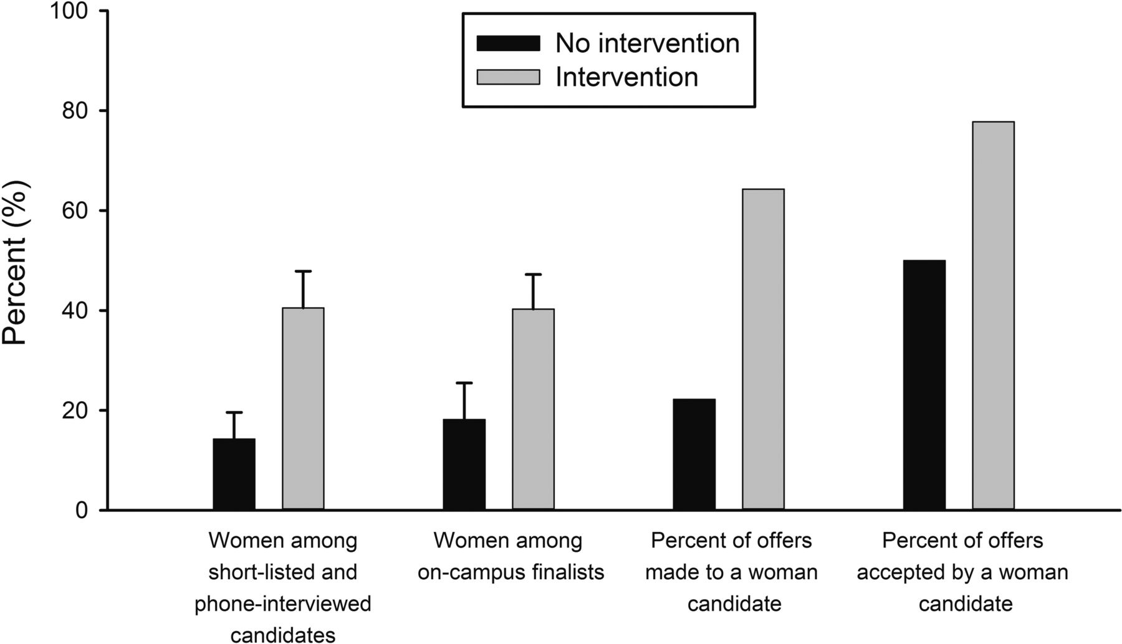
ADVANCE Institutional Transformation
Montana State University
Intervention with search committee chairs had impact on hiring of women compared to control search committees (total searches=23):
6.3 times more likely to make an offer to women
Women were 5.8 times more likely to accept an offer if made
The intervention was provided by a faculty peer:
Tip sheet and search toolkit overview
30 min overview of implicit biases
Discussion of work-life integration and suggestion to have candidates meet with a family advocate for 15 mins
Jessi L. Smith et al. BioScience 2015;65:1084-1087
Notes:
The study compared departments with faculty searches that were randomized to an intervention or a control (#searches =23). The intervention was held in small groups (3-6) of search committee chairs with a faculty peer providing: 1) a search toolkit and a “tip sheet” 2) a 20-30 minute overview of “unintentional” gender-bias research, including a copy of a scientific article, and 3) an introduction to the importance of work-life integration (e.g., partner, family, and recreational support) when recruiting candidates and a recommendation to the search chair that all on-campus interview candidates connect with a faculty Family Advocate for a 15-minute confidential meeting re: w-l integration practices at the university.
Compared to control group departments, intervention departments were 6.3 times more likely to make an offer to a woman candidate, and women who were made an offer were 5.8 times more likely to accept that offer.
Training by HR was also provided but had a primary emphasis on antidiscrimination, equal opportunity, and avoiding lawsuits. In contrast, our intervention offered an inclusive, multicultural, broadening-participation approach (Richeson and Nussbaum 2004) based in Self-Determination Theory (Deci and Ryan 2000).
no differences between intervention and no-intervention searches in mean #of women on the search committees, in the departments, or % of PhDs awarded nationally. Random assignment was effective.
11 women were extended offers for tenure-track faculty positions—9 in the intervention condition and 2 in the no-intervention condition. Odds ratio statistics showed that a search in the intervention condition was 6.3 times more likely to make an offer to a woman candidate than a search in the no-intervention condition (d = 0.93). women offered jobs were 5.8 times more likely to accept the offer from an intervention search (n = 7 accepted) than from a no-intervention search (n = 1 accepted) (d = 0.80). start dates in 2013-14 academic year (n=10 men and 10 women) and start dates in 2014-15 (n=9 men and 9 women hired).
http://www.montana.edu/opa/facultystaffindex/diversity/index.html
Montana State University ADVANCE IT award 1208831, PI Jessi Smith http://m.bioscience.oxfordjournals.org/content/early/2015/10/09/biosci.biv138.abstract

Slide 10
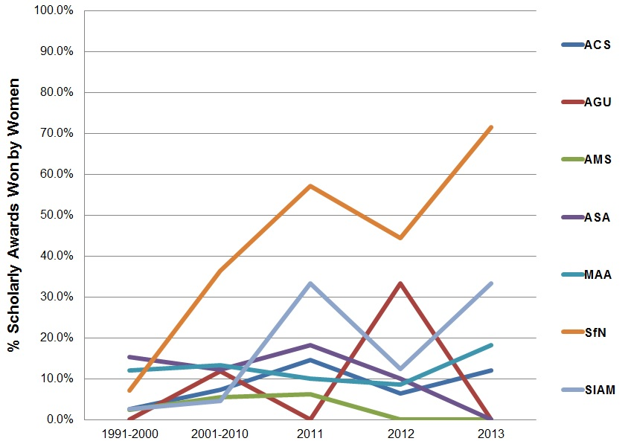
ADVANCE Disseminating Lessons Learned
The Association for Women in Science (2010) worked with 18 scientific societies to provide implicit bias training for awards committees and review award guidelines.
The societies that made changes to the language in their call for nominations and selection process have had increases in the percentage of awards made to women in those disciplines
Data from 7 societies working with AWIS for 3 years (www.AWIS.org)
Notes:
AWIS ADVANCE PAID Award 0930073; ACS: American Chemical Society AGU: American Geophysical Union AMS: American Mathematical Society ASA: American Statistical Association MAA: Mathematical Association of America SfN: Society for Neuroscience SIAM: Society for Industrial and Applied Mathematics
Erin L. Cadwalader , Joan M. Herbers , Alice B. Popejoy (2014), Disproportionate Awards for Women in Disciplinary Societies, in Vasilikie Demos , Catherine White Berheide , Marcia Texler Segal (ed.) Gender Transformation in the Academy (Advances in Gender Research, Volume 19) Emerald Group Publishing Limited, pp.243 – 263
Multiple factors contribute to the attrition of women from STEM. A lack of recognition for scholarly contributions is one piece of the puzzle. Awards are crucial not only for recognizing achievement and for making individuals feel that their contributions are valued. Awards for research are important for tenure and promotion in the academy.
AWIS transparency of awards processes; using gender-neutral language for solicitations and letters of recommendation, increasing the nomination and selection pools, clearly defining and discussing the types of achievements being sought and evaluated, including women on nomination and selection committees (particularly as committee chairs), and educating the committees about implicit bias; an increase in the transparency of awards processes leading to more equitable recognition since the project’s inception in 2010.

Slide 11
ADVANCE Tools
University of Washington LEAD-it-Yourself! (LiY!) toolkit (PAID 1310305)
Online open source toolkit that provides planning and instructional materials for leadership training workshops (train the trainers).
Builds on ADVANCE IT 0123552 and PAID 0619159
University of Wisconsin-Madison Bias Literacy workshop
Bias literacy workshop to educate STEMM (science, technology, engineering, mathematics, and medicine) faculty about implicit gender bias in academia (NIH WISELI, 2010). The “workshop in a box” contains everything needed for facilitators to implement a 2.5 hour workshop.
Builds on ADVANCE IT 0123666
Notes:
U of Washington prior ADVANCE awards:0123552 IT0545273 bio faculty 0619159 department chair training and PD for women
0819407 recruit industry women into academics - Sixty-seven women attended the On-Ramps workshops over three years: Computer Science (30%), Electrical Engineering (18%), Physics and Astronomy (15%), Chemistry (8%), and Biology (5%). 10 transitioned to academic careers – 2 more are in universities. 4 of these women are URM. On-ramping: following women scientists and engineers through their transition from nonacademic to faculty careers
The Journal of Technology Transfer, Coleen Carrigan, Katie O’Leary, Eve Riskin, Joyce Yen, Matt O’Donnell, pp 1-18 December 2015 New U of Washington award 1500310 with focus on engineering
WISELI References
Carnes, Molly; Patricia G. Devine; Carol Isaac; Linda Baier Manwell; Cecilia Ford; Angela Byars-Winston; Eve Fine; David Burke; and Jennifer Sheridan. 2012. “Promoting Institutional Change Through Bias Literacy.” Journal of Diversity in Higher Education. 5(2): 63-77. http://www.ncbi.nlm.nih.gov/pmc/articles/PMC3399596/
Carnes, Molly; Patricia G. Devine; Linda Baier Manwell; Angela Byars-Winston; Eve Fine; Cecilia E. Ford; Patrick Forscher; Carol Isaac; Anna Kaatz; Wairimu Magua; Mari Palta; and Jennifer Sheridan. 2015. “Effect of an Intervention to Break the Gender Bias Habit: A Cluster Randomized, Controlled Trial.” Academic Medicine. 90(2): 221-230.

Slide 12
International Interest in ADVANCE and Modeling
ADVANCE International Activities
Global Research Council - gender equity in STEM research was one of the agenda items for research funding agencies at the 2016 meeting
ADVANCE attended the Americas regional in preparation
ADVANCE invited to present at International Gender Summits
NSF was an observer on the European Union funded GENDER-NET 2015-2016
ADVANCE regularly asked to meet with State Department delegations of women in STEM
Adaption of the ADVANCE model
The EU Commission created a grant program to support institutional transformation in the EU in 2010
Notes:
The European Commission created an ADVANCE-like funding opportunity to support Institutional Transformation projects at EU institutions in 2010
One of these awards included: Trinity College Dublin in Ireland, Siauliai University in Lithuania, and the French National Center for Scientific Research (CNRS).
One of the key achievements at CNRS was the creation of a committee of senior researchers and decision-makers in recruitment and promotion processes at CNRS inspired from the STRIDE Committee created at the University of Michigan with their ADVANCE project.

Slide 13
ADVANCE Outcomes and Impacts

Slide 14
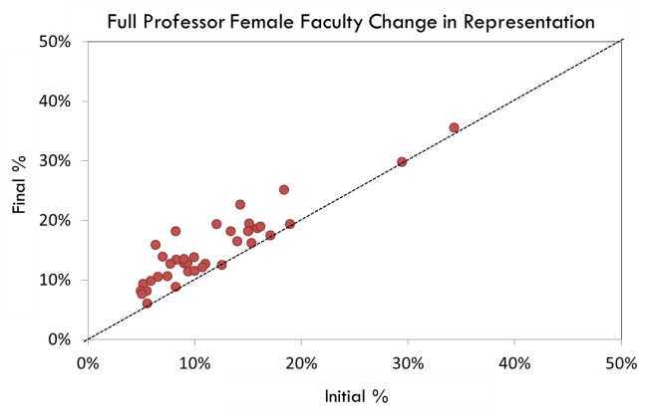
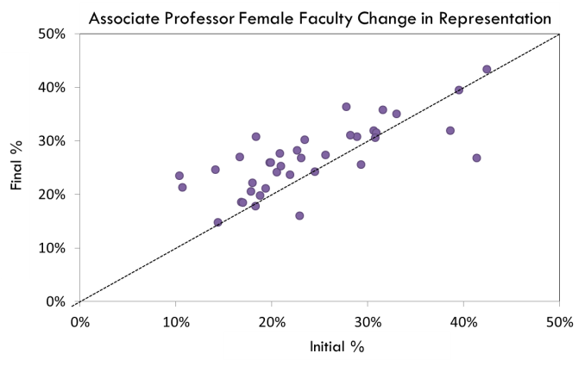
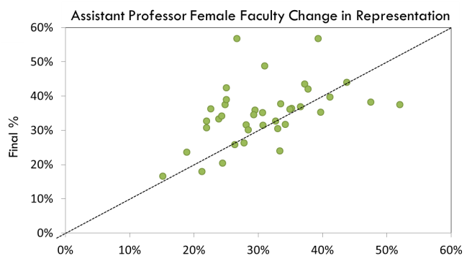
ADVANCE IT Institutions STEM Female Faculty
Total STEM Female Faculty Change in Representation
p < 0.001
Final % in total female faculty representation
** p = 0.003
p < 0.001
Initial % in total female faculty representation
ADVANCE IT Institutions Cohorts 1-4 (n=41)
* p = 0.01
Notes:
Slide 4/28/14; Updated 5/9/14; self reported data from annual, final reports from ADVANCE IT grantees. Analysis by AAAS Fellow Roccio Benabentos 2014-2015.
Being above the line means that the percent women in STEM academics at the end of the project was higher than when the project started being on the line means there was no change – noting of course that IT was never about numbers it was about INSTITUTIONAL CHANGE but everyone asks about numbers – the problem is that we do not know if this is representative of trends for other institutions without ADVANCE IT projects and it does not contain information on State hiring freezes or hiring pushes that happened over the course of IT grants. In addition, there appears to be variation in the change by tenure rank where there was more success at the full professor rank which actually fits with the stated goals of the first several cohorts of IT awards (Data is disaggregated by rank in graphs on side of slide)

Slide 15
Indicators of Organizational Transformation
Changes in Policy Areas Addressed by ADVANCE IT Institutions
Policy Area | Institutions that Addressed Policy Area (%) | Institutions that Indicated Positive Change (%)
Recruitment | 90 | 84
Hiring | 95 | 84
Research Support | 79 | 58
Tenure Criteria | 90 | 58
Standards for Promotion to Full Professor | 79 | 58
Work Life Balance | 79 | 68
Notes:
From a 2012 Program evaluation by Westat – not published or released by NSF
interpretation of existing regulations and laws; often doesn’t require new policy, just reinterpretation of existing policy.

Slide 16
Indicators of Organizational Transformation
Area of Accomplishment | Accomplishment | Description
STEM Women’s Representation | 49% increase in women STEM faculty | The percentage of women among STEM faculty increased by 49% between 2001 and 2008 (from 16% to 24% of faculty). Compared to 24% increase over same time period in comparison group (from 22% to 27% of faculty).
STEM Hiring | 40% increase in new women STEM hires | The percentage of women among new STEM hires increased by 40% in the first six years of the grant (from 25% to 35% of new hires).
Women in Leadership | 64% increase in STEM women in leadership | The percentage of STEM women serving in leadership positions increased by 64% between 2001 and 2008 (from 10% to 16% of leadership).
.
Notes:
From a 2012 Program evaluation by Westat – not published or released by NSF
For top block – compared to 24% increase over same time period in “SDR” comparison group – removed SDR because I don’t know what that means

Slide 17
Indicators of Organizational Transformation
Area of Accomplishment | Accomplishment | Description
Publications | 146 peer reviewed publications | The first cohorts of ADVANCE institutions are responsible for producing 146 peer reviewed publications on STEM gender equity and institutional transformation.
Presentations | 581 professional presentations | Over 500 professional presentations were delivered on gender equity and institutional transformation at national/international scientific meetings.
Research Support | 90% allocated research facilities and resources | 90% of the first cohort of ADVANCE institutions (up from 26%), allocated facilities and resources to equity/diversity related functions after the life of the grant.
Strategic Planning | 79% inclusion of gender in strategic plans | 79% of the first ADVANCE cohorts (up from 22%), incorporated equity/diversity objectives into their strategic plans
.
Notes:
From a 2012 Program evaluation by Westat – not published or released by NSF

Slide 18
Indicators of Organizational Transformation Culture and Climate Metrics
Deteriorated Somewhat
70
Little or No Change
64
Improved Somewhat
Improved Considerable
50
47
44
44
Percent of Institutions
31
31
33
30
30
25
24
20
20
15
Data collected by the WESTAT program evaluation of ADVANCE 2012 when available from the first ADVANCE IT awardee institutions (so the n is <19).
6
6
6
0
0
0
0
0
Overall
Satisfaction
(n=16)
Overall
Collegiality
(n=17)
Women Satisfaction w/Jobs and Career
(n=16)
Men Satisfaction w/Jobs and Career
(n=16)
Women Ties w/ Other STEM Faculty in the Institution
(n=17)
Women Ties w/ Other STEM Faculty Outside the Institution
(n=15)
Notes:
From a 2012 Program evaluation by Westat – not published

Slide 19
Areas for further research and understanding

Slide 20
Areas for Further Research and Understanding
Strategies focused on the intersection of gender, race and ethnicity, disability, LGBTQ, foreign born, foreign trained, etc. have not been developed.
What does the transition to relying on non-tenure track faculty for teaching mean for gender equity in academics?
How can we measure and evaluate systemic change?
What are the metrics to measure organizational change in relation to gender equity if it is not just counting individual women in STEM academics?
How do State policies and economic issues impact systemic change efforts?
Notes:
Strategies focused on the unique situation of women with multiple identities (gender, race and ethnicity, disability, LGBTQ, foreign born, foreign trained, etc.) have not yet fully been developed.
Barriers to gender equity may not be identical for all groups of women faculty in science, technology, engineering, and mathematics (STEM) disciplines, however. For example, African-American women, Hispanic/Latina women, and Native American women are underrepresented as tenured and tenure-track faculty in STEM disciplines compared to white women, and the challenges to recruitment, retention, and advancement may not be the same for these groups of women.

Slide 21
Persistent Issues Impacting Equity in STEM Academics
Lack of understanding of intersectionality
Not all women have the same experiences in the same institution
Gender may not be the most influential in any given situation
Interventions “for women” may not be effective for women of color etc.
Lack of awareness of Title IX protections in STEM
Pregnancy discrimination - STEM faculty and leaders are giving bad advice because they do not know the rules & programs
Joan Williams and Mary Ann Mason http://www.toolsforchangeinstem.org/
On-going explicit bias and sexual harassment
Inadequate systems to discourage and stop it or to deal with it after it happens
The power structure of senior faculty, advisors, and mentors in STEM academics inhibits complaints
Notes:
J. Jovanovic & M. Armstrong a study of the attentiveness of ADVANCE grants to issues of women of color in STEM academics (1207250).
-there is increasing recognition that ADVANCE programs and initiatives designed to support women have not been intersectional in perspective despite evidence that the active intersection of gender and racial/ethnic identity affects the experience of underrepresented minority women in STEM.
This results in policies, programs, and practices that address the disadvantaging effects of different identities (being a women, or being a Latina, or being a Lesbian, etc.) but do not address the issues faced by women at the intersection of multiple identities. These interventions end up not being effective because identities are not experienced independently but simultaneously.
“…efforts at increasing the low numbers of URM women in STEM are paradoxically impeded by the low numbers of URM women in STEM.” Challenges such as identifying and dealing with all the various “climate zones” within the institutions that women faculty of color find themselves (departments, research groups, classrooms, committees, etc.) and are different for different identities (black faculty and Latina faculty will have different experiences in the same climate zone). Each of these “zones” may require the development of different strategies which becomes a daunting challenge even for the most committed. (Mary A. Armstrong, 2015)
A study on scientists and engineers who were women of color J. Williams (1106411). to determine if factors identified in social psychology studies of gender bias existed in STEM academic work settings. The research included interviews of sixty women of color in STEM academics and found that 100% of the women had experienced at least one of four patterns of gender bias:
Prove-It-Again: Women have to provide more evidence of competence than men in order to be seen equally as competent.
The Tightrope: Women find themselves walking a tightrope between being seen as too feminine to be competent and too masculine to be likeable.
The Maternal Wall: Assumption that women lose their work commitment and competence after they have children and stereotypes that penalizes mothers when they remain committed to work.
Tug of War: Women and men are biased against women in traditional masculine fields and distance themselves from women if they have experienced bias themselves.
The study included Latinas, Asian Americans, and African American women which allowed the researchers to identify differences in experienced bias between women of different races. (Williams, 2014). Another indicator that the issues facing women of color are very complex and require additional attention when designing interventions to encourage participation in STEM and to support their success in STEM.

Slide 22
ADVANCE Grant Types NSF 16-594
Institutional Transformation (IT)
Develop, implement, and study innovative organizational change strategies to foster gender equity
Adaptation
Adapt proven organizational gender equity strategies
Partnership
Scale-up proven systemic gender equity strategies for national or regional impact
Single IHE that has not had IT before (all STEM)
Up to $3M over five years
Single IHE that has not had IT before (all STEM) or
Two or more partner orgs.
Up to $1M over 3-5 years
One or more disciplines
Up to $1M over three years
Single non-profit org. (one or more disciplines)
Preliminary proposal April 12, 2017* (required)
LOI Aug. 9, 2017* (required)
LOI Dec. 14, 2016* (required)
Proposal Jan. 11, 2017*
Proposal Sept. 13, 2017*
Proposal (if invited after preliminary) Jan. 17, 2018*
*These deadlines will recur every other year until the solicitation is replaced.
Notes:
All projects are expected to build on prior ADVANCE work and gender equity research to broaden the implementation of organizational and systemic strategies to foster gender equity in STEM academic careers.
All ADVANCE proposals are expected to recognize that gender does not exist in isolation from other characteristics, such as race/ethnicity, disability status, sexual orientation, foreign-born and foreign-trained status, faculty appointment type, etc., and should offer strategies to promote gender equity for all
Faculty (intersectionality)
The Institutional Transformation (IT) track supports the development of innovative organizational change strategies to produce comprehensive change within one institution of higher education across all STEM disciplines. IT projects are also expected to contribute new research on gender equity in STEM academics. Projects that do not propose innovative strategies may be more appropriate for the Adaptation track.
The Adaptation track supports the adaptation and implementation of evidence-based organizational change strategies, ideally from among those developed and implemented by ADVANCE projects. Adaptation awards may support the adaptation and implementation of proven organizational change strategies within an IHE that has not had an ADVANCE IT award, including two-year institutions, predominantly undergraduate institutions, master’s level institutions, and Minority-Serving Institutions. Adaptation awards may also be made to a STEM organization to implement systemic change strategies focused across all STEM disciplines, several STEM disciplines, or within one STEM discipline.
For all proposals, ADVANCE is interested in supporting a range of institution types including: community colleges, primarily undergraduate institutions, minority-serving institutions (e.g. Tribal Colleges and Universities, Historically Black Colleges and Universities, Hispanic-Serving Institutions, Native Hawaiian Serving Institutions, Alaska Native Institutions, Predominantly Black Institutions and Non-tribal, Native American Serving Institutions), women's colleges, institutions primarily serving persons with disabilities, and master’s level institutions.

Slide 23
Best and Promising Practices

Slide 24
Best Practices across the U.S. Federal Context
Analyses of Mandated Workforce Data Sets
Federal Viewpoint Survey, Federal Equal Opportunity Recruitment Plan, EEO status report, Complaints
Workplace climate assessments, reach hiring goals, compared over time for opportunities
Implicit Bias Training
Most include mandatory training for supervisors and managers
Online, informational briefings, workshops, in-class training
Conflict Resolution
Fair, effective, and accessible (Anti-Harassment Program (AHP) at NASA
Lowers # of formal complaints; disputes resolved at an early stage
Work Flexibility
Leadership proactivity matters; collect input about options, conditions for their use, potential impacts on performance assessments
Reducing the Impact of Bias in the STEM Workforce, Interagency Policy Group, Nov., 2016

Slide 25
Promising Practices across the U.S. Federal Context
Diversity Change Agents
Understand nature of bias, provide training to others
Diversity Toolkits
Themes: Informing employees of rights and responsibilities, leadership commitment, attracting top talent, cultivating excellence, teamwork and innovation, serving the American people, advancing STEM
Technical Qualifications Boards
Establish criteria before review and address those criteria then bias is reduced
Promotions and research positions
Proposal Review Experiments
Recruit diverse faculty as reviewers
Virtual panels, reviewer orientation
Reducing the Impact of Bias in the STEM Workforce, Interagency Policy Group, Nov., 2016

Slide 26
Thank you tschneid@nsf.gov

