Slide 1
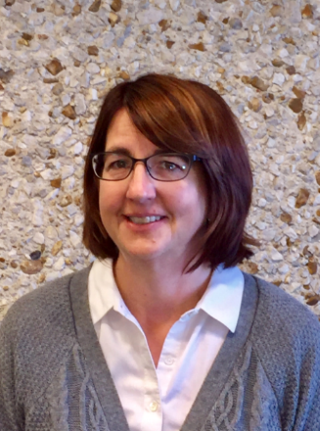
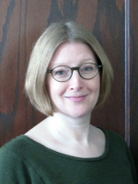
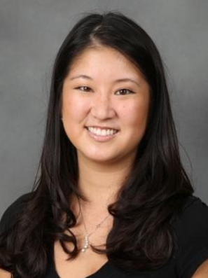
Building Bridges:
Creating Connections for the Next Generation of Faculty Leaders
Bowling Green State University
Dr. Julie Matuga
Vice Provost for Institutional Effectiveness
Co-Director
Dr. Peg Yacobucci
Professor of Geology
Change Leader
Dr. Lisa Hanasono
Associate Professor of Communication
Social Scientist
Dr. Sheila Roberts
Vice Provost of Academic Affairs
Provost’s Office
Notes:
Lisa

Slide 2
Building Bridges
Develop a supportive network of current and future faculty leaders to:
Advance the careers of post-tenure women and URM faculty
Create a cohort of institutional change agents.
Notes:
Lisa

Slide 3
Overview
Challenges
Sustainable Solutions
Looking Ahead
Notes:
Lisa

Slide 4
I. Challenges
Secret Service
= Service activities that remain largely invisible, unrewarded, and taken-for-granted by institutions and institutional members
Relationally oriented, qualitatively rich, and collaborative
Disproportionately affects women and faculty of color
Hanasono, L. K., Broido, E. M., Yacobucci, M. M., Root, K. V., Peña, S., & O’Neil, D. A. (in press). Secret service: Revealing gender biases in the visibility and value of faculty service. Journal of Diversity in Higher Education.
Notes:
Lisa

Slide 5
I. Challenges
(Re)Negotiating Identities
“Going to the Dark Side”
Need to build bridges between faculty and administrators
Faculty Survey Results (N = 388)
Identifying with administrators was predictive of faculty members’ intention to pursue a leadership position, Wald statistic = 6.93, β= 1.55, p = .008.
Notes:
Lisa

Slide 6
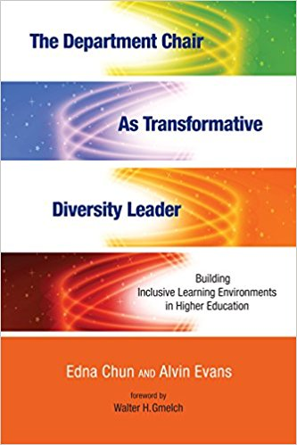
II. Sustainable Solutions
2017-18: Institutional and Structural Change
Inclusive Leadership Training
January Retreat & Ongoing Training for Chairs and Directors
Webinar and Book Discussions on Strategic Diversity Leadership for Chairs, Directors, and Deans
Developing Clear and Measurable Diversity/Inclusion Plans for each Academic Unit
Articulates measurable goals and benchmarks related to diversity and inclusion
Launched a Formal Climate Survey for all BGSU Faculty
MAC Academic Leadership Program
Notes:
Julie

Slide 7
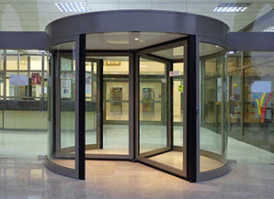
II.a. Sustainable Solutions: Metrics
Turnover Quotient (TQ)
TQ=[1-(end period URM-beginning period URM)/New URM Hires] *100
Moreno, J.F. et al. (2006). The Revolving Door for Underrepresented Minority Faculty: An Analysis from the Campus Diversity Initiative. Claremont, CA: The James Irvine Foundation Campus Diversity Project.
Notes:
Julie

Slide 8
II.a. Sustainable Solutions: Metrics
Turnover Quotient: BGSU NSF Faculty (2015-2017)
Notes:
Julie

Slide 9
II.a. Sustainable Solutions: Metrics
Turnover Quotient: BGSU NSF Faculty Administrators (FAD) and Faculty (2015-2017)
Notes:
Julie

Slide 10
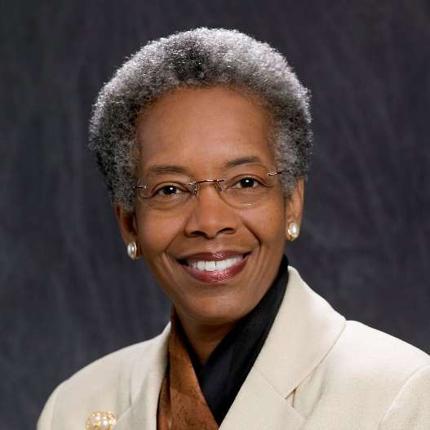
II. Sustainable Solutions
2017-18: Interpersonal and Individual Change
Leadership Breakfast for Women Faculty (n=48)
Dr. Saundra Yancy MacGuire’s Presentation on Self-Mentoring
Building Networks: Mentoring Maps Exercise
National Center for Faculty Development and Diversity (NCFDD)
FDD Learning Community and Professional Development Workshops
Sponsoring Women to Complete the Faculty Success Program
Writing Circles and Research Support Groups
NCFDD Webinar Screenings and Discussion Session with Univ. Toledo
Beginning to Develop a University-wide Mentoring Program
Notes:
Lisa

Slide 11
III. Looking Ahead
Analyze Data: Faculty Climate Survey and Metrics (Turnover Quotient)
Identifying strengths and areas for improvement
Work with administrators and leaders to use the survey results to take action
Present and Publish Social Scientific Research on Faculty Leadership, Secret Service, and the “Dark Side”
Continue to Pursue and Support Sustainable Solutions
Notes:
Lisa

