Slide 1
Institutions Developing Excellence in Academic Leadership-National (IDEAL-N) Annual Plenary April 6, 2018

Slide 2
IUP’s Change Implementation Team
Dr. Deanne Snavely, Co-PI
Dr. Laura Delbrugge, Co-Director
Dr. Tara Johnson, Social Scientist
Dr. Edel Reilly, Change Leader

Slide 3
IUP Transformation Theme
Recruit, support, and advance faculty by providing opportunities for professional development and smooth transitions creating a natural sciences and math community that embraces diversity and inclusion.

Slide 4
Goals of the 2017-18 Change Project
Host a campus-wide event to publicize the IDEAL-N project, especially for women and URM students and faculty in STEM departments.
Administer a survey to all NSF-defined STEM faculty on campus, with a special focus on women and URM, to better understand current perceptions of barriers and opportunities for promotion at IUP.

Slide 5
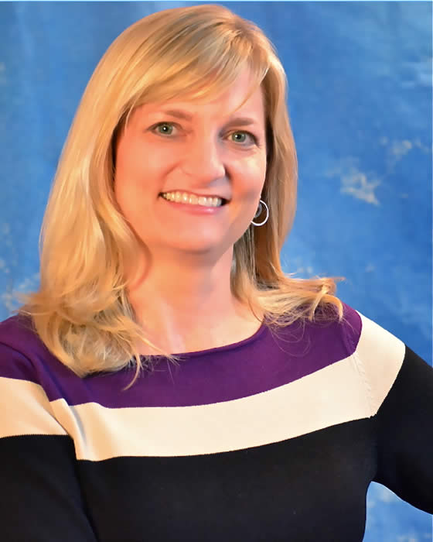
Presentation by Dr. Susan Hinze
On November 2, 2017 the IUP IDEAL-N grant team hosted Dr. Susan Hinze. Dr. Hinze met with the Women in STEM student leadership group and also gave a well-attended public lecture titled “Pathways to STEM Leadership.”
Dr. Susan Hinze

Slide 6
Survey on Perceptions of Promotion and Leadership at IUP
1. Are there gender differences in perceived barriers and avenues to promotion among STEM faculty?
2. Are there gender differences among STEM faculty in leadership positions held or available and their perceptions of those leadership roles?

Slide 7
Administration of Survey
The team carefully designed a survey, obtained IRB approval, publicized the survey, and then administered it. The survey was open from March 5 to March 23, 2018.

Slide 8
Lessons Learned
Good questions are hard to write
Respondent reactions
Issues with gender

Slide 9
Respondent Reactions
Concerns about confidentiality
—Dean of College of Natural Sciences and Mathematics is a member of IUP’s IDEAL-N team
2. Senior male colleagues questioned the structure and content of the survey
“How did this get through IRB?”
Concerns about demographics and content

Slide 10
Issues with Gender
We received immediate feedback on language regarding gender.
Survey: “Man/ Woman/ Transgender/ Other/ Prefer not to say”
Alternative suggested wording: “Man/ Woman/ Non-binary or third gender/ Prefer to self-describe/ Prefer not to say”
Human Rights Council provides inclusive survey language at www.hrc.org.

Slide 11
Goals of 2018-2019 Change Project
Analyze and disseminate results of survey
Determine essential issues and formulate best approaches to solve them, including making recommendations to Administration
Offer workshops and/or campus-wide lectures as appropriate to facilitate solutions to identified issues

Slide 12
Thank you!

