Slide 1
IDEAL-N CMU Progress report
Diana Marculescu
Change Leader, Center for Faculty Success Director & Professor of Electrical and Computer Engineering (dianam@cmu.edu)
with Kathryn Roeder, Vice-Provost for Faculty Affairs & Professor of Statistics (co-Director) and Karen Clay, Professor of Economics and Public Policy (Social Scientist)
Notes:
Main title: 40 pt. Arial
Presenter Name: 16 pt. Arial
Presenters Title: 16 pt. Arial Italic

Slide 2
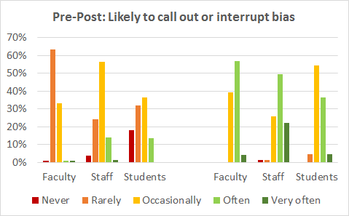
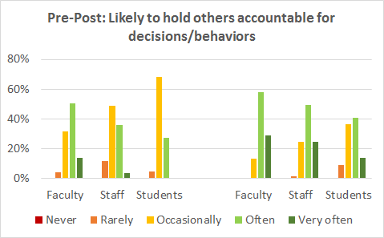
Current CMU activities: three-prong approach
Build on top of our last year activities on mitigating unconscious bias in decision making (search committees/promotion & tenure/etc.)
Family-friendly policies
Women faculty input gathering forums
New Presidential Postdoctoral Fellowship Program (PPFP)
Next steps:
Accelerate data collection for identifying barriers specific to CMU women faculty
STEM women faculty retreat
Gamification for increased awareness and mitigation for unconscious bias

Slide 3
How can we support faculty in achieving family-work balance?
The CMU CareLink Project
Led by Lorrie Cranor, Professor of Computer Science and Engineering and Public Policy
lorrie@cs.cmu.edu

Slide 4
Tutoring. Odd jobs. Proofreading. Music lessons. Technology help. Child care. Pet care. Lawn care. And more.

Slide 5
Development of CareLink at CMU
Faculty diversity committee discussed need to help connect members of the CMU community interested in finding and providing child care and other services
Harvard already has a portal that they hired a firm to develop, willing to let us use their software
We hired the firm to adapt the Harvard software for our use and maintain our system, hosted by a third-party cloud hosting company
We distributed flyers, campus-wide emails, posters, bookmarks, etc. beginning in August

Slide 6
For the CMU community
CareLink is open to all Pittsburgh-based CMU students, faculty, staff, and people with sponsored CMU computer accounts
Users can also create affiliated accounts for family and friends to allow them to post resumes, but not view other peoples’ profiles
Just starting to expand to local alumni

Slide 7
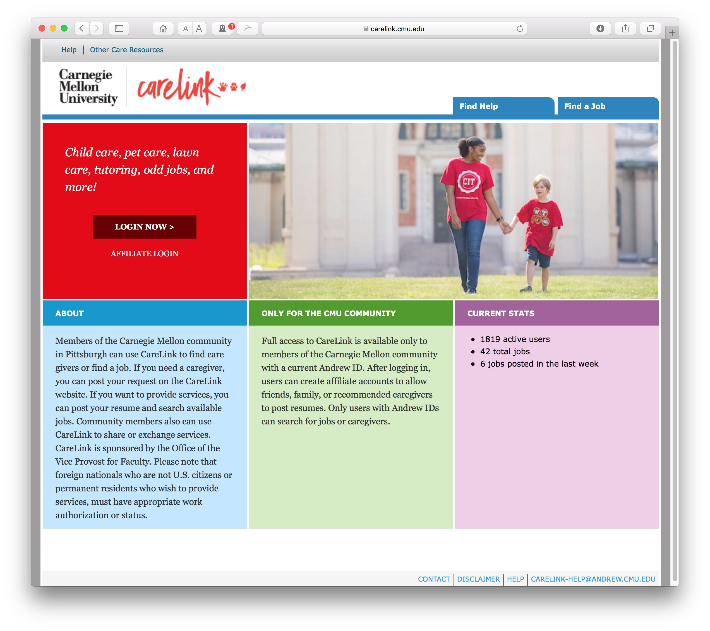

Slide 8
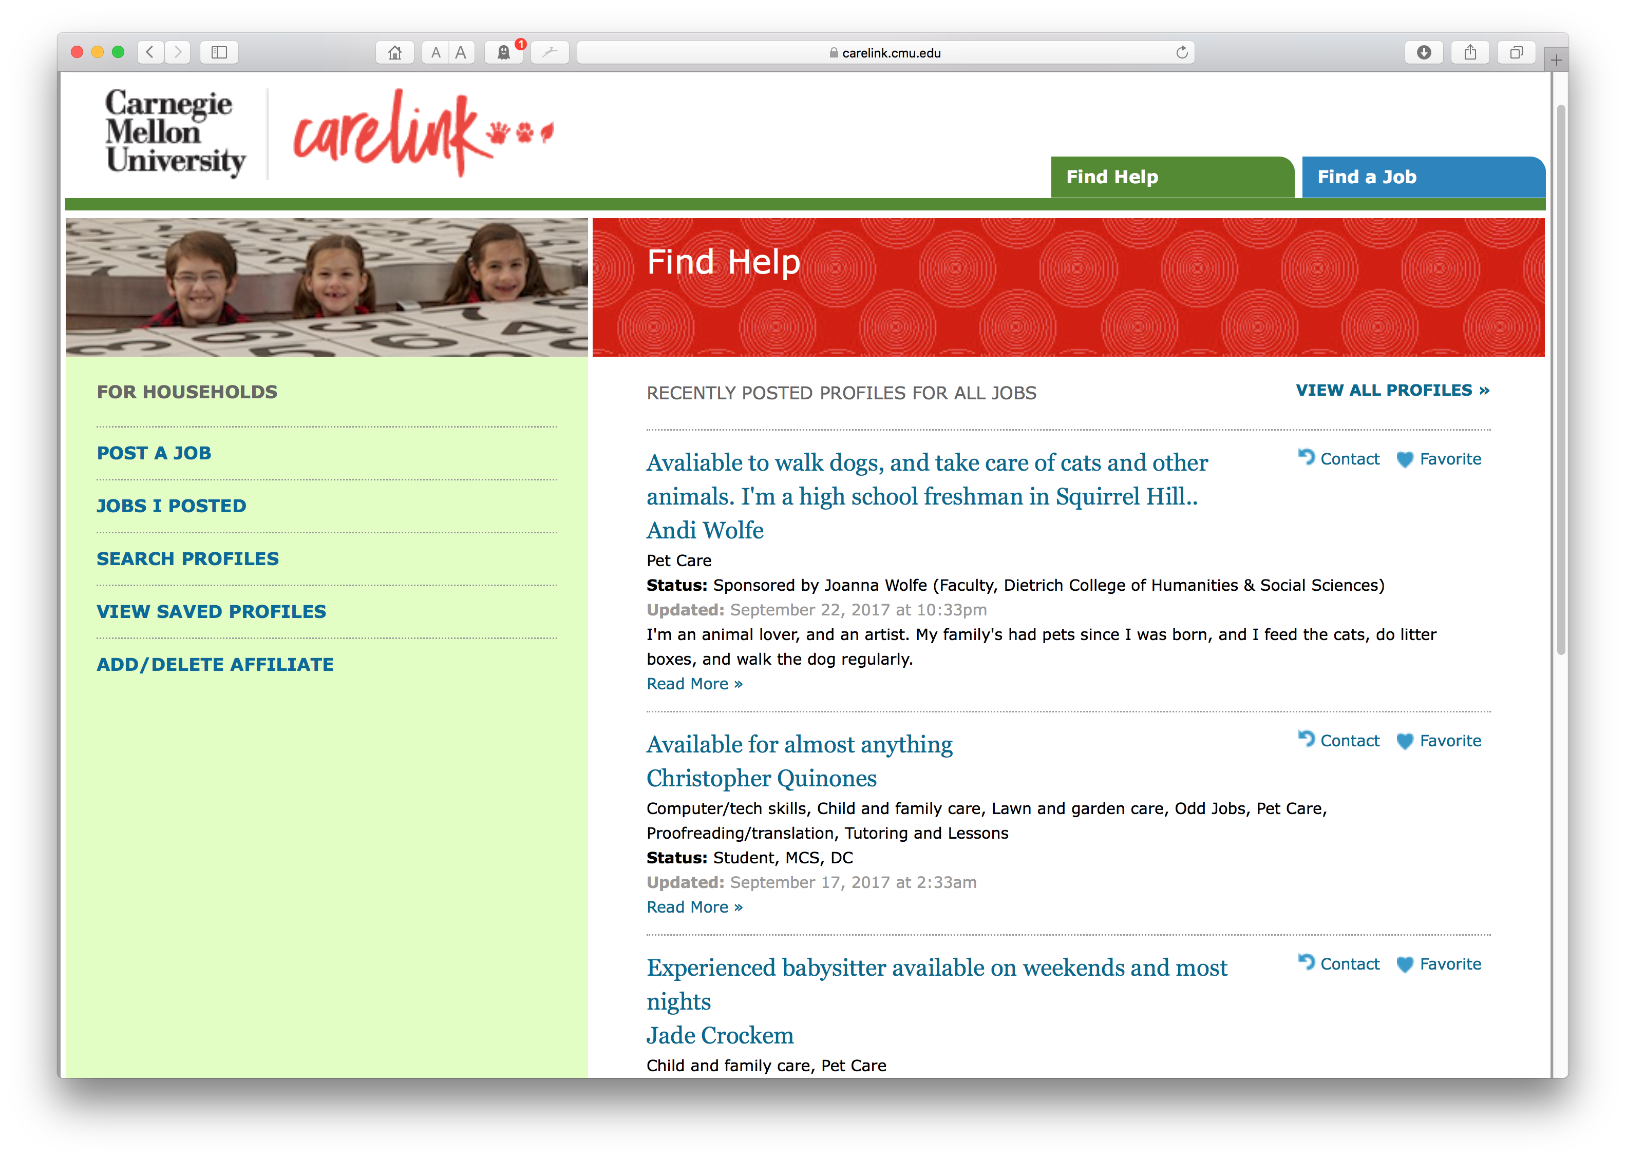

Slide 9
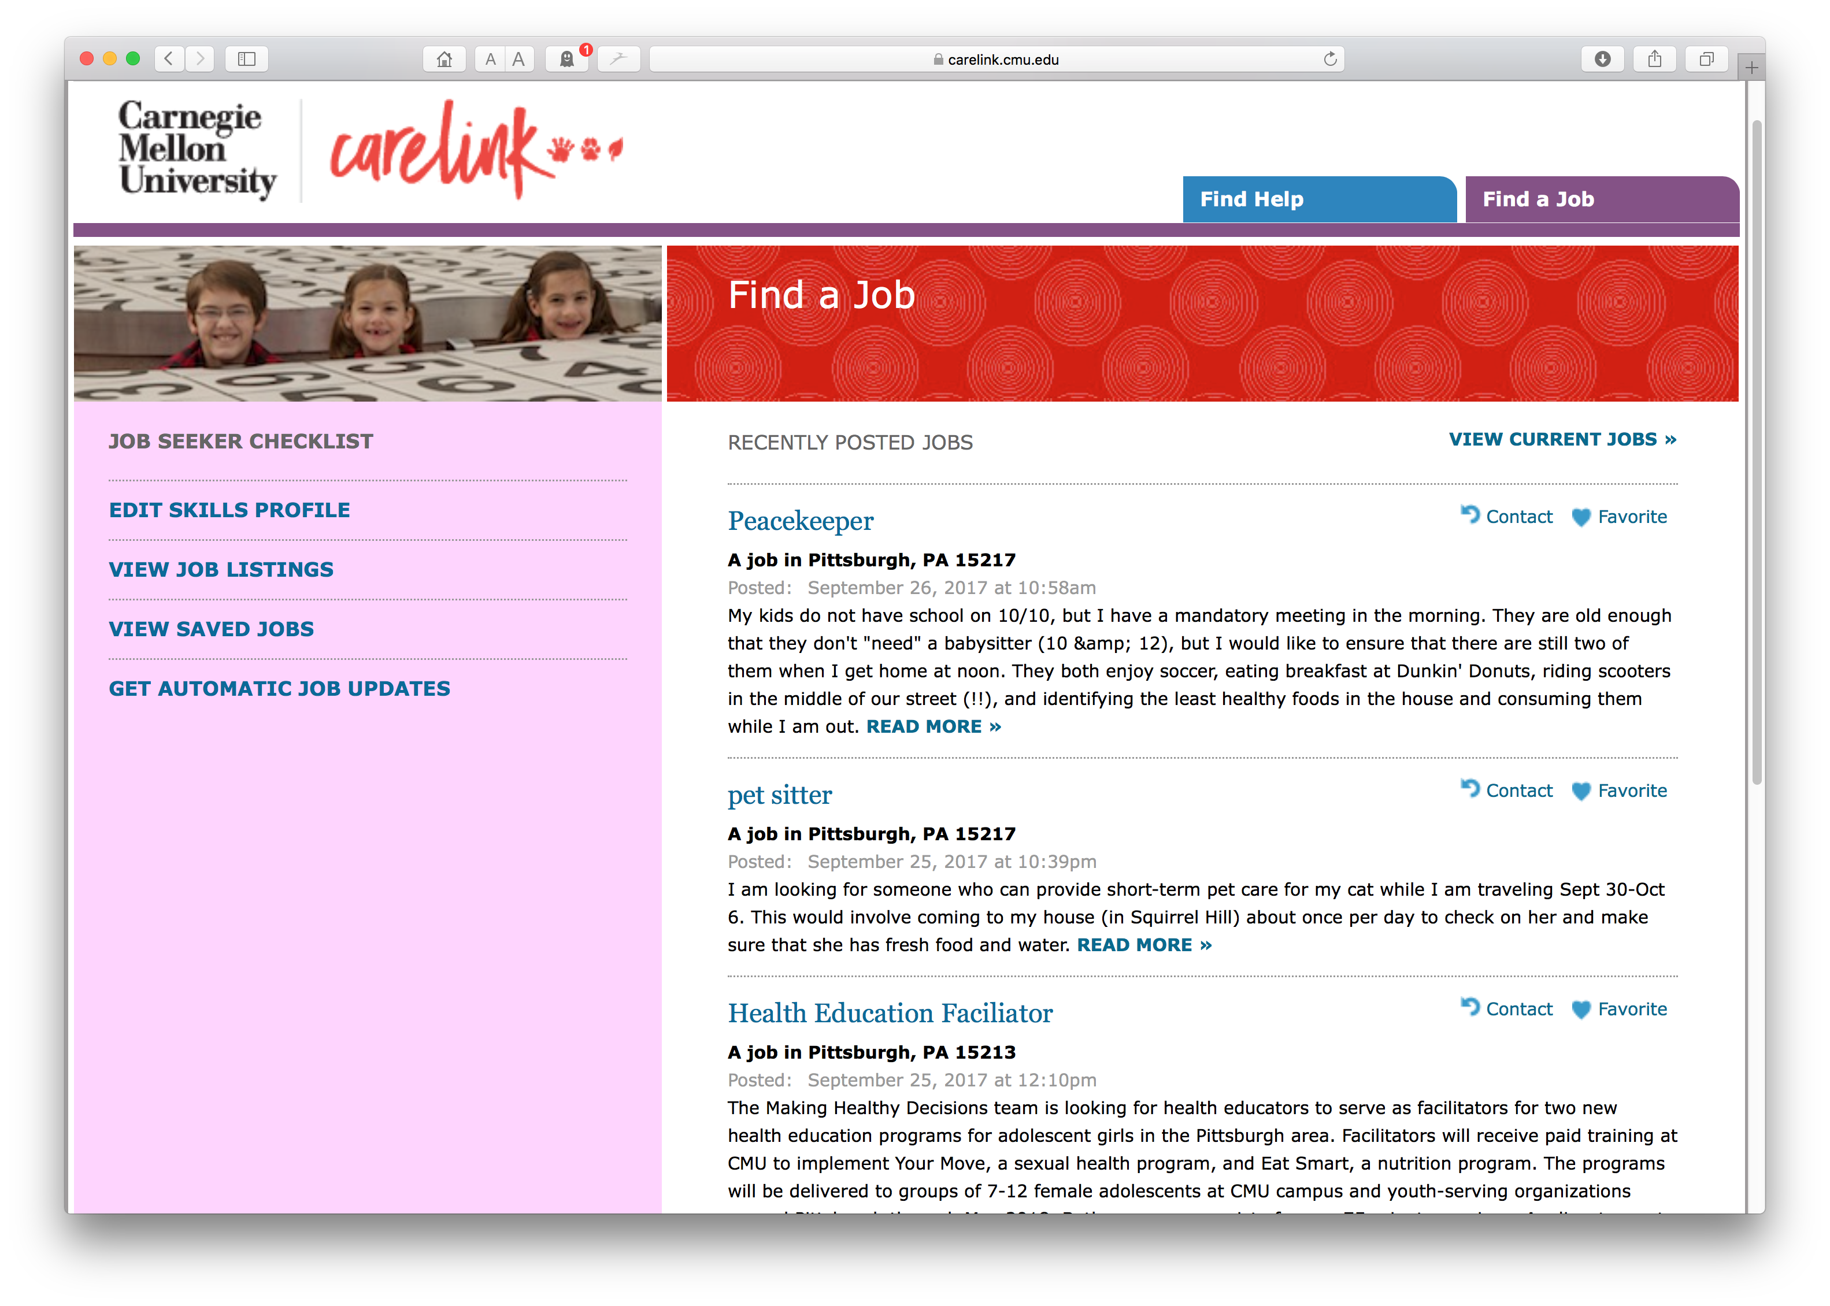

Slide 10
Early adoption
In first 6 months over 2,000 people signed up for CareLink
On any given day there are now about 60 active job postings and 170 job seeker profiles in the system
Typically 30-45 unique users per week, lower during university breaks
Few problems since launch: some usability and account creation issues have been addressed
Wide range of jobs posted including child care, driving children, dog walking, dog sitting, chicken care, gardening, bike lessons, sewing, music lessons, tutoring elementary and high school students, house cleaning, home repairs, transporting recyclables
About equal use by men and women

Slide 11
How can we formulate policies supporting women faculty advancement?
Women faculty forums
Led by Kathryn Roeder, Vice-Provost for Faculty
roeder@andrew.cmu.edu

Slide 12
Empowering culture through conversation
Our faculty climate survey found that women were significantly less satisfied with the campus culture than other groups
The Vice-Provost for Faculty hosted women’s lunches within each college to allow faculty to share issues and ideas
Input will be assimilated and interpreted across colleges
Results to be shared with campus leaders to enhance awareness of problems and distribute ideas for solutions
Ultimately hope to formulate policies that support women at CMU

Slide 13
Creating and supporting a robust and diverse faculty pipeline
Presidential Postdoctoral Fellowship Program
Led by Kathryn Roeder, Vice-Provost for Faculty
roeder@andrew.cmu.edu

Slide 14
Presidential Postdoctoral Fellows Program (PPFP)
To enhance the diversity of our faculty, we joined the PPFP consortium hosted by University of California
UC data show success in increasing faculty diversity
Fellows serve as postdocs for 2 years, but obtain enhanced mentoring and opportunity for independent research
Recruitment is restricted to departments that are looking to expand, or recruit in upcoming year(s)
At the end of their training, PPFP fellows may be considered for faculty positions at CMU

Slide 15
Next steps

Slide 16
Directions for next year
Data collection for identifying barriers specific (or not) to CMU women faculty, including intersectionality information where available
Likely confirming existing research: faculty course evaluations, scholarly recognition, committee work, etc.
Potentially CMU-specific: STEM faculty spread across five different colleges and more two dozen departments in an institution with deeply decentralized decision making – may allow for intersectionality analysis that includes discipline or field within STEM
Women in STEM faculty retreat – enable reflection and identify actionable objectives
Scheduled in October 2018 (last one in June 2014)
Gamification for mitigating unconscious bias
Hypothesis: easily accessible game(s) will have wider adoption than existing sessions on unconscious bias

Slide 17
Thank you!
Questions?

