Slide 1
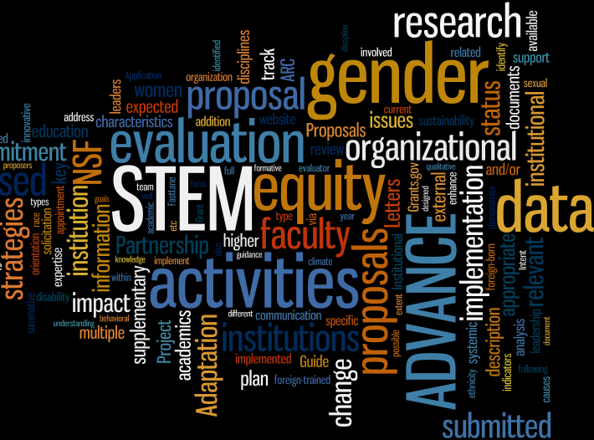
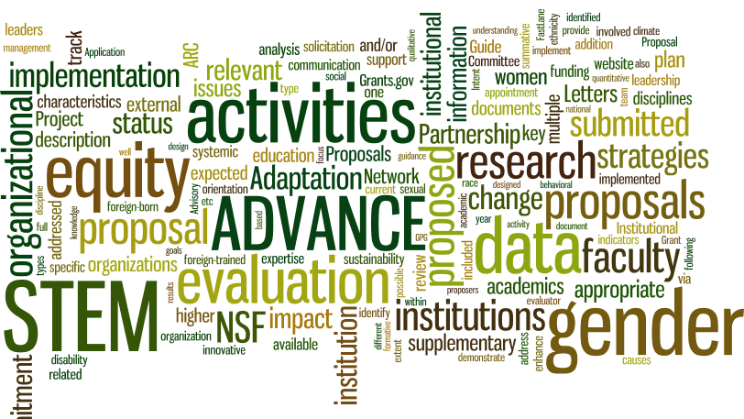
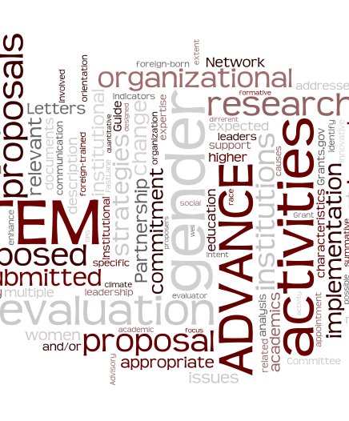
Jessie DeAro, Ph.D. Program Director ADVANCE
National Science Foundation
Notes:
Underrepresentation - Diversity – Inclusion – Broadening Participation - Equity

Slide 2
NSF Budget and Priorities
Recent NSF Budget Requests and Appropriations (Billions)
NSF Strategic Plan 2018-2022
  Strategic Objective 2.2 – STEM Workforce Foster the growth of a more capable and diverse research workforce and advance the scientific and innovation skills of the Nation.
 | NSF Request | Appropriation
FY 2017 | $8.0 | $7.5
FY 2018 | $6.7 | $7.8
FY 2019 | $7.5 | pending

Slide 3






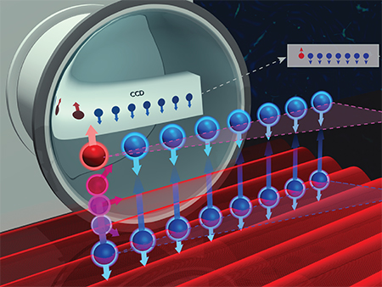
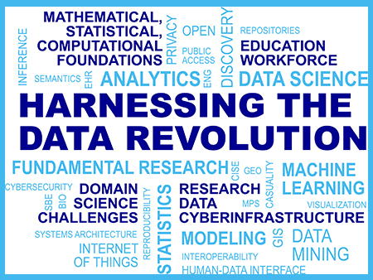


NSF INCLUDES
Understanding the Rules of Life: Predicting Phenotype
NSF 2026 Seeding Innovation
The Future of Work at the Human-Technology Frontier
Growing Convergence Research at NSF
The Quantum Leap: Leading the Next Quantum Revolution
Windows on the Universe: The Era of Multi-Messenger Astrophysics
Navigating the New Arctic
Mid-scale Research Infrastructure
Notes:
NSF INCLUDES (Inclusion across the Nation of Communities of Learners of Underrepresented Discoverers in Engineering and Science): Enhancing STEM through Diversity and Inclusion
Transforming education and career pathways to help broaden participation in science and engineering.
NSF 2026: Seeding Innovation
Investing in bold foundational research questions that are large in scope, innovative in character, originate outside of any particular directorate, and require a long-term commitment. This Big Idea is framed around the year 2026 in order to tie into the Nation's 250th anniversary ("sestercentennial")
Growing Convergence Research at NSF
Framing challenging research questions at inception, and fostering the collaborations needed for successful inquiry
Mid-scale Research Infrastructure
Developing an agile process for funding experimental research capabilities in the mid-scale range. The National Science Foundation's science and engineering activities rely increasingly on infrastructure that is diverse in space, cost and implementation time -- everything from major observatories to nationwide sensor networks to smaller experiments. There are many important potential experiments and facilities that fall between these; this gap results in missed opportunities that leave essential science undone.
Harnessing the Data Revolution
Engaging NSF's research community in the pursuit of fundamental research in data science and engineering, the development of a cohesive, federated, national-scale approach to research data infrastructure, and the development of a 21st-century data-capable workforce.
The Future of Work at the Human-Technology Frontier
Understanding how constantly evolving technologies are actively shaping the lives of workers and how people in turn can shape those technologies, especially in the world of work.
Navigating the New Arctic
Establishing an observing network of mobile and fixed platforms and tools across the Arctic to document and understand the Arctic's rapid biological, physical, chemical, and social changes. Current Arctic observations are sparse and inadequate for enabling discovery or simulation of the processes underlying Arctic system change or to assess their environmental and economic impacts on the broader Earth system.
Windows on the Universe: The Era of Multi-Messenger Astrophysics
Using powerful new syntheses of observational approaches to provide unique insights into the nature and behavior of matter and energy and help to answer some of the most profound questions before humankind
The Quantum Leap: Leading the Next Quantum Revolution
Exploiting quantum mechanics to observe, manipulate, and control the behavior of particles and energy at atomic and subatomic scales, resulting in next-generation technologies for sensing, computing, modeling, and communicating.
Understanding the Rules of Life: Predicting Phenotype
Elucidating the sets of rules that predict an organism's observable characteristics, its phenotype
In 2016, NSF unveiled a set of "Big Ideas" -- 10 bold, long-term research and process ideas that identify areas for future investment at the frontiers of science and engineering. With its broad portfolio of investments, NSF is uniquely suited to advance this set of cutting-edge research agendas and processes that will require collaborations with industry, private foundations, other agencies, science academies and societies, and universities and the education sector. The Big Ideas represent unique opportunities to position our Nation at the cutting edge -- indeed to define that cutting edge -- of global science and engineering leadership and to invest in basic research and processes that advance the United States' prosperity, security, health and well-being.

Slide 4
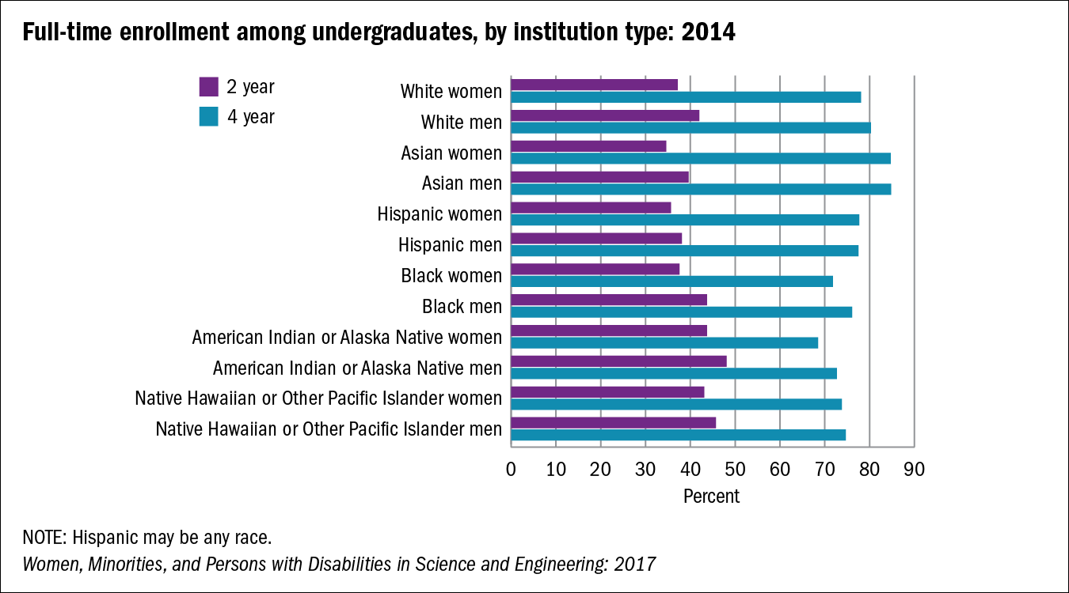
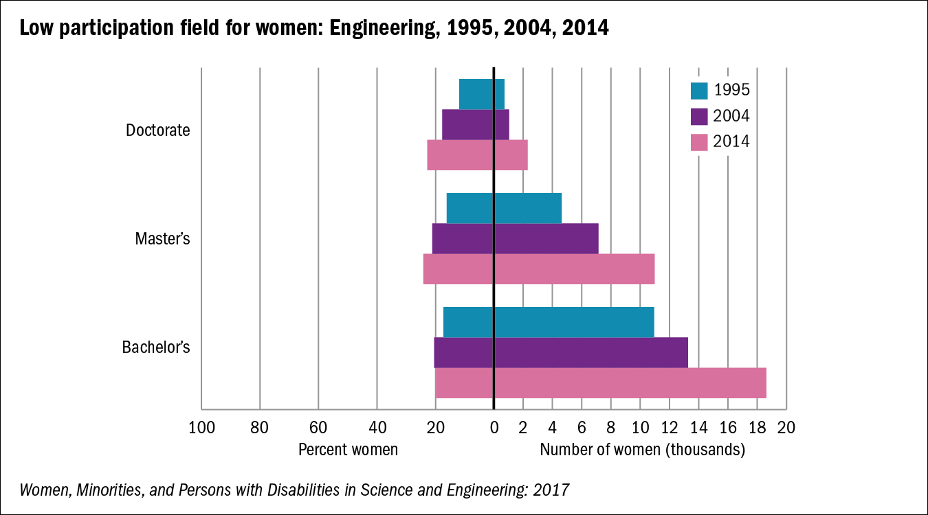
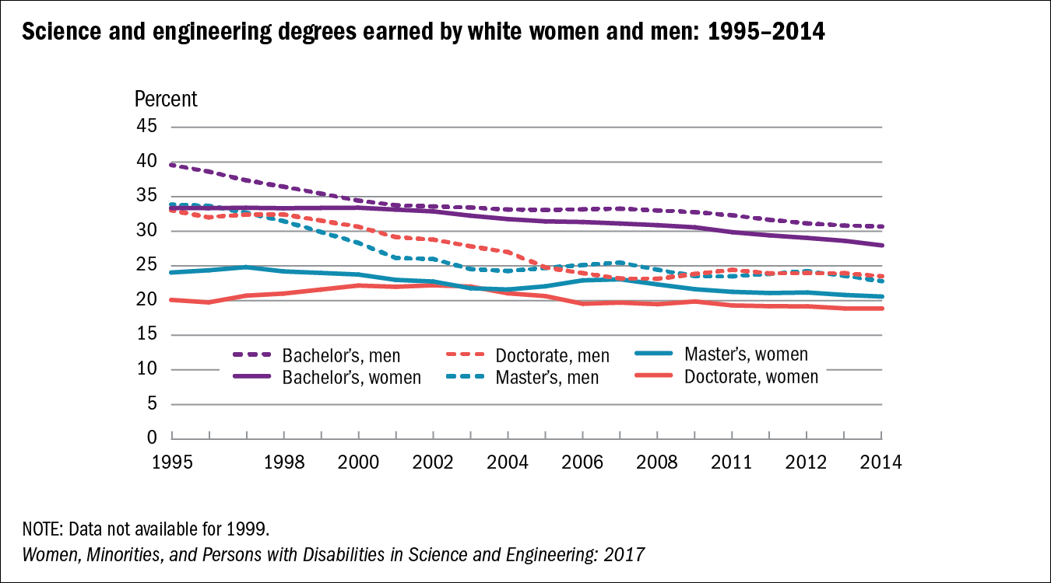
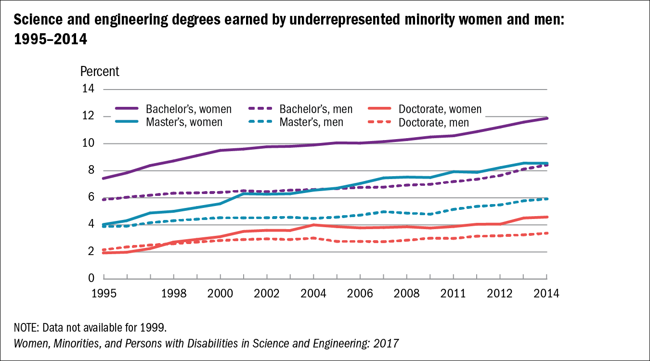

Slide 5
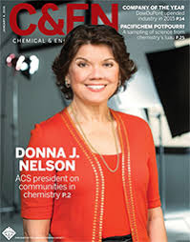






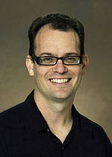
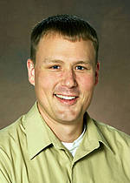








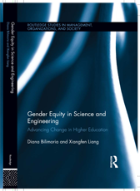
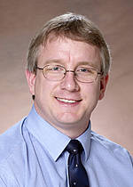
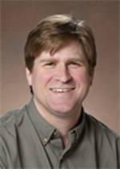

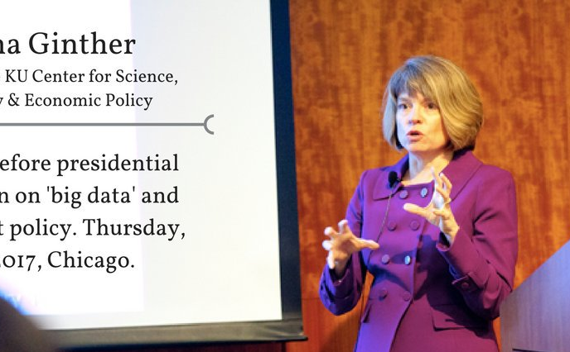

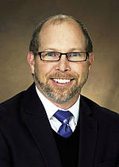
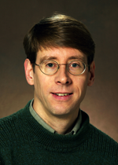
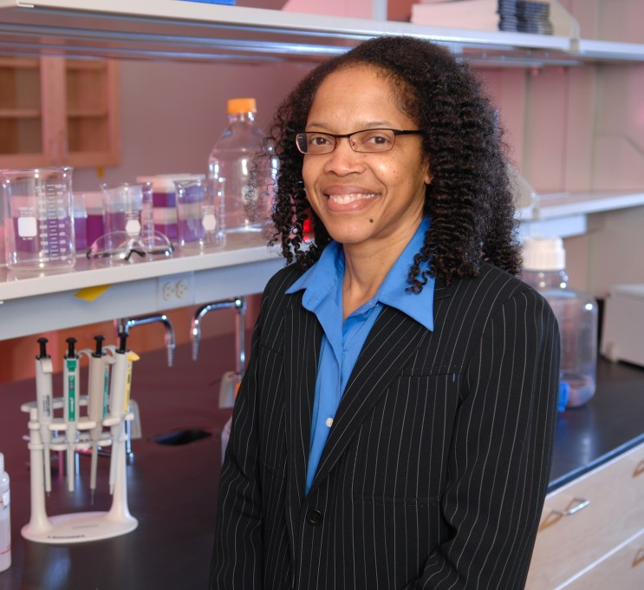
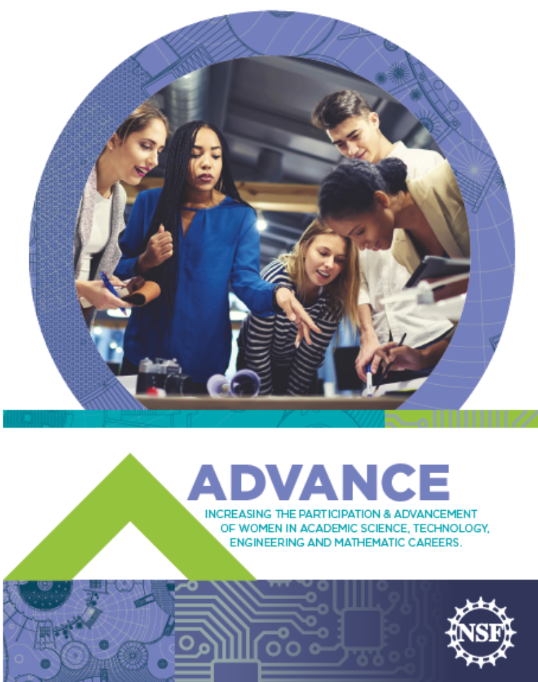

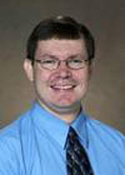
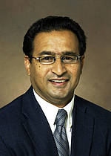
ADVANCE@nsf.gov

Slide 6
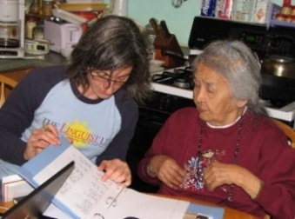
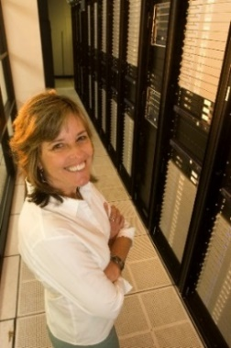
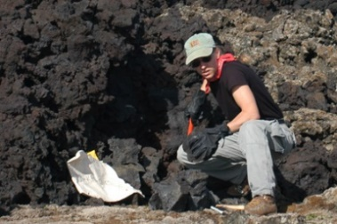
The ADVANCE Program Model
Systemic Change & Gender Equity
“Fixing” the institutions, not
the individuals…
Program Goals:
STEM institutions & organizations that are structured to be equitable
Long-term Goal:
A productive, successful, & diverse STEM academic workforce
Research-based inclusive practices used by STEM institutions & organizations
STEM culture & climate that supports a diverse STEM academic workforce

Slide 7
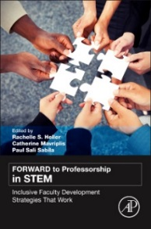

ADVANCE Portfolio 2001-2018
$297M 2001-2018
Products
Publications | ~ 200
Books/book chapters | ~ 30
ADVANE Resource Network | 2017-2022
ADVANCE Journal | 2017
65 Institutional Transformation (IT) grants
  Reach:
    ~2% of all non-profit IHEs in U.S.
    28% of Very High Research Universities
IT-Catalyst, Adaptation, and Partnership grants
  Reach:
    Another ~3% of all non-profits IHEs in U.S.
    14 non-profit organizations (STEM professional societies, FFRDCs, and National Academies)
214 ADVANCE Grants Across the U.S. 01-18
(shading indicates number of awards)
Notes:
This investment has directly reached 177 different IHEs with an NSF ADVANCE grant of some type (which is about 5.3% of all non-profit IHEs in the U.S.). Only 3 states have not yet had an ADVANCE grant Wyoming, Vermont and Arkansas. (2 states have IT proposals in now)
Portfolio Update: 11-30-2017:
ADVANCE IHEs total 177 different IHEs have had ADVANCE funding (all types of awards) [191 total IHEs and organizations]
IT = 65 (includes 61 full IT awards and 4 “mini-IT” awards made early in the program, 4 HBCUs, 9 HSIs (20% MSIs total), 21 are Very High Research IHEs (or 28.7% of all VHR IHEs)
ITC = 37 (two community colleges (first in ADVANCE portfolio), 10 HSIs, 3 HBCUs, 2 ANIPISI, (40% MSIs total) 1 Title IIIa, and 21 non MSI)
Leadership, PAID, PLAN = 103 IHEs (7 HSIs, 5 HBCUs, 1 ANIPISI, 1 IPWD (14% MSIs total) plus 14 non-profit organizations including (11 Professional societies, 2 FFRDCs, and 1 National Academies).
Over 15 years the ADVANCE Institutional Transformation track (just one of three program tracks) has reached 2% of the IHEs in the U.S. and through the other program tracks the program has reached another 3.1% (total 5.1% of the IHEs). (Based on ~3,321 non-profit IHEs in the U.S. in 2015-2016 NCES Education Digest Table 317.10)
Research Us in US = 108 VH and ADVANCE has funded:
31 of the very high research institutions or 28.7%
This is where we see peer institutional pressure effects where institutions take steps on their own to keep up with peer and aspirational institutions on diversity areas
In addition, the movement of leadership between these institutions and high research institutions – brings ADVANCE to new locations for example the former President James Clement of West Virginia University (an ADVANCE IT awardee in 2010) moved to Clemson University in 2013 and has asked his faculty to develop an ADVANCE proposal and has articulated commitments and taken steps to enhance diversity within Clemson.
95% of IT projects experience PI turnover during the project - these PIs take ADVANCE with them to new institutions
*Other outcomes provided by the WESTAT program evaluation of ADVANCE-measured in the first 19 ADVANCE IT awardee institutions
Research Support 90% allocated research facilities and resources - 90% of the first cohort of ADVANCE institutions (up from 26%), allocated facilities and resources to equity/diversity related functions after the life of the grant.
Strategic Planning 79% inclusion of gender in strategic plans - 79% of the first ADVANCE cohorts (up from 22%), incorporated equity/diversity objectives into their strategic plans
The ADVANCE Journal invites manuscripts from a variety of qualitative, quantitative and mixed research methodologies that reflect the journal’s mission to create a forum for conversation about institutional transformations. All manuscripts should speak to structural and institutional transformation, specifically addressing the intersections of gender and STEM fields with other forms of social difference. Manuscripts may or may not be the product of ADVANCE projects, but they must address the outcomes of ADVANCE (institutional transformation towards the representation and advancement of women in academic STEM careers; the development of innovative and sustainable ways to promote gender equity in the STEM academic workforce; and contribute to the research knowledge base about the intersections of gender and other social identities within STEM academic careers). Manuscripts types can include the following:
Scholarly Research Articles (Empirical, Theoretical, and/or Conceptual)
Program Evaluation and/or Assessment Reports
Critical Review of Literature and Resources
Letters to the Editor/Article Responses from Readers
http://advance.oregonstate.edu/advance-journal – uses scholastica

Slide 8



Offices of Diversity and Inclusion - for Faculty too!
Using Culture & Climate Surveys
Family Advocates
Dual Career Policies
Departmental Level Strategies
Start-up checklists
Bookshelf
of Diversity
Strategies
Sponsorship
Salary Equity Surveys
Diversity Goals
Bystander Interventions
Leadership Development
Transparency & Consistency
Chair Training
Interactive Theater
Microaggression Training
Eliminating Hidden Rules
Collecting, analyzing, sharing, using the right data
ADVOCATES AND ALLIES
#MeToo
Implicit Bias Training
Bookshelf
with ADVANCE
Strategies
Train leaders to use policies
Accountability for Leadership
Recognize & value service work
Mitigate Implicit Bias
Vol 2 - tenure
Equitable Policies for Resource Allocation
Mitigate Implicit Bias
Vol 1 – search coms
Mitigate Implicit Bias
Vol 3 - promotion
Monitoring workload
Work Life Policies & Programs
MENTORING
Collect Data
MENTORING Circles
Inclusive Organizations
Dependent Care Policies
Empowerment
Address Academic Stigmas
Intersectional Perspective
Open Searches
Adaptation for Different Contexts
Skill Development
Professional Development
Mini-Grants
Support Programs
Mini-Grants
Support Programs
Just Say No!
Negotiation training
Expand Definition of Excellence
Women who negotiate are nice too!
Culture & Climate Surveys
Using Culture & Climate Surveys
Search Data

Slide 9
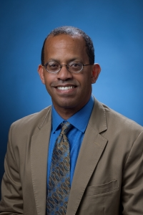
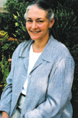
Sustainability of ADVANCE
UC-Irvine
Office of Diversity and Inclusion
Purdue
ADVANCE-Purdue Center for Faculty Success
10 yrs
University of Michigan
University of Wisconsin
Georgia Tech
University of Washington
5 to 9 yrs
CUNY Hunter
U of Colorado Boulder
Case Western Reserve U
UMBC
VA Tech
Kansas State U
New Mexico St U
UC-Irvine
Douglas Haynes
VP for Academic Equity, Diversity & Inclusion
Chris Sahley
Director Center for Faculty Success
Purdue U
U of Illinois Chicago
Cornell University
U of Arizona
UNC-Charlotte
Iowa State University
Washington State U
Ohio State U
MI State U
North Dakota St U
U of Nebraska Lincoln
Northeastern U
2 to 5 yrs
Notes:
For example
- UCI has expanded to include race, ethnicity, disability, in addition to gender - http://inclusion.uci.edu/advance/
- ADVANCE-Purdue Center for Faculty Success within the Division of Diversity and Inclusion http://www.purdue.edu/advance-purdue/center-for-faculty-success/index.html
8 out of 9 IT awards in cohort 1 made in 2001 have been sustained to some degree (3 still use ADVANCE label)
4 out of 10 IT awards in cohort 2 made in 2003 have been sustained to some degree (3 still use ADVANCE label)
= Cohort 1 and 2 together 68% sustained rate (had 20% cost share requirement)
5 out of 9 IT awards in cohort 3 made in 2006 have been sustained to some degree (2 still use ADVANCE label)
7 out of 9 IT awards in cohort 4 made in 2008 have been sustained to some degree (4 still use ADVANCE label)
= cohorts 1-4 together 24/37 = 65% sustained
= cohorts 1-4 using ADVANCE label still 12/37 = 32% sustained

Slide 10
Changes in Policies & Climate from ADVANCE
Policy Areas Addressed by ADVANCE IT Institutions
Policy Area | Institutions (%)
Recruitment | 90
Hiring | 95
Research Support | 79
Tenure Criteria | 90
Standards for Promotion to Full Professor | 79
Work Life Balance | 79
From a 2012 ADVANCE program evaluation – not published - Cohorts 1-2 (n=19)
Notes:
Updated 3-2018
Second graph: Represents data on the culture and climate at IT institutions as reported by faculty on surveys. The data shows dramatic change in overall collegiality reported by women and men.
What works to recruit, retain, and promote women in STEM academics improves the institution for all:
Issues for other underrepresented groups can also be addressed
Men now enter the work force with a greater interest and expectation for work-life balance
Non-STEM disciplines benefit from institution-wide changes
Cost/benefits: The cost of implementing these programs can be offset by productivity and retention of faculty
Institutional peer pressure to remain competitive with peer institutions to recruit and retain faculty and students
Institutional expectations that detailed faculty data will be collected, reported, and used in decision making

Slide 11

Indicators of Long-Term Goal:
A Successful & Diverse STEM Academic Workforce
Percent Change in Women STEM Faculty
From 2001 to 2008 | Accomplishment
Women STEM faculty | 49% increase in women STEM faculty (from 16% to 24%)
Women of color STEM faculty | Increased from 2.4% to 3.8% of STEM faculty
STEM faculty hiring | 40% increase in new women STEM hires (from 25% to 35%)
Women in leadership | 64% increase in STEM women in leadership (from 10% to 16%)
Final % in total female faculty
p < 0.001
Initial % in total female faculty
From 2012 ADVANCE program evaluation (N=13 to 19) not published
ADVANCE IT Institutions Cohorts 1-4 (n=41) from NSF grantee reports
Notes:
First graph (Source – reported data to NSF): Being above the line means that the percent women in STEM academics at the end of the project was higher than when the project started being on the line means there was no change – noting of course that IT was never about numbers it was about INSTITUTIONAL CHANGE but everyone asks about numbers – the problem is that we do not know if this is representative of trends for other institutions without ADVANCE IT projects plus there appears to be variation in the change by tenure rank.
Description
The percentage of women among STEM faculty increased by 49% between 2001 and 2008 (from 16% to 24% of faculty). Compared to 24% increase over same time period in SDR comparison group (from 22% to 27% of faculty).
The percentage of women among new STEM hires increased by 40% in the first six years of the grant (from 25% to 35% of new hires).
The percentage of STEM women serving in leadership positions increased by 64% between 2001 and 2008 (from 10% to 16% of leadership).
Women of color page 4-53 in Westat 2012 publication – 2012 NCSES data indicate 2.3% of tenured track faculty are WOC - Rest from WESTAT presentation slides

Slide 12

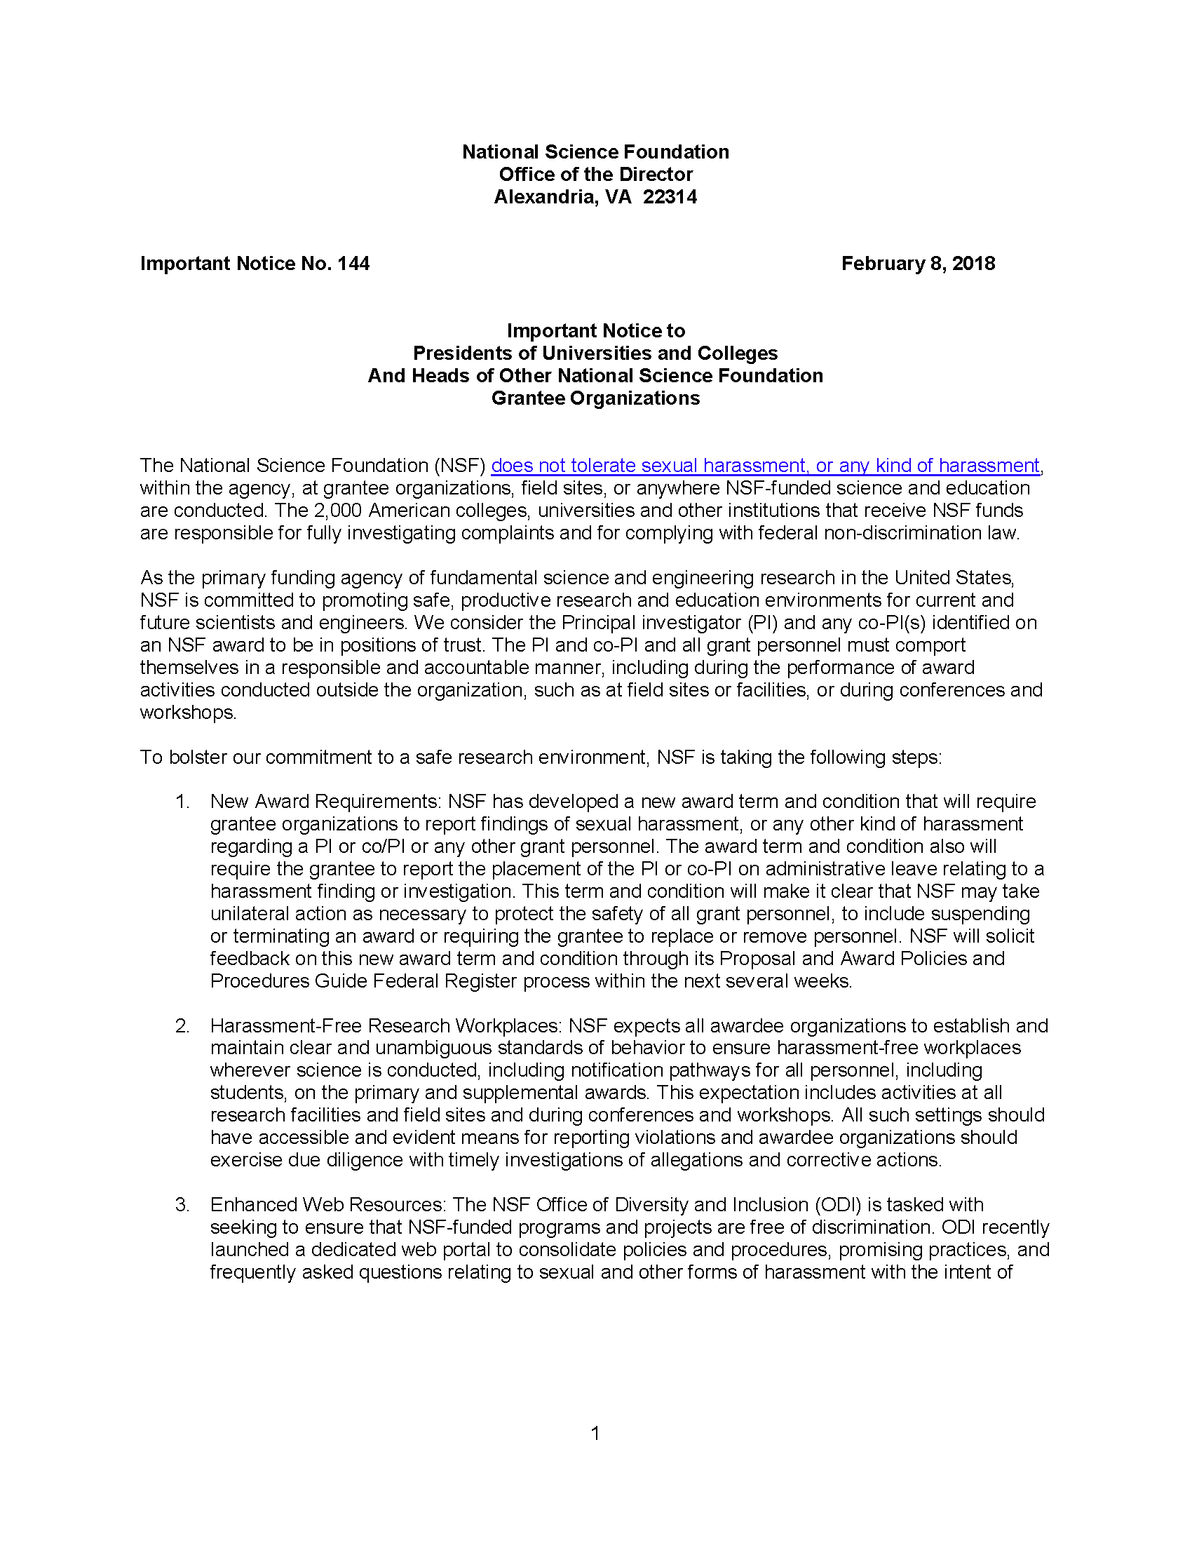
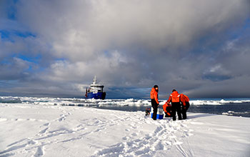
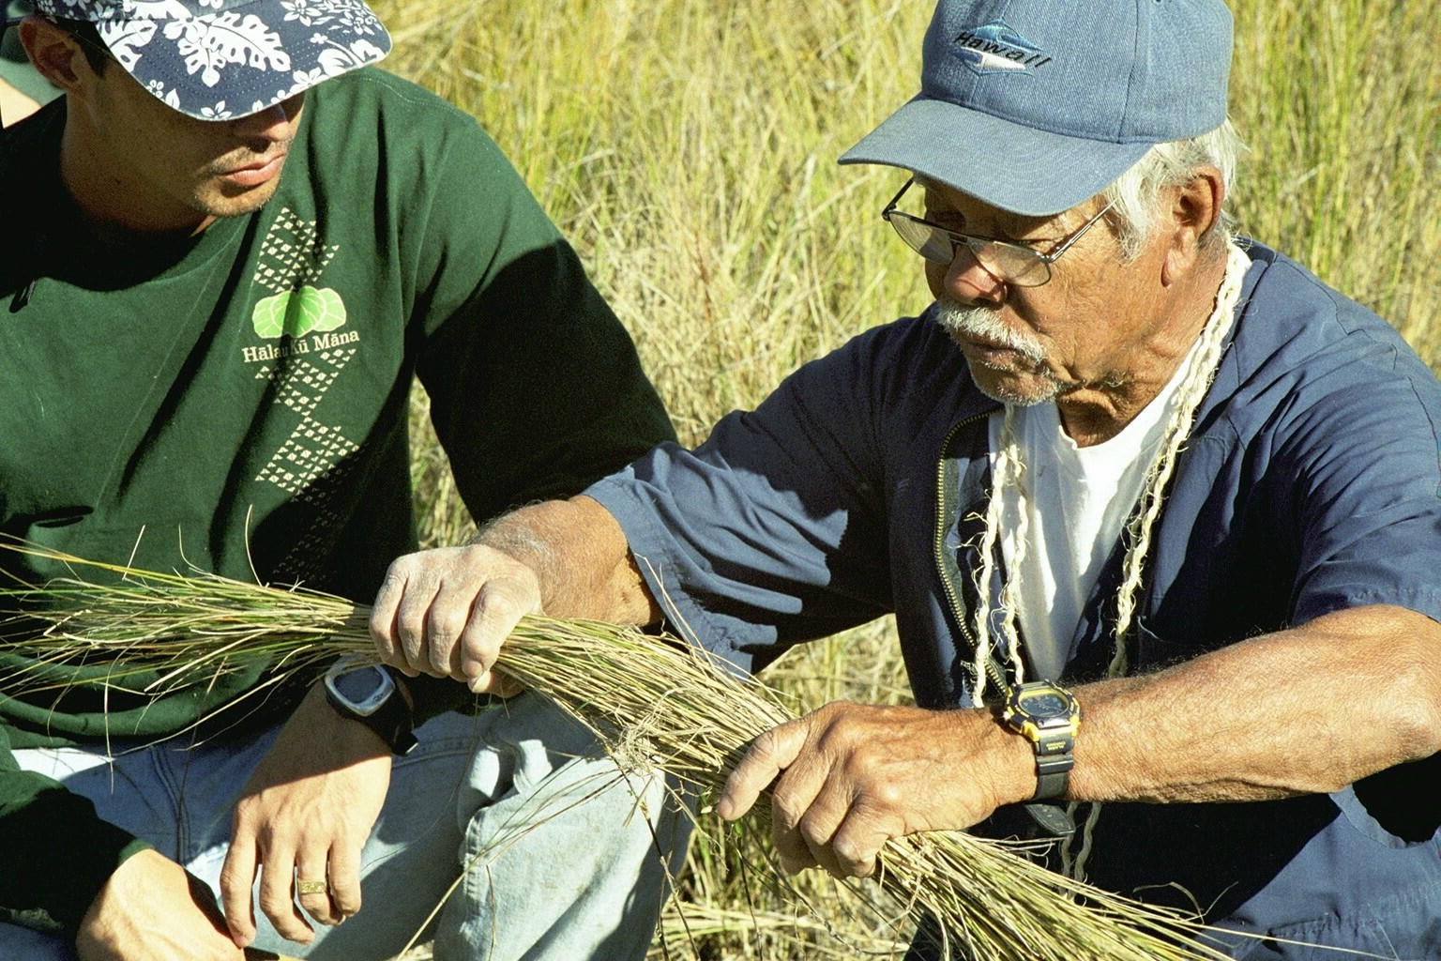
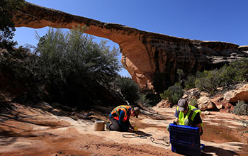
Changing Context and New Challenges
AGU’s updated ethics policy - sexual harassment is now included in the definition of research misconduct Aug. 2017
NSF Important Notice to Presidents... February 2018
ADVANCE grant: From the Classroom to the Field: Improving the Workplace in the Geosciences
Notes:
Lead PI Erika Marin-Spiotta at Wisconsin (1725879)
Billy M Williams AGU executive director co-PI
Meredith Hastings at Brown University cofounder of the Earth Science Women’s Network (ESWN) PI
Asmeret Asefaw Berhe at UC Merced PI
Rebecca Barnes at Colorado College PI
Allison Mattheis at Cal State LA
Blair Schneider at Association for Women Geoscientists (not-co-PI)
Proposed activities are the:
Design of a community-based approach to SH bystander intervention training for women and men academic leaders;
Inclusion of SH into teaching of ethical conduct of research;
Incorporation of geoscience-relevant scenarios into training and teaching materials, including field research and educational settings;
Participation of most vulnerable populations in the development and implementation of training material to identify unique challenges faced by women with intersectional identities; and
Collaboration with society partners for national dissemination, implementation, and sustainability
IHE Partners:
University of Wisconsin-Madison
Brown University
California State University Los Angeles
Colorado College
University of California – Merced

Slide 13
Offices of Diversity and Inclusion - for Faculty too!
Using Culture & Climate Surveys
Family Advocates
Dual Career Policies
Departmental Level Strategies
Start-up checklists
Spectrum of Gender
STEM Workplace Stigmas
Salary Equity Surveys
Sponsorship
Bystander Interventions
Diversity Goals
Chair Training
Interactive Theater
Leadership Development
Transparency & Consistency
Scaling-up
Equity Issues at Community Colleges
Different Contexts
New Questions
On-going SBE Research
Learning from ADVANCE program
Intersectionality
Microaggression Training
Eliminating Hidden Rules
Collecting, analyzing, sharing, using the right data
ADVOCATES AND ALLIES
#MeToo
Implicit Bias Training
STEM Discipline Specific Strategies
Train leaders to use policies
Accountability for Leadership
Recognize & value service work
Mitigate Implicit Bias
Vol 2 - tenure
Equitable Policies for Resource Allocation
Mitigate Implicit Bias
Vol 1 – search coms
Mitigate Implicit Bias
Vol 3 - promotion
Monitoring workload
Work Life Policies & Programs
Role of STEM Professional Societies, funders, etc.
Inclusive Organizations
MENTORING Circles
Dependent Care Policies
Empowerment
Address Academic Stigmas
Intersectional Perspective
Open Searches
Adaptation for Different Contexts
Professional Development
Support Programs
Mini-Grants
Women who negotiate are nice too!
Expand Definition of Excellence
Using Culture & Climate Surveys
Search Data

Slide 14

Systemic Change!

Slide 15
Degree of Systemic Change – Reported IDEAL-N Strategies
Faculty Development Center established
collected institutional data
Search Committee Chair Training
Work-life balance policies
Dual Career policies
Professional Development
Mentoring
Coaching
Women’s events
Coordinate w/ CDO & EEO
Coordinate w/ HR
Hiring Checklist (policy & accountability)
Hiring Checklist
Notes:
Adapted a hiring checklist
Adapted a hiring checklist POLICY & ACCOUNTABILITY
chair interviews
chairs training
climate survey developed
climate survey implemented
collected institutional data
Coordinated with CDO & EEO to incorporate IDEAL-N
Created video on value of diversity
deans training
Developed strategic hiring inititiative
distinguished speakers
evaluating mentoring
Examine HR synergies with IDEAL-N
Faculty Development Center established
faculty focus groups
Faculty search handbook
Faculty search handbook POLICY & ACCOUNTABILITY
Faculty writing groups
highlight women in STEM
implicit bias training search committee
Incorporated diversity into startegic plan
Launch committees for new hires
Mentoring programs
mid-career faculty success coach
mid-career professional development
NCFDD membership
New faculty programming
New partner hiring policies
professional development
Reviewed self study and climate survey data
salary study
White Men as full Diversity Partners training
Womens forums/events
Work-life balance negotiated agreement
workshops based on survey

Slide 16
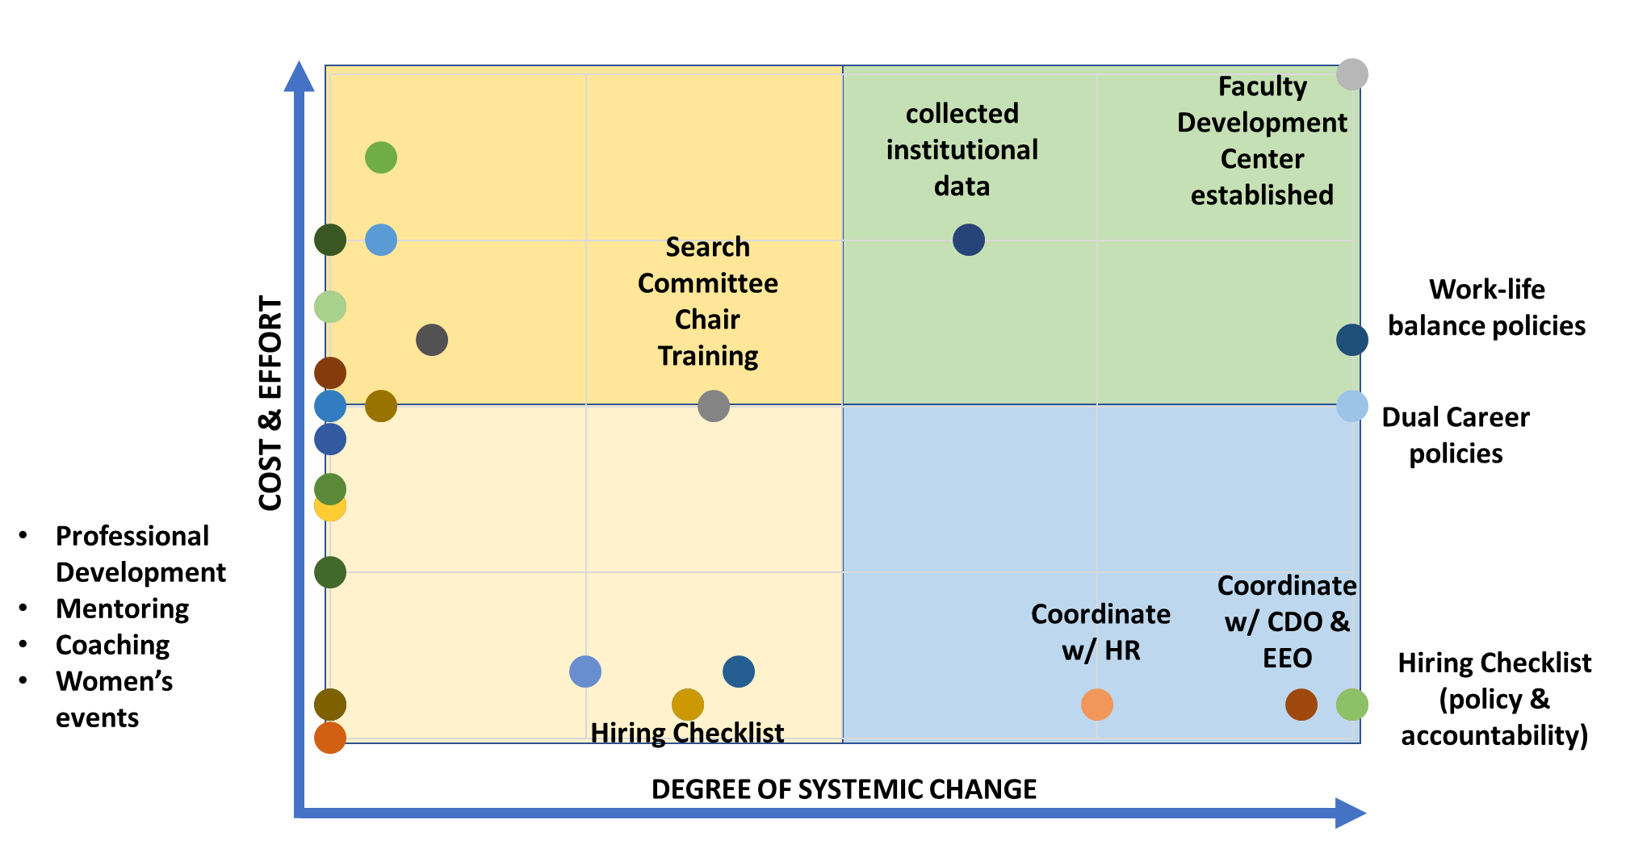
Degree of Cultural Change – Reported IDEAL-N Strategies
Degree of Cultural Change

Slide 17
Systemic & Cultural Change!

Slide 18
ADVANCE - Looking Forward
Evaluation and Diffusion
Program Evaluation FY18 on sustainability & diffusion
Support more knowledge transfer - ADVANCE Resource Coordination (ARC) Network
Maintain focus on systemic change & gender with an emphasize intersectionality
  Partnership projects:
    Academic & non-academic organizations such as STEM Professional societies
    STEM discipline specific projects
    Connect to INCLUDES
  Adaptation projects:
    Adapt promising practices to STEM non-academic organizations
    Increase type and number of academic institutions doing this work

Slide 19
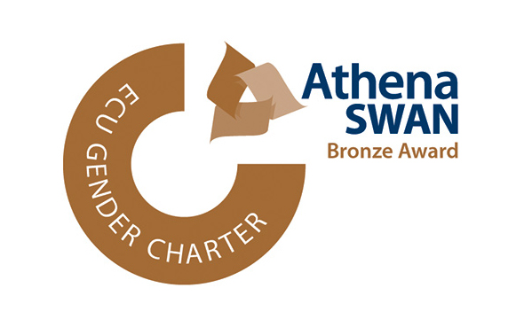
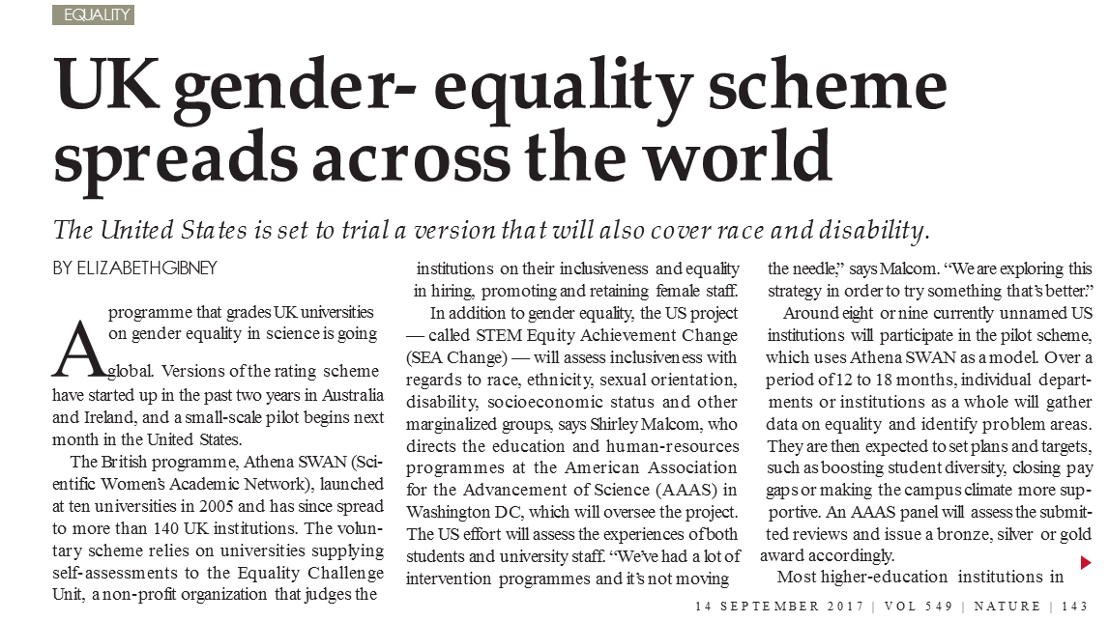


STEM Equality Achievement Project
(SEA Change)
AAAS effort to create award recognition of diversity and equity efforts
  Builds on ADVANCE work showing importance of collecting, analyzing, publishing, and using disaggregated data on faculty
  Adapts the UK Athena SWAN model to the US (and Canada)
SEA Change will award institutions and departments that:
  Use a standard set of metrics for diversity and inclusion in STEM
  Track, assess, and report these metrics
Former & current ADVANCE institutions are:
  Working with AAAS to develop metrics
  Are well positioned to be pilot institutions
Nature news
Notes:
Funding also from the Heising-Simons Foundation, The Kavli Foundation, and The Alfred P. Sloan Foundation
Shirley Malcom, AAAS, is leading the efforts to fund infrastructure support for SEA Change
Paula Rayman, Principal Investigator
Julie Chen, Co-Principal Investigator
Shirley M Malcom, Co-Principal Investigator
Joyce Y Wong, Co-Principal Investigator
April 6-7, 2016, AAAS hosted the NSF workshop on “SEA Change Awards -- expanding Diverse Talent in STEM to Strengthen the Nation”. 40+ invitees attended, representing both public and private higher education institutions, geographically distributed, and from 4-yr colleges, HBCUs, MSIs, and doctoral research universities. OSTP and NSF also invited (ADVANCE funded workshop)
March 3, 2017, a Northeast regional meeting was held at Boston University 75+ participants
October 19-20, 2017, AAAS hosted a pilot launch workshop for SEA Change.
March 23, 2018 at UMass Lowell (with the AAAS guidelines as a focus).
Boston University, UMass Lowell, Northeastern, UMass Amherst, MIT, UNH, and Brown University
NSERC in Canada also interested in piloting
Establishing an online collaboration and communication group through their Trellis platform;
Establishing an Advisory board and Analytics subcommittee;
Putting forward draft guidelines for the pilot institution bronze award (submissions in Fall 2018);
Developing multiple funding sources for the pilot program and sustainability plans.
Press on SEA Change.
“UK gender-equality scheme spreads across the world.” Nature | News. Elizabeth Gibney, September 13, 2017. https://www.nature.com/news/uk-gender-equality-scheme-spreads-across-the-world-1.22599
“SEA Change Program Aims to Transform Diversity Efforts in STEM.” AAAS News. Andrea Korte, January 24, 2018. https://www.aaas.org/news/sea-change-program-aims-transform-diversity-efforts-stem

Slide 20
ADVANCE
ADVANCE@nsf.gov
Thank You
ADVANCE@nsf.gov

Slide 21










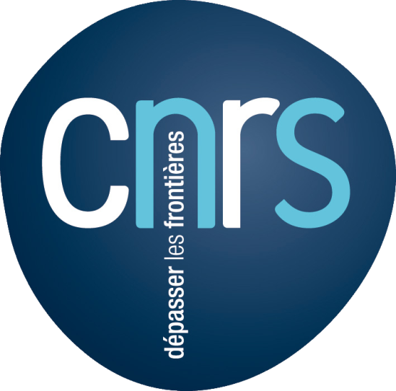










ADVANCE Innovations & Diffusion
Strategies and Tactics for Recruiting to Improve Diversity and Excellence (STRIDE)
Notes:
The University of Michigan STRIDE (Strategies and Tactics for Recruiting to Improve Diversity and Excellence) Committee
Provides training on the unconscious bias literature for senior STEM faculty who work with recruitment committees is very effective
Reduces influences of implicit bias on search committees and strategies for the committees to use to have successful searches
Outcomes
A significant increase in the number of women hired in science and engineering tenure track positions (14% in 2001 – 34% in 2006)
The committee continues to be used at Michigan 10 years after funding.
This model has been adapted by many other institutions in the U.S. and internationally
Training and toolkits for others to use available at http://advance.umich.edu/stride.php
University of Michigan - 2001 to now $3.7M and $1.2M = another $28 M of ADVANCE dollars for new IT awards and $1.5 M for PAID awards at 2 institutions and one prof. society
Grand Valley SU – PAID grant 2006 to 2009 [0620057] $499,922
University of Missouri PAID grant 2007 to 2010 [0618977] $499,993
Society for Neurosciences – PAID 2009 to 2013 [0930184] $589,371
Yellow No NSF funding but MI knows– part of dissemination efforts by U MI and part others seeking solutions - No way to know how much $ has been invested at these organizations
CNRS - The INTEGER Project : Driving Equality and Excellence 2011-2015 CNRS Committee for Gender Equality and Research Excellence Inspired by the STRIDE: Review procedures and practices for the evaluation, recruitment and promotion of researchers at CNRS Membership: Chairs of all CNRS standing peer-review evaluation panels, deputy scientific directors, HR senior officers, senior women researchers & gender experts http://www.integer-tools-for-action.eu/en/institutional-page/about-the-integer-project https://gender-summit.com/images/GS5_Slides/GS5Africa_Pepin.pdf

Slide 22
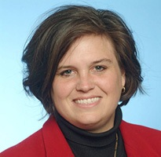
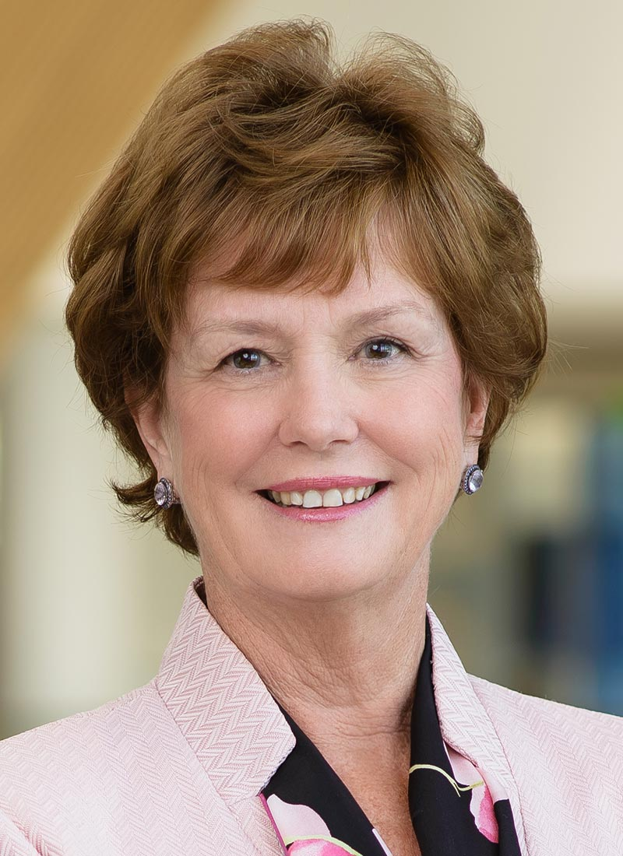
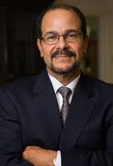
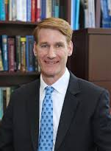

Mobility of ADVANCE Innovations
Luis Falcón co-PI on Northeastern ADVANCE, trained as a STRIDE faculty, becomes Dean at U Mass Lowell in 2012.
Joseph Hartman, Dean of Engineering, adopts strategies shared by Dr. Falcón when he arrives at Lowell in 2013-2014.
Northeastern University ADVANCE IT, PI Sara Wadia-Fascetti, STRIDE Committee Training
2008 to now.
U Mass Lowell awarded IT project in 2016, PI Jackie Moloney, focused on bystander training & subtle gender bias.
Notes:
STRIDE Still being implemented at Northeastern University http://www.northeastern.edu/advance/
One example of the movement of ADVANCE strategies is the story of Dr. Luis Falcón. As vice-provost for graduate education, Dr. Falcón was a co-principle investigator on the Northeastern University 2008 ADVANCE IT project (NSF award #0811170) which, among other things, adapted the University of Michigan STRIDE committee model. At Northeastern, he was trained as a STRIDE facilitator and participated in the committee until he moved to the University of Massachusetts-Lowell to serve as Dean of Fine Arts, Humanities & Social Sciences in 2012. Once at Lowell, he enhanced the role of the Dean in the hiring and recruitment process to improve applicant, interviewee, and candidate diversity using strategies developed within several ADVANCE institutions, including Northeastern University. He shared these strategies with the new Dean of Engineering at Lowell, Dr. Joseph Hartman, who adapted several of those changes in 2013/14. Dr. Falcón also asked the Lowell Human Resources Office to incorporate some of the Northeastern STRIDE training materials into the Lowell search committee training which started a process of moving toward a STRIDE-like committee at Lowell. These activities were implemented and expanded to non-STEM colleges without NSF funds. This work is credited with situating the University of Massachusetts-Lowell to be more competitive for an ADVANCE IT grant which was awarded in 2016 (NSF award #1629761). Because these baseline activities were in place, the proposers were positioned to focus on innovating strategies to disrupt subtle biases and microagressions and other activities (https://www.uml.edu/Research/ADVANCE, personal communication with Dr. Luis Falcón, January 2018).

Slide 23
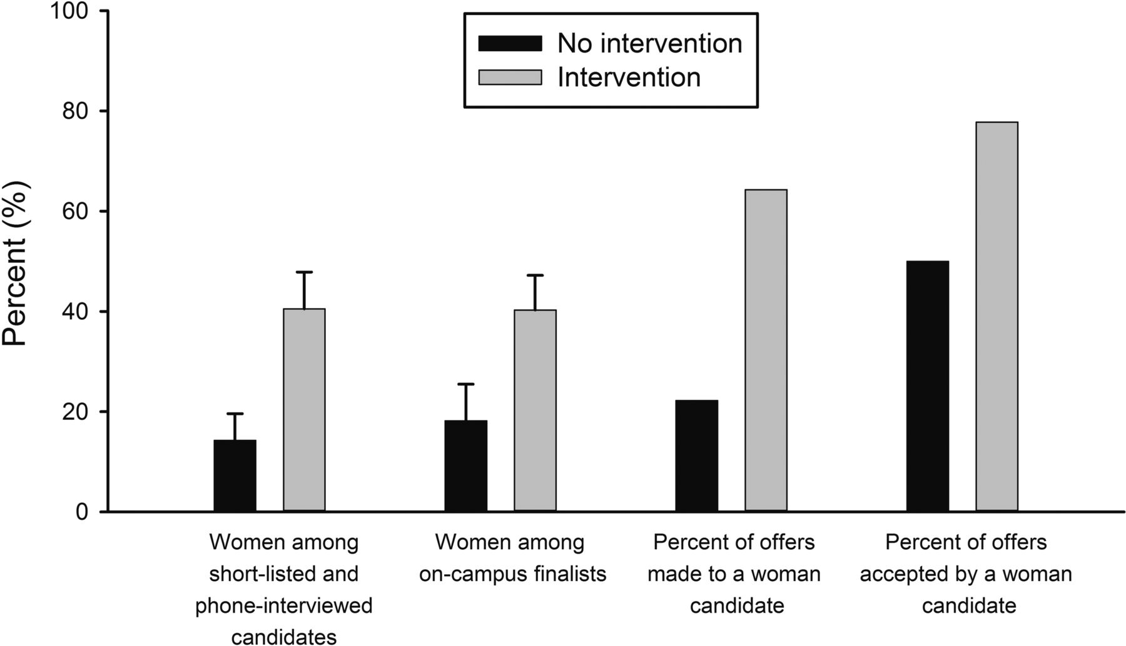

ADVANCE Search Committee Training Example
Montana State University
Intervention with search committee chairs had impact on hiring of women compared to control search committees (total searches=23):
6.3 times more likely to make an offer to women
Women were 5.8 times more likely to accept an offer if made
The intervention was provided by a faculty peer:
Tip sheet and search toolkit overview
30 min overview of implicit biases
Discussion of work-life integration and suggestion to have candidates meet with a family advocate for 15 mins
Jessi L. Smith et al. BioScience 2015;65:1084-1087
Notes:
Montana State University ADVANCE IT award 1208831, PI Jessi Smith http://m.bioscience.oxfordjournals.org/content/early/2015/10/09/biosci.biv138.abstract
The study compared intervention departments to a control group of departments (total number of searches in the study 23) - concludes that the intervention that included training on implicit bias resulted in Searches in the intervention were 6.3 times more likely to make an offer to a woman candidate, and women who were made an offer were 5.8 times more likely to accept the offer from an intervention search.
The intervention was with small groups (3-6) of search committee chairs with a faculty peer providing the following: 1) an explanation of the printed search toolkit and a summary two-page “tip sheet” 2) a 20-30 minute overview of “unintentional” (i.e., implicit) gender-bias research, including a copy of a scientific article on the topic, and 3) an introduction to the importance of work-life integration (e.g., partner, family, and recreational support) when recruiting candidates and a recommendation to the search chair that all on-campus interview candidates connect with a faculty Family Advocate for a brief 15-minute confidential meeting to answer questions and discuss work-life integration practices at the university.
After the randomized control trial was over, the intervention was, and continues to be, offered to all STEM searches on campus (and any other interested search committees). NOTE that this research led to another unexpected study being published: Other research from MT State U: Handley, I. M., Brown, E. R., Moss-Racusin, C. A., & Smith, J. L. (2015). Quality of evidence revealing subtle gender biases in science is in the eye of the beholder. Proceedings of the National Academy of Sciences, 112(43), 13201–13206. http://doi.org/10.1073/pnas.1510649112 http://www.pnas.org/content/112/43/13201.full.pdf. The acceptance of implicit bias research by men and women differs - men, especially male STEM faculty men, evaluate the quality of the research less favorably than women when the research findings show gender bias.
What else could be causing the effect? Because we randomly assigned search committees to the intervention, we can assume that the group of searches in the intervention vs treatment as usual were “equal” in terms of past successes, challenges, etc along a normal distribution of preexisting differences. We also know that groups in the intervention and groups in the treatment as usual condition will differ in a number of ways, but that the only common variable between them is intervention vs non-intervention. As we carefully manipulated the intervention and all else was free to vary we can be confident and draw causal inferences. Indeed, the fact that the groups each differ so much from each other would make it difficult to find statistically meaningful results because of all the error and noise in the data – thus or ability to detect meaningful difference is all the more important.
We know that our intervention was due to the training intervention because we had just received our funding in Sept of 2012 and this was the first thing we did - no other aspects of ADVANCE were in place at the time of the intervention. But the intervention of course is three parts, very complicated, and based in self determination theory. We cannot know which of the three aspects are MOST important as the intervention demands they be considered as a whole. Certainly future research would do well to untangle which part might be most important, but we have theoretical reasons to believe that all are necessary.
Training by HR was also provided but had a primary emphasis on antidiscrimination, equal opportunity, and avoiding lawsuits. In contrast, our intervention offered an inclusive, multicultural, broadening-participation approach (Richeson and Nussbaum 2004) based in Self-Determination Theory (Deci and Ryan 2000).
What STEM Departments involved? All searches in the study were STEM (SBS was not included in the study). We do not reveal the names of those STEM departments for confidentiality/IRB ethical reasons.
What was outcomes from past searches? It is not necessary to compare to past searches as what is important is at that point in time, in the same year, what happens when a new training is introduced? Yes, we ruled out a number of alternative explanations including how many PhDs in that area were awarded to women that year (no-intervention searches 42.1% women in pool, intervention searches 35.2%), how many women were on the search committee (no-intervention searches 1.7 women, intervention searches 1.5), average % of women in both intervention and non-intervention departments was 20%. In supplemental info http://bioscience.oxfordjournals.org/content/suppl/2015/10/09/biv138.DC1
Percent STEM women hired 2009-10 25% (2 of 6)
Percent STEM women hired 2010-11 44% (4 of 5)
Percent STEM women hired 2011-12 0% (0 of 8)
Testing random assignment assumption: First, we ruled out alternative explanations and assessed the effectiveness of our random assignment. Results showed no differences between intervention and no-intervention searches in mean numbers of women on the search committees, mean numbers of women in the departments, or in mean percentages of PhDs awarded nationally to women in the search fields (see Table S1). Random assignment was effective.
Preliminary Analyses - Applicant pool data: Applicant pool sizes were highly variable and ranged from 5 to 511 with a median of 48. Pool sizes in the intervention condition were somewhat larger (M = 117.8, SE = 37.8) than in the no-intervention condition (M = 36.7, SE = 15.4) (t[21] = 1.76, p = 0.09). As discussed above, gender composition of overall applicant pools could not be reliably assessed.
What does 6.3 times more likely mean? To interpret the data, odds ratios means that for searches who got our training, the odds of that search hiring a woman are 6.8 times larger than the odds for a woman being hired in the non-intervention searches. Here is a great summary of how to understand odds ratios: http://www.ncbi.nlm.nih.gov/pmc/articles/PMC2938757/ We also use general linear modeling for our analyses, which shows that there is less than a 5% chance (5 out of 100) that our results are due to random error. We can be more than 95% confident in the results.
The numbers: 11 women were extended offers for tenure-track faculty positions—9 in the intervention condition and 2 in the no-intervention condition. Odds ratio statistics showed that a search in the intervention condition was 6.3 times more likely to make an offer to a woman candidate than a search in the no-intervention condition (d = 0.93; see Figure). Moreover, women offered jobs were 5.8 times more likely to accept the offer from an intervention search (n = 7 accepted) than from a no-intervention search (n = 1 accepted) (d = 0.80). The 3-step intervention effectively increased the number of women hired as incoming STEM faculty at MSU. Subsequent application of our intervention to all STEM searches has continued this trend with women representing precisely 50% of all STEM faculty hires with start dates in 2013-14 academic year (n=10 men and 10 women) and start dates in 2014-15 academic year (n=9 men and 9 women hired).
It is sometimes years and years - even decades - between searches within academia. So it is impossible to say “the last time biology did a hire, this is what happened” and compare results. The last time biology did a hire was likely 5-10 years ago, depending on retirements and other vacancies. We do list all the data starting from before ADVANCE to today on our website – broken down by college, by department, and overall here http://www.montana.edu/opa/facultystaffindex/diversity/index.html

Slide 24
ADVANCE Senior Faculty Training Example
The University of Michigan STRIDE (Strategies and Tactics for Recruiting to Improve Diversity and Excellence) Committee
  Provides training on the unconscious bias literature for senior STEM faculty who work with recruitment committees and promotion and tenure committees is very effective
  Reduces influences of implicit bias on search committees and promotion and tenure committees
Outcomes
  A significant increase in the number of women hired in science and engineering tenure track positions (14% in 2001 – 34% in 2006)
  The committee continues to be used at Michigan 10 years after funding.
  This model has been adapted by many other institutions in the U.S. and internationally (mostly without ADVANCE funds)
  Training and toolkits for others to use available at http://advance.umich.edu/stride.php
Notes:
U of Michigan IT award 0123571

Slide 25

ADVANCE Chair Training Example
The University of Wisconsin at Madison chair training including:
  The need for and use of climate survey data at the department level
  The importance of the chair’s role in mentoring new faculty and fostering positive climates
  Development of departmental action plans based on surveys results
Outcomes
  The number of female department chairs increased from 2 to 10 in 3 years
  Positive changes in faculty climate surveys (less reports of isolation, better “fit”)
  Training still offered 15 years later by WISELI
Products and Leverage
  Workshop toolkits and survey instruments available on website
  NIH grants to do more research and extend work to biomedical workforce
Notes:
Assessing & Enhancing Department Climate: A Workshop Series for Department Chairs http://wiseli.engr.wisc.edu/climate.php

Slide 26
“If you always do what you always did, you’ll always get what you always got.” Unknown author

Slide 27
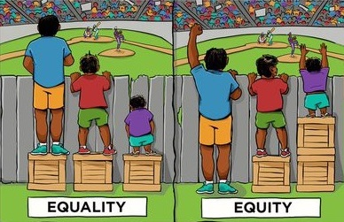
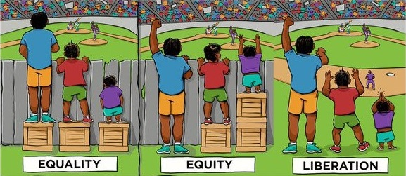
SYSTEMIC CHANGE

Slide 28
ADVANCE Budget FY 2002-2019
FY18 ADVANCE budget range:
$18M
Six highly competitive Adaptation proposals
15 IT proposals submitted and under review (after preliminary process)
Evaluation
$4.9M
Fund $2.3M mortgage and evaluation
Notes:
Plans for the $4.9M FY 2018 Budget scenario:
Fund a program evaluation on sustainability and the reach of the NSF ADVANCE brand.
If NSF’s budget is finalized at this level, the program will release a DCL to inform proposers as to how the number of awards will be reduced
Make a limited number of IT and Adaptation awards (one to two each) from those submitted under the current solicitation.
Archive the ADVANCE solicitation. Total program mortgage is $2.3M.
Plans for the $18M FY18 Budget scenario (or any budget greater than $4.9M):
Fund a program evaluation on sustainability and the reach of the NSF ADVANCE brand.
Fund additional IT and Adaptation awards consistent with available funding.
Develop an updated ADVANCE solicitation in consultation with the AIC and Directorates. Program recommendations supported by the AIC include:
Five IT and six Adaptation awards were estimated in the two year solicitation approved by ADs in 2016 (16-594) that expected level funding of $15M each year

Slide 29
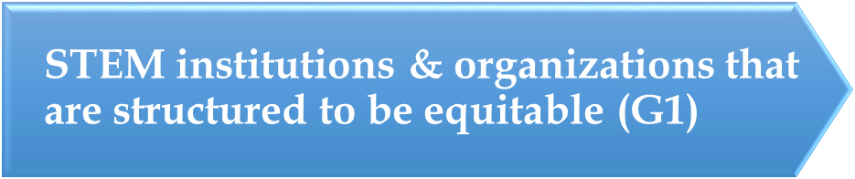
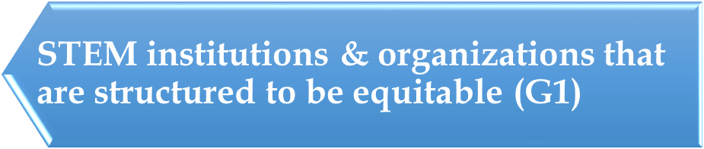
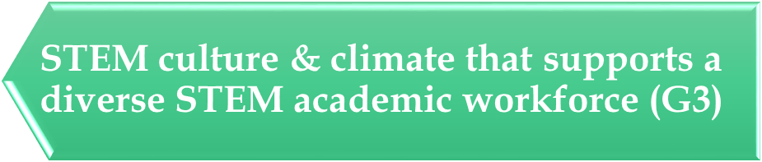
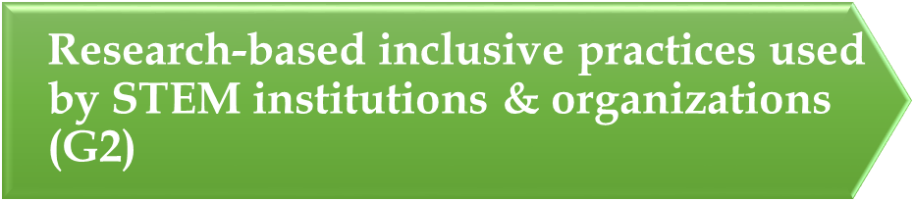
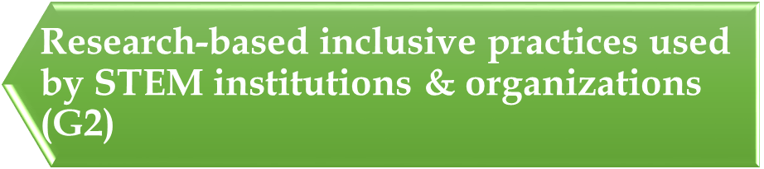
ADVANCE Program Success Measured by…
Revised or new policies, processes, & practices (G1)
Changes in STEM culture & climate
(G1 & G3)
Metrics
# of policies, procedures
Usage & understanding
Accountability mechanisms
Data collection & monitoring systems
Metrics
Job satisfaction
Intent to stay
Perceptions of fit & belonging
Career intention
Changes to infrastructure
New knowledge of systemic change & equity (G2)
Sustainability & Diffusion of ADVANCE ideas
(G1, 2 & 3)
Metrics
Research publications & presentations
Citations
# journals published in, special issues, & new journals
Metrics
Adaptation w/o NSF grants
Mainstreaming of ideas
Degree & period of sustaining

Slide 30
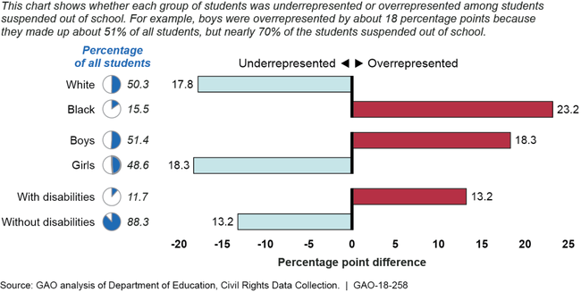

Slide 31



ADVANCE Inspires International Action
“The US has led the way with the ADVANCE programme, funded by the National Science Foundation.”
- European Commission 2012
“Programmes such as the pioneer ADVANCE programme… by the US National Science Foundation, have successfully encouraged major universities into changing their institutional policies, procedures and practices for recruitment, retention, tenure and promotion, improving working conditions, social and gender climates and dynamics and the situation of women faculty in STEM disciplines.”
- GENDER-NET European Research Area Network, accessed Nov. 2017
“In 2009, inspired by the ADVANCE Program created by the US National Science Foundation, the European Commission launched a new set of calls for proposals as part of the Science-in-Society Work Programme of the 7th Framework Programme (FP7), which sought to directly support Universities and Research Organisations into engaging in structural change through the implementation of tailored gender equality plans.”
  - The INTEGER Project, accessed Nov. 2017
Notes:
European Commission report by the Expert Group on Structural Change notes, for example, that “the U.S. has led the way with the ADVANCE programme [sic]” in funding initiatives designed to address “the structural barriers contributing to the well-known leaky pipeline phenomenon,” and that these efforts have “led to a shift in focus towards addressing the structural transformation of institutions, using a systemic, comprehensive and sustainable approach” (, p.6).
http://www.gender-net.eu/spip.php?article70
Examples of being policies that the US does not have in place that impact our ability to address gender inequities in the workplace:
Sweden – source Jessica Hedin Swedish Embassy in Canada (at Universities Canada meeting in Quebec City March 2018 with Jessie Dearo ADVANCE PO)
Right to day care at age 1 – cost to parents capped at 1st child $150/month, 2nd child $100/month, 3rd $80/month
2014 The prime minister proclaimed that the government was a Feminist Government – with expectation that all government decisions have a gender lens
Quebec has day care available at $7/day

Slide 32
Association for Women in Mathematics ADVANCE Project
https://awmadvance.org/
Research Collaboration Topics (2015-2017):
Number Theory
Numerical Analysis and Scientific Computing
Numerical Partial Differential Equations
Mathematical Biology
Algebraic Combinatorixx
Infinite Dimensions
Science of Data and Mathematics
Computational Topology
Noncommutative Algebra and Representation Theory
Early Outcomes
Half of participants report increased research collaborations
40% report more invitations to give colloquia talks
Too early to see changes in numbers of publications
Notes:
Association for Women in Mathematics (AWM) received a five-year ADVANCE grant from the National Science Foundation, Grant #1500481, to foster research collaborations and establishing research networks for women mathematicians in the early to mid-stages of their careers. https://awmadvance.org/awm-advances/
Two successful workshops were held as follow-ups to previous Research Collaboration Conferences for Women (RCCW): (1) AWM ADVANCE workshop at the Joint Mathematics Meetings (JMM) 2017 on Number Theory (follow-up to Women in Numbers’ RCCWs WIN3 and WIN Europe) and (2) AWM ADVANCE workshop at the 2017 SIAM Annual Meeting on Recent Advances in Numerical Analysis and Scientific Computing (follow-up to Workshop for Women in Applied Mathematics: Numerical Partial Differential Equations and Scientific Computing).
Six new week-long RCCWs were supported by the grant: (1) Women in Numbers Europe 2 (WIN) at the Lorentz Centre, Leiden, Netherlands; (2) Women Advancing Mathematical Biology (WAMB) Emphasis Workshop: Understanding Complex Biological Systems with Mathematics at the Math Biosciences Institute (MBI); (3) Algebraic Combinatorixx 2 (ACxx) at Banff International Research Station (BIRS); (4) Women in Control: New Trends in Infinite Dimensions at Banff International Research Station (BIRS); (5) Women in the Science of Data and Mathematics (WiSDM) at the Institute for Computational And Experimental Research in Mathematics (ICERM) and (6) Women in Numbers 4 (WIN4) at Banff International Research Station (BIRS). Four of the RCCWs were organized by already established research networks, WIN, WIMB, and WIN (held two separate RCCWs). WiSDM and Women in Control are in the process of establishing steering committees for their research networks. WiSDM has been scheduled to have a follow-up activity at an AWM workshop at SIAM.
Eight of the nineteen special sessions at the 2017 AWM Research Symposium held at the University of California Los Angles (UCLA), April 8-9, 2017 were organized by research networks supported by the AWM ADVANCE grant. All eight special sessions were held as follow-ups to RCCWs or in some cases RCCW like workshops held prior to the ADVANCE grant. The eight research networks at the Symposium were: WIN: Women In Numbers; Algebraic Combinatorixx (ACxx); WiSh: Women in Shape; WIT: Women In Topology; WIMB: Women in Math Biology; WINASC: Women in Numerical Analysis and Scientific Computing; WINART: Women in Noncommutative Algebra and Representation Theory and WinCompTop: Women in Computational Topology.

Slide 33
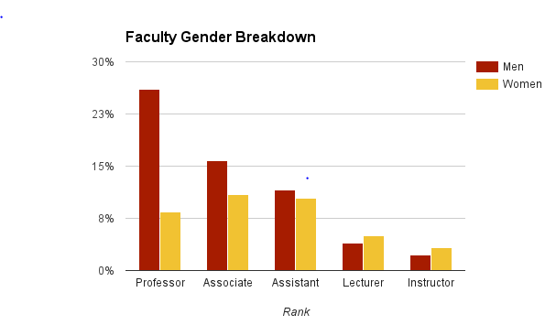

Equity (or Equal Opportunity)
Equity issues may exist even if proportional representation is achieved.
Pay gaps are an example of a gender equity issue in academics that may persist even with full participation of women:
AAUP Faculty salary survey data U.S. doctoral institutions 2014-2015
Notes:
Source: AAUP faculty salary survey: http://www.aaup.org/reports-publications/2014-15salarysurvey
There are more women faculty than ever before, they are still underrepresented at the highest ranks but representation is on an upward trend. However, gender inequities may still persist in STEM academia as they do not depend on representation. One example of an inequity is pay gaps by gender within rank – it is not the only example and may or may not be an issue at your campus – I am just using it as an example of an inequity that are likely the result of policies, procedures and practices within institutions of higher education that allow pay gaps by gender in academia.
A Title IX review may identify these in their data collection but – would not necessarily identify the reasons for the inequity which could be wide ranging and many could be structural such as disproportionate teaching and service for women, inflexible work/family policies, difficult department or classroom climates, lack of transparency in tenure and promotion policies, and differences in starting compensation and start up practices.
So while adding individuals from diverse groups is helpful, it’s not the same as equity as this inequity may exist even where you have 50% representation of women in STEM academia.

Slide 34
ADVANCE Grant Types NSF 16-594
Institutional Transformation (IT)
Develop, implement, and study innovative organizational change strategies to foster gender equity
Adaptation
Adapt proven organizational gender equity strategies
Partnership
Scale-up proven systemic gender equity strategies for national or regional impact
Single IHE that has not had IT before (all STEM)
Up to $3M over five years
Single IHE that has not had IT before (all STEM) or
Two or more partner orgs.
Up to $1M over 3-5 years
One or more disciplines
Up to $1M over three years
Single non-profit org. (one or more disciplines)
Preliminary proposal April 12, 2017* (required)
LOI Aug. 9, 2017* (required)
LOI Dec. 14, 2016* (required)
Proposal Jan. 11, 2017*
Proposal Sept. 13, 2017*
Proposal (if invited after preliminary) Jan. 17, 2018*
*These deadlines will recur every other year until the solicitation is replaced.
Notes:
All projects are expected to build on prior ADVANCE work and gender equity
research and literature to broaden the implementation of organizational and systemic strategies to foster gender
equity in STEM academic careers.
All ADVANCE proposals are expected to recognize that gender does not exist
in isolation from other characteristics, such as race/ethnicity, disability status, sexual orientation, foreign-born and
foreign-trained status, faculty appointment type, etc., and should offer strategies to promote gender equity for all
faculty
The Institutional Transformation (IT) track supports the development of innovative organizational change strategies to produce comprehensive change within one institution of higher education across all STEM disciplines. IT projects are also expected to contribute new research on gender equity in STEM academics. Projects that do not propose innovative strategies may be more appropriate for the Adaptation track.
The Adaptation track supports the adaptation and implementation of evidence-based organizational change strategies, ideally from among those developed and implemented by ADVANCE projects. Adaptation awards may support the adaptation and implementation of proven organizational change strategies within an IHE that has not had an ADVANCE IT award, including two-year institutions, predominantly undergraduate institutions, master’s level institutions, and Minority-Serving Institutions. Adaptation awards may also be made to a STEM organization to implement systemic change strategies focused across all STEM disciplines, several STEM disciplines, or within one STEM discipline.
For all proposals, ADVANCE is interested in supporting a range of institution types including: community colleges, primarily undergraduate institutions, minority-serving institutions (e.g. Tribal Colleges and Universities, Historically Black Colleges and Universities, Hispanic-Serving Institutions, Native Hawaiian Serving Institutions, Alaska Native Institutions, Predominantly Black Institutions and Non-tribal, Native American Serving Institutions), women's colleges, institutions primarily serving persons with disabilities, and master’s level institutions.

