Slide 1
IDEAL-N Annual Plenary
April 6, 2018
Laurie J. Kirsch Vice Provost for Faculty Affairs, Development, & Diversity
University of Pittsburgh

Slide 2
The Core Team
Dr. Anne M. Robertson, William Kepler Whiteford Professor of Engineering, Change Leader
Dr. Kristin Kanthak, Associate Professor of Political Science, Social Scientist
Dr. Laurie J. Kirsch, Co-Director
Ms. Brittany Witoslawski, Assistant to the Provost
Dr. Doris Rubio, Associate Vice Provost for Faculty

Slide 3
Institutional Transformation Theme
Building a culture that encourages and supports the professional development and career progression of mid-career women faculty
Approach
Identify issues and barriers that prevent or slow advancement of women faculty
Identify mechanisms that facilitate career advancement
Design and implement programming
Measure results and assess impact

Slide 4
Pitt Demographics
Notes:
Total # of full-time faculty: 4637
% of full-time faculty who are women: 42.6% (1976)
% of full-time female faculty who are T, TS, NTS
24% of full professors are women Fall 2017 (vs. 21% in 2011; 20% in 2005)
40% of associate professors are women Fall 2017 (vs. 35% in 2011; 29% in 2005)
48% of assistant professors are women (vs. 45% in 2011; 43% in 2005)

Slide 5
Data & Analysis
Study of promotion patterns at Pitt
COACHE survey of full-time faculty
Focus groups of mid-career women faculty
IDEAL-N participants
Research and practitioner literature

Slide 6
Key Findings: Promotion & Tenure (Pitt Study)
Men are significantly more likely to be promoted to Associate Professor than women
It takes men significantly less time to be promoted
Men are significantly more likely to be promoted from Associate to Full
Among those promoted, men and women take similar amounts of time

Slide 7
Key Findings: Promotion & Tenure (COACHE Results)
Compared to faculty at other institutions, Pitt faculty are:
Less satisfied about the clarity of tenure policies and the clarity of tenure expectations.
Less satisfied with the process of being promoted to full professor.
Pitt female faculty are less satisfied across many tenure and promotion metrics than Pitt male faculty.

Slide 8
Key Findings: Promotion & Tenure (Focus Groups, IDEAL-N, Literature, COACHE Results)
Women often lack guidance or mentoring to help them through promotion
Women tend to say “yes” too often, taking on too much service

Slide 9
Actions
Disseminated and used COACHE results
www.pitt.edu/coache
Reports, results, presentations, infographics
Detailed and custom reports for schools
Discussions with deans about results and actions taken at school level

Slide 12
Actions
Launched new Center for Mentoring & Leadership
Third year Office of the Provost offering themed professional development programs
Academics as Leaders:
Mentoring Your Faculty to Success
“Developing Others”
“An Overview of the Tenure and Promotion Processes”

Slide 13
Key Findings: Need for Support and Recognition (Focus Groups, IDEAL-N, Literature)
Women tend not to ask for what they want, including support they need to be successful
Women tend not to challenge the status quo
Women often have more difficulty finding their voice as academics
Women’s contributions can be overlooked or minimized

Slide 14
Actions
Writing Groups for Faculty
Faculty often struggle to find blocs of time
Pilot program in 2017-2018
Provide dedicated space for interested faculty
Groups meet weekly for two-hour bloc
Fall (27) and Spring (39)
“Writing productivity” talk and reception
IRB-approved study of writing groups program and its impacts

Slide 15
Actions
Joined National Center for Faculty Development and Diversity (NCFDD)
Developing a Pitt leadership program for women faculty who are leaders or aspiring leaders
Considering the OpEd project, a think tank and leadership organization that accelerates the ideas of and impact of underrepresented voices

Slide 16
Actions
Faculty development workshops
“Negotiation Tips, Skills, and Strategies for Academic Leaders”
Focus on women and leadership
Spotlight on Women Leaders initiative
Videos on website: http://www.provost.pitt.edu/initiatives/spotlight-women-leaders
Panel discussion of senior leaders and leadership workshop

Slide 17
Actions
A Celebration of Newly Promoted Women Faculty
Held annually in spring, with panel of senior women faculty offering advice, perspective, and guidance
Networking reception with introductions of newly promoted women faculty
Senior leadership attend, including Chancellor and Provost
Complements annual fall lecture and reception welcoming new women faculty to Pitt

Slide 18
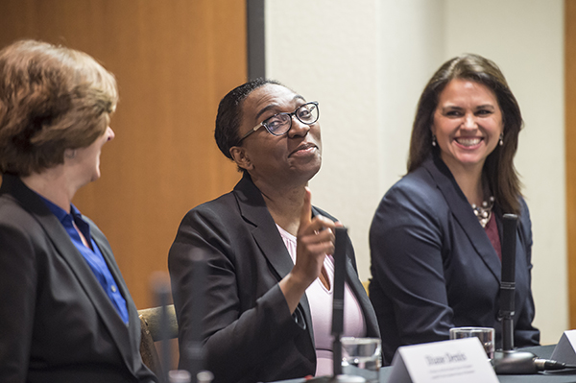
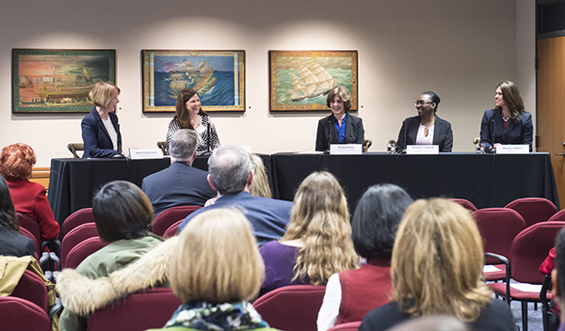
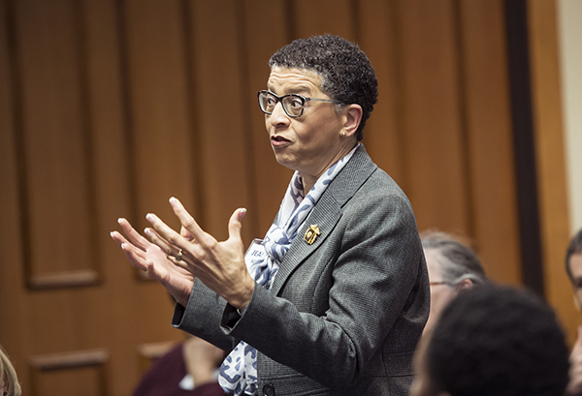
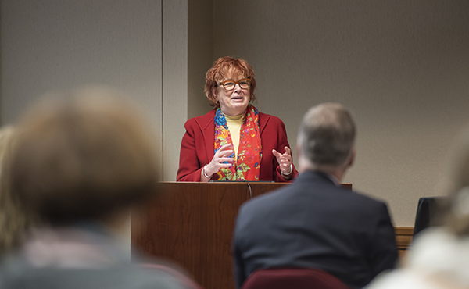
A Celebration of Newly Promoted Women Faculty

Slide 19
Key Findings: Communication Challenges (Focus Groups)
Women faculty seem poorly informed about policies
Faculty seem unaware of scope of resources available to them

Slide 20
Actions
www.provost.pitt.edu/faculty
Prior focus on rules and regulations
Much more content about resources, career development, and opportunities
Family Friendly Programs for Pitt Faculty
Recruiting an Excellent and Diverse Faculty
Teaching Resource Guide for Faculty
New e-newsletter to all faculty
Many more flyers and brochures created

Slide 22
Going Forward
Evaluating efforts and their effectiveness
Focusing on institutionalizing efforts
Additional resource in Office of Provost to help with faculty development
Creating centers to house successful programs
Developing “how to create writing groups” guide
Expanded annual report on climate for women to include information about IDEAL-N

Slide 23
Thank you!

