Slide 1


Scaling the Orange Bond Asset Class:
SCALING
A Practical Toolkit for Investors, Issuers, and Advisors with Legal Frameworks and Insights from the Women’s Livelihood Bond™ Series
ORANGE

Slide 2


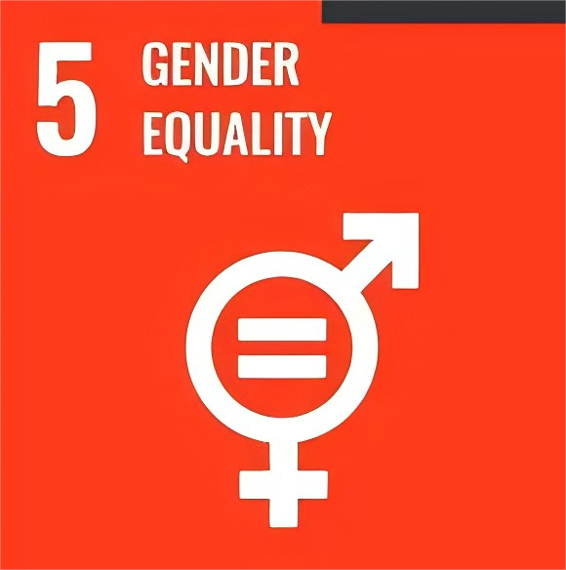
Gender Inequality in Southeast Asia
Gender equality has a positive correlation with other SDGs.
Closing gender gaps can enhance productivity in agriculture to improve food security, the SDG2.
Gnder equality supports health (SDG3) and education outcomes (SDG4).
United Nation set SDG5 to achieve gender equality and empower all women and girls.
Policies that target gender equality are less likely to create negative interactions with other SDGs.
Success in SDG5 leads to overall better development outcomes across various sectors, pushing the UN’s 2030 agenda further.
2

Slide 3

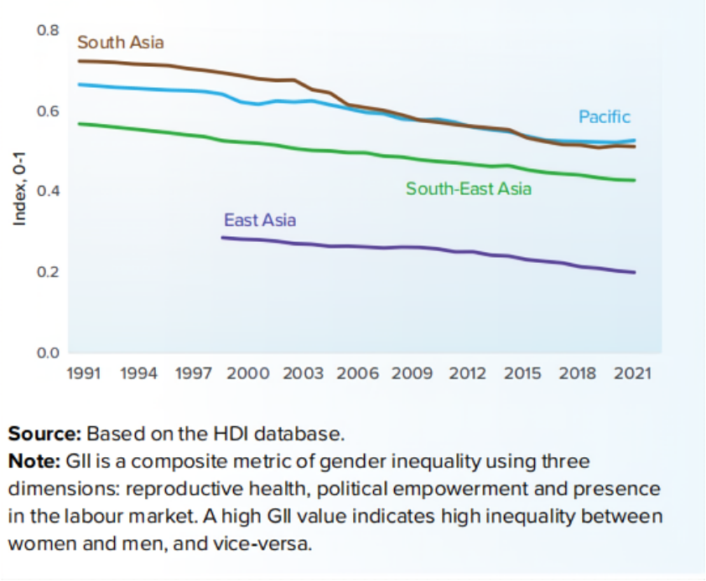
Gender Inequality in Southeast Asia
The Gender Inequality Index (GII) shows that Asia and the Pacific region improved their scores between 1991 and 2021.
South Asia and Pacific still faces notable gender inequality
3

Slide 4

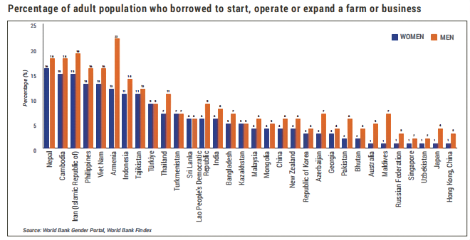
Gender Inequality in Southeast Asia
Despite compelling empirical evidence highlighting the economic and social benefits of women's entrepreneurship, women’s participation in business ownership still faces challenges.
4

Slide 5

Women Entrepreneurs Empowerment
Promoting women entrepreneurs is a more sustainable way to address gender inequality.
Women entrepreneurs
can bring diversity of thought, indigenous knowledge, and innovation, extending benefits to their families and communities and becoming key drivers of economic growth.
5

Slide 6
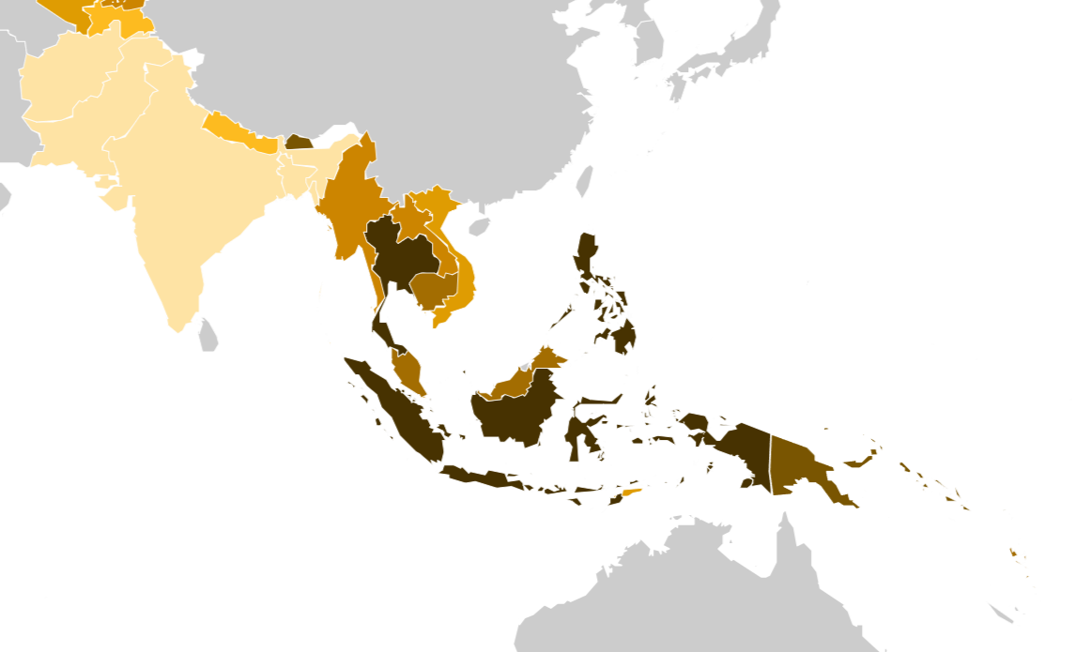
Current progress in Southeast Asia
As of 2023, 40.4% of Cambodian firms had female participation in their ownership. The statistics were 40.9% in Malaysia as of 2019.
In contrast, this gender gap is still significant in other Southeast Asia countries. As of 2022, only 3.9% of Indian firms have female participation in their ownership. The statistic is 6.7% in Bangladesh as of 2022, 36.5% in Laos as of 2018, and 24.8% in Vietnam as of 2023.
Source: World Bank, Enterprise Surveys (http://www.enterprisesurveys.org/).
6

Slide 7
The world needs more progressive approaches
Several limitations of gender bonds
small market size and low issuer participation,
the complexity of gender bonds structure and the lack of guidance,
high administration cost,
ineffective social impact measurement, and
limited private sector participation.
Gender equality in Southeast and South Asia still faces significant challenges.
7

Slide 8


Orange Bonds - Impact Investment Exchange (IIX)
To further SDG5 and advance gender equality, Impact Investment Exchange (IIX) took the color “orange” representing SDG5, and initiated the Orange Movement™.
The Orange Movement™’s mission is to “mobilize US$10 billion by 2030 to empower 100 million women, girls, and gender minorities to drive gender-transformative climate action, sustainable peace, and economic prosperity.”
IIX is a global leader in sustainable finance working at the nexus of gender equality and climate action.
IIX launched the Orange Bond Initiative™ (OBI), an asset class, as “an integral component of the Orange Movement.”
8

Slide 9
Orange Bonds’ framework
Orange Bonds are bonds governed by three Orange Bond Principles™.
  Orange Bonds are the world's first asset class built by and for the Global South, with 99% of them focused on financing gender equality
  Uniquely cross-cutting, the Orange Bond asset class supports not only gender equity but also drives climate resilience, economic prosperity, and sustainable peace.
An Orange Bond must have
  gender-positive capital allocation,
  gender-lens capacity and diversity in leadership, and
  transparency in the investment process and reporting.
9

Slide 10
Orange Bonds’ objectives
Orange Bond Initiative™ provides a catalytic to mobilize financial resources through Orange Bonds and empowers women, girls, and LGBTQI+ people.
Orange Bond Initiative™ equips financial market practitioners with data analytic, market intelligence, and training to build a gender-empowered financial system.
Financial Resources for Gender Equality
Gender-Empowered Financial System
10

Slide 11


Orange Bonds’ objectives
Transforming the current financial system into a gender-empowered one.
Orange Bond Principles™ resolve systemic problems in the current financial system, which are the lack of a systematic approach to gender equality, the lack of inclusive leadership, and the lack of transparency.
Orange Bonds’ objectives
Under the Principles’ guidance, OBI plans for a financial system that (1) “provides multi-dimensional options for proceeds to build gender equality,” (2) “mandates gender and racial representation on the investment committee and team,” and (3) “requires impact verification and confirmation directly with women, girls, LGBTQI+ people.”
11

Slide 12

Orange Bonds’ current participants
The Orange Bond Initiative (OBI) has attracted 249,000 signatories from all six continents to pledge into the Orange movement.
The United Nations Capital Development Fund (UNCDF) is a member of the Orange Bond Initiative Advisory Council.
12

Slide 13
Orange-Bonds-labeled
Women’s Livelihood Bond™ (WLB™) series
WLB is the most successful Orange-Bonds-labeled project
WLB™ is “an innovative gender-lens blended financial product that qualified as Orange bonds.”
WLB™ functions as a debt security with a blended finance structure to balance risk, return, and impact.
13

Slide 14
Orange-Bonds-labeled
Women’s Livelihood Bond™ (WLB™) series
WLB5 is the world’s first Orange Bond dedicated to SDG5 and gender minority empowerment.
WLB6, issued in 2023, is the largest WLB as of date.
WLB6 reached an unprecedented size for gender-based investment bonds of US$100 million, with a 7.25% coupon rate.
WLBs “has mobilized US$228 million and empowers 2,600,000 women and girls across emerging markets while providing consistent returns with no defaults recorded.”
14

Slide 15
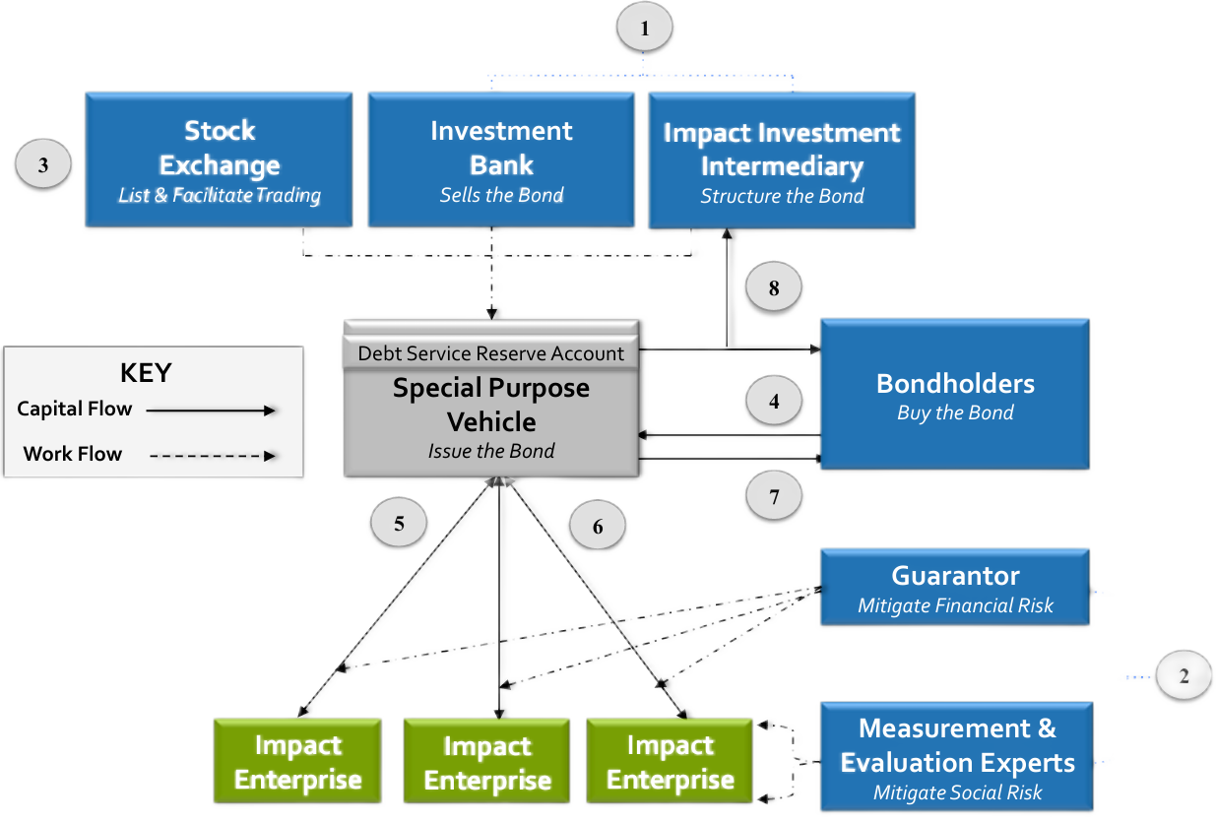
WLB6’s creation
IIX is the Portfolio Manager.
It created its fully-owned WLB Asset VI Pte. Ltd. (the Issuer), a corporation incorporated under the laws of Mauritius, to issue the bond.
The Issuer is a special purpose vehicle.
Its sole purpose is to issue the WLB6 and be obligated by this bond.
It is prohibited from creating other security interests, engaging in non-WLB6 businesses, owning real property, unauthorized asset disposals, incurring debt, or merging, acquiring subsidiaries, or employing staff.
Therefore, it has no operating history.
15

Slide 16
WLB6’s size and purchasing terms
01
The Issuer issues US$88,000,000 in aggregate principal amount of bonds, with a coupon rate of 7.25% and a maturity date of December 21, 2027. The coupon payment is made semi-annually (i.e., every six months).
02
Each bond has a minimum denomination of US$250,000. A denomination refers to the unit classification for the stated or face value of bonds.
So, a bondholder must purchase a bond worth US$250,000 or more, and additional purchases can only be made in increments of US$1,000.
16

Slide 17


WLB6’s accounts
the Funding Account
the Debt Service Reserve Account
the Recovery Account
the Guarantee Fee Reserve Account
the Collection Account
17

Slide 18

WLB6’s risk mitigation structure
WLB 6 utilized three layers of blended finance structure to mitigate risks for investors.
Blended finance combines concessional and commercial capital, leveraging public or philanthropic funds to absorb losses or provide guarantees, thereby reducing risks and enhancing returns to mobilize private investment for development outcomes.
A subordinated indebtedness serves as a first-loss capital
A cushion to absorb the loss for the bondholders
A partial guarantee of up to 40%
of the net losses of WLB6’s principal
A pledge and first-ranking floating charge
The Issuer's bank accounts were secured under the Deed of Pledge and Charge. If a default occurs, the floating charge of the accounts will crystallizes and becomes a fixed charge.
18

Slide 19





WLB6’s Issuer on-lent the proceeds
The regional borrowers are responsible for making loans to women-focused enterprises located in Kenya, Indonesia, Vietnam, Cambodia, and India.
The Issuer uses the proceeds from the issuance of the Bonds to make loans to regional borrowers in the form of a non-convertible debenture.
$
$
$
The regional borrowers are “high-impact enterprises located in South Asia, Southeast Asia, and East Africa that use the proceeds of the Loans to benefit underserved women.”
19

Slide 20
WLB’s gender equality impact
IIX is responsible for monitoring the regional borrower and assessing the impact on gender equality.
The methodology of IIX’s impact assessment
IIX identifies six specific outputs of WLB6.
IIX measures the impact of these six outputs with gender-specific metrics.
The metrics are designed to specifically measure the impact on women, using gender-disaggregated data and input from women to focus on the empowerment factors that matter most to them.
WLB thus achieves five primary outcomes and three secondary outcomes.
These outcomes are considered with the local economic, policy, technological developments. They provide a holistic understanding of the sustainable impact and women empowerment.
IIX calculates WLB’s Social Return on Investment with all of these outcomes.
WLB6’s targeted SROI is 25%
20

Slide 21

WLB’s gender equality impact
First specific outputs of WLB6
Women Entrepreneurs.
Providing loans to around 230,000~250,000 women entrepreneurs who own small businesses or start-ups.
21

Slide 22

WLB’s gender equality impact
Second specific outputs of WLB6
Micro Savings and Insurance.
Providing savings and insurance products to women from low-income communities, enhancing their financial resilience.
22

Slide 23

WLB’s gender equality impact
Third specific outputs of WLB6
Affordable Housing.
Providing affordable housing loans to around 500~600 women in Cambodia, changing social norms and lifting income-related barriers to home ownership.
23

Slide 24

WLB’s gender equality impact
Fourth specific outputs of WLB6
Water and Sanitation (WASH).
Providing loans to improve access to water and sanitation for around 27,000~29,000 women, partially easing women’s burden to collect water.
24

Slide 25

WLB’s gender equality impact
Fifth specific outputs of WLB6
Agriculture Loans for Smallholder.
Providing loans for around 67,000~69,000 women farmers in Kenya and India to boost financial resilience and encourage eco-friendly practices.
25

Slide 26

WLB’s gender equality impact
Sixth specific outputs of WLB6
Clean Energy Solutions.
Providing loans for Vietnamese companies who provide solar and other forms of clean energy to SMEs with a preference for supporting those that are women-owned and operated.
26

Slide 27

WLB’s gender equality impact
First primary outcome
The loans boost women entrepreneurs’ and women smallholder farmers’ income by 10~30% annually. The total impact on income generation is approximately at US$277~278 million over four years. This aligns with SDG1 (No Poverty) and SDG8 (Decent Work and Economic Growth).
27

Slide 28

WLB’s gender equality impact
Second primary outcome
The insurance and saving products improved women’s financial resilience with an estimated impact of US$56~56.5 million, aligning with SDG10 (Reduced Inequalities).
28

Slide 29

WLB’s gender equality impact
Thrid primary outcome
The housing loan increased women’s asset ownership by a value worth approximately US$24.2~24.5 million.
Increased asset ownership aligns with SDG8 and SDG11 (Sustainable Cities and Communities) as well.
29

Slide 30

WLB’s gender equality impact
Fourth primary outcome
The access to water and sanitation creates a value worth $58~59 million, further supporting SDG 2 (Zero Hunger), SDG 6 (Clean Water and Sanitation), and SDG 8. The WASH loans help women to adapt to climate challenges, and save women 1~3 hours daily on water collection.
30

Slide 31

WLB’s gender equality impact
Fifth primary outcome
Renewable energy loans improve women’s access to affordable and clean energy and lower carbon emissions in emerging markets.
The estimated impact is worth US$4.45~4.55 million, advancing SDG 7 (Affordable and Clean Energy), SDG 9 (Industry, Innovation, and Infrastructure), and SDG 13 (Climate Action).
31

Slide 32

WLB’s gender equality impact
The bond proceeds that are on-lent by the regional borrowers should be used to benefit the women’s families and their offspring.
Three secondary outcomes
The improved standard of living also helps to secure women from gender-based violence both domestically and externally. Women can have gender-segregated or private spaces to manage sanitation needs.
The loan-supported sustainable farming practices enhance food security and climate resilience for the local community.
32

Slide 33

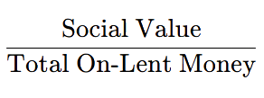
WLB’s gender equality impact
Quantified & Monetized social value allows IIX to calculate the Social Return on Investment (SROI)
IIX quantifies WLB6’s
impact via two methods
Cost-Based Proxies
measure social values that affect productivity
Value-Based Proxies
measure social values that relate to financial resilience
Cost-Based Proxies calculates future cost savings or potential income increases, such as the economic benefit of time saved.
SROI
=
Value-Based Proxies calculates the value of resources such as savings or insurance coverage available to women.
WLB6’s targeted SROI is 25%
33

Slide 34

WLB’s impact assessment align with Orange Bond Principles™
First Principle - promotes gender positive capital allocation
WLB6 ensures that this objective is met by including gender-specific impact covenants in the loan agreements with the regional borrowers.
34

Slide 35

WLB’s impact assessment align with Orange Bond Principles™
Second Principle - promotes gender-lens decision-making and women's leadership
Not only does WLB6 produce positive outputs, but IIX also serves as a model.
IIX is 50% women-owned, with women making up 40% of the investment committee and around 66% of the staff involved in the bond's core functions.
35

Slide 36
WLB’s impact assessment align with Orange Bond Principles™
Third Principle - ensures transparency in investment process and reporting
The impact assessment has positive externalities in that it increases the availability of gender-focused data, improves future portfolio decisions, and enhances transparency for investors in general.
IIX provides semi-annual impact reporting that includes mandatory gender-lens outcomes for all nine regional borrowers.
Correspondingly, the regional borrowers’ loan agreements require them to report their portfolio and financial statements to IIX periodically, and provide support to IIX’s impact assessment efforts.
36

Slide 37


WLB6’s Listing on the Singapore Securities Exchange (SGX)
Listing WLB6 on the SGX can connect the Issuer to global investors.
SGX has an electronic submission system and a market-friendly regulatory framework, making it a preferred platform.
A bonds issuer can list two types of debt securities on SGX, wholesale bonds and retail bonds.
It is intended for investors who purchase and hold the bonds to maturity.
Accordingly, WLB6 is listed as a wholesale bond, not a retail bond.
Although WLB6 is listed on the SGX, WLB bond holders are not easily able to transfer or sell their bonds.
Since SGX maintains an electronic system, a bonds issuer may list wholesale bonds in token format, rendering them completely digital.
37

Slide 38
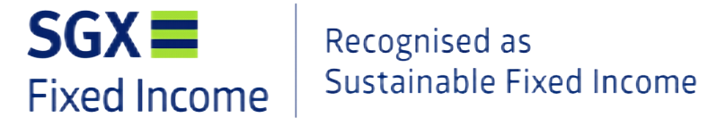

SGX’s endorsement of WLB6
WLB6 obtained SGX’s endorsement as a “sustainable” security.
Successful Issuer(s) are permitted to use the SGX mark:
To qualify for SGX’s endorsement mark
The bonds must align with “recognized green, social or sustainability standards.”
An external reviewer must review and confirm the alignment.
The report that setting out the alignment must be publicly vailable.
The recognized standards must include standards promulgated by International Capital Market Association (ICMA).
IIX employed an independent evaluator for the external review
The external review’s endorsement:
38

Slide 39

Recommendations
Potential investors, NGOs and end-users should analyze whether its program and objectives align with the Orange Principles™.
Second, the organization should determine whether the WLB™ bond structure fits with its objectives, programs and corporate structure to be able to use it as a vehicle for change.
Finally, for more information and guidance, please feel free to contact IIX.
71

Slide 40
Conclusion
The case study on WLB6 demonstrates the practical application of Orange Bonds, showcasing how a financial instrument can advance gender equality in emerging markets.
WLB6 utilizes a blended finance structure to successfully mobilize capital to support women entrepreneurs across Southeast Asia and beyond. Moreover, with its sophisticated risk mitigation structure, financial and other risks are avoided or reduced, thereby helping to protect the interests of private investors.
With the legal structure and the impact assessment structure of WLB6 analyzed and explained, this toolkit provides practical guidance on how sustainable fixed-income debt securities can be leveraged to advance gender equality.
39

Slide 41
Thank you
for your attention!
SCALING
ORANGE
Case Western Reserve University School of Law
International Development Law Lab
Adjunct Law Professor Rumu Sarkar
IDL Lab Student: Yuqi Sun

