Slide 1
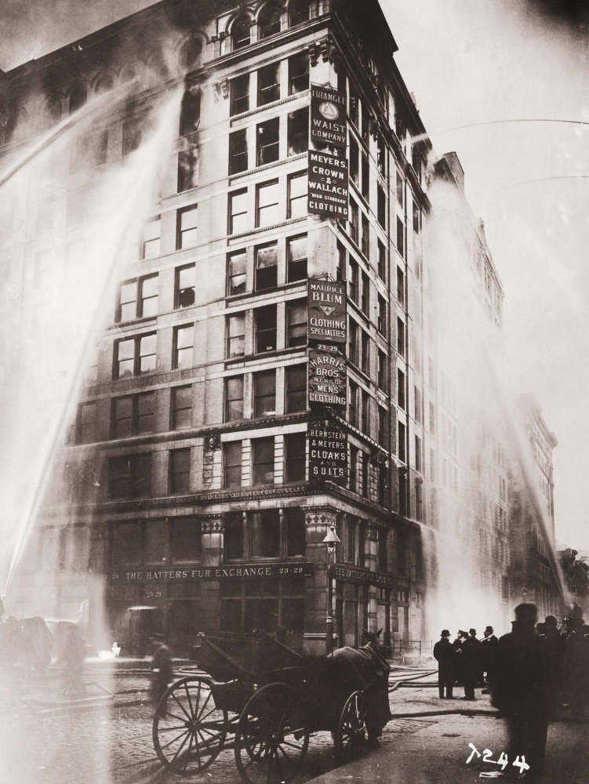
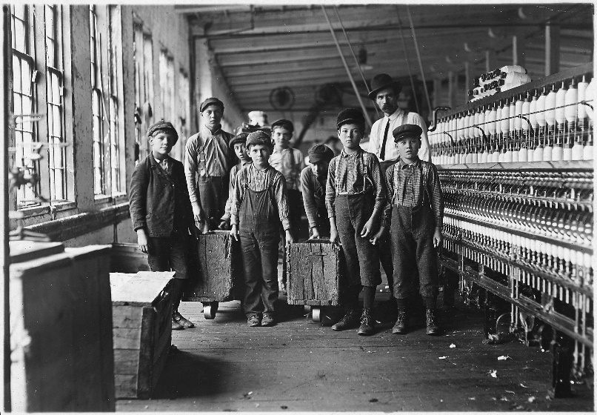
Progressivism and the Triangle fire
1890-1917

Slide 2
Course Thesis: Importance of Events
Often tragic events, often involving young people
Not only the events themselves, but the depiction of the events
Role of the media is crucial
Malignant force
Innocent victim
Drama – good vs. bad, a moral choice
In the aftermath, conclusion that this has to change
A battle of interpretation. These events typically are contested.

Slide 3
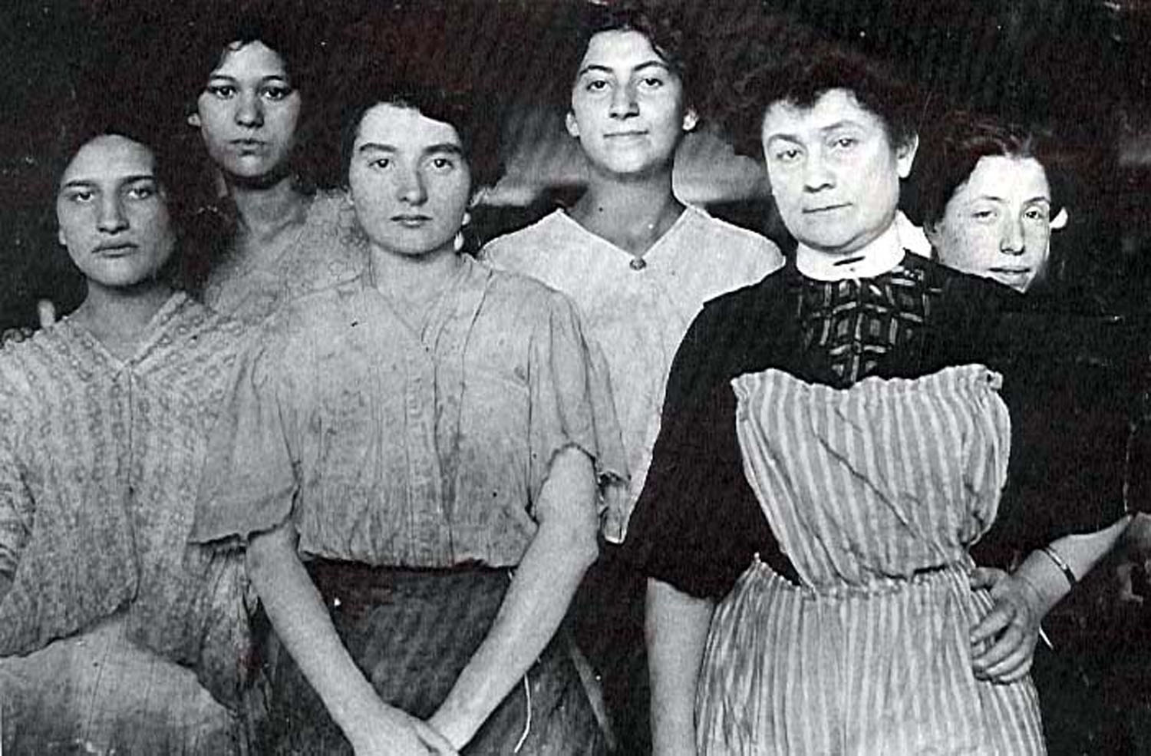
Triangle Shirtwaist fire March 25, 1911
“The sight was more than New York could bear.”

Slide 4
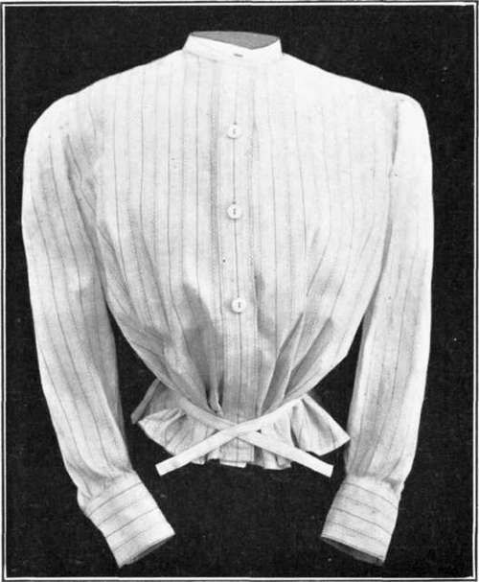
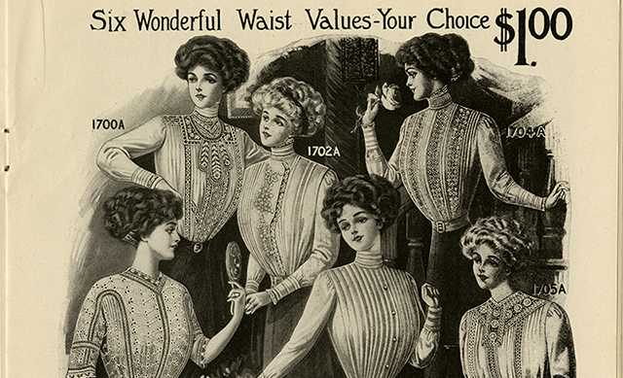
What is a shirtwaist?
A woman’s blouse that resembles a shirt

Slide 5
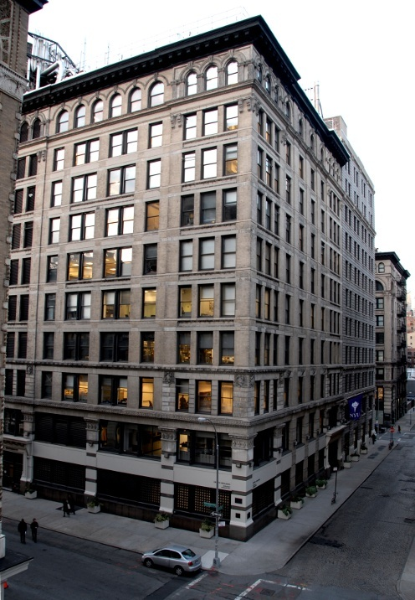
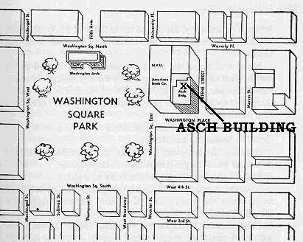
The Triangle site today
Location in lower Manhattan

Slide 6
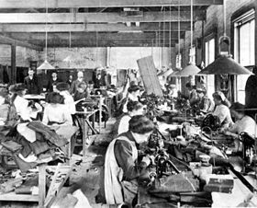
What was/is a “sweatshop”?
A factory where workers are employed at very low wages for long hours
and under poor conditions

Slide 7
Details of the tragedy
Garment industry was (and still is) a highly competitive business centered in Manhattan
A clothing factory – a “sweatshop” – occupied the 8th, 9th and 10th stories of a 10-story building in lower Manhattan
The workers were mostly immigrant women – many of them Italian and Jewish between the ages of 14 and 23
Owners of the factory, the Triangle Waist Co., had fiercely resisted unionization and workers’ demands for safer working conditions
Doors were locked at the direction of owners, supposedly to keep out union organizers
A fire broke out on the 8th floor and quickly spread to upper floors

Slide 8
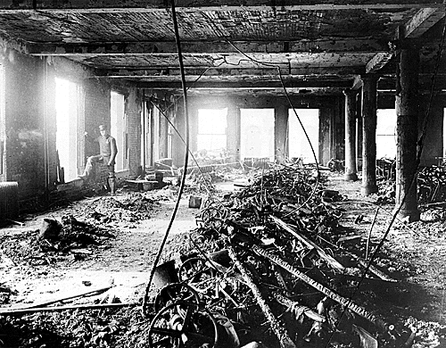
Details of the tragedy, continued
The panicked workers, trapped by the approaching fire, fled to the windows and many jumped to their deaths
Thousands of people, gathering in and around Washington Square, witnessed this
This was downtown New York, so the
media was right there
146 people killed in the most horrible,
visible way possible

Slide 9
It is the thesis of this course that events like the Triangle fire bring about change in history

Slide 10
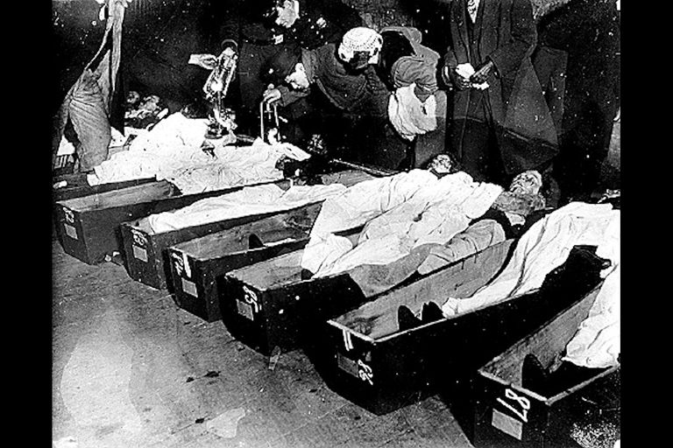
Why was this particular event such a turning point?
Identifying fire victims at the morgue

Slide 11
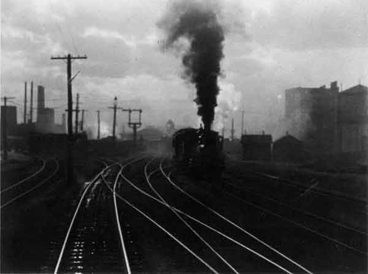
The roots of the tragedy can be traced to the rise of industrialization starting in the late 19th century
The Hand of Man Alfred Stieglitz

Slide 12
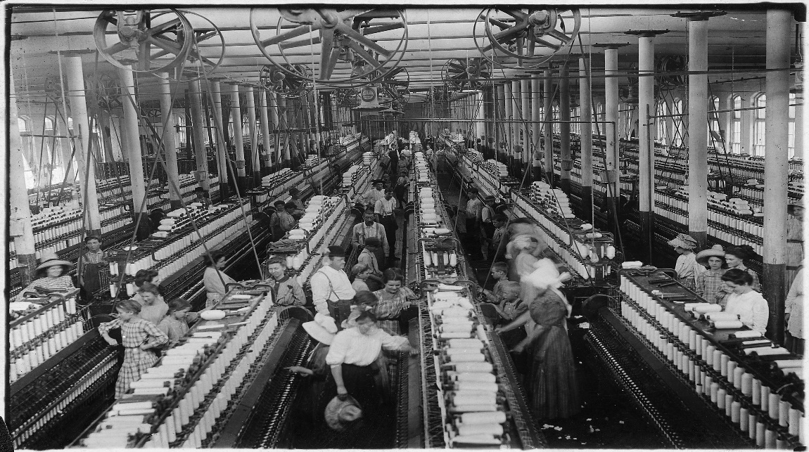
U.S. becomes an industrial giant
U.S. population doubles, 1870-1900
Value of manufactures grows six-fold
From a predominantly rural nation into an urban-industrial society
Mass production, mass consumption, time-clock efficiency
Bigness becomes prevailing standard
Foundation of the “Gilded Age”
Ideal of Social Darwinism

Slide 13
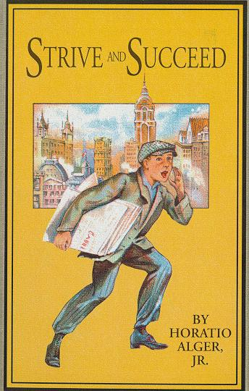
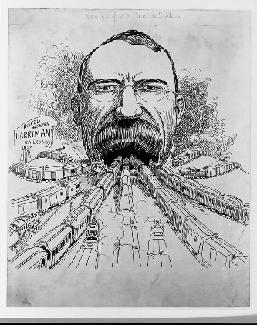
Second Industrial Revolution
Huge corporations formed, dominating the economy
Integration of production and distribution into single companies
Companies joined forces with competitors – trusts
National markets established
Myth of the capitalist hero, the robber baron
This combination of power bred dissent, emergence of labor movement, demands for workers’ rights

Slide 14
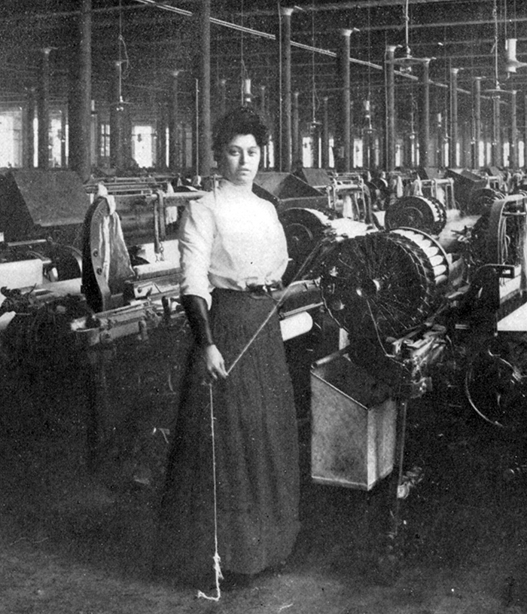
What are some basic elements industries require to do business?
Rhode Island factory worker, 1906

Slide 15
Key factors in big business
Power source
Sources of capital
Proximity to supplies
Proximity to markets
Transportation and communication networks
Cheap labor (key driver of immigration)
Etc.
Mill building, Lowell, Mass.

Slide 16
Where (on the map), typically, would those resources be available?

Slide 17
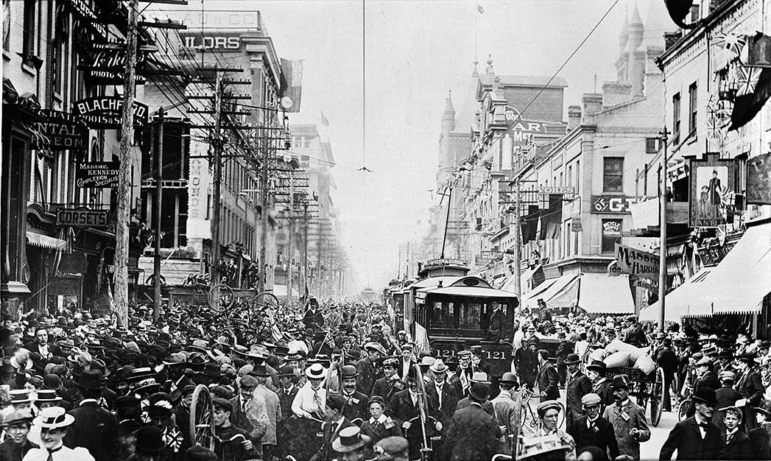
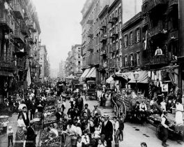
In cities

Slide 18
In the period following the Civil War, American cities grow exponentially
Chicago
Pittsburgh
San Francisco
St. Louis
Cleveland
Buffalo
Baltimore
And, most prominent of all, New York City

Slide 19
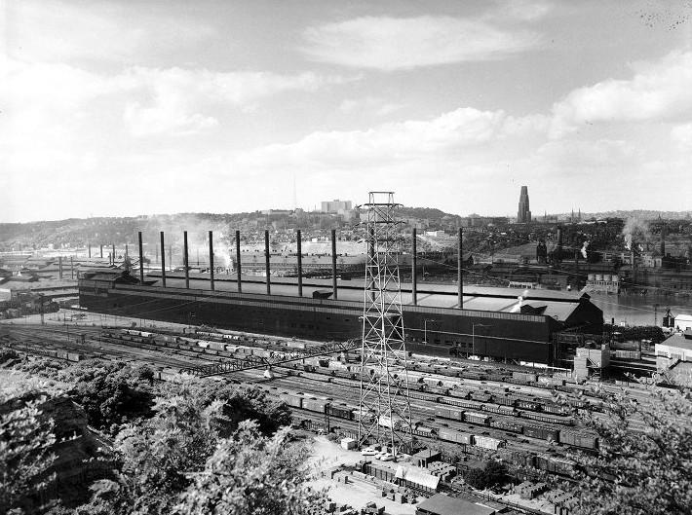
As industries get established in particular cities, the growth gets compounded
Jones and Laughlin plant, Pittsburgh

Slide 20
Between 1870 and 1910, New York City’s population grows from less than 1 million to greater than 4.7 million
Industrialization spurs immigration, a key factor in this population growth

Slide 21
Much of the action in the industrial period was in the cities

Slide 22
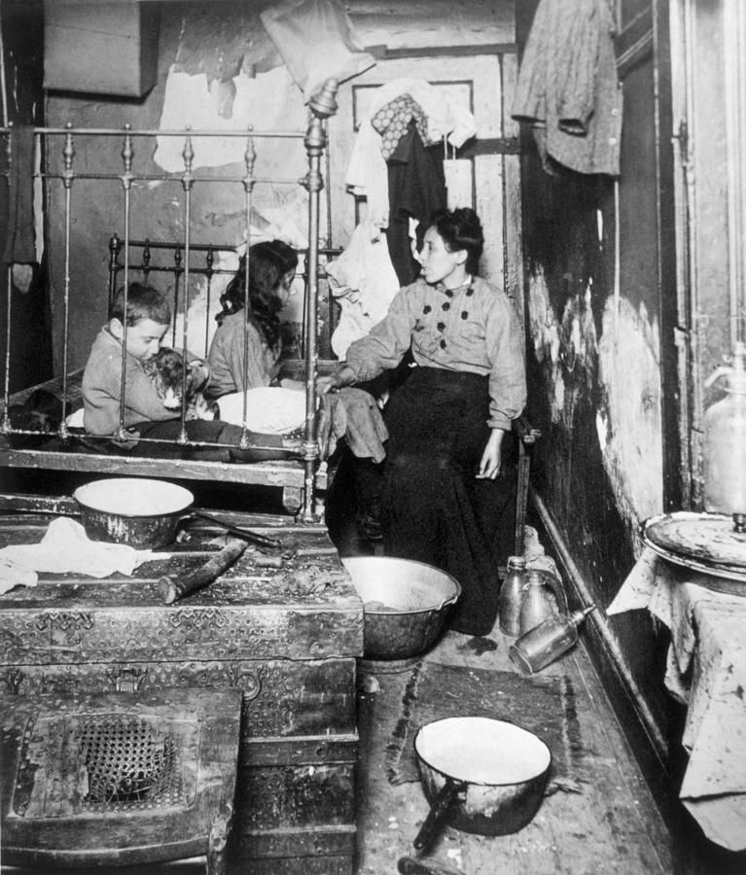
But by the end of the 19th century, the American city is becoming unlivable
Rampant capitalism with few rules

Slide 23
Key aspects of industrialization
Fast-growing industries
Need for workers, which spurs immigration
Deplorable working conditions
Low pay
Job insecurity
Labor movement sometimes leads to violence
Intensifying social unrest

Slide 24
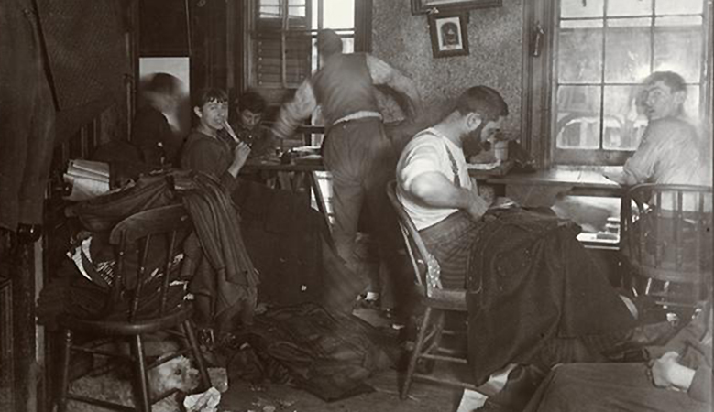
Problems of the Industrial Era
Poverty
Vast inequality of wealth
Slums, crowding in cities
Poor sanitation
Child labor
Poor public services
Jewish immigrants in the garment industry

Slide 25
Other problems
Government non-responsive
Government small, inefficient and dominated by cronyism. An example of this would be Tammany Hall, the Democratic political machine in New York City
Lack of regulation (of business, for example)
Laws had not caught up to growing complexity of society
The result of all these issues is a reform movement known as Progressivism.

Slide 26
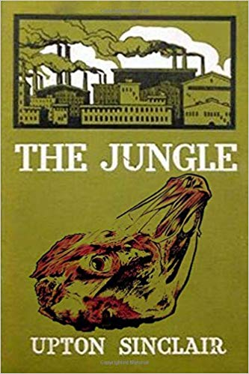
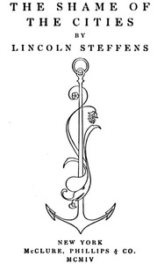
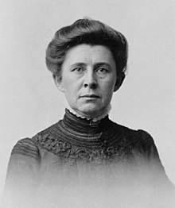
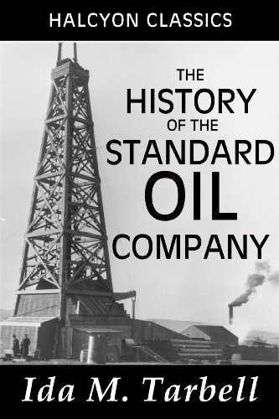
Muckrakers
Journalists, novelists, social critics
Growing power of media
Investigated and exposed problems
In today’s parlance – investigative journalists
Ida Tarbell

Slide 27
Some topics Muckrakers investigated
Prisons
Slums
Factories, “sweatshops”
Insane asylums (as they were then called)
Mines
Food-processing plants

Slide 28
The political system slowly begins to respond
Progressivism gains force
Lasted roughly 1890-1917
Key political figures – Theodore Roosevelt, Woodrow Wilson
An attempt to have the law catch up with growing complexity of an industrial society
A movement for reform – sanitation, workplace safety housing, parks, public health, prisons, the political system (women’s suffrage), etc.
Middle-class movement
Mostly in the cities

Slide 29
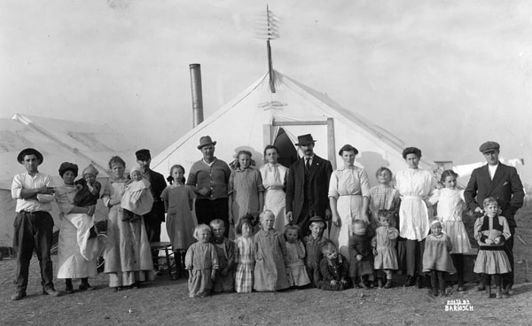
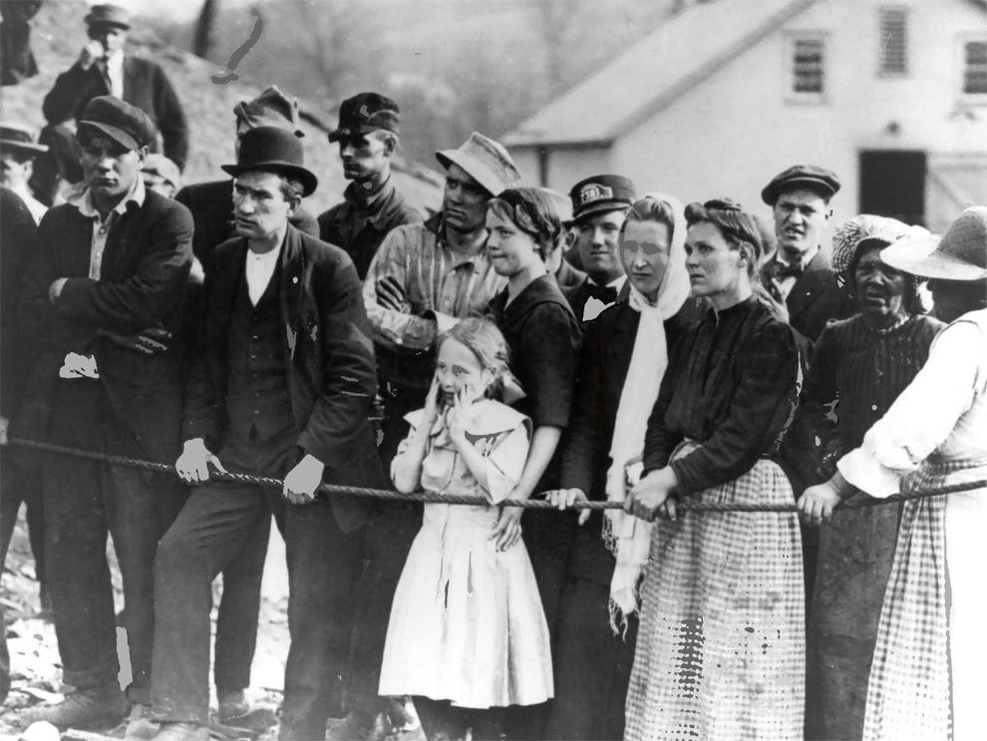
Disasters accentuate public openness to change
Monongah coal mine explosion (1907) – Bureau of Mines
Titanic sinking (1912) – maritime safety, ice patrols
Ludlow massacre (1914) – working conditions, safety, health reforms, public relations, Rockefeller philanthropy

Slide 30
Triangle (historical context)
Garment industry was especially resistant to change
Terrible workplace conditions – “sweatshops”
Working on piecework – emphasis on speed
Wages kept very low
Safety concerns ignored
Labor of immigrant women, in particular, is exploited

Slide 31
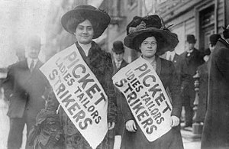
Unionization in garment industry begins
Many women from Triangle go on strike (1909)
They are fired from their jobs
They form an independent strike, and women from another factory join them
Tammany Hall sends the police, and the workers are arrested
This leads to a mass meeting and a strike of 20,000 workers
“Uprising of the 20,000” gets support from women reformers
Strike result: marginal improvement

Slide 32
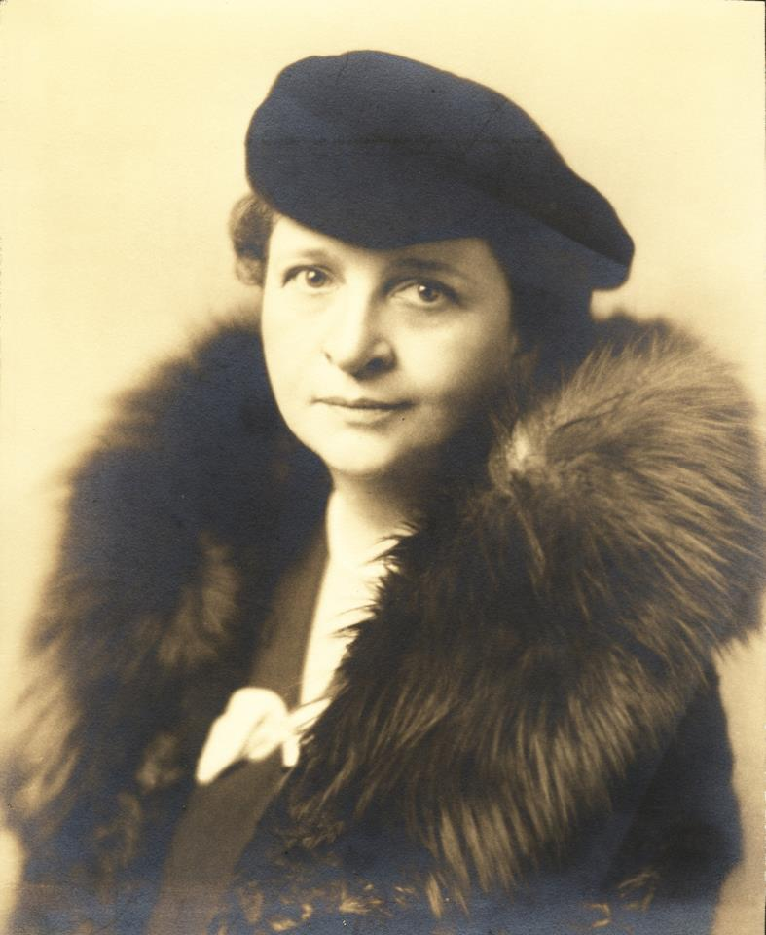
Aftermath of the fire -- changes
Mass funeral
A city with a stricken conscience
Tammany Hall sees city’s demographics are changing
State factory commission
54-hour week
Workers’ compensation
Roles of Al Smith, Robert Wagner, Frances Perkins, FDR
Roots of the New Deal
Frances Perkins

Slide 33
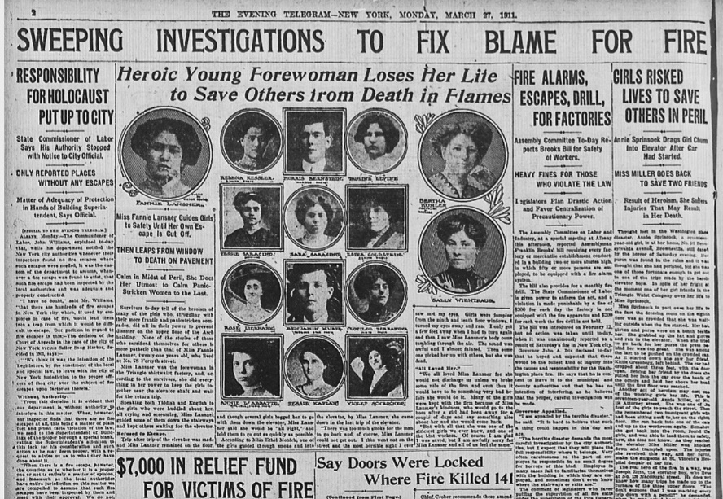
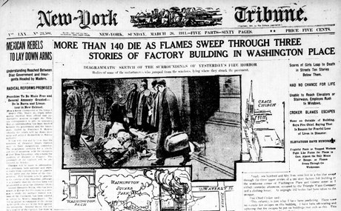
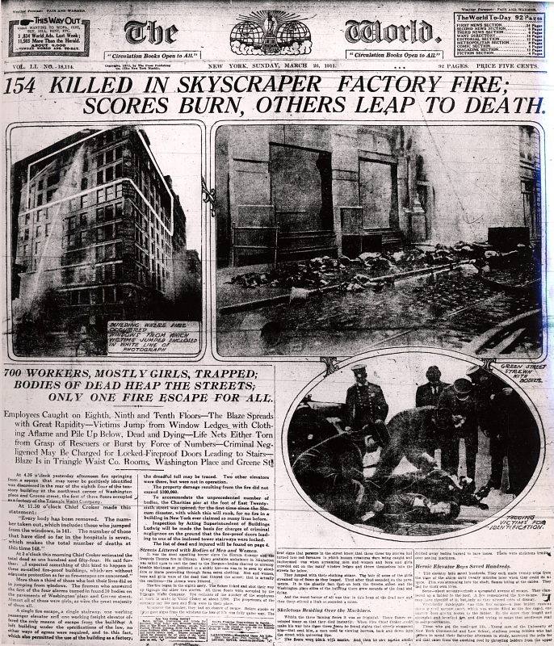
Media coverage of the fire and aftermath

