Slide 1
MSK Radiology + more!
Week 3 Lecture

Slide 2
Contents
Intro to Emergency MSK
Basics of Arthritis
Imaging techniques in MSK
Intro to MSK IR
Appropriate MSK imaging
Intro to Nuclear Medicine

Slide 3
Emergency MSK Radiology, What exams do we see?
Trauma
Ranging from fall in parking lot to high speed MVA
Pediatric vs Adult fx’s
Child abuse
X-ray, CT, MRI
Osteomyelitis, Septic Arthritis
X-ray, MRI

Slide 4
Non-emergent MSK Radiology, What exams do we see?
Arthritis
Usually X-ray
Soft Tissue/Sports Injury
X-ray, MRI
Soft Tissue/Bone Tumors
X-ray, MRI
Pre-Surgical Planning
CT

Slide 5
Describing a Fracture

Slide 6
Describing a Fracture
Direction of the fracture line
Relationship of the fracture fragments
Number of fragments
Communication of the fracture with the outside
Secondary Signs can help increase sensitivity!
Effusion?

Slide 7
Direction of the Fracture Line
Transverse
Diagonal/Oblique
Longitudinal
Spiral

Slide 8
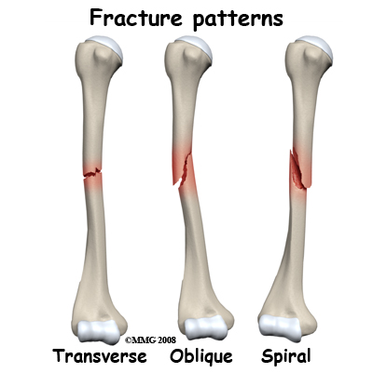
Direction of the Fracture Line
Transverse
Force applied perpendicular to the long axis of the bone
Diagonal/Oblique
Longitudinal
Spiral
Notes:
http://www.learningradiology.com/medstudents/recognizingseries/recogfxsflashpage.htm

Slide 9
Direction of the Fracture Line
Transverse
Diagonal/Oblique
Force applied in the same direction as the long axis of the bone
Longitudinal
Spiral
Notes:
http://www.learningradiology.com/medstudents/recognizingseries/recogfxsflashpage.htm

Slide 10
Direction of the Fracture Line
Transverse
Diagonal/Oblique
Longitudinal
Force applied along the long axis of the bone
Spiral
Notes:
http://www.learningradiology.com/medstudents/recognizingseries/recogfxsflashpage.htm

Slide 11
Direction of the Fracture Line
Transverse
Diagonal/Oblique
Longitudinal
Spiral
Torque injury
Notes:
http://www.learningradiology.com/medstudents/recognizingseries/recogfxsflashpage.htm

Slide 12
Relationship of Fracture Fragments
Displacement
Angulation
Shortening
Rotation

Slide 13
Relationship of Fracture Fragments
Displacement
Amount by which the distal fragment is offset from the proximal fragment
Front-to-back, Side-to-side
Described by percent or fraction of shaft width
Angulation
Shortening
Rotation
Notes:
http://www.learningradiology.com/medstudents/recognizingseries/recogfxsflashpage.htm

Slide 14
Relationship of Fracture Fragments
Displacement
Angulation
Angle between the distal and proximal fragments
Described by degrees and position
anterior/posterior or medial/lateral
Can alternatively describe apex
Shortening
Rotation
Notes:
http://www.learningradiology.com/medstudents/recognizingseries/recogfxsflashpage.htm

Slide 15
Relationship of Fracture Fragments
Displacement
Angulation
Shortening
If any, how much overlap between the fracture fragments
Described in cm
Rotation
Notes:
http://www.learningradiology.com/medstudents/recognizingseries/recogfxsflashpage.htm

Slide 16
Relationship of Fracture Fragments
Displacement
Angulation
Shortening
Rotation
Involves long bones
Describes the orientation of one joint at one end relative to the orientation of the joint at the other end
Notes:
http://www.learningradiology.com/medstudents/recognizingseries/recogfxsflashpage.htm

Slide 17
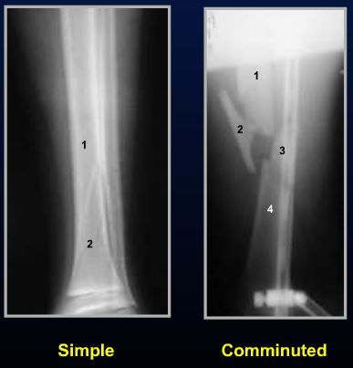
Number of Fracture Fragments
Simple Fracture
Two fragments
Comminuted Fracture
> Two fragments
Notes:
http://www.learningradiology.com/medstudents/recognizingseries/recogfxsflashpage.htm

Slide 18
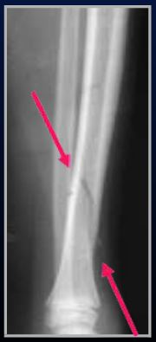
Communication of Fracture with outside
Closed
No communication to the atmosphere
Open
Communication with the atmosphere
Increased risk of infection
Look for soft tissue gas
Notes:
http://www.learningradiology.com/medstudents/recognizingseries/recogfxsflashpage.htm

Slide 19
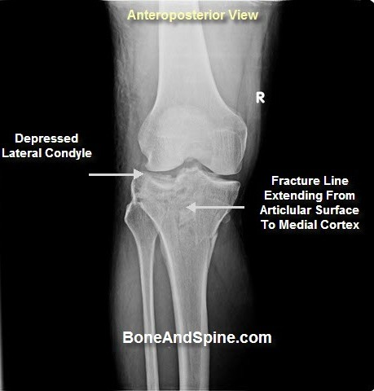
Communication of Fracture with Joint space
If fracture line extends to an articular surface, more likely to be surgical fixation
Increased risk for arthritis.
Notes:
http://www.learningradiology.com/medstudents/recognizingseries/recogfxsflashpage.htm

Slide 20
Aging of fractures (Acute vs Subacute)
Acute fractures will demonstrate cortical irregularity, sharply demarcated
No sclerosis, no bony resorption
Subacute fractures (have begun healing)
Will demonstrate signs of bony remodeling
One of the first changes will be bony resorption
Then will develop callus around the fracture site
Cloudlike calcific densities about the fracture site.

Slide 21
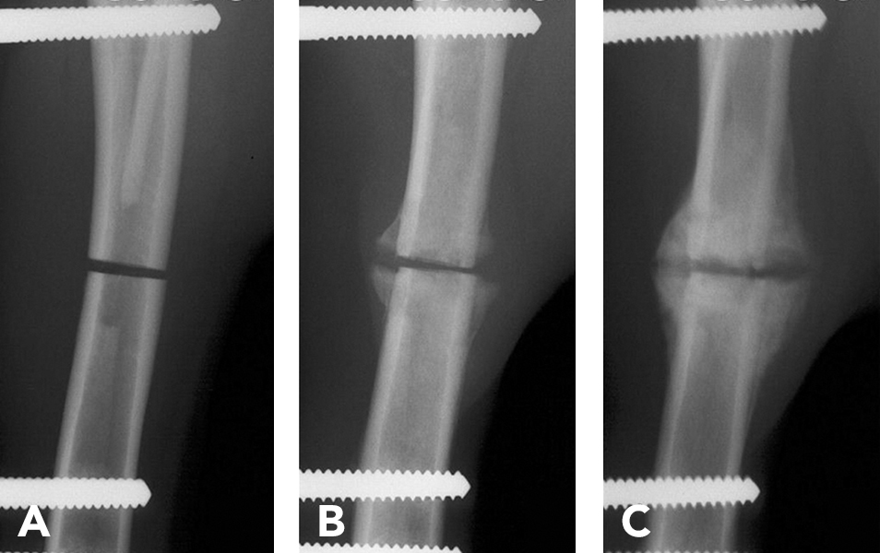
Callus Formation

Slide 22
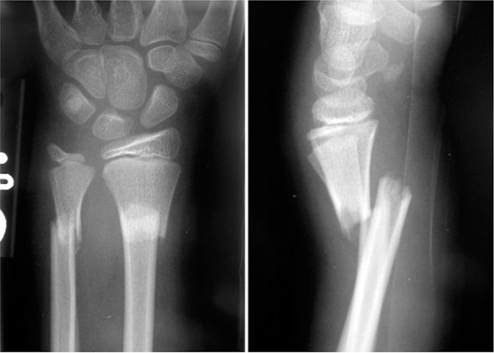
Acute fracture
Acute radius and ulna fractures
Sharply demarcated borders.
No callus.

Slide 23
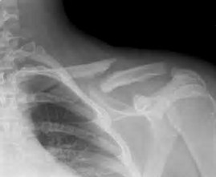
Common Adult Fractures, Practice Describing!
Oblique Fracture
Middle Third of clavicle
Most common
Distal fragment inferior displaced by almost full shafts width

Slide 24
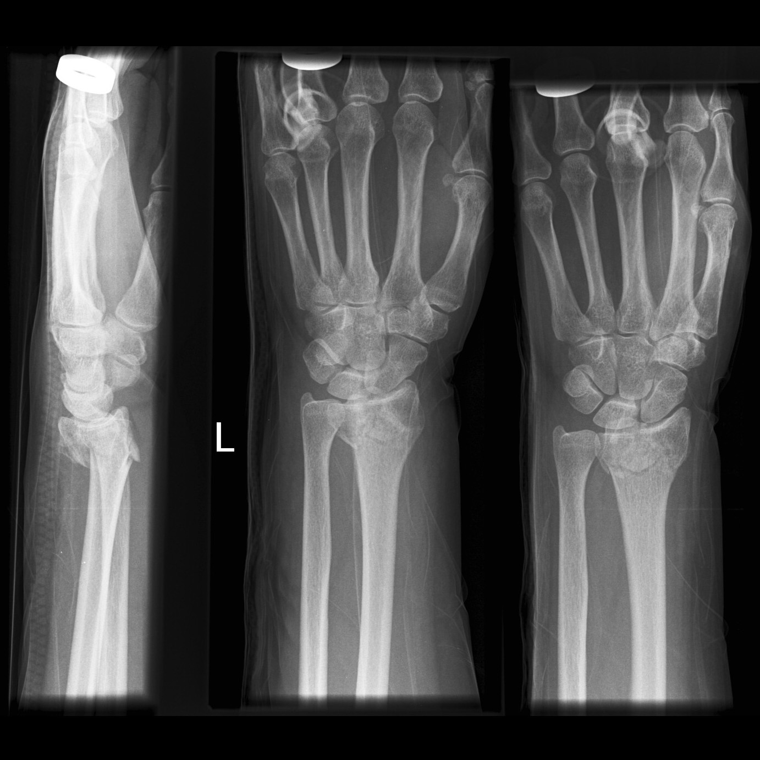
Common Adult Fractures, Practice Describing!
Colle’s Fx
Comminuted
More than 2 fragments
Dorsally angulated or apex volar
Extentsion to articular surface
Minimally displaced

Slide 25
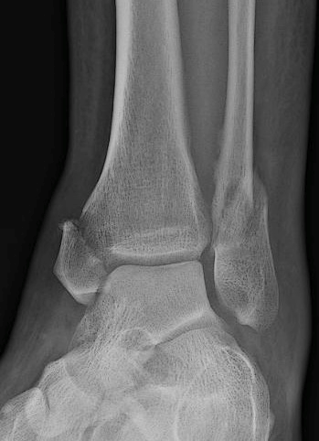
Common Adult Fractures, Practice Describing!
Oblique laterally displaced fibular fx
Extension to ankle mortise (talar dome)
Oblique minimally displaced Medial malleoloar (medial tibal fx)
Extension to tibiotalar joint

Slide 26
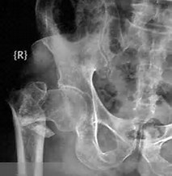
Common Adult Fractures, Practice Describing!
Comminuted
Intertrochanteric
Foreshortened
Apex Lateral, Varus alignment

Slide 27
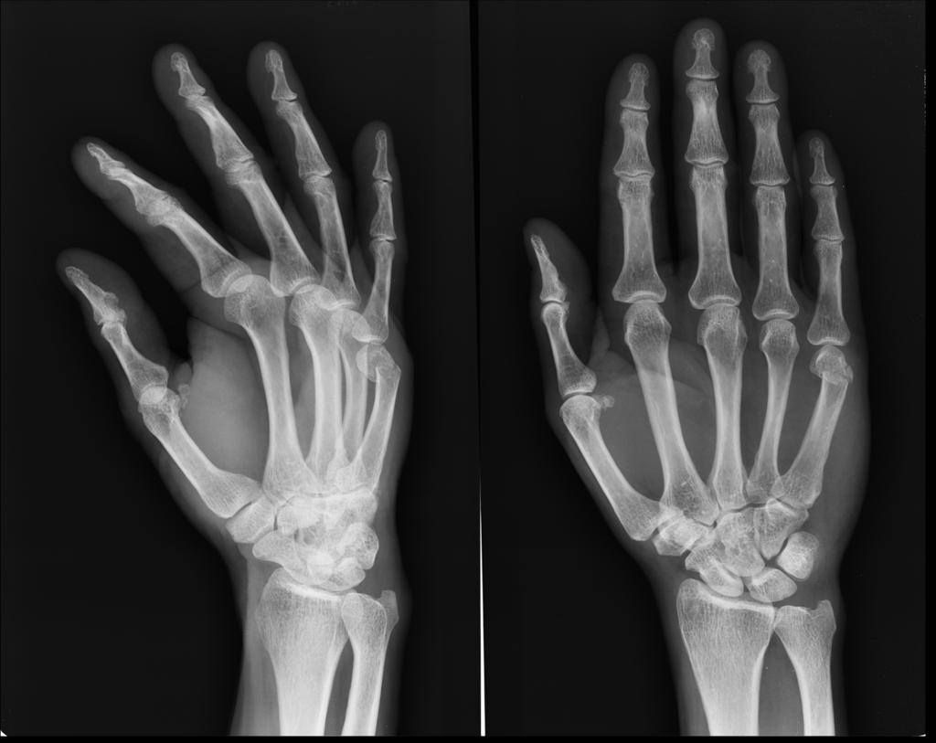
Boxer’s Fracture
Fracture of 4th or 5th metacarpal neck
Typical mechanism is punching something, wall, face, etc. (hence the name, Boxer’s).
Most commonly affects young males.

Slide 28
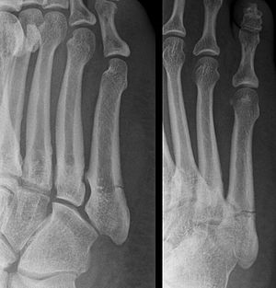
Jones Fracture
Transverse fracture of 5th metatarsal base.
Forefoot adduction force while in plantar flexion
Can be prone to non-union due to weight-baring nature of fracture site.
Non weight-baring treatment is critical.
Can be seen on foot OR ankle films.
Always check 5th metatarsal base on ankle films.

Slide 29
OTHER COOL FRACTURES THAT RADIOLOGISTS MUST PICKUP AND HAVE SECONDARY IMPLICATIONS
SECONDARY SIGNS!!!

Slide 30
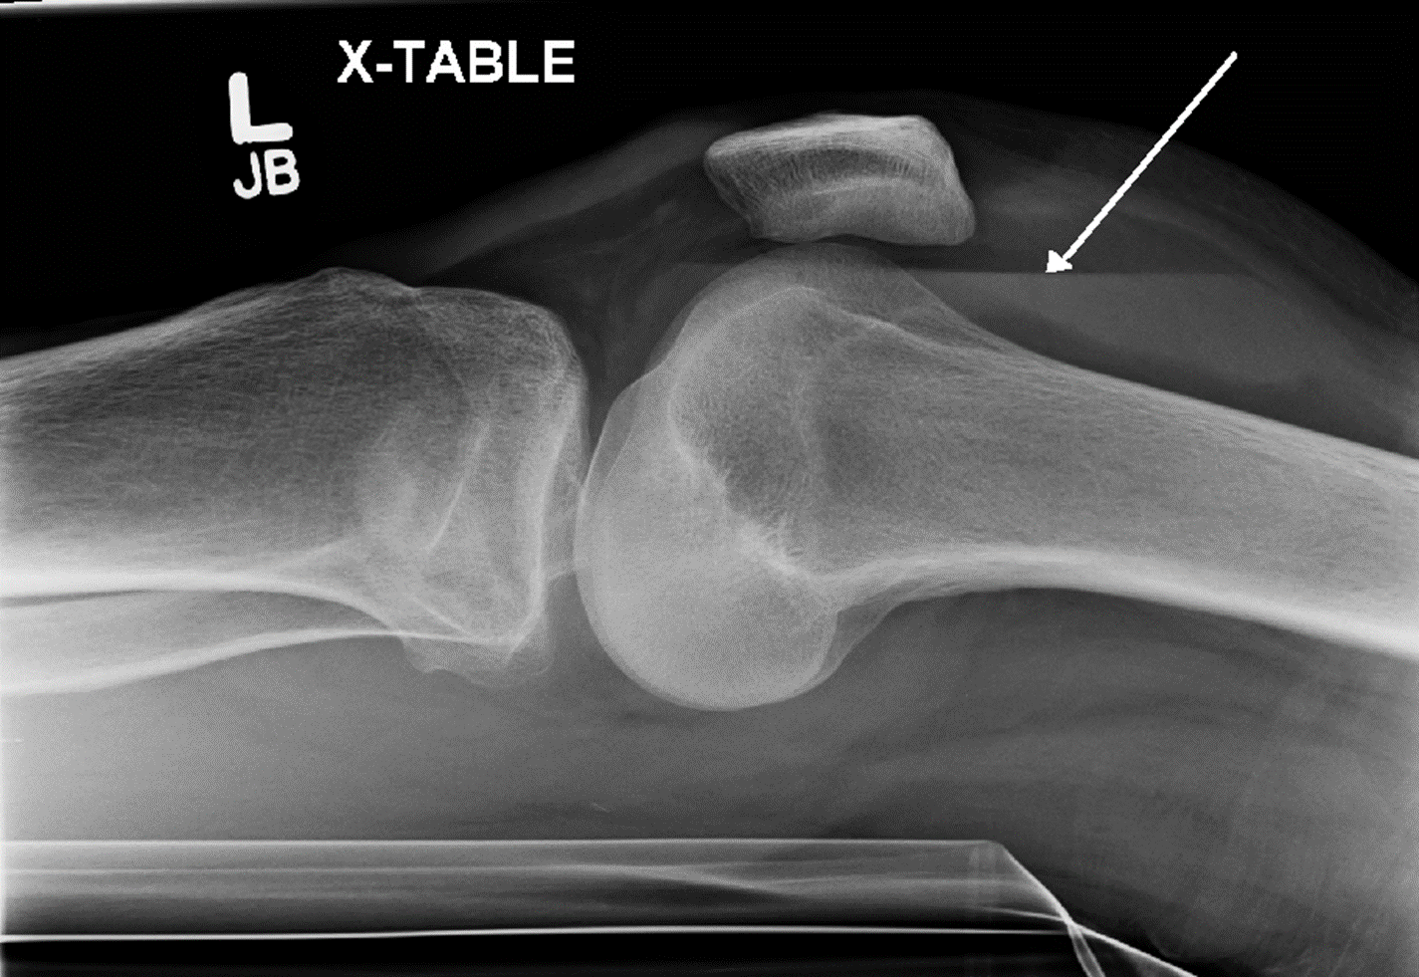
Lipohemarthrosis
Fat-fluid level seen on lateral view
Critical secondary sign to clue in that something else is going on.
Only one way to get fat density into a joint space layering
Fracture until proven otherwise
Fracture line extension from intramedullary space to articular surface allows for fatty marrow to make it to joint space.
If no fracture seen on X-ray, should get CT to exclude.
Notes:
http://images.radiopaedia.org/images/2551867/962d8e9457822cb666d3d11c7b9a7a.jpg

Slide 31
Segond Fracture
Avulsion of the anterolateral margin of the lateral tibial plateau
Caused by internal rotation and varus stress
Associations, secondary sign of
ACL tear
Meniscal injuries
Notes:
http://images.radiopaedia.org/images/2551867/962d8e9457822cb666d3d11c7b9a7a.jpg

Slide 32
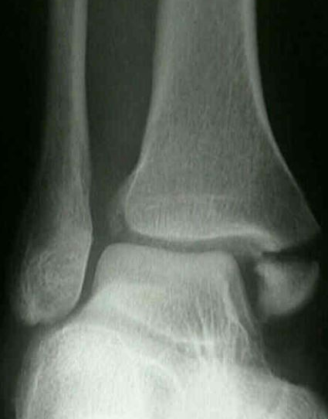
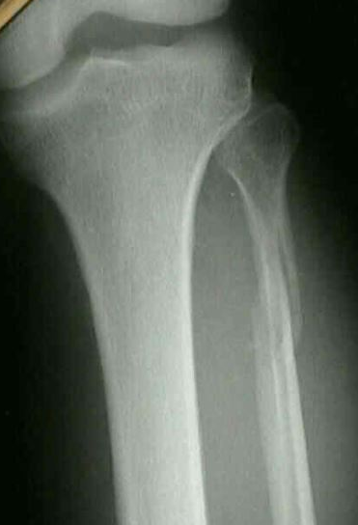
Maisonneuve’s Fracture
Ankle X-ray shows widening of tibiofibular joint and medial malleolar fracture
Must suggest tib/fib films to exclude a proximar fibular fracture due to mechanism of injury. There must be an exit site for the force!
Proximal fibular fracture
Associated - fracture of the medial malleolus
Disruption of the tibiofibular syndesmosis
Caused by ankle eversion injury
transmits force thru the interosseous membrane
Notes:
http://www.wheelessonline.com/ortho/maisonneuve_fracture

Slide 33
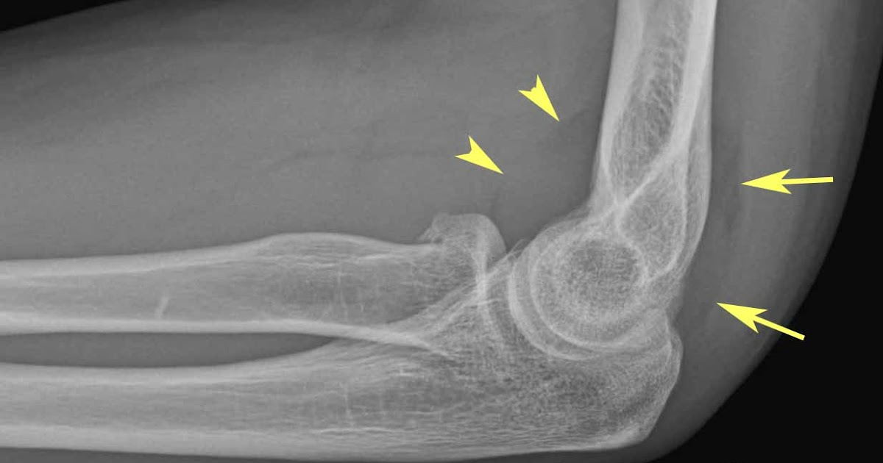
Subtle Elbow Fractures
Look for an elbow joint effusion!
Anterior fat pat (lucency) is a normal finding
Abnormal if superiorly displaced
Visualization of posterior fat pad ALWAYS ABNORMAL
Usually lives in Olecranon Fossa
Posteriorly displaced by joint fluid in setting of joint effusion
Presence of elbow joint effusion
Fracture must be excluded
Look for fx and if none seen can get CT
Notes:
http://www.wheelessonline.com/ortho/maisonneuve_fracture

Slide 34
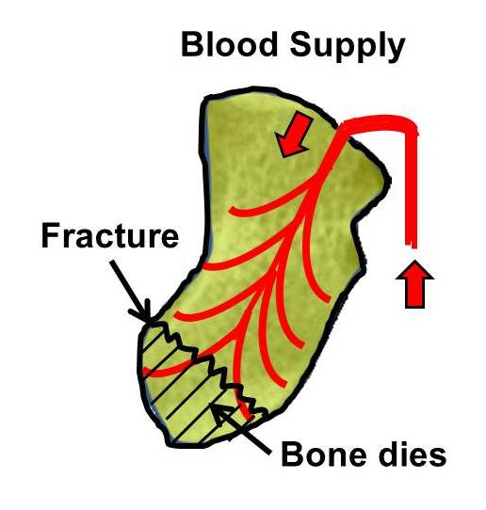
Scaphoid Waist Fracture
Easily missed fracture
Common
Pain in the anatomic snuff box
Caused by fall on an outstretched hand (FOOSH)
High risk of AVN of proximal pole of scaphoid due to more distal vascular supply
Notes:
http://radiology.rsna.org/content/219/1/11/F19.expansion.html

Slide 35
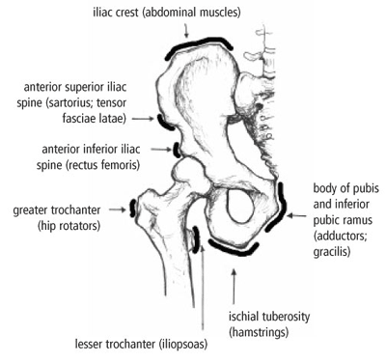
Avulsion fractures
Fracture fragments will correspond to insertion sites of muscle groups on the bone
In the pelvis, seeing an avulsion fracture can pinpoint the injured muscle and indicate a mechanism of action

Slide 36
PEDIATRIC FRACTURES
Salter-Harris Fractures

Slide 37
Salter-Harris Fractures
Epiphyseal Plate Fractures in Children
Growth Plate (Epiphyseal Plate) – most vulnerable in growing bone to shearing injury
30% of all childhood fractures
Classification System – I-V
Method of describing growth plate fractures
Implications for treatment
Predicts likelihood of complications

Slide 38
Salter-Harris Classification
LEAST SEVERE
WORST (MOST SEVERE)
Notes:
http://images.radiopaedia.org/images/282/47e684ad1ce5c226297ae6366d5830.jpg

Slide 39
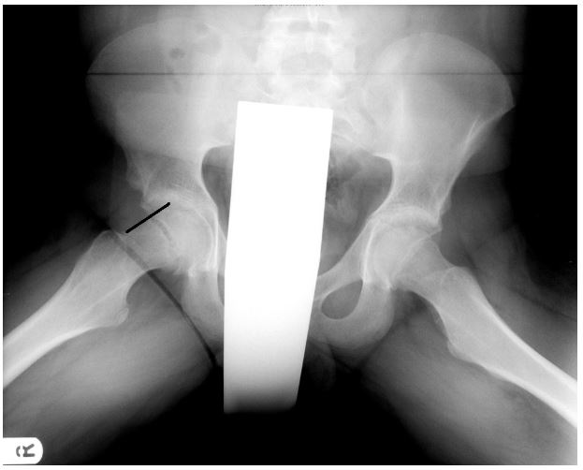
Salter-Harris Type I
Isolated epiphyseal plate injury
Good prognosis – heals well
Example: Slipped capital femoral epiphysis (SCFE)
Tall, heavier teenage boys, 25% bilateral
Line from the lateral femoral neck should intersect a portion of the femoral epiphysis
Notes:
http://www.imageinterpretation.co.uk/pelvis.html

Slide 40
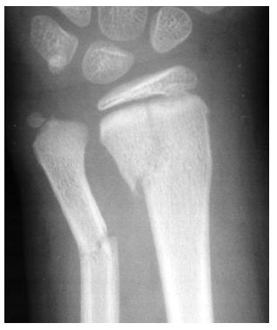
Salter-Harris Type II
Epiphyseal plate and metaphysis
Most common of Salter-Harris fractures
Good prognosis
Notes:
http://img.medscape.com/pi/emed/ckb/orthopedic_surgery/1230552-1260663-1925.jpg
http://www.hawaii.edu/medicine/pediatrics/pemxray/v1c18c.jpg

Slide 41
Salter-Harris Type III
Epiphysis and Epiphyseal Plate
Intra-articular fracture
Fracture enters the joint space
Fracture of the articular cartilage
Long-term implications
Secondary osteoarthritis
Asymmetrical and premature fusion of the growth plate
Notes:
http://www.learningradiology.com/images/boneimages1/bonegallerypages/salter3r3.html

Slide 42
Salter-Harris Type IV
Epiphysis, Epiphyseal Plate, and Metaphysis
Intra-articular fracture
Poor prognosis
Premature, asymmetric
closure of epiphyseal plate
Leg length discrepancy
Angular deformity
Secondary osteoarthritis
Notes:
http://img.medscape.com/pi/features/slideshow-slide/pediatric-sports-injuries/fig20.jpg

Slide 43
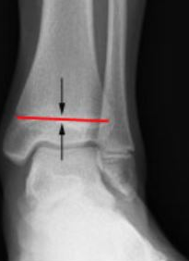
Salter-Harris Type V
Crush Injury of the Epiphyseal Plate
Damages growth plate by direct compression
Associated with vascular injury
Results in growth impairment
Rare
Notes:
http://www.learningradiology.com/ss/salterfxs/data/images/salter_v_fracture.jpg
http://orthoinfo.aaos.org/figures/A00632F10.jpg

Slide 44
Fractures Unique to Pediatrics
Pediatric bone is more malleable than adults and thus demonstrates different fracture patterns.
Buckle or Torus fractures
Due to compressive force
Can be VERY subtle
Greenstick fractures
Named after trying to break a stick that’s still green and not totally dry
Usually one cortex will fracture while the other remains intact (may bend)
Plastic deformation
Bowing deformity without discrete fracture

Slide 45
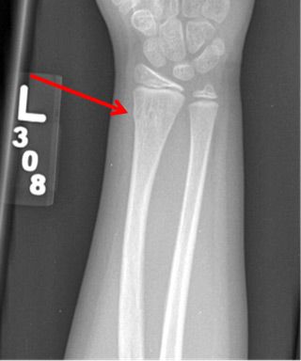
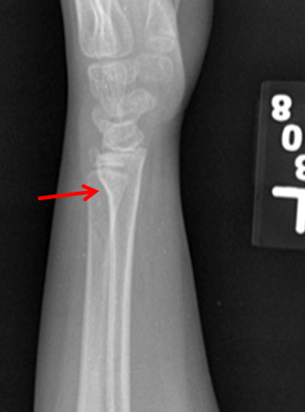
Torus or Buckle fracture
Importance of having multiple views.
Fracture is more easily seen on the lateral view.
Should be able to roll a marble down the cortex without any acute angles or bumps in normal bone. Any deviation from this suggests fracture.

Slide 46
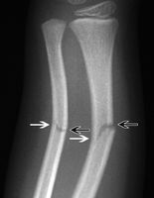
Greenstick Fracture
One side of cortex remains intact while the other is fractured.

Slide 47
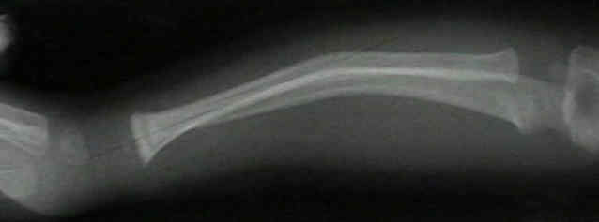
Plastic deformation fracture
Bowing of the bones without cortical discontinuity.
Happens only in very young patients.

Slide 48
Non-accidental Trauma
Specific Fractures for non-accidental injury
Metaphyseal corner fx
Pathagnomonic
Posterior rib fractures
From squeezing the baby
Skull fractures
Non-parietal bone more specific
Mutiple bones
Scapula Fractures
Sternal Fractures
Subdural Hemorrhage-from shaking baby
Order skeletal survey to evaluate—series of radiographs to evaluate extremities, axial skeleton.

Slide 49
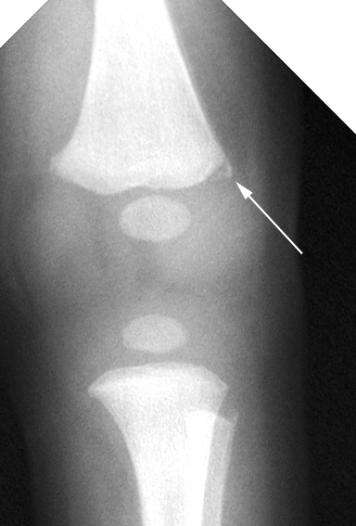
Metaphyseal corner fracture
Usually presents at the distal femur or proximal tibia
Pathognomonic for nonaccidental trauma in children
Mechanism – shaking causing multiple microtraumas

Slide 50
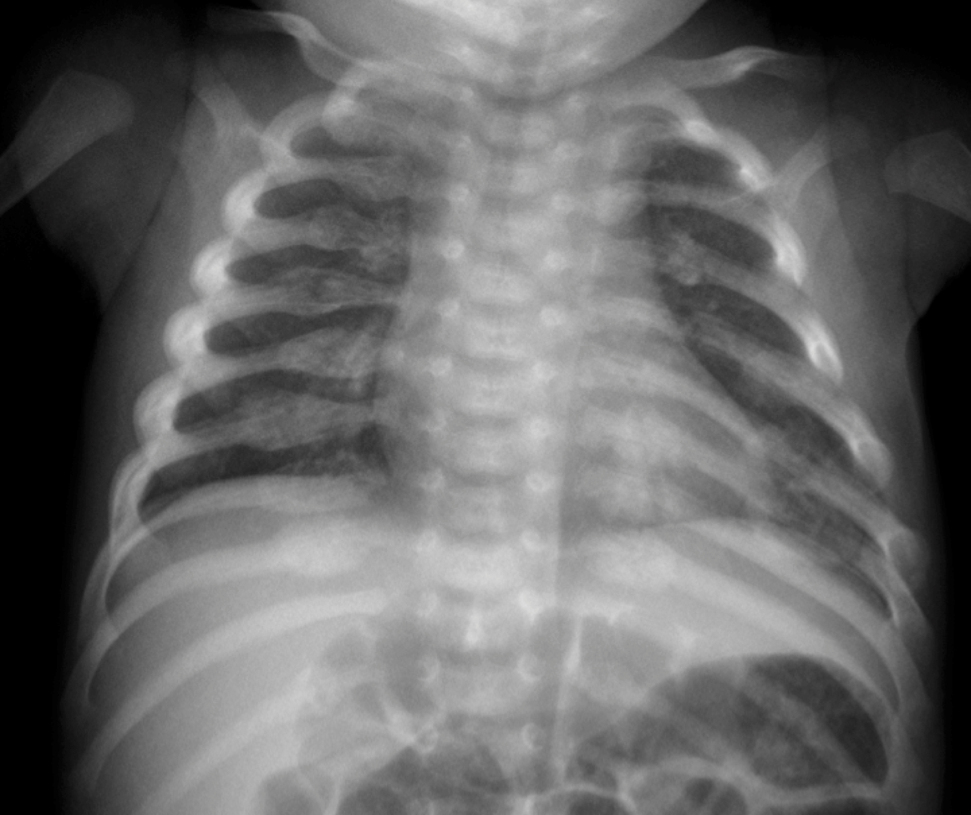
Non-accidental Trauma
Several Posterior Rib Fractures.
Aging of fractures can clue you in on how long the abuse has been occurring. i.e. fractures of different ages lets you know this wasn’t a one time occurance.

Slide 51
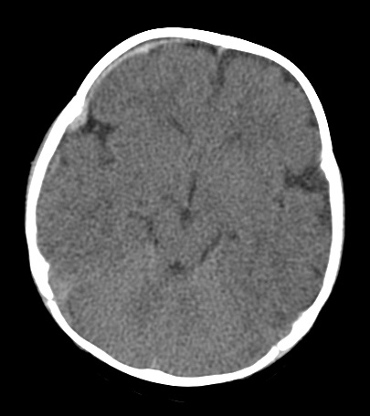
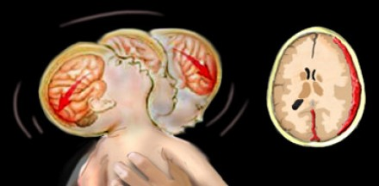
Subdural Hematoma
Crescentic hyprsdensity that respects suture lines.

Slide 52
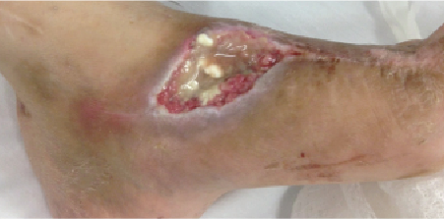
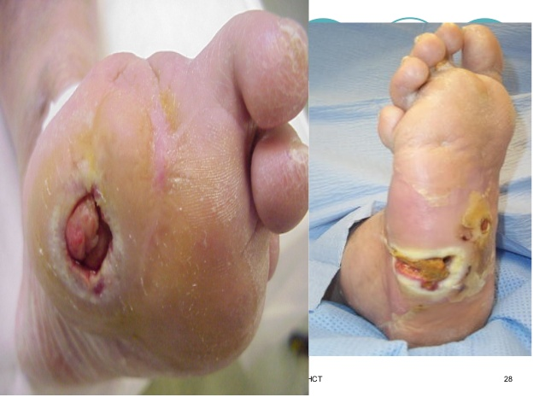
OSTEOMYELITIS

Slide 53
Osteomyelitis
Most commonly due to S. Aureus
Usually due to direct extension from a wound in adults
Diabetes
Usually due to hematogenous spread in children
Other infection-endocarditis, septic joint, etc.
Most common in lower extremity, vertebra, radial styloid, SI joint.
Usually start with plain radiograph
If negative and suspicion high→MRI for further evaluation (+2-3 days after infection)
Can also do Nuclear Medicine bone scan but not as great anatomic detail or speed
Must lose 30-50% bone mineral density to be seen on radiograph
Changes may not be seen until 7-14 days after

Slide 54
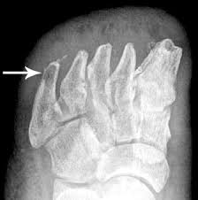
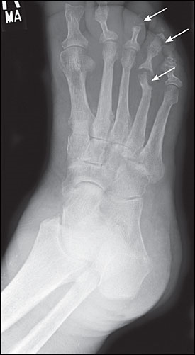
Acute Osteomyelitis
Radiographic findings
Regional osteopenia
Cortical erosions
Endosteal scalloping
Loss of trabeculation
Periosteal reaction
Abscess formation
Cortical erosion/scalloping

Slide 55
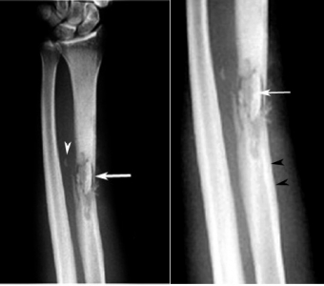
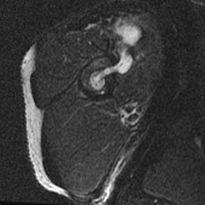
Chronic Osteomyelitis
White arrows-sequestrum
Black arrowheads-involucrum
Sequestrum
“floating piece of bone” due to devascularization of bone with adjacent necrosis and resorption
Involucrum
Thick periosteal new bone around a sequestrum
Cloaca
Sinus tract that allows drainage of purulent material to the skin surface.
Cloaca

Slide 56
Arthritis
Most common MSK pathology – osteoarthritis
Imaging can be used to evaluate for degree of degeneration and for preoperative planning
Degree of arthritis does NOT correlate with symptoms
Major findings:
Osteophytes
Joint space narrowing
Subchondral cystic changes
Sclerosis

Slide 57
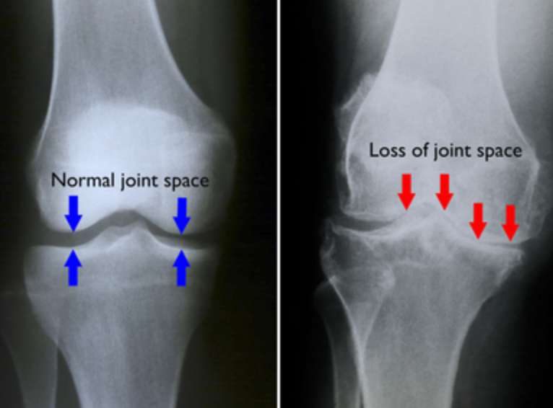
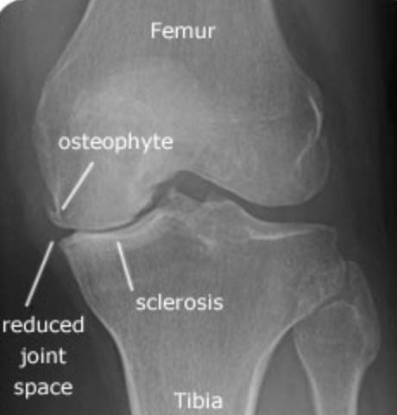

Slide 58
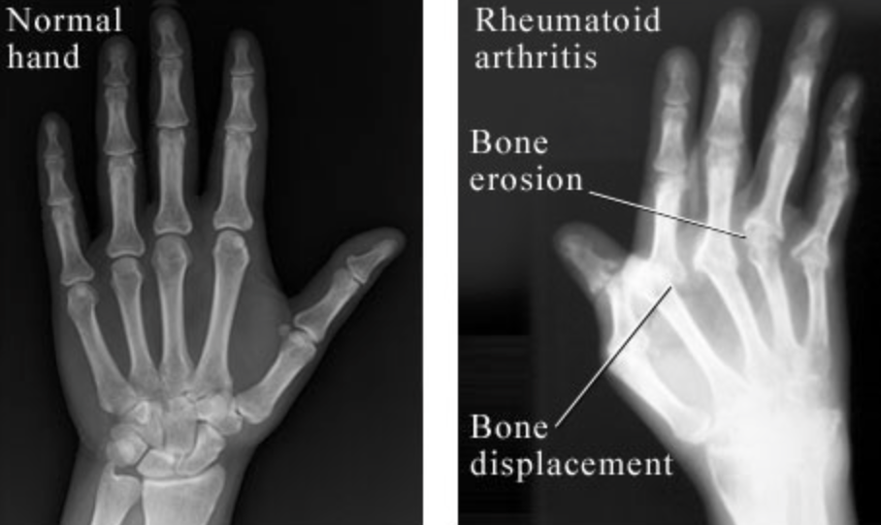
Rheumatoid Arthritis
Major findings:
-erosions
-subluxations
-involvement of particular joints (MCPs)
-bilateral involvement

Slide 59
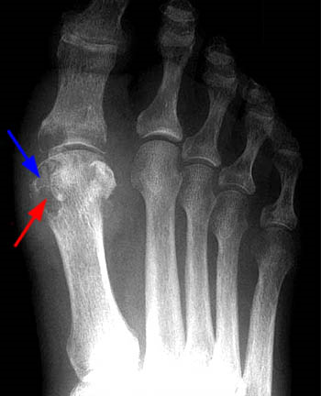
GOUT
Joint effusion
Early joint preservation
No periarticular osteopenia
Eccentric erosions
“Rat Bite” erosions with overhanging edges
Surrounding tophi

Slide 60
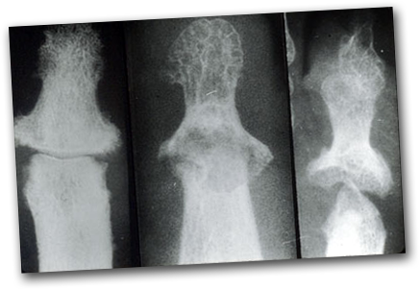
Psoriatic arthritis
Combination or bony erosions and proliferation
Usually affects distal joints
Can also involve SI joints
assymetric
“Pencil-in-cup” deformities
Dactylitis “sausage digit”
“Fuzzy” periostitis

Slide 61
Bone lesions... Diagnosis, benign, malignant?
Most important determinants
Age
Appearance of tumor on X-ray
Do not need MRI to make diagnosis most of the time, MRI for staging.
Other factors
Zone of transition (well defined vs. ill defined)
Location
Periosteal reaction?
Benign vs. Aggressive
Lytic vs Sclerotic?
Cortical destruction?
Number and distribution?

Slide 62
Bone tumors cont’d
Diagnosing individual Bone tumors is probably beyond the scope of this lecture
We will discuss and demonstrate ways to differentiate more aggressive appearing lesions from non-aggressive or more benign appearing lesions.
Realize that osteomyelitis is an aggressive appearing infections process.
While other bone neoplasms may be nonaggressive even though they are bone tumors.

Slide 63
Aggressive or non-aggressive
Aggressive
Non-aggressive
Wide zone of transition
Ill-defined
Lammellated, spiculated (sunburst), or Codman’s triangle periosteal rxn
Cortical destruction
Narrow zone of transition
Well defined
Solid, smooth periosteal reaction
No cortical destruction

Slide 64
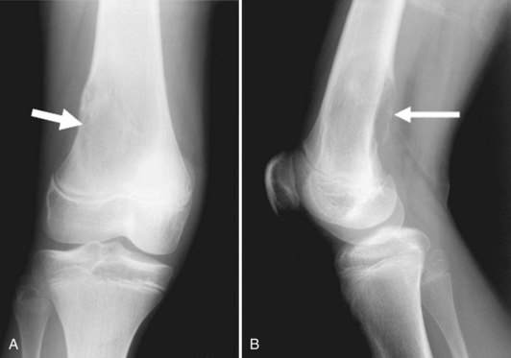
Wide Zone of transition
Wide zone of transiotion-ill-defined. Note that it is difficult to differentiate where normal bone begins and abnormal bone ends.

Slide 65
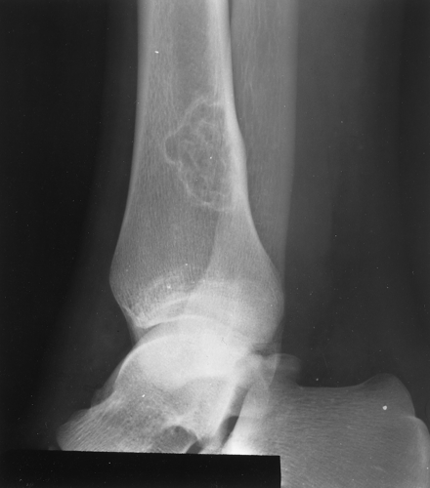
Narrow zone of transition
Notice the well defined geographic nature of this lesion which implies a non-aggressive process.

Slide 66
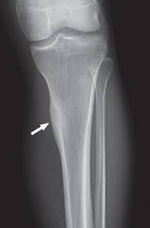
Non-aggressive Solid periosteal reaction
Solid appearance. Not hazy, triangular, or sunburst.

Slide 67
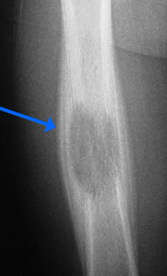
Lamellated or “Onion-skin” periostitis
This type of periosteal reaction is further along the spectrum implying a more aggressive lesion than a solid periosteal reaction. Note that this is less aggressive than sunburst or Codmans triangle.

Slide 68
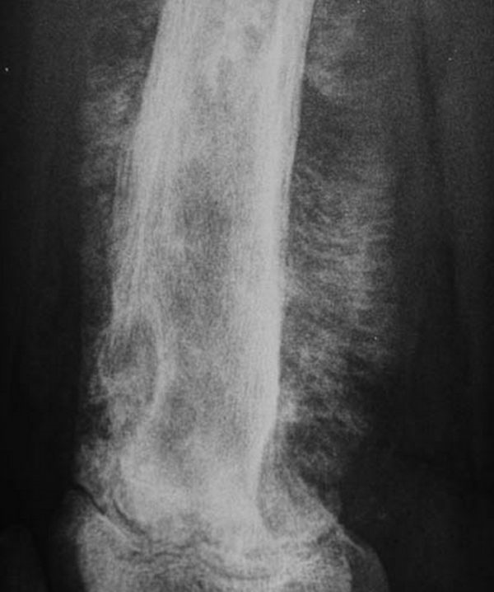
Sunburst periosteal reaction
Aggressive appearing lesion with sunburst “hair-on-end” periostitis.

Slide 69
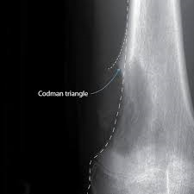
Codman’s Triangle
Most aggressive in the spectrum of Periostitis.

Slide 70
Other factors
In a patient greater than 30-40
Must always lead or include multiple myeloma in the differential diagnosis.
Location of lesion
Which bone?
Which part of bone?
Epiphysis, metaphysis, diaphysis
Eccentric, central, cortically based?
Lytic or sclerotic?
Ostroid or chondroid matrix
The sum of these factors can lead to a plainfilm diagnosis

Slide 71
Appropriate Imaging in MSK

Slide 72
Appropriate imaging
Xrays are always the first stop for MSK complaints:
Pain
Trauma
Evaluation of arthritis
Infection
Tumors
MRI is used in conjunction with xrays
Evaluation of pathology on MR relies on seeing how it also looks on xrays
If you order an MR for anything other than ligament evaluation, an xray is also needed

Slide 73
Additional modalities
MRI
Evaluation of equivocal pathologies on xray
STAGING of bone tumors (xray provides the diagnosis)
Infection when xray is negative (otherwise it doesn’t add much)
Ligamentous injury
Soft tissue pathologies – tumors
CT – only used for preop planning or if unable to get MR
Nuclear medicine – bone scan
Osseous metastases
Infection not seen on xray
Best way to evaluate for infection in orthopedic hardware
Ultrasound
Newer method – can be used to evaluate muscular pathology

Slide 74
Inappropriate imaging in MSK
Most clinicians know to order xray or MR for MSK disease
Inappropriate imaging in MSK is mostly not ordering enough views on xray or the right kind of views
**when in doubt, more is better
Examples:
-elbow –
-for non-trauma – 2 views – PA and lateral
-for trauma – 5 views – including radial head
-knee –
-for evaluation of ACL – tunnel view
-for evaluation of the patella – sunrise view

Slide 75
Elbow – non trauma – 2 views are enough

Slide 76
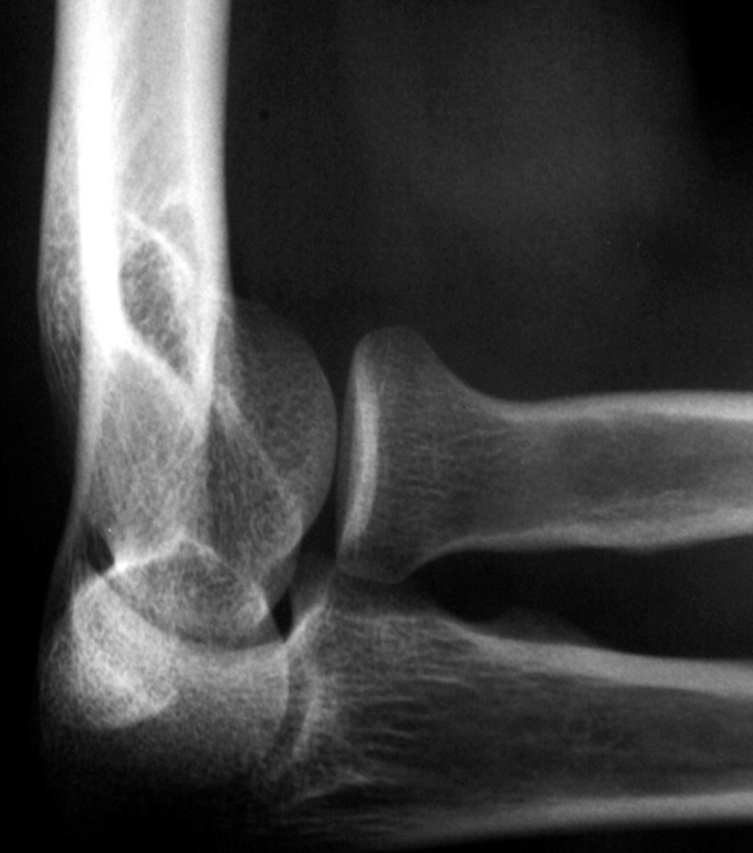
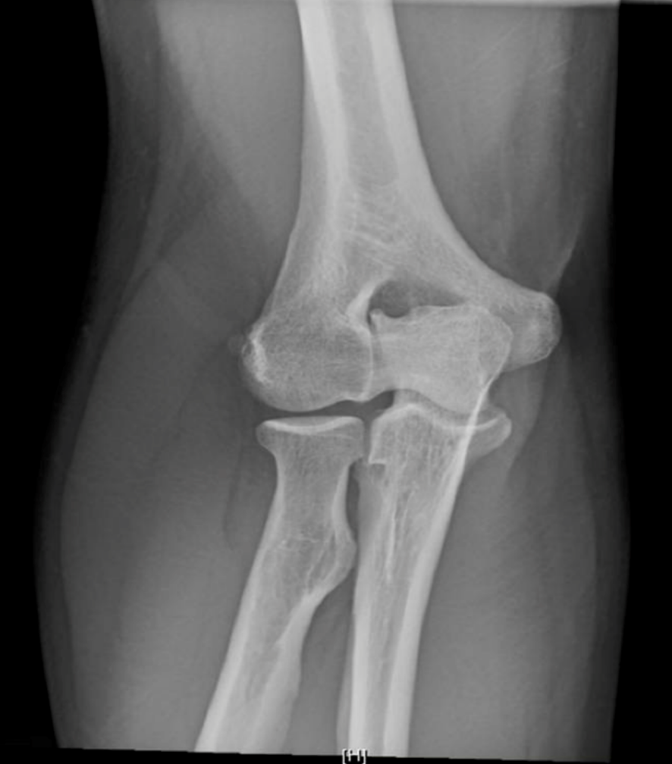
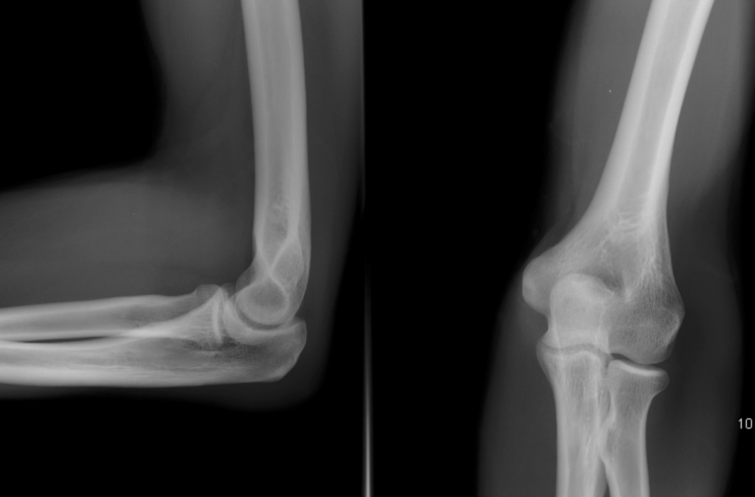
Elbow – trauma – 5 views
Bilateral obliques

Slide 77
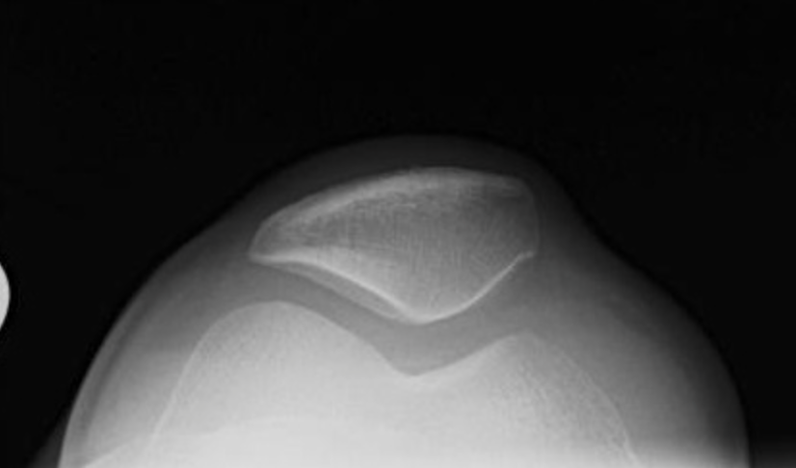
Knee views
For knee trauma, two views is insufficient.
Will want AP, lateral, b/l obliques.
Tunnel view is good for looking for OA
Sunrise is good to evaluate patellofemoral joint.

Slide 78
Shoulder Views
AP, scapular-Y, axillary, grashey views.
In setting of trauma, dislocation will definitely want at least AP and scapular-Y. Axillary also useful.
Scapular-Y is a great view for evaluated dislocation.
Grashey view is a modified AP view best for glenohumeral arthritis. Not that useful in acute setting.

Slide 79
Inappropriate imaging in MSK
What do you think is the most common incorrectly ordered test in MSK?

Slide 80
Inappropriate imaging in MSK
What do you think is the most common incorrectly ordered test in MSK?
Lumbar radiographs for chronic low back pain

Slide 81
Back pain imaging
The majority of back pain is due to muscular strain
Imaging is often not needed – treatment is conservative
Start with management, NOT imaging first
Weight loss
Back strengthening exercises
Muscle relaxants
NSAIDs
If continuous back pain despite conservative management, THEN proceed to imaging

Slide 82
Back pain imaging
Exceptions (for which immediate imaging is warranted):
Trauma history
Red flag signs:
Incontinence
Lower extremity weakness or inability to walk
History of malignancy that can commonly cause osseous mets (breast, lung, prostate)
Fevers – concern for osteomyelitis
History of spine surgery
MR is needed for most red flag signs, although starting with radiographs can be ok

Slide 83
ACR appropriateness criteria
The American College of Radiology has made a list of indications for particular examinations and rated each imaging test with regard to efficacy and appropriateness in particular situations.
https://acsearch.acr.org/list
Great guide for clinicians to check which study to order for which indications

Slide 85
Uncomplicated chronic back pain—No imaging necessary

Slide 87
Plain Radiograph limitations
C-spine Trauma/Injury
X-ray only 52% sensitive vs CT 98% sensitive
https://www.ncbi.nlm.nih.gov/pubmed/15920400
Radiographs good for low risk patients , low suspicion
Need CT for high risk patients
Thoracolumbar fracture
X-ray only 75% sensitive vs CT 100% sensitive
https://www.ncbi.nlm.nih.gov/pubmed/16394914
Need CT for high risk patients
Hip Fracture
X-ray 90% sensitive, CT 98% sensitive, MRI 100% sensitive
https://www.ncbi.nlm.nih.gov/pubmed/22459594

Slide 88
MRI Pros and Cons
Pros
No radiation
Great for kids and Pregnancy
Excellent soft tissue contrast
Can see and evaluate ligaments, tendons, cartilage
Great for evaluating bone marrow signal in osteomyelitis
Cons
Time consuming
If need quick results-not best test
Patient must cooperate as very prone to motion artifact
Some patient cannot undergo MRI
Ferromagnetic implant or foreign bodies
EXPENSIVE
Limited spatial resolution

Slide 89
Interventions in MSK Radiology

Slide 90
Common procedures done by radiologists
Cryoablations of bone tumors
Bone biopsies
Joint aspirations and steroid injections
Drains for abscesses
Treatment for spinal fractures – kyphoplasty/vertebroplasty
Nerve ablations for pain

Slide 91
Interventional procedures in MSK, example
Eccentric peripherally sclerotic lesion with central lucency
Pediatric patient with pain which is partially relieved by NSAID’s
Failed Outpatient therapy in this case
Osteoid Osteoma
Benign lesion
Can be treated because of pain

Slide 92
MSK procedure Cont’d
An interventional or MSK radiologist can treat this lesion with typically exceptional outcomes using radiofrequency ablation.
This image demonstrates placement of an ablation probe under CT guidance.
Outpatient procedure.
Non-emergent

Slide 93
Emergent MSK procedure example
Patient with prior right hip arthroplasty
Pain, swelling, fever in right hip
Need for emergent arthrocentesis to direct antibiotic therapy and solidify diagnosis.
Can be done under fluoroscopic guidance to confirm intra-articular location.

Slide 94
Introduction to nuclear medicine
Nuclear medicine uses radioactive material given IV or inhaled to give physiologic information.
Radioactive material is bonded with a physiologic carrier substance
Resolution is usually low so not great for anatomic detail
Great for functional or physiologic information
The radioisotopes have half-lives from hours to days
Can combine with anatomic information from CT or MRI to give greater anatomic detail

Slide 95
Examples of Nuclear medicine studies
V/Q scans
Radiotracer given inhaled and IV and comparisons made between images to detect any mismatches
Must have concomitant X-ray for comparison as pneumonia, atelectasis can give reasons why a defect may be present.
Results given as low, intermediate, or high probability of pulmonary embolism
CTPE is a better study but in patients with AKI,V/Q may be ontained

Slide 96
Examples of Nuclear medicine studies cont’d
Bone Scan
Can be used to look for infection, malignancy, radiooccult fractures most commonly.
3-phases
Blood flow, Blood pool, Delayed
Comparison between three phases helps to yield diagnosis
Uses Technetium labeled diphosphonate.

Slide 97
Examples of Nuclear medicine studies cont’d
HIDA Scan aka cholescintigraphy
Assess biliary system and liver (indirectly)
Uses Technetium
Most commonly used to assess cholecystitis after equivocal ultrasound.
Positive if you don’t see tracer in the gallbladder after sufficient time.
Bile leaks
Chronic cholecytitis

Slide 98
PET-CT and PET-MRI
Use radiolabeled glucose (FDG) to evaluate cellular metabolism.
Most commonly used in cancer staging and tx monitoring.
Must be fasting, resting
FDG avid or bright spots are thought to demonstrate higher rates of glucose metabolism. This is nonspecific and must correlate with clinical picture.
Can be neoplastic, infectious, inflammatory

Slide 99
Nuclear medicine used for treatment
Theragnostics
Nuclear medicine used for treatment as well as diagnosis
Examples
I-131 scans are used to treat and monitor thyroid cancer and metastases. Uptake of iodine by malignant thyroid tissue. Radioactivity released can then ablate the thyroid tissue.
8 day half-life
Usually have patients stay in a hotel and away from family for 2-3 days
Usually preceded by thyroidectomy which is usually subtotal to preserve parathyroid tissue
I-131 then given to radioablate remaining thyroid tissue using beta decay.
Additionally, can image afterwards to see where the uptake and leasions are located.
Similar process with prostate cancer skeletal metastases using Xofigo
Radium 223 dichloride
11.4 day halflife
Absorbed by bone due to similar chemical properties as calcium
Uses alpha radiation to ablate osseous prostate mets.

Slide 100
QUESTIONS?

