Slide 1
Medical Student Lecture Series
Neuroradiology

Slide 2
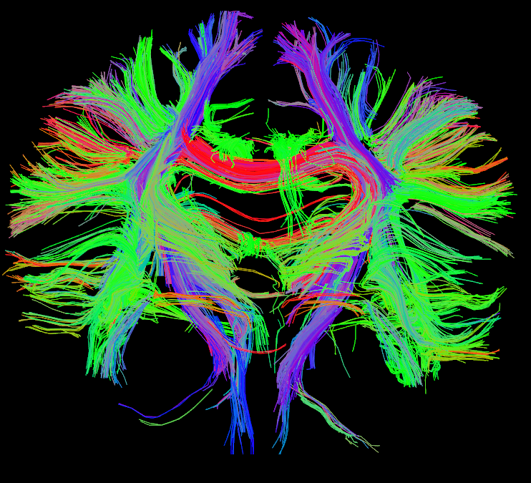
Outline
Anatomy at Headneckbrainspine.com
Imaging modalities
Introduction to MRI
Emergency Neuroimaging
Bleeds
Head trauma
Hydrocephalus & Herniation
Child Abuse
Stroke
Spinal trauma
Common tumors
Infection
Appropriate imaging (ACR criteria)
Interventional Neuroradiology

Slide 3
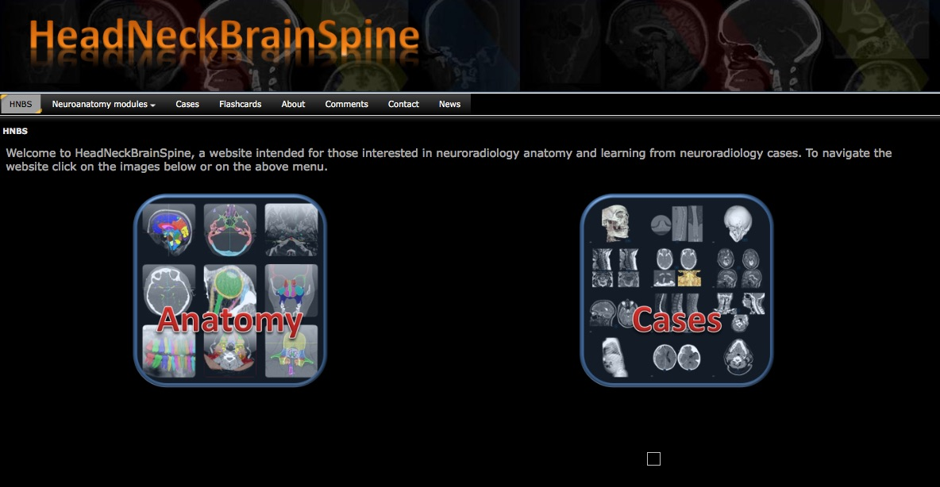
Anatomy
To learn anatomy please go to
Headneckbrainspine.com then click

Slide 4
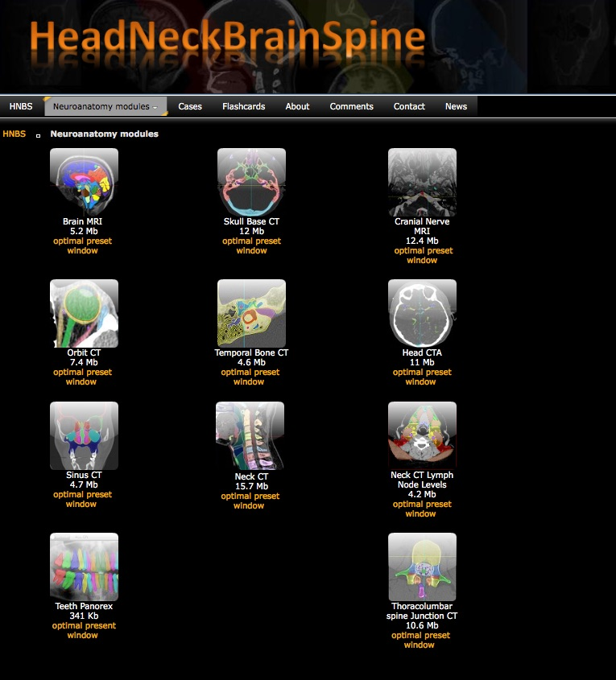
Then click Brain MRI
“optimal preset” here
Review the anatomical structures on the Brain MRI and then use the quiz mode to quiz yourself.
Of note: if using a Mac computer, the safari browser seems to work best

Slide 5
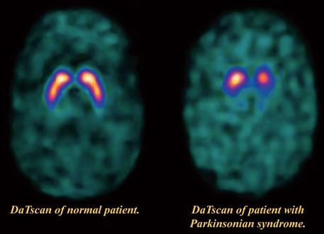
Common imaging modalities in Neuroradiology
Computed Tomography (CT)
CT head w/o contrast = workhorse of neuroradiology for acute pathology
CT Angiography of head and neck
w/ or w/o perfusion
CT cervical spine w/o contrast (see spine trauma section)
CT neck with contrast
Magnetic Resonance Image (MRI)
MR head w/ or w/o Gd
MRA head and neck
MR cervical spine w/ or w/o contrast
Plain Radiographs
Head and C spine may be used in pediatric trauma (see cervical spine trauma section later)
Often initial imaging modality in chronic back pain
Ultrasound – done on infants through the fontanelle to evaluate bleeds & hydrocephalus
Nuclear imaging – DaTscan used for Parkinsons dz, PET agents available for Alzhemiers dz, Nuclear cisternogram for CSF leaks
Images from https://www.cedars-sinai.edu/Patients/Programs-and-Services/Imaging-Center/For-Patients/Exams-by-Procedure/Nuclear-Medicine/DatScan/DaTscan-Procedure-Information.aspx
Notes:
https://www.cedars-sinai.edu/Patients/Programs-and-Services/Imaging-Center/For-Patients/Exams-by-Procedure/Nuclear-Medicine/DatScan/DaTscan-Procedure-Information.aspx

Slide 6
Noncontrast CT head
Displays the average density of a pixel (measured in Houndsfield units) with gray scale image output
Strengths
Speed & availability
Relatively lower cost
No contrast
Best initial modality for emergent pathology
Fractures
Bleeds
Herniation
Pneumocephalus
Weaknesses
Brain parenchymal abnormalities
Blood vessels
Acute stroke
Although obtained first to rule out hemorrhage
Enhancing lesions
Posterior fossa and brainstem

Slide 7
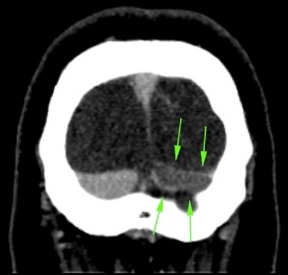
CT head w/ contrast
Below: CT venogram showing clot within the left transverse sinus
Most commonly performed as CT angiogram
Vascular malformations and aneurysms in patients with
intracerebral hemorrhage or subarachnoid hemorrhage
Vascular injury post trauma
Intravascular thrombus in stroke patients
Can be performed with CT perfusion to evaluate acute stroke to determine core infarct and ischemic penumbra (more on this later)
CT head routine phase w/ contrast
Rarely performed when concern for intracranial infection or intracranial mass
MRI w/ Gad is much better, but if contraindication to MRI or Gd→ CT w/ contrast
CT venogram
Good alternative to MR venogram for evaluating for cerebral venous or dural sinus injury in patients that cannot tolerate CT due to inability to hold still or too unstable

Slide 8
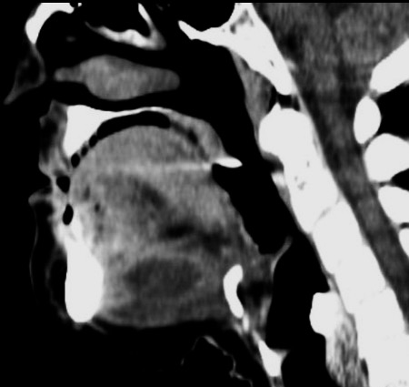
CT Neck with contrast
Generally used when concern for neck infection
Retropharyngeal abscess
Peritonsillar abscess
Ludwig angina
Can be used as alternative to MRI to evaluate for neck mass in patient with contraindication to MRI or not available
Above: Sagittal CT neck post contrast demonstrates a peripherally enhancing sublingual/submental fluid collection consistent with Ludgwig angina.
Image from https://radiopaedia.org/cases/ludwig-angina-1

Slide 9
Basic overview of MRI
What is it?
When to use it
Contraindications
Cost compared to other modalities
Limitations

Slide 10
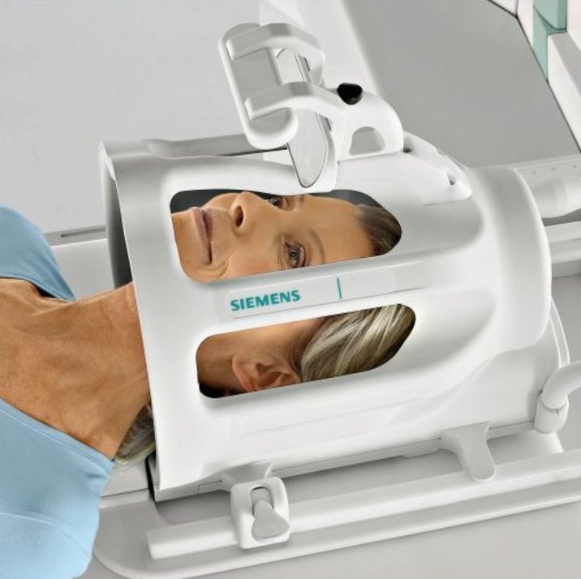
What is MRI
Patient is put in a very strong magnetic field
The atoms that make up the body have small spinning magnetic fields that align with the magnetic field of the scanner
Energy is transferred to the atoms from a coil that sends radio frequency (RF) current that changes their spinning magnetic fields to a higher energy state
The radiofrequency coil is turned off and as the magnetic fields of the nuclei “relax” to their lower energy state, they send off a radio signal that is detected by the scanner
Hydrogen nuclei from water molecules make up the vast majority of measured signal
Different tissues return to their normal spinning state at different rates and therefore can be differentiated by the scanner and on the images
Head coil sending RF current

Slide 11
Basics of MRI physics
If you would like to learn more about MRI physics, this is a great intro video to the topic
https://www.youtube.com/watch?v=Ok9ILIYzmaY

Slide 12
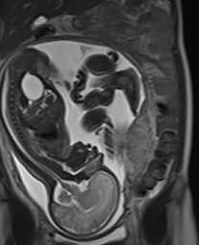
When to use it
MRI is very good at distinguishing between soft tissues and therefore is very good at evaluating solid organs
Other strengths are evaluating tendons and ligaments in joints and bone marrow; brain and spinal cord
No radiation makes it’s use ideal for use in children and pregnant patients
Image from https://www.birthinjuryjustice.org/wp-content/uploads/2013/01/Fetal-MRI.jpg
Notes:
https://www.birthinjuryjustice.org/wp-content/uploads/2013/01/Fetal-MRI.jpg

Slide 13
Common uses for different organs
Brain
Will be discussed in detail
Generally best study for everything except acute trauma or concern for intracranial hemorrhage
CT is often the initial study of choice in the emergency department
Ultrasound used in neonates because their open fontanelle provide a window for US scanning and no sedation is needed
Spine
CT has highest resolution to detect fractures
MRI best for evaluating spinal cord, ligament injuries, disc pathology, hematomas, and osteomyelitis/discitis

Slide 14
Common uses for different organs
Chest
Lungs
CT is much superior
Mediastinal masses
MRI is generally the study of choice
Heart
Congenital anomalies
Tumors and ischemic, infectious, and inflammatory conditions
MRI SSFP cine images showing a normal heart beating.

Slide 15
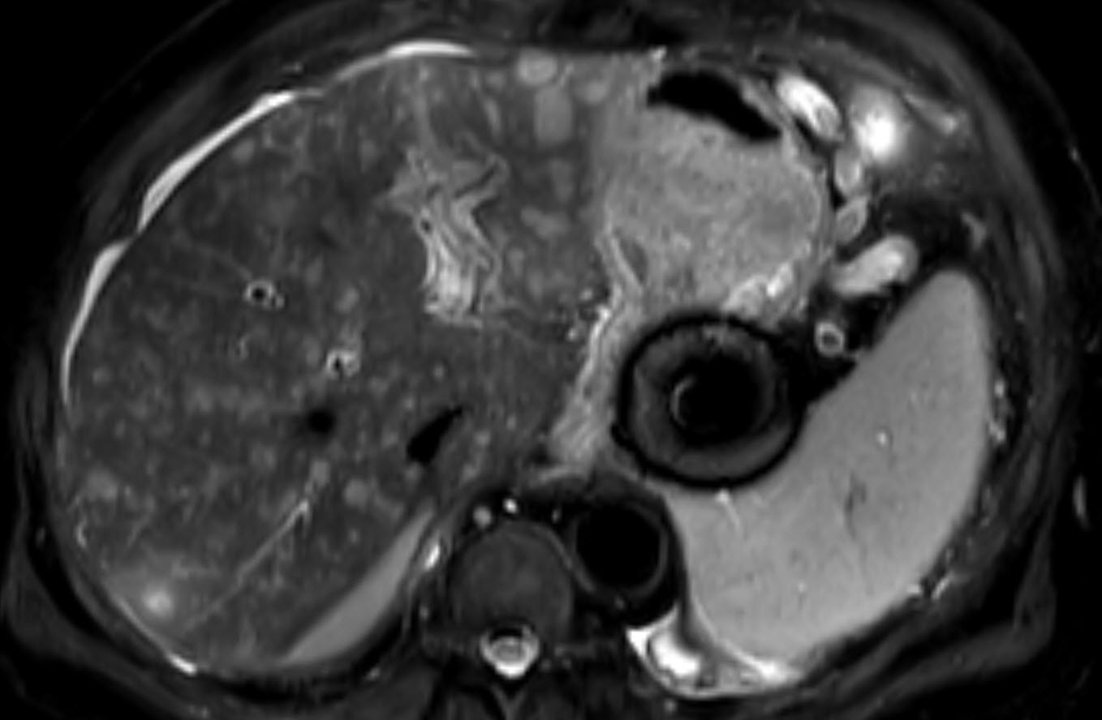
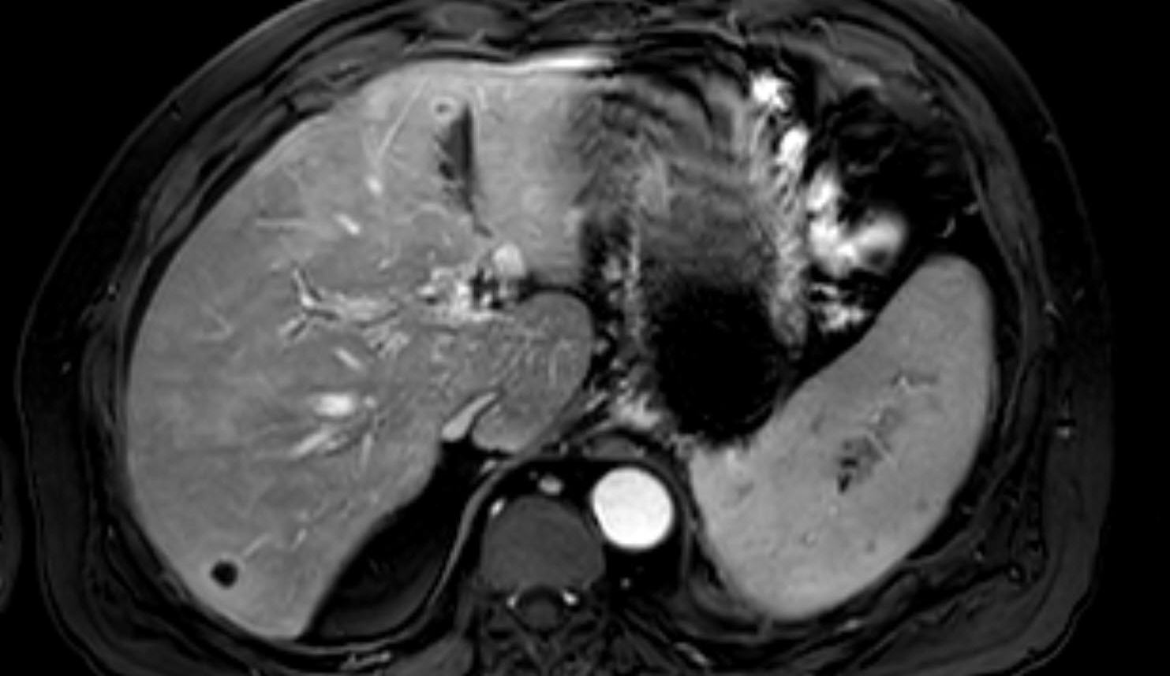
Common uses for different organs
Abdomen
MRI is study of choice for evaluating tumors of the stomach, liver, kidney, pancreas, adrenal glands, and gallbladder
MR Enterography is great for evaluating Crohn’s disease, ulcerative colitis, or other inflammatory pathologies
Above T2 weighted image showing innumerable T2 bright lesions in a patient with metastatic cancer to the liver. Below T1 weight post Gd image showing ring enhancement of several of the lesions.

Slide 16
Common uses for different organs
Pelvis
MR is the study of choice for
Uterine and ovarian tumors
Prostate gland for cancer
PI RADs scoring system is a structured reporting system to evaluate the risk of cancer for lesions in the prostate gland
Large heterogeneously enhancing mass in the endometrial cavity in a patient with Embryonal Rhabdomyosarcoma.

Slide 17
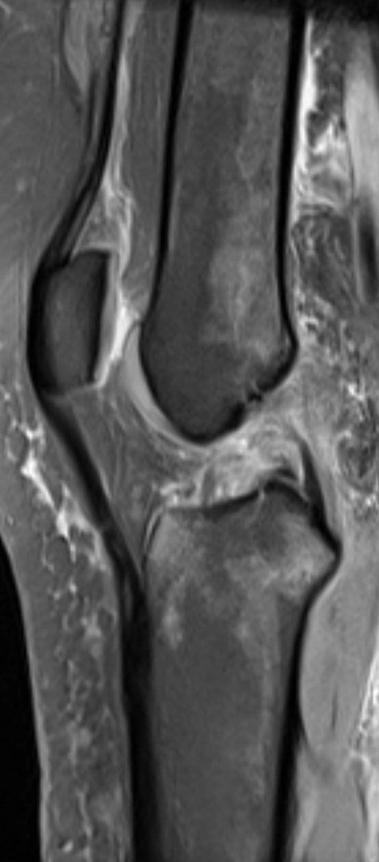
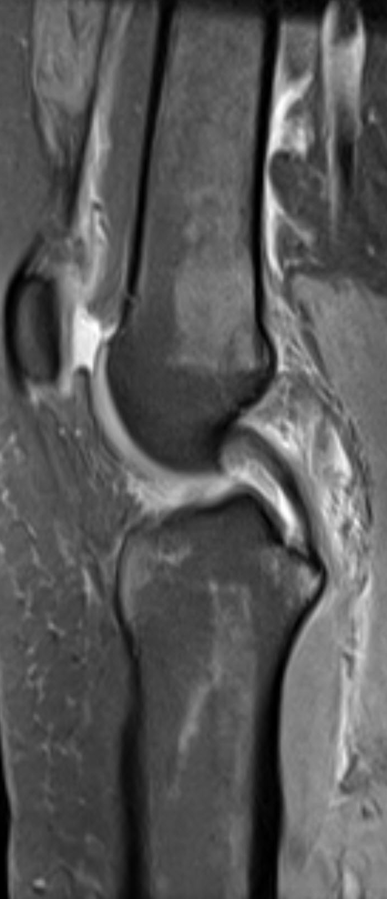
Common uses for different organs
Musculoskeletal
Study of choice for:
Ligamentous and tendon injury
Osteomyelitis
Bone tumors
Breast
May be used for surveillance in patients with:
BRCA mutations
Greater than 20% lifetime risk of breast cancer
Breast implants
Evaluates extent of disease in newly diagnosed breast cancer
Determines involvement of fascia
Extent of DCIS
Patients status post lumpectomy with positive margins
Evaluate response to neoadjuvant chemotherapy
Recurrent breast cancer
Metastatic breast cancer when primary unknown and suspected to be breast CA
MRI Fat saturated proton density images of the knee showing a torn ACL and intact PCL.
Notes:
https://www.acr.org/~/media/2a0eb28eb59041e2825179afb72ef624.pdf

Slide 18
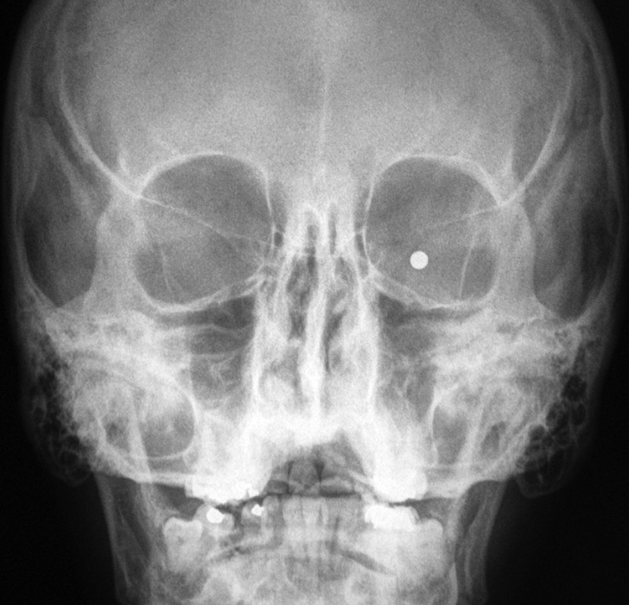
Contraindications to MRI
Implanted electric and electronic devices are a strict contraindication to the magnetic resonance imaging, and in particular:
heart pacemakers (especially older types)
insulin pumps
implanted hearing aids
neurostimulators
intracranial metal clips
metallic bodies in the eye
Other considerations:
Claustrophobia
Inability to lay still for the long examination
Altered mental status
Young child
Patients that fall into the above categories may need sedation
You can look up whether medical devices are safe on MRISAFETY.COM
Metallic foreign body in the patients left orbital soft tissues.
Image from http://medapparatus.com/ForeignBodies/Images/BB_in_orbit_AP.jpg
Notes:
http://www.voxel.pl/en/indications-and-contraindications-magnetic-resonance-imaging
http://medapparatus.com/ForeignBodies/Images/BB_in_orbit_AP.jpg

Slide 19
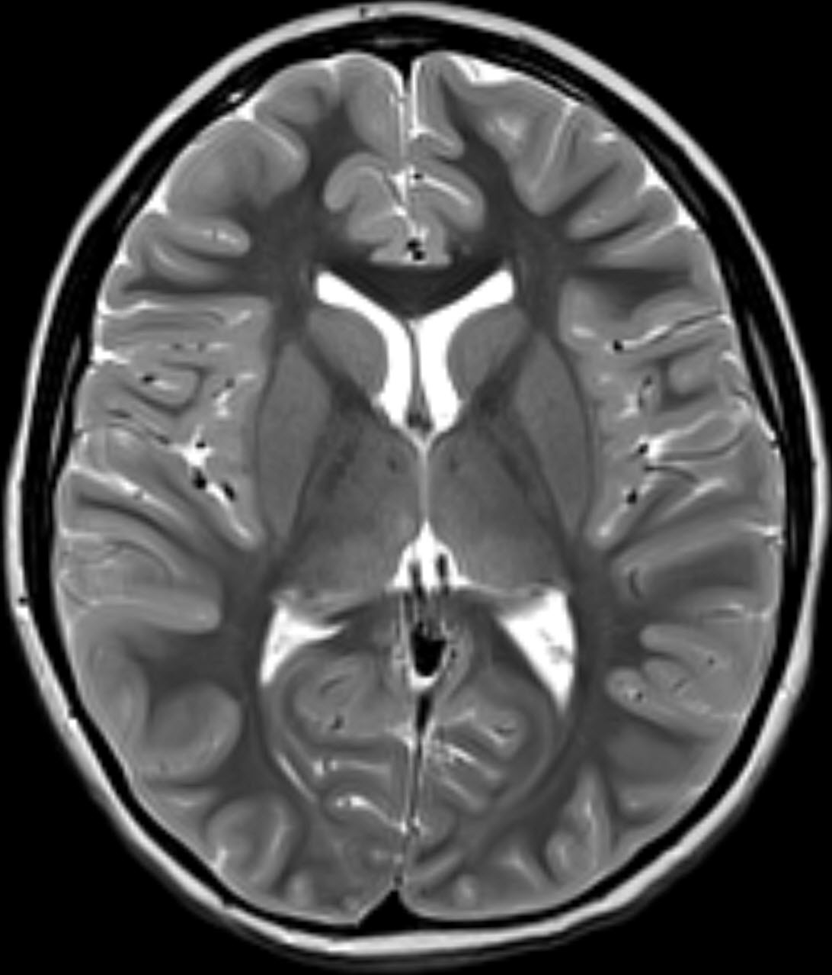
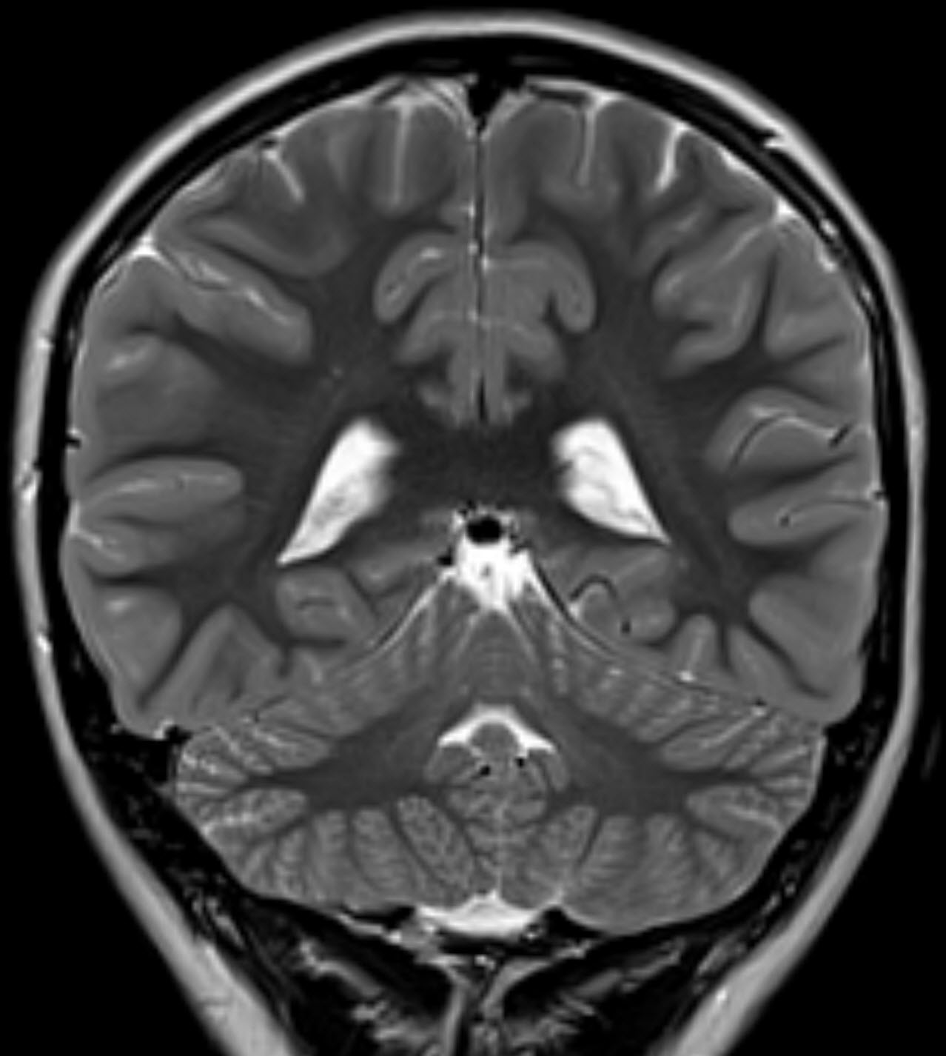
MRI in Neuroradiology

Slide 20
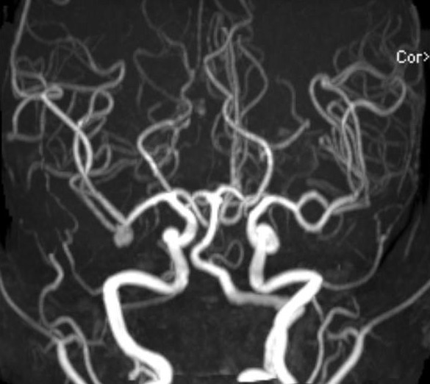
MRI & MRA head w/o contrast
Great study for acute ischemic stroke if hospital has it available emergently
MRI best for soft tissue lesions and evaluating brain parenchyma non-emergently
Often used in children with neurologic congenital anomalies
MRA
Performed using time of flight and usually without contrast
Great for looking for aneurysms or intravascular clots in stroke
Above: MRA demonstrating a saccular aneurysm at the right MCA bifurcation

Slide 21
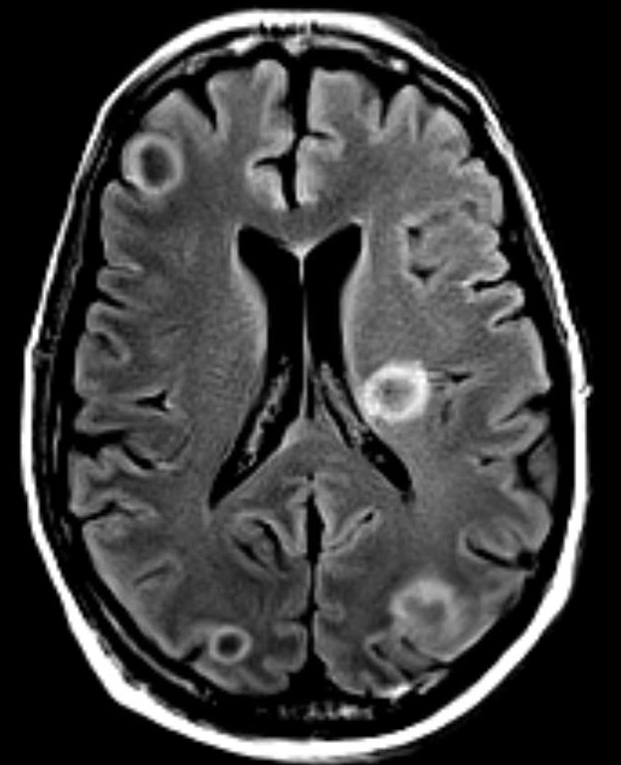
MRI head w/ contrast
Routine:
Study of choice for looking for tumors, infection, or acute demyelination
MR venogram
Generally study of choice for looking for Dural venous thrombosis in stable, cooperative patients
Above: T1 post Gd axial image with multiple ring enhancing lesions mostly at the gray white junction in an IV drug using patient with multiple cerebral abscess

Slide 22
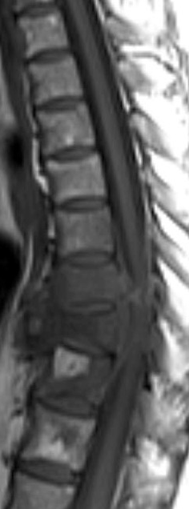
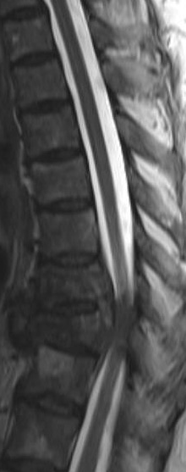
MRI spine
When to not use contrast
Looking for spine mets
Evaluating degenerative spine
Post traumatic evaluation of ligamentous injury (see spine trauma section)
When to use contrast
Concern for infection – not absolutely necessary but enhancement helps identify abscesses
Concern for spinal cord tumor or cord mets
Acute demyelinating disease
Left: T1 sagittal image showing hypointense metastatic lesions involving mostly vertebral bodies T8-T10 with a pathologic fracture at T9.
Right: T2 sagittal image showing the metastatic lesions and compression fracture causing cord compression

Slide 23
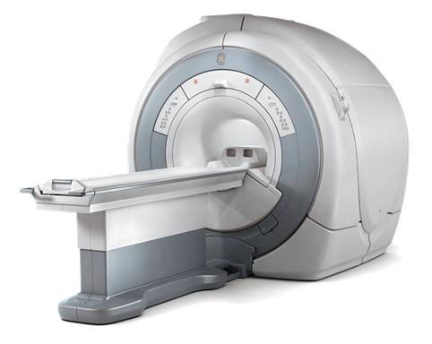
Common Neuro MRI Sequences
T1
T2/FLAIR
DWI and ADC
Gradient recall echo (GRE)
Post Gadolinium (Gd) T1
MRA
Time of flight
Post gadolinium

Slide 24
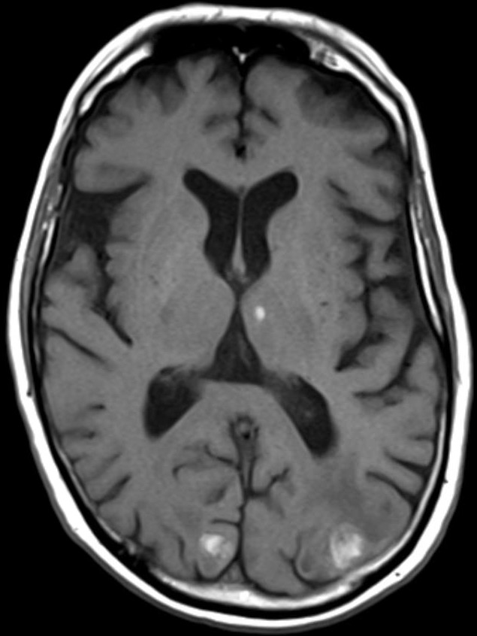
T1
Most lesions being or malignant are iso or hypointense to gray matter
Things that are bright
Gadolinium
Fat
Proteinaceous fluid
Some states of blood (intra and extracellular methemoglobin
Melanin
Mineralization (some types)
Slow flowing blood
Above: T1 pre-Gd shows hyperintense metastatic melanoma lesions in the left thalamus and bilateral occipital lobes.

Slide 25
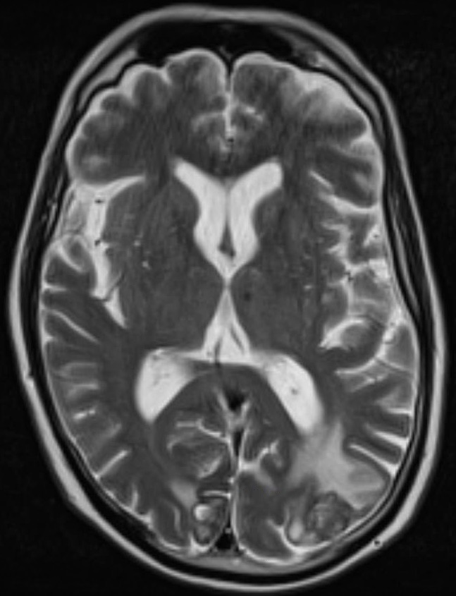
T2
Bright signal is nonspecific and many times correlates with relatively increased water content
Edema
Gliosis
Things that are dark
Most stages of blood (except hyperacute and extracellular methemoglobin)
Calcification
Fibrous lesion
Highly cellular tumors (low water content)
Vascular flow void
Mucin CTA
Above: T2 axial of the patient with melanoma mets from the prior slide showing T2 bright edema surrounding the melanoma mets.

Slide 26
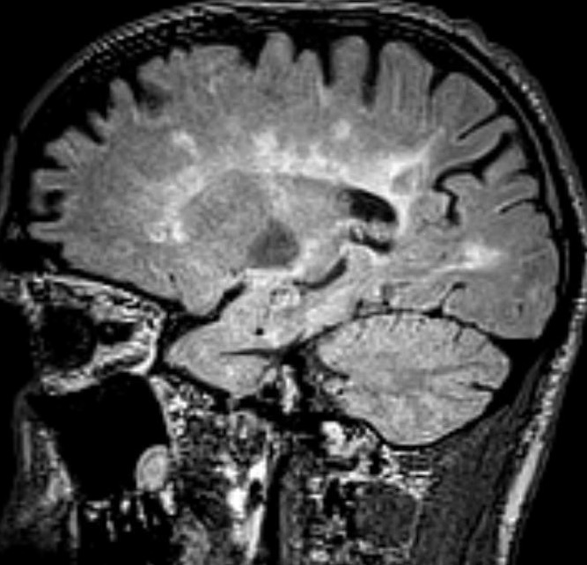
FLAIR
Similar to T2 except that the water signal is suppressed
Uses
Periventricular lesions
Pathology more conspicuous than T2
If something doesn’t suppress then it isn’t simple fluid
Above: Sagittal FLAIR image demonstration finger-like periventricular hyperintense white matter lesions in a patient with multiple sclerosis.

Slide 27
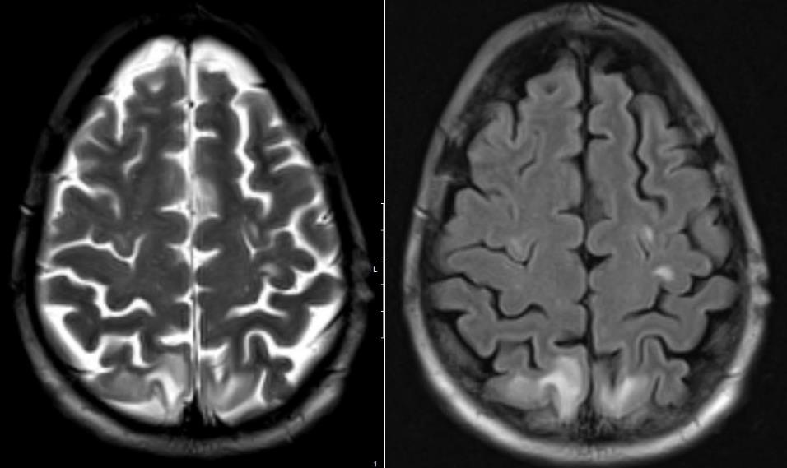
Left T2 axial and right FLAIR axial demonstrates hyperintense subcortical lesions in the bilateral parietal lobes in a patient with PRES which are much better visualized on the FLAIR image.

Slide 28
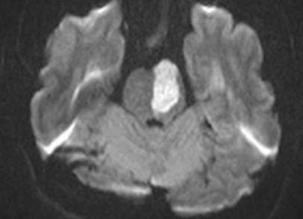
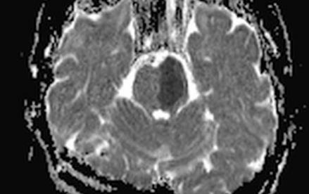
Diffusion weighted imaging
Used to evaluate for restricted diffusion, which will be bright of the diffusion sequences and dark on ADC map
Differential for thing causing diffusion restriction
Acute stroke
Abscess
Cellular tumors
Epidermoid cyst
Herpes encephalitis
CJD
Top image is DWI B1000 image showing increased signal in the left hemipons with a corresponding dark area on the ADC map consistent with restricted diffusion in a patient with a brainstem stroke.

Slide 29
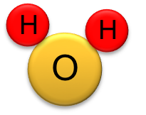
Basics physics and physiology of diffusion restriction explained
Cell
Na+/K+ ATPase pump
Intracellular space
Interstitial/extracellular space
Water molecule
Diffusion imaging measures random Brownian motion of water molecules within a voxel of tissue
Things that decrease the ability of water to diffuse freely cause imaging signs of “restricted diffusion

Slide 30
H2O molecules
Have a lot of area to diffuse freely
2K⁺
ATP → ADP
This slide represents normal tissue where cell are normal size and the water molecules are able to diffuse normally for the given tissue
The Na/K ATPase pump is working normally due to normal supply of glucose
Diffusion can be restricted by:
Being in the intracellular compartment
More organelles and proteins within the cytoplasm limit the degree of free diffusion of water molecules
Decreased size of the extracellular space
Additional substances such as proteins in the extracellular space that increase the viscosity of the fluid
3Na⁺

Slide 31
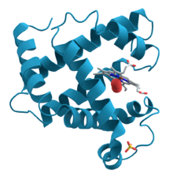
H2O molecules
Have less room to
Diffuse freely →
“Restricted diffusion”
Na⁺
Spillage of cell debris
Protein
Cell lysis
2K⁺
Ca²⁺
3Na⁺
This slide represents findings seen in an acute ischemic stroke
Lack of glucose and oxygen limits ATP production → shutting down Na/K ATPase pump → Na+ flows into cells → water follows and causes cell swelling
As mentioned before, water molecules have less room to diffuse freely when inside cells due to organelles, proteins, etc.
The large swollen cells decrease the extracellular space limiting H2O diffusion
Also cell lysis from influx of Ca2+ causes spillage of intracellular debris and increased viscosity of the extracellular fluid → restricted diffusion of H2O molecules

Slide 32
H2O molecules
Don’t have as much space in the extra-cellular compartment
This slide represents restricted diffusion in highly cellular tumors
The tightly packed cells in hypercellular neoplasms such as some lymphomas, meningiomas, and glioblastomas results in decreased size of the extracellular space
The diffusion restriction in these cases is generally not as striking as in acute ischemic stroke or abscesses.

Slide 33
Abscess
Protein
Viscous Pus
This slide represents restriction of water diffusion in an abscess
The viscosity from the proteinaceous contents and cellular debris within the abscess cause restriction of the free diffusion of water molecules

Slide 34
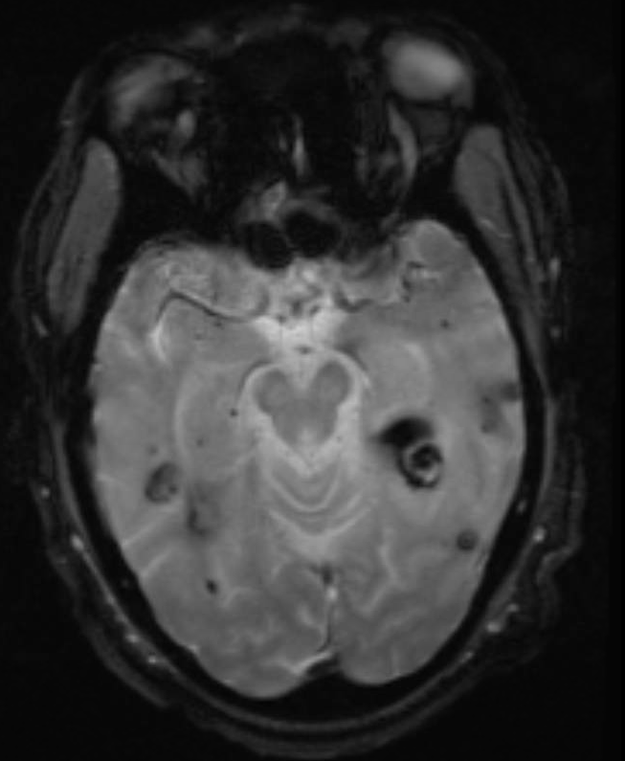
Gradient Echo
AKA GRE or T2*
High sensitivity for detecting blood or calcium because of blooming artifact, which makes small lesions containing hemosiderin or calcium larger and more obvious
Differential for multiple small dark spots on GRE:
Hypertensive microbleeds
Cerebral amyloid angiopathy
Multiple cavernous malformations
Diffuse axonal injury
Multiple hemorrhagic brain mets
Axial Gradient echo image showing numerous hemorrhages (most are old) in the bilateral temporal lobes

Slide 35
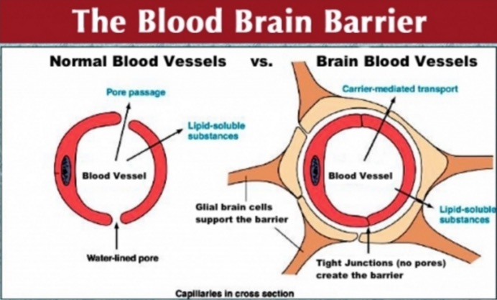
T1 post gadolinium
Post Gad enhancement has a very wide differential diagnosis and depends on the pattern of enhancement
Differential is also very dependent on the clinical scenario
Enhancement depends on disruption of the blood brain barrier commonly from infection, inflammation, neoplasm, trauma, and vascular etiologies
Structures that normally enhance include:
Choroid plexus
Pituitary and pineal glands
Tuber cinereum (inf hypothalamus)
Area postrema (inf aspect of 4th ventricle)
Figure from http://www.worthingbusinessawards.org/therapeutic-targeting-blood-brain-barrier-gene-therapy-and-vascular-biology/
Notes:
http://www.worthingbusinessawards.org/therapeutic-targeting-blood-brain-barrier-gene-therapy-and-vascular-biology/

Slide 36
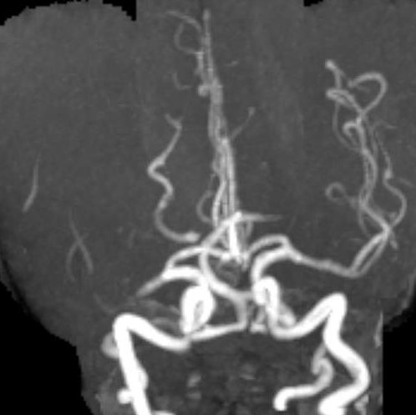
MRA
Time of Flight (TOF) imaging does NOT require gadolinium
Also no radiation
Based on rapid transit of moving arterial blood
Weaknesses
More sensitive to motion artifact
Has difficulty detecting slow flow
Spatial resolution compared to CTA
Physics behind it are somewhat complicated but an explanation can be found here…
https://www.imaios.com/en/e-Courses/e-MRI/MR-Angiography-Flow-imaging/time-of-flight-mra
3D MRA TOF showing an abrupt cutoff of the M1 segment of the right MCA. Findings on diffusion imaging were also consistent with an acute right MCA stroke

Slide 37
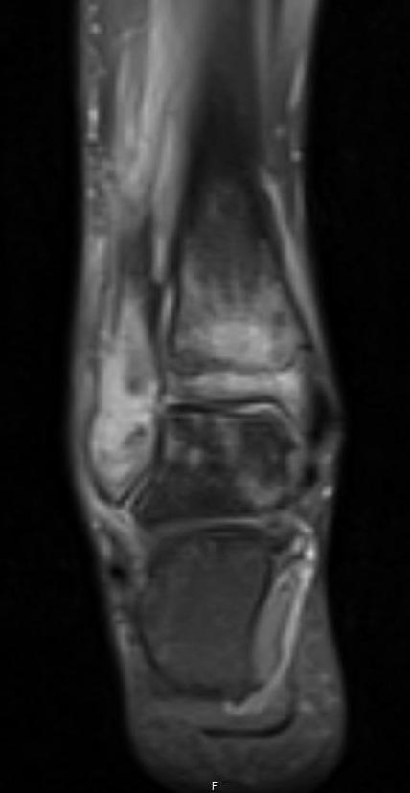
Common MRI sequences outside brain
Fat saturated T1 (+/- Gd) and T2 sequences
Fat saturation using radiofrequency pulses time to cancel out the signal created by fat
Used frequently in spine, MSK, body, and breast imaging
Proton density +/- fat saturation
Used in MSK, best for evaluating cartilage
In phase and out of phase Gradient Echo
Used in body imaging for evaluating for microscopic fat in liver, adrenal nodules, and renal lesions
Numerous cardiac sequences
Coronal proton density fat saturated image of the ankle shows high signal representing edema within the bone marrow of the tibia, fibula, and talus in a patient with osteomyelitis

Slide 38
HEAD TRAUMA & INTRACRANIAL HEMORRHAGES

Slide 39
Differentiating Bleeds
Extra-axial
Epidural
Subdural
Subarachnoid
Intra-axial
Intraparenchymal hemorrhage
Intraventricular

Slide 40
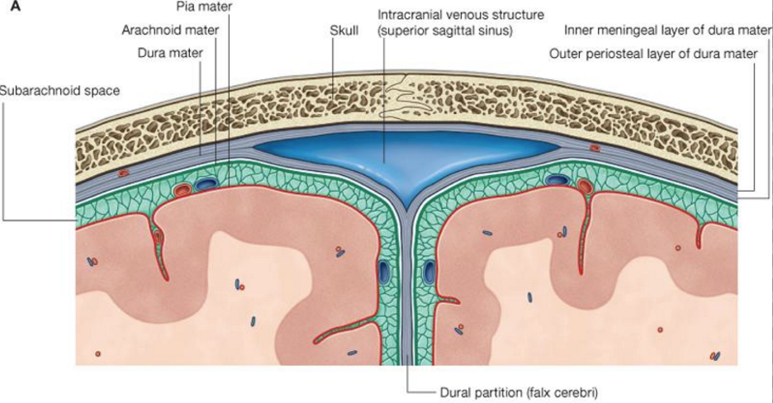
Extra-axial hemorrhage & Anatomy of the meninges
Image from https://www.studyblue.com/notes/note/n/regional-anatomy-meninges/deck/4684068

Slide 41
Epidural hematoma
Size of epidural hematoma usually limited by dural attachments at
cranial sutures
Bleeding in potential space between inner surface of skull and outer layer of dura/periosteal layer

Slide 42
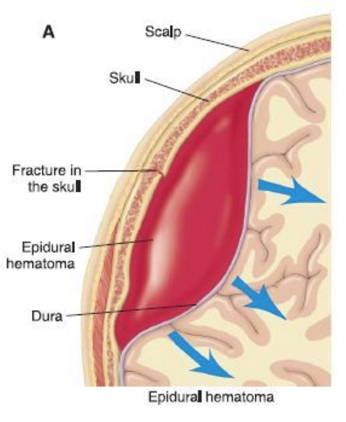
Epidural Hematoma
Causes
Blunt trauma
Approx. 75% associated with skull fracture
Middle meningeal artery most common source
Uncommonly can also result from injury to dural sinuses
Location
>95% supratentorial
Most commonly temporoparietal
Imaging
Biconvex hyperdense and extra-axial on CT
Limited by cranial sutures
Noncontrast CT is generally the only study needed for diagnosis
Figure from https://www.pinterest.com/explore/epidural-hematoma/?lp=true
Notes:
https://www.pinterest.com/explore/epidural-hematoma/?lp=true

Slide 43
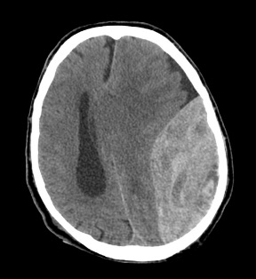
Epidural Hematoma
Clinical features
Classically: loss of consciousness →
Lucid interval →
worsening neurologic symptoms
Signs and complications
Swirl sign may indicate ongoing bleeding
Mass effect and herniation
Treatment
Immediate surgical evacuation often is needed
Venous bleeds can sometimes undergo conservative treatment with observation
Noncontrast CT head: Large epidural hematoma with mixed density swirl sign (arrow) and causing mass effect on underlying temporal and parietal lobes with left to right subfalcian herniation

Slide 44
Subdural hematoma
Spread of the hematoma is limited by the dura
Bleeding in space between the inner layer of the dura mater and the arachnoid mater

Slide 45
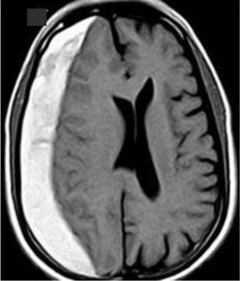
Subdural hematoma
Causes
Child abuse in infants
High energy blunt trauma in young adults
Falls or anticoagulation in elderly
Stretching or tearing of the bridging cortical veins where the cross the subdural space
Location
Usually unilateral in adults
Usually bilateral in infants after child abuse
Most commonly along the frontal and parietal lobes
Imaging appearance
Crescent shaped density
Limited by dural reflections (ex. cerebral falx and cerebellar tentorium)
Above: T1 axial hyperintense crescent shaped subacute subdural hematoma along the right cerebral convexity.

Slide 46
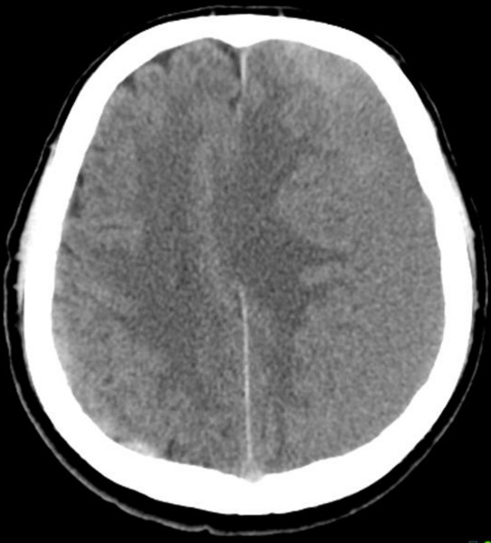
Subdural hematoma
Image from https://radiopaedia.org/cases/isodense-subdural-haematoma
Imaging continued
Noncontrast CT often all that is needed for diagnosis
Acute bleed = Hyperdense
Subacute = Isodense (to brain parenchyma)
Chronic = Hypodense
MRI useful in subacute bleeds and cases where the diagnosis is uncertain
Complications
Herniation, mass effect, hydrocephalus
Treatment
Symptomatic and large collections need surgical evacuation, usually through craniotomy
Above: Axial non-contrast CT demonstrates a large isodense subdural hematoma along the left cerebral hemisphere cause left to right midline shift.
Image from https://radiopaedia.org/cases/isodense-subdural-haematoma
Notes:
https://radiopaedia.org/cases/isodense-subdural-haematoma

Slide 47
Subarachnoid hemorrhage
Blood collects below the arachnoid mater
At the periphery of the brain the blood collects along the cerebral sulci

Slide 48
Subarachnoid hemorrhage
Can be divided into 2 types:
Traumatic
Most common cause of SAH
Clinical presentation
Headache, vomiting, decreased level of consciousness after trauma
Often associated with other traumatic injuries
Demographics
Young males, drugs/alcohol
Causes
Tearing of the vessels in the SAS
Rarely: traumatic dissecting aneurysm (mostly commonly vertebral artery)
Appearance mimics aneurysmal SAH
Spontaneous
Clinical presentation
Thunderclap headache/”WHOL”
Loss of consciousness (~50%)
10-15% die before reaching hospital
Demographics
Older middle age
Causes
Ruptured berry aneurysm (most common)
Dissecting aneurysm
Vascular malformations
Arteriovenous malformation
Cavernous hemangioma
Perimesencephalic SAH
Notes:
Stat dx

Slide 49
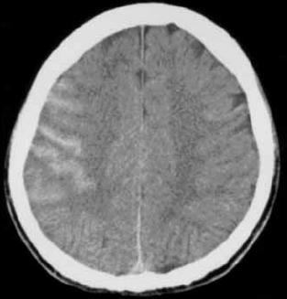
Traumatic SAH (tSAH)
Imaging appearance
High density ~80 HU in the subarachnoid spaces/basal cisterns
Adjacent to contusions & SDHs
Adjacent to sulci along the cerebral convexities
Noncontrast head CT is the workhorse of trauma brain imaging
Highly sensitive to acute tSAH
Axial CT image of the head shows hyperdense blood layering along the cerebral sulci of the right frontal and parietal lobes. There is also a small amount of subdural hematoma along the falx.
Notes:
https://www.researchgate.net/profile/Keisuke_Seki/publication/7426978/figure/fig4/AS:281547975479299@1444137676410/Fig-6-Traumatic-subarachnoid-hemorrhage-Axial-non-enhanced-CT-shows-high-density.png

Slide 50
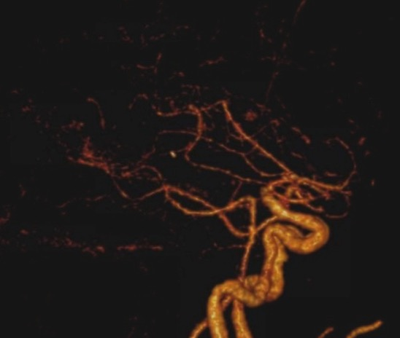
Traumatic SAH (tSAH)
Prognosis
GCS on admission
Amount of blood
Other associated injuries
Complications
Hydrocephalus (~12%)
Acute hydro is rare
Most commonly 2-4 weeks after SAH^{SOURCE}
Vasospasm
Peak 7-10 days
CTA head
⬇ vessel caliber
Infarction
3D reconstruction from a CT angiogram showing barely visible proximal anterior cerebral arteries (which are much smaller in caliber compared to the prior study) in a patient with vasospasm after having a large traumatic SAH. Vasospasm can be very subtle on imaging and comparison to prior studies is often most helpful.
Notes:
STAT DX
PMID 17707493

Slide 51
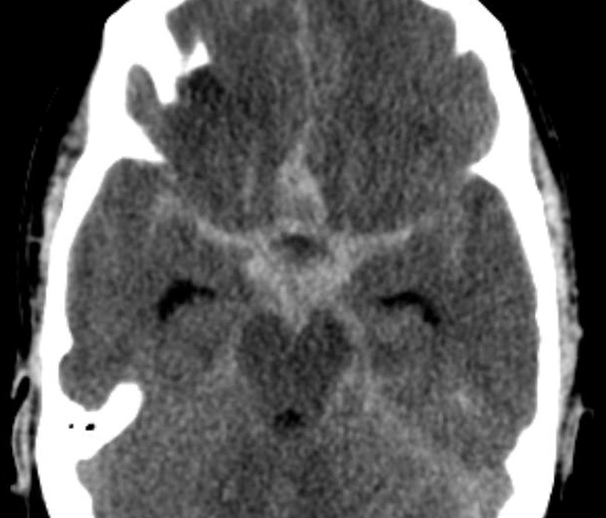
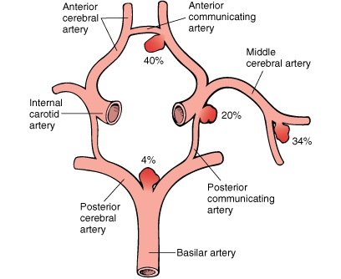
Aneurysmal SAH
Below: Axial NECT image of the brain showing SAH in the basilar cisterns and sylvian fissures
Most common cause of spontaneous SAH is saccular aneurysm
Imaging appearance
CT: 95% positive in first 24 hours
Hyperdense blood in the basal cisterns and sulci
Distribution depends on culprit vessel
ACCom → anterior interhemispheric fissure
MCA → sylvian fissure
Basilar tip, SCA, PICA, vertebral artery → prepontine, foramen magnum and 4th ventricle
Not rule but can be helpful to suggest vessel
+/- Intraventricular hemorrhage
MRI can be helpful if CT neg and suspicion high
FLAIR more sensitive than CT
After spontaneous diagnosis made → find cause
CTA: 90-95% positive if aneurysm ≥ 2mm
MRA: 85-95% sensitive for aneurysm ≥ 3mm
Digital subtraction angiography: can also treat
All above also evaluate for vascular malformations
Image from Robbins & Cotran Pathologic Basis of Disease: With STUDENT CONSULT Online Access, 8e (Robbins Pathology) 8th Edition
Notes:
(IMAGE) Robbins & Cotran Pathologic Basis of Disease: With STUDENT CONSULT Online Access, 8e (Robbins Pathology) 8th Edition

Slide 52
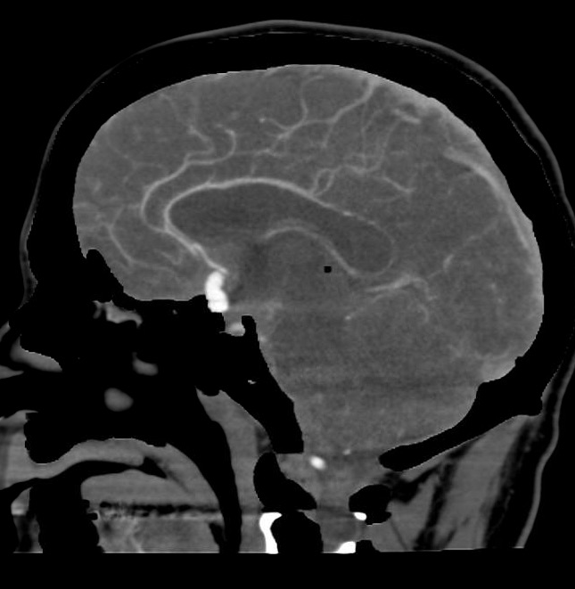
Aneurysmal SAH
Complications
Rebleeding (common in first 6 hrs)
20% within first 2 weeks
Vasospasm
Imaging evidence in 50-70% of patients ^{(E)}
5-15 days after SAH^{SOURCE}
Hydrocephalus
90% at presentation
Treatment
Percutaneous coil embolization by Neuro IR
Less invasive and better clinical outcome^{(F)}
Higher risk of rebleeding^{SOURCE2}
Microneurosurgical clipping
Sagittal CTA w/ bone subtraction of the head of the same patient on the prior slide showing a large aneurysm from the anterior communicating artery.
Notes:
https://ccforum.biomedcentral.com/articles/10.1186/cc5958
http://stroke.ahajournals.org/content/strokeaha/44/1/29.full.pdf

Slide 53
Intracerebral hemorrhage
Please watch the following two short videos:
Lobar hemorrhage
https://www.youtube.com/watch?v=7-IS9OBWIvg
Hypertensive hemorrhage
https://www.youtube.com/watch?v=d8G7zEXzKRk

Slide 54
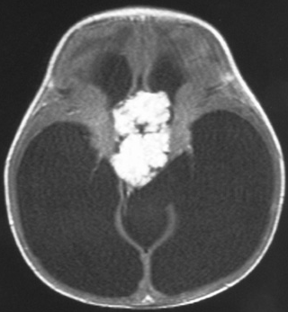
Hydrocephalus
Communication hydrocephalus (comm hydro)
Either due to reduced absorption by arachnoid granulations
Ex. after subarachnoid hemorrhage
Or increased CSF production
Ex. Choroid plexus papilloma
Obstructive hydrocephalus (obst hydro)
Blockage of CSF from flowing out of the ventricles
Obstructing mass or congenital aqueductal stenosis
T1 post Gd axial image showing a large enhancing choroid plexus papilloma in the third ventricle with severe hydrocephalus.
Image from http://www.pedsradiology.com/Historyanswer.aspx?qid=118&fid=1
Notes:
https://radiopaedia.org/articles/hydrocephalus-vs-atrophy-1
https://radiopaedia.org/articles/obstructive-hydrocephalus
https://radiopaedia.org/articles/communicating-hydrocephalus
From: http://www.pedsradiology.com/Historyanswer.aspx?qid=118&fid=1

Slide 55
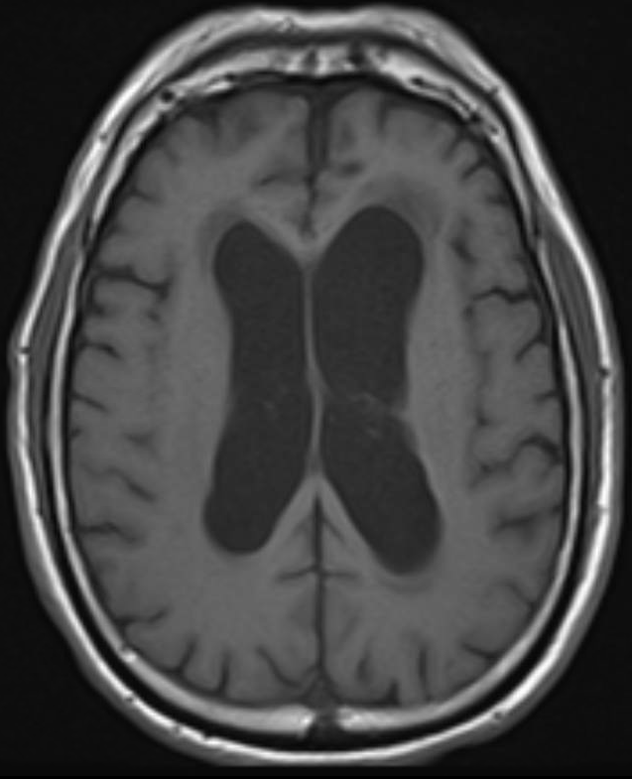
Hydrocephalus
Imaging
Comm hydro usually has diffuse symmetric dilatation of the ventricles
Obstr hydro may have asymmetric involvement of the ventricles depending on location, 4th ventricle not dilated
Comm hydro vs. brain volume loss
Both have large ventricles but factors that suggest hydro include dilatation of temporal horns and third ventricle, periventricular interstitial edema, among others
T1 weighted image of the brain demonstrates enlarged bilateral ventricles in a patient with with normal pressure hydrocephalus (a type of communicating hydrocephalus ).

Slide 56
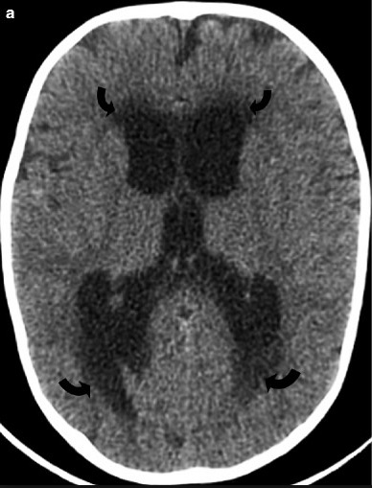
Acute obstructive hydrocephalus
Note that only acute obstructive hydro is usually an emergency
Enlargement of the temporal horns of the lateral ventricles, transependymal edema, and outward bowing of the lateral walls may suggest acute hydro
Interval enlargement of ventricles compared to previous studies is the most useful
Axial CT image of a patient with acute obstructive hydrocephalus. The curved arrows point to transependymal edema.
Image from https://www.researchgate.net/figure/278707496_fig1_Figure-12-612-Obstructive-hydrocephalus-a-b-Noncontrast-CT-of-the-head-demonstrates
Notes:
https://www.researchgate.net/figure/278707496_fig1_Figure-12-612-Obstructive-hydrocephalus-a-b-Noncontrast-CT-of-the-head-demonstrates

Slide 57
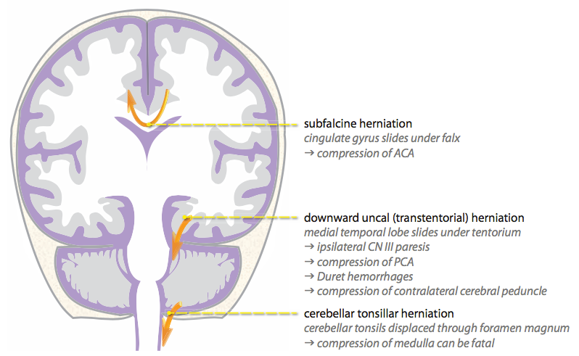
Types of herniation and the associated complications
Figure from Mandell, J. (2013). Core radiology: a visual approach to diagnostic imaging. Cambridge: Cambridge University Press.

Slide 58
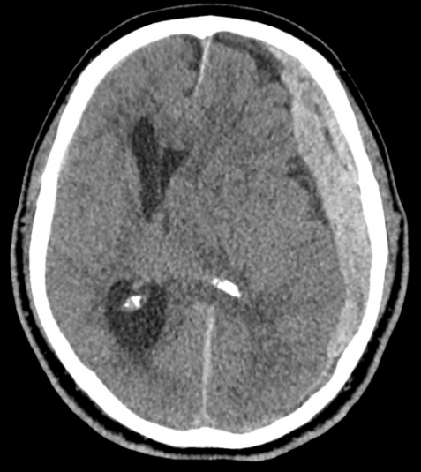
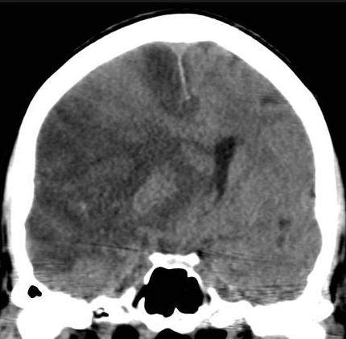
Subfalcian Herniation
Measured by drawing a line from the front attachment of the cerebral falx to the posterior attachment and then measure how far midline structures such as the septum pellucidum are displaced.

Slide 59
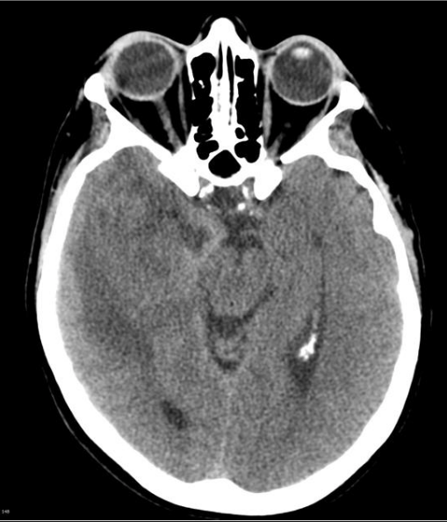
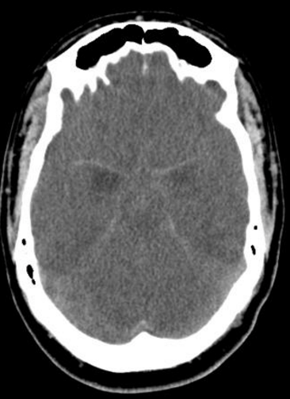
Uncal Herniation
Axial NECT head image demonstrate herniation of the uncus of the right temporal lobe herniating over the cerebellar tentorium and causing effacement of the normally star shaped suprasellar cistern.
Axial NECT head image demonstrates bilateral uncal herniation causing complete obliteration of the suprasellar cistern.

Slide 60
Tonsillar Herniation
Axial (left) and Sagittal (right) NECT head image demonstrate tonsillar herniation with effacement of the foramen magnum.

Slide 61
Nonaccidental Head trauma
Axial CT head showing bilateral fluid attenuation subdural collections with a small hyperdense area. These could represent bilateral subdural hematomas, effusions, or hygromas.
In the U.S. abusive head trauma is the most common cause of serious head trauma in children <1 year old
Types of injuries suggesting nonaccidental trauma (AKA child abuse) over true accidental trauma
Subdural hemorrhages especially when….
Multiple
Different ages of blood
interhemispheric fissure
over the convexity
posterior fossa
Hypoxic ischemic injury
Cerebral edema
Retinal hemorrhages
Axial T1w MRI head of the same patient showing T1 isointense subdural collections confirming subdural hematomas in a child who was abused.
Notes:
http://www.ajronline.org/doi/full/10.2214/AJR.14.13228
https://www.ncbi.nlm.nih.gov/pubmed/21844052

Slide 62
ACR Appropriateness Criteria
Note that head imaging is not necessarily required in all suspected child abuse cases and usually obtained when there are symptoms are concerning for head injury, facial injuries, or in cases of confirmed child abuse
CT head w/o contrast is exam of choice in acute setting
Fast scan = no sedation needed
Good at detecting bleeds and fractures
MRI w/o Gd is great for non-emergent cases
Higher sensitivity for small bleeds and parenchymal injuries (especially diffuse axonal injury)
Better at detecting SDHs of different age
Slow & requires sedation

Slide 63
Ischemic stroke

Slide 64
General imaging algorithm for Ischemic stroke
New focal neurologic deficit
<6 hrs, suspected stroke
Follow up Noncontrast CT head vs. neurosurgery
Noncontrast CT head
Intracranial hemorrhage
No evidence of
Intracranial
hemorrhage
Large ischemic penumbra and no contraindications
MRI brain and MRA head and neck
-OR-
CT angiogram of Head and Neck +/- CT perfusion
Neurointerventional radiology
for cerebral angiography and
possible percutaneous intervention

Slide 65
ACR APPROPRIATENESS CRITERIA

Slide 66
Imaging findings of ischemic stroke
Please watch the following video on imaging findings of acute brain infarction
https://www.youtube.com/watch?v=H4xErylBd1g

Slide 67
Ischemic stroke: CT head w/o contrast
Why start with noncontrast CT?
Fast, low motion artifact
Looking for intracranial hemorrhage (ICH) to evaluate is IV tPA is safe
High sensitivity for (ICH)
May see signs of acute ischemia
ASPECTS score can be used with noncontrast CT head in patient’s with MCA strokes to predict patient outcome and help with decision on taking the patient to neuroIR for intervention
If interested can read a short overview here
https://radiopaedia.org/articles/alberta-stroke-program-early-ct-score-1
Patient has a poor ASPECTS score of 2 (score = 10 - # of infarcted territories)
Images from https://teddybrain.wordpress.com/2013/03/16/alberta-stroke-program-early-ct-score-aspects-in-ischemic-stroke/ (accessed June 21, 2017).

Slide 68
Findings of Ischemic stroke on Noncontrast CT head
Hyperdense artery sign
Pictured: Hyperdense right MCA
Represents dense blood clot in the artery from thromboembolism
Can be seen immediately after stroke
Some studies report up to sensitivity of 52% and specificity of 95%¹
Loss of the insular ribbon
Pictured: Normal insular ribbon on left with loss of the insular ribbon on the right due to right MCA infarction → cytotoxic edema
Notes:
https://www.ncbi.nlm.nih.gov/pmc/articles/PMC4338528/
2. https://radiopaedia.org/cases/hyperdense-mca-sign-7

Slide 69
Findings of Ischemic stroke on CT angiography
On CT angiography, an abrupt cut off of flow related enhancement of the blood vessel is often seen representing the blockage of blood flow from the occlusive thrombus.
On the left is a CTA image and on the right is a 3D CTA reconstruction both showing abrupt cutoff of the M1 segment of the left MCA.

Slide 70
Findings of Ischemic stroke on CT perfusion
Infarct core is the area of brain that is unsalvageable and destined to infarct regardless of therapy
Ischemic penumbra is the area that is potentially salvageable with intervention if blood flow is restored
In both the infarct core and penumbra, the mean transit time (MTT) is prolonged.
In the infarct core, the CBF is significantly decreased while in the penumbra it is moderately decreased.
The key difference is in the cerebral blood volume (CBV)
Infarct core CBV is decreased
Penumbra CBV is normal or sometimes increased due to autoregulatory vasodilatation
Some software can automatically calculate and draw the infarct core and penumbra, see right image

Slide 71
Findings of Ischemic stroke on MRI Brain w/o Gadolinium
Diffusion restriction
Bright on Diffusion Weighted imaging (DWI)
Dark on Apparent diffusion coefficient (ADC)
Both must be present
If bright on both DWI and ADC = “T2 Shine through”, which represents bright T2 signal that is showing up on DWI and is not true restricted diffusion
Images from https://radiopaedia.org/articles/pontine-infarct
Notes:
https://radiopaedia.org/articles/pontine-infarct

Slide 72
Figure from Mandell, J. (2013). Core radiology: a visual approach to diagnostic imaging. Cambridge: Cambridge University Press.

Slide 73
SPINE TRAUMA

Slide 74
OUTLINE
Status post cervical spine trauma
Imaging needed?
What type of scan?
Brief discussion of spine fracture stability
Classic/eponymous spine fractures
Spine cord injury
To scan or not to scan?

Slide 75
Neuroimaging in Trauma
Some guidelines are available to help make decision of what to scan during trauma
CT Cervical spine
Canadian C Spine rules (see next slide for further details)
NEXUS Criteria (see next slide for further details)
Some algorithms are also available for thoracic and lumbar spine, head, and torso

Slide 76
Guidelines available at https://acsearch.acr.org/docs/69359/Narrative/
Notes:
Guidelines available at https://acsearch.acr.org/docs/69359/Narrative/

Slide 77
If cervical spine imaging is necessary according to NEXUS or CCR…
≥ 14 years old
< 14 years old
AP, lateral & Open mouth radiographs
Cervical Spine
OR
CT C Spine
CT cervical spine
If on CT or radiograph series of the Cervical spine or on physical exam there is…
Concern for ligamentous injury → MR spine
Concern for cord compression → MR spine
Cervical spine fracture present → At least CT of entire spine
Finding concerning for vascular injury i.e. fracture extending through transverse foramen or near major vessels → CTA Neck
If the patient is unable to be evaluated after 48 hours due to low GCS or other reason
→ MRI Cervical Spine

Slide 78
Denis three column classification
All fractures involving all three columns are unstable
All fractures involving only one column are stable
Fractures involving 2 columns may or may not be stable
Figure from http://www.radiologyassistant.nl/en/p4906c8352d8d2/spine-thoracolumbar-injury.html#i494cb0504ef3c
Notes:
https://radiopaedia.org/articles/three-column-concept-of-spinal-fractures
http://www.radiologyassistant.nl/en/p4906c8352d8d2/spine-thoracolumbar-injury.html#i494cb0504ef3c

Slide 79
Jefferson fracture
Burst fracture of C1
Fracture involves both anterior and posterior arches of C1
Mechanism = excessive axial loading
Imaging
Open mouth view is best radiograph view of the fracture
CT axials are useful for further characterization or initial diagnosis
Treatment
Usually managed conservatively with hard collar immobilization and imaging follow up
If it involves the transverse ligament, it is considered unstable and surgical intervention may be required
Axial CT 3D recon showing fractures through the anterior and posterior arches of C1.
Axial CT image showing fractures through the anterior and posterior arches of C1.

Slide 80
Odontoid fracture
Figure from https://radiopaedia.org/articles/odontoid-fracture
Fracture through the odontoid process (aka dens) of C2
Frequently occurs in old, osteoporotic pts
Mechanism is variable
flexion or extension +/- axial loading
Imaging
May see fracture line on open mouth or lateral radiographs
CT more sensitive
Important to evaluate for displacement (especially into spinal canal) and injury to the transverse ligament (TL) (MRI T2 has highest sensitivity for TL injury)
Treatment:
Type 1 and type III usually conservative
Type 2 most likely → nonunion → surgical immobilization
(Left) Sagittal CT cervical spine and (right) lateral radiograph of the cervical spine demonstrate a type 2 odontoid fracture with mild posterior angulation of the odontoid process.
Notes:
https://radiopaedia.org/articles/odontoid-fracture

Slide 81
Flexion teardrop
Figure from https://app.statdx.com/document/cervical-hyperflexion-injury/30290c3f-c353-4e7a-9df2-0ae49027bd3d?searchTerm=flexion%20teardrop
Most severe fracture of the cervical spine
Highly unstable with high risk of cord injury
Mechanism = severe flexion +/- axial loading
Imaging
On CT or radiographs of Cervical spine
Focal kyphosis of the spine
Anterior wedge compression deformity with teardrop fracture of the anterior inferior endplate
Anterolisthesis of the fractures vertebra with perched facets
Widening of the spinous processes
Treatment:
Generally all go to surgery for stabilization
(Left) Sagittal T2 and (right) sagittal CT images of the cervical spine demonstrate a flexion teardrop deformity of the the C5 vertebral body with edema of the spinal cord consistent with cord contusion.
Notes:
https://app.statdx.com/document/cervical-hyperflexion-injury/30290c3f-c353-4e7a-9df2-0ae49027bd3d?searchTerm=flexion%20teardrop

Slide 82
Hangman fracture
Fractures of the bilateral pars interarticularis of C2
Mechanism = high velocity hyperextension +/- distraction
Misnomer, virtually never seen in suicidal hanging
Usually from high speed MVAs
Imaging
On CT or radiographs of Cervical spine
Bilateral C2 pars interarticularis fractures
Usually anterolisthesis of C2 on C3
Treatment:
Usually conservative treatment with C collar
Sagittal (upper 2) and axial (lower) CT images demonstrate fractures of the bilateral pars interarticularis of the C2 vertebra with anterolisthesis of C2 on C3 consistent with a Hangman fracture.

Slide 83
Burst fracture
Compression fracture on vertebral body with retropulsion of the posterior vertebral body into the spinal canal
Most commonly occurs from T9-L5 spinal levels
Mechanism = high energy axial loading
Often fall from height or MVA
Imaging
On CT or radiographs of the spine
Loss of vertebral body height, mostly anteriorly
Retropulsion of the posterior portion of vertebral body into the spinal canal
May also involve posterior elements becoming a 3 column fx
Treatment:
Stability depends on degree of vertebral body height loss and retropulsion as well as involvement of posterior elements. If unstable → surgery
Left T2 Sagittal and right CT sagittal of the lumbar spine demonstrates a burst fracture of L1 cause significant narrowing of the spinal canal and effacement of the cauda equina nerve roots.

Slide 84
Chance fracture
AKA seatbelt fracture
Anterior wedge fracture of vertebral body with horizontal fracture or distraction of the posterior elements
Mechanism = Flexion-distraction
Imaging
On CT or radiographs of the spine
Anterior wedge compression deformity of the vertebral body
May see widening of the interpedicular distance on AP Xray
Widening of facet joints and interspinous spaces
Transverse fractures across the pedicles and lamina
Treatment:
Although 3 column fracture, often treatment with brace holding spine in hyperextension
May need surgery
Top image: Crash dummy demonstrating classic flexion distraction mechanism of action for chance fracture.
Lower image: shows anterior compression fracture with horizontal fracture extending through the vertebral body and distraction of the posterior elements.
Images from https://www.pinterest.com/pin/454933999831636207/ and
http://boneandspine.com/chance-fracture-of-spine/
Notes:
https://www.pinterest.com/pin/454933999831636207/
https://radiopaedia.org/articles/chance-fracture
http://boneandspine.com/chance-fracture-of-spine/

Slide 85
Brain tumors

Slide 86
Common tumors
Adult
Malignant
Most common = Metastasis
Most common primary = Glioblastoma
Benign
Meningioma: most common benign intracranial tumor
Pediatric
Medulloblastoma
Pilocytic astrocytoma

Slide 87
Brain metastasis
Approx 25-50% of intracranial tumors in hospitalized patients
Most common primary tumors
Lung
Renal cell carcinoma
Breast cancer
Melanoma
Clinical presentation
Headaches, seizures, altered mental status, nausea/vomiting, visual disturbances
Common locations
Gray white junction
Arterial watershed areas
MRI best imaging modality
Enhancement of post gadolinium T1
Due to breakdown of the blood brain barrier
Surrounded by increased T2/FLAIR signal from vasogenic edema
May have increased T1 signal if recently hemorrhagic
May be difficult to see on noncontrast CT
Top: Axial noncontrast CT head show a heterogeneous appearing intraparenchymal hemorrhage with surrounding edema in a patient with renal cell carcinoma.
Bottom: Axial T1w post gadolinium image showing an underlying enhancing lesion consistent with a left occipital hemorrhagic metastasis
Notes:
https://radiopaedia.org/articles/brain-metastases

Slide 88
Glioblastoma
Epidemiology
Most common adult primary intracranial neoplasm
15% of all intracranial neoplasms
Primary GBM most common
Generally IDH wild type (part of new WHO tumor classification)
10% secondary = arising from pre-existing lower grade astrocytoma
Generally IDH mutant
Clinical presentation
Focal neuro deficit, seizures, headache
Location
Predilection for subcortical white matter and deep gray matter of the cerebral hemispheres
Commonly temporal lobe
T1 post Gad (upper) and FLAIR (lower) axial MR images of the brain showing an irregular and nodular peripherally enhancing mass in the left frontal lobe with surrounding high FLAIR signal consistent with vasogenic edema.

Slide 89
Glioblastoma
Appearance/Common imaging features
MRI w/ Gadolinium = study of choice
Large tumor
Thick enhancing rim with central necrosis (T1 dark, T2 bright center)
Solid component diffusion restriction
Surrounding bright T2/FLAIR signal = edema and tumor
Spreads along the white matter tracts
May spread along corpus callosum to involve both cerebral hemispheres
Relatively specific for GBM
“Butterfly glioma”
MR spectroscopy and PET can be helpful to evaluate post treatment recurrence versus radiation necrosis
Above: T1 post Gd axial image of the brain demonstrates a heterogeneous mostly peripherally enhancing butterfly glioma that crosses midline involving the bilateral frontal lobes.
Notes:
https://radiopaedia.org/articles/glioblastoma
https://radiopaedia.org/cases/glioblastoma-nos-butterfly-morphology

Slide 90
Glioblastoma
Treatment
Tumor debulking with post op chemo & radiation
Despite therapy median survival time <2 years
Negative prognostic factors
Degree of necrosis
Degree of enhancement
Involvement of deep gray matter structures
MGMT unmethylated (high MGMT activity)
Predicts response to alkylating chemo agents
Increased age at diagnosis
Patient status post resection of a high grade glioma and radiation with a new enhancing right temporal mass (A) which could be a recurrence of the tumor or radiation necrosis. PET (B) and MR/PET (C) show decreased metabolic activity in these region and the cerebral blood volume map (D) shows decreased perfusion consistent with radiation necrosis. This would be impossible to differentiate with only the T1 post Gad image (A).
Images from Hojjati, M., Badve, C., Garg, V., Tatsuoka, C., Rogers, L., Sloan, A., . . . Wolansky, L. J. (2017). Role of FDG-PET/MRI, FDG-PET/CT, and Dynamic Susceptibility Contrast Perfusion MRI in Differentiating Radiation Necrosis from Tumor Recurrence in Glioblastomas. Journal of Neuroimaging. doi:10.1111/jon.12460
Notes:
https://radiopaedia.org/articles/glioblastoma

Slide 91
Meningioma
Most common primary intracranial tumor in adults
1-1.5% autopsy prevalence
<10% are symptomatic
Symptoms based on mass effect on surrounding structures
Hemiparesis, cranial nerve defects, anosmia, visual defects, seizures
Middle aged, female predominance
Location
90% supratentorial
Parasagittal/cerebral convexity > sphenoid ridge > olfactory groove = parasellar
10% infratentorial
Cerebellar pontine angle
Coronal (upper) and axial (lower) T1w post Gad MR images of the brain demonstrate a homogeneously enhancing mass originating from the cerebral falx with a small enhancing dural tail consistent with a meningioma.
Notes:
STatdx

Slide 92
Meningioma
Imaging findings
Frequently seen initially on NECT
Hyperdense, well defined, smooth, dural based lesion
~25% calcifications
Hyperostosis bone adjacent to mass (increased density)
MRI w/ Gd = study of choice
Homogeneous intense enhancement
Enhancing dural tail
Buckling of underlying cortex
Treatment
If asymptomatic usually followed w/ imaging
Surgical resection if symptoms/complications
Sagittal (upper) and coronal (lower) T1 post Gd MR images of the brain show a homogeneously enhancing meningioma at the planum sphenoidale/sella turcica. The mass is encasing the right optic nerve, note the normal optic nerve on the left.
For anatomical reference of planum sphenoidale see http://img.medscapestatic.com/pi/meds/ckb/67/25167tn.jpg
Notes:
Statdx
https://app.statdx.com/document/meningioma/0fe978ef-220e-4af9-a1a2-561a76ba5577?searchTerm=meningioma
http://emedicine.medscape.com/article/882627-overview?pa=MwyJ4nLSKQz1JTXAPKYZy4FgKTKp%2B3erpBX24NYl52tT0SwYohwe5iLWbfCl%2BFXGOb2pnhNquRDfxKOj2fIp3SchrzF%2F7vlnSF6AEX%2F09M8%3D

Slide 93
Medulloblastoma
Most common malignant brain tumor of childhood (WHO Grade IV)
Most patients diagnosed by 5 y/o
Highly cellular, blue cell tumor
Most commonly arise from cerebellar vermis (75%) and protrude into 4th ventricle through roof
Rapid growth → hydrocephalus
Clinical symptoms from increased ICP
Treatment = surgical resection with chemo & radiation
Prognosis
Based on surgical resection, presents of CSF mets
Expression of c-erbB-2 oncogene = worse prognosis
T1 post Gd axial image showing a heterogeneously enhancing medulloblastoma extending from the cerebellar vermis into the expanded 4th ventricle.
Notes:
https://radiopaedia.org/articles/medulloblastoma
https://app.statdx.com/document/medulloblastoma/87927ecd-ef21-4028-8468-54ee0c537b48?searchTerm=medulloblastoma

Slide 94
Medulloblastoma
Imaging findings
NECT
Hyperdense mass (due to high nucleus to cytoplasm ratio) protruding into the 4th ventricle
Central low density = necrosis (~50%)
Calcifications in 10-20%
MRI w/ Gad (study of choice)
Enhancement, often heterogeneous
Central necrosis (decreased enhancement)
Diffusion restriction (due to high cellularity)
Important to look for CSF seeding
Drop metastases
Spread through CSF spaces → along spinal cord
Leptomeningeal spread
Spread along the meninges
Axial T1 post Gad MR image of the lumbar spine in the patient on the previous slide with a medulloblastoma which shows a small enhancing nodule along the left lateral aspect of the thecal sac consistent with a drop metastasis.
Notes:
https://radiopaedia.org/articles/medulloblastoma

Slide 95
Key differential diagnosis for enhancing 4th ventricular mass = ependymoma
Often indistinguishable from medulloblastoma by imaging
Ependymoma may squeeze through the foramina of the 4th ventricle (AKA toothpaste tumor)
Hemorrhage and calcification is more common in ependymoma
Lower ADC values in medulloblastoma (due to cellularity)
Sagittal (upper left) and axial (lower left and upper right) T1 post Gd images demonstrate a heterogeneously enhancing mass in the 4th ventricle which squeezes posteriorly out the foramen of Magendie, laterally out one foramen of Lushka and inferiorly through the obex. This was found to be an ependymoma. Note how similar it looks on the upper right image to the medulloblastoma on the prior slide.

Slide 96
Pilocytic astrocytoma
WHO Grade 1 = not considered malignant
Most common primary brain tumor in children
Peak incidence 5-15 y/o
Location
Cerebellar hemisphere
May compress 4th ventricle
Also common along the optic nerve/optic chiasm
Clinical presentation
Cerebellar → headache, N/V, ataxia
Optic → visual symptoms
Associated with NF1
Especially if involving the optic pathway
Well circumscribed, slow growing, little edema
Upper axial and lower sagittal T1 MR images of the brain demonstrate the classic appearance of a pilocytic astrocytoma in the cerebellum with a large cystic component and enhancing nodule. Notice that it is compressing the 4th ventricle rather than residing inside and expanding it like the previous tumors.

Slide 97
Pilocytic astrocytoma
Imaging
MRI w/ Gd = study of choice
Cystic lesion (high T2 signal) with heterogeneously enhancing mural nodule
Little surrounding edema
Calcification ~20%
Treatment
Cerebellar or cerebral hemisphere → resection
Optic pathway → observation
Debulking surgery considered if vision is lost
Radiation or chemo if rapid progression
Prognosis
Median survival at 20 years > 70%
FLAIR Axial images from the patient on the prior slide demonstrating obstructive hydrocephalus with large lateral ventricles and third ventricle from compression of the 4th ventricle seen on prior slide. Note the bright FLAIR signal around the vents consistent with transepnedymal edema.

Slide 98
Infection
Common types of CNS infection (will discuss the pathology in yellow)
Brain
Meningitis
Encephalitis
Herpes encephalitis
Cerebral abscess
Cerebritis
Ventriculitis
Subdural empyema
Epidural abscess
Spine
Discitis/osteomyelitis

Slide 99
Meningitis
Not imaging diagnosis
Sometimes see thin leptomeningeal enhancement but nonspecific
Also seen frequently after lumbar puncture which confounds findings
Imaging is for complications (HACTIVE)
Hydrocephalus
Abscess
Cerebritis
Thrombosis
Infarct
Ventriculitis/Vasculopathy
Extra-axial collection (empyema/hygroma)
Axial T1 post Gad (upper) and axial FLAIR (lower) images in a patient with cryptococcal meningitis showing findings concerning consistent with ventriculitis including thin enhancement along the lateral ventricles, debris layering within the left lateral ventricle and periventricular edema.

Slide 100
Viral encephalitis
Pathogens:
HSV (most commonly diagnosed)
VZV
Enterovirus
Influenza A
CMV
Flaviviruses
Japanese encephalitis
West Nile
JC Virus
HIV

Slide 101
Herpes encephalitis
Imaging findings
Common pattern of involvement
Bilateral asymmetric
Limbic system
Medial temporal lobes
Insular cortices
Inferolateral frontal lobes
CT
Commonly normal
Low density → hemorrhage
MRI
Diffusion restriction is most sensitive from cytotoxic edema
High T2/FLAIR early
Gyral, ring, leptomeningeal or diffuse enhancement late
May see hemorrhage of GRE
Axial diffusion weighted image of the brain showing diffusion restriction in the bilateral temporal lobes, greater on the right compared to left in a patient with herpes encephalitis.

Slide 102
Cerebral abscess
Key imaging findings
MRI post Gd
Ring enhancement
May see ventriculitis commonly with hydrocephalus
High T2/FLAIR internal signal with surrounding high signal from vasogenic edema
Low T2 signal thin capsule
Diffusion restriction
Key differentials
Mets or high grade glioma
Abscess tend to have thinner wall and satellite lesions
Cystic component usually doesn’t diffusion restrict in gliomas
Clinical history
Others include subacute infarction/hemorrhage, demyelination, radiation necrosis

Slide 103
Discitis/Osteomyelitis
Bimodal age distribution
Children
Older population (50+ y/o)
Fever and back pain
Staph aureus 60% cases
Most commonly lumbar spine
Radiographs often initial workup
Can be normal for up to 2-4 weeks
Cannot visualize epidural abscesses or septic facet arthritis
May see endplate irregularity and later collapse
Sclerosis doesn’t appear until 10-12 weeks
Lateral radiograph of the cervical spine showing increased lucency and edema in the prevertebral soft tissues with irregularity and cortical erosion of the inferior endplate of C4 and superior endplate of C5 in a patient with discitis/osteomyelitis & prevertebral abscess.
Notes:
https://radiopaedia.org/articles/spondylodiscitis
https://radiopaedia.org/cases/cervical-spondylodiscitis

Slide 104
Discitis/Osteomyelitis
MRI w/ Gad is study of choice
MRI w/o Gad is also sensitive and specific if patient cannot get Gad
T1: Dark signal in disc space (fluid) & adjacent vertebral endplates (edema)
T2 w/ fat suppression: Bright signal in the disc space, endplates, and paravertebral soft tissues (edema/phlegmon/abscess)
T1 post contrast: Peripheral enhancement surrounding fluid → abscess
Notes:
https://radiopaedia.org/articles/spondylodiscitis
https://radiopaedia.org/cases/cervical-spondylodiscitis

Slide 105
ACR Appropriateness Criteria

Slide 106
Neuro IR
There has been a shift of neurointerventional procedures from neuroradiologists to neurosurgeons, however, both radiologists and also neurologists can be trained in neuro IR
Perform a wide variety of procedures, for example:
Diagnostic cerebral and spinal angiograms
Cerebral aneurysm coiling
Treatment of cerebral and spinal vascular malformations
Treatment of ischemic stroke
Mechanical thrombectomy
Catheter directed thrombolysis
Treatment of vascular injuries of the head and neck
Vascular stenting in head and neck

Slide 107
Neuro IR
Please watch this short video on Endovascular management of ischemic stroke
https://www.youtube.com/watch?v=wY3fMI7LcCY

Slide 108
Mechanical thrombectomy in Ischemic stroke
Noncontrast axial CT image of the head demonstrates a dense right MCA sign consistent with a R MCA infarct.
Digital subtraction images of the head during contrast injection through the right internal carotid artery before (left) and after (right) mechanical thrombectomy of a right MCA clot. Note the cutoff of the right MCA on the left image consistent with R MCA stroke. On the right image, note the restored flow throw the right MCA and distal branches.

Slide 109
Coiling aneurysms
DSA run after successful coiling of the basilar tip aneurysm showing no contrast flow into the aneursym
DSA Run showing a tip of the basilar artery aneurysm

Slide 110
Diagnostic Angiogram of AVM
Diagnostic DSA showing a large right occipital arteriovenous malformation supplied by branches of the right middle, posterior and anterior cerebral arteries. Notice the early filling of the large dilated draining vein into the right vein of Galen and straight sinus. This is a Spetzler-Martin grade 5 AVM.

Slide 111
DAWN trial – Prelim results
Targeted patients for mechanical thrombectomy arriving after 6 hrs and up to 24 hours after the onset of stroke symptoms (previously patient must be less than 6 hrs from symptom onset)
Inclusion criteria based on imaging and clinical scores to find patients with a large mismatch between their potentially salvageable penumbra and core infarct
Prelim results
2-point difference in the 90-day weighted modified Rankin Scale (mRS) score
73% relative reduction of dependency in activities of daily living
Number needed to treat for any lower disability of 2.0
This is a huge breakthrough in the treatment of ischemic stroke
UHCMC is one of the sites participating in this multicenter trial
More details can be found at https://clinicaltrials.gov/ct2/show/NCT02142283?term=dawn+stryker&rank=1
Notes:
http://www.medscape.com/viewarticle/880144

Slide 112
Work Cited
1) https://www.ncbi.nlm.nih.gov/pmc/articles/PMC4338528/
B) https://teddybrain.wordpress.com/2013/03/16/alberta-stroke-program-early-ct-score-aspects-in-ischemic-stroke/ (accessed June 21, 2017).
C) http://www.medscape.com/viewarticle/880144
D) http://www.voxel.pl/en/indications-and-contraindications-magnetic-resonance-imaging
E) https://ccforum.biomedcentral.com/articles/10.1186/cc5958
F) http://stroke.ahajournals.org/content/strokeaha/44/1/29.full.pdf
G) https://radiopaedia.org/articles/hydrocephalus-vs-atrophy-1
https://radiopaedia.org/articles/brain-metastases
https://radiopaedia.org/articles/chance-fracture
H) https://radiopaedia.org/articles/obstructive-hydrocephalus
https://radiopaedia.org/articles/communicating-hydrocephalus
Mandell, J. (2013). Core radiology: a visual approach to diagnostic imaging. Cambridge: Cambridge University Press.
http://www.ajronline.org/doi/full/10.2214/AJR.14.13228
https://www.ncbi.nlm.nih.gov/pubmed/21844052
Hojjati, M., Badve, C., Garg, V., Tatsuoka, C., Rogers, L., Sloan, A., . . . Wolansky, L. J. (2017). Role of FDG-PET/MRI, FDG-PET/CT, and Dynamic Susceptibility Contrast Perfusion MRI in Differentiating Radiation Necrosis from Tumor Recurrence in Glioblastomas. Journal of Neuroimaging. doi:10.1111/jon.12460

