Slide 1
Centralized
Scheduling Request System
(cSRS)

Slide 2
Centralized Scheduling Request System (cSRS)
CWRU SOM Registrar’s Office and all affiliate hospitals to use the same system to provide consistency across affiliate hospitals which will help ensure students are registered for their confirmed/scheduled rotations.
Allows students to see what rotations are possibly available during each block in real time before submitting their requests.
Students would NOT be able to double book courses across the affiliated hospitals because it limits students to one request per block.
Once the student “accepts” the rotation, the information will transfer to the registrar’s page which eliminates the need for the student to “register” using a separate system (which students often forget to do).
CSRS has the capability to create reports needed i.e. on-boarding reports
Can be modified to accommodate your process.
Capable of a lottery signup for a rotation or for multiple rotations (and multiple sites)

Slide 3
Purpose of cSRS
  Help Students with rotation REQUESTS
    See what rotations may be available in real time, before requesting
    Keep track of their schedules/all of their rotations (requested/approved/completed)
    Students cannot double book at affiliate sites which opens up more spots to students and minimizes unnecessary work for admin (approve spots then having to cancel them)
  Affiliate Hospital/Site Admin
    Student requests will be listed in the scheduling request system instead of emails
    Can set up to accommodate your current process since the system is customizable
    Requests can be sent directly to faculty/departments for review/approval through the system (no account needed for dept approver)
    Automatic confirmation emails are sent to the students from the system and cc others
    Cross training would be much easier
  Registrar’s Office –
    Once the student has accepted the approved rotation, otation information is automatically transferred to the SOM Registrar Page for enrollment in SIS (on the transcript)
    This will minimize students from forgetting to register for rotations or forgetting that they had already scheduled a rotation during a specific block

Slide 4
Course Criteria Page
This page is the driving force of the rotations offered to the students in CSRS
This page is managed by the hospital admin team who oversees the rotation(s)
The admin will manage the course criteria for each rotation such as…
  Course Duration – 2-week, 4-week, 2- or 4-weeks, and longitudinal
  Scheduling Lead Time – how much notice does the dept need to schedule (2 weeks advance?)
  Combined Courses – is total number of spots shared with another rotation (ex. Anes AI and Anes/Periop at CC share spots)
  Prerequisites – if offered to 3rd year students, what pre-reqs are required?
  Student Type / Year that can schedule e.g. CWRU University Program (UP) and College Program (CP) students, and/or visiting and what year for home students (Y3 and/or Y4/Y5)
  Pre-approval required – if so, who? Must list this name in “Course Faculty and Contact” section as dept approval
  Number of spots available per block - this can vary from block to block and can be marked as unavailable for specific time/period. Default is set at 1 spot each block unless changed by the admin team
  Preference in residency specialty for certain blocks can be listed
  Special documents can be collected for review i.e. CV or Statement of Interest must be uploaded for specific rotations
  Contact information for everyone needing notification of rotation (who will be cc’d on confirmation email)
  Student instructions for first day to be added to the confirmation page (customizable by admin)

Slide 5
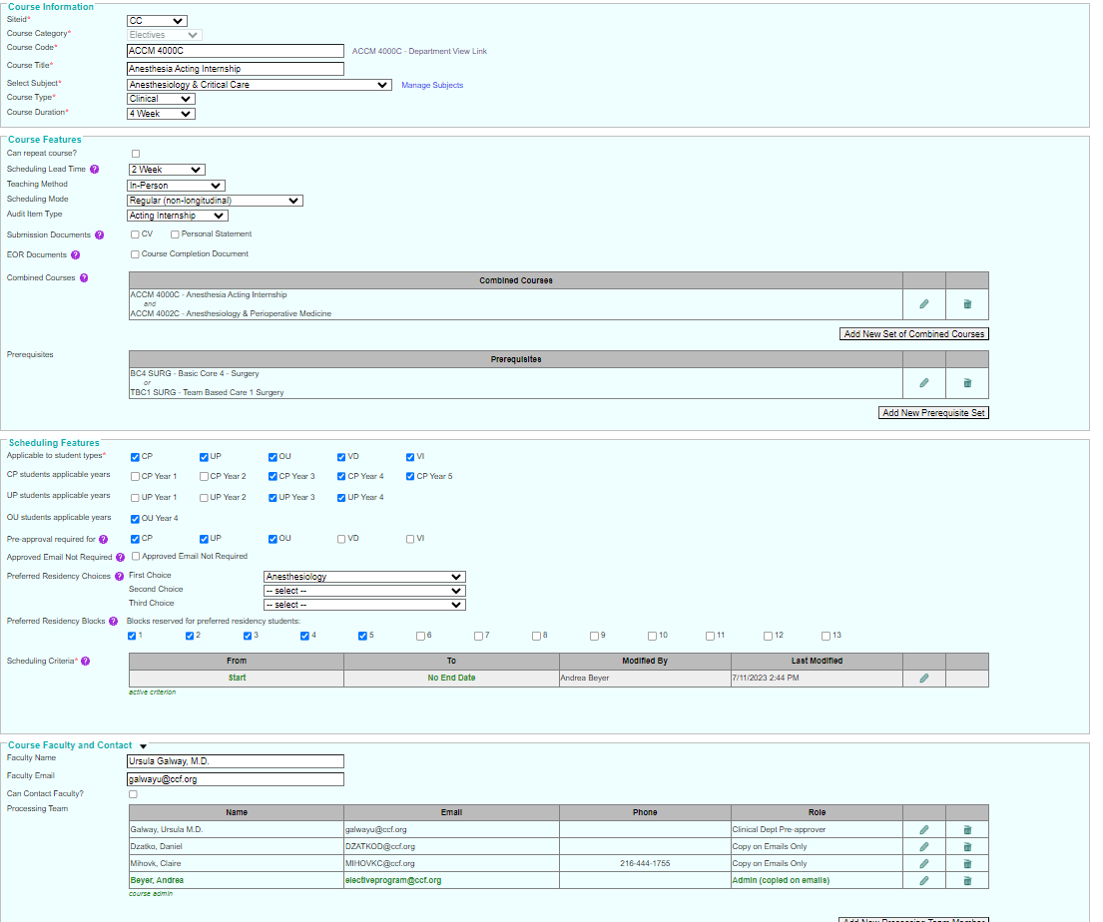
Course Criteria Page -
The site admin/coordinator is responsible to update this page
This is what drives the course offerings to students in CSRS
  Course Information - duration
  Course Features – lead time to schedule, pre-reqs, etc.
  Scheduling Features – what students and how many spots
  Course Faculty and Contact
  Student Instructions (added to confirmation email)

Slide 6
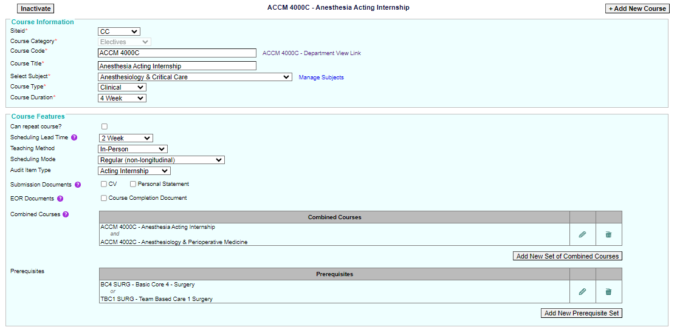
Course Criteria Page – Course Information and Course Features

Slide 7
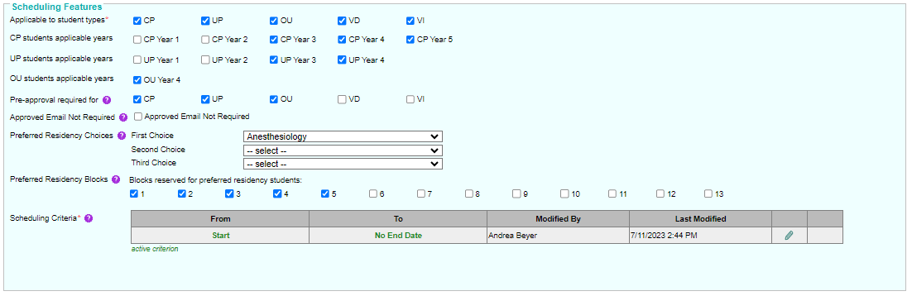
Course Criteria View – Scheduling Features
Scheduling Criteria
Click pencil to edit
This is what controls number of spots offered per block

Slide 8
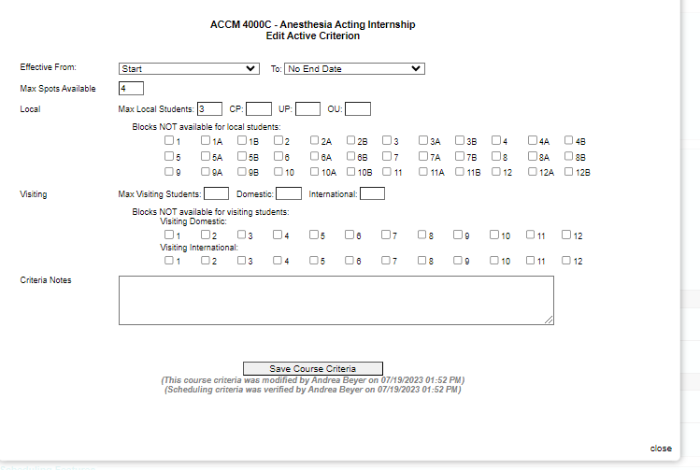
Course Criteria View – Scheduling Features –
Scheduling Criteria
This is what controls number of spots offered per block
  Can change number of spots per block
  Close blocks as needed
  Limit certain student types

Slide 9
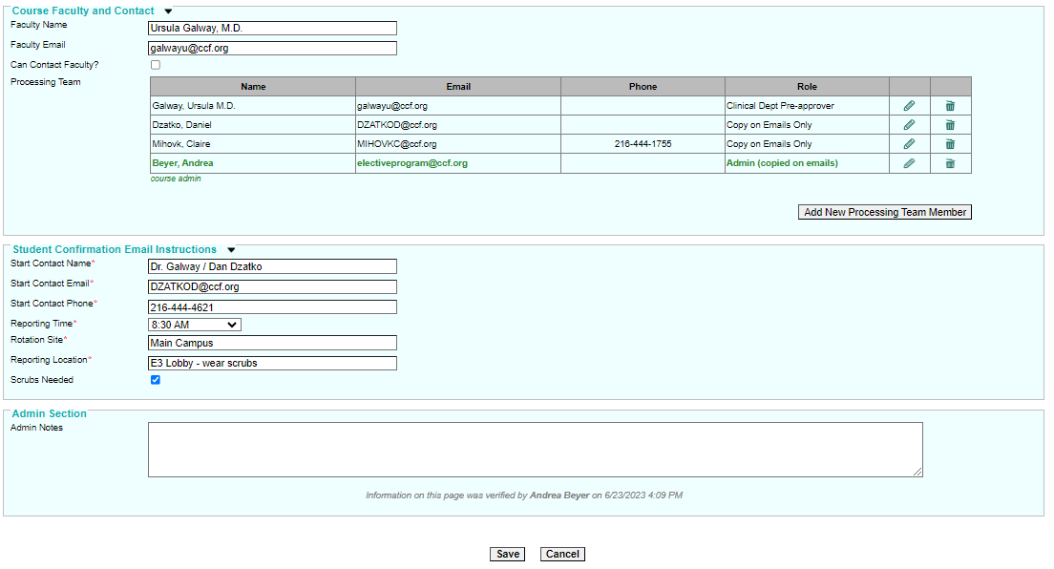
Course Criteria View – Course Faculty and Contact Information / Student Instructions (added to confirmation email)

Slide 10
Student Page
The student view includes links for…
  Scheduling Instructions
  Course Catalog
  Academic Calendars
Student view will have 3 tabs
  Tab 1: Course Catalog Requests – default page: this is where students submit their requests
  Tab 2: Unlisted Elective Forms – faculty and society dean approval functionality within CSRS
  Tab 3: My Rotation Schedule - view all of their rotations (pending/approved/completed)
From the Rotation Request Page (image on next slide)
  Students can see their schedule (pending and confirmed rotations) across the top row titled “My Schedule”
  Students can see what rotations are available in real time, they can submit a REQUEST for those rotations with an “R”. These spots are not guaranteed, but it helps students identify rotations that are more likely available (keeps them from requesting rotations that are full or not available)
  There is a filter option to select specific course criteria i.e. academic year, rotation type, rotation length, preapprovals, site, or blocks.
  Students can also search for specific rotations e.g. PEDS or Cardiology in the search field

Slide 11
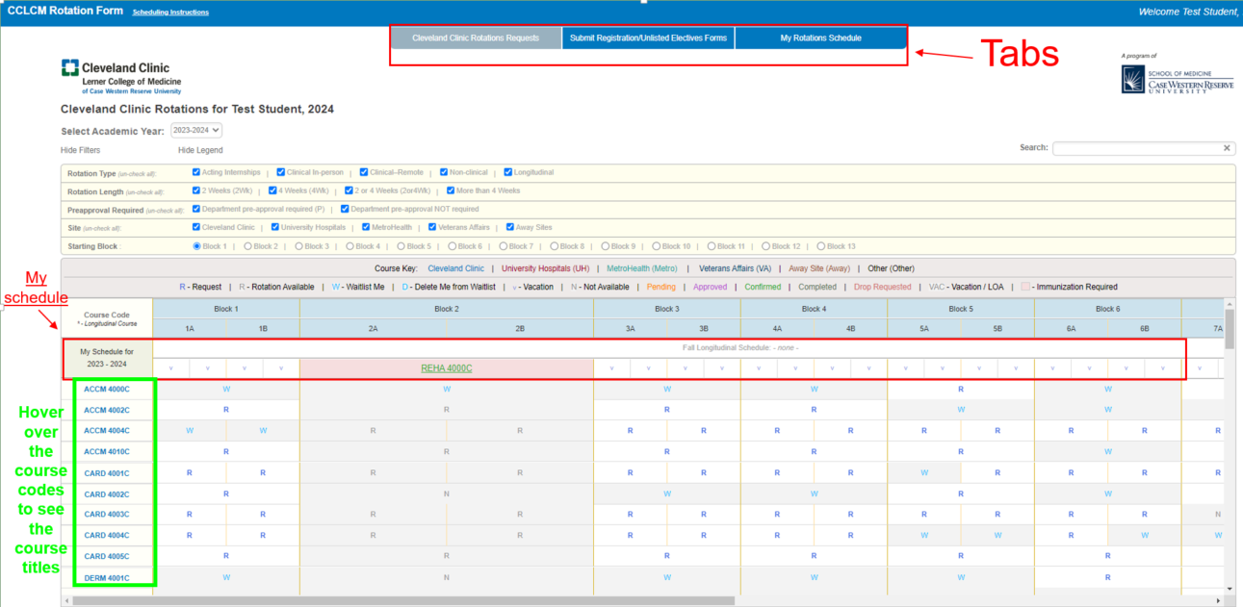
Student View - Example

Slide 12
Admin Page
(Course Coordinator/Site Admin Team)
Requests for listed courses populate in sortable table
Approval Options:
  Admin has the option to approve the student request instantly (Admin approval pending)
  Requests can be sent to the department for approval through CSRS (since this is all completed within the system you do not have to track emails outside of the system)
  Who approves is determined by information in the courses criteria page

Slide 13
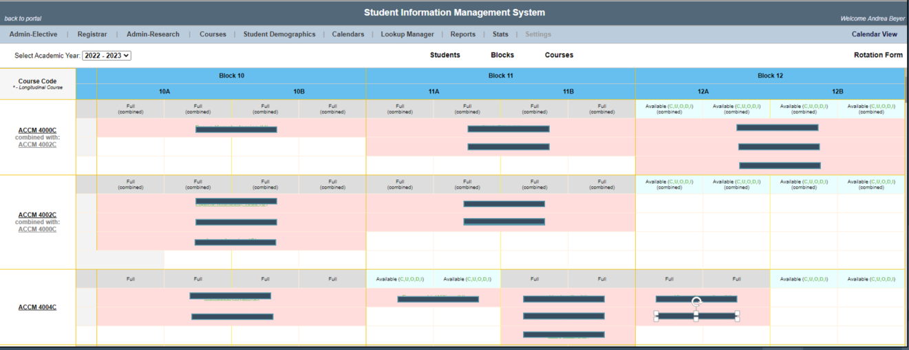
Admin Home Page View – Grid
This page/grid view shows all of the courses/rotations the admin manages (# of courses vary per admin)
The grid also shows which students are completing a rotation during which block. However, we blacked out the student names from this view for FERPA compliance.

Slide 14
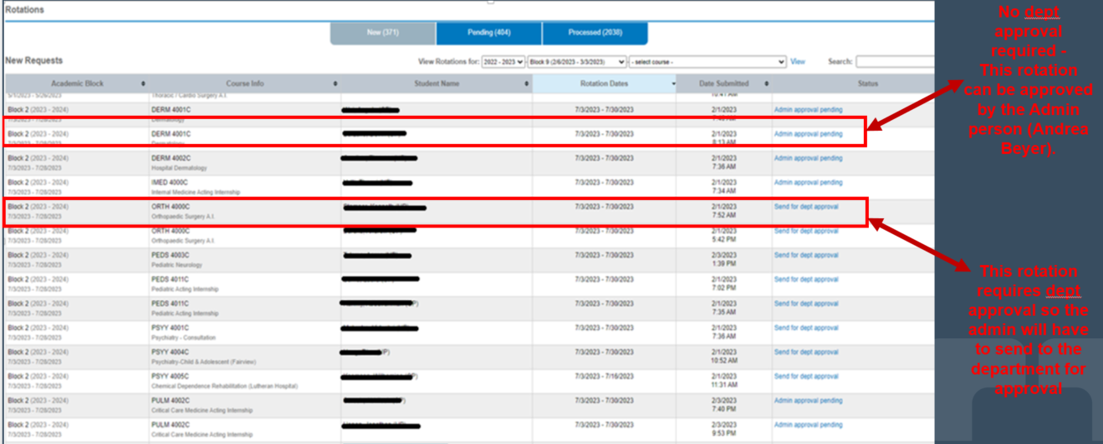
Admin View of New Requests- Example

Slide 15
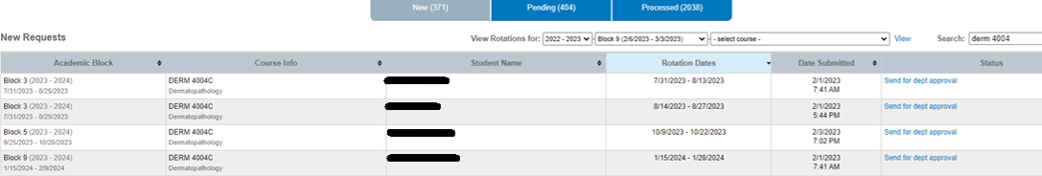
If admin. has more than one elective to manage, CSRS gives the ability to send multiple requests for approval at one time (search by code and/or title)
Admin Page View

Slide 16
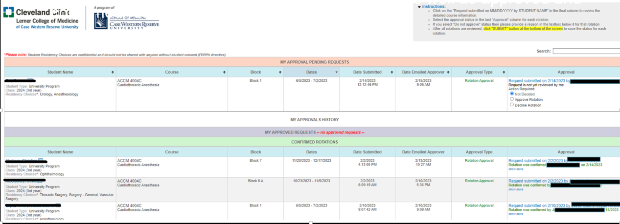
Admin Page – Dept Approval View
If elective needs approval from dept contact(s), cSRS will send email to rotation contact asking to approve or decline the block date
Approver view is accessible via hyperlink sent in email, link never changes
Departments are able to see “pending requests” as well as approved, confirmed and cancelled rotations

Slide 17
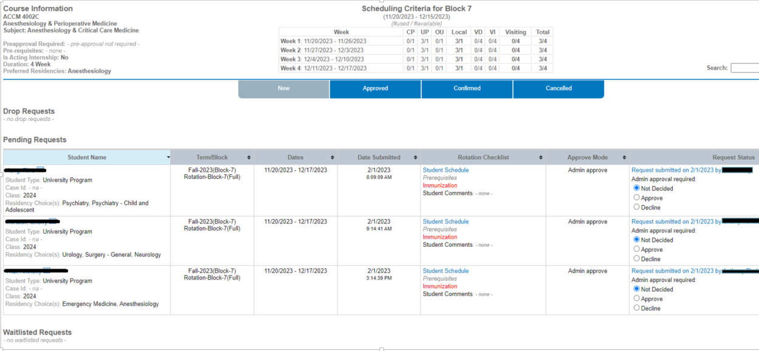
Ability to approve many requests at one time (same course and block)
Admin Page View continued…

Slide 18
Registrar Office Benefits
Once the student is approved for the rotation request then an email will be sent to the student to accept or decline the rotation.
If accepted by student, then the rotation information will then AUTOMATICALLY transfer over to the Registrar’s page in order to be registered in SIS which is how the rotation is recorded on the student’s transcript.
  Prevent double booking
  Ensures rotation is registered (students often forget this step)
  Prevents delay in logging in CAS

Slide 19
Student Benefits for CSRS
Students are able to see elective availability in real time before submitting requests
  Although all requests are not guaranteed to be approved, students have a better idea of what may be available which provides better odds of being approved for the rotation
  Students will not blindly request rotation spots that are already full or spots that have already been identified as not available
  There will be times that a spot may show available, but will be denied for various reasons (e.g. short staffed or another type of learner scheduled), spot can be closed in courses page so no future requests come through.
Ease of enrollment (automated) for confirmed rotations at affiliated sites.
Students can use CSRS to submit unlisted electives (faculty and society dean signatures/approval)
CSRS will show the student’s complete schedule (pending requests, confirmed and completed rotations, vacation time, and any gaps in their schedule).
Student will be able to share their schedule with others e.g. their society dean/physician advisor
Student is able to add themselves to a rotation waitlist for any elective that is full, just in case there are any drops.
Cancellations submitted via cSRS. If less than 30 days to start, admin or dept must approve drop.

Slide 20
Admin Benefits for CSRS
All rotation requests are submitted through the system instead of emails
    Rotation requests sent from students are listed in the Admin Page view
    Requests that require department/faculty approval are sent and managed through the system as well (no extra emails)
    If a rotation is denied, a note can be included and a denial letter will be sent to the student automatically
    If approved, an offer letter is sent to the student to accept or decline the offer within a week.
      If student declines, the rotation is removed from student page/schedule and the spot is available in CSRS again.
      If the student accepts the offer, the rotation is confirmed on student page, a confirmation email is automatically sent to the student (cc the department), and the rotation information is automatically sent to the SOM Registrar’s page to be added to the student’s transcript (in SIS).
You control the rotation (course criteria) page which lets the students know whether or not a rotation is available. This will cut down on getting requests for rotations that are NOT available or full.
Students are limited to request one rotation per block in CSRS – so this will eliminate double booking across the affiliated hospitals which will minimize the number of rotation drops needed.
You can customize the system to fit your process and create standard and ad-hoc reports as needed
  Departments can create a waitlist to accept multiple requests and then select from the pool of students instead of using the first-come option
  You can require specific information to be included with their requests e.g. CV, Personal Statement
  Option for departments to prioritize residency matching into particular timeframes (via course criteria view)

Slide 21
Feedback
Feedback from Students is very positive…
  Students like seeing available rotations in real-time
  Students like seeing their schedule in one location (pending/confirmed/completed rotations, vacation time, and gaps within their schedule). Helps with planning their final year schedule
  Scheduling is much quicker and less stressful with SRS and would like the other sites to use the system as well
  CSRS causes some anxiety during the first few days the system opens for final year elective scheduling because of the limited number or AI spots…especially the Internal Medicine AIs across the affiliate hospitals.
Admin feedback…
  Since using SRS at CC, rotations have increased significantly
  Processing rotations is much easier to manage and because of the automatic functions then it is much faster and efficient:
    Processed approximately 50 elective requests within 24 hours of opening for scheduling
    Within 48 hours after start of processing, over 100 rotations confirmed and over 80 requests are pending department approval or waiting on students to accept/decline the rotation offer
  Most rotations at CC are first-come/first-serve option since this is the only way that the real-time available spots can be used which normally works great for the students with the exception of the Internal Medicine – AI rotations during Blocks 1 – 4 as students has mentioned. Students would prefer a lottery system for the IM AIs offered across affiliate hospitals during blocks 1 – 4.
    We can create a lotto across all sites where students would be advised to sign up (if interested) and then the system would have an algorithm to assign students for spots across affiliate hospitals.
    The criteria would need to be set for the algorithm i.e. residency choice, site preference vs block preference, and ensure each student receives a rotation before offering another student a second IM AI.

Slide 22
Next steps
SOM office to alert students of change in requests.
Finalize / review your courses to go live on August 1.
Collect information for students already scheduled / confirmed as of July 21 and freeze on scheduling from 7/21-8/1 (specific details will be shared soon on what to collect

Slide 23
Next steps – Info to collect on those scheduled
Student Name
Student Type (visiting domestic, visiting international, UP or CP)
Gender
Student case Id (if applicable)
Email Address
School name (especially for visiting students)
Request status (pending/confirmed) or drop request
Course code
Start Date
End Date
Date confirmed (or date submitted / approved depending on status)
Admin responsible for rotation (name and email)
Student comments (if any)

Slide 24
Questions/Feedback?
csrs_team@case.edu

