Slide 1
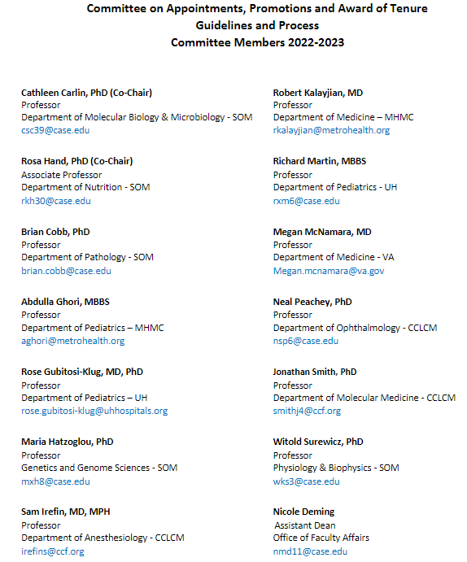
*
*
*
SOM CAPT
FCSC
#
*
*
#
*
*
*
#
*
#

Slide 2
COMMITTEE CHARGE
1. Ensure that practices across the five campuses remain compliant with Faculty Handbook and SOM Bylaws and are sufficient to capture and promote faculty activities.
2. Provide recommendations on distinguishing and more explicitly defining the criteria for promotion versus award of tenure with attention to faculty diversity in academic medicine.
3. Make recommendations on the suﬃciency of the current standards and
opportunities for improved processes and oﬀer guidance on considering information submitted in the optional COVID and DEI statements.

Slide 3
METHODOLOGY
Monthly meetings January – December 2023
Committee reviewed following documents:
CWRU Faculty Handbook
• SOM Bylaws
• SOM Bylaws Appendix I
• Documents from Faculty Affairs
• Examples of arms-length violations in external letters
• CV template
• Promotion and tenure success statistics provided to Faculty Council
• Letter of concerns from CCF
Committee queried Faculty Affairs representatives from ~ 20 peer institutions

Slide 4
Committee met with:
SOM Dean
SOM Standing Committee on Bylaws
Committee representatives met with:
Recently promoted faculty from the four aﬃliate hospitals
Faculty Council Steering Committee
Chief Academic Oﬃcers and support staff from four hospital affiliates
Council of Basic Science Chairs
SOM Standing Committee on Women and Minority Faculty
SOM Standing Committee on Medical Education
CWRU and SOM DEI staﬀ

Slide 5
Concerns/Committee Recommendations
Regional reputational requirement for promotion to associate professor in NTT track
Career track for faculty primarily engaged in clinical supervision
Local versus regional reputation
Definition of ‘part-time’
Appointment/promotion criteria for Instructor and Senior Instructor faculty positions
NTT 6-year reviews/improve communication
TT faculty engaged in medical education scholarship
Public and policy advocacy portfolio
Senior level appointments

