Slide 1
Faculty Counsel Report
CME
Committee on Medical Education
Corinne Bazella MD
May, 2024
Notes:
Thanks for your willingness to watch this video that details the requested approvals needed to move the recommendations of the M1-4 University Program task force forward.

Slide 2
Elected Committee Members
Chair - Corinne Bazella, MD - Dept of Reproductive Biology Melissa Jenkins, MD - Dept of Medicine
Mildred Lam, MD - Dept of Medicine
Marina Magrey, MD - Dept of Medicine
Katherine Miller, MD - Dept of Pediatrics
Jessica Taylor, PhD - Dept of Physiology and Biophysics
Jennifer Yoest, MD - Dept of Pathology
Caroline Abramovich, MD – Dept of Pathology
Preeti Gandhi, MD – Dept of Anesthesiology & Perioperative Medicine
Anantha Harijith, MD – Dept of Pediatrics
Oliver Schirokauer MD, PhD – Dept of Bioethics
Abigail Basson, PhD – Dept of Nutrition
Marcus Germany, MD – Dept of Medicine

Slide 3
Meetings
Meetings: 7/27/2023, 8/24/2023, 9/28/2023, 10/26/2023, 11/30/2023, 1/25/2023, 2/22/2024, 3/21/2024, 4/25/2024, 5/23/2024, 6/27/2024
4th Thursday of the month-Zoom 4-5:50pm

Slide 4
CME year in review
Evaluated, reviewed and made recommendations of CME sub-committees activity through regular reports of JCOG, WR2, CCLCM Steering Council, and assessment committees. Oversaw the charge changes for those committees.
Reviewed the revision of Educational Program Objectives- what all students must learn prior to graduation and the curriculum mapping.

Slide 5
CME year in review
Evaluated and approved several new policies: Technical standards, Transfers and Drug Screening.
Reviewed graduation rates, USMLE results, resident readiness survey, and Whole curriculum review report.
Monitored LCME standards dashboard- areas of compliance and non-compliance and improvement plans for standards of non-compliance.
Reviewed data from Graduate Questionnaire and the Independent Student Analysis survey of student satisfaction with their educational experience in preparation for LCME site visit.

Slide 6
Charge Edits
GOALS of our CME Bylaw changes:
-Student representation proportional to the number of students in the various program
-Add new leadership positions & remove positions that have not been either combined or eliminated. Ex Dean of DEI and Dean of Health Systems Sciences. Adjust membership to allow leadership representation within the confines of the bylaws.
-Re-structure subcommittees to address the flow of information on LCME standards, assessment and curriculum effectiveness. Update the charge to reflect new committees that have been created.

Slide 7
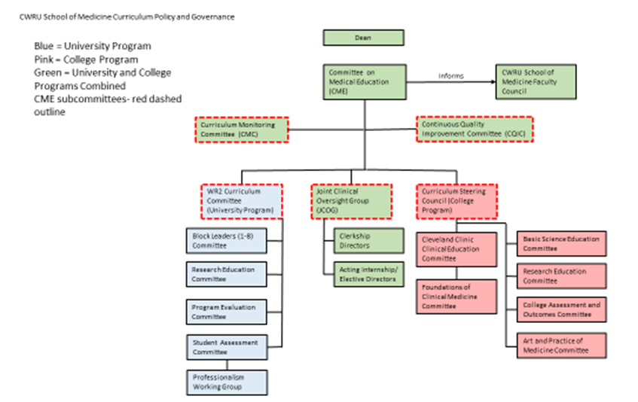

Slide 8
Additional Edits
Article 2 Section 5 Voting- The quorum required to conduct the committee’s business shall be the presence of 50% or more of the voting members, with a majority of the voting members present being elected or appointed faculty members.
Eliminated redundant wording lines 261-267 based on Bylaws committee recommendations
Article 2 Section 4 Membership- Elected Members- added additional member that is separate from the Chair and clarified the verbiage of the chair being from either an elected member or an appointed member.
Descriptors of the CQIC and CMC committee added, removal of PEAC
Membership of CQIC and CMC committee added, PEAC removed
Executive Dean of CP removed from JCOG membership per request of the Executive Dean

Slide 9
Bylaws
Article 2.6b states that: The majority of the voting members of each of these Standing Committees shall be elected by the regular members of the Faculty of Medicine.

Slide 10
Membership Article 2.6b
Voting:
13 Elected Voting members
1 Chair of CME voting member
4 Student votes
2 appointed faculty members
1 Associate Dean DEI
2 Associate Deans Curriculum
2 Society Dean/CP
Total 25 Voting Members- 13 Elected members are 52% in compliance with Article 2.6b

Slide 11
Bylaws
Article 2.6d Standing committees may include members holding the office of assistant, associate, or vice dean, as long as their number does not exceed 25% of the membership. The exception to this rule is the Committee on Medical Education, which may include members holding the office of assistant, associate, or vice dean, as long as Faculty of Medicine Bylaws 8 Approved by the Faculty Senate 1/30/18 their numbers do not exceed 40% of the membership.

Slide 12
Membership Article 2.6d
Membership:
1 CME Chair
13 Elected Faculty Members
2 Appointed Faculty Members
4 Student votes
2 Associate Deans for Curriculum
1 Vice Dean for Medical Education
1 Executive Dean for CP
2 Basic Science Deans (CP/UP)
1 Associate Dean GME
2 Assistant Deans for Clinical Education
1 Assistant Dean DEI for students
2 Society Dean/CP
Member Total- 31
13 Elected
12 hold office of DEAN
38% of the Committee in compliance with Article 2.6d

Slide 13
Voting Members
Associate Deans of Curriculum (2-UP &CP)
Amy Wilson-Delfosse
Neil Mehta
Student Representatives (7) 4 votes shared
UP (4 - M1, M2, M3, M4)
CP (2 - preclerk, clerk)
MSTP (1)
Assistant Dean, DEI
Monica Yepes-Rios
Student Affairs Leads (2 – UP and CP)
Steven Ricanati
Christine Warren

Slide 14
Non-Voting Members
Vice Dean for Medical Education-Lia Logio
Executive Dean (CP)-Bud Isaacson
Basic Science Deans (2 – UP and CP)-Colleen Croniger
Christine Moravec
Associate Dean GME
(1 – rotating among 3) UH, Metro, and CCF
Assistant Deans Clinical Education (2 – UP and CP)-Anastasia Rowland-Seymour
Craig Neilsen

Slide 15
Faculty Comments
Questions?
Gratitude to Bylaws committee and NEC
CME is an open committee. We invite and welcome your insight.

