Slide 1



Presenting
The Entering Class of
20
24
Dr. Lina Mehta
Associate Dean for Admissions

Slide 2

Application Statistics
Total Applications Nationally: 50,181 (+1%)
Total Applications to CWRU: 8,441 (-2%)
2024 Entering Class Size: 215
University Program
Applications: 7,821
Interviews: 798
Matriculants: 170
Lerner College Program
Applications: 2,295
Interviews: 195
Matriculants: 32
MSTP
Applications: 474
Interviews: 116
Matriculants: 13

Slide 3

56.4%
Women
41.7%
Men
LGBTQ: 15%
1.4%
Nonbinary/Gender
queer
Gender non-conforming
23.2
Average Age
Age Range: 20-33
Women

Slide 4
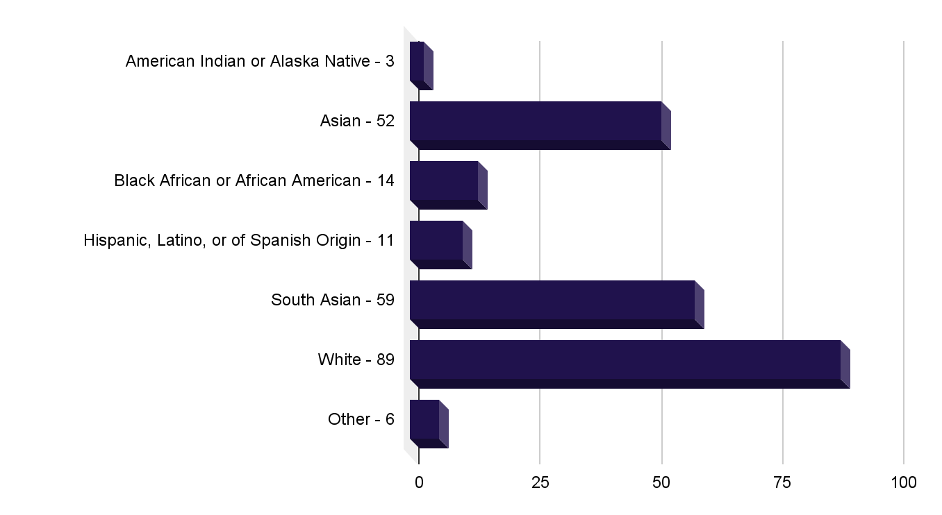
Self-described Race/Ethnicity
*Alone or in combination
Data includes duplicate information in each category
Unduplicated Total = 215 Matriculants

Slide 5





Other Information
Underrepresented in Medicine: 12%
First Generation College: 7%
At least one gap year: 82%
37% = 1 yr.
23% = 2 yrs.
17% = 3 or more
Rural Areas of US: 6%
Military Service: 1.4%

Slide 6
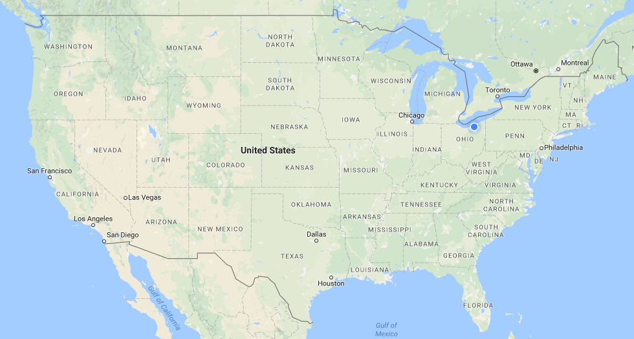

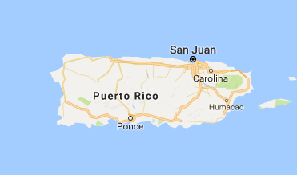

5
5
1
2
2
1
15
13
MA-8
CT- 4
13
36
9
NJ - 14
2
1
MD- 8
1
1
1
1
32
DC - 1
6
DE- 1
1
1
1
2
4
2
2
7
1
3
7
35 States of Residence & DC
1 Country outside of US: Nigeria
17% In-state 83% Out-of-state

Slide 7
79 Different Colleges & Universities
Bethel University- 1
Boston University- 2
Brandeis University- 1
Brown University- 2
Carleton College- 1
Case Western Reserve University- 31
Claremont McKenna College- 1
Cleveland State University- 1
College of William and Mary- 2
Columbia University- 2
Cornell University- 5
Dartmouth College- 6
Davidson College- 1
Duke University- 8
Emory University- 8
Florida Atlantic University- 1
Florida State University- 1
George Washington University- 1
Georgetown University- 1
Georgia Institute of Technology- 1
Hamilton College - 1
John Carroll University- 1
Johns Hopkins University- 9
Kenyon College- 1
Lee University- 1
Lewis and Clark College- 1
Michigan State University- 2
Middlebury College- 1
Misericordia University- 1
Northeastern University- 4
Oberlin College- 1
Ohio University- 2
Oregon State University- 1
Princeton University- 4
Rice University- 3
Rutgers University- 2
St. Olaf College- 1
Stanford University- 2
Swarthmore College- 1
Temple University- 1
Ohio State University- 9
Tulane University- 1
United States Air Force Academy- 1
United States Military Academy- 1
United States Naval Academy- 1
University of Arizona- 1
University of California- Berkeley- 3
University of California- Davis- 3
University of California- Irvine- 2
UCLA- 5
University of CA- San Diego- 2
University of Central Florida- 2
University of Chicago- 1
University of Cincinnati- 1
University of Connecticut- 2
University of Florida- 2
University of Georgia- 2
University of IL-Urbana Champaign- 1
University Maryland College Park- 2
University of Miami- 1
University of Michigan- 12
University of Minnesota Twin Cities- 1
University of Missouri- Kansas City- 1
University of North Carolina at Chapel Hill- 1
University of Notre Dame- 3
University of Pennsylvania- 9
University of Pittsburgh- 4
University of Southern California- 4
University of Tennessee- 1
University of Texas at Dallas- 1
University of Utah- 1
University of Virginia- 3
University of Wisconsin-Madison- 1
Vanderbilt University- 6
Wake Forest- 1
Washington University in St. Louis- 3
Wellesley College- 1
Williams College- 1
Yale University- 1

Slide 8


Majors and Graduate Degrees
Most Common Majors
Biology
Neuroscience
Psychology
Chemistry
Biochemistry
Biomedical Engineering
Biological Sciences
Economics
Cognitive Science
Molecular & Cellular Biology
41
18
1
Double Majors
Graduate Degrees
Triple Major

Slide 9
Undergraduate Degrees
Biochemistry, Molecular Biology, Anthropology, Biological Mathematics, Biology, Health and Society, Biological Engineering, Biomedical and Health Sciences Engineering, Biomedical Engineering, Biomedical Science, Biomolecular Science, Biophysics, Biopsychology, Business, Cell Biology, Chemical Engineering, Chemical Biology, Chinese, Chemistry, Child Development, Cognitive Science, Computational Biology, Computer Science, Data Science, East Asian Studies, Economics, Electrical Engineering, Environmental Studies, Gerontological Studies, Health and the Human Sciences, Health and Societies, Health Promotion and Disease Prevention, Health, Health Science, History, Human Biology, Human Health, International Affairs, Legal Studies, Literature, Medical Anthropology, Medical Laboratory Science, Medical Science, Microbiology / Bacteriology, Microbiology and Cell Science, Molecular and Cell Biology, Natural Sciences, Neurobiology, Movement Science, Music, Neurobiology, Neuroscience, Nursing, Nutritional Biochemistry and Metabolism, Pharmaceutical Sciences, Pharmacy, Physiology, Political Science, Psychological Sciences, Psychology, Public Health, Spanish, Statistical Science, Sociology, Sustainable Development

Slide 10



Academic Credentials
3.87
Cumulative GPA
Range: 3.12-4.0 Median: 3.92
Mode: 4.0
National Avg. Matriculating Student Cumulative GPA (2024): 3.77 (SD = .23)
Average Cumulative GPA
Science GPA
Range: 3.03-4.00 Median: 3.89
Mode: 4.0
National Avg. Matriculating Student Science GPA (2024): 3.71
(SD = .310
3.84
Average Science GPA
Notes:
Need National Averages for 2023

Slide 11
Academic Credentials
n= 200
Average: 518 (95%)
Median: 518 (95%)
Mode: 518
Range: 507-526
National Matric. Student Avg. 2024 = 511.7 (80-83%) (SD = 6.9)
MCAT

Slide 12








Work/Extracurricular/Academic Activities
90%
Volunteer Medical Experiences
67%
Paid Medical Experiences
16%
Artistic Endeavors
94%
Research Experiences
87%
Physician Shadowing,
Clinical Observation
64%
Teaching/Tutoring/TA
87%
Other Volunteer Experiences
32%
Publications
9%
Intercollegiate Athletics
63%
Leadership Experiences

Slide 13
Just For Fun
Campus Tour Guide
Song Writer
Crisis Text Line Volunteers
Pharmacy Technician
Substitute Teacher
Ice Hockey Coach
Youth Baseball Umpire
EMT
Diving Coach
Weightlifter
Orientation Leader
Rock Climbing Coach
Rec Center Front Desk Worker
Tax Return Volunteer
Marathon Runner
Instacart Personal Shopper
Hair Stylist
Sports Writer for College Newspaper
ESL Teacher
Triathlon Finisher
Wellness Coach
Golf Caddy
Meals on Wheels Delivery Driver
Service Dog Provider
Lifeguard
Personal Trainer
Server
Food Kitchen Volunteer
Church Deacon
Bartender
AMSA President
Registered Nurse
Fire Team Leader for Naval Academy
SAT/ACT Tutor
Restaurant Cashier
Gymnastics Coach
Peace Corps Member
Plumber
Painter
Fulbright Scholar
Dishwasher
Red Cross Volunteer
Software Engineer
Instruments Played:
Piano Violin
Cello Ukulele
Guitar French Horn
Saxophone
Spanish Interpreter
Food Blogger
Chess Player
Marching Band Drill Instructor
Property Manager
Radio DJ
Yoga Instructor
Case Worker
Hair Stylist
Crossword Puzzle Creator for NY Times
Origami Artist
Mechanic
Music Therapy Assistant
Most Popular Names:
Alexander (3), Julia (3)

Slide 14
