Slide 1
CWRU School of Medicine Bylaws Committee Update
September 2025

Slide 2
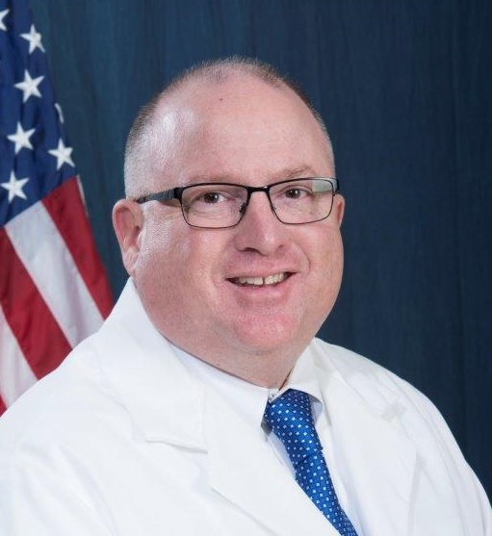
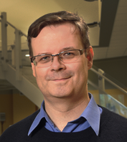
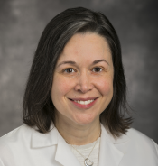

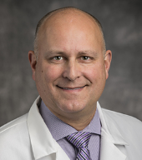
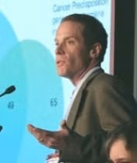
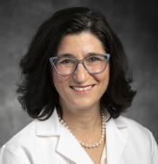
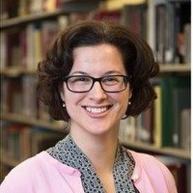
Bylaws Committee 2025-2026
Thomas Collins, MD - Chair Emergency Medicine (MH) | Matthias Buck, PhD Physiology & Biophysics, (SOM) | Heather Gornick, MD Medicine (UH)
N. Scott Howard, MD Otolaryngology (UH) | Thomas LaFramboise, PhD Genetics & Genome Sciences (SOM) | Stephanie Teal, MD Reproductive Biology (UH) | Nicole Deming, JD, MA Office of Faculty Affairs

Slide 3
Prior Year Activities 2024-2025
9 meetings
4 presentations to FCSC/FC
Major Bylaws and APT guideline updates
Committee charge updates
Committee on Biomedical Research
Committee on Faculty Community and Representation
Committee on Medical Student Promotion and Advancement

Slide 4
Planned Activities 2025-2026*
Follow completion of Bylaws/APT Guideline through Faculty Senate
Update Bylaws regarding Dean’s responsibilities
Per LCME recommendation
Language in School of Engineering bylaws as foundation
Update Bylaws regarding formation of new academic departments
Already established by Faculty Senate and in new Faculty Handbook
*currently identified projects

