Slide 1

Faculty Council Report
CME
Committee on Medical Education
Corinne Bazella MD- 2024-25 Chair
Oliver Schirokauer MD, PhD 2025-26 Chair
September 2025

Slide 2
Elected Committee Members
Appointed Faculty Members
Chair Corinne Bazella, Department of Reproductive Biology (2021-2025)
Melissa Jenkins, Department of Infectious Disease (2021-2027)
Jennifer Yoest, Department of Pathology (2021-2027)
Caroline Abramovich, Department of Pathology (2022-2025)
Preeti Gandhi, Department of Anesthesiology & Perioperative Medicine (2022-2025)
Anantha Harijith, Department of Pediatrics (2022-2025)
Oliver Schirokauer, Department of Bioethics (2022-2025)
Abigail Basson, Department of Nutrition (2023-2026)
Marcus Germany, Department of Medicine (2023-2026)
Timmie Sharma, Department of Dermatology (2024-2026)
Puja Van Epps, Department of Medicine (2024-2026)
Calen Frolkis, Department of Medicine (2014-2027)
Vikas Gampa, Department of Medicine (2024-2027)
Debra Leizman, Department of Internal Medicine (2019-2025)
Vanessa Maier, Department of Family Medicine (2024-2027)

Slide 3
Meetings
4th Thursday of the month-Zoom 4-5:50pm
https://case.edu/medicine/faculty-staff/committee-medical-education/committee-members

Slide 4
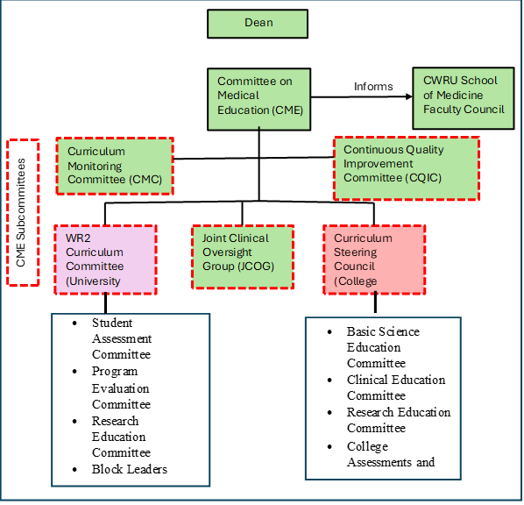
Notes:
Notes:
CWRU SOM is comprised of two medical education programs (LCP and UP) and a third bridging research program (MSTP)
CME subcommittees of the CMC and the CQCI were established to ensure that the curricula in LCP and UP programs were similarly achieving the LCME accreditation measures (one of which is being comparable), and were addressing the same Educational Program Objectives (EPOs) with similar outcomes.

Slide 5
CME year in review- Routine
Evaluated, reviewed and made recommendations of CME sub-committee activity through regular reports of:
Curriculum Monitoring Committee
Continuous Quality Improvement Committee
CCLCM Steering Council
Joint Clinical Oversite Group
WR2 Curriculum Committee

Slide 6
CME year in review- Routine
Yearly data reviewed:
Student advancement and graduation rates- 100%
USMLE step results- 2-3% higher than national avg
Clinical Skills Exam 3 results- 100%
Resident readiness survey
Graduate Questionnaire
Independent Student Analysis survey of student satisfaction with their educational experience
CMC Phase 1, 2 and 3 reports through Education Program Objective mapping and recommendations for longitudinal curriculum assessment.
Notes:
Ultimately telling the story that CWRU is highly successful in graduating and producing doctors who are prepared for residency- perhaps provide numbers/percentages for first 4 categories
In 2024- 100% graduation rate, with very low Attrition rate of 0.45%

Slide 7
Changes
Approved changed to clinical elective grading policy- to Pass/Fail
Acting internship assessment tool creation
Generative AI Task Force creation
Approval of the Kowal-SAGE Program expansion- 6 visits with a “SAGE”- 65 or older patients over 8 months focusing on communication, healthcare system interactions, and healthcare navigation.
Notes:
Why are we doing these changes?
1&2- to improve the quality of feedback that our students get in their clinical electives and AIs
3- so we can plan how we will proactively interact with AI in the curriculum, teaching students to use it responsibly not burying our heads in the sand
4- prepare our students from their early preclerkship years to appreciate the importance of becoming clinically comfortable with older adults because regardless of whatever field they are going into they will need to know how to approach the aging population.

Slide 8
LCME visit prep
LCME standard dashboard - areas of compliance and non-compliance monitored. Improvement plans considered, reviewed and monitored.
Reviewed and approved Policies- Graduation Requirements, Student Records/FERPA, Leave of Absence or Extensions, Background Checks, Student Exposure and Prevention, Learning Environment, MS Promotion and Advancement Due process, Policy on Protest and Free Speech, Policy on Student Transfers, Grade Appeals and Inclement Weather Plan.
Notes:
Purpose of all the policies- to improve student understanding of process and improve the learning environment

Slide 9
Faculty Comments
Questions?
CME is an open committee. We invite and welcome your insight.

