Slide 1

Program Review Committee
Report to Faculty Council
April 28, 2025
Nicholas P. Ziats, Ph.D., Chair
Professor of Pathology,
Biomedical Engineering and Anatomy

Slide 2
Program Review Committee- Charge
“The Program Review Committee shall consist of eight full-time members of the School of Medicine faculty, elected at-large by the full-time faculty, with no more than two members from a single department, and three ex officio members. The elected members shall serve staggered three-year terms, two or three new members being elected each year. Elected members may stand for re-election and serve at most two consecutive terms. All elected and ex officio members shall be voting members on the committee.”
Standing Committee of the Faculty of Medicine
Serves as the “college curriculum committee” in the CWRU approval matrix
Reviews major changes to existing programs (>50%)
Presents recommendations to the Faculty Council
Review other non-MD programs at the Dean’s request
Distinct from the Curriculum Review Committee that reviews new courses

Slide 3
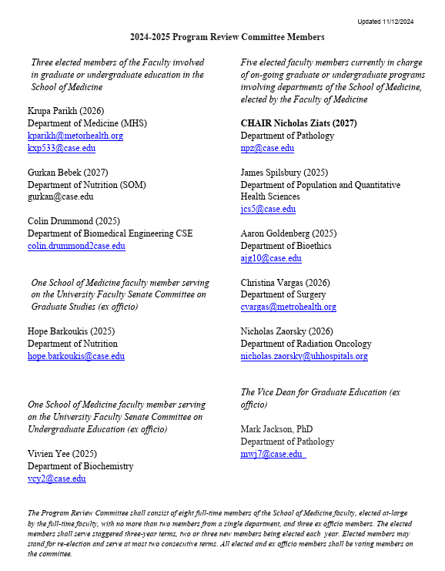
Program Review Committee- Members, 2024-25
2025:
Three members leaving:
Drs. Spilsbury, Goldenberg
and Drummond, ex officio
members need reappointment

Slide 4
Program Review Committee- Process
The workflow follows the new online Program Action Form
https://case.edu/registrar/
Faculty and Staff - Curriculum and Program Management
Office of the Provost
https://case.edu/provost/faculty-academics/approvals-and-governance-academic-programs-and-processes
School of Graduate Studies
https://case.edu/gradstudies/faculty/faculty-guidelines/new-program-development-guidelines

Slide 5
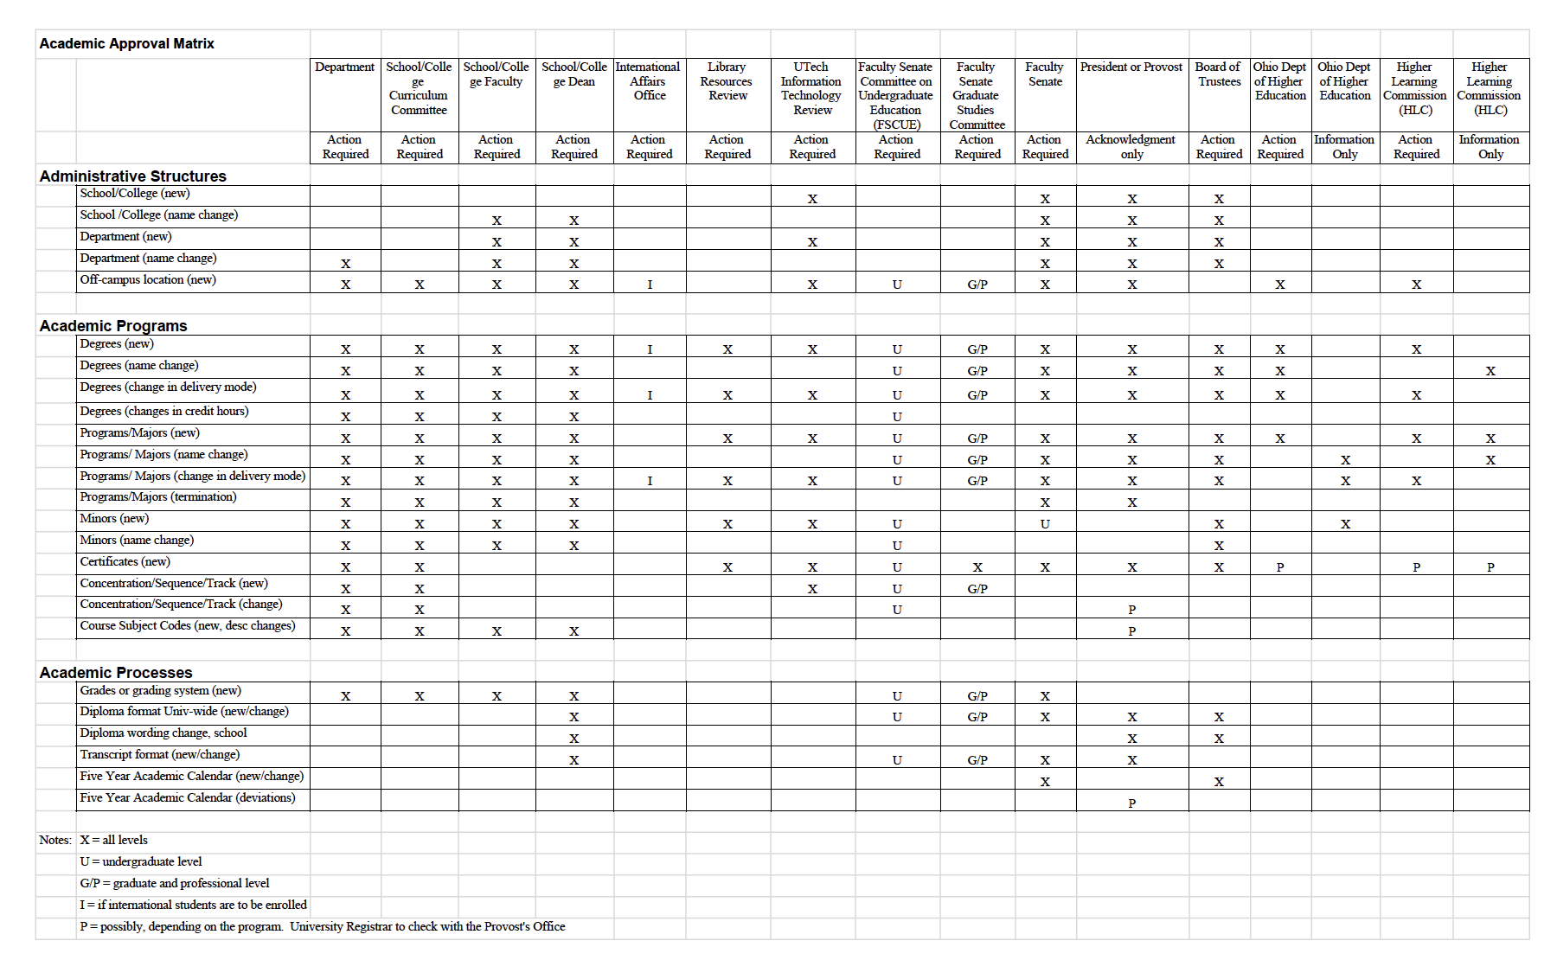
Program Review Committee- Approval Matrix

Slide 6
Program Review Committee- Flow
Approval Process for New Programs
Department Review
Library Resources Review
UTech - IT review
Program Committee Review
Faculty Council
Dean’s Review
Faculty Senate - Graduate Studies Committee
Faculty Senate
President or Provost
Board of Trustees
Ohio Department of Higher Education

Slide 7
Program Review Committee- Reviews in 2024-25
MS in Regenerative Medicine and Entrepreneurship
MS in Molecular & Cellular Biology of Disease
PhD in Bioethics
Clinical Ethics Graduate Certificate
MS in Clinical Research
Public Health Minor
PhD in Pharmacology
MS in Biotechnology
Health Informatics Graduate Certificate
MS in Aerospace Physiology
Bioethics and Medical Humanities Minor
Nutrition and Metabolism Minor
Nutrition for Women and Children Minor
Nutrition Minor
Nutrition and Lifestyle Medicine Minor
Environmental Nutrition, Food Systems Sustainability and Health Minor

Slide 8
Program Review Committee
Questions?

