Slide 1
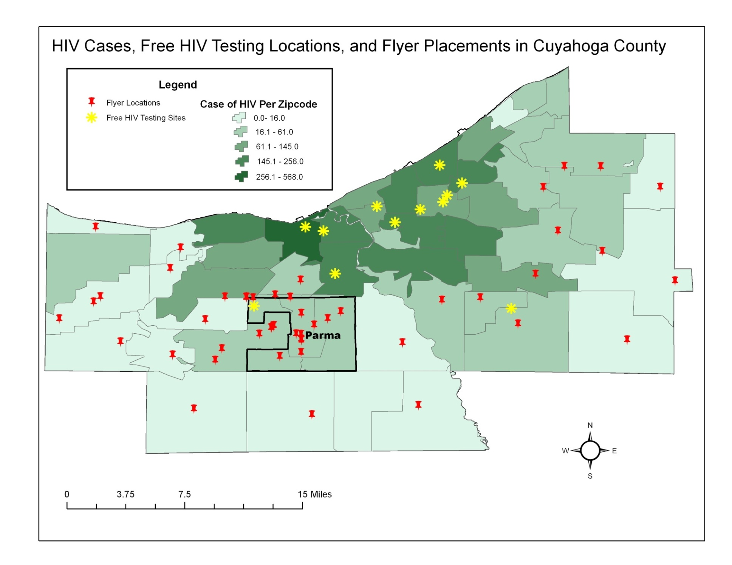

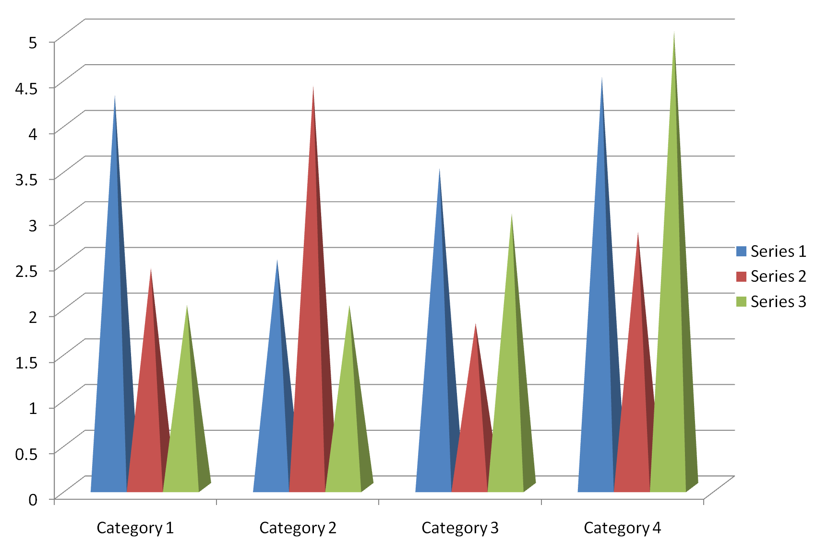
Type Your Title here – this is bold Arial 96
Type authors here or below - use font size between 40- 70
This is for a CAPSTONE poster 40”w x 30”h
Introduction (font size 44)
Project Description
Conclusion
Write your introduction here.
This is font Arial 35.
This is a text box.
To type or paste in information, insert a text box for each area of information.
Text boxes can be moved around, fonts changed, pictures added.
Outline photos using Format Picture>Text Box>Line Color >Solid Line - so they stand out crisper
Goal & Outcome Objectives
This is a Text Box with No Border
This
Is a
text box
With a
border that
lines up
w/heading
text box
References
To change the background of a text box:
Right click on the text box > Format Shape> click on Solid Fill or Gradient Fill and use the drop down menus to select colors or texture. Hold the shift key as you click on the text boxes to select multiple text boxes.
Evaluation
Pictures:
Save image to your computer as a jpeg or tif file. (Make sure you use pictures so that the final print size is between 72-100 dpi. If you need to scan an image, scan at 300 -600 dpi.)
Open your poster > Insert > Picture > from file, select image and > Insert. Resize the picture by adjusting it from the corners.
To change the background of the poster:
Right click on the background, select Format Background to change the color, add a texture or make a nice gradient color.
The possibilities are endless.
You can insert Graphs or Charts and Tables by copy-pasting it from Excel.
Copy the chart or table in Excel, open your poster, click on Paste > Paste Special > Picture (Enhanced MetaFile). Many other types of files do not copy well into PowerPoint. If you are having trouble, export the file as a jpeg or tif and save to your computer and then use insert>Picture.
Cleveland, Ohio

