Slide 1
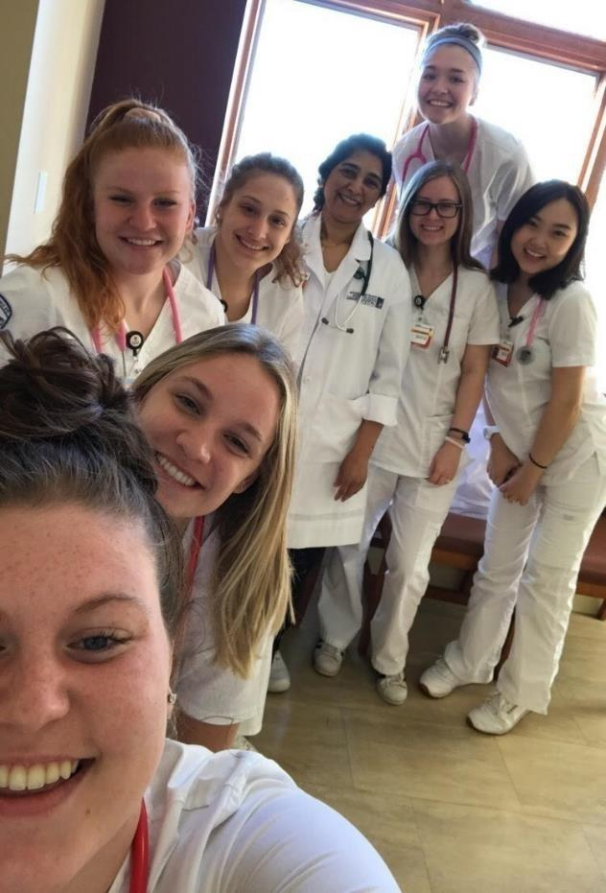

                State of the School
                October 4, 2019
                Carol M. Musil, PhD, RN, FAAN
                Dean
                Marvin E. and Ruth Durr Denekas Professor
Notes:
Good afternoon and thank you for joining me for this year’s State of the School for the Frances Payne Bolton School of Nursing.

Slide 2

Our Mission
Create and empower nurse leaders who develop and implement innovative and interprofessional research, education and practice.
Notes:
Our mission is to create and empower nurse leaders who develop and implement innovative and interprofessional research, education and practice.

Slide 3

Our Mission
Make a positive difference in the health
of individuals and communities
at home and around the world
Notes:
This mission speaks to the first goal of our strategic plan: to create an excellent work environment for faculty and staff, and a premier learning environment for our students. We are making FPB the place to be!

Slide 4
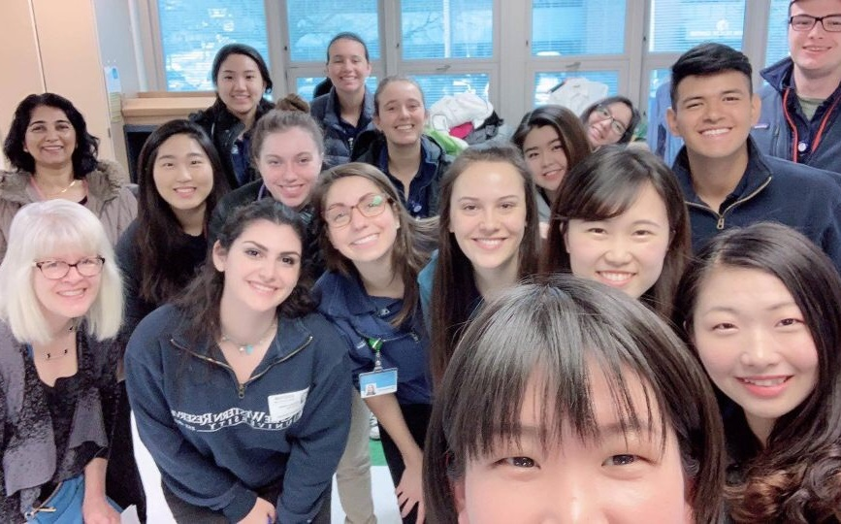
Focus Area: People & Environment
Goal: Make FPB the Place to Be
Notes:
One way to ensure our school is a space where students thrive and want to learn, and where faculty and staff feel supported to forge ahead with innovations in teaching, research and practice is through developing an inclusive supportive culture. We have made some progress in this regard through the culture and climate and diversity and inclusion committees and many inidivual efforts, but more to do.

Slide 5
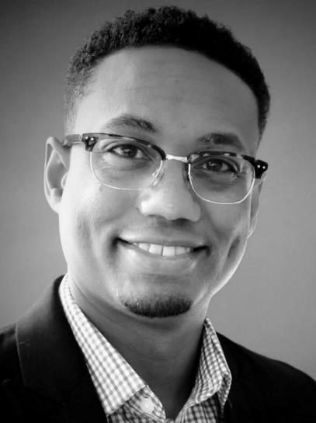
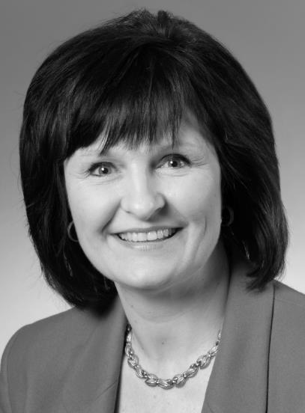
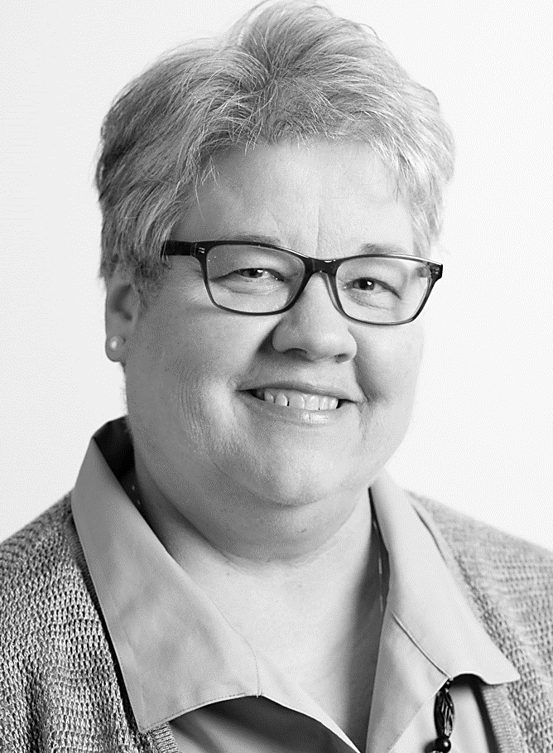
New Endowed Chairholders
Ronald Hickman, PhD, RN, FAAN
Inaugural Chair
Ruth M. Anderson Professorship
in Nursing
Mary Dolansky, PhD, RN, FAAN
Independence Foundation
Professorship
in Nursing Education
Rebecca Patton, DNP, RN, FAAN
Inaugural Chair
Lucy Jo Atkinson Professorship in Perioperative Nursing
Notes:
This academic year we’re excited to add three newly endowed professorships, including:
Dr. Ron Hickman as the inaugural chair of the Ruth M. Anderson Professorship in Nursing;
Dr. Mary Dolansky as the chair of the Independence Foundation Professorship in Nursing Education; and
Dr. Rebecca Patton as the inaugural chair of the Lucy Jo Atkinson Professorship in Perioperative Nursing

Slide 6
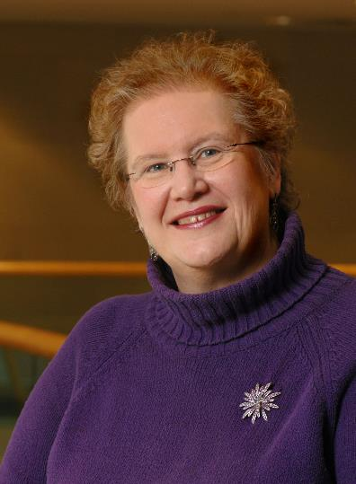
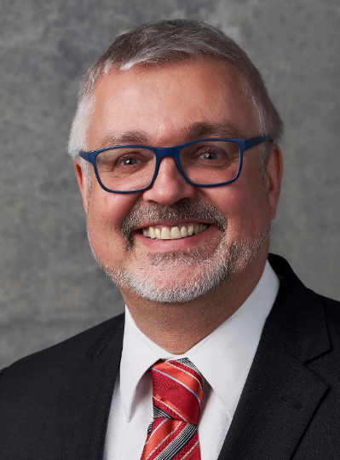
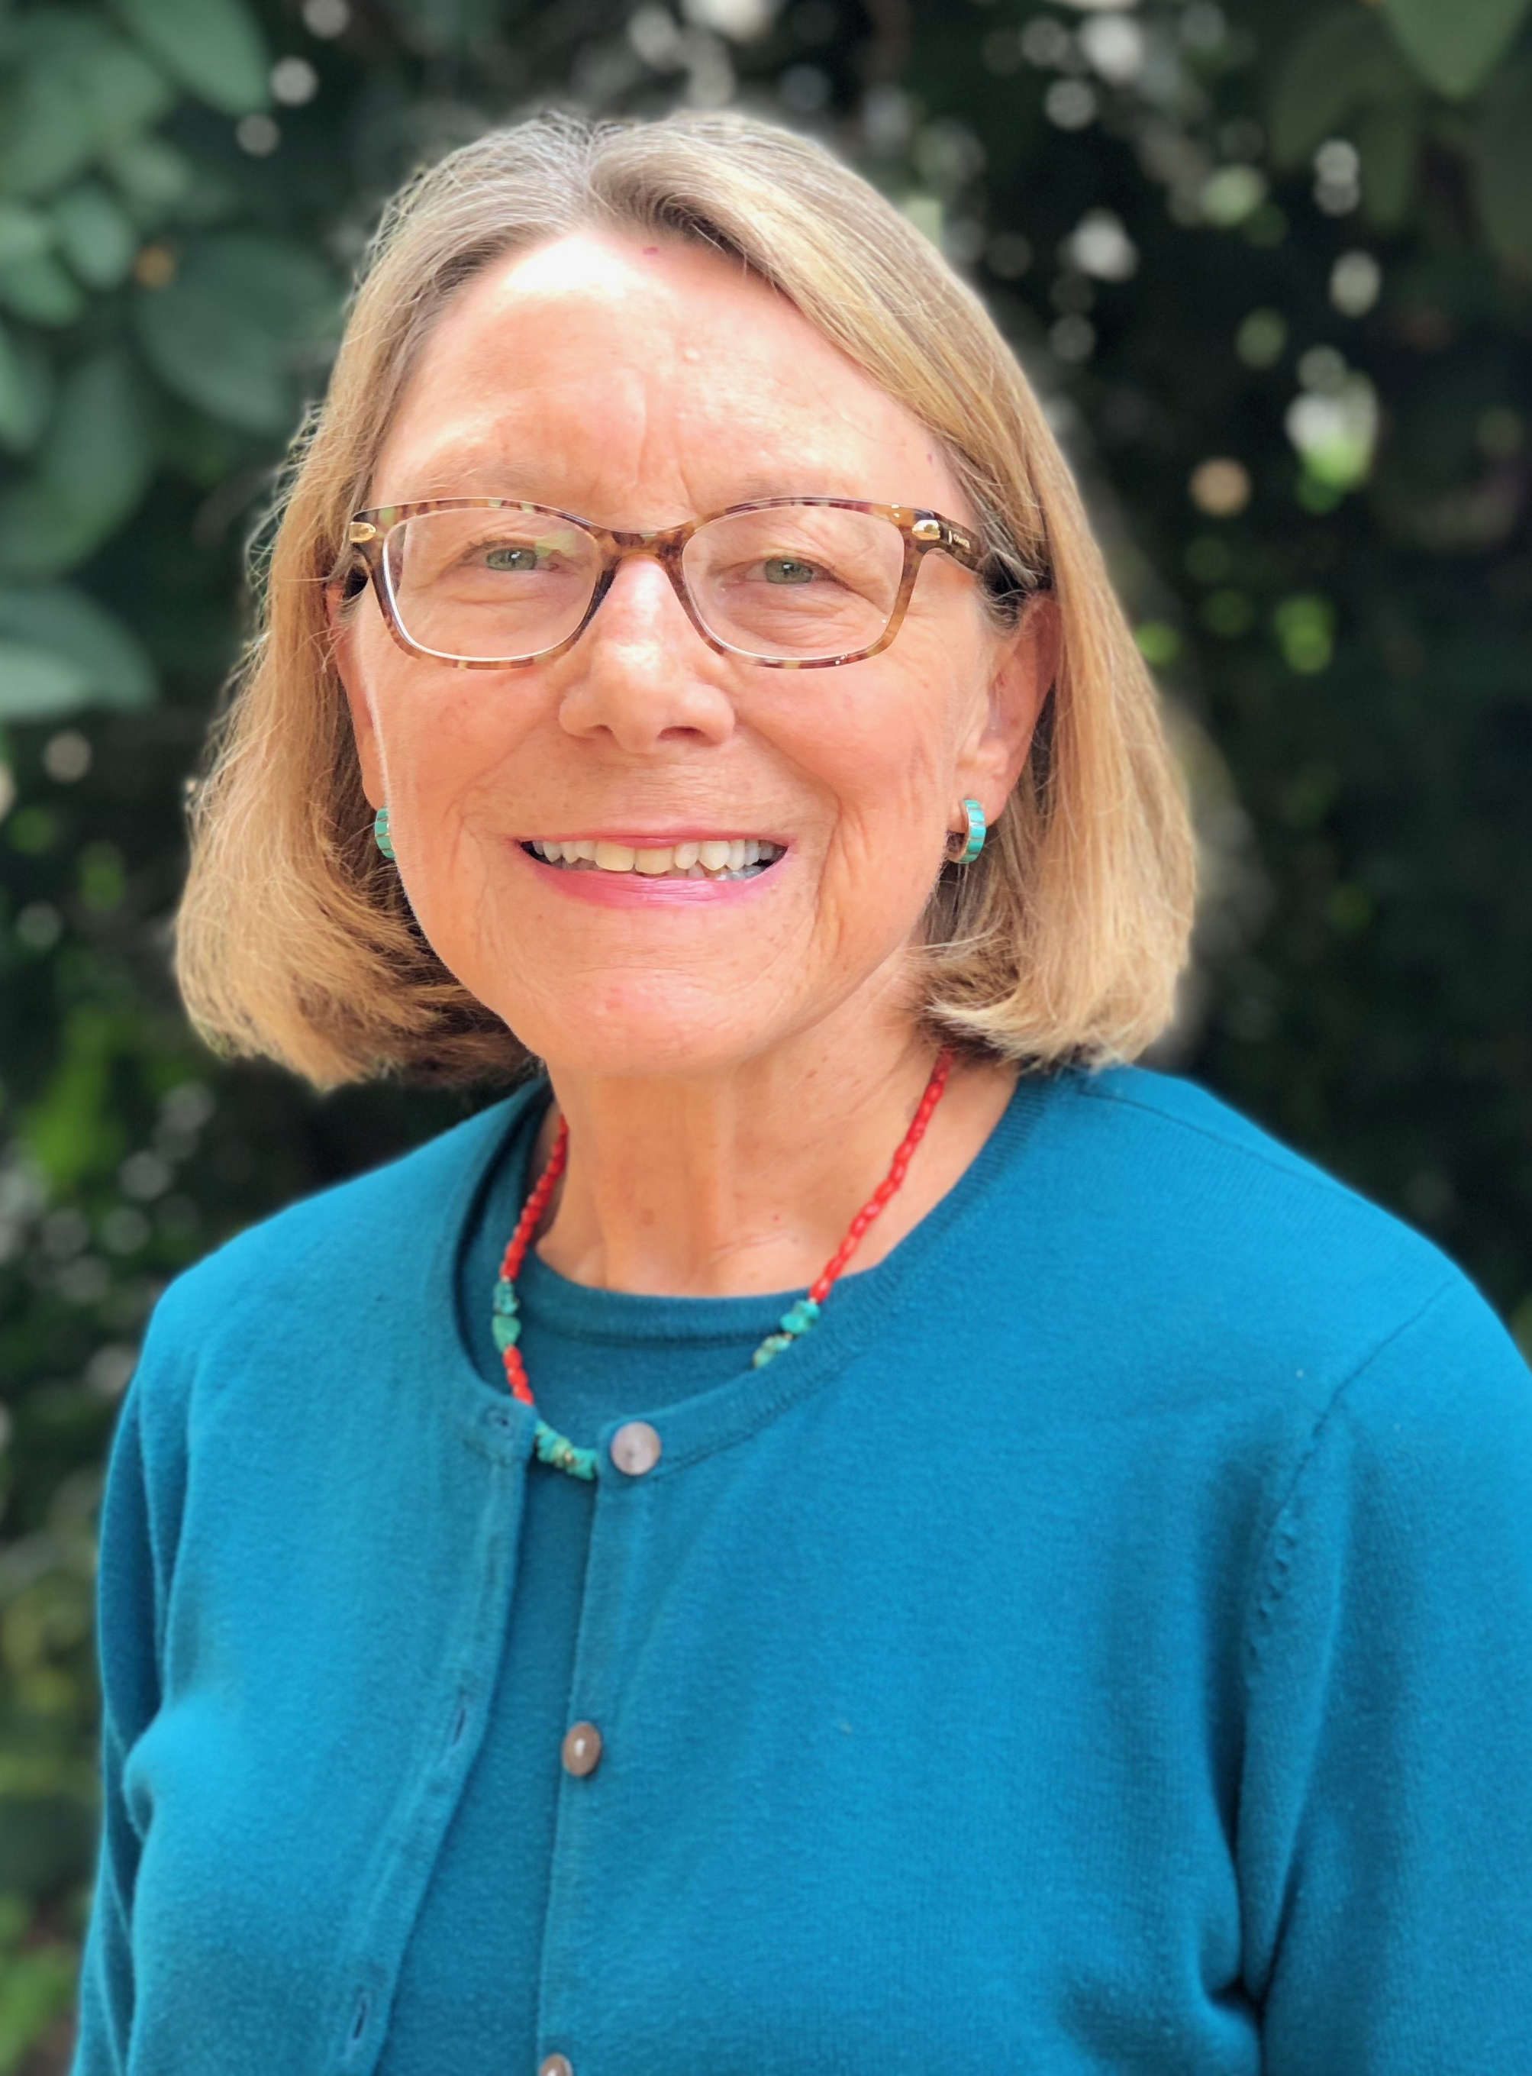
New Leadership
Diana Morris, PhD, RN, FAAN, FGSA
Interim Associate Dean
of Academic Affairs
Joachim Voss, PhD, RN, FAAN
Director, PhD Program in Nursing
Deborah Lindell, DNP, RN, FAAN
Assistant Director, DNP Program
Notes:
We’re also excited to have long-time faculty members transition into new roles at the school, including:
Dr. Diana Morris as the Interim Associate Dean of Academic Affairs;
Dr. Joachim Voss as the Director of the PhD Program; and
Dr. Deborah Lindell as the Assistant Director of the DNP Program

Slide 7
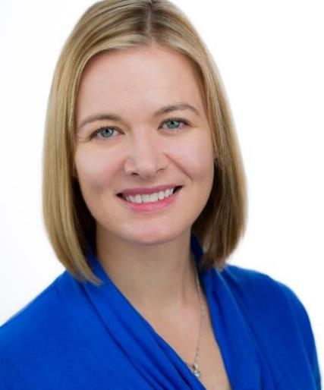
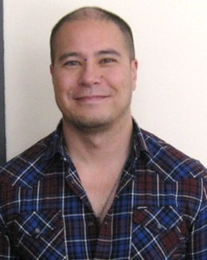


Promotions and Appointments
Allison Webel,
PhD, RN, FAAN,
Associate Professor
Nathaniel Schreiner,
PhD, MBA, RN
Assistant Professor
Shanina Knighton,
PhD, RN,
Instructor and KL2 Clinical Research Scholar
Grant Pignatiello,
PhD, RN,
Instructor and KL2 Clinical Research Scholar
Notes:
The faculty has also seen promotions and added a strong group of new researchers and educators to its ranks.

Slide 8
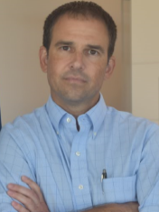
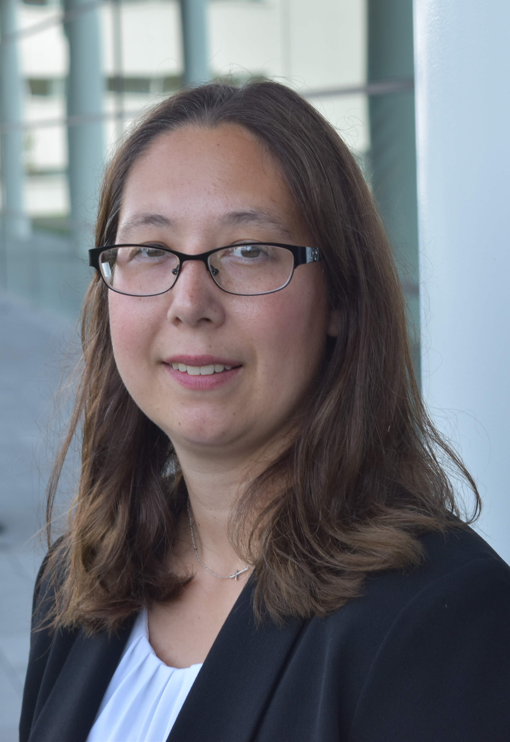
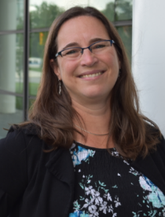
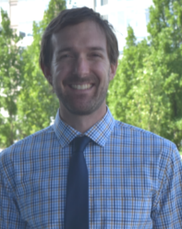
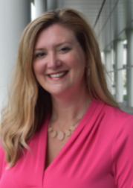
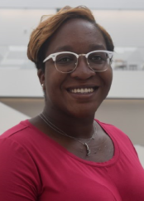
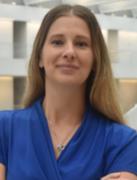
New Faculty
Todd Smith, PhD, APRN, AGACNP-BC,
FNP-C, FF/EMT-P
Director, Center for Flight Nursing
Assistant Professor
Christina Henrich,
MSN, APRN, ACNS-BC
Instructor
Anne Kolenic,
DNP, RN
Instructor
Christopher Bibro,
MSN, CRNA
Lecturer
Hollie Gentry,
MSN, RNC-MNN
Lecturer
Me'Chelle Hayes, DNP, RN
Lecturer
Jennifer Nicholson,
MSN, CRNA
Lecturer
Notes:
I want to continue and grow the FPB tradition of mentorship and promotion of nursing leaders. It is exciting to know that 24 percent of FPB’s lecturers and instructors are progressing through the DNP program, and

Slide 9

By the numbers

Slide 10
2018-19 Budget: Operating Results
Total Income/Revenues $34,240,000
Notes:
Our total income and revenues for the 2018-2019 year was $34,240,000.

Slide 11
2018-19 Budget: Operating Results
Total Income/Revenues $34,240,000
Total Expenses
$33,783,000
Notes:
Our total expenses for the 2018-2019 year was $33,783,000

Slide 12
2018-19 Budget: Operating Results
Total Income/Revenues $34,240,000
Reserve
$457,000
Total Expenses
$33,783,000
Notes:
At the end of the 2018-2019 Fiscal Year, we added more than $450,000 to the reserve.

Slide 13

Support from our Alumni & Friends
Campaign Goal: $45,000,000
Campaign Attainment: $49,321,268
Attainment FY19: $ 3,200,610
Annual Fund: 22% increase
Almost $500,000 - Record Breaking Year!
Notes:
Last year marked the close of CWRU’s Forward Thinking Campaign. CWRU’s capital campaign launched October 2011 and the Nursing goal was $35 million. Nursing and CWRU reached the campaign goal ahead of schedule and in October 0f 2016 the Nursing campaign goal was expanded to $45 million. At the close of the expanded campaign FPB exceeded our goal for a total of $49.3 million. The fundraising priorities were Capital, Faculty Support, Scholarships, Programs and Annual Fund
As for annual support in FY19 we had another very strong cash donation total of $3,056,830 and just over $3.2 million overall fundraising attainment.
Over the last 5 years the Annual Giving program has grown by 44%! And this past year we had a record breaking year and experienced 22% growth over the previous fiscal year. The Annual Giving program now provides support for: the unrestricted annual fund, current use operating expenses, undergraduate and graduate scholarships and interprofessional education.
A special thank you to all of you who have participated in our faculty and staff campaigns and supported the work of our development and alumni relations team to make this possible.

Slide 14
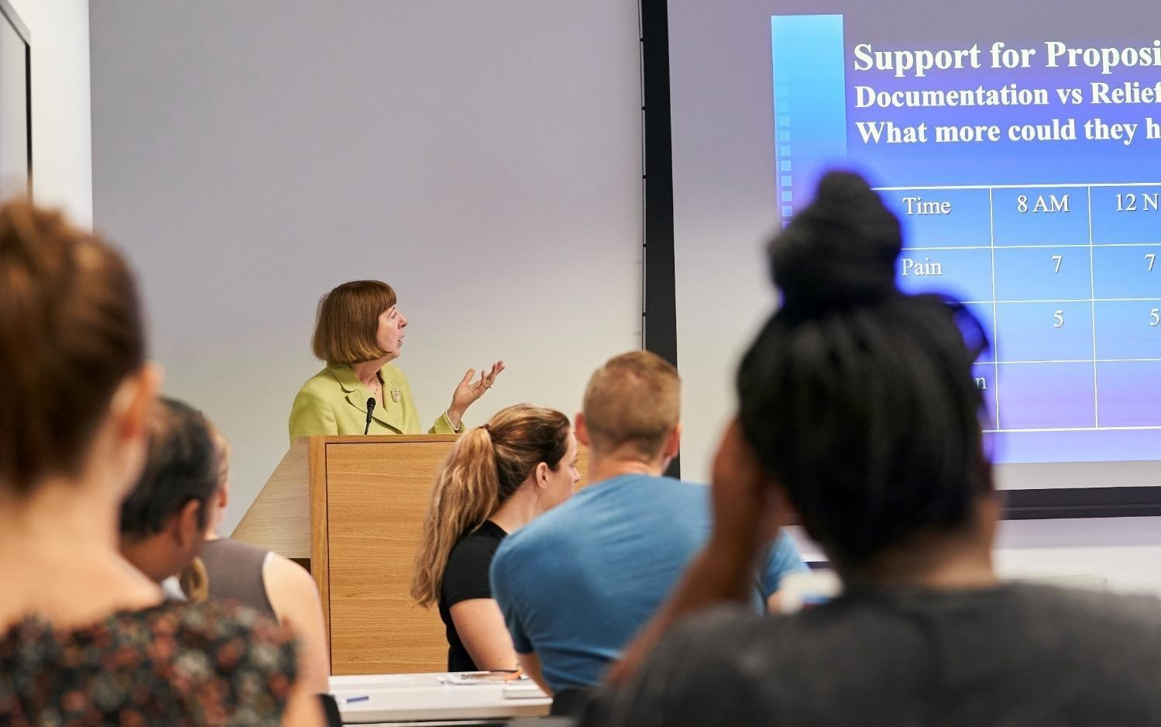
Focus Area: Research
Goal: Lead the discovery of new knowledge through innovative and high impact research
Notes:
The second focus area of our strategic plan is research. Our goal is to lead the discovery of new knowledge through innovative and high-impact research.

Slide 15
11th
Ranked in
NIH Funding
$10, 329, 049
Total Funds Awarded
Notes:
In the past year, two-thirds of the grants FPB researchers submitted received funding. In total, FPB researchers were awarded $10.3 million. Of that $10.3 million, $4.8 came from NIH, making FPB 11th in the nation in NIH funding. That is an amazing accomplishment for our research department and speaks both to the in-demand nature of our research and the support researchers received.
With results like this, it is clear that the research efforts and activity are paying off and our researchers are knocking it out of the park.

Slide 16

New Research Grants
Caregiver Resourcefulness Interventions
Valerie Toly, PhD, CPNP
  RO1r NIH NINR: $2,201,184
Susan Mazanec, PhD, RN
  R37 NIN/NCI: $2,138,102
Jaclene Zauszniewski, PhD, RN, FAAN
  RO1 Diversity Supplement: $400,000
  RO1 Admin Supplement: $108,272

Slide 17

New Research Grants
Self-Care and Caregiving for People Living HIV
Allison Webel, PhD, RN, FAAN
  RO1 NIH/NINR: $3,218,907
  RO1 Div. Sup. NIH/NINR: $371,509
  RO1 Admin Sup. NIH/NINR: $353,430

Slide 18

New Research Grants
Quality and Safety & Workforce Training
Mary Dolansky, PhD, RN, FAAN
  NEPQR HRSA: $2,187,305
  John A. Hartford Foundation: $845,684

Slide 19

New Research Grants
Big Data
Andrew Reimer, PhD, RN
    R15 NIH/NINR $476,971
  Patient Outcomes
  Joachim Voss, PhD, RN, FAAN
    DOD Subaward $540,882

Slide 20

Faculty Productivity
Tenured and tenure track faculty (n=28)
100% had at least one publication.
100% had their work cited by others.
Non-tenure track faculty (n=70)
87% had at least one publication.
84% had their work cited by others.
Notes:
Of our tenured and tenure track faculty, 100 percent at least one publication and had their work cited by others. For our non-tenure track faculty, 87 percent had at least one publication, and 84 percent had their work cited by others.

Slide 21
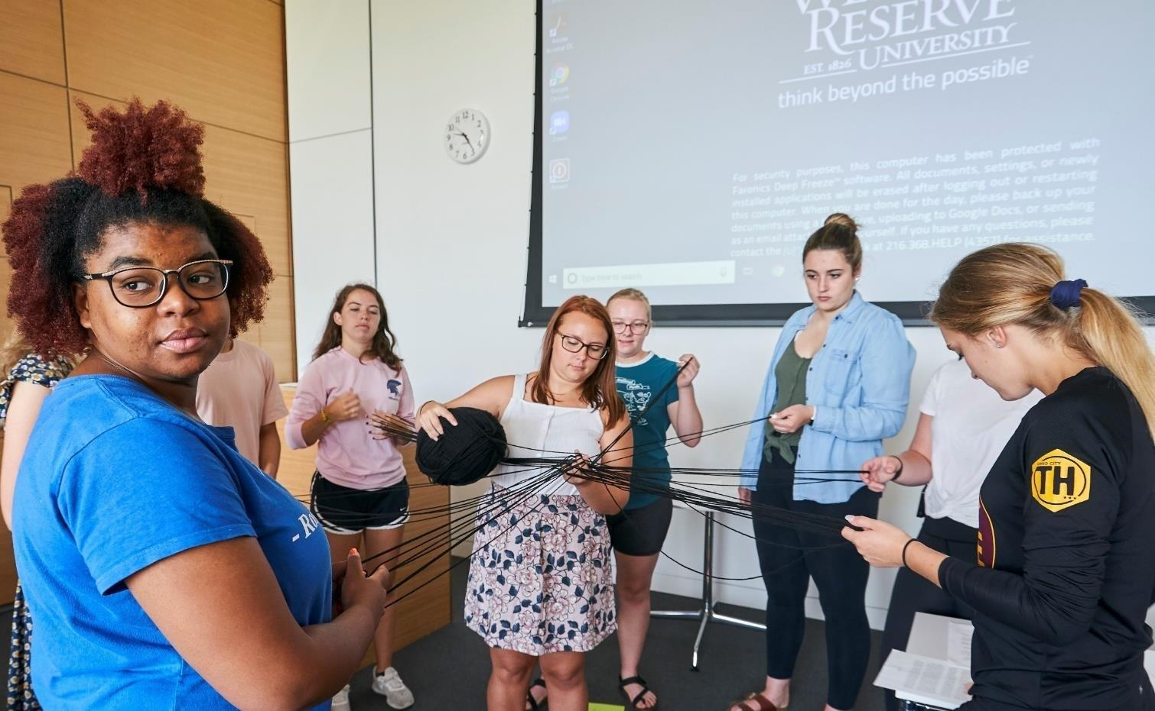
Focus Area: Education
Goal: Ensure high value nursing education
Notes:
Strong leadership and robust research pursuits make our third strategic plan goal, ensuring high-value nursing education, an easier task.

Slide 22
FPB Enrollment Trends: Fall 2007 to Fall 2019
Notes:
Though enrollment has slowed in our MSN, DNP, and PhD programs, our faculty leadership have worked incredibly hard to make those programs better and more dynamic.
Additionally, the new structure of the centralized marketing and communications department includes a newly formed group focused specifically on Graduate & Professional Enrollment Marketing. Those positions are still being filled, and when that team is established we expect more university support in marketing our graduate programs. In 2019, we have 380 BSN students enrolled, 78 MN, 222 MSN students, 118 DNP students, and 45 PhD students.

Slide 23
% Underrepresented Minorities
Across Programs
Notes:
We need to continue to diversify our student body, so that we develop nurses at all levels who the broader community can relate to. University-wide, students from underrepresented minorities are 12%, and the school of nursing is at 14 percent.

Slide 24
% Males Across Programs
Notes:
Our gender data spread remains the same as last year with 14 percent of nursing students self-reporting as male.

Slide 25
NCLEX Scores
Notes:
Our NCLEX pass rates remain well above the national average for our BSN and MN programs.

Slide 26
MSN Advanced Practice Nursing
1st Time Pass Rates
Notes:
Though official results for 2019 from most of the APRN certifying bodies won’t be in until Feb/March 2020, our participation remains strong. The most recent official results from calendar year 2018 have most of our first time pass rates at 100%.

Slide 27

Focus Area: Professional Practice
Goal: Develop and promote new models of
professional and interprofessional practice
Notes:
Another focus area of the strategic plan is how we engage in professional practice. We achieve our goal of developing and promoting new models of professional and interprofessional practice by being proactive about Interprofessional Education and engaging in the national movement for nurses to practice to the full extent of their education and competencies.

Slide 28
CWRU Vision for IPE
Institutional Leadership/Steering Committee
Faculty & Staff Development
Associate Provost
+
Team of faculty and staff
Coordination
Communication
Budget Management
Administration/Organization
Development/Fundraising
Culture/Learning Community
Research and
Scholarship
Student Organizations
Projects/Pilots
Evaluation/Assessment
Curriculum
Foundational course
Simulation
Community Experience
___________________________
Clinical Experiences for later learners
Learn. Care. Lead.
case.edu/nursing
Notes:
Our current IPE curriculum, which the university established through small grants and projects in 2009, focuses on health professions students at Case Western Reserve. Currently, first-year health professions students and 3rd year BSN students participate in a series of workshops over an academic year to learn about roles, responsibilities and team skills, which they then practice in a simulation.

Slide 29
CWRU IPE Curriculum
Skill Based & Progressive
Collaborative Care Team Skills Based Curriculum
Foundational
Introduction to collaborative care team skills
Define, teach, and assess team skills
Simulation
Practice of collaborative care team skills
Simulate
Community & Clinical Experiences
Application of collaborative team skills
Collaborate
Communicate
Learn. Care. Lead.
case.edu/nursing
Notes:
Each year more than 500 students participate in these foundational workshops. This year students from 7 professions, including dental medicine, medicine, nursing, nutrition, physician assistant, social work and speech pathology will participate in 2 interactive workshops in the fall and 2 simulations in the spring.

Slide 30
Foundational Learning
Community & Clinical Experiences
Over 500 Students
7 Professions
  Dental Medicine
  Medicine
  Nursing (BSN, MN)
  Nutrition
  Physician Assistant
  Social Work
  Speech Pathology
4 Sessions over 1 year
  2 Workshops
  2 Simulations
Skills for Collaborative Care
402 Students
  133 Students in formal IPE programs
  296 Students in volunteer IPE experiences
Experiences focus on service learning, student teams add value to the site
Next Steps
  Increase capacity for more students
  Partner with more sites
  Integrate IPE curriculum into volunteer experiences
Learn. Care. Lead.
case.edu/nursing
Notes:
As we further enhance the university’s IPE curriculum, our path forward in next few years is to provide clinical or community-based experiences for students to practice skills with each other in a real world setting.
Toward this end, we have a good start with some of our grant-funded programs as well as existing volunteer experiences. We hope to increase the capacity of this programming over the next few years by integrating formal IPE learning into existing experiences and by growing our network of sites where we can send students.

Slide 31

Focus Area: Culture of Leadership
Goal: FPB as the Leadership Destination
for all nurses
Notes:
Supporting our commitment to increased engagement in professional practice is FPB’s commitment to maximizing our culture of leadership. Everyone is a leader and we are working to strengthen that. Rose Sherman was here about 6 weeks ago, talking about change management and leadership. More to come.

Slide 32
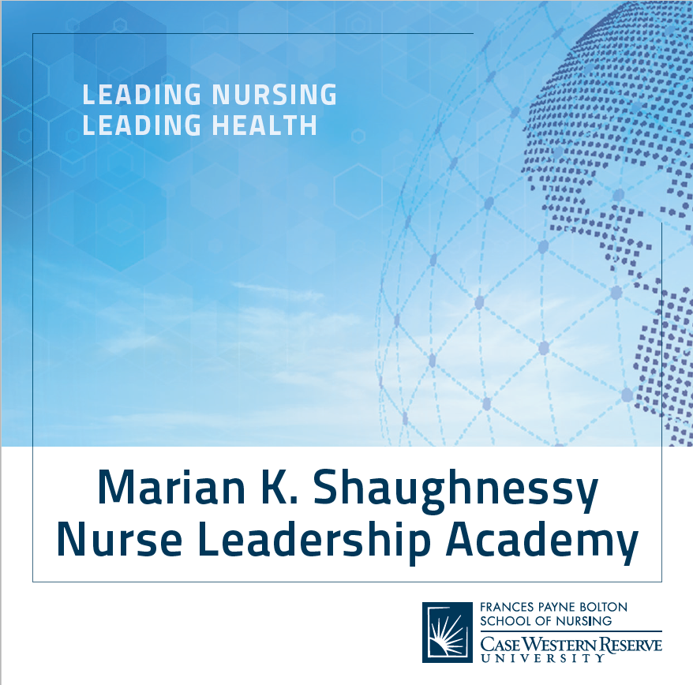
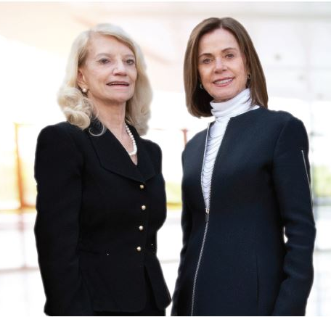
Nurse Leadership
Notes:
This initiative, led by the Marian K. Shaughnessy Nurse Leadership Academy, has resulted in reimagining curriculum to include leadership content from the outset and a DNP-alumni driven leadership lecture series that has been warmly received by alumni and nursing professionals.

Slide 33


DNP Leadership Lecture Series
Distinguished CWRU faculty member
Dr. Richard Boyatzis presented the inaugural
DNP Post-Doctoral Leadership Lecture Series
in New York City in April 2019.
Dr. Peter J. Pronovost, Chief Clinical
Transformation Officer at University Hospitals
Health System, presented the second DNP
lecture in Cleveland in August 2019.
Notes:
The DNP Post-Doctoral Leadership Lecture Series premiered in April 2019 in New York City. The Cleveland debut was in August 2019.

Slide 34
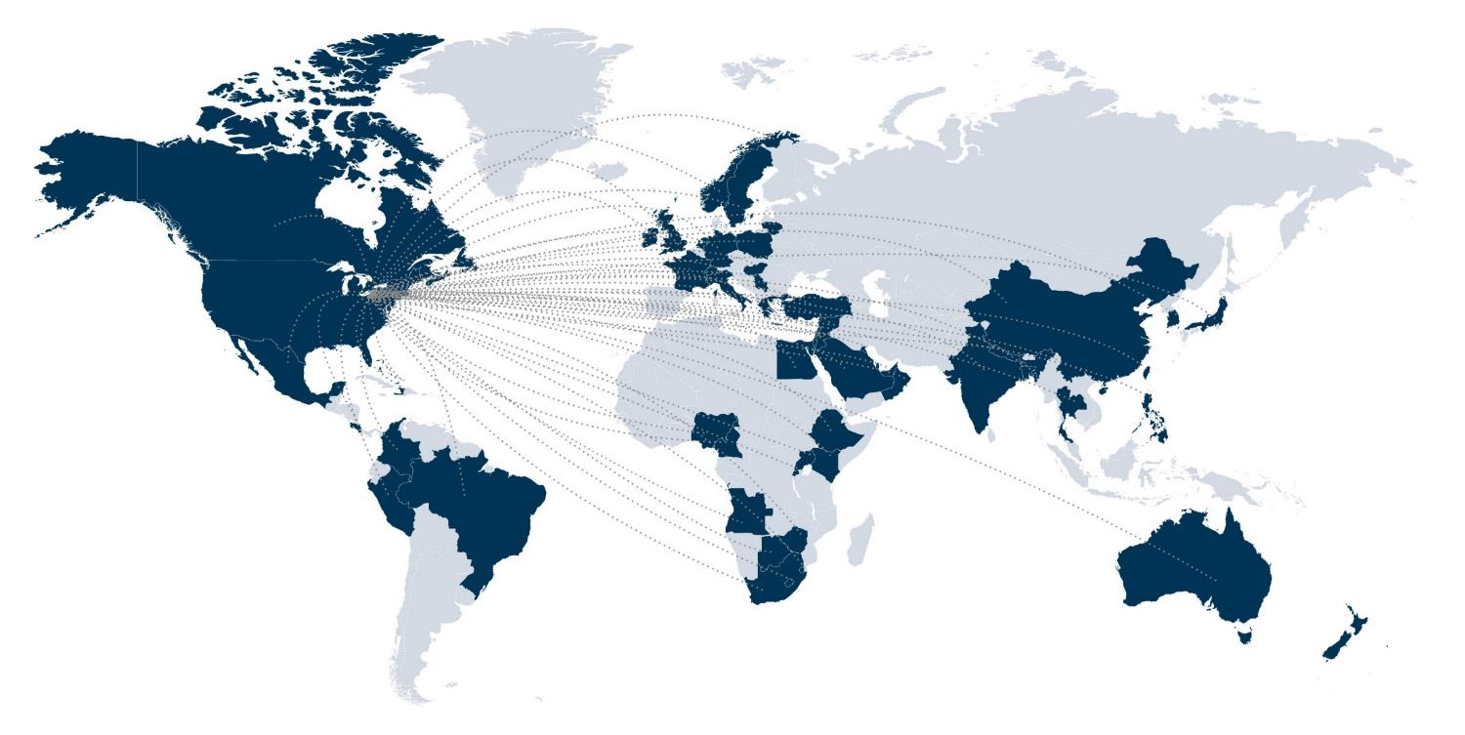
Focus Area: Global Health
Goal: Promote a Global Health Presence
Notes:
A new focus area of our strategic plan is global health. The goal of our focus is to promote a global health presence through developing targeting initiatives to support our global health presence; engaging with alumni in building stronger global nursing education, practice and research networks; and building programs of research and practice across continents.

Slide 35

Excellence in the Classroom
#13 DNP, US News
#16 MSN, US News
#10, Adult/Gero, Acute Care
#19 Family Nurse Practitioner
Top 100, QS World University
Notes:
FPB is well positioned to undertake this goal. The university is focused more on international rankings, and FPB is the highest ranked school for QS World University.

Slide 36
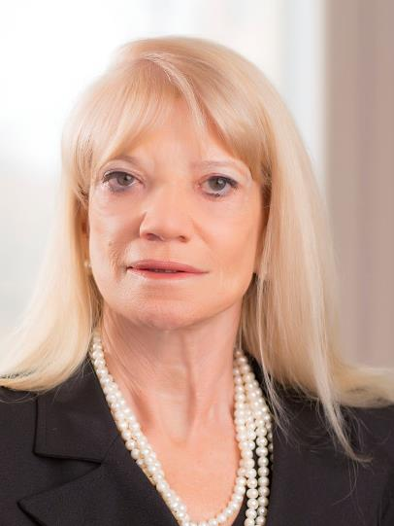
International Awards
Joyce J. Fitzpatrick,
PhD, RN, MBA, FAAN
2019 Recipient
International Achievement Award
Florence Nightingale International Foundation
& International Council of Nurses
Notes:
Multiple FPB faculty members received international awards this past year, further boosting our international profile. These include:
Dr. Joyce Fitzpatrick, the 2019 recipient of the International Achievement Award from the Florence Nightingale International Foundation and the International Council of Nurses;

Slide 37

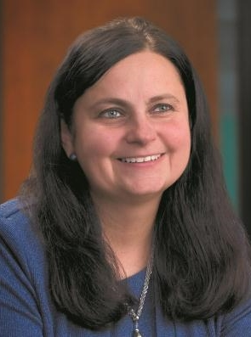
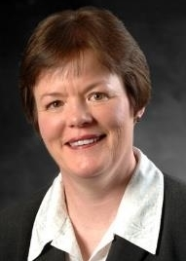
STTI International Awards
Joachim Voss, PhD, RN, FAAN
STTI Researcher Hall of Fame
J. Zauszniewski, PhD, RN-BC, FAAN
STTI Researcher Hall of Fame
STTI Founders Award - Research
Mary Quinn Griffin, PhD, RN, FAAN
STTI Founders Award - Education
Notes:
Drs. Joachim Voss and Jaclene Zauszniewski, who were both inducted into the STTI International Nurse Researcher Hall of Fame;
And Drs. Jaclene Zauszinewski and Mary Quinn Griffin, who both received an STTI Founders Award for Research and Education, respectively.

Slide 38

Expand our Global Presence
Strengthening engagement in international community
The Global Congress for Qualitative Health Research
June 2020
New Study Abroad Opportunities
Notes:
In the coming year we will continue this goal by working on expanding our global presence through strengthening our engagement in the international community, participating in the Global Congress for Qualitative Health Research conference in June 2020, and promoting new study abroad opportunities, including one in Spring semester 2020 in Ireland.

Slide 39
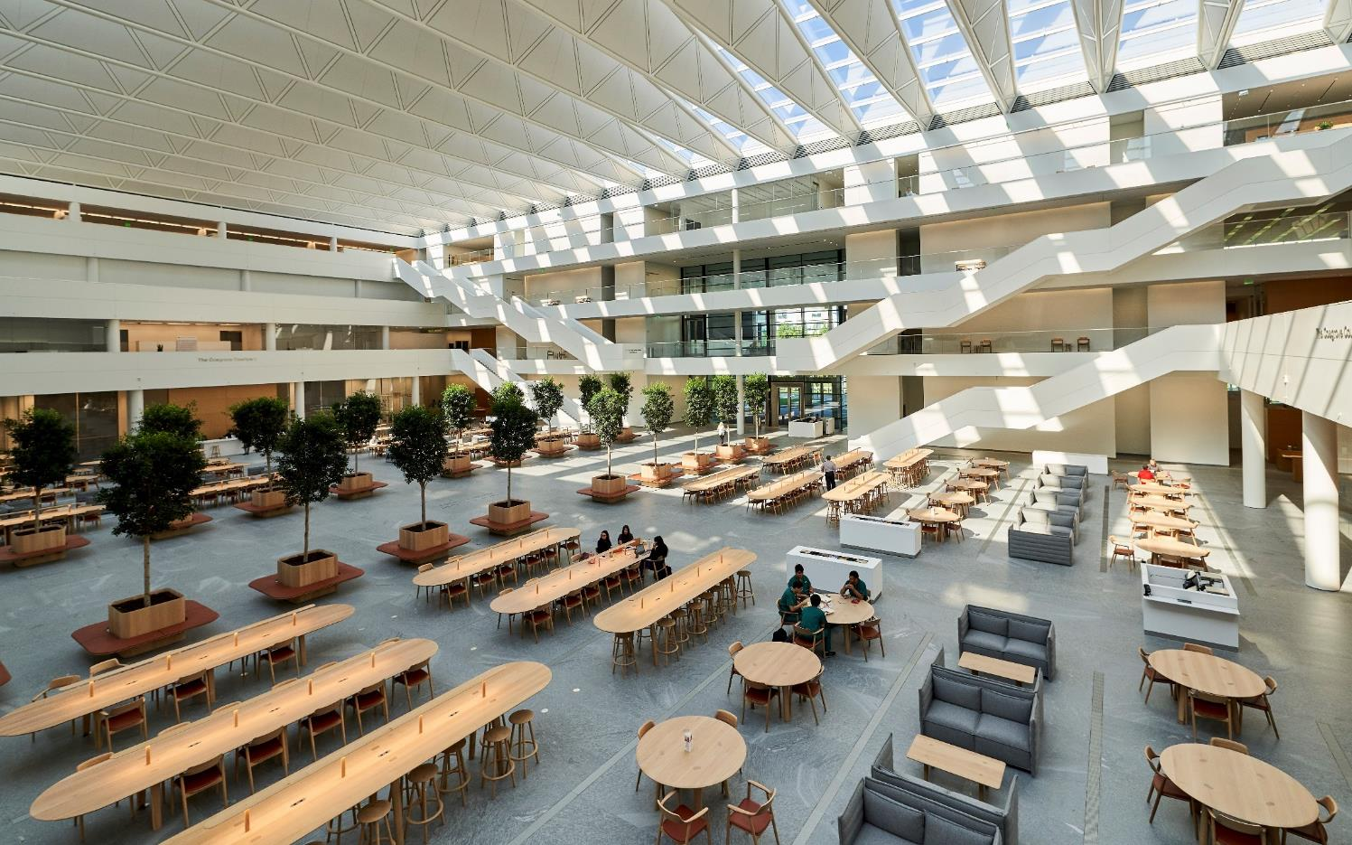
Focus Area: New Health Education Campus
Goal: Implement a smooth transition to the
New Health Education Campus
Notes:
The final focus area of the strategic plan that I want to discuss is our goal to implement a smooth transition to the HEC.

Slide 40

  The Future of Nursing Science
  Building a Health Research Campus
  for 2035
Notes:
Now that the move is over, there are issues that we need to come to terms with. FPB now stretches from the Health Education Campus (HEC) and the Health Research Campus (HRC). This is a huge change for us. We are examining designs for the new HRC.

Slide 41
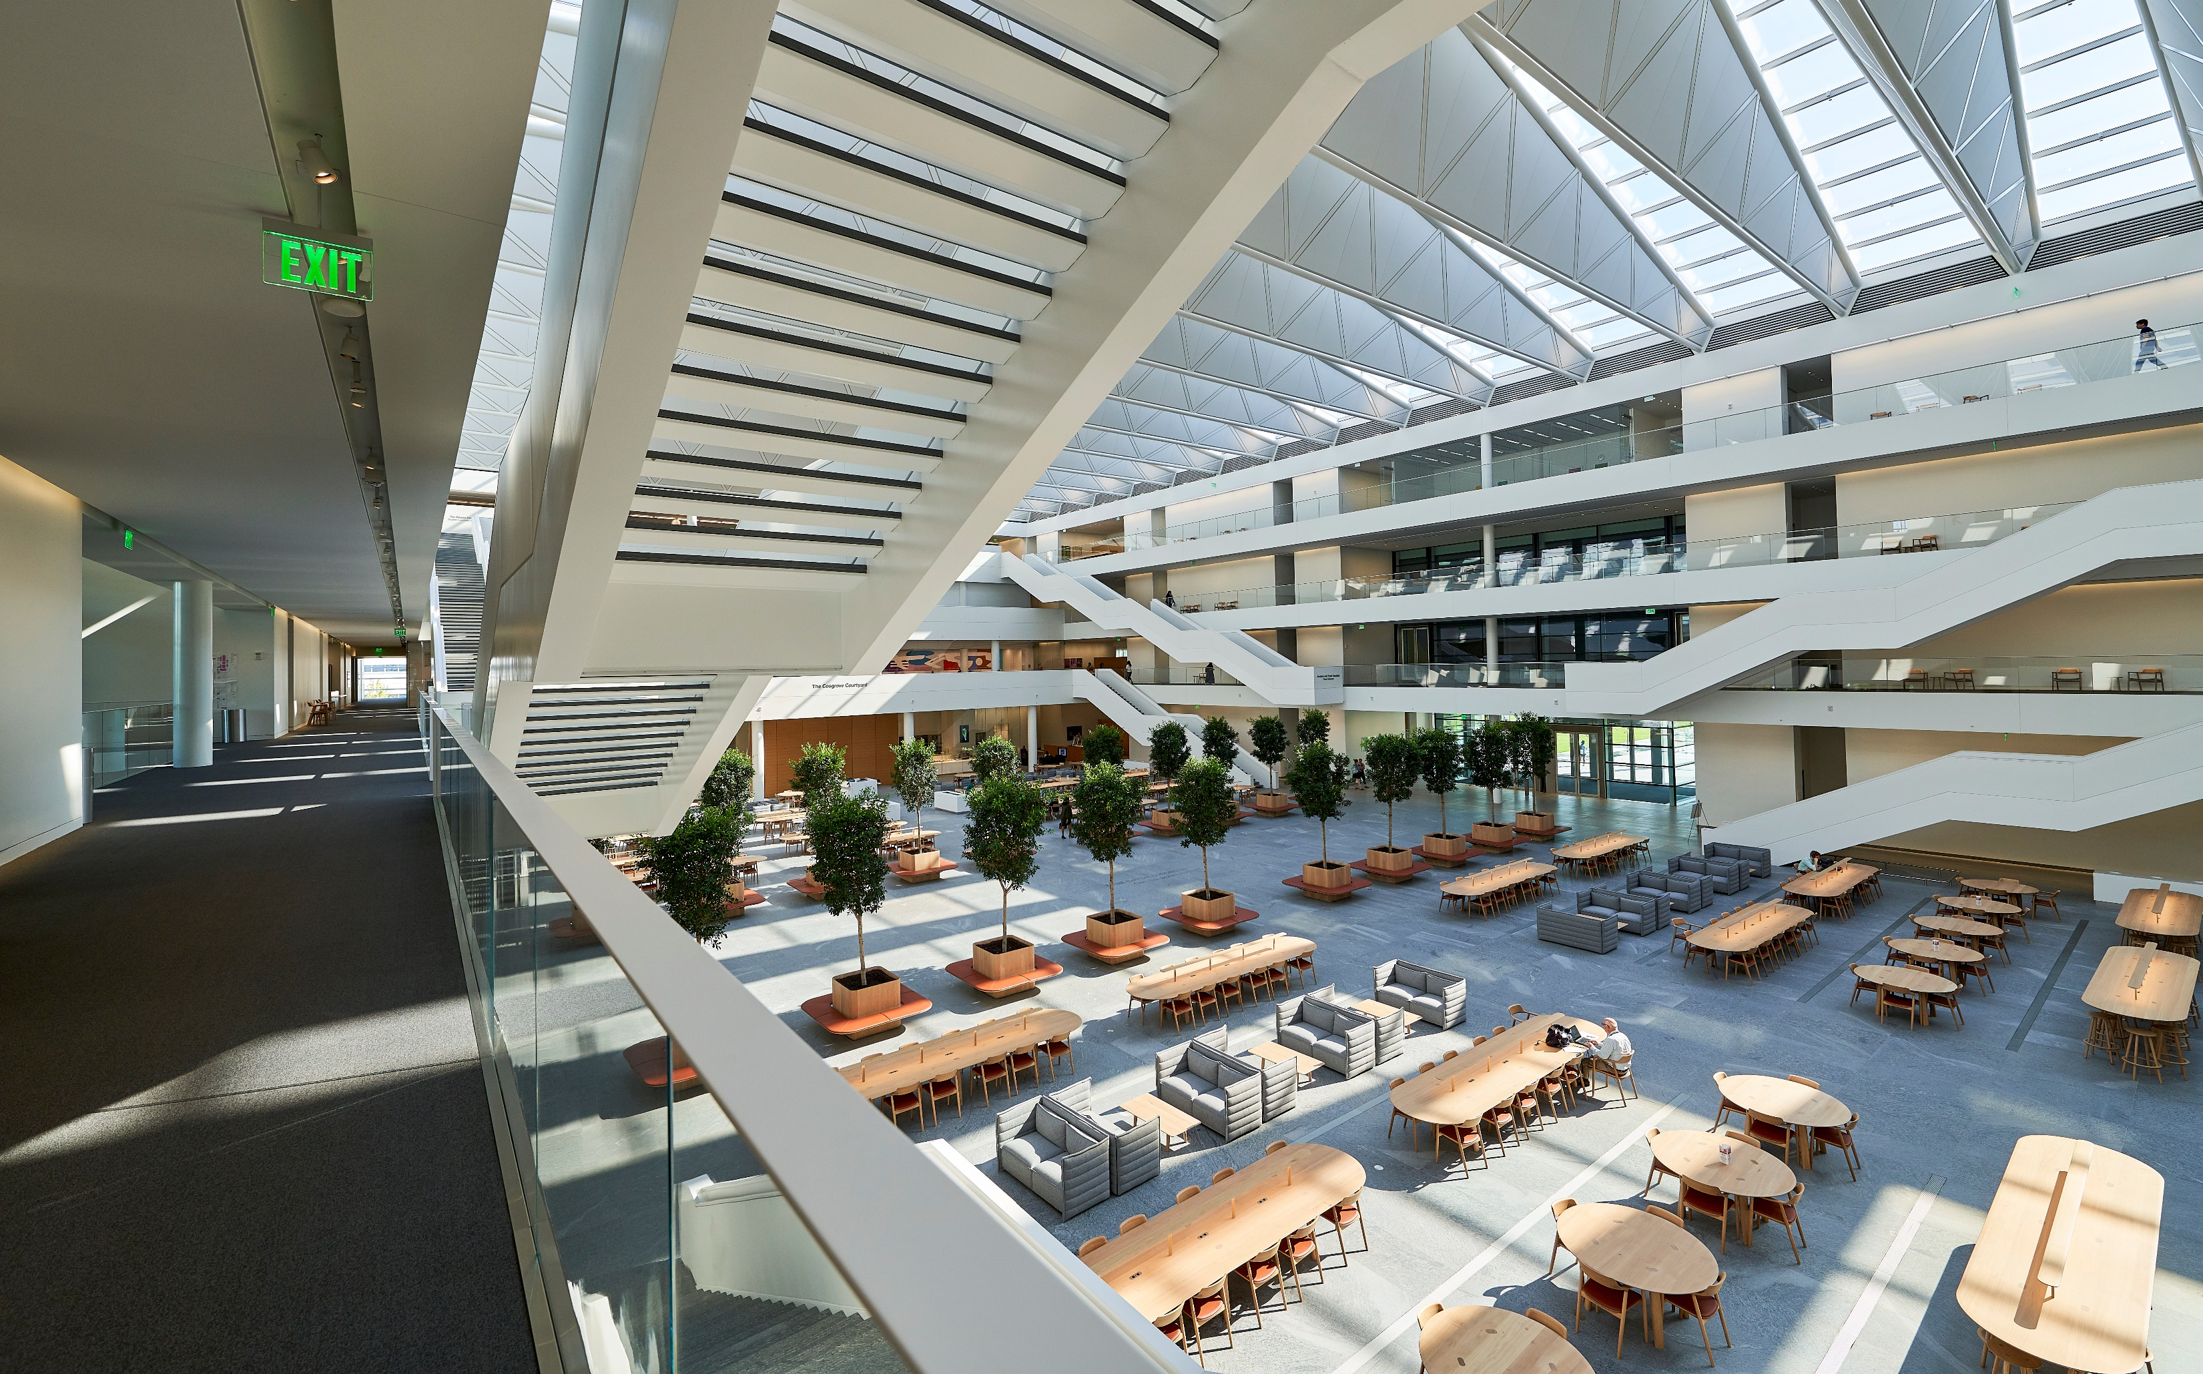
  Supporting Two Campuses
  Renovation of the Health Research Campus
  Maintaining Two Facilities
Nursing Innovation and Leadership
Notes:
The challenge is what is research going to look like in the years ahead. Most schools on campus have multiple buildings, but it’s new to nursing. Researchers expect HEC-quality spaces as they should. While we explore the financial implications of maintaining two facilities, with promised help from the university to support the HRC, we have to remember one crucial thing.

Slide 42

Things to look for
Continuing Initiatives
Notes:
And now I want to talk a little bit about what to expect in the coming year at FPB, starting with the university planning initiative Think Big.

Slide 43

Think Big: North Star Philosophy
Case Western Reserve is a
high-impact research university that aspires to be a community where humanity, science & technology meet to create a just and thriving world.
Notes:
The Think Big North Star statement carves a vision for CWRU that brings the university to a place where we can see ourselves as ONE Case Western University guided by our North Star.

Slide 44

Notes:
Finally, as many of you probably know 2020 has been dubbed the year of the nurse, and FPB will play a role in celebrating the nursing profession on a large stage. This goes back to our strategic plan initiative of expanding our global footprint. Stay tuned as a we continue to formalize our involvement and events in the 2020 year of the nurse campaign.

Slide 45
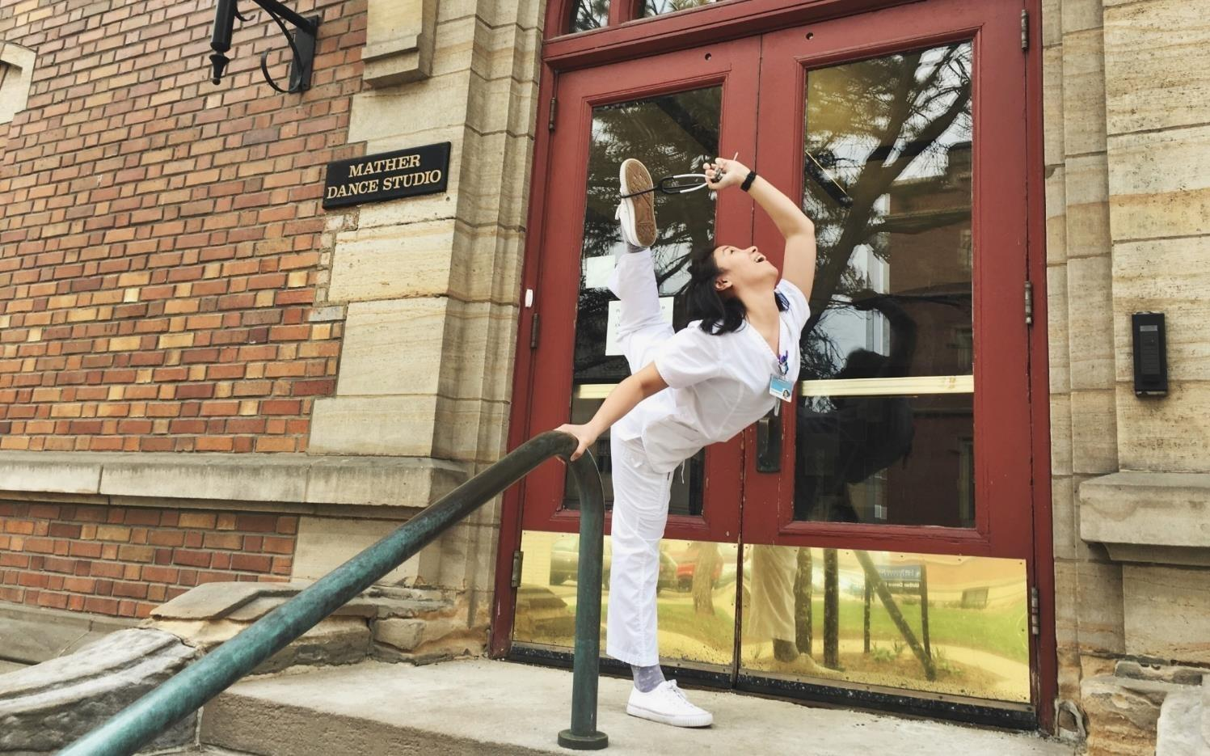
Thank you!
Notes:
Thank you all for joining me today for the State of the School. I look forward to this new academic year and am excited to achieve our goals with you. Thank you.

