Slide 2
DISCUSSION TOPICS
Why is an IDP important?
Postdoc & Mentor Responsibilities
Taking Control of Your Career
Next Steps-Developing Your IDP

Slide 3
WHAT IS AN IDP?
I
ndividual
D
evelopment
P
lan
It is a framework to identify and pursue professional development and career objectives.
Notes:
Rachel

Slide 4
WHAT CAN AN IDP DO FOR YOU?
Help you to identify both short-term and long-term goals that can push you towards action
Serve as a communication tool between you, your faculty mentor, and others
Function as a visual representation/reminder of how you will spend your time achieving your goals
Serve as a display of milestones along the way that can be acknowledged and celebrated
Notes:
Rachel

Slide 5
WHY IS FILLING OUT AN IDP IMPORTANT TO YOU?
It helps ensure that you acquire a good academic foundation and transferable skills ¹
It helps you to identify your strengths and gaps, interests, and career paths
It can make a huge impact on the quality and flow of your professional and personal advancements¹
¹ C. Gita Bosch, PhD, Building Your Individual Development Plan (IDP): A Guide for Undergraduate Students, SACNAS
Notes:
This is about what you like to do, what you are good at, and what impact you want to have on the world. It is a combination of your academic and professional aspirations, as well as your personal and social ideologies.

Slide 6
AN IDP TELLS YOUR FACULTY ADVISOR THAT YOU DO NOT PLAN ON WORKING FOR THEM FOREVER,
OR BEING A LIFE-LONG POSTDOC
Or does it, what will your self assessment tell you?
Your faculty advisor will not plan your future for you
If you they don’t know what your plan is, how can they help you get there?
Generally people want to help and do the right thing if they are made aware
Lays the groundwork for your time as a postdoc or your break-away
Lessens surprises and anxiety
Provides a template to your future position

Slide 7
IF YOU DON’T HAVE A DESTINATION AND A ROUTE MAPPED OUT, THEN YOU CAN TAKE ANY DIRECTION TO GET THERE
12,000 miles
Notes:
12,000 miles

Slide 8
2,300 miles
Notes:
I-80 to I-70 to I-15 2300 miles

Slide 9
DELIBERATE CAREER PLANNING
A nationwide study of 7600 postdocs found that those who developed training plans with their advisers at the start of their appointments reported:
Greater Satisfaction
Published More Papers
Experienced Fewer Conflicts with those Advisors
Davis G. (2005). “Doctors Without Orders.” American Scientist, 93 (3), supplement 1-13
Notes:
People who develop and implement strategies to pursue career-specific goals achieve greater career success
Measured by Salary, Promotions, Level of responsibility
Report greater career satisfaction and rate themselves as more successful than their peers compared to those without a career plan

Slide 10
NATIONAL POSTDOCTORAL ASSOCIATION (NPA) CORE COMPETENCIES
Discipline-specific conceptual knowledge
Research skill development
Communication skills
Professionalism
Leadership and management skills
Responsible conduct of research
Source: The NPA Postdoctoral Core Competencies Toolkit: www.nationalpostdoc.org
Notes:
The NPA has established six core competencies The Core Competencies are meant to serve primarily as:
A basis for self-evaluation by postdocs/students
A basis for developing training opportunities that can be evaluated by mentors, institutions, and other advisors
May be incorporated into a framework for evaluation and feedback using the IDP

Slide 11
POSTDOC & FACULTY ADVISOR RESPONSIBILITIES

Slide 12
POSTDOC RESPONSIBILITIES
Take charge of your own professional development; actively seek opportunities outside the lab or classroom (e.g. professional development seminars and workshops in oral communication, writing, and teaching)
Seek regular feedback on your performance
Work towards progressive responsibility and management of your research project as it matures
Build your network!

Slide 13
FACULTY ADVISOR RESPONSIBILITIES
Review IDP and provide feedback
Regular reviews of progress
Provide opportunities
(networking, colleagues, conferences, etc.)
Provide guidance

Slide 14
TAKING CONTROL OF YOUR CAREER: FILLING OUT AN IDP

Slide 15
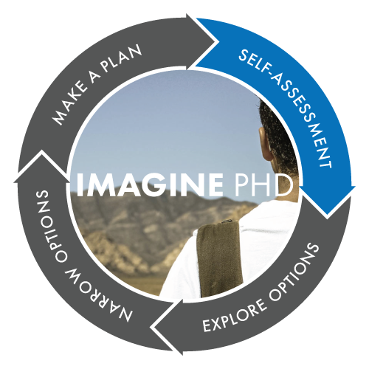
IDP OPTIONS
Career Exploration and Planning Tool for the Humanities and Social Sciences
(also useful for STEM)
https://chemidp.acs.org
https://www.imaginephd.com
STEM
myIDP
http://myidp.sciencecareers.org
www.apa.org/education/grad/individual-development-plan

Slide 16
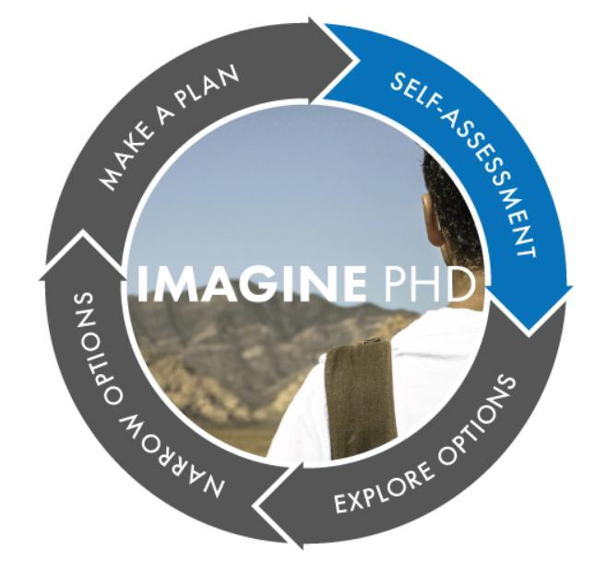
CAREER DECISION MAKING PROCESS

Slide 17
SELF-ASSESSMENT
Skills Assessment
What are your work-related abilities and experience? Interests Assessment What activities do you enjoy doing most at work?
Values Assessment What is important to you in your work environment?

Slide 18
SKILLS ASSESSMENTS
Choose 10 job families of interest
Consider your experience and ability with each skill
Your skills are assessed against the selected job families
Notes:
Skills Assessment
What are your work-related abilities and experience?

Slide 19
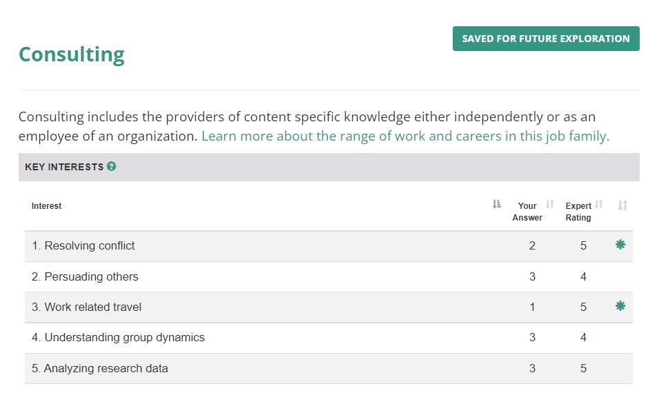
INTERESTS ASSESSMENT
What activities do you enjoy doing most at work?
This assessment will help you evaluate what career-related activities you enjoy doing most and those you would prefer to avoid.

Slide 20
Complete the values assessment worksheet Break-out: Group Discussion
VALUES ASSESSMENT
What is important to you in your work environment?
Notes:
Read through the values and questions. Rank each value as
1 = Not important 2 = Somewhat important 3 = Important 4 = Most important Choose your top 3 values
Introduce yourselves, program/dept, student/postdoc. Values are the principles by which we live. Your values can help define the environment in which you are likely to function best, and the conditions of a job that will keep you motivated.

Slide 21
NEXT STEP: EXPLORE
Notes:
Consider Career Fit, Read About Careers, Attend Events, Talk to People
CAREER EXPLORATION VIDEO INTERVIEW LIBRARY: https://institutions.beyondprof.com/career-exploration-video-resource-library/

Slide 22
NEXT STEP: CONNECT

Slide 23
BUILD YOUR SUPPORT NETWORK
At least 80% of jobs are filled through a professional network connection.
Estimates show between 70% and 80% of all jobs are never posted.
Build your LinkedIn profile and make connections
Identify your Mentoring Team
Sources: http://myidp.sciencecareers.org
https://www.forbes.com/sites/forbestechcouncil/2020/10/15/networking-its-not-what-you-think/?sh=5e8800597985
Notes:
Why is this important?
Mentors can provide both personal and professional guidance throughout your career, helping you to reflect on your skills, interests, and values; refine your career and professional development goals; and stay motivated and focused on achieving those goals.

Slide 24
TALK TO PEOPLE!
How to conduct an informational interview:
Email an invitation to your informational interview “target” Tell him or her that you seek advice, not a job offer.
Ask to set up a 30-60 minute appointment to talk.
Take a customized list of questions to your meeting.
Conduct the informational interview.
Follow up with a thank you note.
If appropriate, follow up periodically.
(download example correspondence, and questions on myIDP or
the Finding Your Next Career workbook by Beyond the Professoriate )
Source: http://myidp.sciencecareers.org
https://institutions.beyondprof.com/
Notes:
Get advice from someone who has traveled down the path before you; conduct an informational interview
The process of gathering information about a career path from another professional who is experienced in that field is called “informational interviewing”
What does your typical day look like? • What types of skills are required for this career? • What do you value about working at this organization? • How did you transition into this career? • Do you have any advice for someone who would like to transition into this career? • Is there anyone else that I should speak to?

Slide 25
Break-out: Group Discussion Informational Interviews
Break into groups of 2 or 3, discuss, and then report:
Discuss with your group the types of people you might want to interview.
Identify one person the you will interview in the next month that you can add to your IDP.

Slide 26
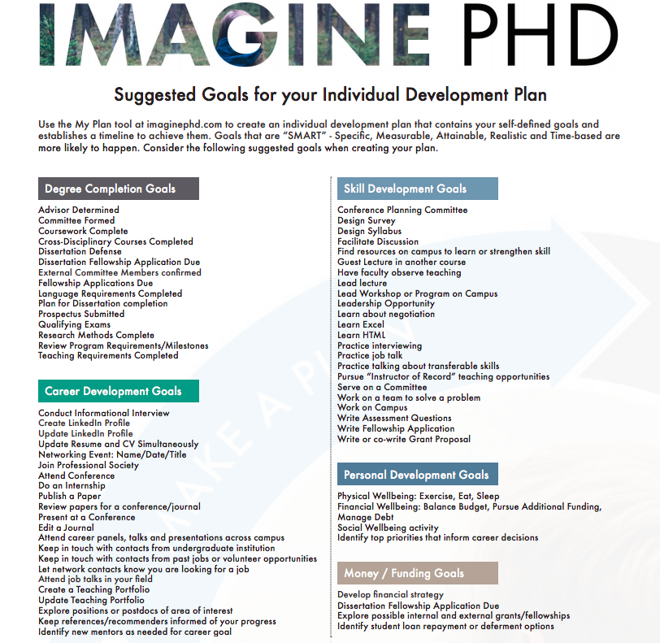
NEXT STEP: SET GOALS
DEGREE COMPLETION
CAREER DEVELOPMENT
SKILL DEVELOPMENT
PERSONAL DEVELOPMENT
MONEY / FUNDING
**REMEMBER YOUR TOP FIVE VALUES !
Notes:
Think broadly about what you want to accomplish. Reflect on your VALUES
ImaginePhD contains list of potential goals, but you can add your own or edit them. The easiest way to add goals is to click directly on the calendar and add them in.
Data suggests that those who make concrete plans using “SMART” goals are much more likely to achieve these goals and have a clearer idea of how to achieve them..

Slide 27
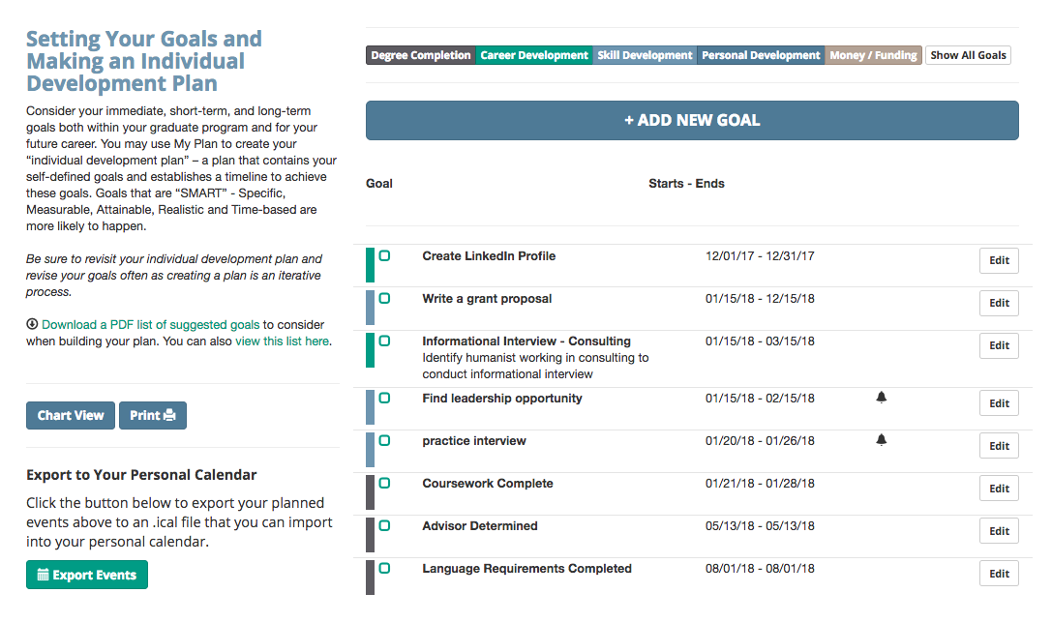
MY PLAN
Notes:
Think broadly about what you want to accomplish. Reflect on your VALUES
ImaginePhD contains list of potential goals, but you can add your own or edit them. The easiest way to add goals is to click directly on the calendar and add them in.

Slide 28
S.M.A.R.T GOALS
S
M
A
R
T
SPECIFIC
MEASURABLE
ATTAINABLE
RELEVANT
TIME-BOUND
Notes:
Data suggests that those who make concrete plans using “SMART” goals are much more likely to achieve these goals and have a clearer idea of how to achieve them..

Slide 29
SMART GOAL SETTING
STEP 1: Identify Your Goal
STEP 2: Map out next steps toward completion
STEP 3: Add them to the timeline
STEP 4: Hold yourself accountable
Notes:
Goals for your postdoc training, research projects or personal milestones. The goals are meant to be unique to you. And should be determined by where you are in your program and what you want to learn / accomplish
Specific - what does it look like? What is the expected result?
Measurable - How will you know you reached it? Is there a quality standard?
Attainable - Is it reasonable? Can it be accomplished?
Relevant - Is it meaningful? Does it help you reach your larger goals?
Time-Bound - Know when will it be completed
Example -
Submit Conference Abstract

Slide 30
SHORT TERM GOAL
By 5 pm Friday April 15:
Review Call for Proposals
Write 500 word abstract
Revise abstract
Have senior colleague (Advisor, Prof Development Director, etc.) review abstract
Incorporate feedback
Complete Online Submission Form
SUBMIT CONFERENCE ABSTRACT
VS
Notes:
Goals for your postdoc training, research projects or personal milestones. The goals are meant to be unique to you. And should be determined by where you are in your program and what you want to learn / accomplish
Specific - what does it look like? What is the expected result?
Measurable - How will you know you reached it? Is there a quality standard?
Attainable - Is it reasonable? Can it be accomplished?
Relevant - Is it meaningful? Does it help you reach your larger goals?
Time-Bound - Know when will it be completed
Example -
Submit Conference Abstract

Slide 31
LONG TERM GOAL
Get a Job in Higher Education Administration in the Los Angeles Area by June 2023
Go through EXPLORE resources in ImaginePhD and identify 3 areas in administration to learn more about by Dec 15th, 2022
Conduct informational interviews with 3 professionals by January 15th, 2023
Set up email alerts for higher ed jobs on indeed, inside higher ed by Jan 22nd
Create a resume first draft by February 1st - meet with a career advisor to review
Update LinkedIn profile and add 3 groups by February 15th
Finalize Resume and Cover Letter Drafts by February 15th
Start applying for jobs by March 1st
Notes:
Specific - what does it look like? What is the expected result?
Measurable - How will you know you reached it? Is there a quality standard?
Attainable - Is it reasonable? Can it be accomplished?
Relevant - Is it meaningful? Does it help you reach your larger goals?
Time-Bound - Know when will it be completed

Slide 32
ROADBLOCKS OR DETOURS
What if I don’t accomplish the goals I established?
I already have a plan in my head; I follow my gut instinct
How do I account for the unknown (i.e. health issues, family concerns, etc.)
Is this really useful beyond my postdoc position?

Slide 33
Break-out: Group Discussion Roadblocks or detours
Break into groups of 2 or 3, discuss, and then report:
Take a few minutes to think about potential (or past) roadblocks or detours and discuss them as well as potential ways to overcome.

Slide 34
ROADBLOCKS OR DETOURS
Your IDP lets you create a road map to navigate your way; and even if along the way you encounter detours caused by one’s personal life (marriage, birth, death, etc.), you hold your destination in sight at all times.⁴
⁴ C. Gita Bosch, PhD, Building Your Individual Development Plan (IDP): A Guide for Undergraduate Students, SACNAS

Slide 35
NEXT STEP: IMPLEMENT PLAN
The plan is just the beginning of the career development process and serves as the road map.
Put your plan into action
Revise and modify the plan as necessary. The plan is not cast in concrete; it will need to be modified as circumstances and goals change.
The challenge of implementation is to remain flexible and open to change.
Notes:
-You can Share parts of your IDP with your faculty advisor, mentor, or peers.
-Add items to your google calendar
-Submit the plan to your institution

Slide 36
RESOURCES
BEYOND THE PROFESSORIATE
A professional development e-learning platform
CWRU has an institutional membership to Aurora, so you can access their content for free.
Professional Job Search Courses
Discover: Know Your Options
Research: Evaluate Your Opportunities
Implement: Launch Your Job Search
Career Exploration Video Library
Academic Career Success
Faculty Job Search: Humanities and Social Sciences
Faculty Job Search: STEM and Biological Life Sciences
Webinars
Monthly Challenges
Annual Conferences
Join a Cohort
Login using your CWRU network ID and password
https://institutions.beyondprof.com

Slide 37
RESOURCES
LinkedIn Learning is FREE for CWRU Postdocs!
LinkedIn Learning offers thousands of self-paced video courses covering software, creative and business skills.
Login to CWRU's portal to LinkedIn Learning using your CWRU network ID and password. More details here:
https://case.edu/utech/linkedin-learning

Slide 38
RESOURCES
CWRU POST-GRADUATE PLANNING AND EXPERIENTIAL EDUCATION
Postdocs can use their services!
Individual Appointments
Career consulting
Career assessments
Academic and non-academic job search
Networking & LinkedIn
Resume/CV/cover letter/LinkedIn profile review
Interview/mock interview
Offer/salary negotiation
Web Resources
MyCareer
Handshake
CWRU Alumni Career Network
CareerShift
Liquid Compass
GoinGlobal
Big Interview
WayUp
Career Search Guide
https://case.edu/postgrad/

Slide 39
Contact Information
Rachel Begley, Director
Professional Development Center
School of Graduate Studies
Tomlinson Hall 217
reb23@case.edu

