Slide 1
CWRU Works System Training For PCard Users

Slide 2
The Works System
Introduction To The Works System
Navigating The Works System

Slide 3
The Works System
Introduction To The Works System
Navigating The Works System

Slide 4
What Is The Works System
The Works system is a web-based application provided by the Bank of America that offers a complete set of features which enables organizations to automate its existing processes for purchasing goods and making payments with credit card accounts.
Works provides real-time purchasing card administration, purchase request approval workflow, and a post-purchase reconciliation process that adheres to the university’s existing payment process workflow and internal purchasing policies
https://payment2works.com

Slide 5
PCard Activation
You will receive a welcome email from the Bank of America
If you do not receive this welcome email, please email the PCard Administrator at Pcard@case.edu
Once received, click on the link and set your password and security questions
Save the Works link in your favorites
Quick tips:
Activation Line: 888-233-8855
please email the PCard Administrator at Pcard@case.edu for your Verification ID
The system will prompt you to create a PIN
Cardholders will activate their card using the Global Card Access system

Slide 6
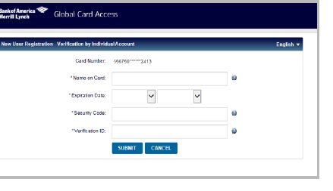
Global Card Access System
To register as a new user for Global Card Access, complete the following:
Access the Global Card Access website at https://spacardportal.works.com/gar/login
From the Global Card Access Login Screen, click Register Now
Enter your corporate card number or your company billing account number
Click Continue

Slide 7
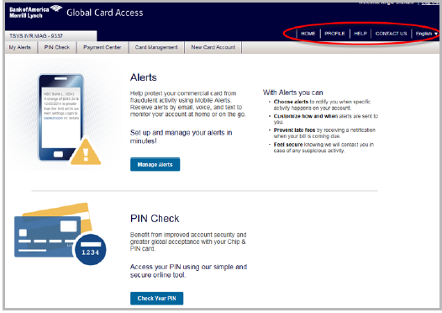
Global Card Access: Creating Your PIN and Alert Preferences
After creating a Global Card Access account, you will be taken to the Home Screen where you can create your PIN
Click PIN Check
Click Set Your PIN
Please be advised CWRU, Procurement department, and the PCard Administrator do not have access to your PIN
Setting your alert preferences
Click Manage Alerts
Customize your alert preferences to notify you of any suspicious activity, low-balance, etc
Provide your preference of text, email or phone call for notification

Slide 8
The Works System
Introduction To The Works System
Navigating The Works System

Slide 9
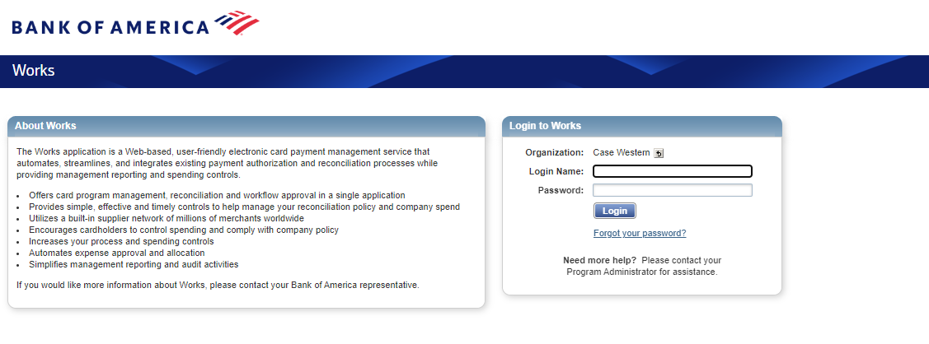
Works: Login Screen
For first time access, click the link provided in your Welcome Email. If you need another Welcome Email sent, please reach out to Pcard@case.edu
After you follow the prompts to set your password and security questions, you will be sent to the Login Screen

Slide 10
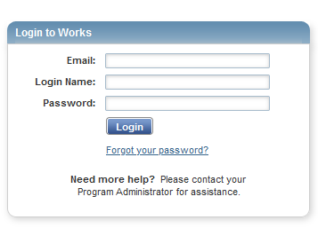
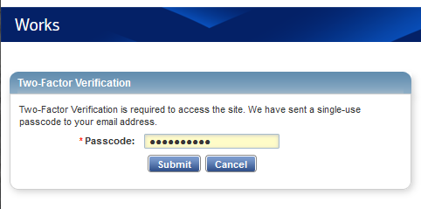
Works: Forgot Your Password
If you forget your email address and/or login name for the Works system, please contact the PCard Administrator at Pcard@case.edu
You can reset your password from the Works system login screen too
Click Forgot Password
Input your email and login name
Once you have input your email and login name, the Works system will email you a Two-Factor Verification code
Retrieve that code from your email and input it into the Two-Factor Verification field

Slide 11
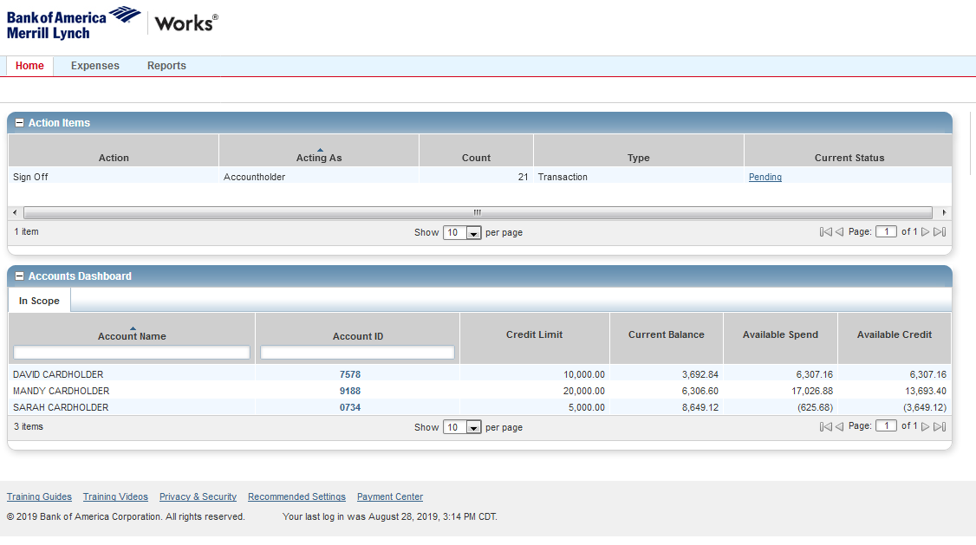
Works: Accounts Dashboard
The Accounts Dashboard lists the accounts you are authorized to use
Summary information for each account includes:
Credit limit
The credit limit is the total spend (or ceiling) allowed on the account during the month
Current Balance
Available Spend
Available Credit
The available credit is the calculated total of the credit limit minus the amount of money already spent this month
The Available Credit amount calculates only posted transactions. If you have outstanding authorizations that have not yet posted to Works, those amounts are not included in this total
To view the account address, Merchant Category Code Group (MCCG) descriptions and restrictions, Secondary Accountholder, or other account details, click the Account ID, then select View Full Details from the single-action

Slide 12
Works: Reviewing Transactions
To review transaction information
Hover your mouse over the Expenses tab and click Transactions
This will open a list of recent transactions

Slide 13
Works: Transaction Tab
The Transaction tab displays overall information pertaining to the selected transaction
Always enter a description for the transaction in the comment section because it can help identify charges
Example: Presentation material for Dr. Bob Smith’s NIH Conference

Slide 14
Works: Allocation & Detail Tab
You can locate all allocation information pertaining to your transaction from the Allocation & Detail tab

Slide 15
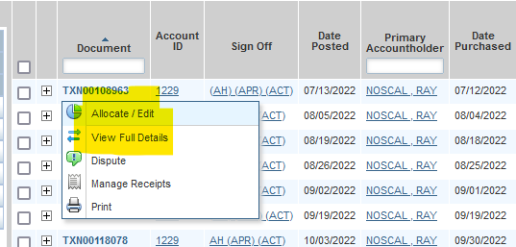
Works: Allocating Transactions
Allocating transactions allows you to
Charge your intended speed type
Select the correct account number
Enter a description of the transaction
How to allocate a transaction
Once you log into the Works system, you will see your transactions as pending under your Action Items
Once again, if you are a manager, you will also see the cardholder(s) you are responsible for
Click Pending
Hover your mouse over a transaction number to access the Transaction Menu
Click Allocate/Edit
You will see blank boxes in which you can type or select the appropriate account code for your transaction(s)
After you finish allocating, click Save and Allocate Next

Slide 16
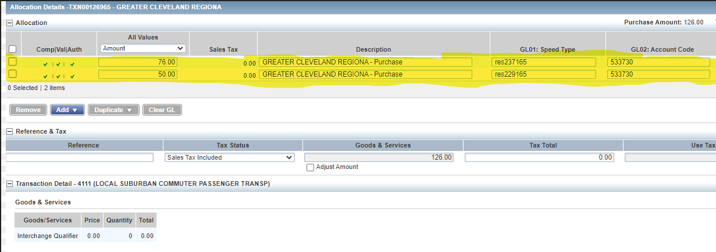
Works: Allocating Transactions
Adding multiple lines to your transaction allows you to split a charge among multiple speed types and/or accounts
Speed type and account can be changed per transaction
The Works system will divide your transaction evenly among the lines
Incorrectly split transactions will result in a variance
Variance is when transaction lines are imbalanced
Always sign off on your allocated transactions after they are adjusted
Examples of common allocation mistakes
Entering incorrect or unassigned speed types
Punctuation marks before or after the speed type
Spaces before or after the speed type

Slide 17
Works: Splitting Transactions
If a transaction consists of purchases that will be paid for by two or more speed types or accounts, a split must be created
Correctly split transaction
Distributing the total transaction amount among different speed types or accounts
Allocation total equals the purchase amount
Variance total is 0.00
Incorrectly split transaction
Attempting to purchase an item above your transaction limit by splitting the total into two acceptable purchases in your single transaction limit
Allocation total does not equal the purchase amount
Variance total is -63.00

Slide 18
Works: Signing Off
Once all transactions have been allocated, you will see all green check marks on the Transactions Screen. The Cardholder’s assigned Approver must sign-off on all allocated transactions
Check the boxes to the left of each transaction and then click Sign Off
If you need to add any comments, you will be prompted upon sign-off
It is required to click sign off in order to complete your Action Items
Transactions must be signed off for your monthly balance to reset
Example: If your monthly limit is 10K, and you don’t sign off for $6K of transactions, your balance the next month will start at $4K, not $10K

Slide 19
Resetting The Monthly Limit
Bank of America electronically charges the university for the total amount of transactions processed during the billing period
The Procurement office uses speed types in the Works system to create journal entries in the General Ledger, which distributes the charges back to the business units

Slide 20
Works: Dispute Tab
You can upload, review, and delete dispute information pertaining to your transaction from this Dispute tab

Slide 21
Works: Receipts
You can add, remove, or view receipts pertaining to your transaction from the Receipts tab
Always upload your receipts into the Works system
2

Slide 22
Works: Adding Receipts
Keep your paper receipts and store them in a safe place
Required for audits (must retain for 5 years)
Attach all image of receipt(s) onto your transactions on Works
Once you log into the Works system, go to the Expenses tab
Click transactions
Select the appropriate transaction that you wish to add the receipt to
A box will appear
Click Add
Click New Receipt
Select Browse
Locate image and upload new receipt
Note: Must be a .pdf, .png, .jpg, .gif, or .jpeg image
Select OK
Once the receipt is attached, the transaction will update from no to yes

Slide 23
Works: Creating Printable Statements
The Cardholder and assigned manager must both sign the printed monthly statement and upload it back into the Works System
On the Home Screen, hover over Reports
Click Template Library
Scroll down to Shared
Click Statement of Account Portrait
Click Modify/Run
If you are looking for the previous month. Check to see if the date listed is correct
If it is, click OK
If you need to change the date range, click the blue calendar icon and this will bring up a calendar with options
Generally you will want to set your date range for the previous cycle
On the bottom right, click Submit Report

Slide 24
Works: Opening Printable Statements & Troubleshooting
Opening Printable Statements
Once you create the printable statement, you will be taken to the completed Reports Screen
You can also navigate here by selecting Reports in the main menu, then clicking Completed
Click the Refresh button in Works until the Status reads ready
To download the statement, click PDF
Troubleshooting Printable Statement Issues
If you run the report and do not see cardholders/transactions you are expecting, start filtering by last name
Find the filter portion of the Modify/Edit Screen
Click the drop-down
On the left, in bold and italics, click Cardholder
Click CH Last Name
Add the last name of the person whose statement you are looking for
Click Submit Report
You cannot run multiple cardholders in one statement

Slide 25
Retaining Documentation
Download the monthly statement of account reports from the Works system
Shows splits and redistributions
Available in the Works system for 24 months
Sign (wet sign) the statement
Cardholder and Approver should both sign
File the statement with documentation
Save to both electronic and physical files
File the statement with receipts for the monthly cycle transactions
Retain all physical documentation for 5 years

Slide 26
Works: Locating Pending or Declined Transactions
On your Accounts Dashboard
Select the card with the last 4 digits of the account in question
Click View Auth Log
These are your processing transactions and declined transactions
If a fraudulent transaction occurs, please contact the Bank of America Fraud Department at 866.500.8262

