Slide 1

CWRU Consolidated Amazon Business Prime Account Training

Slide 2
CWRU Consolidated Amazon Business Prime Account Training
  CWRU Amazon Business Prime Program Overview
  Amazon Business Prime Payment Method
  Amazon Business Prime Registration
  Amazon Business Prime SSO Sign In
  CWRU’s Business Prime Restricted & Blocked Items
  Amazon Business Shopping Best Practices

Slide 3
CWRU Consolidated Amazon Business Prime Account Training
  CWRU Amazon Business Prime Program Overview
  Amazon Business Prime Payment Method
  Amazon Business Prime Registration
  Amazon Business Prime SSO Sign In
  CWRU’s Business Prime Restricted & Blocked Items
  Amazon Business Shopping Best Practices

Slide 4
CWRU’s Consolidated Amazon Business Prime Account
Amazon Business Prime is not a preferred vendor for CWRU and should be a vendor of last resort after consulting preferred vendors and vendors in SmartCART.
Case Western Reserve University’s Amazon Business Prime Account offers many business-specific benefits:
  Free Shipping
  Tax-exempt purchasing (NOTE: not all marketplace sellers honor tax-exempt purchasing. Choose a different item if the marketplace sellers does not accept our tax-exempt certificate)
  Business-specific and bulk pricing
  Access to millions of additional products, available to only Business Customer
  Free Amazon Business Prime Membership - If your department previously purchased a Prime Membership, it will be proactively refunded when you transfer the account to our CWRU Consolidate Amazon Business Prime Account
  CWRU SSO login

Slide 5
CWRU Consolidated Amazon Business Prime Account Training
  CWRU Amazon Business Prime Program Overview
  Amazon Business Prime Payment Method
  Amazon Business Prime Registration
  Amazon Business Prime SSO Sign In
  CWRU’s Business Prime Restricted & Blocked Items
  Amazon Business Shopping Best Practices

Slide 6

Amazon Business Prime Payment Method
Payment Method
  PCard Only (limited exceptions may apply. Contact us for questions)
  Effective November 1, 2022 - PCard transactions made outside of consolidated Amazon Business Prime are against the revised PCard policy and are grounds for PCard suspension. https://case.edu/compliance/university-policies
Please contact pcard@case.edu or visit https://case.edu/procurement/purchasing/procurement-card-suite for additional information pertaining to the PCard

Slide 7
CWRU Consolidated Amazon Business Prime Account Training
  CWRU Amazon Business Prime Program Overview
  Amazon Business Prime Payment Method
  Amazon Business Prime Registration
  Amazon Business Prime SSO Sign In
  CWRU’s Business Prime Restricted & Blocked Items
  Amazon Business Shopping Best Practices

Slide 8
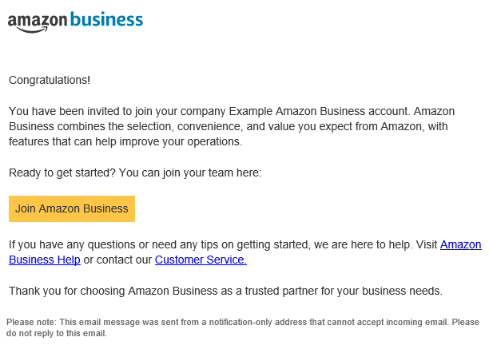
CWRU’s Consolidated Amazon Business Prime Account Registration
Account Invitation
  You will receive an email invitation on “DATE” to your CWRU email.
  Click on the “Join Amazon Business” link in the email to ensure you have access to your Amazon Business Account
  If you don’t take action within 90 days, your invitation will expire

Slide 9
Amazon Business Registration
Depending on how you have used your CWRU email on Amazon in the past, you will be prompted through a corresponding registration flow.
It goes against university policy to use your CWRU email for personal purchases
Scenario Type | Objective
New User | Has never used an @CWRU.edu email domain on any Amazon account
Existing Amazon account used for Business Purchases | Amazon User has @CWRU.edu email linked to Amazon. Since you have only made business purchases in the past, your order history and account information should be converted / migrated to the centralized Business Account
Existing Amazon account used for Personal Purchases | Amazon User has @CWRU.edu email linked to Amazon. Since you have made personal purchases, you would like to transfer all previous order history and account information to a personal email, and start a clear profile in the new centralized Business Account

Slide 10
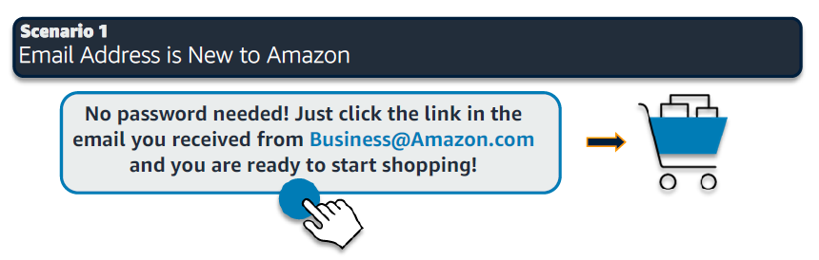
CWRU’s Consolidated Amazon Business Prime Account Registration
Scenario 1
  New User: Has never used an @CWRU.edu email domain on any Amazon account
If you have issues migrating your Amazon or Amazon Business account to the CWRU Amazon Business account, you can contact their customer support at www.amazon.com/gp/help/contact-us OR 888.281.3847

Slide 11
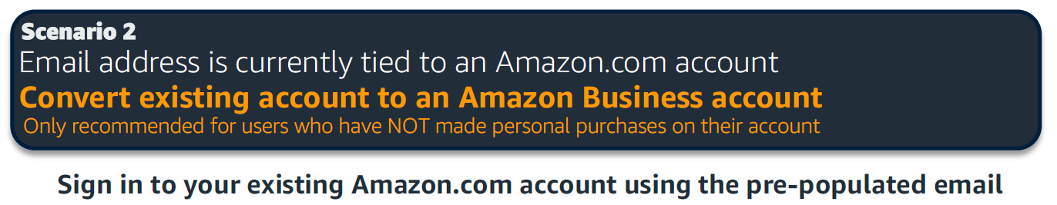
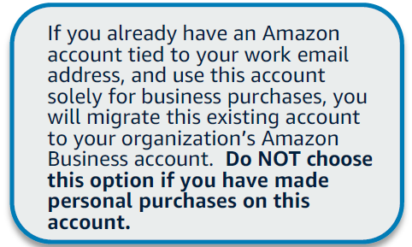
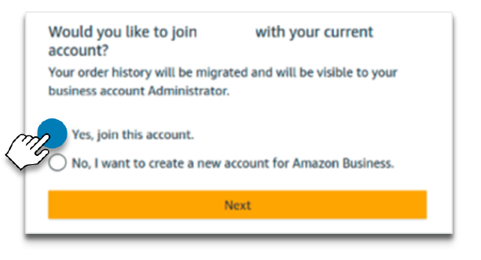
CWRU’s Consolidated Amazon Business Prime Account Registration
Scenario 2
  Existing Amazon account used for Business Purchases: Amazon User has @CWRU.edu email linked to Amazon. Since you have only made business purchases in the past, your order history and account information should be converted / migrated to the centralized Business Account

Slide 12
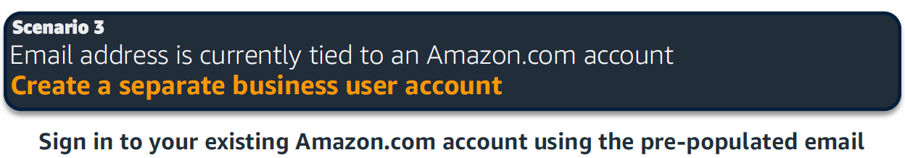
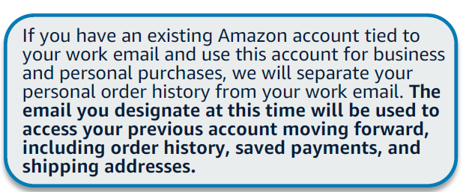
CWRU’s Consolidated Amazon Business Prime Account Registration
Scenario 3
  Existing Amazon account used for Personal Purchases: Amazon User has @CWRU.edu email linked to Amazon. Since you have made personal purchases, you would like to transfer all previous order history and account information to a personal email, and start a clear profile in the new centralized Business Account

Slide 13

CWRU’s Consolidated Amazon Business Prime Account Registration
  The CWRU Procurement department does not have access to Amazon’s accounts database. You will need to contact Amazon directly to troubleshoot issues with your account migration.
  If you have issues migrating your Amazon to the CWRU Amazon Business account, contact
  Amazon Business Customer Support at www.amazon.com/gp/help/contact-us OR 866.486.2360

Slide 14
CWRU Consolidated Amazon Business Prime Account Training
  CWRU Amazon Business Prime Program Overview
  Amazon Business Prime Payment Method
  Amazon Business Prime Registration
  Amazon Business Prime SSO Sign In
  CWRU’s Business Prime Restricted & Blocked Items
  Amazon Business Shopping Best Practices

Slide 15
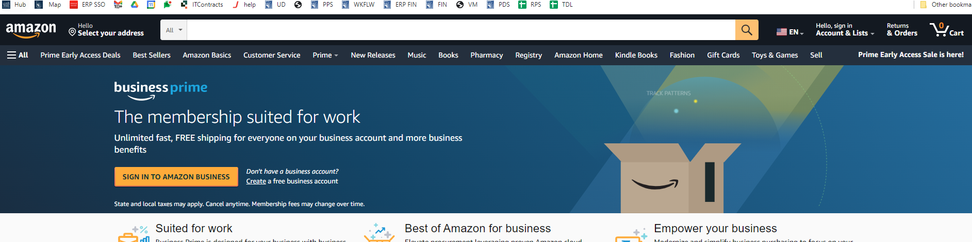
Amazon Business Prime SSO Sign in
Step 1
  Click on “Sign In”
  To sign into Amazon Business Prime use link: https://www.amazon.com/businessprime

Slide 16
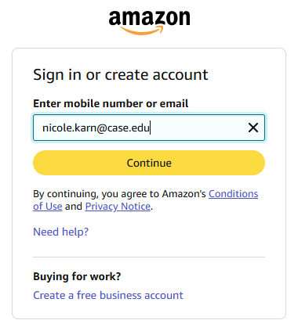
Amazon Business Prime SSO Sign In
Step 2
  Enter your firstname.lastname@case.edu Case Email to Login.

Slide 17
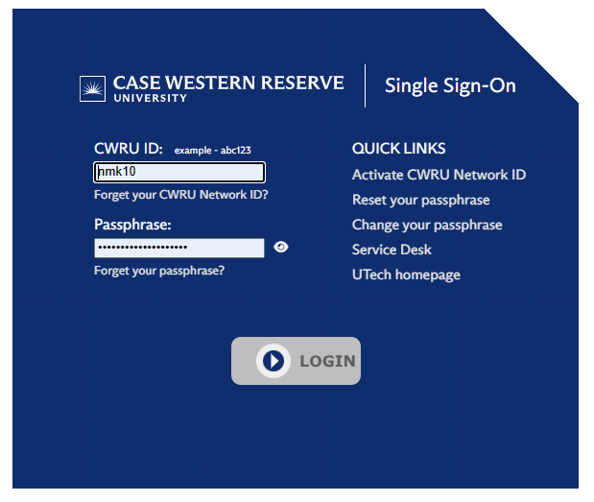

Amazon Business Prime SSO Sign In
Step 3
  You will be prompted to Sign into CWRU’s SSO Portal
If you are not prompted to CWRU Single Sign-On, then you are not using the Consolidated Amazon Business Prime Account

Slide 18
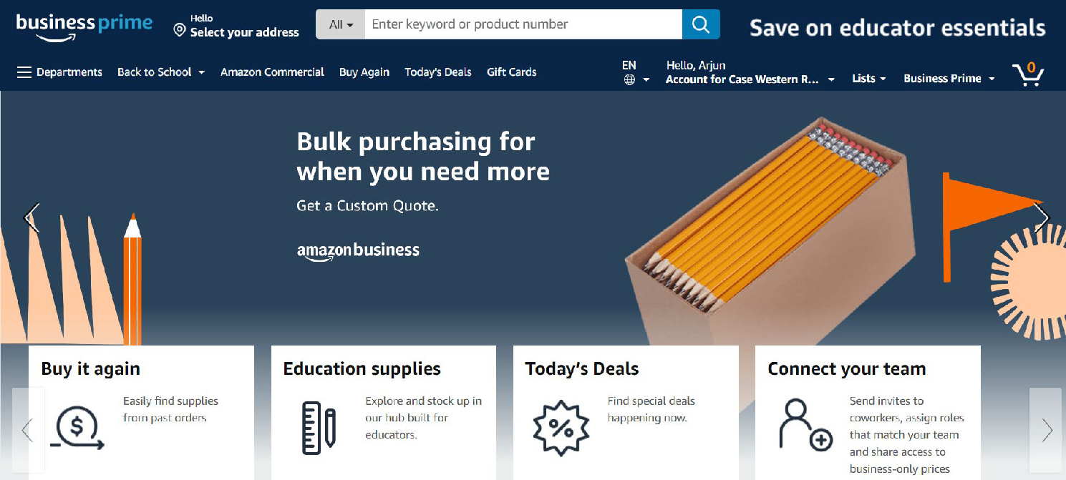
Amazon Business Prime SSO Sign In
  Step 4
  Once you successfully log into CWRU’s SSO Portal you will be routed to Amazon Business Prime Home Page

Slide 19
CWRU Consolidated Amazon Business Prime Account Training
  CWRU Amazon Business Prime Program Overview
  Amazon Business Prime Payment Method
  Amazon Business Prime Registration
  Amazon Business Prime SSO Sign In
  CWRU’s Business Prime Restricted & Blocked Items
  Amazon Business Shopping Best Practices

Slide 20
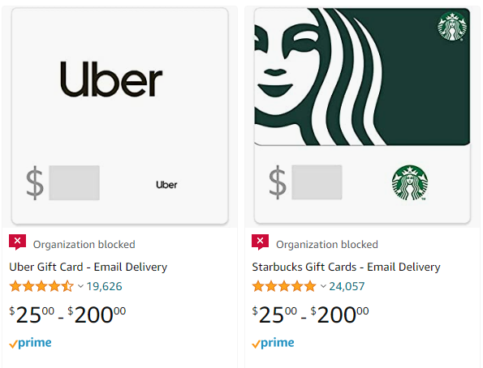
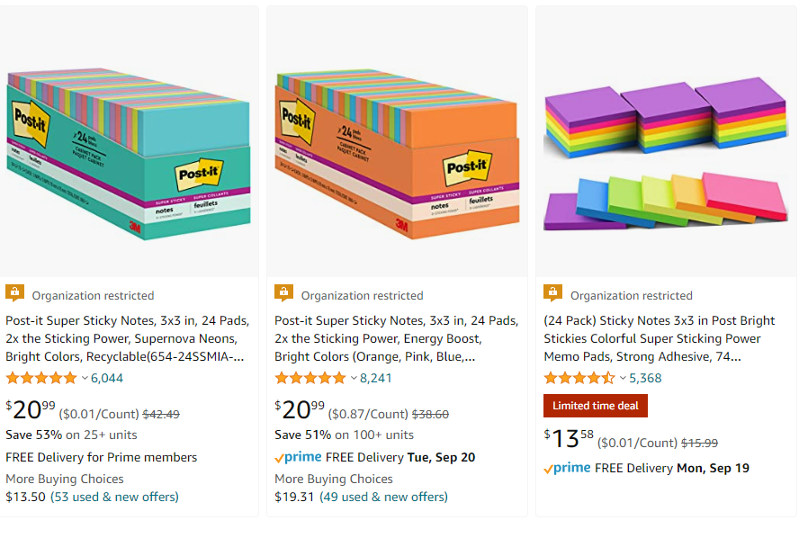
CWRU’s Restricted Items & Blocked Items
Case Western Reserve University has Restricted and Blocked certain product categories based on University’s Buying Policies.

Slide 21

CWRU’s Restricted Items & Blocked Items
  Restricted Items:
  These items usually belong to categories found in SmartCART
  During the checkout process, you will be prompted to explain the reason for the purchase. If approved, you can check out. Common reasons may include the item is unavailable on SmartCART or the pricing is better than a preferred vendor
  Examples of Restricted Items
  Office Supplies
  Electronics Supplies
  Furniture
  Test kits
  Medical devices that might predict human healthcare outcomes
Please contact pcard@case.edu for additional guidance.

Slide 22

CWRU’s Restricted Items & Blocked Items
  Blocked Items:
  These items cannot be purchased from CWRU’s Amazon Business Prime account
  Example of Blocked Items:
  Live Animals
  Adult Products
  Alcohol
  Gift Cards
  Covid Test Kits
  Drugs and Pharmaceutical Products
  Debarred Vendors
Please contact pcard@case.edu for additional guidance.

Slide 23
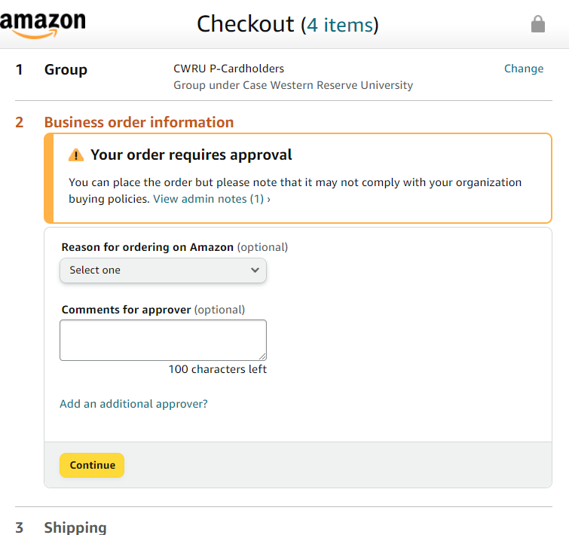
Order Approvals
All Amazon Business Prime orders are reviewed by Procurement and spot checked for compliance with:
  University policy, PCard Policy, price comparison to SmartCART vendors, and risk concerns
  The typical review takes less than 3 business days
Enter how much you are saving if you are purchasing items on Amazon because the pricing is better than a preferred vendor on SmartCART
  Comments to the approver can expedite the review process
$35 less than Staples

Slide 24
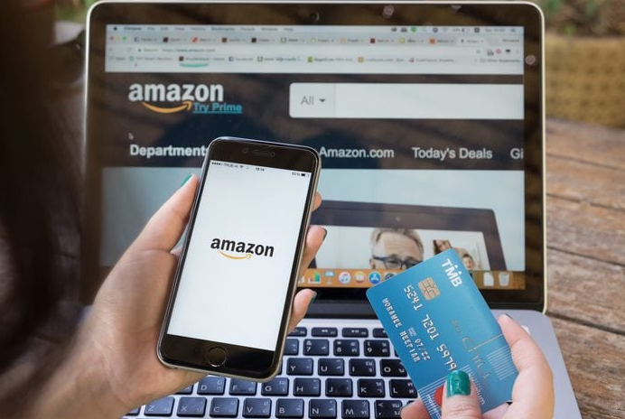
Additional Information
  Marketplaces are notorious for fake and counterfeit items
  We highly discourage the purchase of medical devices and equipment through marketplaces
  Items supporting human health and safety outcomes should be purchased from a reputable medical supply vendor
  Items of concern will be reviewed on a case-by-case basis
  Not all marketplace vendors on Amazon are required to participate in offering tax exemptions.
  Taxable purchases are not permitted on a PCard
  Individual orders may be permitted on a case-by-case basis

Slide 25
CWRU Consolidated Amazon Business Prime Account Training
  CWRU Amazon Business Prime Program Overview
  Amazon Business Prime Payment Method
  Amazon Business Prime Registration
  Amazon Business Prime SSO Sign In
  CWRU’s Business Prime Restricted & Blocked Items
  Amazon Business Shopping Best Practices

Slide 26
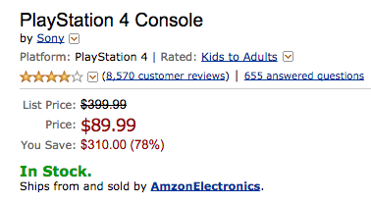
Amazon Business Shopping Best Practices
Amazon Business, like many marketplaces (examples: Amazon.com, Ebay, Walmart.com, Etsy, etc), is a mucky mess of ads, unknown sellers, misleading sales, and specious information. Defend your dollars with these tips and tricks.
  Buy from Reputable Sellers
  Avoid Fake Discounts
  Don’t Trust Every Review
  Avoid phishing scams
More Tips: https://www.wired.com/story/how-shop-safe-amazon/

Slide 27
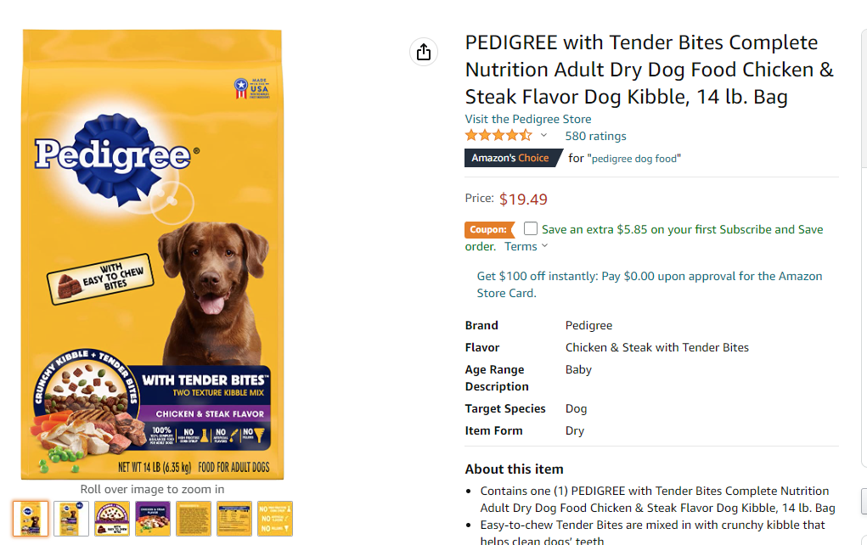
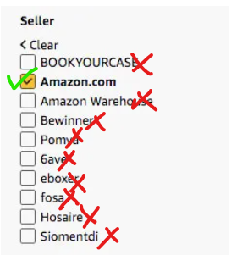
Amazon Business Shopping Best Practices #1 Buy From a Reputable Seller
  Choose items sold by the manufacturer or “Sold and Shipped by Amazon”. This ensures a higher likelihood you are receiving higher quality items and reduces the likelihood of you receiving fake, counterfeit, low-quality, or expired products
  Purchasing from a reputable seller means you will likely have a better customer service experience when reporting issues to Amazon Business and require a return or credit for the purchase

Slide 28
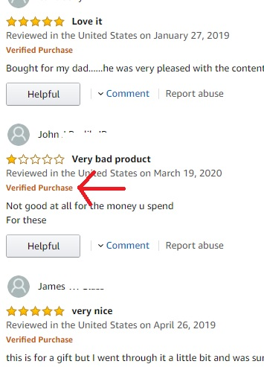
Amazon Business Shopping Best Practices Additional Tips
  Avoid Fake Discounts - When people see that a product they like is on sale, a little wave of excitement washes over them. Instead of thinking about how much we’re spending, we start to think about how much we’re saving, or winning. Coupons and discounts exist because they create a sense of urgency that causes many people to buy things they normally wouldn’t.
  Don’t Trust Every Review - Amazon's 5-star review system is supposed to make choosing products simpler, but it's easily gamed. If you’re looking at an expensive product from a company you’ve never heard of, or if there are hundreds or thousands of very positive reviews, do a little sleuthing. Many sellers try to manipulate reviews to get their products listed more prominently on Amazon. Examine the basic stuff too, - check the manufacturer and product, check the seller’s name, and check if the product is fulfilled by Amazon
  Avoid phishing scams - Amazon/Amazon Business is the most popular online retailer. A good rule of thumb is to not click links in an email unless YOU know it was sent by Amazon Business and were expecting the email.
More Tips: https://www.wired.com/story/how-shop-safe-amazon/

Slide 29

3 Things to Remember
  The university pays for the centralized Amazon Business Prime Membership
  PCard is the only Payment Method. Starting Jan 1, 2022, no Amazon or Amazon Business purchases will be reimbursable through T&E
  Lookout for Restricted and Blocked Items

