Slide 1

CWRU Works System Training For PCard Users

Slide 2
The Works System
Introduction To The Works System
Navigating The Works System

Slide 3
The Works System
Introduction To The Works System
Navigating The Works System

Slide 4


What Is The Works System
The Works system is a web-based application provided by the Bank of America that offers a complete set of features which enables organizations to automate its existing processes for purchasing goods and making payments with credit card accounts.
Works provides real-time purchasing card administration, purchase request approval workflow, and a post-purchase reconciliation process that adheres to the university’s existing payment process workflow and internal purchasing policies
https://payment2works.com

Slide 5

PCard Activation
You will receive a welcome email from the Bank of America
  If you do not receive this welcome email, please email the PCard Administrator at Pcard@case.edu
Once received, click on the link and set your password and security questions
  Save the Works link in your favorites
Quick tips:
  Activation Line: 888-233-8855
  please email the PCard Administrator at Pcard@case.edu for your Verification ID
  The system will prompt you to create a PIN
Cardholders will activate their card using the Global Card Access system

Slide 6
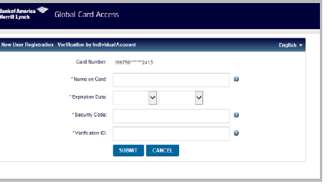
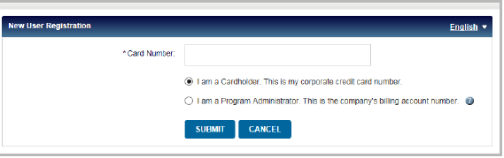
Global Card Access System
To register as a new user for Global Card Access, complete the following:
  Access the Global Card Access website at https://spacardportal.works.com/gar/login
  From the Global Card Access Login Screen, click Register Now
  Enter your corporate card number or your company billing account number
  Click Continue

Slide 7
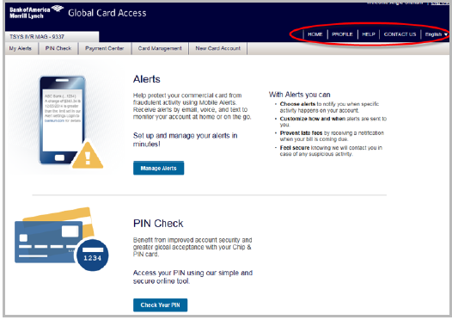
Global Card Access: Creating Your PIN and Alert Preferences
After creating a Global Card Access account, you will be taken to the Home Screen where you can create your PIN
  Click PIN Check
  Click Set Your PIN
  Please be advised CWRU, Procurement department, and the PCard Administrator do not have access to your PIN
  Setting your alert preferences
  Click Manage Alerts
  Customize your alert preferences to notify you of any suspicious activity, low-balance, etc
    Provide your preference of text, email or phone call for notification

Slide 8
The Works System
Introduction To The Works System
Navigating The Works System

Slide 9
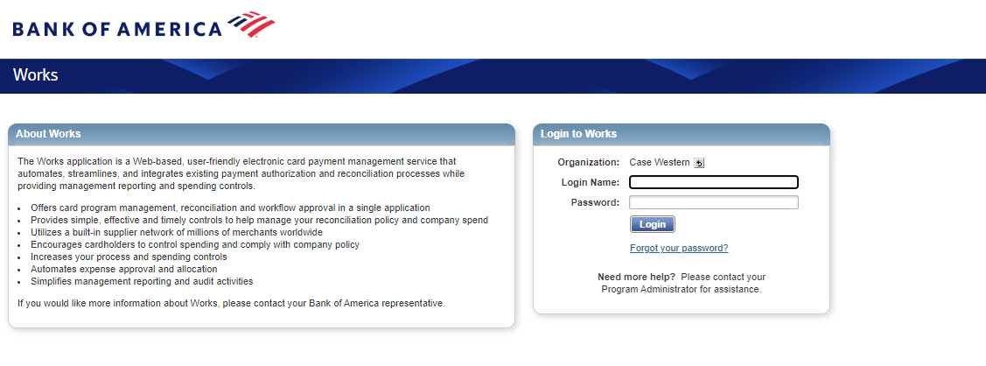
Works: Login Screen
  For first time access, click the link provided in your Welcome Email. If you need another Welcome Email sent, please reach out to Pcard@case.edu
  After you follow the prompts to set your password and security questions, you will be sent to the Login Screen

Slide 10
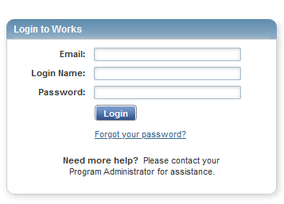
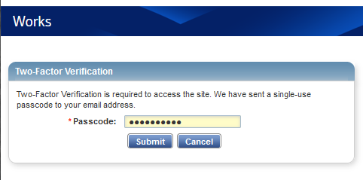
Works: Forgot Your Password
If you forget your email address and/or login name for the Works system, please contact the PCard Administrator at Pcard@case.edu
You can reset your password from the Works system login screen too
  Click Forgot Password
  Input your email and login name
  Once you have input your email and login name, the Works system will email you a Two-Factor Verification code
  Retrieve that code from your email and input it into the Two-Factor Verification field

Slide 11
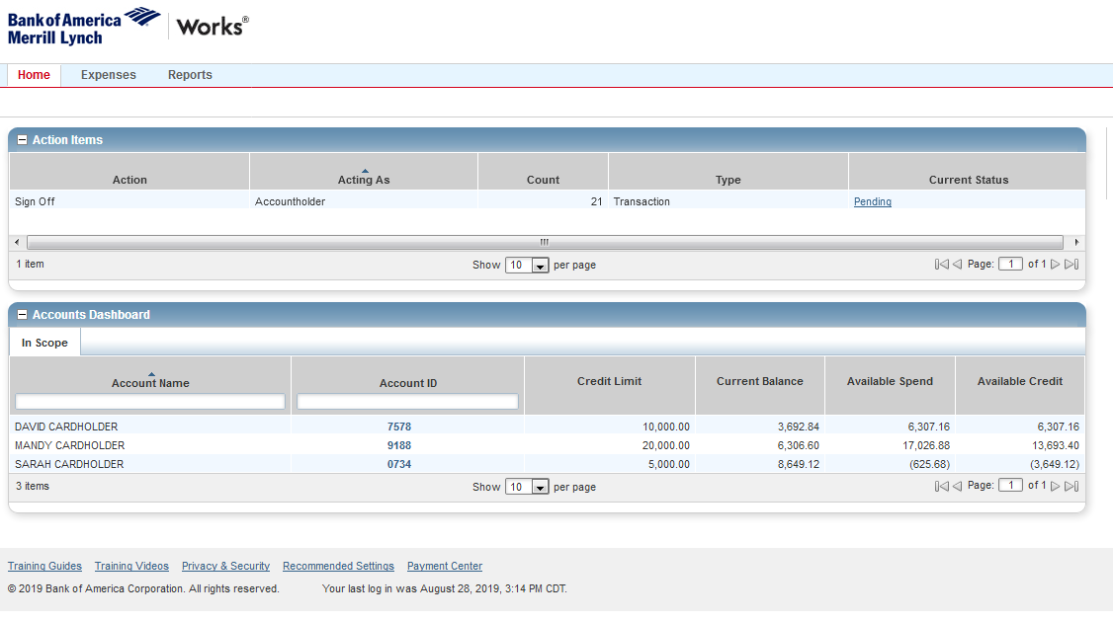
Works: Accounts Dashboard
The Accounts Dashboard lists the accounts you are authorized to use
  Summary information for each account includes:
  Credit limit
    The credit limit is the total spend (or ceiling) allowed on the account during the month
  Current Balance
  Available Spend
  Available Credit
    The available credit is the calculated total of the credit limit minus the amount of money already spent this month
    The Available Credit amount calculates only posted transactions. If you have outstanding authorizations that have not yet posted to Works, those amounts are not included in this total
  To view the account address, Merchant Category Code Group (MCCG) descriptions and restrictions, Secondary Accountholder, or other account details, click the Account ID, then select View Full Details from the single-action

Slide 12
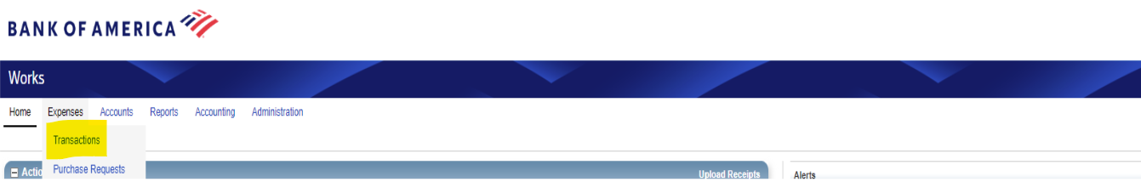
Works: Reviewing Transactions
To review transaction information
Hover your mouse over the Expenses tab and click Transactions
This will open a list of recent transactions

Slide 13
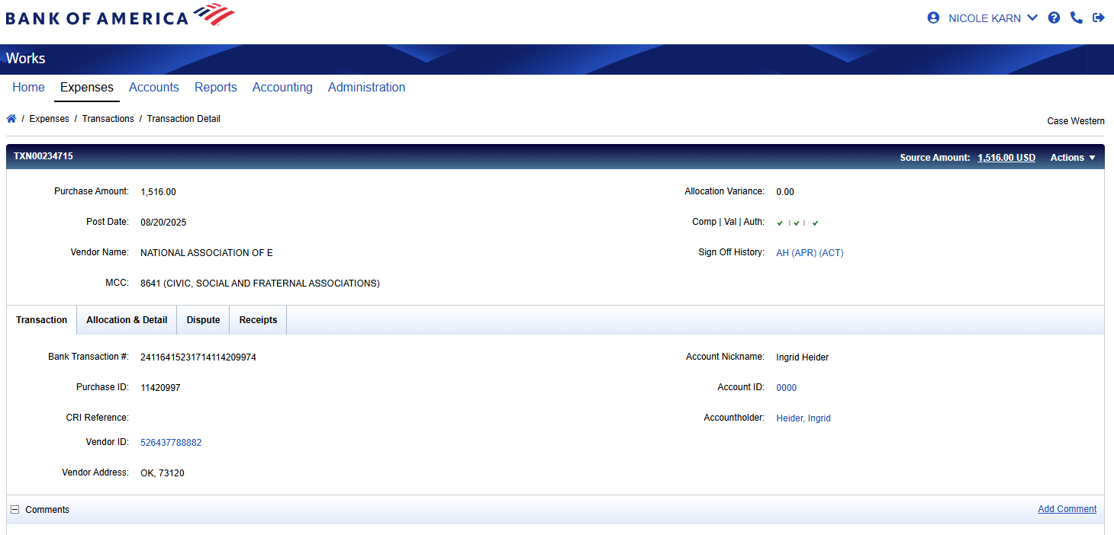

Works: Transaction Tab
The Transaction tab displays overall information pertaining to the selected transaction
Always enter a description for the transaction in the comment section because it can help identify charges
  Example: Presentation material for Dr. Bob Smith’s NIH Conference

Slide 14
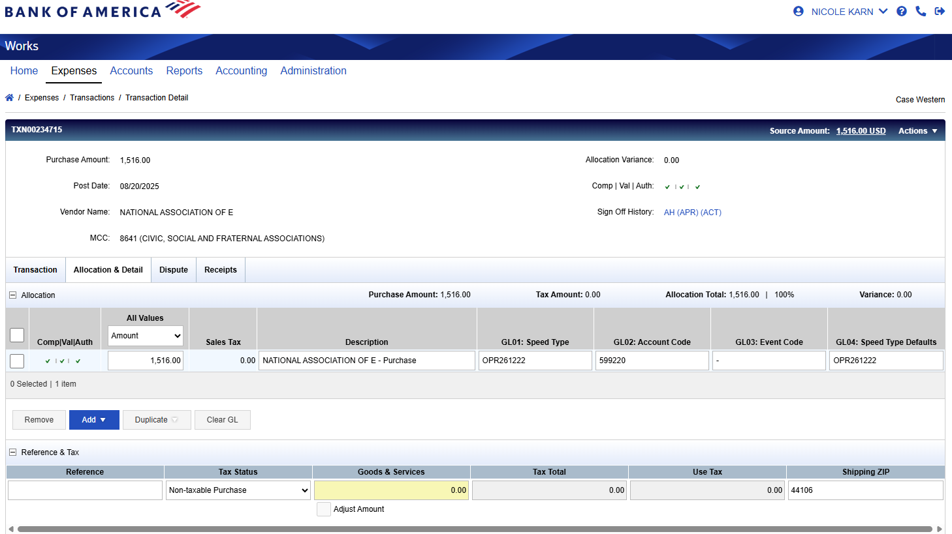

Works: Allocation & Detail Tab
You can locate all allocation information pertaining to your transaction from the Allocation & Detail tab

Slide 15
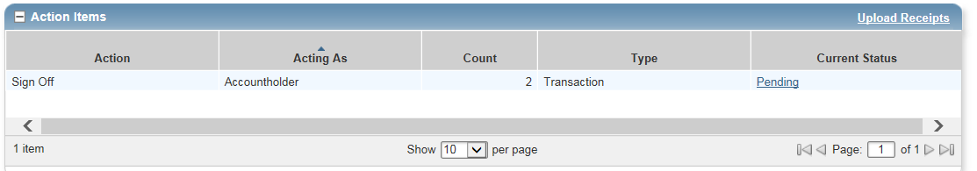
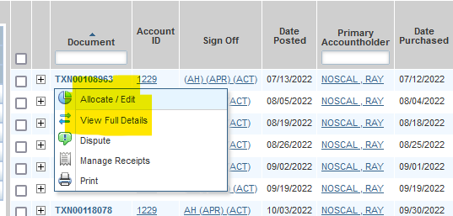
Works: Allocating Transactions
Allocating transactions allows you to
  Charge your intended speed type
  Select the correct account number
  Enter a description of the transaction
How to allocate a transaction
  Once you log into the Works system, you will see your transactions as pending under your Action Items
    Once again, if you are a manager, you will also see the cardholder(s) you are responsible for
  Click Pending
  Hover your mouse over a transaction number to access the Transaction Menu
  Click Allocate/Edit
  You will see blank boxes in which you can type or select the appropriate account code for your transaction(s)
  After you finish allocating, click Save and Allocate Next

Slide 16
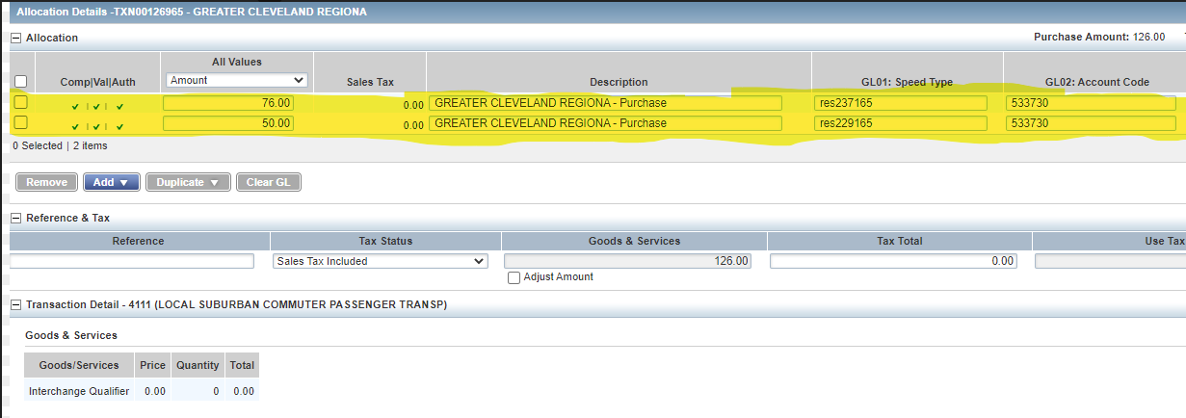
Works: Allocating Transactions
Adding multiple lines to your transaction allows you to split a charge among multiple speed types and/or accounts
  Speed type and account can be changed per transaction
  The Works system will divide your transaction evenly among the lines
Incorrectly split transactions will result in a variance
  Variance is when transaction lines are imbalanced
Always sign off on your allocated transactions after they are adjusted
Examples of common allocation mistakes
  Entering incorrect or unassigned speed types
  Punctuation marks before or after the speed type
  Spaces before or after the speed type

Slide 17
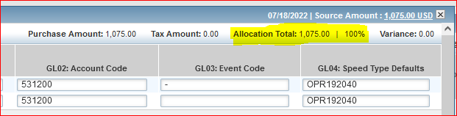
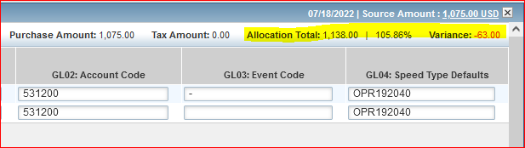
Works: Splitting Transactions
If a transaction consists of purchases that will be paid for by two or more speed types or accounts, a split must be created
Correctly split transaction
  Distributing the total transaction amount among different speed types or accounts
  Allocation total equals the purchase amount
  Variance total is 0.00
Incorrectly split transaction
  Attempting to purchase an item above your transaction limit by splitting the total into two acceptable purchases in your single transaction limit
  Allocation total does not equal the purchase amount
  Variance total is -63.00

Slide 18
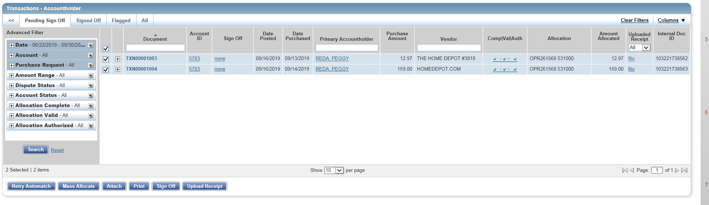
Works: Signing Off
Once all transactions have been allocated, you will see all green check marks on the Transactions Screen. The Cardholder’s assigned Approver must sign-off on all allocated transactions
Check the boxes to the left of each transaction and then click Sign Off
  If you need to add any comments, you will be prompted upon sign-off
  It is required to click sign off in order to complete your Action Items
Transactions must be signed off for your monthly balance to reset
  Example: If your monthly limit is 10K, and you don’t sign off for $6K of transactions, your balance the next month will start at $4K, not $10K

Slide 19

Resetting The Monthly Limit
Bank of America electronically charges the university for the total amount of transactions processed during the billing period
The Procurement office uses speed types in the Works system to create journal entries in the General Ledger, which distributes the charges back to the business units

Slide 20

Works: Dispute Tab
You can upload, review, and delete dispute information pertaining to your transaction from this Dispute tab

Slide 21
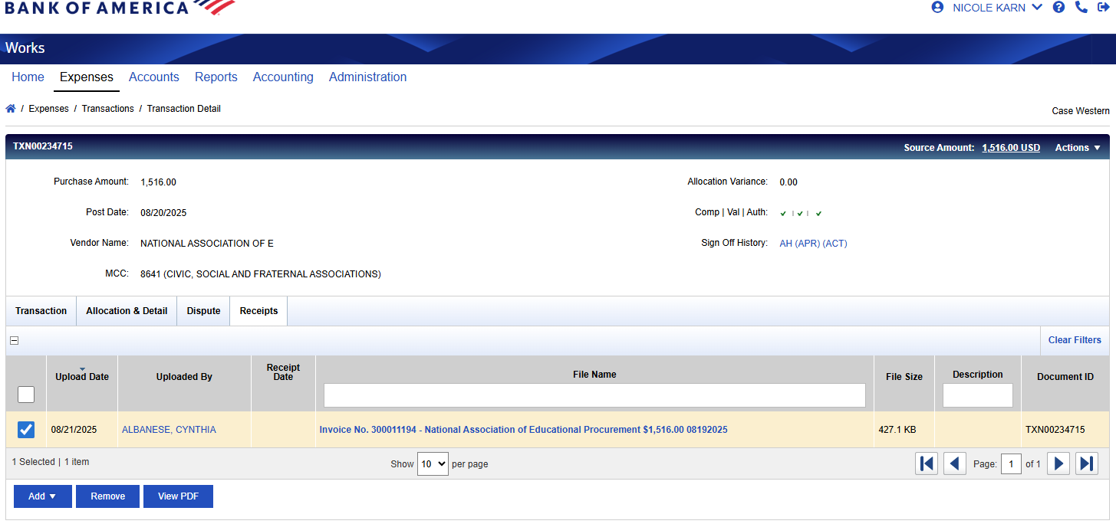


Works: Receipts
You can add, remove, or view receipts pertaining to your transaction from the Receipts tab
Always upload your receipts into the Works system

Slide 22
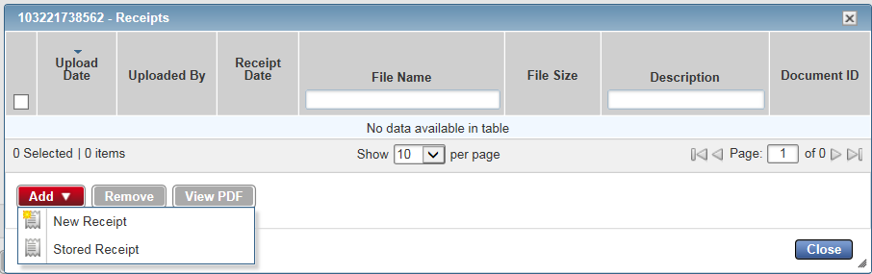
Works: Adding Receipts
Keep your paper receipts and store them in a safe place
  Required for audits (must retain for 5 years)
Attach all image of receipt(s) onto your transactions on Works
  Once you log into the Works system, go to the Expenses tab
  Click transactions
  Select the appropriate transaction that you wish to add the receipt to
  A box will appear
  Click Add
  Click New Receipt
  Select Browse
  Locate image and upload new receipt
    Note: Must be a .pdf, .png, .jpg, .gif, or .jpeg image
  Select OK
  Once the receipt is attached, the transaction will update from no to yes

Slide 23
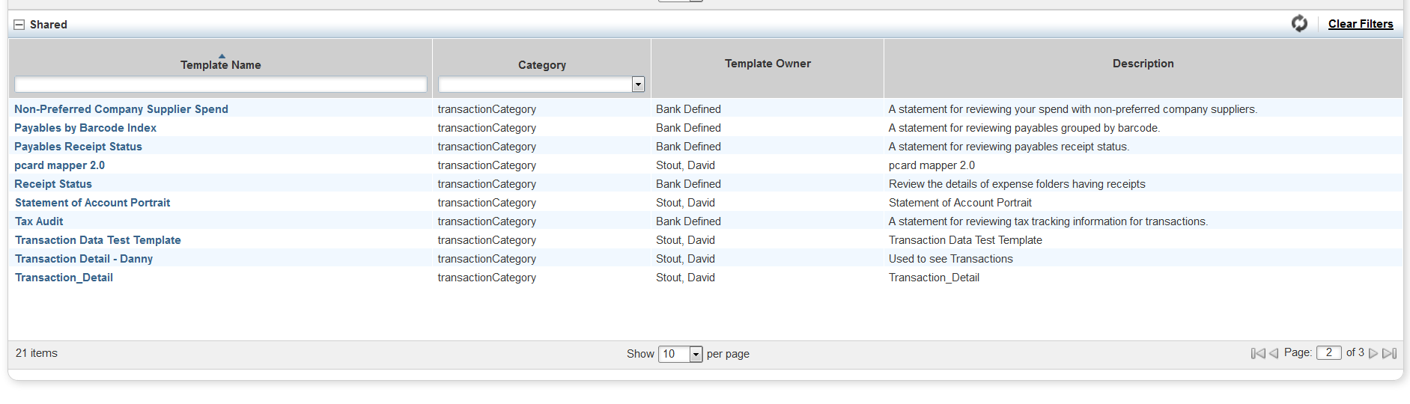
Works: Creating Printable Statements
The Cardholder and assigned manager must both sign the printed monthly statement and upload it back into the Works System
On the Home Screen, hover over Reports
Click Template Library
Scroll down to Shared
Click Statement of Account Portrait
Click Modify/Run
If you are looking for the previous month. Check to see if the date listed is correct
  If it is, click OK
  If you need to change the date range, click the blue calendar icon and this will bring up a calendar with options
  Generally you will want to set your date range for the previous cycle
On the bottom right, click Submit Report

Slide 24
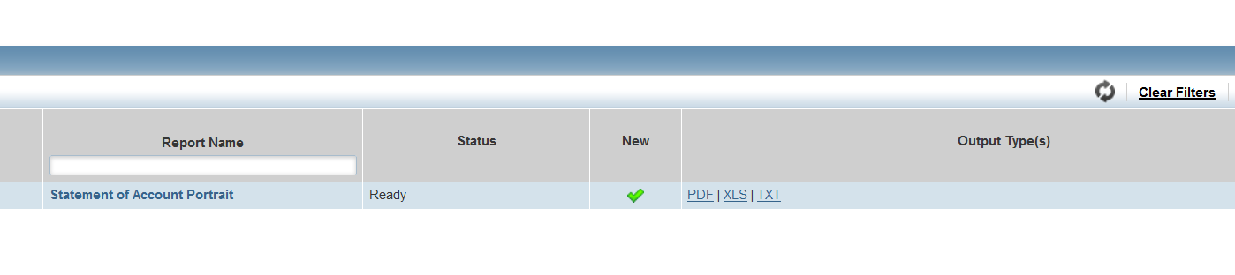
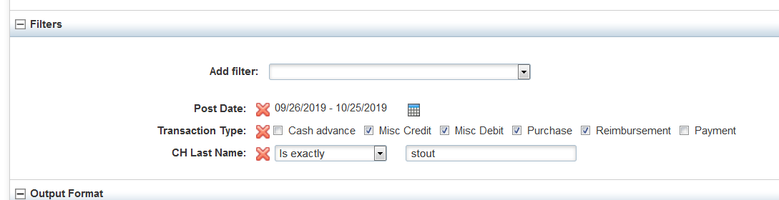
Works: Opening Printable Statements & Troubleshooting
Opening Printable Statements
Once you create the printable statement, you will be taken to the completed Reports Screen
  You can also navigate here by selecting Reports in the main menu, then clicking Completed
Click the Refresh button in Works until the Status reads ready
To download the statement, click PDF
Troubleshooting Printable Statement Issues
If you run the report and do not see cardholders/transactions you are expecting, start filtering by last name
  Find the filter portion of the Modify/Edit Screen
  Click the drop-down
  On the left, in bold and italics, click Cardholder
  Click CH Last Name
  Add the last name of the person whose statement you are looking for
  Click Submit Report
    You cannot run multiple cardholders in one statement

Slide 25

Retaining Documentation
Download the monthly statement of account reports from the Works system
  Shows splits and redistributions
  Available in the Works system for 24 months
Sign (wet sign) the statement
  Cardholder and Approver should both sign
File the statement with documentation
  Save to both electronic and physical files
  File the statement with receipts for the monthly cycle transactions
  Retain all physical documentation for 5 years

Slide 26
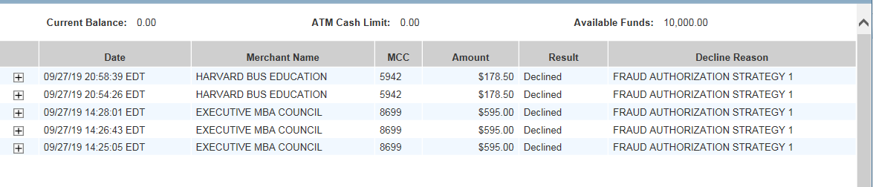
Works: Locating Pending or Declined Transactions
On your Accounts Dashboard
    Select the card with the last 4 digits of the account in question
Click View Auth Log
  These are your processing transactions and declined transactions
  If a fraudulent transaction occurs, please contact the Bank of America Fraud Department at 866.500.8262

