Slide 1

CWRU PCard Training

Slide 2
Procurement Cards & The PCard
Procurement Cards
Becoming a PCard Cardholder
Using the PCard
Responsibilities

Slide 3
Procurement Cards & The PCard
Procurement Cards
Becoming a PCard Cardholder
Using the PCard
Responsibilities

Slide 4

Procurement Cards
There are three different Procurement cards offered at CWRU.
  Procurement Card (PCard) - Used for small-dollar goods and services issued to an individual
  Departmental Card (DCard) - Used for food and beverage needs (under $500) in service of a department
  Travel and Expense Card (T&E) – Available at no fee and can be used for approved business travel as long as the individual remains on the CWRU payroll
Every payment method at CWRU has its own purchasing guidelines and restrictions
Cardholders must be CWRU employees
  Temporary employees will not be issued cards
  Cards issued to employees of CWRU affiliate institutions will remain active until either termination of employment or reassignment of duties in relation to CWRU
  New cards will not be issued to any non-CWRU employee

Slide 5

Procurement Card
Referred to as PCard
A Visa charge card that is maintained by Bank of America, issued to the university, and assigned to an individual as needed
The university is liable for the payment of monthly transactions
The card is administered by Procurement and Distribution Services
For business related small-dollar goods and services needed by individuals or their department
  For example: Professional memberships, conference registration fees (not including lodging), teaching materials, books, periodicals, and supplies
Accepted universally
  At supplier’s location (with PIN)
  Over the phone
  Via secure websites

Slide 6

Departmental Card
Referred to as DCard
Visa charge card issued by Bank of America to CWRU
Designed for use by department employees for low-cost food and food service products that support the mission of the department
Assigned to an entire department, not an individual, and managed by a custodian
Users can spend up to $500 per transaction
Departments can spend up to $5000 per month
The card is administered by Procurement and Distribution Services
It is subject to similar Procurement Card (PCard) Policies
  Billing process
  Cardholder responsibilities
Food and service must be used on campus
Food purchased from the Jolly Scholar can be eaten at the restaurant or in your office
The DCard cannot be used for dining out at any other restaurant or establishment

Slide 7
Travel & Expense Card
Often Referred to as a T&E Card
Issued by American Express
The T&E Card is available at no fee and can be used for approved business travel as long as the individual remains on the CWRU payroll
  The T&E Card can be used with the Peoplesoft Travel and Expense Module to facilitate and expedite direct payment of approved expenses to American Express
  Personal (non-CWRU business) charges are prohibited
Every T&E Cardholder is responsible for
  Proper use of the T&E Card according to policy
  Reconciling charged expenses in a timely manner
  Ensuring timely payment of charges regardless of the status of any outstanding expenses
  Remitting payment directly to American Express for any unapproved or non-reimbursable expenses placed on the card
  Handling American Express late fees and/or delinquency charges
    If there is not timely, correct submission of expense reporting into PeopleSoft. No balances can be carried month-to-month
Misuse of the card may result in
  Card suspension
  Card revocation
  Other actions by the university
  You can learn additional information pertaining to the T&E Card at https://case.edu/travel/travel-resources/travel-policy or email Travel@case.edu

Slide 8
Procurement Cards & The PCard
Procurement Cards
Becoming a PCard Cardholder
Using the PCard
Responsibilities

Slide 9
Becoming a PCard Cardholder
Your personal credit information is not used or affected
You are responsible for complying with the policies and procedures set forth in the PCard Policy
After the appropriate authority has designated an employee as a Cardholder, all Cardholders must:
  Arrange and complete orientation training. Your card application won’t be processed until training is completed with a passing score (above 90%)
  Complete a PCard Application
    Forms are located at https://case.edu/procurement/purchasing/procurement-card-suite/p-card-resources
    The university requires authenticated signatures (Wet signature or third party authenticated signatures liked DocuSign) when extending their credit line
New PCards will be mailed from the bank directly to Procurement and be available for pickup at the Cashier’s Office
The PCard Administrator will notify the Cardholder when the card is ready for pickup
Cards not picked up and activated from the Cashier’s Office within 30 days are subject to having the card deactivated and the Cardholder having to reapply for a new card
See https://case.edu/procurement/purchasing/procurement-card-suite/p-card-resources and email Pcard@case.edu with any questions

Slide 10
Procurement Cards & The PCard
Procurement Cards
Becoming a PCard Cardholder
Using the PCard
Responsibilities

Slide 11
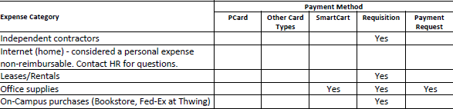
Using the PCard: How to Pay Matrix
The How to Pay Matrix is meant to be an example guideline for the most popular categories and is not an all-inclusive list
Any purchases requiring a contract or signature of any kind must be made on a requisition
Please refrain from downloading this matrix because of constant adjustments
You can see the full Matrix on https://case.edu/procurement/purchasing/procurement-card-suite/p-card-resources

Slide 12

Using the PCard: Prohibited Charges
Examples of non-allowable purchases with a PCard
  Personal items
  Food
  Animals
  Radioactive material
  Gas cylinders
  Software & Electronics
  Promotional items
  Subscriptions
  Auto-renewal charges
  Prescription drugs, medications, and supplements
  Travel or lodging
  Shipping services
  SmartCART purchases
Exceptions may be available per situation, express an exception request to the Procurement department Pcard@case.edu before purchasing
This list is not all-inclusive, see https://case.edu/procurement/purchasing/procurement-card-suite/p-card-resources and email Pcard@case.edu with any questions or concerns

Slide 13

Using the PCard: Prohibited Use
  The only person entitled to use a PCard is the person whose name appears on the card
  Do not lend your card to another person for any reason
  Lending the card violates PCard Policy
  Protect your account number carefully
  The account number can be used just like the card
  Do not post it at your desk, write it in your day planner, save it to an account, or give the card account number to a vendor for use on a standing or blanket basis

Slide 14

Shipping Requirements for Card Purchases
  All card purchases must be shipped to an on-campus address. Shipping items to off-campus locations is not allowable.
  If a business need requires off-campus delivery, written approval must be included with the transaction documentation. The approval letter must:
    List the items being shipped
    Include the off-campus shipping address
    Clearly state the business purpose
    Be signed by the Department Chair or Department Head
  Transactions shipped off campus without the required approval documentation may be subject to exception review or disallowance.

Slide 15

Using the PCard: Purchases
It is ESSENTIAL that you
  Obtain an itemized receipt
  Partial receipts are not adequate, the receipt must display all costs
  Summary receipts of total purchases, quotes, and estimates are not acceptable
  Notify the vendor that the purchase is exempt from sales tax
  The university is tax exempt in the state of Ohio and for federal taxation purposes
  CWRU’s tax exempt number is noted on PCard
  If you need a tax-exempt certificate for a vendor, please email the Procurement Customer Care Team at Customercareteam-pds@case.edu
  If you are charged tax, it is your responsibility to work with vendors to ensure that the tax amount is credited back to the PCard

Slide 16
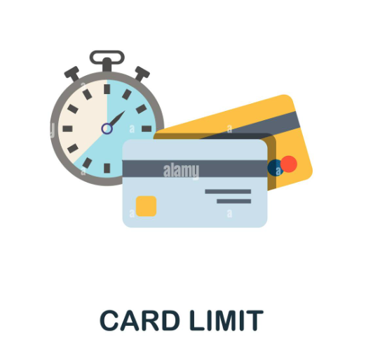
Using the PCard: Limits
  During the PCard application process, the Cardholder will be assigned a monthly credit limit and a single transaction limit, both of which are authorized by the Finance Director in the school of area and the Procurement Department
  Your department’s financial manager or Budget Director may email Pcard@case.edu to request a limit change
  These limit changes may be either temporary or permanent
  Cardholders MAY NOT submit a request for limit increases to their own PCard
  Requesting a limit higher than the tiers allowed requires an email from your dean, chairperson or vice-president
  The limit increase must be pre-approved by the Vice President of Campus Services
  There are three monthly transaction tiers and three single transaction tiers
  Monthly Credit Limits
    $5,000
    $10,000
    $20,000
  Single Transaction Limits
    $1,500
    $3,000
    $4,999
Notes:
Monthly Credit limit (Indent more)

Slide 17
Procurement Cards & The PCard
Procurement Cards
Becoming a PCard Cardholder
Using the PCard
Responsibilities

Slide 18
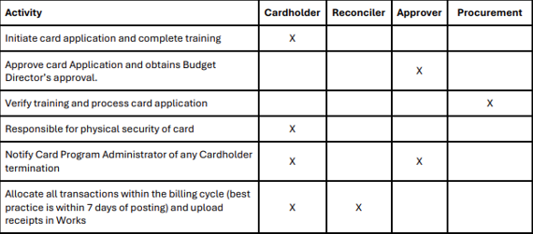
Responsibility Matrix
There are 4 major roles associated with PCard responsibilities
  For additional information pertaining to responsibilities, please see the PCard Policy document at https://case.edu/procurement/purchasing/procurement-card-suite/p-card-resources or email Pcard@case.edu

Slide 19
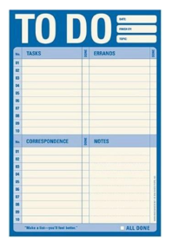
Cardholder Responsibilities
  A PCard Cardholder’s responsibilities include
  Paying vendors at the time of the transaction
  Regularly reviewing and allocating transactions to the correct accounting codes on the Works system
  Providing a business purpose for all transactions
  Reporting and attempting to resolve discrepancies
  Returns and exchanges
  Retaining documentation
  Uploading receipts for review and audit purposes
  Reconcile and sign off on monthly statements
  Even if you have an assigned Reconciler, you must ensure that all your transactions must be reconciled and distributed at the end of every billing cycle appropriately
  Best practice is to reconcile transactions within 7 days of purchase
  Know and comply with all CWRU policies found at https://case.edu/compliance/university-policies
  Keep your card information secure and do not share it with other employees or allow vendors to store on file
  If the card is lost, stolen, or used by a person other than the authorized Cardholder, such action must immediately be reported to the issuing bank, which at this time is Bank of America 1-888-449-2273. After reporting to the issuing bank, notify the Program Administrator at Pcard@case.edu

Slide 20

Cardholder Responsibilities: Reconciling
  Reconciling is the process of making sure receipts for PCard purchases match transactions on the monthly statement
  Make sure transactions are charged to appropriate speed type accounts
  For example: Reassigning charges from your department speed type to a grant speed type
  It is your responsibility to identify erroneous, incorrect, or missing charges and act immediately to resolve the problem
  Not properly reconciling your transactions by the monthly close could result in suspension or termination of PCard

Slide 21

Cardholder Responsibilities: Resolving Issues
  It is your responsibility to identify problems and take action with the supplier
  Erroneous charges
  Duplicate charges
  Unauthorized charges
  Unidentifiable charges
  Missing debits/credits
  Vendors that charge tax
  You have up to 60 days to file a dispute
  Failure to take action may result in termination of Cardholder privileges
  Contact the vendor directly and attempt to resolve the issue
  If an agreement cannot be reached, contact Bank of America Customer Service at 1-888-449-2273
  Dispute the claim in the Works system
    Works is an online system provided by the Bank of America for PCard management and will be talked about more in the next chapter

Slide 22

Cardholder Responsibilities: Returns
  When requesting a return for a purchase, merchants will most likely cooperate with you for exchanges, replacements, or a credit
  Contact the supplier to arrange for a return/exchange
  For shipping assistance with returns, contact the mail room at 216-368-2565
  If a resolution cannot be reached, contact the PCard Program Administrator for assistance
  Phone: 216-368-2560
  Email: Pcard@case.edu

Slide 23
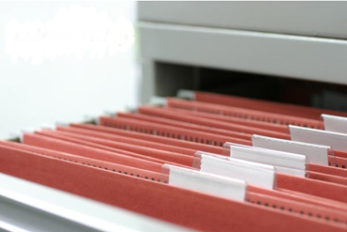
Cardholder Responsibilities: Documentation & Lost/Stolen Cards
Document Retention
  According to university policy, you must retain documentation for at least 5 years
  Detailed, itemized receipts
    Ensure that itemized receipts show the individual items and cost
  Order confirmations
  Statements
  Supporting documentation
  For additional information pertaining to the CWRU document retention policy, please go to https://case.edu/library/research/special-collections-archives/university-archives/about-records/policy-retention-university-records or email the Procurement Customer Care Team at Customercareteam-pds@case.edu
  Lost/Stolen Card
  Immediately notify the Bank of America customer service
  Staffed 24 hours a day, 7 days a week
  Call 1-888-715-1000
  After notifying the Bank of America, notify your supervisor and the PCard Administrator
  Call 216-368-2560 or Email Pcard@case.edu

Slide 24

Cardholder Responsibilities: Cancellation
  Your PCard may be cancelled when
  You no longer use it
  Leaving the university
  Moving to another department
  Failing multiple PCard audits
  Improperly completing monthly billing cycle responsibilities
  If terminating or leaving the university
  Email the PCard Program Administrator Pcard@case.edu no later than 24 hours prior to termination
    Non-compliance will cause you to become personally responsible for transactions that originate after the termination date

Slide 25

Reconciler Responsibilities
Reconcilers are the people to whom the Cardholder has delegated all the functions associated with post-purchase processing in the Works system
  The Reconciler cannot make purchases using the card they are assigned to reconcile
  The Cardholder is responsible for all actions taken by the Reconciler on the Cardholder’s behalf

Slide 26

Approver Responsibilities
  An Approver is the person who approves purchases that have been made by the Cardholder(s) to which they are assigned
  Must complete CAPS training on PCard policies and procedures
  The Approver must have sufficient knowledge and understanding of the Cardholder’s PCard activity to competently perform the approval process
  Will also be held accountable for their Cardholders’ transactions and daily activity
  Are required to verify that their Cardholders’ transactions are completed accurately and on time
    Allocation total must match transaction total
    Receipts and other backup documentation must be uploaded into the Works system to ensure compliance with CWRU policies
    Transaction comments must be documented
    Transactions must not be charged sales tax

Slide 27

Approver Responsibilities
  By approving each transaction, the Approver exercises critical control by ensuring authorized and appropriate PCard use and correct allocation of expenses
  The Approver signs the statement of the Cardholder, monthly, verifying the reconciliation process has taken place
  If the Approver identifies activity not in compliance with CWRU policies or business purposes, they must notify the Program Administrator at Pcard@case.edu for support and review/investigation if necessary
  An Approver should not report to the Cardholder whose transactions they are reviewing
  No Cardholder may approve their own purchases/transactions, nor may they direct someone else to approve transactions in a manner that would violate policy, i.e., without reviewing the transactions in detail, etc.

Slide 28

Procurement Department Responsibilities
  The university has contracted with Bank of America for a variety of purchasing-related cards, all designed to streamline business operations and accounting practices for those who do business on behalf of the university.
  The Procurement & Distribution Services Department administers this suite of purchasing tools, which includes the following responsibilities for the PCard and DCard programs:
  Verifying Canvas training
  Processing card applications
  Performing daily oversight of program and weekly review of card activity
  Auditing card activity and submitting results and recommendations to stakeholders
  Reviewing and notifying the responsible departments or personnel of any non- compliance, policy violations, etc.

Slide 29
Monthly Billing Cycle
The monthly billing cycle
Runs from the 26th of the previous month to the 25th of the current month
  The billing cycle ends early if the 25th falls on a Saturday, Sunday, or a public holiday
All transactions must be signed off (Approved) after allocated
  In order to encourage prompt reconciliation, a Cardholder’s available credit is restored to the full monthly credit limit at the beginning of each PCards billing cycle only when all transactions from the previous PCard billing cycle have been allocated and signed off
    Reconcile receipts with the monthly statement
    Review the Works system for redistributed charges
    Reconcile by 9:00 pm the day before the last business day of the month
Please see https://case.edu/procurement/purchasing/procurement-card-suite/p-card-resources or email Pcard@case.edu for additional information pertaining to billing cycle deadlines

