Slide 1
Extra, Extra,
Read all about it:
The Coronavirus
By
Kyle Fogarty, MS
Adam Gross, MS
Livia Timpanaro-Perrotta, MS

Slide 2
Outline
Learning Objectives
Virus Biology
Myth Busting
The Coronavirus
Coronavirus Basics
Epidemiology
Signs & Symptoms
Treatment & Prevention
Demonstration
Your Role

Slide 3
Learning Objectives
Learning the basics of viruses, the immune system, and disease transmission
Learning about the Coronavirus (COVID-19), where it came from, how it has spread, the signs, symptoms, and the outcomes for individuals who have contracted the virus
Learning the precautionary steps that you can take in your everyday life to protect yourself and those around you
Learning where to get reliable information on health outbreaks and dispelling the myths of the current outbreak

Slide 4
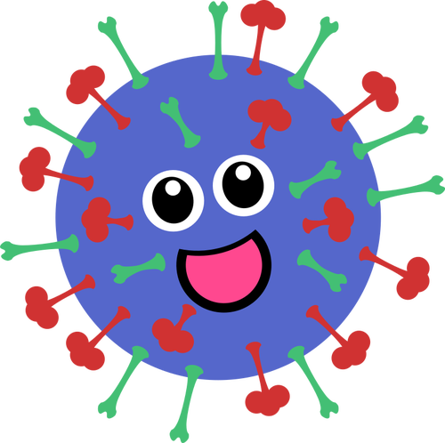
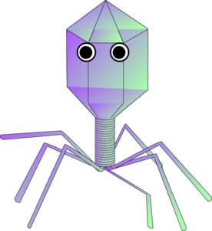
Virus Basics
Viruses come in all different shapes and sizes!
Some scientists argue that viruses are not even living things!
Viruses cannot reproduce on their own.
They need to infect or invade a host cell. That host cell will do all the work to duplicate (make more) of the virus.
Viruses don't really respond to anything.
You can poke them or set up barriers, it doesn't matter. They either function or they are destroyed.
Viruses don't really have any working parts.
While there are some advanced viruses that seem fancy, viruses don't have any of the parts you would normally think of when you think of a cell. They have no nuclei, mitochondria, or ribosomes. Some viruses do not even have cytoplasm.
Notes:
Maybe start out by asking students what they may already know about viruses
Source: http://www.biology4kids.com/files/micro_virus.html

Slide 5
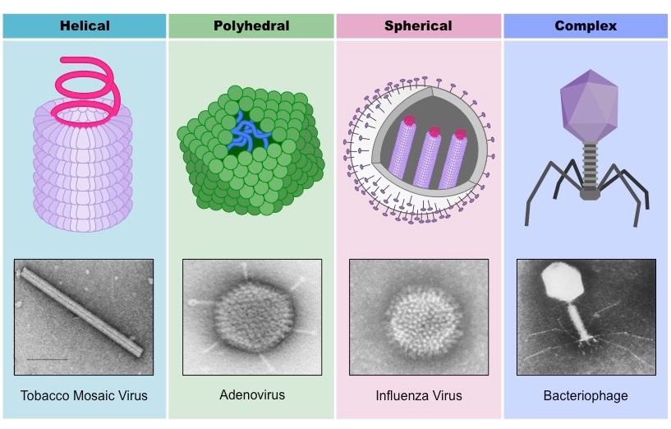
Types of Viruses
There are a few basic shapes of Viruses:
1) Helical virions.
They are set up like a tube. The protein coat winds up like a garden hose around the core.
2) Polyhedral shape.
This shape group includes the classic virus shape that looks like a dodecahedron. A dodecahedron is a geometric shape with twelve (12) sides. These viruses have many facets and a seemingly hard shell of capsomeres (pieces of a capsid).
There is a variation of the polyhedral called globular. Globular shapes are basically polyhedral virions inside of a spherical (like a ball) envelope. It is what the Coronavirus (COVID-19) is. It is a envolved, spherical, positive sense RNA virus
4) Complex virus shape.
You may have seen this one in books with the geometric head and long legs.

Slide 6
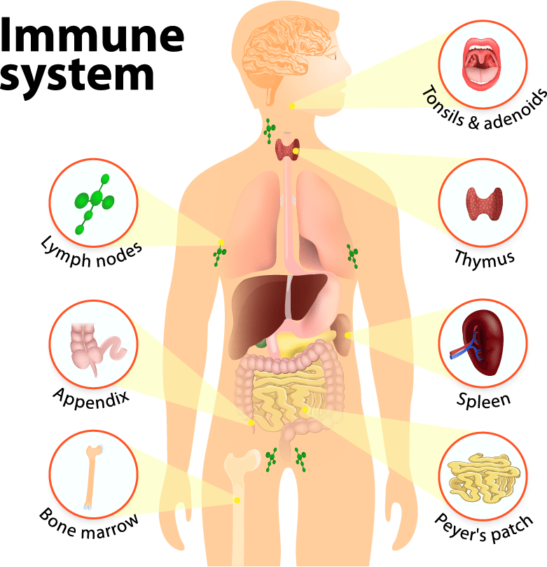
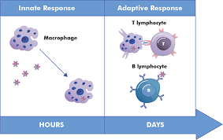
The Immune
System:
A brief overview
The immune system is our bodies way of fighting off infections

Slide 7
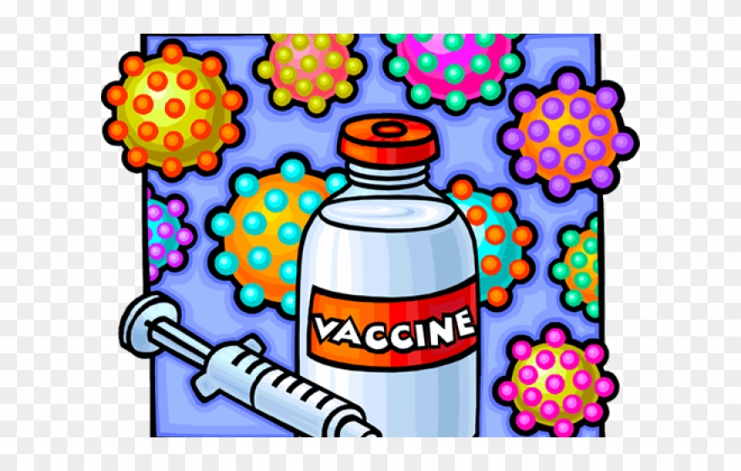
Vaccines
Currently, there is no vaccine for COVID-19, but scientists around the world are working on it!
What is a vaccine?
Vaccines contain the same germs that cause disease. But they have been either killed or weakened to the point that they don’t make you sick. Some vaccines contain only a part of the disease germ.
Why do we need vaccines?
A vaccine stimulates your immune system to produce antibodies, exactly like it would if you were exposed to the disease. After getting vaccinated, you develop immunity to that disease, without having to get the disease first!

Slide 8
Myth Busting
MYTH | TRUTH
Are hand dryers effective in killing the new coronavirus? | No! Hand dryers do not effectively kill the virus. To protect yourself, you should clean your hands frequently by following the procedure discussed later!
Can pets at home spread the new coronavirus (2019-nCoV)? | There is no evidence that pets such as dogs or cats can be infected with the coronavirus. It is always a good idea to wash your hands with soap and water after contact with pets.
Is it safe to receive a letter or a package from China? | Yes, it is safe! People receiving packages from China are not at risk of contracting the coronavirus. Coronaviruses do not survive long on things like letters or packages.
Does the new coronavirus affect older people, or are younger people also susceptible? | People of all ages can be infected by the new coronavirus (2019-nCoV).
Notes:
https://www.who.int/emergencies/diseases/novel-coronavirus-2019/advice-for-public/myth-busters
I just chose a few to add here, but you should feel free to add/subtract!

Slide 9
How is the Coronavirus similar to what we know?
01
It is in the same family as the SARS virus and MERS
02
This is not the first time a coronavirus has mutated and created a new strain
03
Like SARS and MERS, is one of the more severe strains

Slide 10
How is the Coronavirus different?
01
While it is in the same family as SARS and MERS, it is not the same disease
02
Does not transmit as easily as influenza but causes a more severe disease
03
Is a new disease so the worldwide population does not have immunity to it

Slide 11
Epidemiology
What does epidemiology mean?
Per the CDC, Epidemiology is: the study (scientific, systematic, and data-drive) of the distribution (frequency, patterns) and determinants (causes, risk factors) of health-related states and events (not just diseases) in specified populations (neighborhood, city, state, country, global)
A little simpler:
The branch of medicine which deals with the incidence, distribution, and possible control of disease and other factors relating to health
“Marc Lipsitch, a Harvard epidemiologist and the director of the Center for Communicable Disease Dynamics, estimated that between forty per cent and seventy per cent of the world’s roughly five billion adults will get the virus, which was first reported in China, in late December. -The New Yorker

Slide 12
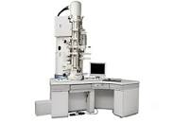
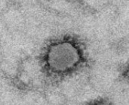
Let’s take it back to the beginning
Where did the Coronavirus (COVID-19) start?
The current COVID-19 outbreak is believed to have originated in Wuhan, a city in the province of Hubei, China
When did it begin?
The first case is believed to have been in December 2019
Image of the coronavirus under electron microscopy

Slide 13
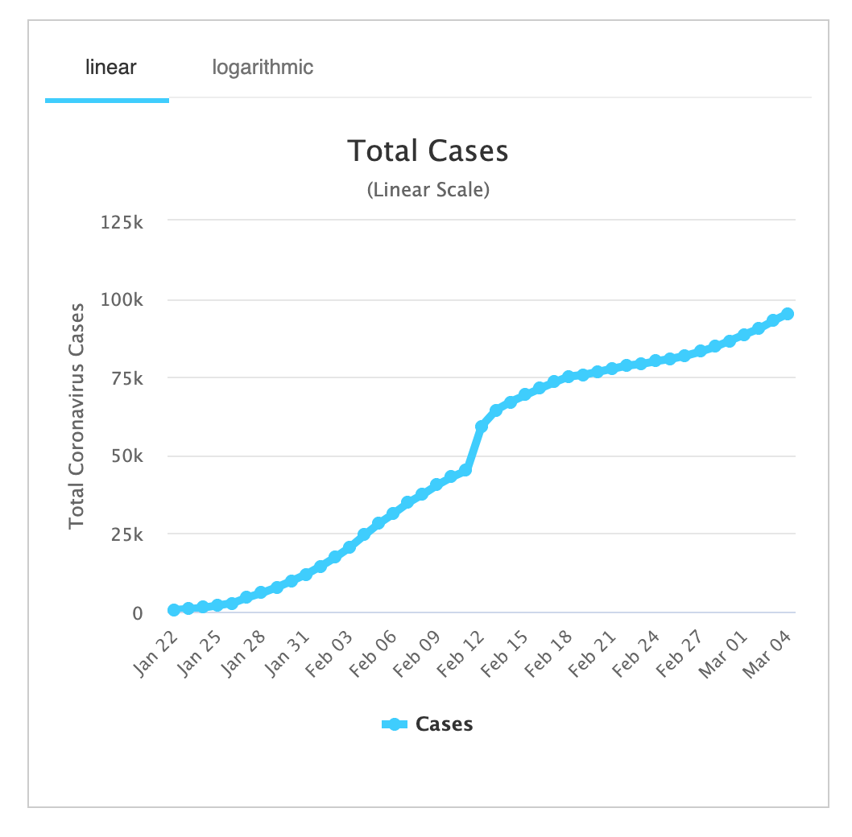
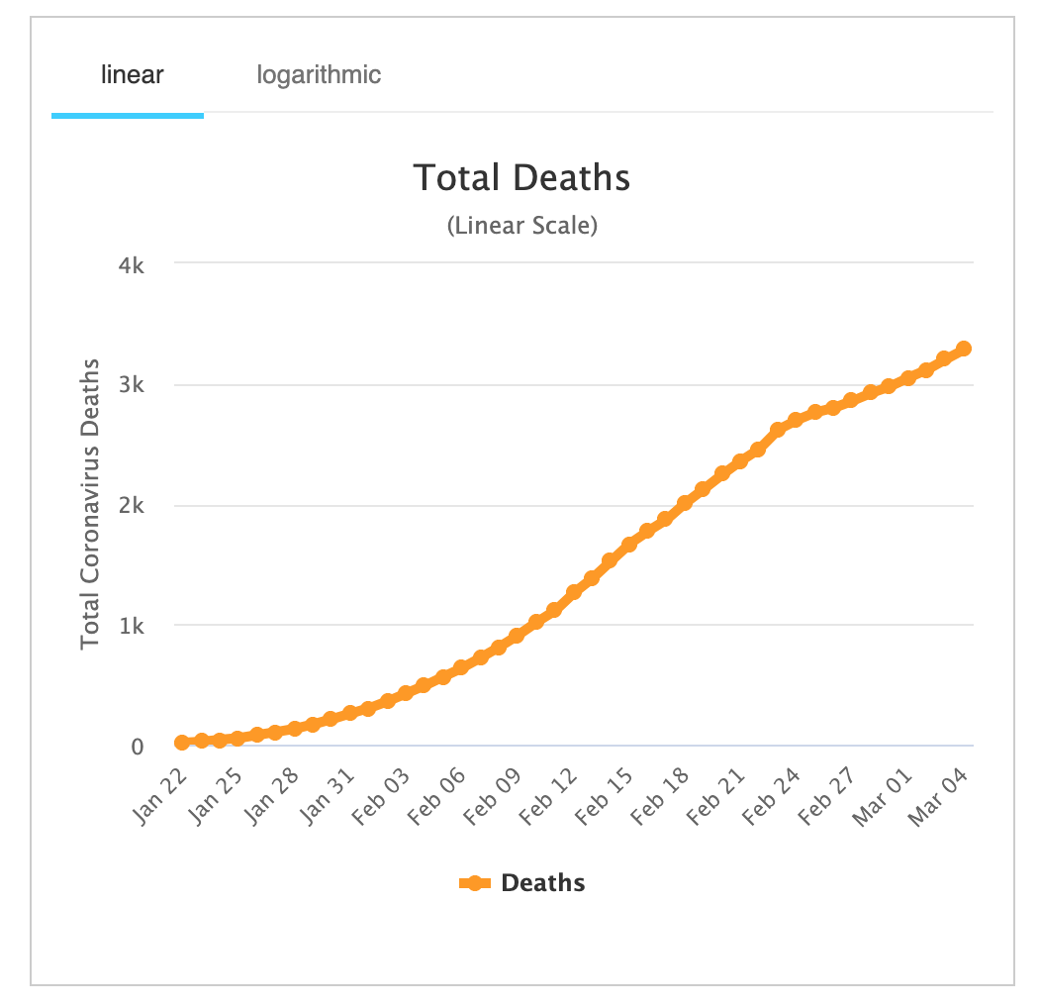
How many cases are there?
Note: Most of the fatal cases have occured in patients with advanced age or underlying diseases
Coronavirus Cases:
95,483
Recovered:
48,201
Deaths:
3,286
Mortality Rate:
3.4% (WHO Estimate)

Slide 14
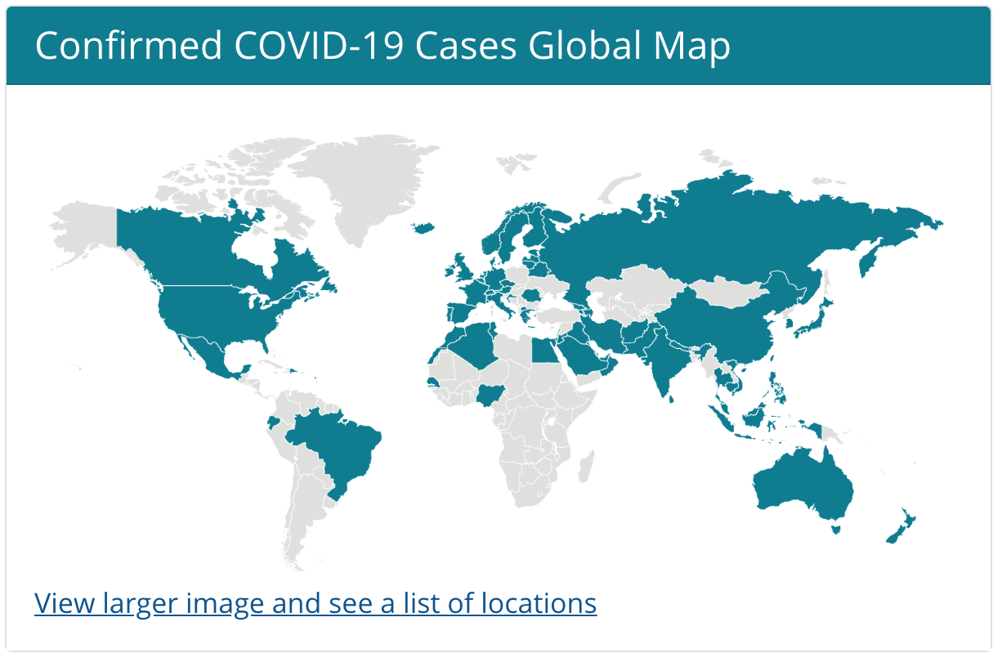
Where has it spread?
It now affects
84 countries and territories around the world
Per CDC.org website

Slide 15
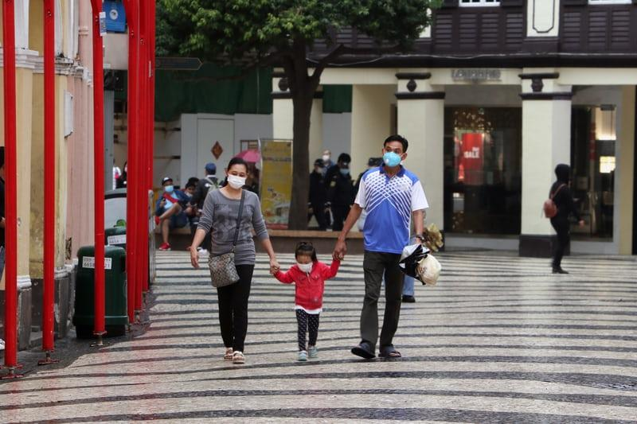
Countries Affected
1. China - 80,430 cases
2. S. Korea - 5,766 cases
3. Italy - 2,922
10. USA - 159
Deaths
By Country
3,0133,013
92
11
3,013
107
China
Italy
Iran
USA

Slide 16
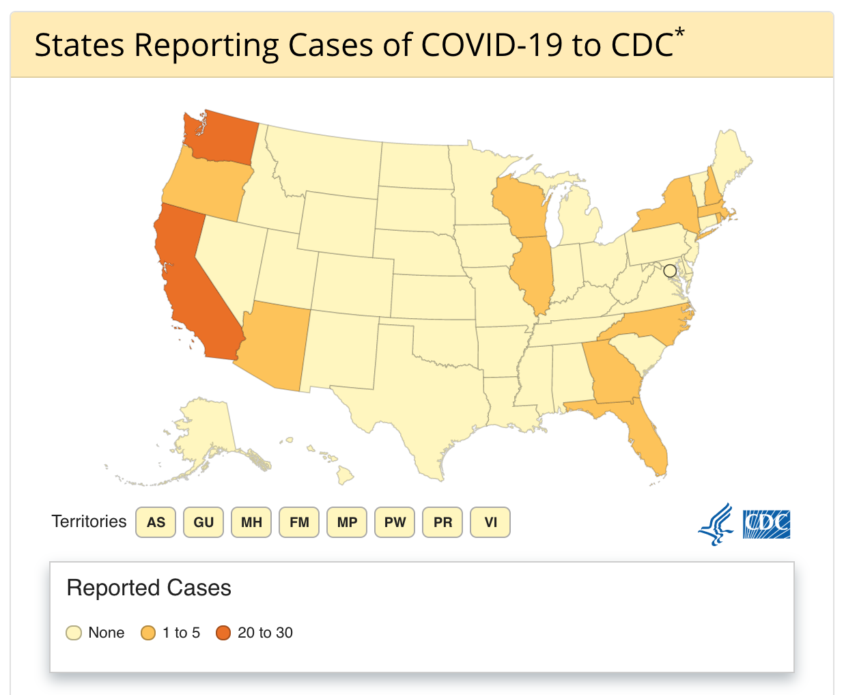
Where in the US is affected?
*Data include both confirmed and presumptive positive cases of COVID-19 reported to the CDC or tested at the CDC since January 21, 2020
with the exception of testing results for persons repatriated to the United States from Wuhan, China and Japan.
States are now testing and publicly reporting their cases. In the event of a discrepancy, state case counts are the most up to date.

Slide 17
States Affected
The States with the most cases are:
Washington, California, and New York
On March 4th, 2020 - There were 34 new cases and 2 new deaths in the US
39
36
11
0
Washington
California
New York
Ohio

Slide 18
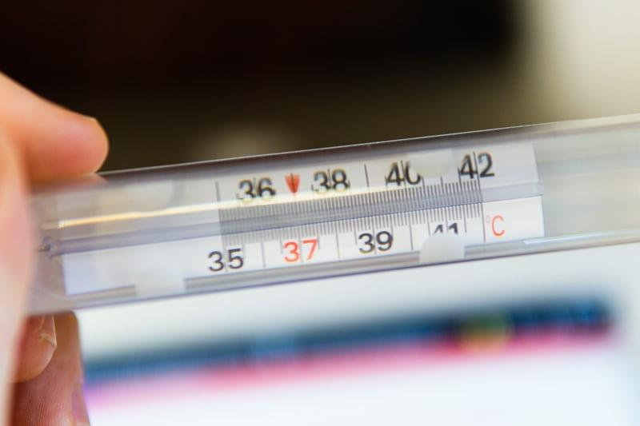
Why are the number of cases so much lower in the US?
One of the main reasons is:
We have lower testing parameters than many other countries
To quote epidemiologist Mitch Lipsitch:
“We haven’t found hundreds or thousands of cases because we’re not looking hard enough,” Lipsitch said.
“We don’t have the testing capacity to find out what’s going on. We’ve looked largely at people who had a relation to China or high-risk areas.” That’s too low, he said, by several factors of ten.

Slide 19
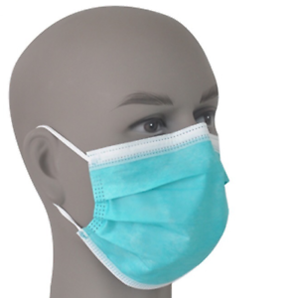
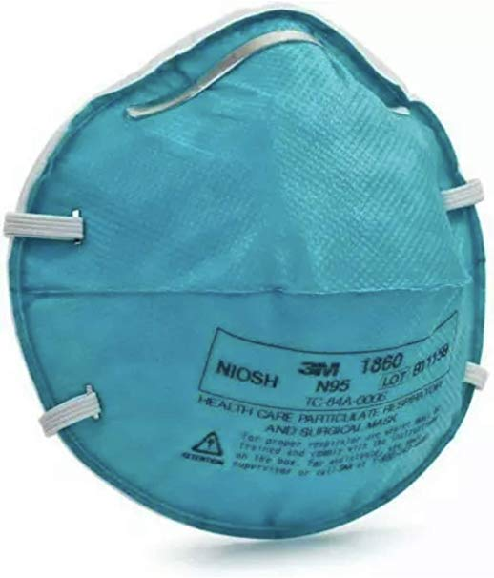
Medical Impact of the Coronavirus
As the news continues to churn out stories, there has been a surge in the public buying protective equipment and supplies. This has resulted in a shortage and price increase of things such as surgical masks
Do surgical masks protect against the virus?
NO!! The virus is too small and can pass through surgical masks
Also, now there is talk about creating screening sites, what do you think that will to do the healthcare industry?
Currently estimated that the first two months of testing will cost $25 Million
Congress has approved $8 Billion in funding to the Coronavirus response
Insurance or the government will cover the cost of testing for Americans who may have COVID-19

Slide 20
Who is at risk?
These is the current risk assessment from the CDC:
For most of the American public, who are unlikely to be exposed to this virus at this time, the immediate health risk from COVID-19 is considered low.
People in communities where ongoing community spread with the virus that causes COVID-19 has been reported are at elevated, though still relatively low risk of exposure.
Healthcare workers caring for patients with COVID-19 are at elevated risk of exposure.
Close contacts of persons with COVID-19 also are at elevated risk of exposure.
Travelers returning from affected international locations where community spread is occurring also are at elevated risk of exposure.
Also, the elderly and/or those who are immunocompromised are at greater risk of having a worse prognosis

Slide 21
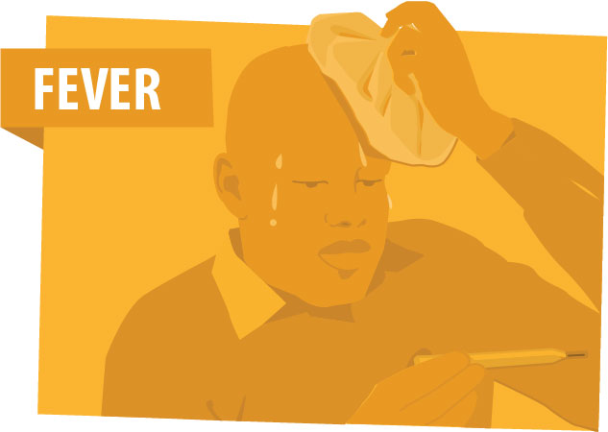
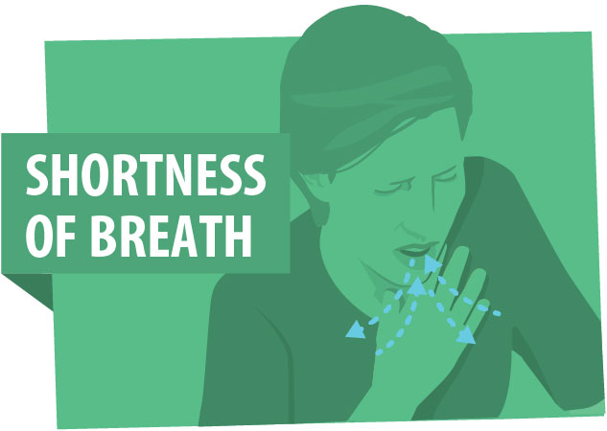
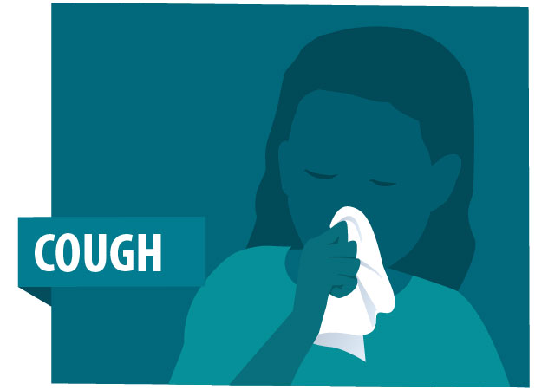
Signs and Symptoms
We are still learning a lot about how coronavirus affects people
Some people experience very severe symptoms, whereas others experience a more mild disease course, and there are some who have the disease but display no symptoms.
The CDC is reporting that symptoms are expected to present 2-14 days after exposure to the virus.
Be on the lookout for:
Fever
CDC defines as a temperature of over 100.4℉
Cough
Shortness of Breath
Feeling like you can't breathe or like you’ve just run a mile but you haven't moved
Notes:
https://www.cdc.gov/coronavirus/2019-ncov/about/symptoms.html
Maybe define each symptom?

Slide 22
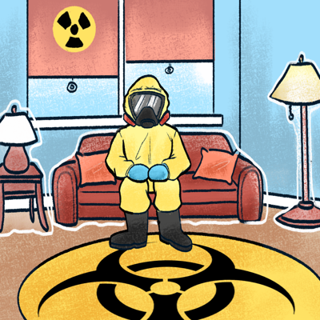
Quarantine vs Isolation
The CDC defines isolation as: separating sick people with a contagious disease from people who are not sick.
The CDC defines quarantine as: separating and restricting the movement of people who were exposed to a contagious disease to see if they become sick.
So what's the main difference?
Isolation deals with people who are for sure sick and quarantine is a preventative step to see if people will get sick so that they do not get others sick.
Should there be a quarantine issued by local authorities – or you self-impose one on you and your family – it would be unlikely to go beyond 14 days, which is the expected incubation period.

Slide 23
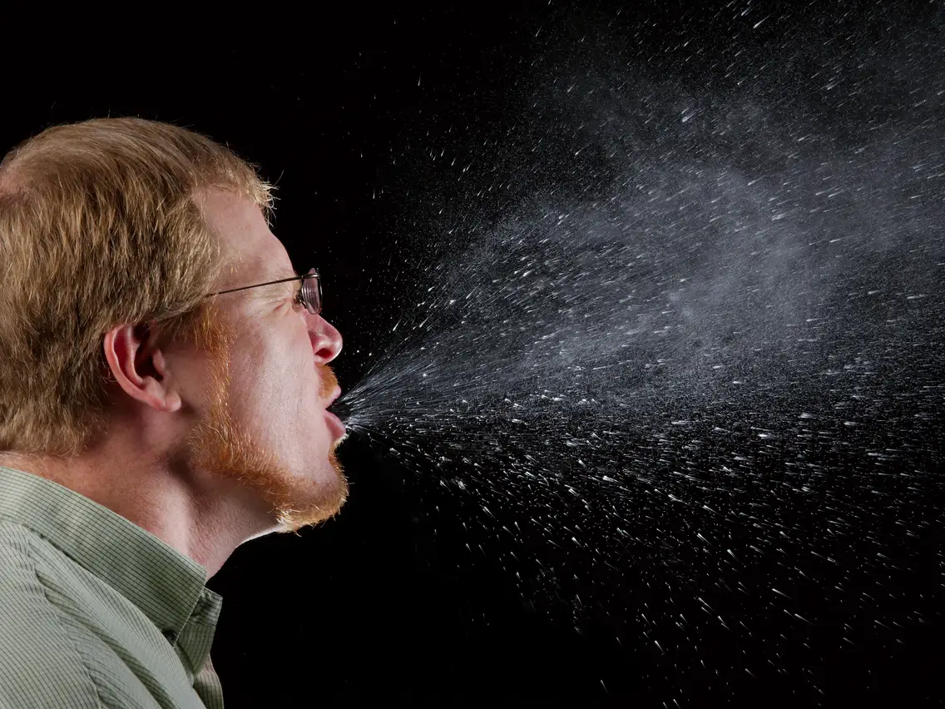
How is COVID-19 transmitted?
COVID-19 is thought to be spread through respiratory droplets
Respiratory droplets are drops of water that come from your respiratory system (think lungs, nose) when you sneeze and/or cough.
As you can see, one sneeze can produce many droplets and send them far away!
This range can be about 1 meter ~ 3.2 feet
Thes droplets can then either be breathed in by someone else, land on someone else, or on some surface.
If on a surface, a person could touch that surface (think handrail), then go eat a burger without washing their hands.
It is unknown, at this time, how long the coronavirus can last on a surface

Slide 24
Treatment and Prevention
There is currently no vaccine to prevent coronavirus disease 2019 (COVID-19). The best way to prevent illness is to avoid being exposed to this virus.
Avoid close contact with people who are sick.
Avoid touching your eyes, nose, and mouth.
Stay home when you are sick.
Cover your cough or sneeze with a tissue, then throw the tissue in the trash.
Clean and disinfect frequently touched objects and surfaces using a regular household cleaning spray or wipe.
WASH YOUR HANDS OFTEN!
According to the WHO, recovery time appears to be around
two weeks for mild infections and three to six weeks for severe disease

Slide 25
Practicing Proper Hand Hygiene
When to wash your hands:
Before, during, and after preparing food
Before eating food
Before and after caring for someone at home who is sick with vomiting or diarrhea
Before and after treating a cut or wound
After using the toilet
After changing diapers or cleaning up a child who has used the toilet
After blowing your nose, coughing, or sneezing
After touching an animal, animal feed, or animal waste
After handling pet food or pet treats
After touching garbage
Notes:
https://www.cdc.gov/handwashing/when-how-handwashing.html

Slide 26
Practicing Proper Hand Hygiene
5 Essential Steps for Hand Washing:
Wet your hands with clean, running water (warm or cold), turn off the tap, and apply soap.
Lather your hands by rubbing them together with the soap. Lather the backs of your hands, between your fingers, and under your nails.
Scrub your hands for at least 20 seconds. Need a timer? Hum the “Happy Birthday” song from beginning to end twice.
Rinse your hands well under clean, running water.
Dry your hands using a clean towel or air dry them.

Slide 27
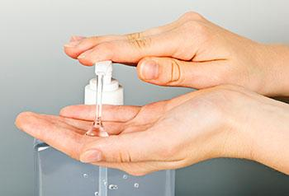
Using Hand Sanitizer
Hand sanitizer can be used if soap and water are not readily available.
Use an alcohol-based hand sanitizer that contains at least 60% alcohol.
You can tell if the sanitizer contains at least 60% alcohol by looking at the product label.
Sanitizers can quickly reduce the number of germs on hands in many situations. However:
Sanitizers do not get rid of all types of germs.
Hand sanitizers may not be as effective when hands are visibly dirty or greasy.
Hand sanitizers might not remove harmful chemicals from hands like pesticides and heavy metals.
Notes:
Maybe pass around a bottle and see if they can pick out the %?
https://www.cdc.gov/handwashing/when-how-handwashing.html

Slide 28
YOU can help counter stigma during the COVID-19 response!
Maintain privacy and confidentiality of those seeking health care and those who may be part of any contact investigation.
Timely communication of the risk or lack of risk from associations with products, people, and places.
Raise awareness about COVID-19 without increasing fear.
Share accurate information about how the virus spreads.
Speak out against negative behaviors, including negative statements on social media about groups of people, or exclusion of people who pose no risk from regular activities.
Be cautious about the images that are shared. Make sure they do not reinforce stereotypes.
Engage with stigmatized groups in person and through media channels including news media and social media.
Share the need for social support for people who have returned from China or are worried about friends or relatives in the affected region.

Slide 29
What are some reliable resources?
www.cdc,gov
www.who.int
www.nih.gov
odh.ohio.gov
www.uptodate.com
www.redcross.org

Slide 30
Now It’s Up To YOU!
BE ACCOUNTABLE!
Take this information and help to educate friends and family!
“Each one teach one!”

Slide 31
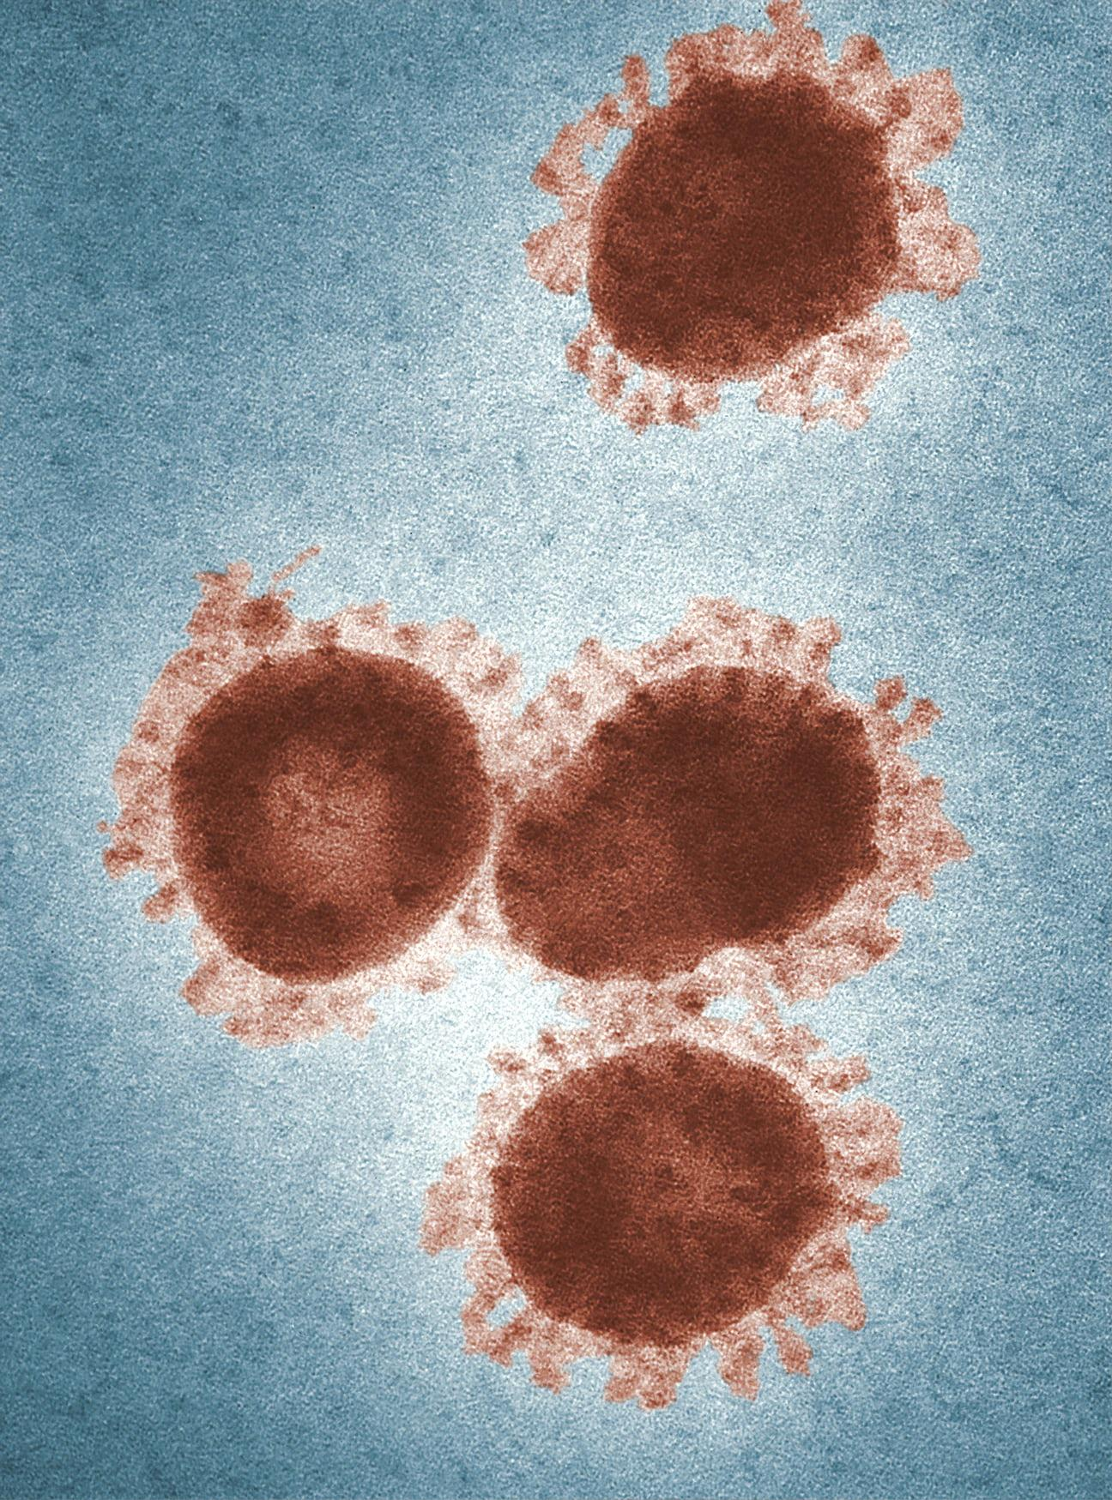
Any Questions?
THANK YOU! Check out our research sources:
https://www.cdc.gov/coronavirus/2019-ncov/index.html
https://www.uptodate.com/contents/coronaviruses
https://www.who.int/emergencies/diseases/novel-coronavirus-2019
https://www.nih.gov/health-information/coronavirus
https://www.worldometers.info/coronavirus/
https://www.newyorker.com/news/our-columnists/the-coronavirus-is-causing-a-global-panic-but-thats-a-good-thing?
https://www.who.int/dg/speeches/detail/who-director-general-s-opening-remarks-at-the-media-briefing-on-covid-19---3-march-2020
https://www.wsj.com/articles/coronavirus-costs-whos-paying-for-all-this-11583317801
https://www.usatoday.com/in-depth/money/2020/03/04/coronavirus-what-stock-u
https://www.cnn.com/2020/03/03/health/us-coronavirus-cases-state-by-state/index.htmlp-and-how-prepare-your-emergency-kit/4937518002/

Slide 32
What is a pandemic and what does that mean?
According to the NIH:
“Pandemics are large-scale outbreaks of infectious disease that can greatly increase morbidity and mortality over a wide geographic area and cause significant economic, social, and political disruption”
That sounds scary, what does that mean?
A disease needs to hit 3 criteria to be called a pandemic:
Transmitted person to person
Can cause illness
Worldwide spread

