Slide 1
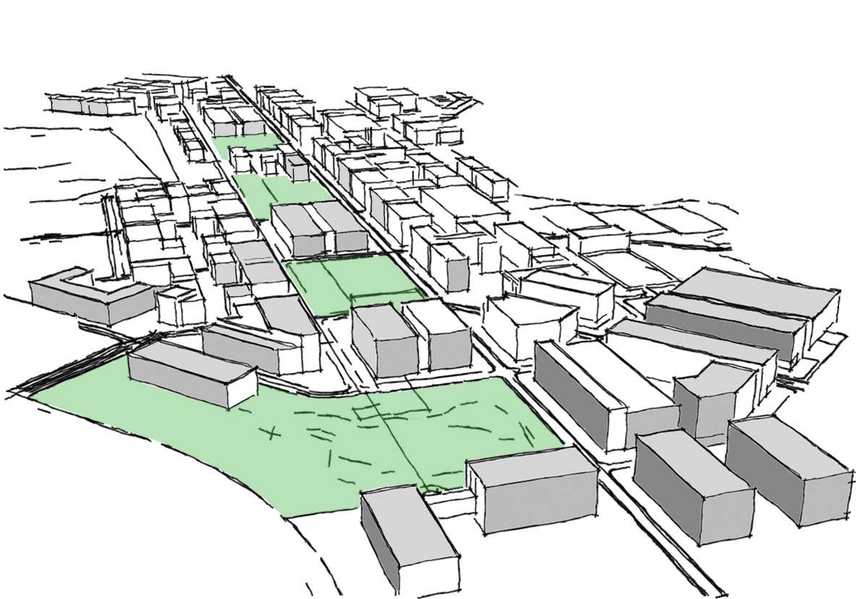
Climate Action Plan (CAP)
Case Western Reserve University
12 October 2010

Slide 2
Agenda
Welcome and Introductions
“Direct” Impact Resource Options
Technologies that measurably impact greenhouse gas emissions
“Foundational” Projects &Policies
A basis upon which something stands or is supported
afternoon morning

Slide 3
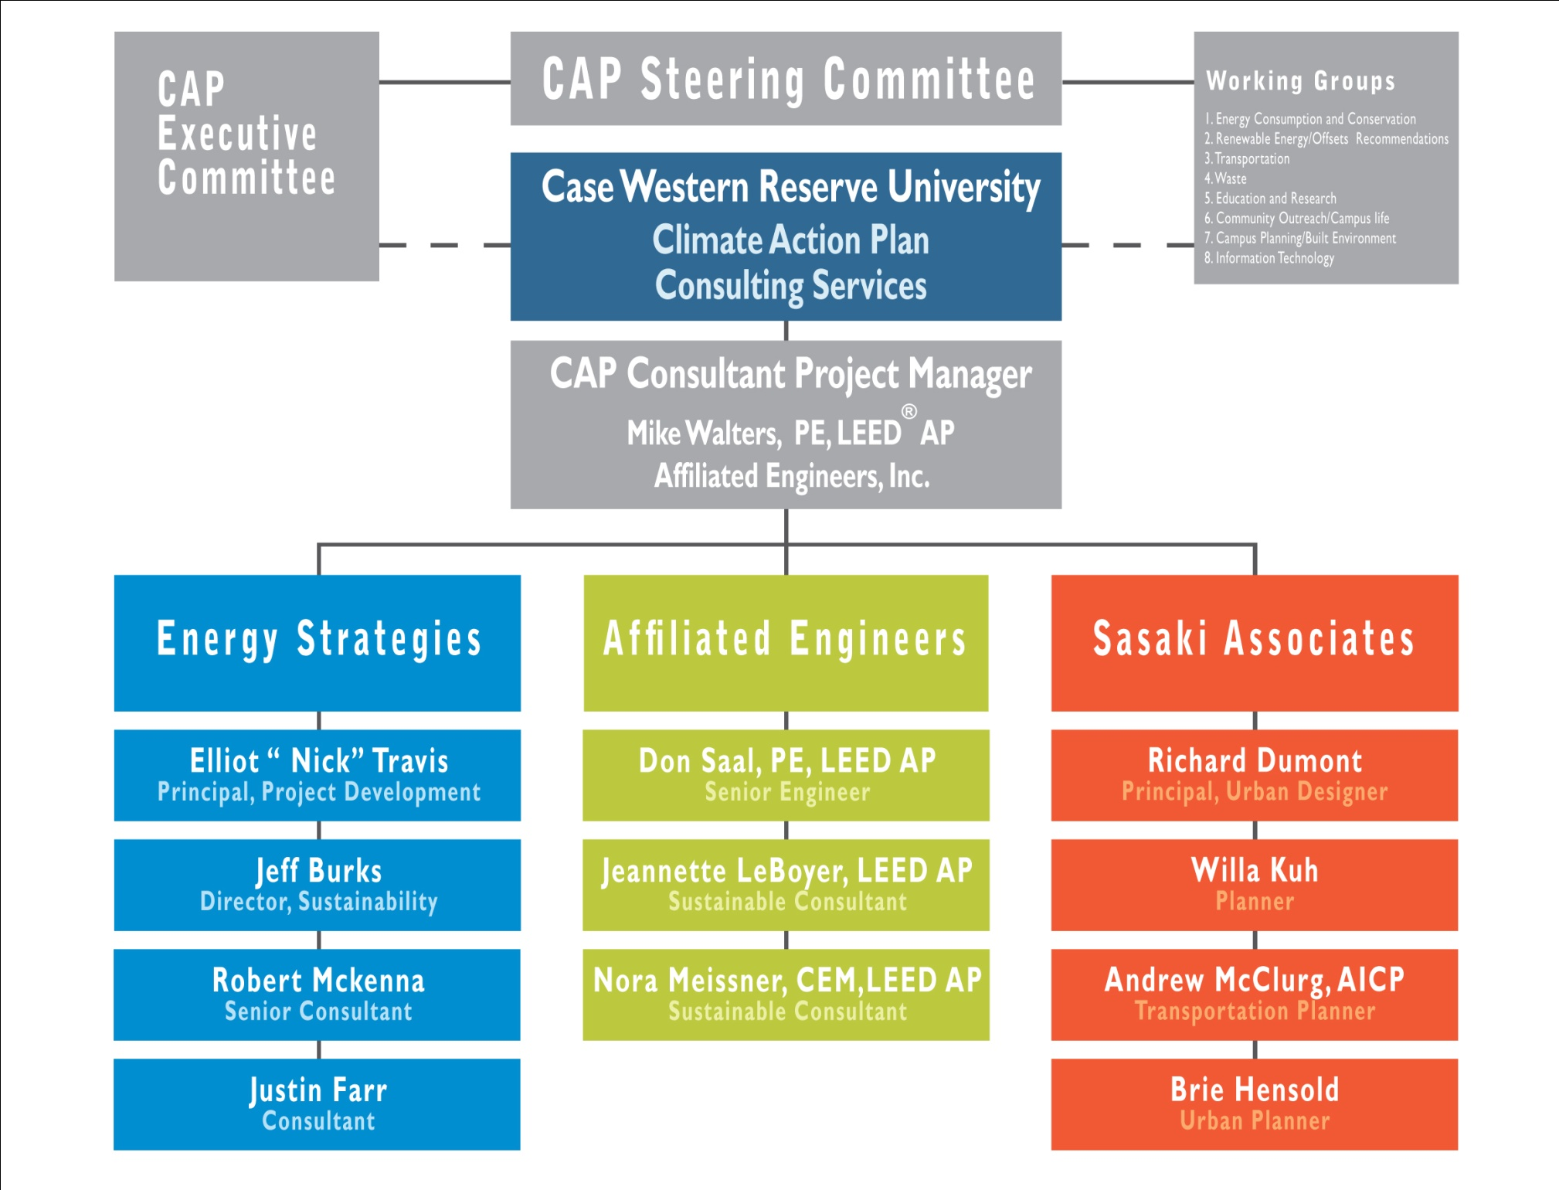

Slide 4
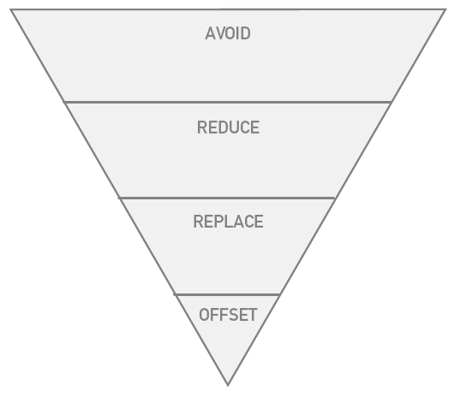
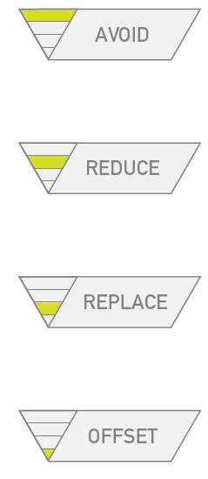
GHG Abatement Hierarchy

Slide 5
Direct GHG Mitigation Options
Demand for Energy
Supply of Energy
Offsets
People, Policies, & Practices
Physical Systems & Technologies
Space Planning & Management
Supply Efficiency
Substitute Fuels
Renewable Energy
Unitary Chiller Upgrades
Geothermal
Solar Thermal: Domestic Hot Water
Mission-Linked
Solar Thermal: Electric
Solar Photovoltaic
On-Site Wind
Off-Shore Wind
Community Based
Biochar
Low Income Housing Weatherization
Coal to Natural Gas Conversion at Steam Plant
Building Design & Construction Standards
IT Systems: Centralized Energy Management
IT Systems: Centralized Server Virtualization
Procurement Goods & Services: Toxicity, Packaging, Recyclability, and Energy Demand
Energy Policy
IT Systems: Cisco EnergyWise
Conservation Outreach / Behavior Change
Building Intelligent Quotient
Campus-wide Energy Conservation Measures
IT Systems: Vampire Load Management
Central Chiller Expansion
Combined Heat and Power
Green Power Purchase
Alternative Transportation Strategies
Reduced Commuting Strategies
Telepresence
Waste: Increase Capture Rate and Material Types
Waste
Transportation
Campus Planning & Built Environment
Information Technology
Energy Conservation & Consumption
Renewable Energy and Offsets
Notes:
IT
Campus Planning
Renewable Energy
Energy Conservation
Transportation
Waste
Procurement: Toxicity, Packaging, Energy Demand, Recyclability
Increase capture rate and material types

Slide 6

Notes:
Original Image path: C:\Users\bhensold\Desktop\fruit-in-a-bowl-1986.jpg
Original Size: 310KB W:1,400px H:1,087px
Compressed Size: 457KB W:1,280px H:993px (-47.6% using JPEG compression of 90)
Last Updated: 10/11/2010 9:46:05 PM by bhensold via Sasaki PPT Image Manager

Slide 7

ABATEMENT
MEASURES
ABATEMENT
MEASURES
LEARNING
ABATEMENT
MEASURES
PHYSICAL
ENVIRONMENT
CAMPUS CULTURE
Notes:
Original Image path: C:\Users\bhensold\Desktop\fruit-in-a-bowl-1986.jpg
Original Size: 310KB W:1,400px H:1,087px
Compressed Size: 457KB W:1,280px H:993px (-47.6% using JPEG compression of 90)
Last Updated: 10/11/2010 9:46:05 PM by bhensold via Sasaki PPT Image Manager

Slide 8
“Direct” Impact Resource Options
  Energy Consumption and Conservation (Gene Matthews)
Renewable Energy / Offsets Recommendations (Roger Saillant)
Waste (Tangela Scott-Jones)
Transportation (Beth Nochomovitz)
Information Technology (Jeff Gumpf)

Slide 9
Energy Consumption & Conservation
PROPOSALS – Demand Side
Physical Systems and Technologies (in descending order of priority)
Metering & Monitoring
Campus Wide ECM's
Green IT
Campus Vehicle Fleet
BIQ Building Intelligent Quotient
Smart Grid

Slide 10
Energy Consumption & Conservation
PROPOSALS – Supply of Energy
Supply Efficiency (in descending order of priority)
Building level heat recovery systems
Building chiller upgrades /removal
Steam tunnel upgrades
Central CHW expansion
Building level heat distribution systems
Central CHP Co Gen

Slide 11
Energy Consumption & Conservation
PROPOSALS – Supply of Energy
Substitute Fuels - On-Site combustion (in descending order of priority)
Wind Electric - Owned *
Solar Electric - Owned *
Fuel Switch Coal to NG
Solar Thermal
Building Level Turbines DG Building CHP
Used Cooking Oil in Diesel Equipment
Waste to Energy
Fuel Cells
Municipal Solid Waste
Biomass
Landfill Gas

Slide 12
Energy Consumption & Conservation
PROPOSALS – Supply of Energy
Substitute Fuels - Purchased Electricity (in descending order of priority)
Wind
Solar Electric (OSC)
Green Power Purchases
Battery Technology
Pumped Storage

Slide 13
Energy Consumption & Conservation
PROPOSALS – Demand Side
People Practices & Policies (in descending order of priority)
Temperature standards / Energy Policy
Conservation Outreach / Behavior Change
Green Building Standards
Space Utilization
Rate Design/ Price Signals / Behavioral Economics / Rebates
Space Planning / Management
Grounds Management Policies / Practices

Slide 14
Renewable Energy/ Offsets Recommendations
ALREADY UNDERWAY
Central supply
  Heating and cooling for the campus is provided by the Med Center Company (MCCo)
  Electricity purchased through the MCCo
  MCCo has undertaken development of a long-term strategy to reduce coal dependence
  MCCo is evaluating demand scenarios for its customers
  MCCo is evaluating possible redesign of its current site / relocation.

Slide 15
Renewable Energy/ Offsets Recommendations
PROPOSALS – Solar
Solar Thermal for Domestic Hot Water
Test 1-2 sample campus locations for potential for solar thermal domestic hot water
Use test sites to roughly assess campus wide potential
Test Site #1 – Veale/Emerson to provide hot water for showers, locker rooms, swimming pools etc.
SolarThermal for Electric
Small scale (<1 acre) solar electric project for Valleevue farm for local use and exporting electricity to grid
Solar Photovoltaic
Solar Electric Co-op underway
Further study needed

Slide 16
Renewable Energy/ Offsets Recommendations
PROPOSALS – Geothermal
Geothermal (Geo Exchange/Ground Source Heat Pumps)
Conduct a high level analysis to understand geothermal possibilities for CWRU
Potential locations - open fields, either a quad with no trees or sporting field, bodies of water, parking lots

Slide 17
Renewable Energy/ Offsets Recommendations
PROPOSALS – Wind
On-site Wind
Leverage opportunities with Ohio Wind Energy Research and Commercialization Center (Ohio-WERC Center)
Work with local companies to advance design and manufacture of the critical components in a wind turbine
David Matthiesen leading coordination
Off-shore Wind
Build on in-progress regional, off-shore developments

Slide 18
Renewable Energy/ Offsets Recommendations
PROPOSALS – Carbon Offsets
Biochar
Charcoal created by recycling waste biomass (such as animal manures and greenwaste) to produce renewable energy (displacing fossil fuels) and a stable form of carbon which can be sequestered long-term in soils.
Primarily for bio-sequestration or atmospheric carbon capture and storage.
Home weatherization in low income households
Collaborate with community partners to study impacts of home weatherization
Goal is to observe changes in household behavior and establish causal relationships between weatherization and effects such as improved health, financial stability, increased household size, increased energy consumption, or observe how household heating / cooling decisions are made

Slide 19
Waste
ALREADY UNDERWAY
Recycling Program
  Multiple waste streams – paper, cardboard, containers, e-waste, pallets, paint, fluorescent light bulbs, carpet, and printer cartridges.
Compost
  700 cubic yards of organic materials per year; 24 tons of food waste (by Bon Appétit)
  Yard waste (leaves, grass, twigs, etc.) reinstalled on flower beds throughout the campus.
Dining
  Bon Appétit (food caterer) serves locally grown fruit and vegetables.
  Some dining halls eliminated self-serve portions
  Reusable dinnerware and utensils used when practical.

Slide 20
Waste
PROPOSALS
Long-term Goal – Zero waste
Short-term Goal – 25% waste reduction in 5 years
Education
  Continue community hour programs about negative effects of waste and consumption habits
  Expand learning into all schools’ curriculum (ie. Managing By Design and Sustainability at WSOM)
  Create programs to educate new employees and students during orientation sessions
  Institute a suggestions system to gather fresh ideas from and engage campus members
  “Less is Best Campaign” – Example: Remove trash cans from offices (recycle bins in interim)
Procurement
  Require packaging standards for RFP winners (ie. ship goods on reusable pallets, use electronic billing interfaces, have double-sided capabilities, and source and purchase for durability.
  Choose less toxic materials (e.g. cleaning, lab, and construction materials).
Dining / Food related
  Adopt a no bag policy.
  Incentivize use of re-usable travel coffee mugs

Slide 21
Waste
PROPOSALS – Recycling
Recycling
  Fully comprehensive recycling program
  Enhance existing, successful program
Materials
  Expand list of materials to include: Aluminum, including aerosol containers, batteries, cell phones (through UPS), concrete asphalt, sheetrock, film, media and cases, plastic containers and bags, signs, and banners, packaging materials through UPS), Styrofoam, tennis balls and transparencies.
  Resell office supplies between departments with proceeds to community
Infrastructural / operational needs - personnel, vehicles, equipment, receptacles
  Dedicated vehicle for campus recycling (Curb-Side Sorter)
  Distinct uniform for recycling staff

Slide 22
Transportation
PROPOSAL
OBJECTIVES
Shift to non-motorized transportation
Reduce commuter miles

Slide 23
Transportation
PROPOSALS
TOP 5 ACTIONABLE ITEMS
Develop bike paths/bike lanes to campus, in concert with City
Invest and promote distance communication technology for non-essential travel
Consider closing for incremental periods (e.g between Christmas and New Year) to reduce commuter and plant impact
Consider reduced work week where feasible (e.g. 4 day week)
Reconceive parking department as an access department focusing on commuting alternatives (tied with above)

Slide 24
Transportation
PROPOSALS: PARTIAL LIST
FACULTY / STAFF COMMUTING
Rideshare Programs- carpool and park-and-ride options
Incentives to promote use of public transit
Guaranteed ride home (for emergencies) for those using public transportation
Transportation Demand Management
Incentives for people to live closer to campus

Slide 25
Transportation
PROPOSALS: PARTIAL LIST
STUDENT COMMUTING
Use abandoned bikes for campus bike share.
Bus system - improve reliability, visibility of stops, heated shelters, promotion of use
Car pool and ride share programs supported for commuters
Additional bike racks and shelters
Restrict parking availability to upperclassmen
Car Share utilizing the fleet vehicles after hours
Grow and promote car-sharing program

Slide 26
Transportation
PROPOSALS: PARTIAL LIST
GENERAL GROUND TRANSPORTATION
Change perception of campus size and ease of getting from place to place
Greeny buses or other shuttles converted to electric or some other less GHG intense option, e.g. bio-diesel
Physical facilities for bicycling – secure racks, showers
Work with Cleveland and Cleveland Heights to co-operate in improving bicycle access on and through campus
Commuter shuttle promoted and improved for intra-campus transport
Reconceive parking department with focus on commuting alternatives

Slide 27
Transportation
PROPOSALS: PARTIAL LIST
AIR TRAVEL
Invest and promote distance communication technology for non-essential travel
Build carbon impact awareness to reduce travel frequency
Focus on offsets - through airlines and/or self developed offset programs
OTHER
Virtual classrooms: supplement traditional teaching with greater levels of tele-instruction
1. Telecommuting where feasible (tied with above)

Slide 28
Information Technology
PROPOSALS
Purchase and install a system in all university-owned computer systems that allows for query and setting of power management configuration.
Replace single server hardware with server virtualization system to save between 40% and 90% of server-related energy consumption.
Use outlet strips to turn off IT devices.
Behavior change through education: turn off computer, computer monitor, printers, and other accessories when not in use (eg, overnight)
Behavior change through equipment and education: replace motorized travel with video teleconferencing.
Behavior change: telecommute.
Behavior change: enhanced sharing of printing devices.

Slide 29
Information Technology
PROPOSALS
Equipment: replace old/purchase new IT devices that are energy- efficient.
Equipment: purchase only LED-lighted LCD displays.
Data Center improvements: Use free air cooling, improve hot/cold aisle separation, raise normal ambient data center temperature, power down devices, use waste heat to pre-heat air or water.
Perform focused audit of IT-driven electricity use to focus efforts to reduce related energy demand.
Engage services of more power efficient data centers by moving Central IT services to off-campus provider.
Behavior change through education and equipment: install building intelligent control systems to manage building energy consumption.

Slide 30
Climate Action Plan (CAP)
Case Western Reserve University
12 October 2010

Slide 31
Direct GHG Mitigation Options
Demand for Energy
Supply of Energy
Offsets
People, Policies, & Practices
Physical Systems & Technologies
Space Planning & Management
Supply Efficiency
Substitute Fuels
Renewable Energy
Unitary Chiller Upgrades
Geothermal
Solar Thermal: Domestic Hot Water
Mission-Linked
Solar Thermal: Electric
Solar Photovoltaic
On-Site Wind
Off-Shore Wind
Community Based
Biochar
Low Income Housing Weatherization
Coal to Natural Gas Conversion at Steam Plant
Building Design & Construction Standards
IT Systems: Centralized Energy Management
IT Systems: Centralized Server Virtualization
Procurement Goods & Services: Toxicity, Packaging, Recyclability, and Energy Demand
Energy Policy
IT Systems: Cisco EnergyWise
Conservation Outreach / Behavior Change
Building Intelligent Quotient
Campus-wide Energy Conservation Measures
IT Systems: Vampire Load Management
Central Chiller Expansion
Combined Heat and Power
Green Power Purchase
Alternative Transportation Strategies
Reduced Commuting Strategies
Telepresence
Waste: Increase Capture Rate and Material Types
Waste
Transportation
Campus Planning & Built Environment
Information Technology
Energy Conservation & Consumption
Renewable Energy and Offsets
Notes:
IT
Campus Planning
Renewable Energy
Energy Conservation
Transportation
Waste
Procurement: Toxicity, Packaging, Energy Demand, Recyclability
Increase capture rate and material types

Slide 32
ABATEMENT
MEASURES
ABATEMENT
MEASURES
LEARNING
ABATEMENT
MEASURES
PHYSICAL
ENVIRONMENT
CAMPUS CULTURE
Notes:
Original Image path: C:\Users\bhensold\Desktop\fruit-in-a-bowl-1986.jpg
Original Size: 310KB W:1,400px H:1,087px
Compressed Size: 457KB W:1,280px H:993px (-47.6% using JPEG compression of 90)
Last Updated: 10/11/2010 9:46:05 PM by bhensold via Sasaki PPT Image Manager

Slide 33
“Foundational” Projects and Policies
Community Outreach/Campus Life (Latisha James)
Education & Research (John Ruhl)
Campus Planning & the Built Environment (Margaret Carney)
Communications (Glen Bieler)

Slide 34
Community Outreach & Campus Life MISSION/VALUES
The Community Outreach and Campus Life Working Group is dedicated to identifying and advancing ongoing activities to help motivate cultural change and behavior to further advance the plan’s goals. Its recommendations for activity will support the following principles:
Cultural changes are motivated by a combination of programs, services and initiatives that serve to educate, motivate and engage the campus community through leadership support.
Citizenship is reinforced through constant and visible queues of associated cultural norms.

Slide 35
Community Outreach & Campus Life PROPOSALS
Develop a strategy to increase public awareness about CWRU’s commitment and its CAP. Ensure strategy identifies opportunities to provide information and training at the following faculty, staff and/or student events:
  Orientation (for students, staff and faculty),
  All-class assemblies,
  Share the Vision Program,
  State of the University Address, and
  Others ,as identified
Assess CWRU’s sustainability programs, events, services and initiatives. Increase university support for those identified as worthy of sustaining.

Slide 36
Community Outreach & Campus Life PROPOSALS
Identify programs at other universities to use as models for Case Western Reserve University.
Survey the CWRU community to establish what does or would motivate them to take action to reduce the university’s carbon footprint.
Provide incentives and rewards for CWRU community who contribute to reduction of green house gas emissions.
Create an undergraduate sustainability requirement, either a class or SAGES First Seminar.
Create a major campus-wide sustainability event.

Slide 37
Community Outreach & Campus Life PROPOSALS
Encourage green/sustainable practices at special events: inform attendees of these.
Share knowledge of Climate Action Plan with community stakeholders.

Slide 38
Campus Planning & Built Environment
THE “BIG” IDEAS
Create sustainable buildings and landscapes.
Enhance walkability on the campus and in University Circle (university acting on its own and in partnerships).
Establish policy to ensure uniform use of sustainable design and engineering standards.
Exploit opportunities to reuse existing buildings before planning to construct new ones.
Use existing square footage more efficiently.

Slide 39
Campus Planning & Built Environment
PROPOSALS (PROJECTS)
Implement a campus-wide Building Condition Assessment (consistent base-line evaluation of buildings and infrastructure systems).
Undertake space utilization assessment of all schools and the college.
Revise existing Building Design and Construction Standards to improve sustainability aspects.
Establish policy to require employment of design and construction standards.
Develop new campus master plan to direct implementation of CAP goals and strategies related to the physical environment. This will feature building reuse and improved pedestrian/bicycle circulation.
Strengthen policies that promote/encourage sustainability & energy conservation of the built environment.
Enhance facility management (construct database to support decisions about which buildings to take off-line, justifiable investment in renovations/rehabilitation for existing or changed building use)

Slide 40
Education & Research
PROPOSALS
Undertake a 6-month curriculum review to plan for better integration of environmental/sustainability education.
Through programs like the Glennan Fellows and Freedman Fellows, provide incentives to develop sustainability-related courses and/or course content.
Engage students in sustainability through new student orientation and similar forum.
Expand the SURES Program (which supports undergraduate research in energy-related fields) to increase overall activity, broaden the scope within and beyond natural sciences and engineering.

Slide 41
Education & Research
PROPOSALS
Create an “idea bank" for student research competitions that would investigate improvements in on-campus energy/utility opportunities to reduce CO2 production.
Create an annual competition for student “externships” with sustainability or climate-change organizations.
Sponsor ongoing, campus-wide sustainability lecture series.
Create a web-based map of educational opportunities directly relating to climate change knowledge or response, or to sustainability knowledge or response.

Slide 42
ABATEMENT
MEASURES
ABATEMENT
MEASURES
LEARNING
ABATEMENT
MEASURES
PHYSICAL
ENVIRONMENT
CAMPUS CULTURE
Notes:
Original Image path: C:\Users\bhensold\Desktop\fruit-in-a-bowl-1986.jpg
Original Size: 310KB W:1,400px H:1,087px
Compressed Size: 457KB W:1,280px H:993px (-47.6% using JPEG compression of 90)
Last Updated: 10/11/2010 9:46:05 PM by bhensold via Sasaki PPT Image Manager

Slide 43
Case Western Reserve University
CAP MISSION/VALUES
Case Western Reserve University is dedicated to realizing the goals of its Climate Action Plan. The university recognizes that this represents enduring commitments, involving significant capital investments and culture change. The university will advance the CAP through the following principles of engagement in an academic setting:
Change results from a combination of programs, services and initiatives that educate, motivate and engage
Leadership support is critical to cultural change.
Citizenship that is foundational to sustaining change is reinforced through constant and visible queues.

Slide 44
LEFTOVER SLIDES FOLLOW
XYZ

Slide 45
Climate Action Plan Schedule
Discovery – interviews, information gathering, engage with key parties
Ideation – idea collection, research engagement, community outreach
Analysis – engage the experts, advance analysis, refine with executive/steering committee
Plan Creation – university and community reviews
Five months, five visits

Slide 46
Foundations of an Actionable Climate Plan ….
Stakeholder Engagement
Credible Business-As-Usual Reference Case
Evaluation of Financial Exposure
  Factoring in a Cost for Carbon in the Analysis
Analysis that “fits the purpose”
Dynamic Portfolio Modeling
Considering Non-Traditional Value Measures
  Qualitative TBL criteria
Notes:
Couple of key things we have learned …….

Slide 47





Climate Planning and Decision Framework
Solicit Ideas
“Wedge Groups”
Idea Generation
-Qualitative Screening

Slide 48
Discovery
Profile the Situation
Profile the Situation
Profile: Carbon Inventory, Forecast Model, Calculate Risk Exposure
Carbon Inventory
Calculate Risk Exposure
-Forecast Model
-Forecast Model

Slide 49
Reference Case Model underpins all models and analysis
Notes:
We use the Base Case model which will reflect expected operations of Carleton College under a business-as-usual scenario forecast out to 2050..
The model includes demand drivers such as student and faculty population, gross square footage, building energy intensity, utility demands, primary energy consumption, e.g. purchased electricity, natural gas, coal, distillate fuel oil), transportation data (e.g. vehicle miles traveled, volumetric campus fleet energy consumption, ridership, commuting, air travel information).
Enables us to forecast energy use (by fuel) and GHG emissions (by Scope) (2) Evaluate financial exposure to future climate regulations, and (3) provide a baseline to perform an economic analysis for alternative actions that the College would consider in the development of a climate action plan.
Forecast Energy Demand…by energy source
Breakdown and Forecast GHG Emissions by Scope
Derive Forward Price Curves for “Carbon” Allowances…
Identify GHG Emissions at Risk for Compliance and …
… Calculate Financial Exposure
The Base Case will also include select financial information. that will be necessary as a baseline to perform an incremental economic analysis for alternative actions that the College would consider in the development of a climate action plan.

Slide 50
Forecast Baseline: 2009 GHG Inventory

Slide 51
Inventory & Energy Demand Forecast
DRAFT

Slide 52
Inventory & GHG Emissions by Source
DRAFT

Slide 53
GHG Emissions as Compliance Risk
DRAFT
Notes:
…..Under federal cap and trade regulation

Slide 54
Financial Exposure & Policy/Technology Scenarios
DRAFT

Slide 55
Ideation
Profile the Situation
Profile the Situation
Profile: Carbon Inventory, Forecast Model, Calculate Risk Exposure
Carbon Inventory
Calculate Risk Exposure
-Forecast Model
Solicit Ideas: Wedge Groups, Idea Generation, Qualitative Screening
-Forecast Model

Slide 56
Wedges: Organizing Concept
ILLUSTRATION ONLY

Slide 57
Identify Options to Reduce GHG Emissions
GHG Management
Demand for Energy
Supply of Energy
Other
People, Practices & Policies
Physical Systems & Technologies
Supply Efficiency
Substitute Fuels - NG
Building Level Renewables
Offsets / Other
Market / 3rd Party Purchases
Transporta-tion
Avoided Travel
Business Travel
Green Building Standards
Conservation Outreach / Behavior Change
Space Planning & Management
Campus-wide ECMs
Green IT
Metering and Monitoring
Campus Vehicle Fleet
Grounds Management Policies / Practices
Improved Commuting
Central CHP
Central Chilled Water
Biomass
Municipal Solid Waste
Used Oil
Solar DHW
Solar PV
Geothermal
Steam Line Upgrades
Waste to Energy
Land Management (Sequestration)
Waste Management
Waste Reduction
Waste Diversion
Composting
Rate Design/ Price Signals/ Behavioral Economics/ Rebate
Supply Chain Emissions
“Smart Grid”
Landfill Gas
Substitute Fuels – Purchased Electricity
Wind
Solar Electric
Small Scale Hydro
Pumped Storage
Green Power Purchases
Solar Thermal
Regional Biomass Project
Space Utilization (incl. non-school year use)
Building Chiller Upgrades
Heat Storage
Fuel Cells
Green Development
Energy Conservation
Fuel Mix & Renewables
Transportation
Sample for Illustration Only
Land Use
Waste Management
Carbon Offsets

Slide 58
Analysis
Profile the Situation
Profile the Situation
Profile: Carbon Inventory, Forecast Model, Calculate Risk Exposure
Carbon Inventory
Calculate Risk Exposure
-Forecast Model
Solicit Ideas: Wedge Groups, Idea Generation, Qualitative Screening
Screen Ideas: Technical & Metric Briefs,
Quantitative Screening, Test Viability
-Forecast Model
Screen Ideas

Slide 59
Traditional Valuation
Sample for Illustration Only

Slide 60
Value When GHG Has a Price
Sample for Illustration Only

Slide 61
Plan Creation
Profile the Situation
Profile the Situation
Profile: Carbon Inventory, Forecast Model, Calculate Risk Exposure
Carbon Inventory
Calculate Risk Exposure
-Forecast Model
Solicit Ideas: Wedge Groups, Idea Generation, Qualitative Screening
Screen Ideas: Technical & Metric Briefs,
Quantitative Screening, Test Viability
-Forecast Model
Screen Ideas
Endorse Actions: Portfolio Analysis, Decision Support, Draft Report

Slide 62
Near Term Portfolio Wedge Chart
Sample for Illustration Only

Slide 63
Near Term Portfolio Emissions by Scope
Sample for Illustration Only

Slide 64
Near Term Portfolio Metrics
Sample for Illustration Only

Slide 65
Near Term Portfolio Cash Flow
Sample for Illustration Only

Slide 66
Long Term Portfolio Path Metrics
Portfolio Path | Levelized Cost (Savings) per MTCDE Avoided | Adjusted Levelized Cost (Savings) per MTCDE Avoided | New Capital Cost (MM) | 2050 Abatement (MTCDE) | Average Abatement (MTCDE)
50% Natural Gas, 50% Coal Substitute | $49.59 | ($2.06) | ($45.2) | 196,757 | 192,356
100% Coal Substitute | $29.74 | ($21.47) | ($45.2) | 260,443 | 255,818
MSW Plasma Gasification – Syngas w/ NG | $53.2 | ($21.98 | ($64.5) | 221,829 | 214,789
Large Scale Biomass Plant | $80.14 | ($12.45) | ($73.7 | 266,172 | 258,754

Slide 67
Portfolio Comparison:Carbon Reduction

Slide 68
Evaluation
Profile the Situation
Profile the Situation
Profile: Carbon Inventory, Forecast Model, Calculate Risk Exposure
Carbon Inventory
Calculate Risk Exposure
-Forecast Model
Solicit Ideas: Wedge Groups, Idea Generation, Qualitative Screening
Screen Ideas: Technical & Metric Briefs,
Quantitative Screening, Test Viability
-Forecast Model
Screen Ideas
Endorse Actions: Portfolio Analysis, Decision Support, Draft Report
Implementation: Feasibility Studies, Capital Budgets. Governance, Projects

Slide 69
Next Steps with Working Groups
Would like to discuss what we describe here, if anything, for the process we plan to take each group through on the 14th. Or should we let each WG leader describe this? My preference is the latter, but would like to agree on what that process is. The following slides give some ideas of ways we have done this, but would obviously need to be cleaned up and be made more coherent.
Also, do we want a “seed” set of options for each Working Group to start from? Slide 31 gives one view of that, but we need to customize it more to CWRU based on what we already know.

Slide 70
Identity Preferences

Slide 71
CAP Values & Identity

Slide 72
Options to Reduce GHG Emissions
GHG Management
Demand for Energy
Supply of Energy
Other
People, Practices & Policies
Physical Systems & Technologies
Supply Efficiency
Substitute Fuels - NG
Building Level Renewables
Offsets / Other
Market / 3rd Party Purchases
Transporta-tion
Avoided Travel
Business Travel
Green Building Standards
Conservation Outreach / Behavior Change
Space Planning & Management
Campus-wide ECMs
Green IT
Metering and Monitoring
Campus Vehicle Fleet
Grounds Management Policies / Practices
Improved Commuting
Central CHP
Central Chilled Water
Biomass
Municipal Solid Waste
Used Oil
Solar DHW
Solar PV
Geothermal
Steam Line Upgrades
Waste to Energy
Land Management (Sequestration)
Waste Management
Waste Reduction
Waste Diversion
Composting
Rate Design/ Price Signals/ Behavioral Economics/ Rebate
Supply Chain Emissions
“Smart Grid”
Landfill Gas
Substitute Fuels – Purchased Electricity
Wind
Solar Electric
Small Scale Hydro
Pumped Storage
Green Power Purchases
Solar Thermal
Regional Biomass Project
Space Utilization (incl. non-school year use)
Building Chiller Upgrades
Heat Storage
Fuel Cells
Green Development
Energy Conservation
Fuel Mix & Renewables
Transportation
Land Use
Waste Management
Carbon Offsets

Slide 74
At-Large & Steering Committee Meeting
Reporting back of today’s session –
Review mitigation chart
Establish metrics for consultants to use in assessing the direct mitigation options (other than GHG emissions and economics)
Next steps
Qualitative criteria we heard today
Influences culture and behavior
Change motivating initiatives should respond to values and financial incentives.
Measurable initiatives
Fosters collaboration
Supports transition to sustainability research
Comprehensive reach (faculty, students staff or areas of study)
Using sustainability to attract faculty, students and staff
Actionable
Outreach into/impact greater community
Visible
Touch every student
Meets or exceeds Gene’s level of performance

