Slide 1
Time Mastery Profile ®
Swetland Center—Time Management
Human Resources
Professional Development and Learning
Notes:
Interruptions is by far one of the biggest time wasters people identify. On average in an office, people are interrupted 6 times per hour! But not only is the amount of interruptions a problem, but what it does to our cognition is also a problem. How long do you think it takes for your brain to switch back to a task that it’s been interrupted from? It takes 45-90 seconds to get back to the cognitive level you were at prior to the interruption. This means you could be losing almost ten minutes an hour just from interruptions alone!

Slide 2
Time Mastery Profile ®
Curbing Interruptions
Human Resources
Professional Development and Learning
Notes:
Interruptions is by far one of the biggest time wasters people identify. On average in an office, people are interrupted 6 times per hour! But not only is the amount of interruptions a problem, but what it does to our cognition is also a problem. How long do you think it takes for your brain to switch back to a task that it’s been interrupted from? It takes 45-90 seconds to get back to the cognitive level you were at prior to the interruption. This means you could be losing almost ten minutes an hour just from interruptions alone!

Slide 3
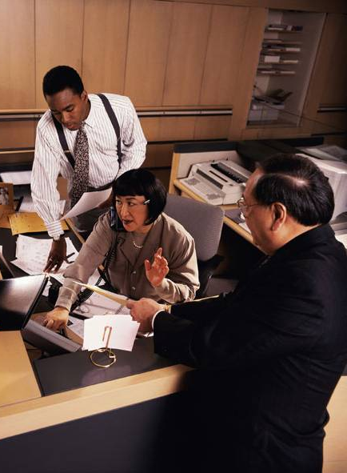
Interruptions
Biggest time waster
Part of the job
Notes:
But let’s be real – interruptions are a part of the job. They will happen. So what we need to do is find the best ways to reduce the number of interruptions and manage the ones that do occur. Just like with how we spend our time, the best place to begin reducing interruptions is to collect some data – how after are you being interrupted and by whom.

Slide 4
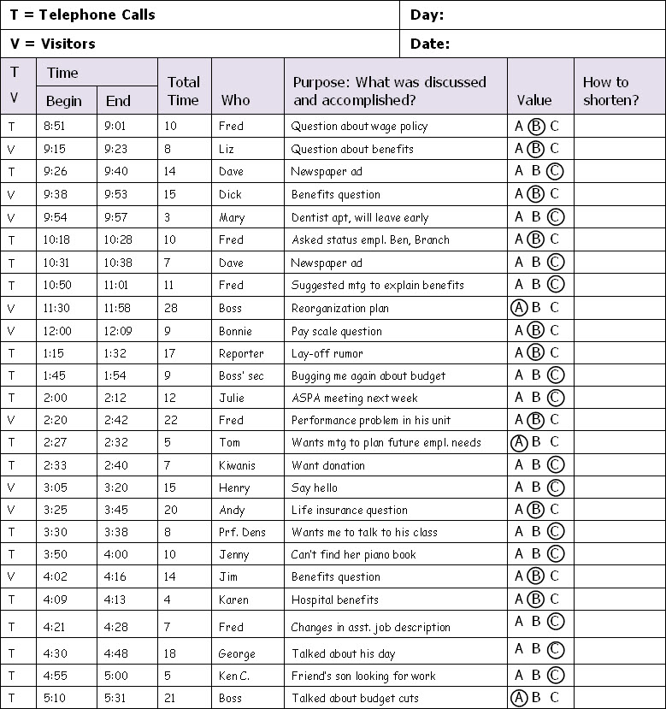
Sample Interruption Record HO 9-1
Notes:
Handout 9-1 Sample Interruption Record
Let’s look at Handout 9-1, the Sample Interruption Record.
How many telephone calls interrupted her day? [17]
How many drop-in visitors? [9]
Which took more time, phone calls or visitors? [Phone calls]
How long was the average interruption? [12 minutes]
How many interruptions were considered high priority? [if “A” means high priority, there were only 3 high priority interruptions]
What suggestions could you offer to help her improve conditions?

Slide 5
Curbing Interruptions
How do you handle different types of interruptions?
Drop in visitors?
Phone calls?
Emails?
Notes:
Even though interruptions are inevitable on the job, we don’t need to be at the mercy of whatever interruptions occur. We can’t control everything, but we can probably control more than we realize. So how do you handle different types of interruptions like drop-in visitors, phone calls, and emails?
If we plan to be interrupted and allow room in our daily schedule for the unexpected, we’ll be well on our way to developing a strategy for handling the interruptions that occur most often.

Slide 6
Handling Drop-in Visitors HO 9-2
Consider priorities
Keep visits short
Stay on track
Meet outside office
Go see them
If we allow room for the unexpected, we are beginning a strategy for handling interruptions that occur most often.
Appointments
Rearrange furniture
Manage “open-door”
Notes:
Consider priorities. Keep in mind that some interruptions are important but most are merely routine.
Keep visit short.
Keep the discussion focused and on track.
Meet outside of your office.
Go see them. When you’re the visitor, it’s easier to control the length of the visit.
Use routine appointments. Bunch together items to discuss and address them all in one visit at a specific time. If you find you’re being interrupted regularly by the same person, consider setting up a regularly scheduled meeting with them.
Rearrange your furniture so you don’t face the door or the traffic flow.
Manage your “open-door policy” wisely. Having an open door means that you should be easily accessible to those who really need you. Is does not means that you are at the mercy of anyone who walks through your door. You can close your door occasionally or establish regular quiet time when you won’t be disturbed.

Slide 7
Managing Telephone Interruptions HO 9-2
Analyze
Screen
Plan
Set preferred times
Move past small talk
Managing time spent on telephone calls will enable you to work more efficiently.
Use timers
End the call
Notes:
Studies have shown that about half of all business calls aren’t about business. Even calls that start with discussing worthwhile topics often digress into social talk. So we need to find a way to curb phone interruptions and manage them when they do occur.
Analyze. Determine how often your day is interrupted by unexpected phone calls and develop an approach for handling them.
Screen. Keep in mind that even though a lot of us may prefer to answer our own phones, this policy can often waste a great deal of time. The higher a person is in an organization, the greater the cost of that wasted time. Analyze your phone calls to determine who should answer the phone and make sure they are properly trained. They’ll need to know which questions to ask callers, how to ask them, when and how to refer callers, and which questions to answer themselves
Plan your calls. Have information at hand, make an agenda, be prepared to talk, organize yourself before you call.
Establish periods when you prefer to take calls and make them known. At the same time, ask when they prefer to receive calls and call at those times.
Move past small talk as quickly as possible by getting to the point and staying there.
Use timers to remind yourself of the amount of time you’ve spent on the phone.
End the call when necessary. Tell your caller that you have another call, appointment, or urgent task. Don’t worry about offending people – don’t be rude, but be firm.
Keeping track of the interruptions that disrupt your day is bound to be an eye-opening experience. At the same time, recognizing how much time you lose because of telephone calls, drop-in visitors, and other distractions will help you gain control of these interruptions.

Slide 8
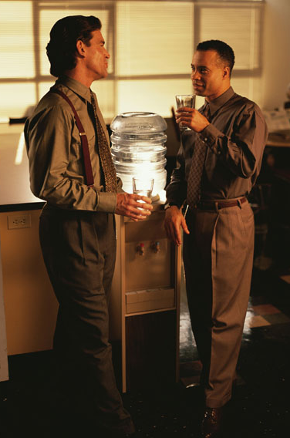
Socializing
Helps to build necessary relationships
Use consideration
Notes:
However, it’s important for us to keep in mind that we do need to socialize and communicate with each other on the job. Socializing helps build and maintain the relationships we need. But too much socializing will not only prevent us from performing our jobs, it can tear down the same relationships we’re trying to build.
Most of us think of interruptions as something that other people do to us. We seldom think that the interruptions we create for others is part of the problem. Yet if we’re honest with ourselves, we will realize that we are also part of the problem. Let’s try to treat others with the same consideration for their time as we’d like them to treat us.

Slide 9
Time Mastery Profile ®
Improving Meetings
Human Resources
Professional Development and Learning
Notes:
How many of you have ever experienced a meeting that felt unproductive? What about it made it feel that way?

Slide 10
Case Study
Handout 10-1: Budget Meeting
Read the meeting notes
Discuss the questions with your table group
Notes:
We’re going to start today by looking at a case study and discussing it. In small groups, read over the Budget Meeting case study and discuss the questions.

Slide 11
Budget Meeting
What went wrong?
Who was responsible?
Notes:
What went wrong with this meeting? [The meeting didn’t start on time, it didn’t accomplish its objective to discuss the marketing division’s budget for next year, there was a lack of clarity on how to prepare for the meeting, not everyone participated]
Who is responsible for these problems? Why? [Everyone was responsible in one way or another but the person in charge bears the brunt of the responsibility.

Slide 12
Types of Meetings
Type of Meeting | Daily | Weekly | Monthly | As Needed
Check-ins/Huddles
Full staff/team
One-on-ones
Projects/Events
Inter-team
Full department
Other one-on-ones
Other groups
Notes:
Daily/Weekly check-ins/huddles: These are 10-15 minute check ins where people can update on what they have been working on and what they will be working on. A good time to coordinate schedules and quiet time. Connects the team and allows for more consistent face-to-face time.
Weekly staff meetings with all your directs: Usually 60 minutes, a regular meeting for problem solving, question asking, brainstorming, and sharing.
Weekly one-on-ones with each of your directs: Usually 60 minutes, a space for your directs to ask you questions, bring up issues, and build a relationship with you.
Weekly/monthly project meetings: For projects, events, or any other type of multi-effort coordination, usually 60 minutes long.
Weekly/monthly inter-team meetings: This is for teams who have high contact or interaction with one another, for updates, make sure everyone is on the same page, and how can things like communication and work be done better.
Monthly department meetings: Usually 60-90 minutes, a chance for everyone across the department to know what’s going on and how they can support one another.
Other one-on-one meetings when needed
Other group meetings when needed

Slide 13
Different Meeting Structures
Type of Meeting
Standing
Walking
Sitting
Virtual
Check-ins/Huddles
Full staff/team
One-on-ones
Projects/Events
Inter-team
Full department
Other one-on-ones
Other groups
Notes:
Not every meeting that you have with people has to be in a conference room or office with people sitting down for 60-90 minutes. There are different ways you can have meetings to keep them fresh, interesting, or short.
Different meeting formats
Standing meetings (as in literally standing up): A good way to keep meetings short as most people don’t like standing still for long. Great for 10-15 minute check-ins or huddles
Walking meetings: This adds variety to meetings, keeps you active, and can help generate ideas. Good for one-on-one meetings.
Sitting meetings: The most common form with people sitting together, but you can get creative in where you sit – at chairs around a table, on couches, at a café around a coffee table, etc. Good for one-on-ones or group meetings.
Virtual meetings:

Slide 14
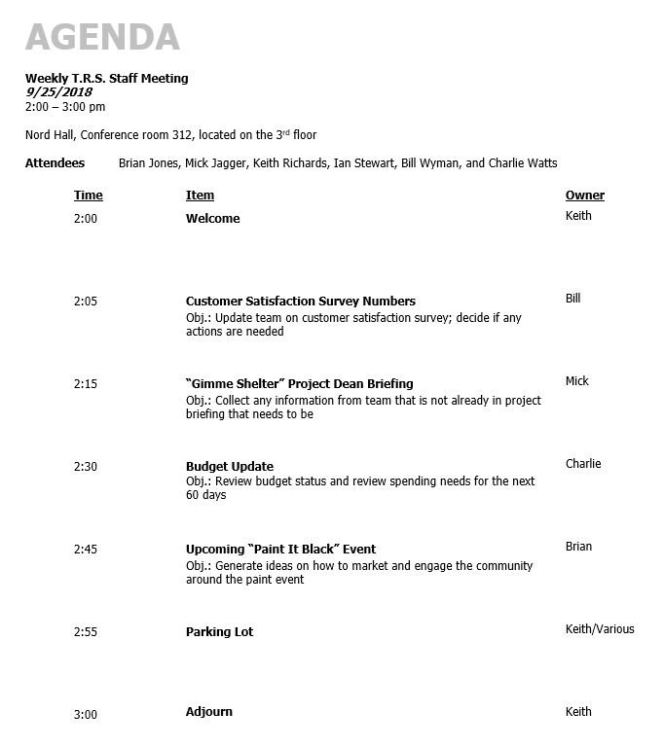
Effective Meeting Components
Have an agenda
Name, date, time, location, and attendees
Time, item, and owner
Objective
Notes:
The agenda is what guides the conversation – it’s basically the north star to make sure you cover everything that needs to be covered and to help you keep things on track
The agenda should be written and passed out to everyone in advance of the meeting
If you are having an impromptu/unscheduled meeting, take the first couple of minutes to quickly jot down an agenda – again, it guides the conversation and gives you something to bring people back on track
In the case of the daily huddle, the format you follow every day essentially becomes the agenda, so a written agenda is not always necessary. If you are a very interdependent team, a written agenda may be helpful if a lot of work requires coordination on a daily level. I have worked with physician offices to implement these and one of the most difficult things for people to see is truly how much they do work together. They didn’t recognize how important it was to their schedule to prevent small stops and starts that could throw off an office visit by 5 minutes. By the end of the morning, they could be behind by more than a half hour, which meant nobody got time to really eat lunch and take a break.
Keeping it to one page or less, it should include:
A header with the name of the meeting, date, time, location, and attendees
If an attendee is not needed for the entire meeting, let them come and go for their portions.
Then lists items, who owns them, and their start times (not duration because people will be sitting doing the math to figure out if you’re still on schedule or not)
Many people don’t put the time on their agendas, but that is the best way to make sure that meetings stay on track and end on time – it allows everyone to hold one another accountable
You also may want to explicitly state what the objective is for the meeting and/or for each agenda item so that everyone knows why, exactly, you are meeting and why you are there. People are more likely to contribute if they know why they are there and what they’re supposed to do. Some possible objectives are: Do you want to generate ideas? Are you getting status reports? Are you communicating something? Are you making plans? Could word it like, “At the close of the meeting, I want the group to…” with the end clearly defined and everything in the agenda working toward that end.
Even if this is not written out explicitly, everyone should know what the purpose of the meeting is and their role in it – why are they there, what do they need to prep beforehand and bring to the meeting, and how are they expected to contribute
This means people may need to do some pre-work or you may need to touch base with people before the meeting. When people know what the objectives are beforehand, they have a better sense of how and what they need to prepare to make the meeting as effective as possible.
Some meetings, such as standing meetings like one-on-ones, don’t have to have an agenda, but they should have an understood process (such as one-on-ones has the process of the employee’s time, the supervisor’s time, and remaining time focused on development)

Slide 15
Effective Meeting Components
Have an agenda
By consistently starting on time, people will start coming on time
The leader should arrive a few minutes early
If people come in late, ignore them and don’t recap
Start on time
Notes:
Start on time
If the meeting is to begin at 8:00, it should start at 8:00 even if everyone is late. By consistently starting on time, people will learn that you mean it and will start showing up on time. And if you have anyone who is consistently late, that’s a good opportunity for feedback
This means that whoever is leading the meeting should arrive a couple of minutes early so that they are settled in and ready to go when the meeting is scheduled to start
If people come in late, just ignore them – no need to call them out. Also don’t recap for them, and if they ask for a recap you can say something like “I would be happy to catch you up after the meeting so we can stay on track” or “James has a meeting to get to right after this, can I catch you up afterwards?”

Slide 16
Effective Meeting Components
Have an agenda
Some ground rules to consider:
We start and end on time
We will stick to the agenda
How time reminders work
How the parking lot works
No cell phones
One person speaks at a time
Start on time
Set ground rules
Notes:
Set ground rules
Spend the first couple of minutes, such as during the welcome, to set the ground rules for the meeting and to cover the process of how the meeting will work.
Some good ground rules to consider: we start on time, end on time, stick to the agenda, how time reminders will work, the use of the parking lot, no cell phones, and one person speaks at a time (no side conversations)
Weekly meetings will usually have the same ground rules, so it might be a good idea to write them down and post them wherever you commonly meet. To set those ground rules, consider having an agenda item at an early meeting to come up with them.

Slide 17
Effective Meeting Components
Have an agenda
Start on time
Set ground rules
Stick to the agenda
Use time reminders to keep people on track
Notes:
Stick to the agenda
As mentioned earlier, the agenda is the guiding star of the meeting, so stick to it. If an item is supposed to begin at 8:30, then you need to wrap up the previous agenda item with an action step and keep it moving (that action step might be something like, “Sarah will bring more information on the project for the next meeting’s discussion”). If more time is needed for an item, you can always schedule a separate meeting for it or put it on the next agenda.
To make sure people don’t feel completely cut off by the time restraints, give time warnings by saying something like, “Two minutes” and “You have one minute.”
If an agenda item finishes early, it’s fine to start the next item early. However, you should always end each item on time to make sure you have the time to get to everything.
If you find people are getting off track, you can use the agenda to help guide people back to the conversation (“that’s a great point, but we’re currently talking about this quarter’s goals”). If someone brings up something that is off topic but important, tell them to put it in the parking lot

Slide 18
Effective Meeting Components
Have an agenda
Start on time
Parking Lot
Set ground rules
T.B.B. coordination
Negative results from survey
Supply order
Stick to the agenda
Use a parking lot
Notes:
Use a parking Lot
The parking lot is a great place to put items or issues that come up in the meeting but are not related to the agenda. They’re important but aren’t scheduled for today.
It’s a good idea to consider posting it in a way where everyone can see it and add to it
Keep five minutes at the end of the agenda for the parking lot so you create action steps for them – you don’t have to discuss them at that time, but figure out a plan to deal with them (such as scheduling a separate meeting for them, putting them on the next week’s agenda, etc.)
Bonus – if there’s nothing on the parking lot and you have 5 minutes scheduled for it, you’ll end early!

Slide 19
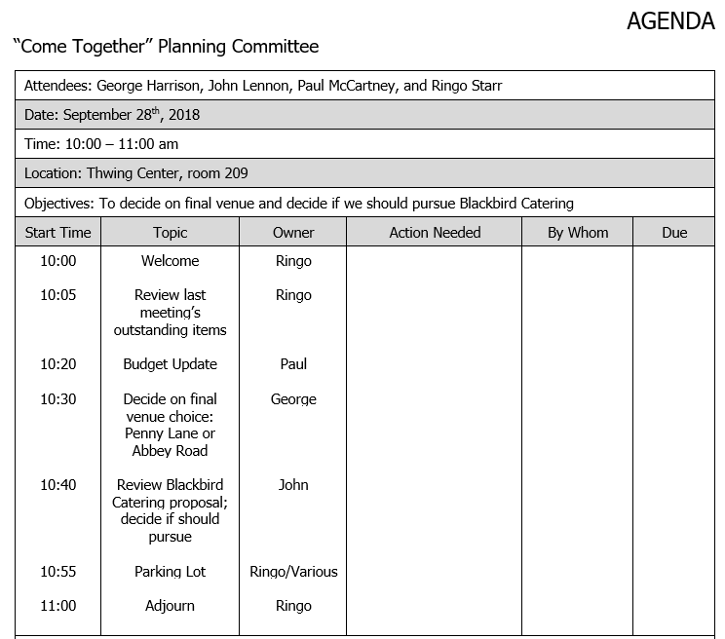
Effective Meeting Components
Have an agenda
Start on time
Set ground rules
Stick to the agenda
Use a parking lot
Create action steps
W.W.D.W.B.W.
When determining actions, ask as a question so they verbally commit to it
Notes:
Create action steps – W.W.D.W.B.W. “Who will do what by when?”
Wrap up agenda items by determining action steps – who will do what by when? It makes people walk away feeling like the meeting served a purpose because now they have something to do coming from it.
If the meeting is a mixture of different items, create action steps for each agenda item. It’s a great way to wrap each of them up. If all the agenda items are geared toward a specific overall meeting outcome, it’s okay to wait until the end to create the action steps (but you should probably plan/schedule time in the meeting for that).
When assigning tasks, ask it as a question so they verbally confirm to the group they’re committing to that item. “Lawrence, you’ll do x by Thursday, right?” or “Who said they were going to do y?”
Creating action steps is a great practice, especially if you have to cut someone off to get to the next agenda item. For example, let’s say an item’s objective is to agree to a solution to a problem but the discussion was more contentious than expected so it took longer than expected. You might need to cut off the conversation and say something like, “Unfortunately, we’re going to need to end it there. For next week’s meeting, can everyone bring a possible solution to this issue?”

Slide 20
Effective Meeting Components
Have an agenda
Summarizes:
Who is doing what by when
What decisions were made
What was reported out
Start on time
Set ground rules
Stick to the agenda
Use a parking lot
Create action steps
Publish the minutes
Notes:
Publish the minutes
The minutes don’t have to be super formal, don’t need to be overly detailed, they don’t need to summarize every point made, and not every item necessarily needs much written about it
Instead, it should include a roundup of who is doing what by when, what decisions were made, and what was reported out. They should be sent to everyone who attended the meeting.
It’s totally fine for this to be a series of bullets in the body of an email

Slide 21
Effective Meeting Components
Have an agenda
Leader: In control of the content of the meeting
Start on time
Set ground rules
Stick to the agenda
Use a parking lot
Create action steps
Publish the minutes
Facilitator: In control of the process of the meeting
Minute taker: Keeps notes about the meeting
Rotate roles
Notes:
Rotate roles
There are different roles that people can have during meetings, and it’s a good idea to consider rotating these roles to give people practice running and managing meetings
Leader: The leader is in control of the content of the meeting. If at a staff meeting, they are usually the supervisor. They usually are the people with decision-making authority. They ask questions, gather information, ensure everyone contributes, and make decisions when necessary.
Facilitator: The facilitator is in control of the process of the meeting. They start the meeting, keep everyone on the agenda, keep time, wrap items up by confirming action steps, makes sure the parking lot is covered, etc.
It’s possible for the leader to be the facilitator, especially at first, but by focusing on the process you may not be able to engage as much with the content or, conversely, you may be so focused on the content you loosen the process (like by allowing more time to items because you want to hear more). By separating the two, the leader can focus on the content and doesn’t have to watch the clock as closely. However, that means the leader needs to support the facilitator – when they say it’s time to move on, it’s time to move on.
Minute taker: The minute taker keeps notes about the meeting and sends out the minutes after the meeting. The minute taker should not be someone who has a lot to contribute in that meeting.
Evaluate regularly - continuous improvement

Slide 22
Effective Meeting Components
Have an agenda
Every quarter, evaluate how the meetings are going:
Are we sticking to the ground rules?
Do the ground rules need to be changed?
Are we running meetings as efficiently as possible?
How can we improve?
Are these meetings still necessary?
Start on time
Set ground rules
Stick to the agenda
Use a parking lot
Create action steps
Publish the minutes
Rotate roles
Evaluate regularly
Notes:
Evaluate regularly - continuous improvement
Every quarter, add an agenda item to standing meeting to review how the meetings are going. Are we sticking to the ground rules? Do they need to change? Are we running things as efficiently as possible? How can we improve? Are these meetings still necessary?
It’s a good opportunity for open feedback to the whole group and to help get things back on track if they’ve been drifting.

Slide 23
Time Mastery Profile ®
Conquering Procrastination
Human Resources
Professional Development and Learning
Notes:
How many of you feel like you don’t have a problem with procrastination? It’s pretty safe to say that all of us procrastinate occasionally. What kind of things at work do you find yourself putting off, or delaying, most often?

Slide 24
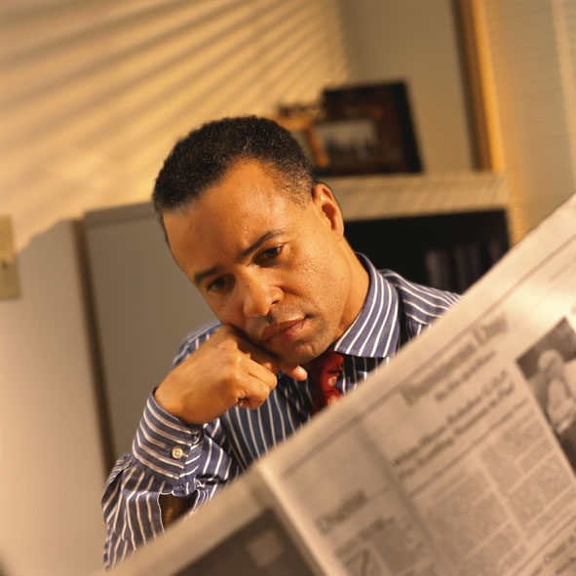
Procrastination
…doing lower- rather than higher-priority tasks
Unpleasant
Complex
Overwhelming
Notes:
Procrastination is doing low priority actions or tasks rather than higher priority ones. So why do you think people procrastinate? We tend to put off things that are unpleasant, complex, or overwhelming.

Slide 25
Cost of Procrastination HO 13-1
Time
Money
Health
Good Will
What problems am I likely to create for myself?
Notes:
What does procrastination cost us? Time and money are obvious, but what do you feel like when you procrastinate doing something important? [guilty, tense, defensive, depressed, etc.] This is how procrastination also costs us our health and good will. The quality of our work and relationships suffer when we procrastinate, and we end up disliking ourselves and our job.
To conquer procrastination, we need to understand the role of two important elements: habit and inertia.

Slide 26
Role of Habit
Procrastination breeds procrastination
Changing a do-it-later urge into a do-it-now habit requires positive action
Notes:
Habit: Procrastination breeds procrastination. It’s easy to get into the habit of saying “I’ve got to do something about that,” and then putting it out of your mind. Changing this habit will require some positive action on your part, but it can be done.

Slide 27
Role of Inertia
A body at rest tends to remain at rest
Once begun, action is much more likely to continue
Notes:
Inertia: A body at rest tends to remain at rest. To conquer procrastination, we must first overcome our inertia. Once we get going, action is more likely to continue. It’s the beginning that’s difficult.

Slide 28
Conquer Procrastination
Do you have any procrastination “habits”?
How do you help prevent procrastination?
How do you get yourself going when you realize you are procrastinating?
Notes:
Do you have any procrastination “habits”? How do you help prevent procrastination? How do you get yourself going when you realize you are procrastinating?

Slide 29
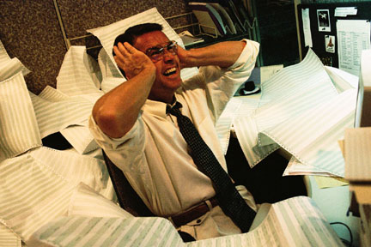
Conquer Procrastination HO 13-1
Admit it; analyze it
Consider consequences
Break it down
Delegate it
Use pep talks (switch cost)
Changing a do-it-later urge into a do-it-now habit requires positive action.
Reward yourself
Commit to action
Notes:
Admit that you’re delaying action. As long as you continue to deny or rationalize your procrastination, you’re in no position to stop it. Once you admit that you are indeed procrastinating, examine your situation and try to determine why.
Consider the consequences if you continue to delay.
Break it down. If the task is unpleasant, complex, or overwhelming, break it down into smaller steps and focus on one step at a time. Completing one small task will give you a sense of accomplishment that can help propel you forward.
Delegate the task, if possible, to someone who may enjoy doing it.
Give yourself pep talks when you begin a task. When you do, make sure that words you are using are positive action. Our brains focus on action works, so when we think “don’t spill the wine” our bring focuses on “spill” and we are more likely to do it; avoid negative stems and focus instead on positive action (“do the work” versus “don’t procrastinate”)
Reward yourself for completing a task, but make sure you earn it!
Commit yourself to action by setting deadlines and promising results to others.

Slide 30
Case Study
Handout 13-2: There’s Always Tomorrow
Read the procrastination case study
Discuss the questions with your neighbors
Notes:
Read the study and discuss answers with your neighbors.

Slide 31
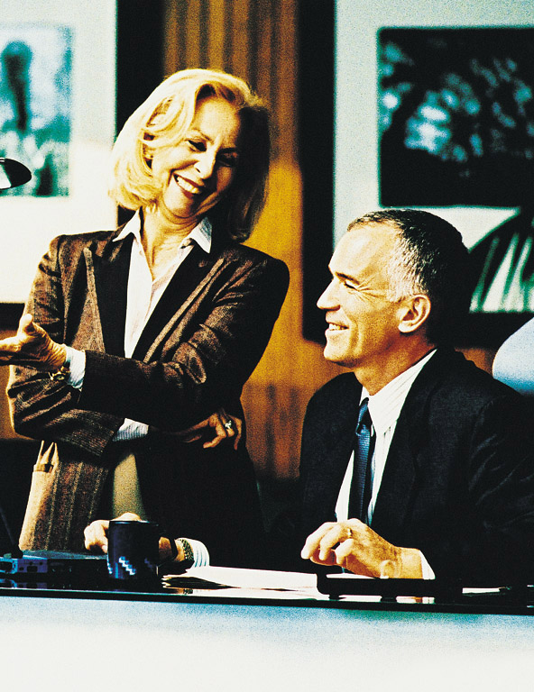
There’s Always Tomorrow
What are Chris’s work habits?
What could go wrong if Chris procrastinates too long?
What suggestions would you offer to Chris?
Notes:
“What do we know about Chris’s work habits?” [he’s a procrastinator and doesn’t appear to be able to break projects into smaller pieces]
“What are the possible results if Chris procrastinates too long?” [miss important deadlines, not complete the report at all, jeopardize his position]
“What suggestions would you offer to Chris?”

