Slide 1
Social Determinants and the Opioid Epidemic in Ohio
Elisabeth D. Root, PhD
Professor
Geography & Epidemiology
Notes:
Thank you for the opportunity to present some of the work Ohio’s done over the past several years on the SDH and the opioid epidemic in our state.

Slide 2
Overview
Social determinants of health (SDH)
Substance use disorders and SDH
The HEALing Communities Study (HCS)
How SDH are important for HCS/community-based interventions
Some work on SDH of OUD

Slide 3
Intersection of Health, Place, and Equity
Health facilities
Access to
Healthy
Food
Schools/
Childcare
Health
Social Determinants of Health
Responsible for significant health inequities within and across communities
Housing
Community
Safety/
Violence
Environment
Equity
Parks/Open Space/
Playgrounds
Transportation Traffic patterns
Geospatial inequalities in health
Work
environments
Notes:
Outline the Issues
Some points for elaboration:
Schools – both youth education and higher education
Safety – on many levels, starting with youth safety in the home and at school; safe places for everyone to work, live and play; traffic safety; etc.
Transportation – safe and affordable options for commuting; ability to access needed resources
Pollution – the water we drink, the air we breathe, our food sources
Climate change – critical issue internationally
Access to resources – access to healthy foods, clothing, necessities for living
Housing – safe and clean housing that is affordable
“These issues are complex and interrelated.”
Combined these community environmental factors are unequally distributed across place (geography) and ultimately impact the health and well-being of the population.
Point out links between Environment, Economy & Health as well
This diagram does not reflect all of the linkages or all of the factors

Slide 4
Place Matters
Communities of Opportunity
Good Health Status
High Vulnerability Communities
Parks
Sidewalks
Grocery Stores
Financial Institutions
Better Performing Schools
Good Public Transportation
Safe and Clean Housing
Fast Food Restaurants
Liquor Stores
Unsafe/Limited Parks
Poor Performing Schools
Increased Pollution and Toxic Waste Sites
Limited Public Transportation
High Levels of Crime
Poor Health Status contributes to health disparities:
Obesity
Diabetes
Asthma
Infant Mortality
Notes:
We know that place and health are inextricably linked. That WHERE you live impacts HOW you live.
Improving health cannot be addressed disease by disease but must be informed by a comprehensive understanding of the wide range of factors that shape health status.
That people thrive when parents earn living wages, when children can get a quality education and have easy access to safe parks, grocery stores selling F&V. Families cannot thrive in unhealthy environments
People living in communities with walking paths, parks are more active than those who not have access to these. When people have access to healthier foods, they make healthier choices- and that securing new or improved local grocery stores can also improve local economies and create jobs
All community environments are not created equal when it comes to opportunities for healthy living. Low-income and communities of color are more likely to lack health-promoting infrastructure and resources
.
At the same time, a national health movement is growing
More and more people are recognizing the impacts that chronic diseases such as diabetes and obesity are having on their communities, which are often preventable, and wanting to do something about it to change the health of their families, communities and constituency. This movement recognizes that healthy people and healthy places go together. The growing movement for healthy communities—with its push for changes in the physical, economic, social, and service environments –holds great promise

Slide 5
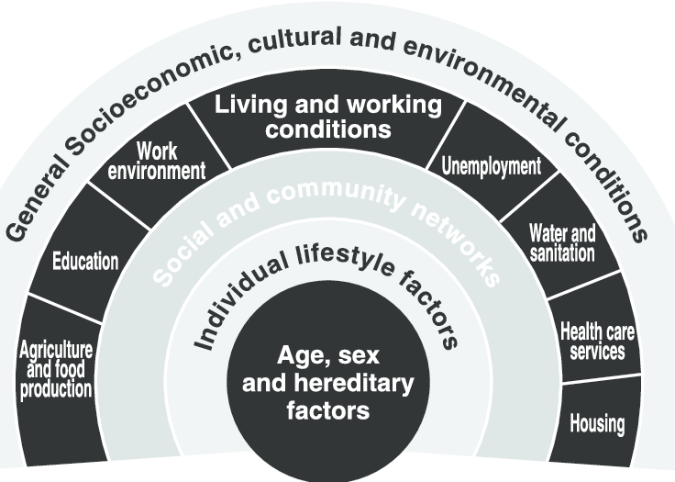
Social Determinants of SUD
Proximal vs. Distal
Individual vs. Community
Generally, SUD/OUD literature focuses on:
proximal determinants (e.g., demographic and individual lifestyle)
social/community networks (e.g., peer support, stigma, exposure to prevention programs)
Dahlgren and Whitehead (1992)
Notes:
A significant body of literature demonstrates that the social determinants of health are responsible for significant health inequities within and across communities. But the SDOH are a complex and multidimensional concept which must not only consider the multitude of social, economic and structural factors which impact people’s daily lives, but also the ways in which these factors interact in time and space.
There are a variety of conceptual frameworks that show the complex and interacting nature of the SDH. Many of you will recognize Dahlgren and Whitehead’s conceptual model show here. I like this model because it groups determinants into more proximal factors (such as age, sex, and individual behaviors) and distal factors (the conditions that exist in the communities) and leaves room for even higher order political and economic policy influences.
This distinction between proximal and distal determinants is important because it lays the groundwork for research that seeks to pull apart the impact of individual- level factors and community-level factors.
Generally, the SUD/OUD literature focuses on these proximal determinants. Things like:
Homelessness, marital status, unemployment, family history of SUD, prior incarceration, low income
Social/community networks: personal support systems, engagement with peer support programs, perceived stigma

Slide 6
Social Determinants of SUD
Only a very small SUD literature focusing on distal factors
Community-level living and working conditions
Political structures, larger economic and structural components of community that are barriers or facilitators
Dahlgren and Whitehead (1992)
Notes:
But, the SUD literature focusing on distal factors, the community-level living and working conditions, political structures and larger economic conditions, and structural components are the environment is quite modest and not well developed.

Slide 7
SDH are complex and interrelated
SDH is a geographic, multidimensional concept
Multitude of social, economic, and structural factors which impact people’s daily lives
Factors interact in time and space to produce health inequalities
Need small area estimates to capture significant differences in n’hoods within a county
The multidimensional nature of the SDH creates challenges for empirical measurement
One variable cannot adequately capture the complexities of the concept
Need an index which combined multiple measures of the SDOH
Notes:
SDH is a multidimensional concept…
The SDOH also often affect different gender, racial/ethnic, or socioeconomic groups unequally, even when these populations live within the same community
This adds a layer of difficulty when trying to identify populations most in need of support or to determine effective interventions.
Rural areas may have a high poverty level, for example, but they may also have lower crime rates.
Some places suffer disproportionately from drug overdose while others are in the middle of a food desert.
Because of this complexity, a single variable cannot adequately measure the impact of social and economic inequalities on health.
Opportunity or deprivation indices are often used to aggregate and quantify the impacts of SDOH on a population.
A variety of individual measures, such as unemployment, walkability, or median rent, are chosen to reflect the different facets of SDOH and these are then combined into an overall score for a specific area.
As a composite index, this approach allows researchers to include multiple variables while also producing a measure that allows for comparisons across locations.

Slide 8
The Ohio Opportunity Index
Transportation
Education
Employment
Housing
Health
Environment
Crime
Public Transit Access
Average Commute Time to Employment
Households without access to a vehicle
Traffic proximity
Population with an Associate’s Degree or Higher
Average school performance
Average free & reduced lunch rate
High school graduation rate
Households with a residential internet connection
Low-wage job access by educational attainment
Access to workforce or job training sites
Unemployment rate
Poverty
Median Rent
Median Home Value
Concentration of existing LIHTC units
Population living with overcrowding
Population that moved 3+ times in the last year
Age-adjusted mortality rate
Preventable ED admits/visits
Diabetes admits/ diagnoses
Geographic access to medical providers
Geographic access to healthy food options
Geographic access to hospitals
Access to green space
Average PM2.5 levels
Neighborhood walkability score
High density urban landcover
Traffic related air pollution
Homicide, aggravated assault and sexual assault
Robbery
Burglary, larceny-theft, and motor vehicle theft
Public drunkenness and DUI
Drug-related crime
Each variable is standardized by converting it into a z-score and summed. Domain-specific were ranked in order of increasing deprivation and transformed to an exponential distribution.
The variables for each domain are combined using standardized scoring coefficients (weights) generated by factor analysis.
Overall Opportunity Index
Notes:
I know some of you have seen this before, but part of the effort was to develop a multidimentional index to capture key social determinants of health. Our state partners call this the Ohio Opportunity Index. It was developed at the census tract level to facilitate small area analyses. You can see the 7 domains selected in collaboration with our state agency partners. The data are a combination of publicly available information (census data, HUD, EPA) and requests made to state agencies (education, crime and health).
In modeling, domains can be used individually or combined into a full index.

Slide 9
The HEALing Communities Study (HCS)
Test the impact of an integrated set of evidence-based practices across health care, behavioral health, justice, and other community-based settings
Primary Study Outcome: Reduce opioid-related overdose deaths by 40 percent over the course of three years
Notes:
Ohio has over 11.7 million citizens.
12 metropolitan statistical areas but much of the state’s geography is rural, including 32 Appalachian counties where access to healthcare and behavioral health services is limited.
Of our 19 selected counties their demosgraphics vary greatly
X Opioid deaths with rate of X per 100.000
19.8% AA ranges from 0.3 percent (Wyandot) to 29.7
percent (Cuyahoga)
The circumstances of daily living vary considerably from county to county.
For example, in the 19 counties participating in the OHiO Study, median family income ranges from $51,101
(Athens) to $80,555 (Greene)1, unemployment ranges from 3.1 percent (Wyandot) to 6.1 percent (Scioto),2 and
life expectancy ranges from 74.8 years (Scioto) to 79.6 years (Greene).3 With respect to race and ethnicity, the
percentage of the population represented by African-Americans and the Latino population ranges from 0.9 percent (Brown) to 6.9 percent (Lucas).4,5 This
diversity is what draws market researchers and presidential candidates to the state (as Ohio goes, so goes the
nation).
This heterogeneity across our state creates an ideal environment for a research site for the HEALing Communities Study.

Slide 10
How will HCS address the problem?
Support Community Decision Making to select among a list of evidence-based practices found to be effective at reducing opioid-related mortality
Capacity Building: Engage with communities to identify and support community access to resources necessary to implement the selected practices in their community
Evaluation: Evaluate each community’s process to identify the core components associated with successful outcomes
Aim: Learn which community-engaged processes are most effective and efficient to reduce opioid deaths
Notes:
Becky

Slide 11
Ohio (HCS) communities are highly diverse
County | Total Pop | Pop Growth/ Decline | % Poverty | % Black | % HS Grad | Violent Crime | % Severe Housing Problems
Allen | 102,725 | -3.7 | 13.9 | 14.5 | 85.0 | 407 | 14.0
Ashtabula | 97,241 | -4.1 | 19.9 | 5.3 | 88.0 | 82 | 15.0
Athens | 65,327 | -0.9 | 30.2 | 3.8 | 92.0 | 72 | 22.0
Brown | 43,432 | -3.2 | 15.3 | 1.4 | 94.0 | 29 | 12.0
Cuyahoga | 1,235,072 | -3.5 | 17.5 | 31.5 | 86.0 | 6,940 | 17.0
Darke | 51,113 | -3.5 | 10.5 | 1.3 | 97.0 | 56 | 12.0
Franklin | 1,316,756 | 13.2 | 15.7 | 25.1 | 89.0 | 5,136 | 16.0
Greene | 168,937 | 4.6 | 11.6 | 8.7 | 92.0 | 198 | 13.0
Guernsey | 38,875 | -3 | 19.9 | 2.9 | 87.0 | - | 13.0
Hamilton | 817,473 | 1.9 | 15.8 | 27.9 | 87.0 | 3,579 | 17.0
Huron | 58,266 | -2.3 | 13.2 | 2.3 | 96.0 | - | 11.0
Jefferson | 65,325 | -6.3 | 17.5 | 7.0 | 93.0 | 54 | 11.0
Lucas | 428,348 | -3 | 18.7 | 21.9 | 84.0 | 3,404 | 16.0
Morrow | 35,328 | 1.4 | 9.7 | 1.6 | 93.0 | 19 | 11.0
Ross | 76,666 | -1.8 | 17.3 | 7.3 | 90.0 | 192 | 13.0
Scioto | 75,314 | -5.2 | 22.6 | 3.7 | 95.0 | 143 | 15.0
Stark | 370,606 | -1.3 | 13.6 | 9.6 | 92.0 | 1,120 | 12.0
Williams | 36,692 | -2.5 | 11.2 | 1.9 | 94.0 | 10 | 11.0
Wyandot | 21,772 | -3.7 | 7.4 | 0.8 | 95.0 | 20 | 11.0
Poverty ranges from 7 to 30%
% African American ranges from 0.8 to 31%
Notes:
The reason using this perspective, this research lens, is important for our work in HCS is that our communities are really diverse. If you take a look just at Ohio, the 19 HCS communities have significant contextual differences. Many of our communities are seeing significant population decline, with the exception of Franklin, Green, and Hamilton Counties. Poverty rages from 7 to 30%, and our minority populations is highly concentrated in the urban centers of the state. We also have a serious urban/rural divide. But rural is not the same across Ohio. Poor white communities, especially in rural Appalachia, have been disproportionately hit by the opioid crisis.

Slide 12
SDoH in HCS Communities
HCS is a community-based intervention
Tremendous heterogeneity across communities in distal factors that impact SUD
Healthcare infrastructure
Social and economic opportunity
Community recovery capital
Stigma towards OUD/MOUD
Policies and laws
Critical for HCS to incorporate SDOH data into analyses on intervention impacts
Notes:
All this is to underscore why the SDH is so important for the Healing Communities Study. HCS is a community-based intervention and it will be evaluated at the community level. Given the tremendous heterogeneity across communities, applying a SDH perspective becomes even more important. There are a variety of distal factors that could impact the effectiveness of the intervention through a variety of mechanisms.
Community contextual characteristic may lead coalitions to select certain EBPs or to implement those EBPs in certain types of service organizations. This may be a type of selection bias, especially if some EBPs are more likely to impact study outcomes.
Differences in community SUD infrastructure and recovery capital resources or higher levels of stigma around certain resources could make implementation more challenging, successes more modest, and ultimately lead to a smaller overall impact on study outcomes.
Communities with larger minority populations may focus on equity interventions, which are likely to impact a smaller proportion of the population making the community-level effect more difficult to see in the evaluation of study outcomes.
These are just a few thoughts on why it’s so critical for HCS to incorporate SDOH data into our evaluation.

Slide 13
Objectives
Share some of the OUD SDoH work we have done in Ohio
Think about why SDoH are important to evaluate for community-based interventions
Area-level factors to guide program/policy investment:
Access to (MH/SUD) healthcare resources
Workforce development resources (job opportunity)
Public transportation
Housing availability
(Drug) crime
Notes:
So, the Ohio HCS site wanted to share some of the work we’ve done on the SDH and Opioid outcomes in Ohio. The directors of several of our agencies – Ohio Department of Medicaid and RecoveryOhio – are very health equity and social determinants focused and has supported much of this work.
We’ve had a series of projects that sought to estimate….
The study period was 2013-2017
Some of these projects focused on the individual-level factors that impact OUD outcomes with the goal of assisting practitioners in making decisions at the point of service.
Another set of projects was focused at a much higher level – and sought to examine the area-level factors that could be areas for program and policy interventions

Slide 14
Factors/Independent Vars/Drivers/ Inputs
Primary Endpoint
MOUD Treatment Retention
Intermediate Endpoint
BH Treatment Enrollment/Initiation
MOUD type
Number of treatment/recovery attempts
Behavioral health
Census tract SES
Demographics (age, sex, education)
Hepatitis C, other comorbidities
Trauma or Pain Dx (Medicaid)
Public transportation availability
Regional drug trafficking seizures (HIDTA)
Providers who prescribe buprenorphine
Drivers/ Factors
Independent Variables
MOUD Enrollment/ Initiation
Job availability
Number of treatment facilities within 30 miles
OUD or SUD Dx
Continuity of primary health care
Criminal / Child Protective Services / Drug court involvement
Drug court availability
EMS dispatches to zip code of residence
Affordable housing, food security
Individual Level
Area Level/ Contextual
Notes:
This figure shows a conceptual framework used to think about MOUD enrollment and retention. You can clearly see the proximal and distal factors considered. Clearly, we examined important proximal factors such as age and sex, medical history, individual health behaviors, and personal linkage with health services.
But we also considered the distal, area-level factors that impact MOUD enrollment and retention. For example, availability and use of public transportation and the availability of treatment facilities and DEA waivered providers are important for treatment. But researchers heard that job opportunities, affordable housing and food security were important to patients. Finally, drug courts are vital links between individuals and MOUD programs.

Slide 15
Research Questions
Is there geographic variation in OUD study measures?
These “spatial inequalities” are often indicative of area- or community-level SDoH that impact outcomes
What area-level social determinants are associated with this geographic variation?
Notes:
The specific research questions that I’ve been involved in examine spatial patterns of OUD outcomes and try to examine the social determinants association with this geographic variation.
Keep in mind, the analyses that I’m going to share aren’t causal, they are geared toward trying to find community-level associations with OUD outcomes and serve as a jumping off point for both additional research and for helping to make some high-level decisions about community level programming and interventions.

Slide 16
Methods #1: Small-area rate maps and spatial cluster analysis
For small areas and rare events, rates are very unstable, and maps of rates can be misleading
Spatial smoothing can reduce the random noise in rate maps
Rates for each area are adjusted by creating spatially smoothed estimates which “borrow strength” from data in other areas
The observed rate in area A and average rate in surrounding areas are combined by taking a form of weighted average
Spatial cluster analysis is a statistical method that identifies geographic areas with an excess of events given the distribution of cases and population
Notes:
TO examine the geographic variability in our outcomes, we used a series of different spatial methods. We constructed small-area rate maps using a spatial smoothing technique. Spatial smoothing adjusts area-level rates using data from surrounding areas. It stabilizes rates in a similar way to a 3 or 5 year average by using space instead of time to increase sample size.
We also conducted spatial cluster analysis which is a method that uses small geographic areas (clusters) to search for localized regions with an excess of events that would be expected if that event were completely spatially random. Here we search for small areas with rates of our OUD outcomes which are higher than expected given the geographic distribution of the population.

Slide 17
Methods #2: Spatial Regression Modeling
Ecological spatial Conditional Autoregressive Models (CAR) to examine area-level factors associated with outcomes
Poisson regression with counts and a population offset by census tract
Include a set of spatially correlated random effects as part of a Bayesian hierarchical model
Spatial proximity based on census tract adjacency
Inference based on MCMC simulation
Report incidence rate ratio (IRR) and 95% credible interval (CIs)
The IRR represents the change in the dependent variable in terms of a % increase/decrease
Notes:
The second method we employed was a series of ecological spatial regression models to examine the association between our OUD related outcomes and a series of area-level predictor variables.
We used a Poisson specification (the count of each outcome in a census tract) and a population offset
These models use a set of spatially correlated random effects as part of a hierarchical model to control for the impact of spatial correlation in the outcome on estimates and standard errors. It’s a more efficient method for examining spatial data which produces less bias in estimates.
Here I’ll report he incidence rate ratios and the 95% credible intervals
95% CIs are similar to a 95% confidence interval and can be interpreted similarly
IRRs represent the change in our OUD outcomes as a % increase or decrease given the change in one of the area-level independent variables

Slide 18
Overdose Rate per 1,000 by census tract Raw Rate (A) vs. Smoothed Rate (B)
Notes:
This is a small area rate map of the opioid overdose rate by census tract. The left is the raw map, the right is the spatially smoothed map and you can see how the smoothing makes the patterns in the map more apparent.

Slide 19
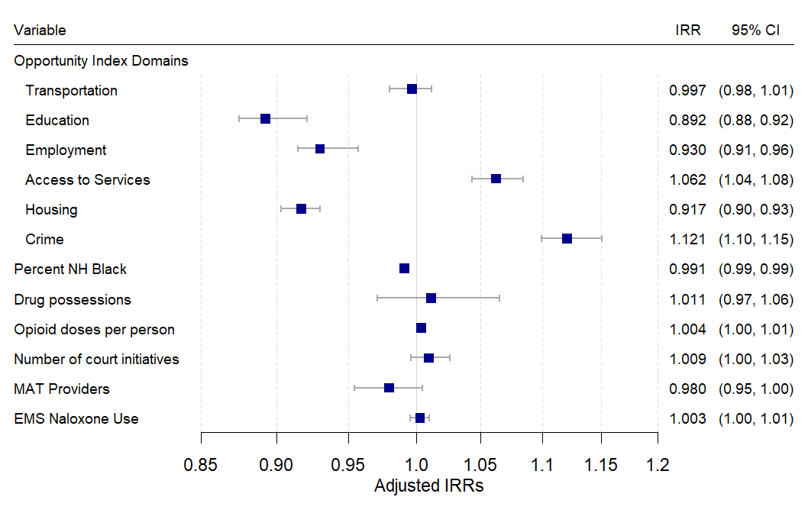
Spatial Conditional Autoregressive Model OUD Overdoses: IRRs and 95% CIs
Notes:
Here are the results of the Spatial regression models on opioid overdoses in the state. There are some interesting associations here.
First, remember that higher levels of the opportunity index represent better conditions in an area (more opportunity). The OI runs from 0 to 100 and the model interpretation is using deciles – a one decile increase in the opportunity index scale leaves to a % increase in our outcomes.
So, you see as educational, employment and housing opportunities increase (by a decile), opioid overdoses decrease by about 10%. As crime increases, so does overdose, by about 12%.
Access to services is interesting. As access to healthcare services increases, so does opioid overdose. This is likely because overdose is overall higher in urban areas of the state, where access to services is greater.
Some of the other OUD specific area-level factors are not as impactful.
An increase of 1% in the black population, decreases overdose by a bit less that 1%
And an increase in prescription opioid (1 - 100 mg equivalent dose per capita) increases overdose by about a half a percent.

Slide 20
Maternal Opioid Use per 1,000 Medicaid Births Raw Rate (A) vs. Smoothed Rate (B)
Notes:
One of the other outcomes we examined was the material opioid use
The raw rate map and the smoothed map on the right show a very clear pattern with a large area in the south with very high rates of maternal opioid use.

Slide 21
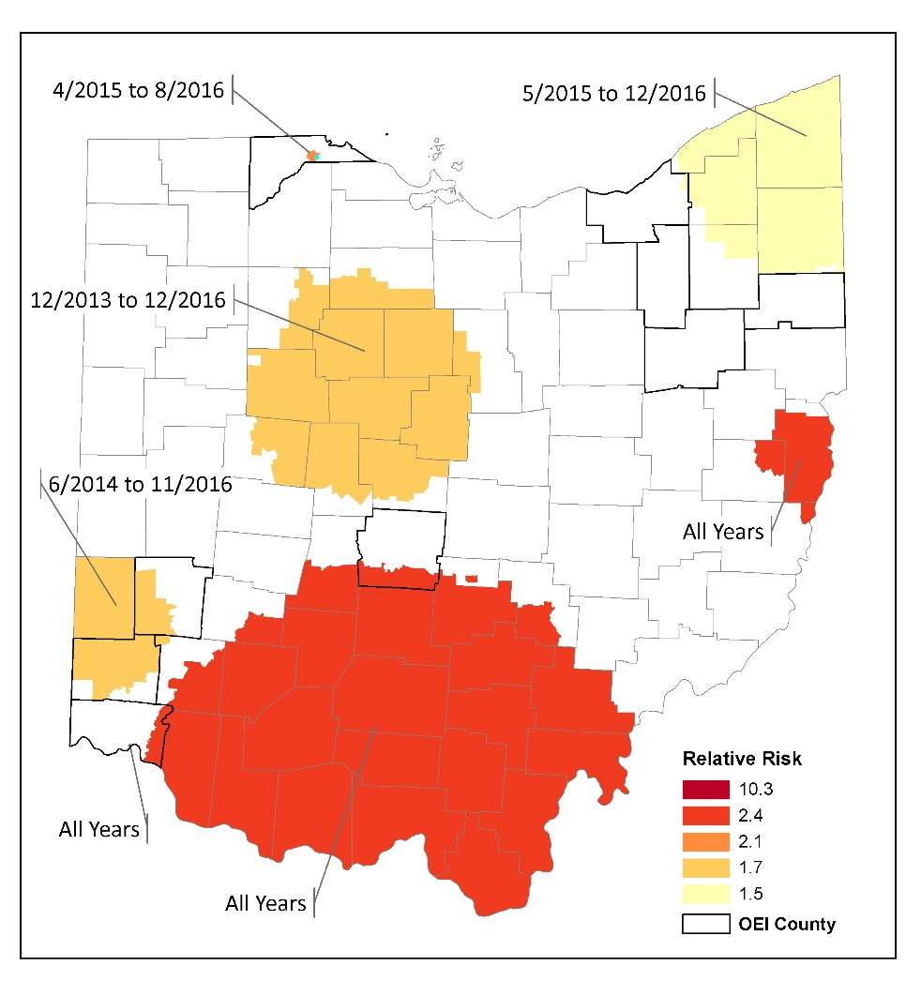
Spatio-temporal cluster analysis
Large high-risk area in the south, Jefferson and small cluster in Cincinnati are temporally persistent
Other high-risk clusters appear at the end of the study period
Reflects worsening of the opioid problem
Notes:
This is an example of a spatial cluster analysis. Here we actually show a space-time cluster analysis, and it confirms the patter on the map. The two large red areas show temporally persistent clusters – meaning they are problematic throughout the study period. In these areas in the south and east, pregnant women are 10 times more likely to have an opioid exposure compared to women in the rest of the study area. Some of the clusters, like the one in the northeast only appear at the end of the study period, showing a worsening of the problem. That cluster is between 2015 and 16 and shows that women living in that area are 1.5 more likely to have an opioid exposure relative to women in the rest of the state during that time period.

Slide 22
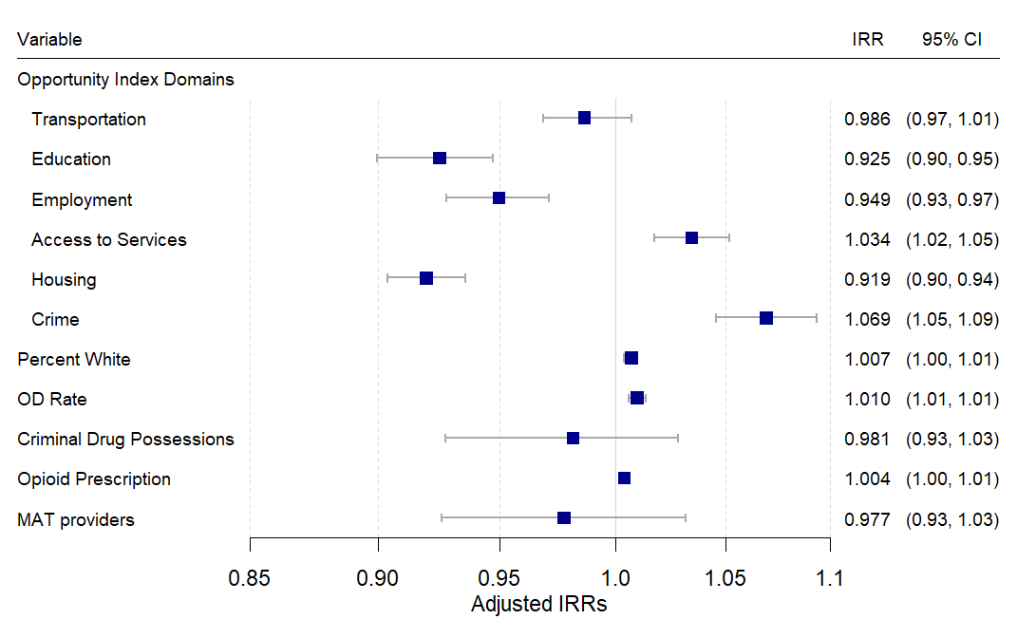
Spatial Conditional Autoregressive Model Maternal Opioid Use: IRRs and 95% CIs
Notes:
Here again are the results of the Spatial regression models on opioid overdoses in the state. There are some interesting associations here.
Similar to opioid overdose, you can see as educational, employment and housing opportunities increase (by a decile), maternal opioid use decreases by about 5%. As crime increases, so does opioid use, by about 6%.
Some of the other OUD specific area-level factors are interesting but with a smaller impact.
An increase of 1% in the white population, increases maternal opioid use by about 1%
And an increase in prescription opioid (1 - 100 mg equivalent dose per capita) increases overdose by about a half a percent.
While an increase of 1 per 1,000 population opioid overdose actually corresponds to a 1% increase in maternal opioid use.

Slide 23
Naloxone Administration by EMS per 1,000 population
Notes:
Finally, I’ve recently been playing around with the EMS naloxone administration data we have. Here’s a spatial smoothed map of the naloxone administration rate for 2017-2019 per 1,000 population. There are clear rural-urban patterns, but also some interesting patterns within cities. In Franklin County the small map on the bottom, the NW corner of the cities has very low rates of administration – this is the predominantly welthy (high opportunity) area of the city.

Slide 24
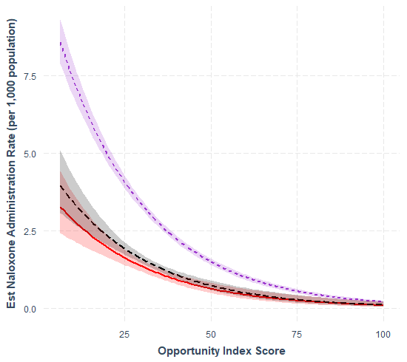
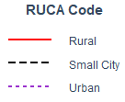
Spatial CAR: Naloxone Administration Predictors: Opportunity Index * Rural/Urban
Included an OI by Rural/Urban interaction
Overall, lower opportunity communities have higher rates of Naloxone administration
But, urban communities have significantly higher naloxone administration rates compared to rural communities and small cities in all but the highest opportunity areas
Notes:
I’ve also been playing around we some spatial regression models that interact the Opportunity index by rural urban codes. You can see the results of one of these models here. I have rural, small cities, ad urban areas pulled out separately.
Overall…the lower opportunity areas (on the left) have higher rates of naloxone administration, this pattern is statistically significant across all rural/urban areas.
But…urban communities have significantly higher nalox admin compared to rural and small cities in all but the highest opportunity areas. This is show because the prediction curves and 95% Cis for naloxone admin do not overlap on the left.

Slide 25
Key Takeaways
Ecological modeling indicates there are modifiable area-level factors impact a variety of OUD-outcomes:
Ohio Opportunity Index Measures: Education, Employment, Housing, Access, Crime
Court Initiatives
MAT Initiation Rate
Opioid Prescribing Rates
Rural/Urban Residence

Slide 26
SDoH in HCS
Our analyses in Ohio show that the SDoH are vitally important for understanding OUD across diverse communities
Developing a core set of SDoH indicators will be important for HCS given the heterogeneity across communities
But it is also important not to lose site that the SDoH are complex and multidimensional, not easily captured by just a few variables
Data on the SDoH can also assist communities with planning and selecting EBPs
Targeting populations, targeting geographic areas, targeting specific services or programs
Include in the community profiles or dashboards

Slide 27
Thank You Questions?

