Slide 1
Time Mastery Profile ®
Swetland Center—Time Management Part 2
Human Resources
Professional Development and Learning
Notes:
Interruptions is by far one of the biggest time wasters people identify. On average in an office, people are interrupted 6 times per hour! But not only is the amount of interruptions a problem, but what it does to our cognition is also a problem. How long do you think it takes for your brain to switch back to a task that it’s been interrupted from? It takes 45-90 seconds to get back to the cognitive level you were at prior to the interruption. This means you could be losing almost ten minutes an hour just from interruptions alone!

Slide 2
Today’s agenda:
Quick Review: Habits and Change
Improving Meetings
Handling Written Communications
Delegation
Improving Team Time

Slide 3
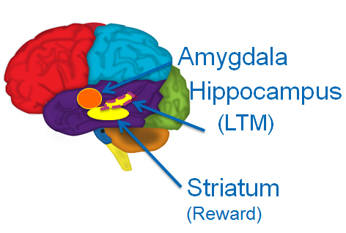
Stress Perpetuates Habits
“Your brain is wired for change but it’s not wired to change”
Srini Pillay M.D., CEO of NBG
Habits are reinforced groups of neural pathways in your brain
The brain doesn’t like uncertainty
The change is being compared to past experiences (good or bad)

Slide 4
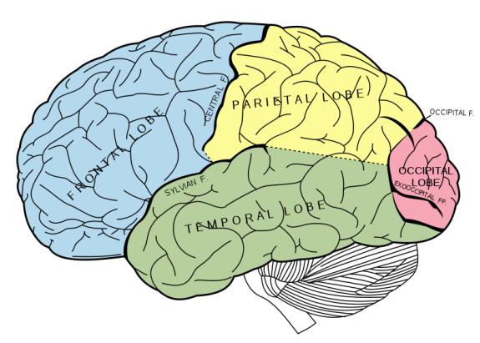
Time and Switch Cost
New behaviors mean a change in how you
think and act
Intention must be connected to action
for change to occur
Changing behavior places considerable
demands on precious brain resources

Slide 5
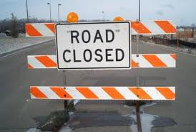
Managing Switch Cost
What to look for? Prepare your brain for:
Decrement in performance
Slower
Mistakes
Less proficiency
May be wrong
Roadblocks = change
Have a plan
Backwards inhibition

Slide 6
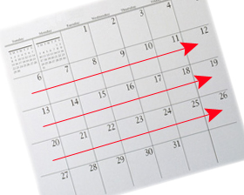
New Habits
Identify old habit
Define new habit
Commit to 3 weeks
Never deviate
Many of your work-related habits can be successfully changed in three days to three weeks.
Ask for help

Slide 7
Time Mastery Profile ®
10. Improving Meetings
Human Resources
Professional Development and Learning

Slide 8
Waste of Time?

Slide 9
Case Study
Handout 10-1: Budget Meeting
Read the meeting notes
Discuss the questions with your table group

Slide 10
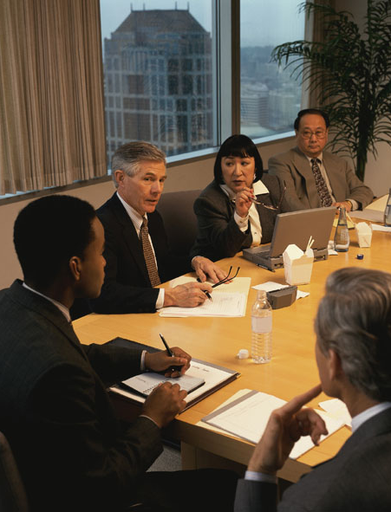
Budget Meeting
What went wrong?
Who was responsible?

Slide 11
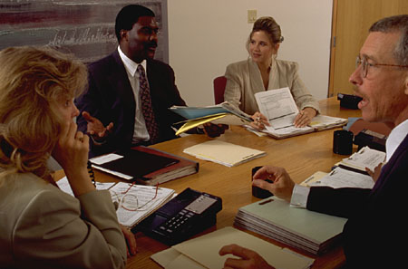
Effective Meetings HO 10-2
Plan and organize
Who, how many?
Although meetings are notorious time-wasters, they are also easy to control.

Slide 12
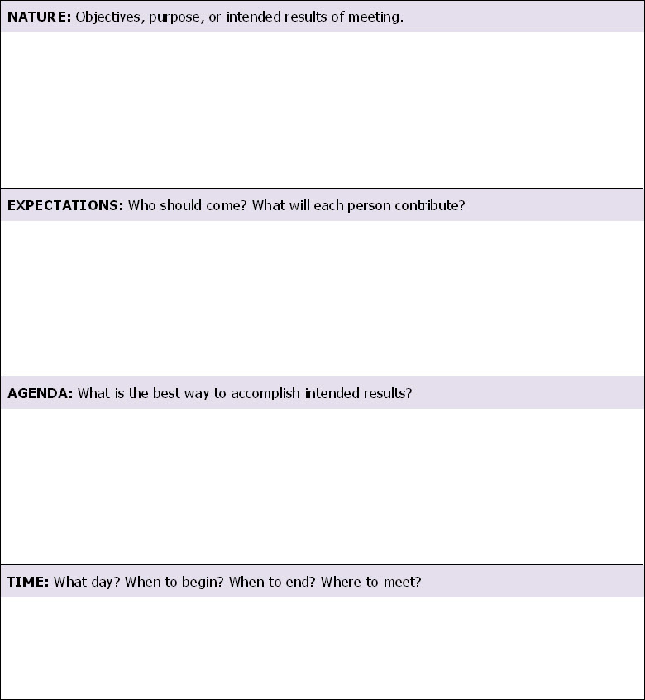
Meeting Planner HO 10-3
Is the goal:
Ideas?
People?
Analyze?
Assign/act?
Match behavior to goal.

Slide 13
Effective Meetings HO 10-2
Plan and organize
Who, how many?
Prepare an agenda
Although meetings are notorious time-wasters, they are also easy to control.

Slide 14
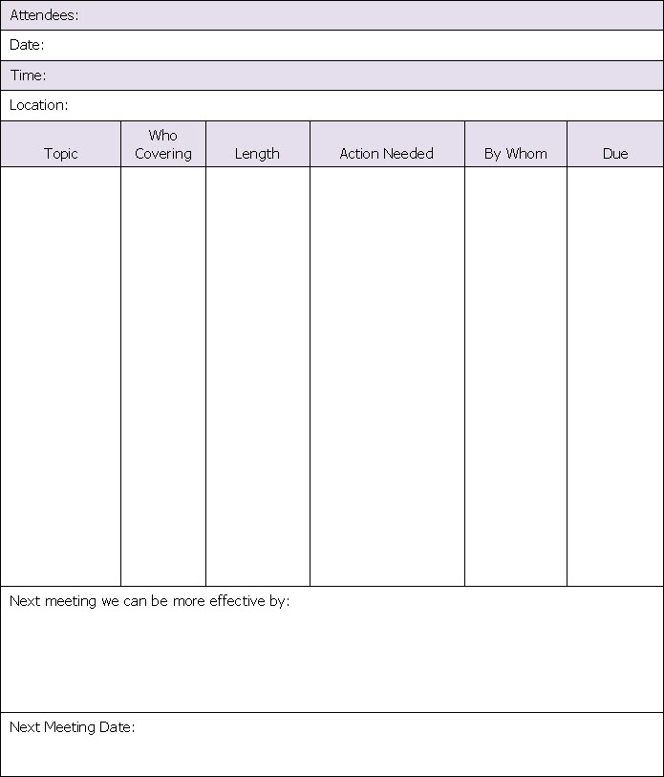
Meeting Agenda HO 10-4

Slide 15
Effective Meetings HO 10-2
Plan and organize
Who, how many?
Prepare an agenda
Stay in control
Take minutes
Although meetings are notorious time-wasters, they are also easy to control.
Follow up

Slide 16
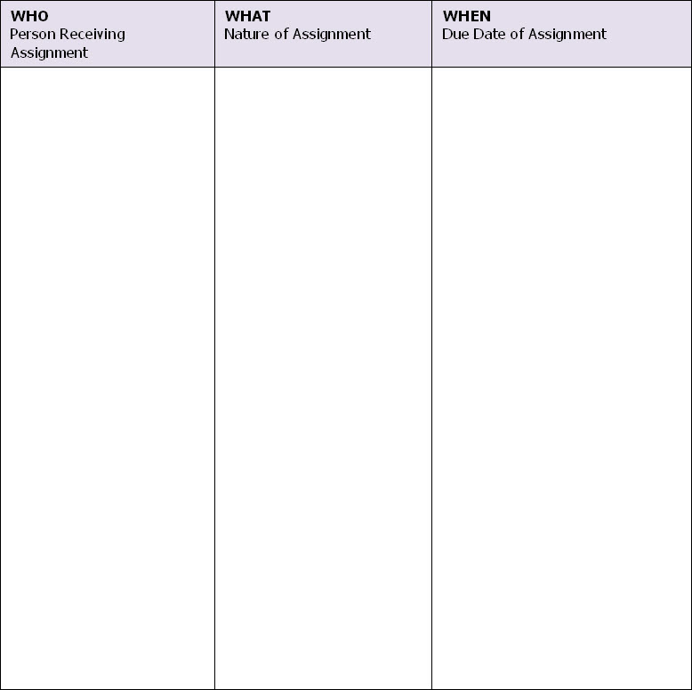
Meeting Follow-up HO 10-5

Slide 17
Effective Meetings HO 10-2
Plan and organize
Who, how many?
Prepare an agenda
Stay in control
Take minutes
Although meetings are notorious time-wasters, they are also easy to control.
Follow up
Critique

Slide 18
Improving Meetings
What if you aren’t leading the meeting? How can you help improve them?

Slide 19
Time Mastery Profile ®
11. Handling Written Communications
Human Resources
Professional Development and Learning

Slide 20
Document Accumulation
Failure to make decisions about them
No systematic way to handle them
Written communications are increasing at a rate of 20 percent per year.

Slide 21
Handling Written Communication
What is the most problematic written communication you deal with?
How do you organize and address written communication?

Slide 22
Four Options HO 11-1
Dump it
Delegate it
Do it
Delay it

Slide 23
Three Questions
⬧
1.
Will I really do anything with this?
2.
When will I do it?
3.
Where will I keep it?

Slide 24
Written Communications
Resist junk mail
Analyze the flow
Screen and sort
Develop a tracking system
There are four things you can do with a document: dump it, delegate it, do it, or delay it.
Handle it once
Schedule time for it

Slide 25
Writing
What are ways people waste time when writing?

Slide 26
Ten Percent Rule
You can do an adequate job in about 10 percent of the time it takes to do a “perfect“ job.

Slide 27
Writing Tips
Avoid overwriting
Plan or outline what to write
Have a clear purpose
You can do an adequate job in about 10 percent of the time it takes to do a perfect job.
Keep the reader in mind

Slide 28
Time Mastery Profile ®
12. Delegation
Human Resources
Professional Development and Learning

Slide 29
Ineffective Delegation
What are common reasons for ineffective delegation?

Slide 30
Effective Delegation HO 12-1
Responsibility
Assignment
Results
Obligation
Authority
Right to act and make decisions
Equal to responsibility
Delegation is sharing responsibility and authority with others, and holding them accountable.

Slide 31
Delegated Authority
Level 1: Get the facts; I’ll decide.
Level 2: Suggest alternatives; I’ll decide.
Level 3: Recommend an alternative; I’ll decide.
Level 4: Decide; wait for my approval.
Level 5: Decide; act unless I say no.
Level 6: Act; report results.
Level 7: Act; report if unsuccessful.
Level 8: Act, reporting not needed.

Slide 32
Effective Delegation HO 12-1
Responsibility
Assignment
Results
Obligation
Authority
Right to act and make decisions
Equal to responsibility
Delegation is sharing responsibility and authority with others, and holding them accountable.
Accountability
Answer for actions
May include rewards and penalties

Slide 33
Case Study
Handout 12-4: It’s Called Delegation
Read the meeting notes
Discuss the questions with your table group

Slide 34
It’s Called Delegation
How would you rate Marie’s delegation skills?
What do we know about the authority, responsibility, and accountability in this case?
How could Marie have done things better?

Slide 35
Delegation Guidelines
Plan first
Responsibilities/results
Right person
Authority
Checkpoints
Delegation is sharing responsibility and authority with others, and holding them accountable.
Motivating environment
Accountability

Slide 36
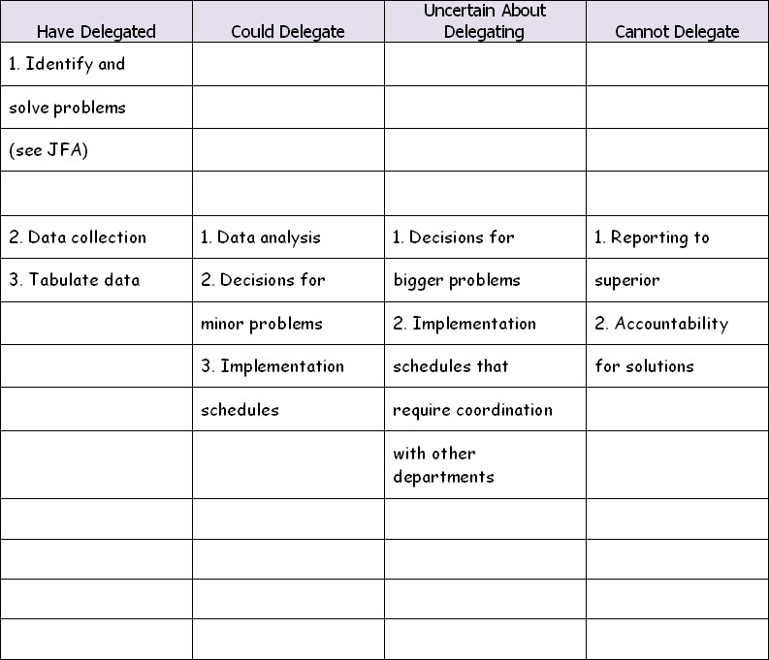
Sample Delegation Analysis HO 12-2

Slide 37
Time Mastery Profile ®
14. Improving Team Time
Human Resources
Professional Development and Learning

Slide 38
Team Interactions

Slide 39
Improving Team Time
How does a good team work together?
What do they do to help each other manage their time?

Slide 40
Working with Team Members HO 14-1
Respect their time
Look for ways to save time
Offer to help in a crisis or overload
Set up mutual expectations for performance
Communicate with your team regularly to ensure everyone knows the team’s goals and priorities.

Slide 41
Working with Team Members
Respect their time
Meet deadlines
Reduce interruptions
Communicate with your team regularly to ensure everyone knows the team’s goals and priorities.

Slide 42
Reducing Interruptions
Question importance of your interruption
Schedule a meeting to group questions and discussions
Have team track all interruptions
Focus on common goals and on the importance of improving time efficiency.

Slide 43
Working with Team Members
Respect their time
Meet deadlines
Reduce interruptions
Set a good example
Keep them informed
Communicate with your team regularly to ensure everyone knows the team’s goals and priorities.
Encourage improvement

Slide 44
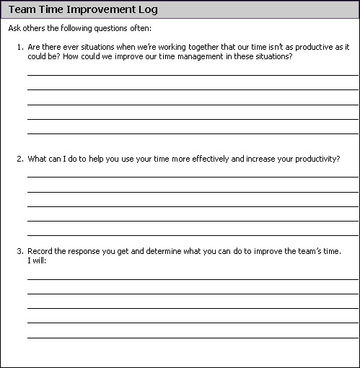
Team Time Improvement Log HO 14-2

Slide 45
Discussion
Handout 14-4: Tips for Working as a Team
Read through suggestions
Discuss how you could implement them with your team.

Slide 46
Time Mastery Profile ®
Thank You!

